Slide 1

DriveNow
Rentals
A Car Rental System Website
Built with HTML, CSS & JavaScript

Slide 2





Introduction
DriveNow Rentals
What It Does
Car Rental System Website
Allows users to browse cars, select models, book rental dates, and simulate payment — all in a smooth, step‑by‑step flow.
Designed to simplify car rental booking through a clean and user‑friendly web interface

Slide 3

WHY IT MATTERS
Problem & Objectives
The Problem
Traditional car rental booking is time‑consuming and inconvenient. Many systems lack easy online access and a smooth user experience.
The Objectives
Create a responsive and attractive interface
Allow users to select cars by category and model
Enable booking with date selection
Simulate a complete payment process

Slide 4



System Architecture
Database (Future)
Tech Stack
Persistent storage: MySQL or MongoDB
A client‑side web application built for simplicity and scalability, ready for full‑stack integration.
Backend (Future)
Server layer: Node.js or Django for APIs
Frontend
HTML, CSS, JavaScript — current client-side app
"Built client‑side today, scalable to full‑stack tomorrow."
The current flow runs entirely in the browser, but the architecture is designed for seamless backend integration.

Slide 5
Features
Car Categories
Booking Form
Payment Simulation
Confirmation
Browse Sedan, SUV, and Convertible categories with dynamic model selection and images
Date input fields for rental period selection with form validation
A success confirmation page providing clear feedback on completed bookings
A simulated payment form completing the end‑to‑end rental flow

Slide 6
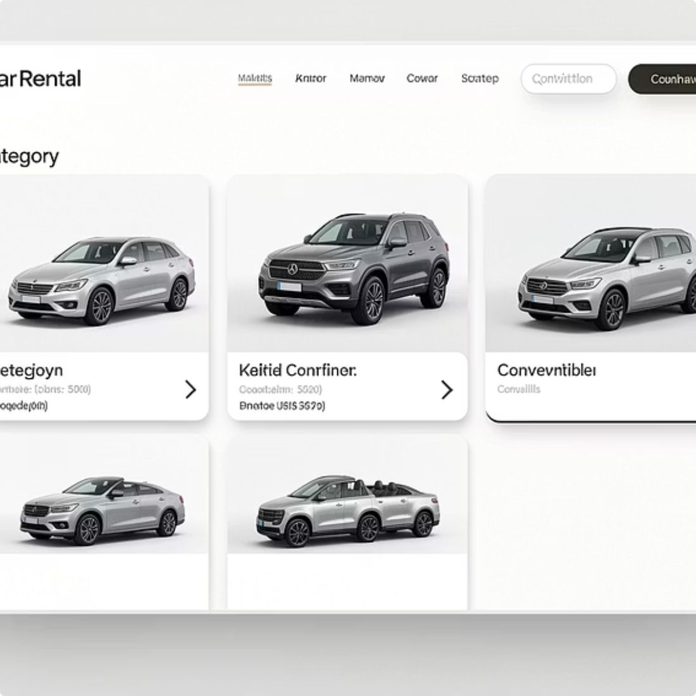
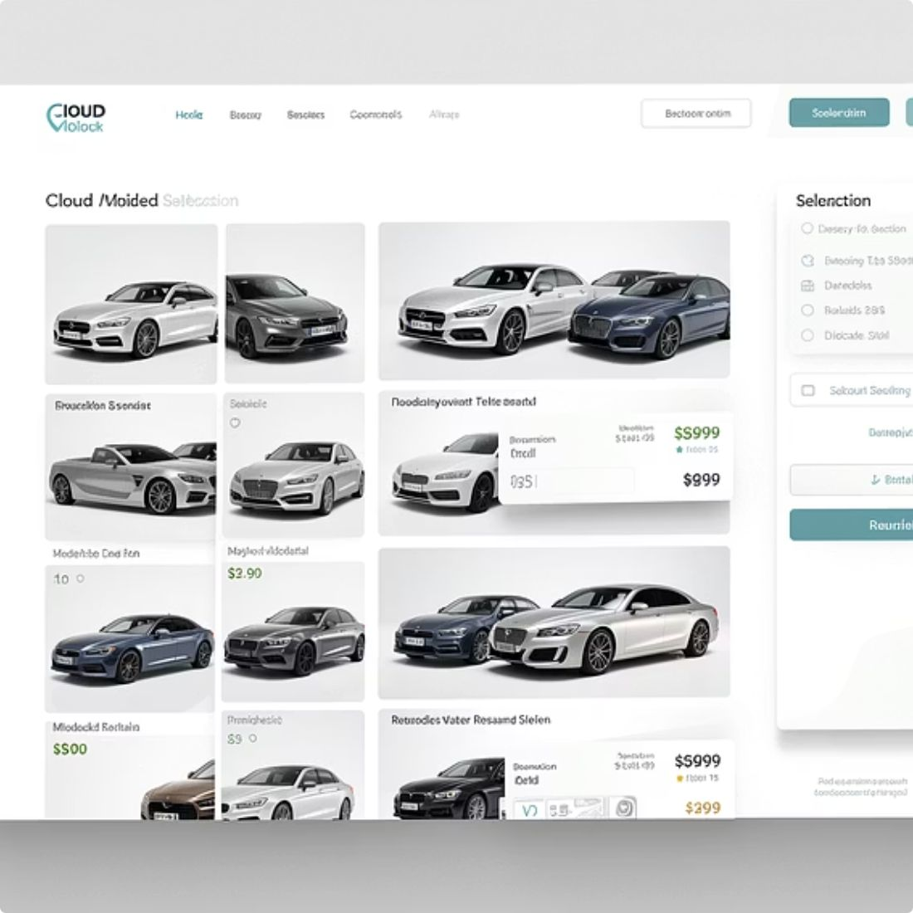
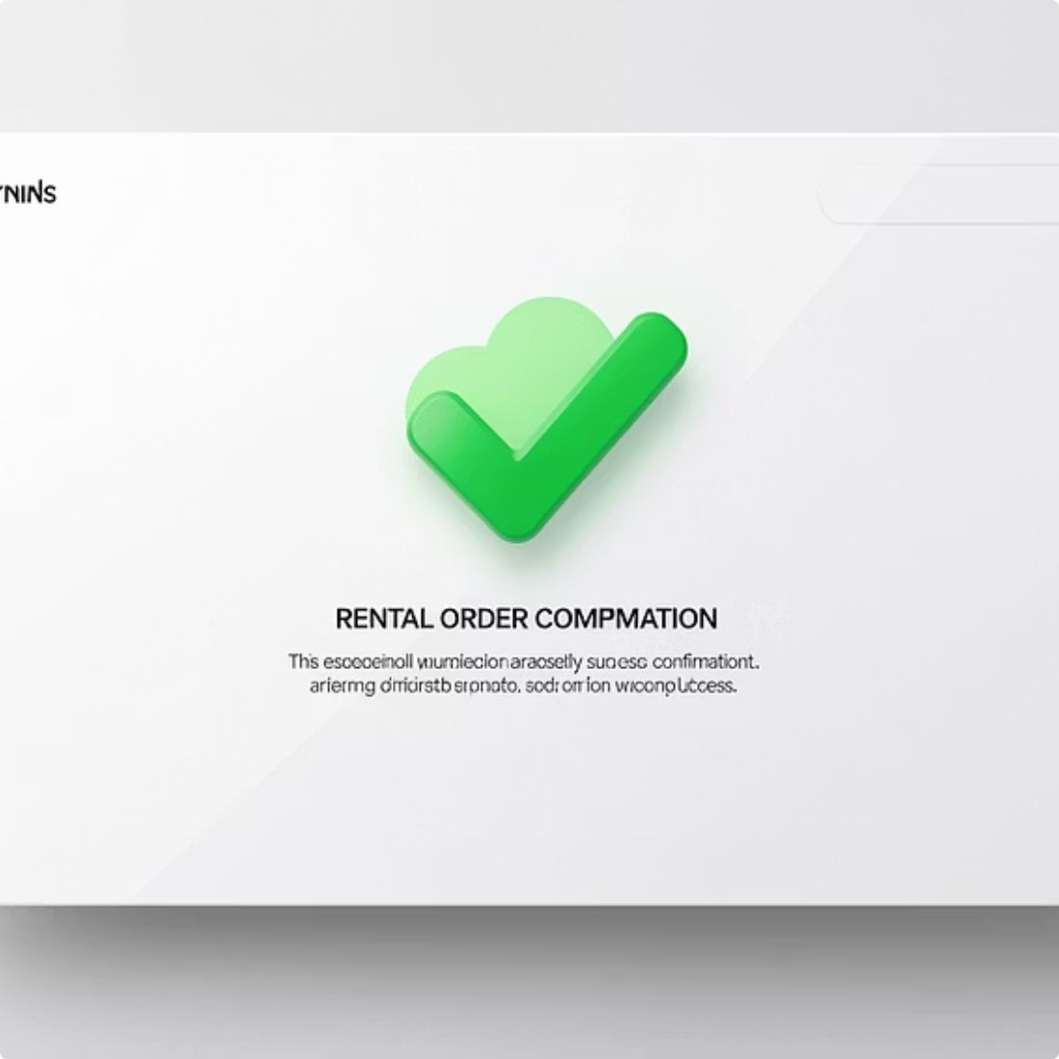
DEMO
Screenshots & Flow
Homepage & Categories
Booking & Payment
Confirmation Screen
Landing page displaying car categories for users to begin their selection
Date selection form and simulated payment form in a guided multi‑step flow
Final success page confirming the completed rental booking to the user

Slide 7









Advantages & Challenges
Advantages
Challenges Faced
Easy to use with a clean, visually appealing design
Responsive Design
Designing adaptive layouts across screen sizes
Scalable for real‑world full‑stack integration
Strong foundation for real payment gateways and user accounts
Form Validation
Handling date and payment field validation correctly
Multi‑Step Flow
Structuring multi‑step booking logic in JavaScript

Slide 8
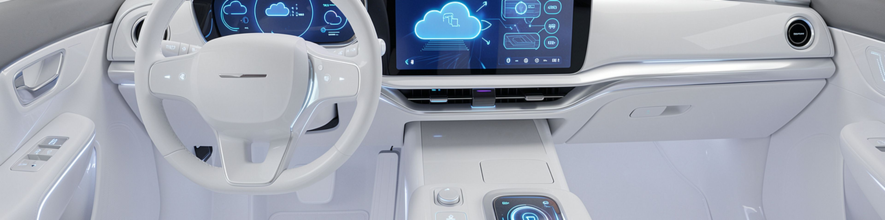
Future Enhancements
Real payment gateway integration
User login & profile management
DriveNow Rentals is built to grow. Planned upgrades will transform this prototype into a production‑ready full‑stack platform.
Admin dashboard for managing cars
Cloud hosting & deployment

Slide 9

CONCLUSION
Wrapping Up
What Was Built
What It Shows
DriveNow Rentals is a functional prototype demonstrating core web development skills — responsive design, dynamic content, and multi‑step user flows.
A smooth booking flow built entirely with HTML, CSS, and JavaScript, ready to be expanded into a full‑stack project with a real backend and database.
Tech Stack: HTML · CSS · JavaScript

Slide 10

Thank You
🚗 DriveNow Rentals
I'd be happy to answer any questions about DriveNow Rentals — the design decisions, the code, or the roadmap ahead.
💻 HTML · CSS · JavaScript
❓ Questions Welcome

