Slide 1

Hackathon Ideas & Design
08:00 AM
000 000 000 000 00
CARDS
Hackathon Team Name: Artificially Intelligent
Date: 20th Oct 2024
Confidential

Slide 2
Agenda
1
｜
Hackathon Ideas
2
｜
Technology Choices
3
｜
Code Repo & Structure
4
｜
Hospitality Agent
5
｜
AWS Architect Agent

Slide 3
Hackathon Ideas
Domain | Sub-domain | Concept
Hospitality | Personalized recommendation & Reservation Booking Agent | GenAI-Powered Booking Assistant for a Resort, seamlessly handles hotel, spa, and golf bookings
CPG Retail | Personal Product Recommendation | GenAI-Powered Shoe retailer agent helps to purchase shoes by invoking multiple external APIs to accomplish the sub-tasks. Invokes /get_customer API to know the customer “traits” and gives personal recommendation Checks inventory DB for shoe matching “traits” Invoke /place_order API for buying the product
AI Engineering | AWS Architect Agent | Gen-AI Powered AWS Architect Agent can answer any queries on AWS Architecture, documentation, suggest and explain AWS solutions, generate Infrastructure as Code (IaC) from diagram, and estimate the monthly cost to run a solution on AWS.
Banking | Banking Agent | GenAI-Powered banking personal assistant designed to revolutionize the way users interact with their bank account information, transaction history, and payment functionalities.
Idea finalized internally for Hackathon implementation

Slide 4
Technology Choices for Hackathon
Concept | Technology
Frontend | React with Typescript OR Streamlit
Backend | FASTAPI (Python)
AI/ML | Integration with Groq LLM (Llama 3.1), OpenAI Models (GPT-4o mini) and Claude (for AI Engg use-case)
Database / Vector DB | Postgres SQL with pgvector
Real-time Communication | Websockets
GenAI - Framework | Langchain
Tool to Agents | OpenAI’s function call (a.k.a OpenAI Assistants) to invoke custom APIs
CI/CD | GitHub Actions
Note: Avoid Cloud for the POC to reduce the cost, keep everything opensource.

Slide 5
Code Repo & How to raise PR?
https://github.com/shyamnarayan2001/hachathon-genai
Note: Refer the develop branch.
Code contribution:
It is not possible to create a branch on the above repo, instead, you need to fork the repo to your github and then only can raise the PR. Please follow the steps below:
Steps on how to raise a PR: 1. Go the repo, click the Fork button at the top-right of the page. This creates a copy of the repository in your own GitHub account. 2. Clone the Forked Repository using git clone command 3. You can now create a feature branch (git checkout -b feature-branch-name 4. Make changes, commit and push to feature branch (git add . | git commit -m "Description" | git push origin feature-branch-name) 5. Go to your fork on GitHub and click the "Compare & pull request button" and raise a PR

Slide 6
01
Hospitality Agent

Slide 7
Problem Statement – Solution & Key Features
Problem Statement:
Hospitality industry struggles with:
Complex, multi-service bookings
High volume of customer inquiries
Need for 24/7 personalized service
Current solutions are often fragmented and inefficient
Solution:
AI-Powered Booking Assistant for LJ Resorts
Seamlessly handles hotel, spa, and golf bookings
Provides real-time information and personalized recommendations
Available 24/7, reducing staff workload
Key Features:
Integrated booking system across multiple services
Real-time availability checks
Special offers and package recommendations
FAQs and general inquiries handling
Personalized customer experience

Slide 8
Technology Choices
Concept | Technology
Frontend | React with Typescript
Backend | FASTAPI (Python)
AI/ML | Integration with Groq LLM (Llama 3.1) and OpenAI Models (GPT-4o mini)
Database | Postgres SQLwith pgvector
Rea-time Communication | Websockets

Slide 9


Architecture
R
R
User Input
R
R
R
UI (React)
API (FastAPI)
Prompt Augmentation
LLM
Response
R
Additional Context
Embedding Model LLM
Lama (Groq)
R
R
Open AI
Semantic Search
R
R
Data Sources
Document
Chunks
Vector DB
(Postgres + Pgvector)

Slide 10
02
Retail Agent

Slide 11
Problem Statement and Solution
Problem Statement:
Customers face difficulty finding the right shoes due to:
Limited product discovery options
Lack of personalized recommendations
Inconsistent stock availability information
Inefficient checkout process
Solution:
AI-powered Retail Bot provides:
Natural language interaction for easy product search
Personalized shoe recommendations
Real-time stock availability updates
Seamless order processing and checkout experience

Slide 12
Features
Functional Features
Natural language interaction for intuitive user experience
Smart product recommendations based on customer queries
Real-time stock updates and availability checks
Price comparisons for different shoe options
Order processing and checkout directly through the bot
Activity-specific shoe filtering (e.g., running, hiking, walking)
Detailed product information and comparison for better decision-making
Technical Features:
FastAPI for high-performance asynchronous APIs
WebSocket support for real-time chat interactions
LangChain integration for advanced language model orchestration
Fallback mechanisms between Groq and OpenAI for reliable performance
SQLite database for lightweight, local data storage
Comprehensive test suite covering various conversation and edge cases

Slide 13
Technology Choices
Concept | Technology
Frontend | React with Typescript
Backend | FASTAPI (Python)
AI/ML | Integration with Groq LLM (Llama 3.1) and OpenAI Models (GPT-4o mini)
Database | SQLite (for inventory and order data storage)
Communication | Websockets and REST API
Framework | Langchain

Slide 14
Architecture
UI (React)
API (FastAPI)
User Input
Prompt Augmentation
LLM
Response
Additional Context
Lama (Groq)
Open AI
SQLite
Invokes /get_customer API to know the customer “traits” and gives personal recommendation
Checks inventory DB for shoe matching “traits”
Invoke /place_order API for buying the product

Slide 15
Example Conversation with Bot
1. Basic Query:
User: "What running shoes do you have?"
Bot: "We have Speed Runner Pro and Marathon Elite available in sizes 9, 10, and 11."
2. Size and Activity Query:
User: "I need running shoes in size 10."
Bot: "We have Speed Runner Pro and Marathon Elite in size 10."
3. Product Comparison:
User: "What's the difference between Speed Runner Pro and Marathon Elite?"
Bot: "Speed Runner Pro is $129.99 and Marathon Elite is $149.99, designed for long-distance running."

Slide 16
03
AI Engineering – AWS Architect Agent

Slide 17
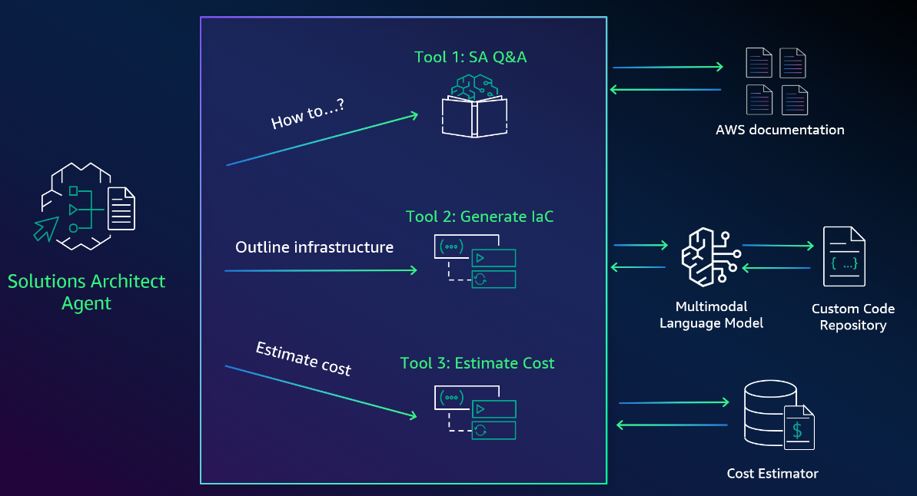
Architecture

Slide 18
03
Appendix

Slide 19
References:
Topic | Link
Hospitality Agent | https://blog.serverlessadvocate.com/automating-tasks-using-amazon-bedrock-agents-and-ai-4b6fb8856589
AI Engineering – AWS Architect Agent | https://github.com/viktoriasemaan/ai-agents
CPG Retail Agent | https://github.com/aws-samples/agentsforbedrock-retailagent

Slide 20
Thank You
Let us create outstanding experiences together!

