Slide 1
Honeywell
Whole-Hospital Application Concept
Honeywell Connected Hospital 360
Patient Journey Command Center from OPD to post-discharge care
OPD
Emergency
IPD
OT / ICU
Discharge
Post-discharge
An intelligent operating layer that connects patient monitoring, hospital operations, risk prediction, discharge coordination, and care continuity.
Impact by Honeywell
Connected Hospital 360 | Patient Journey Command Center
1

Slide 2
Honeywell
Executive message
Connected Hospital 360
Honeywell Connected Hospital 360 follows the patient across the full hospital journey and gives leaders one operating picture for care, capacity, assets, discharge, and post-discharge risk.
Clinical impact
Operational impact
Patient impact
Business impact
Continuous risk visibility, early warning, faster intervention.
Bed flow, discharge readiness, asset availability, staff coordination.
Less waiting, safer transitions, stronger post-discharge follow-up.
Better throughput, lower delays, scalable software and services model.
From device innovation to whole-hospital application
Impact by Honeywell
Connected Hospital 360 | Patient Journey Command Center
2

Slide 3
Honeywell
End-to-end patient journey
OPD to post-discharge
OPD
Emergency / triage
Admission / IPD
OT / ICU / step-down
Discharge readiness
Post-discharge care
OPD
Emergency
IPD
Appointment, queue, vitals, ECG snapshot, risk pre-screening.
Triage scoring, ER vitals, intervention readiness.
Patch monitoring, BP/SpO2, nurse task queue, risk score.
OT/ICU
Discharge
Post-care
Readiness board, transfer queue, post-procedure monitoring.
Clinical, pharmacy, billing, diagnostics, transport, housekeeping.
Remote monitoring, adherence, follow-up, readmission risk.
Impact by Honeywell
Connected Hospital 360 | Patient Journey Command Center
3

Slide 4
Honeywell
Clinical imperative
Creating time to intervene
Leading hospitals can save lives when patients reach the right intervention team in time. Connected Hospital 360 creates that time window through continuous monitoring, risk scoring, and coordinated escalation.
Detect earlier
Predict risk
Act faster
Continuous vitals, ECG, BP, SpO2, trends, missed observations.
Patient-specific risk score and deterioration prediction.
Escalation queues, OT/ICU readiness, team coordination.
Clinical outcome: right patient, right team, right time
Impact by Honeywell
Connected Hospital 360 | Patient Journey Command Center
4

Slide 5
Honeywell
OPD and pre-admission
Front door intelligence
Connected vitals capture
Risk pre-screening
Doctor dashboard
BP, SpO2, temperature, heart rate, ECG snapshot.
Cardiac, respiratory, diabetic, elderly, post-operative follow-up cohorts.
Patient history, risk trend, previous vitals, next action.
Queue visibility improves patient flow before consultation.
High-risk patients are fast-tracked to diagnostics, emergency, or admission.
OPD becomes a risk-detection layer rather than only a consultation endpoint.
Impact by Honeywell
Connected Hospital 360 | Patient Journey Command Center
5

Slide 6
Honeywell
Emergency and triage
Critical-front-door workflow
Rapid triage score
ER command board
Pre-arrival handoff
Vitals, symptoms, age, comorbidity, history.
Waiting risk, observation status, intervention priority.
Ambulance vitals and patient context before arrival.
When risk crosses threshold, OT/ICU readiness begins before deterioration becomes irreversible
Emergency outcome
Earlier prioritization, faster escalation, better preparedness for cardiac and high-acuity events.
Impact by Honeywell
Connected Hospital 360 | Patient Journey Command Center
6

Slide 7
Honeywell
Admission and IPD
Continuous ward intelligence
Patient-bed-device assignment
Wearable monitoring
Nurse task queue
Risk score
Patient, bed, patch, BP device, ward, episode context.
ECG, HR, respiration, temperature, posture, restlessness.
Vitals, alerts, medication reminders, escalation follow-up.
Vitals, trends, missed observations, patient context.
IPD outcome: fewer blind spots between rounds and clearer escalation ownership
Impact by Honeywell
Connected Hospital 360 | Patient Journey Command Center
7

Slide 8
Honeywell
OT, ICU, and step-down
High-acuity coordination
OT readiness board
ICU / CCU capacity
Step-down readiness
Patient, staff, equipment, clearance, transfer status.
Bed availability, transfer queue, acuity demand.
Stability trend, post-procedure monitoring, deterioration alerts.
Post-procedure patients remain visible through patch and connected vitals.
Step-down transitions become data-backed rather than only schedule-driven.
Care teams see deterioration risk after transfer, not only during ICU stay.
Impact by Honeywell
Connected Hospital 360 | Patient Journey Command Center
8

Slide 9
Honeywell
Diagnostics, pharmacy, and support workflows
Department coordination layer
Diagnostics queue
Pharmacy readiness
Billing clearance
Biomedical status
Patient transport
Housekeeping queue
Workflow state events
Command-center value
Each department updates readiness, delay reason, owner, and expected completion time.
Bottlenecks become visible before they delay admission, discharge, or bed release.
Impact by Honeywell
Connected Hospital 360 | Patient Journey Command Center
9

Slide 10
Honeywell
Discharge Command Center
Turning discharge into bed capacity
Clinical
Diagnostics
Pharmacy
Billing
Nursing
Transport
Housekeeping
Bed release
Discharge visibility
Operational trigger
Capacity impact
Clearance status, delay reason codes, expected discharge time.
Bed cleaning starts after discharge confirmation and bed release.
Admission and emergency teams see upcoming bed availability.
Discharge readiness becomes a measurable operating workflow
Impact by Honeywell
Connected Hospital 360 | Patient Journey Command Center
10

Slide 11
Honeywell
Post-discharge remote care
Care continuity beyond hospital walls
Home monitoring
Patient engagement
Readmission risk
Wearable patch, BP monitor, SpO2, home vitals kit.
Medication reminders, follow-up coordination, symptoms check-ins.
Risk prediction and escalation to hospital care team.
Post-discharge patients remain visible during the risk window after hospitalization.
Care teams receive alerts when vitals or symptoms cross thresholds.
The hospital extends its care relationship and reduces avoidable readmission risk.
Impact by Honeywell
Connected Hospital 360 | Patient Journey Command Center
11

Slide 12
Honeywell
Whole-hospital operations modules
Beyond patient monitoring
Bed management
Asset intelligence
Staff coordination
Occupancy, cleaning, blocked, maintenance, transfer, discharge-ready.
Pumps, monitors, wheelchairs, cylinders, ECG carts, stretchers.
Nurse tasks, transport requests, housekeeping, biomedical actions.
Patient flow
Service SLAs
Leadership KPIs
OPD queues, ER wait, transfer queue, discharge queue.
Department delays, owner, aging, bottleneck view.
Throughput, occupancy, risk heatmap, utilization, readmission risk.
Impact by Honeywell
Connected Hospital 360 | Patient Journey Command Center
12

Slide 13
Honeywell
Clinical Risk Engine
Continuous scoring and early warning
Vitals
ECG
BP
SpO2
Respiration
Temperature
Symptoms
History
Missed observations
Care context
Risk score + deterioration prediction
Clinical output
Operational output
Risk band, trend, reason codes, escalation queue, intervention readiness.
Nurse task, doctor review, OT/ICU readiness, transfer priority.
Impact by Honeywell
Connected Hospital 360 | Patient Journey Command Center
13

Slide 14
Honeywell
Leadership Command Center
One hospital operating picture
OPD load
ER risk
IPD acuity
Queue, wait, high-risk OPD patients
Triage status, observation, critical escalations
Ward risk heatmap, nurse workload
Bed flow
Asset availability
Readmission risk
Occupancy, cleaning, discharge-ready, blocked
Critical equipment location and utilization
Post-discharge alerts and follow-up gaps
Impact by Honeywell
Connected Hospital 360 | Patient Journey Command Center
14

Slide 15
Honeywell
Data and integration foundation
Hospital systems plus connected telemetry
HMS / EHR / EMR
ADT + appointments
Device telemetry
Workflow events
Connected Hospital 360 Platform FHIR / HL7 / REST / adapters
Telemetry
Workflow state
Analytics
Patch, BP, SpO2, bed sensors, asset tags.
Nursing, pharmacy, diagnostics, billing, housekeeping.
Patient risk, flow KPIs, utilization, readmission risk.
Impact by Honeywell
Connected Hospital 360 | Patient Journey Command Center
15

Slide 16
Honeywell
Business impact
Measurable value across hospital and Honeywell
Patient safety
Capacity
Productivity
Continuous risk visibility and faster escalation.
Better bed utilization, discharge readiness, and turnover.
Lower manual coordination and asset search time.
Care continuity
Leadership control
Honeywell growth
Remote monitoring and reduced avoidable readmission risk.
One operating picture across departments and facilities.
Software, devices, analytics, integration, services, enterprise licensing.
Impact by Honeywell
Connected Hospital 360 | Patient Journey Command Center
16

Slide 17
Honeywell
Application packaging
Modular platform for phased hospital adoption
Care module
Operations module
Discharge module
OPD, ER, IPD, OT/ICU monitoring and clinical risk engine.
Bed management, asset intelligence, staff tasks, service queues.
Discharge readiness, clearances, delay reasons, bed release.
Remote care module
Command center
Integration layer
Post-discharge monitoring, adherence, follow-up, readmission risk.
Leadership dashboards, KPIs, bottlenecks, multi-site analytics.
HMS/EHR/EMR, ADT, FHIR/HL7, REST, hospital adapters.
Impact by Honeywell
Connected Hospital 360 | Patient Journey Command Center
17

Slide 18
Honeywell
Closing statement
Whole-hospital intelligence
Honeywell Connected Hospital 360 is the intelligent operating layer for modern hospitals.
It connects the full patient journey with hospital operations, helping providers move from reactive care to predictive, coordinated, and measurable care across OPD, IPD, discharge, and post-discharge services.
From wearable patch to whole-hospital command center
Impact by Honeywell
Connected Hospital 360 | Patient Journey Command Center
18

Slide 19
Honeywell
Technical Architecture Deep Dive
Wearable Smart Patch foundation, edge architecture, data flows, integrations, security, and deployment model
Section 2: Architecture and implementation depth
Impact by Honeywell

Slide 20
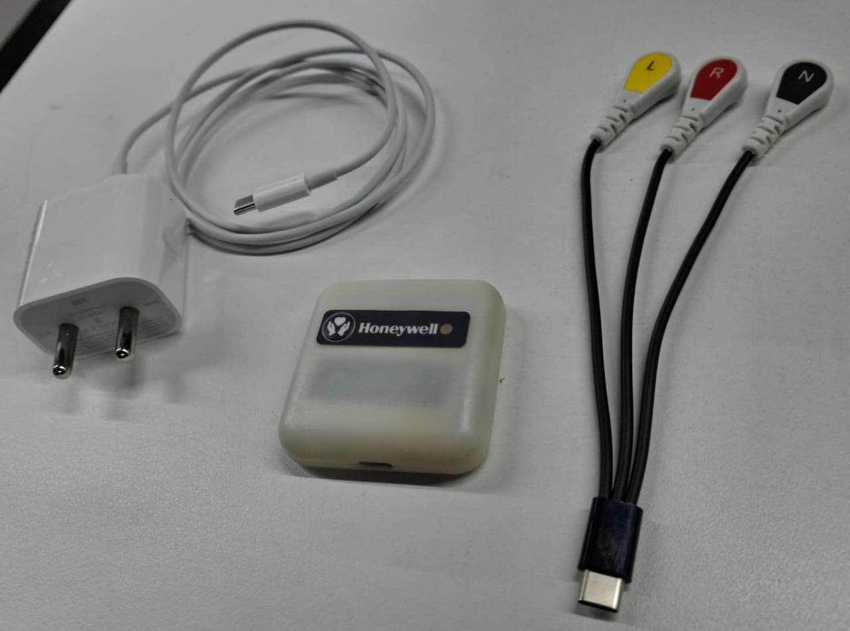
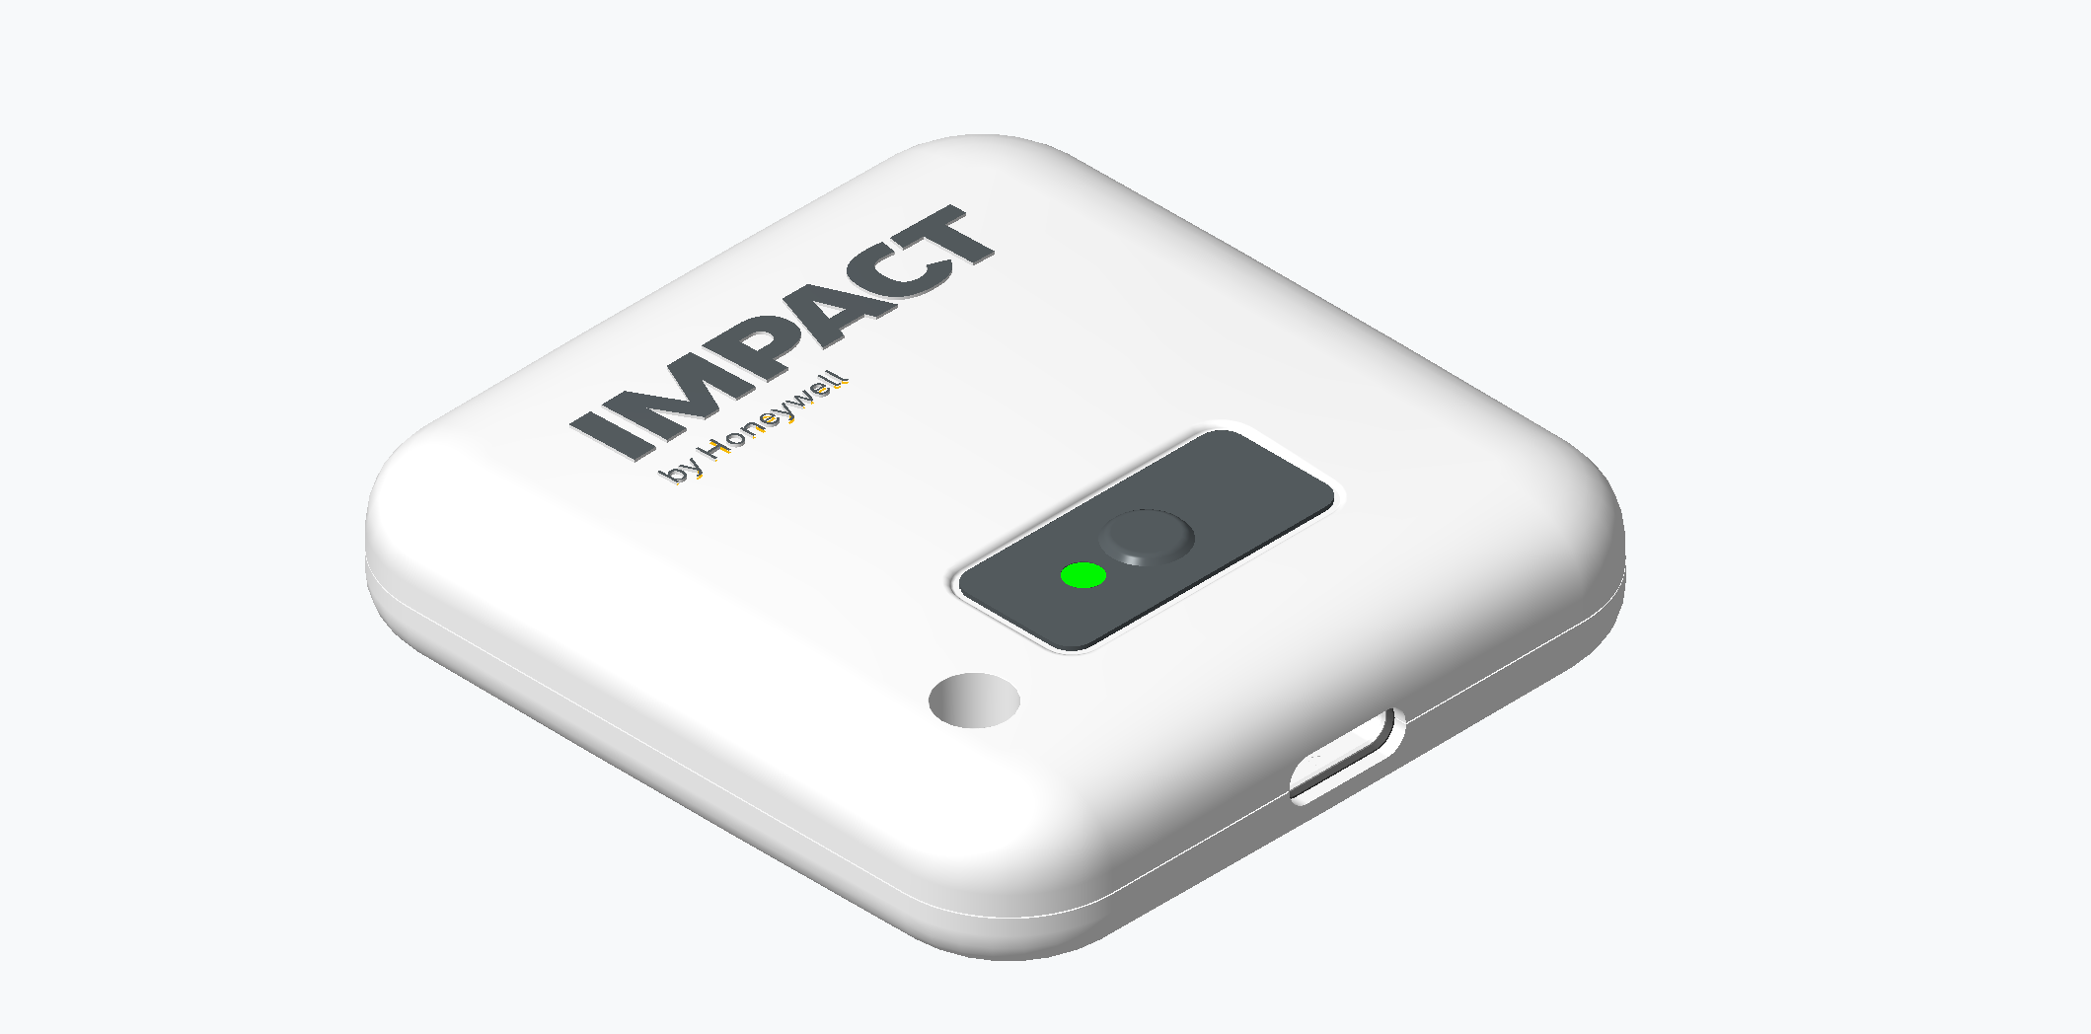
Honeywell
Technical Architecture Version | Phase 2
Connected Care and Hospital Operations Platform
A technically rich architecture view using existing WSP product, prototype, and component visuals
Patient telemetry
Edge + APIs
Command center
2026 India and APAC Innovation Challenge
Impact by Honeywell
Technical Architecture Version | India and APAC Innovation Challenge - Phase 2
1

Slide 21
Honeywell
Technical thesis
Architecture demonstration
Clinical imperative: world-class hospitals can save patients when they reach the intervention team in time. Honeywell creates that time window through continuous risk scoring, deterioration prediction, and faster escalation.
Device ecosystem
Resilient edge
Platform services
Hospital apps
Patch, BP, SpO2, bed sensors, asset tags.
Authentication, buffering, protocol normalization, gateway orchestration.
Registry, assignment, time-series ingest, rules, alerts, analytics.
Nurse, doctor, bed board, asset map, leadership command center.
Clinical objective: monitor risk continuously, predict attacks earlier, and help save lives
Impact by Honeywell
Technical Architecture Version | India and APAC Innovation Challenge - Phase 2
2

Slide 22
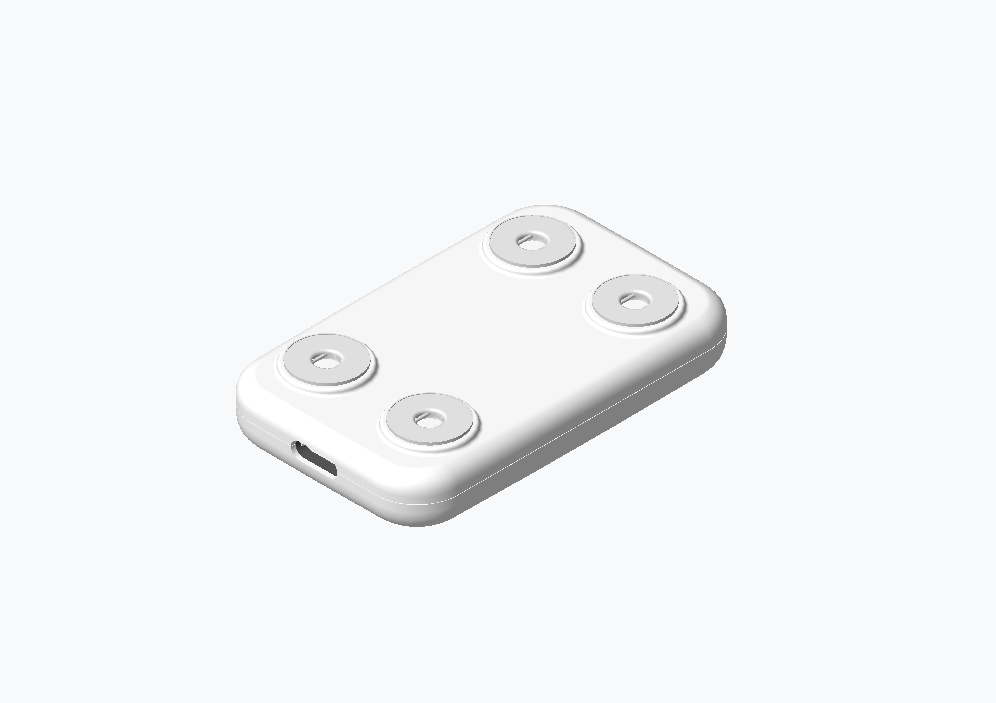
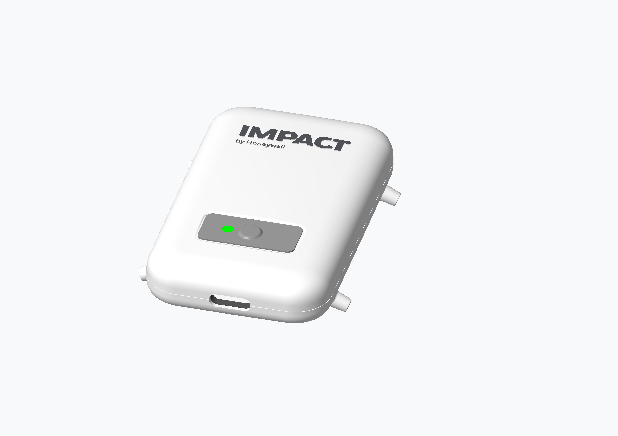
Honeywell
WSP foundation already achieved
Prototype, concept, and hardware visuals already documented
Industrial design render
Prototype kit
Electrode-side concept
Reusable patch housing, LED indication, button, USB-C opening.
Physical WSP unit, ECG cable, charger, and lead interface.
Electrode placement concept for ECG and body-contact sensing.
Source visuals embedded from existing concept and MVO documents
Impact by Honeywell
Technical Architecture Version | India and APAC Innovation Challenge - Phase 2
3

Slide 23

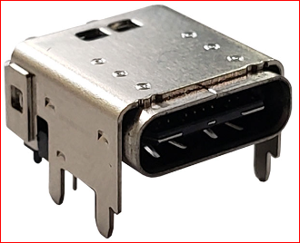
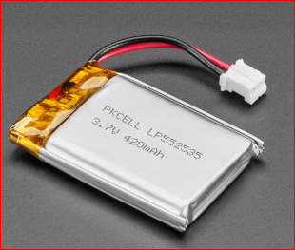
Honeywell
Wearable patch hardware architecture
Current MVO component baseline
ESP32-S3-MINI-1 MCU + Wi-Fi + BLE
MAX30003 ECG AFE
TMP1075 Skin temp
ADXL367 Posture + motion
MAX20356 PMIC Charger + power path + fuel gauge
450 mAh Li-Po Rechargeable battery
USB-C + ECG lead cable Power + data + sensor interface
RGB LED + button Status + wakeup
Debug UART Manufacturing + support
Hardware role
Patient-worn telemetry endpoint for ECG, temperature, posture, movement, derived respiration, device health, and future vitals expansion.
Impact by Honeywell
Technical Architecture Version | India and APAC Innovation Challenge - Phase 2
4

Slide 24
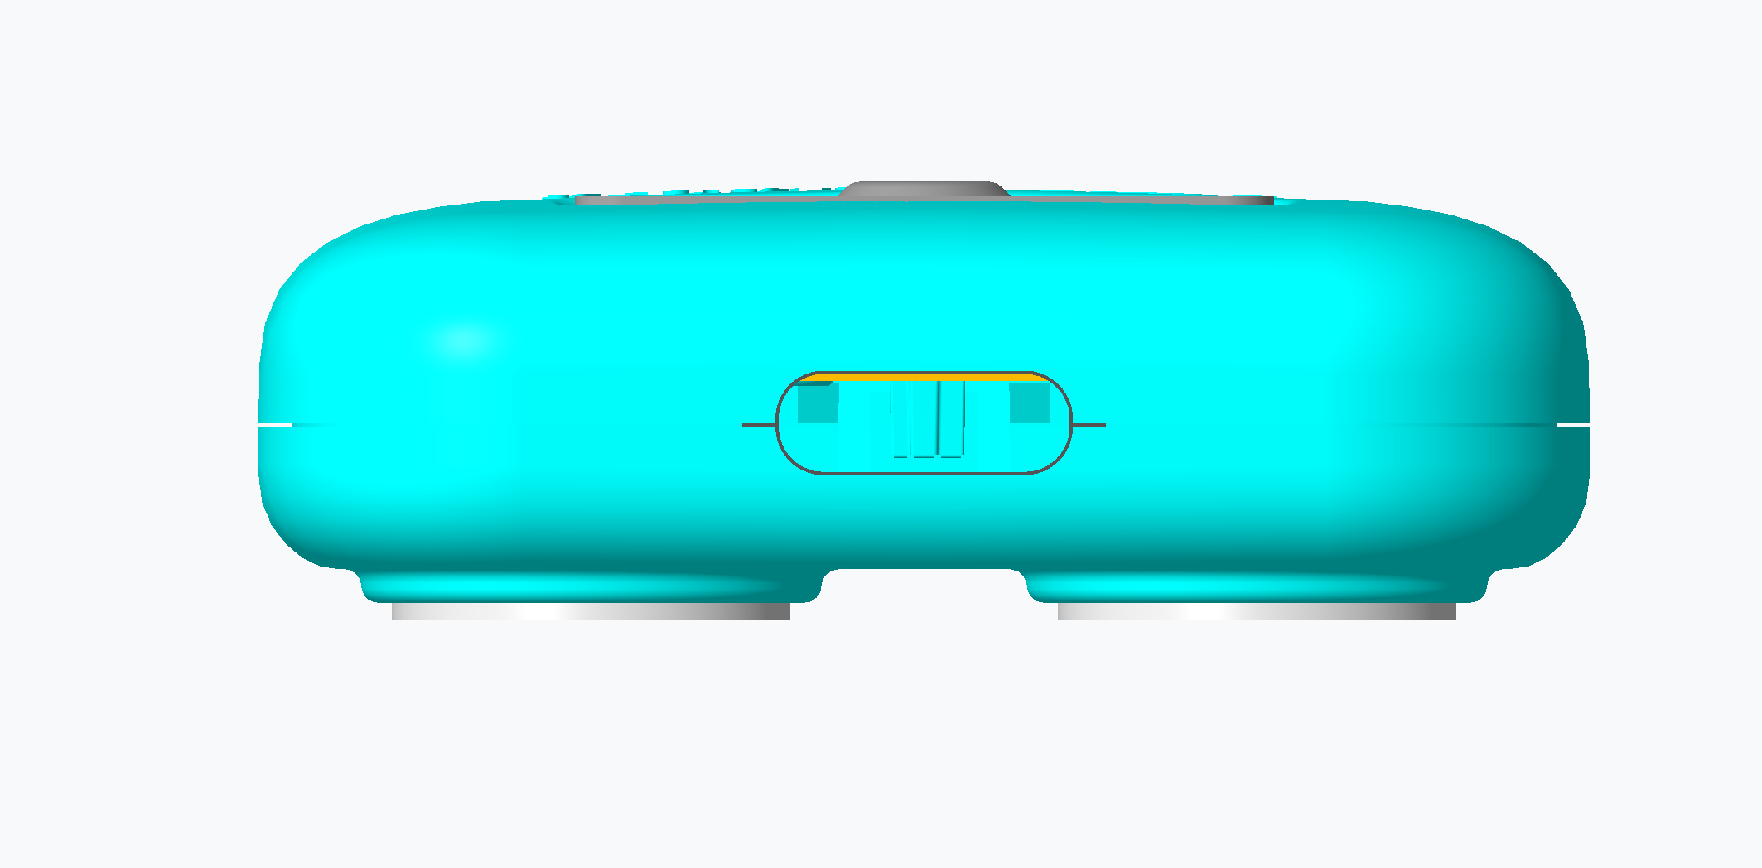
Honeywell
Patch signal pipeline
From body signal to actionable telemetry
Sampling and packet cadence configurable by clinical workflow and battery budget.
Telemetry contains sensor values, timestamp, device ID, battery, RSSI/connectivity state, and firmware/config version.
Edge buffering protects against temporary hospital Wi-Fi disruption.
Platform association links every payload to patient, bed, ward, and care episode.
Body contact ECG/temp/motion
Analog front end filter + sample
MCU processing packetize + status
Wi-Fi/BLE telemetry authenticated send
Edge ingest buffer + normalize
Rules + dashboard alerts + trends
Impact by Honeywell
Technical Architecture Version | India and APAC Innovation Challenge - Phase 2
5

Slide 25
Honeywell
Expanded device ecosystem
Clinical and operational telemetry endpoints
Connected BP + SpO2
Bed state input
Asset tags
Telemetry role
Telemetry role
Telemetry role
Periodic vitals capture during ward rounds and high-risk monitoring.
Occupied, vacant, cleaning, blocked, transfer, discharge-ready, maintenance.
BLE, Wi-Fi, RFID, or UWB tags for pumps, monitors, cylinders, carts, wheelchairs.
Wearable patch
Continuous ECG, HR, temperature, respiration, posture, restlessness.
Unified event model across clinical signals and operations events
Impact by Honeywell
Technical Architecture Version | India and APAC Innovation Challenge - Phase 2
6

Slide 26
Honeywell
Connectivity and edge topology
Hospital-grade connectivity under network variability
Patch + BP + SpO2
Wi-Fi / BLE
Device registry
Bed sensors
BLE / wired input
Honeywell Edge Gateway Auth + buffer + normalize + route
Time-series ingestion
Asset tags
BLE / RFID / UWB
Event bus + rules
Mobile workflows
Tablet / workstation
Command center APIs
Edge resilience
Local buffering, retry logic, time synchronization, device-health monitoring, and controlled reconnect behavior support hospital network variability.
Impact by Honeywell
Technical Architecture Version | India and APAC Innovation Challenge - Phase 2
7

Slide 27
Honeywell
Event-driven data architecture
Telemetry, workflow state, and analytics separation
Raw telemetry store
Sensor payloads, ECG snapshots, vitals values, device metadata, timestamps.
Operational event stream
Bed state changes, asset zone events, assignment changes, alert lifecycle.
Rules outputs
Thresholds, trends, missed-vitals windows, battery/connectivity, bed/asset exceptions.
Workflow tasks
Nurse queue, doctor review, housekeeping queue, biomedical action, transport task.
Analytics aggregates
Ward, hospital, and hospital-chain KPIs for throughput, acuity, utilization, response.
Impact by Honeywell
Technical Architecture Version | India and APAC Innovation Challenge - Phase 2
8

Slide 28
Honeywell
Patient-bed-device assignment model
Avoiding orphan telemetry
Patient
Admission
Bed
Device
Asset
Data keys
Data keys
Data keys
Data keys
Data keys
MRN / episode / demographics
ward / department / care episode
bed ID / state / location
serial / firmware / battery / status
tag ID / class / zone / service state
Assignment service responsibilities
Why it matters
Pair device to patient, patient to bed, asset to zone, and events to care episode with auditability.
Every telemetry point, bed event, and asset event is traceable to the right operational context.
Impact by Honeywell
Technical Architecture Version | India and APAC Innovation Challenge - Phase 2
9

Slide 29
Honeywell
Rules engine and alerting
Clinical and operations logic in one configurable layer
Vitals threshold
Trend detection
Missed vitals
BP, HR, SpO2, temperature, ECG-derived alerts
Change over baseline, repeated abnormalities, escalation windows
Expected observation not received within defined time
Device health
Bed workflow
Asset exception
Battery, RSSI, offline, firmware/config mismatch
Cleaning delay, blocked bed, discharge-ready queue
Missing asset, zone exit, service due, low utilization
Alert lifecycle: generated -> routed -> acknowledged -> resolved -> audited
Impact by Honeywell
Technical Architecture Version | India and APAC Innovation Challenge - Phase 2
10

Slide 30
Honeywell
Bed management technical model
State machine plus workflow queues
Vacant
Occupied
Discharge-ready
Cleaning
Blocked
Maintenance
Transfer
State inputs
Workflow queues
Operational KPIs
ADT feed
Nurse/ward update
Housekeeping update
Maintenance status
Transfer request
Admission queue
Cleaning queue
Transport queue
Maintenance queue
Discharge coordination
Turnaround time
Blocked-bed time
Cleaning cycle time
Occupancy
Transfer bottlenecks
Bed intelligence connects patient acuity, capacity, and hospital flow
Impact by Honeywell
Technical Architecture Version | India and APAC Innovation Challenge - Phase 2
11

Slide 31
Honeywell
Asset tracking architecture
Accuracy tiers matched to operational value
BLE tags
RFID gates
Low cost zone proximity for pumps, wheelchairs, monitors.
Entry/exit control for storerooms, wards, departments.
UWB zones
Wi-Fi tags
Higher precision for critical assets and high-value equipment.
Network-based location where infrastructure supports it.
Asset event model
tag_id, asset_class, zone, timestamp, movement event, utilization state, service state, exception type, assigned department
Impact by Honeywell
Technical Architecture Version | India and APAC Innovation Challenge - Phase 2
12

Slide 32
Honeywell
Hospital integration architecture
API-first, adapter-ready interoperability
Hospital systems HMS / EHR / EMR
Integration adapter FHIR / HL7 / REST
Platform services ADT + assignment + alerts
Applications Dashboards + APIs
Inbound hospital context
Outbound platform events
Mapping controls
ADT, patient demographics, ward, bed, encounter, clinician assignment.
Alerts, vitals summaries, device events, bed-state updates, asset exceptions.
Hospital-specific data dictionaries, interface monitoring, retry/error handling.
Integration pattern supports heterogeneous India and APAC hospital environments
Impact by Honeywell
Technical Architecture Version | India and APAC Innovation Challenge - Phase 2
13

Slide 33
Honeywell
Security and compliance architecture
Controls across device, edge, platform, and users
Device identity
Secure transport
Access control
Provisioning, device registry, serial binding, firmware/config visibility.
Authenticated ingestion, encryption in transit, controlled gateways.
Role-based access for nurse, doctor, biomedical, operations, admin, leadership.
Auditability
Network segmentation
Deployment control
Assignment changes, alert lifecycle, integration events, device actions.
Device, edge, platform, and hospital integration zones separated.
On-premise, private cloud, or hybrid data-retention policies.
Impact by Honeywell
Technical Architecture Version | India and APAC Innovation Challenge - Phase 2
14

Slide 34
Honeywell
Deployment topology
Ward, hospital, and hospital-chain scale
Ward deployment 50-100 beds
Hospital deployment Multiple wards + ops
Chain deployment Multi-site dashboards
Enterprise Analytics
Ward package
Hospital package
Enterprise package
Patch devices, BP/SpO2, BLE gateway, nurse dashboard, basic alerts.
Bed board, asset tags, integration adapter, command-center workflows.
Multi-site KPIs, analytics aggregates, standard deployment template.
Impact by Honeywell
Technical Architecture Version | India and APAC Innovation Challenge - Phase 2
15

Slide 35
Honeywell
Technical non-functional requirements
Architecture guardrails for hospital operations
Reliability
Scalability
Maintainability
Buffered edge telemetry, retry logic, device health monitoring.
Ward-to-chain architecture with event partitioning and modular services.
Device registry, firmware/config visibility, interface monitoring.
Interoperability
Usability
Traceability
FHIR/HL7 where available, REST adapters for local hospital systems.
Role-specific dashboards and exception-first workflows.
Telemetry-to-patient-to-bed-to-event lineage and audit logs.
Impact by Honeywell
Technical Architecture Version | India and APAC Innovation Challenge - Phase 2
16

Slide 36
Honeywell
End-to-end technical demo flow
How the platform demonstrates value
1. Assign
2. Capture
3. Normalize
4. Evaluate
5. Act
6. Analyze
Patient + bed + patch + BP device
ECG, vitals, posture, temperature, device health
Edge authentication, buffering, payload normalization
Risk scores, trends, thresholds, missed vitals, battery, connectivity
Nurse queue, doctor review, bed board, asset map, command center
Ward KPIs, throughput, utilization, enterprise reporting
Demo story: sensor signal becomes risk score, clinical action, and measurable outcome
Impact by Honeywell
Technical Architecture Version | India and APAC Innovation Challenge - Phase 2
17

Slide 37
Honeywell
Technical differentiators
Architecture-led healthcare platform
Honeywell sensing foundation connected to hospital workflow intelligence.
Multi-domain architecture for vitals, bed state, asset tracking, and command-center operations.
Edge resilience for real-world hospital network variability.
Integration-aware design for heterogeneous India and APAC hospital systems.
Scalable event model supporting ward deployment, hospital operations, and chain-level analytics.
From wearable telemetry to whole-hospital technical architecture
Impact by Honeywell
Technical Architecture Version | India and APAC Innovation Challenge - Phase 2
18

Slide 38
Honeywell
What we have already achieved
Wearable Smart Patch
Clinical scope defined
MVO1 requirements captured
Prototype and concepts created
ECG, heart rate, skin temperature, respiration, posture, restlessness, SpO2 expansion, connected vitals workflows.
Narayana Hrudayalaya business overview, reusable rechargeable device, periodic telemetry, API endpoint direction.
Industrial design renders, POC visuals, electrode placement, ECG cable options, USB-C interface, enclosure concepts.
Hardware baseline developed
Deliverables identified
Integration model mapped
ESP32-S3-MINI-1, MAX30003 ECG AFE, TMP1075, ADXL367, MAX20356 PMIC, Li-polymer battery, LED, debug support.
Smart patch device, ECG-USB cable, adhesive samples, user manual, Type-C charger, ECG plotting utility.
Honeywell hardware/firmware/backend responsibilities and NH API, HMS/patient-ID, reporting, alerts, validation roles.
Clinical protocols researched
Business case prepared
MVO expansion path outlined
Pre-surgical, post-cardiac, post-major surgery, emergency chest pain, arrhythmia, ICU/sepsis/shock monitoring.
Bed capacity, launch device assumptions, pricing rationale, lifecycle view, patient-charge positioning, benefit/cost framing.
MVO1 foundation toward respiration rate, HRV, posture, IPX4, and SpO2 expansion.
Impact by Honeywell
Technical Architecture Version | India and APAC Innovation Challenge - Phase 2
19

