Slide 1
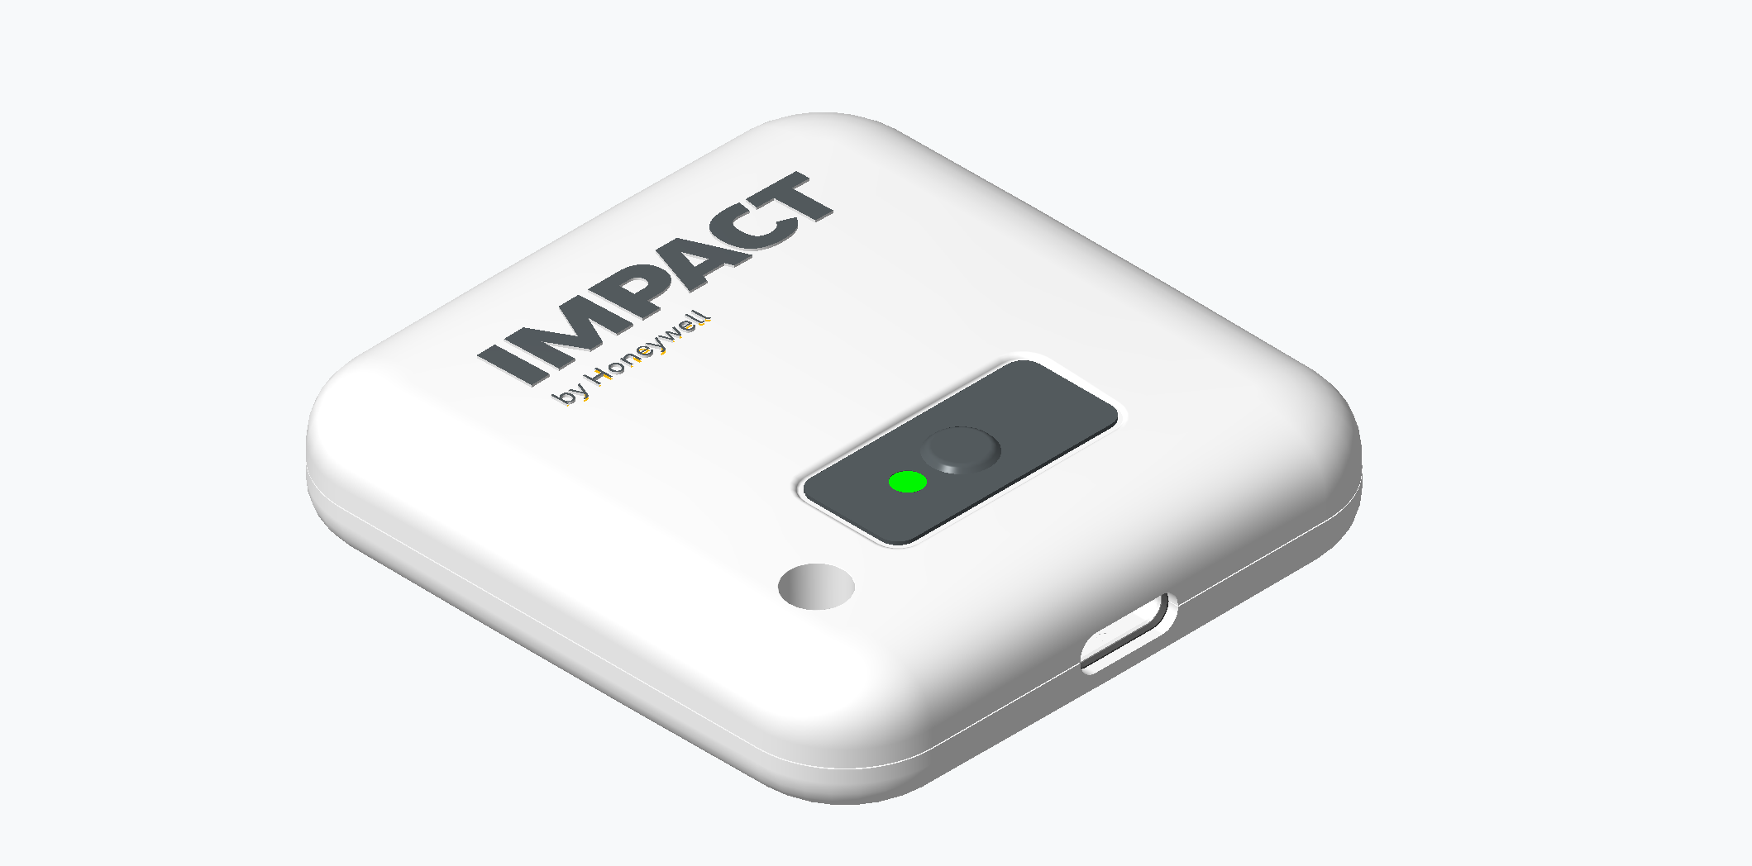
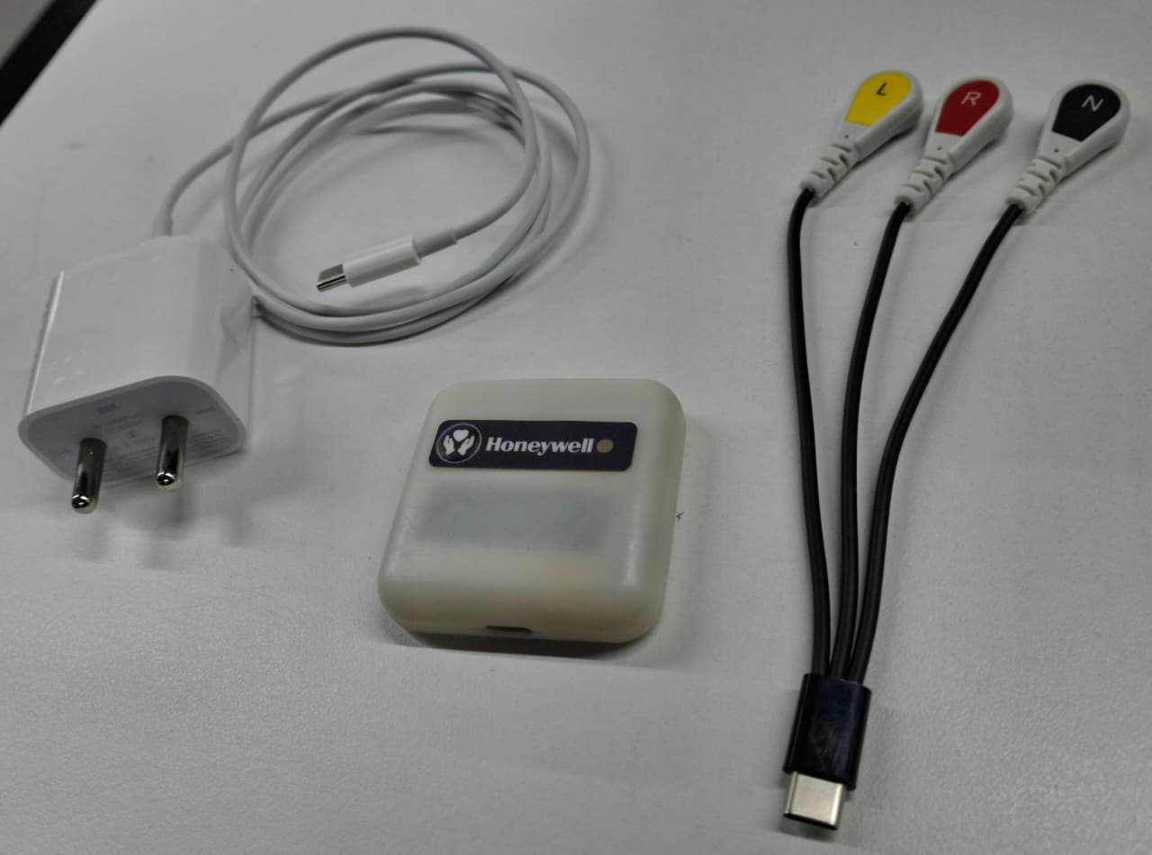
Honeywell
Technical Architecture Version | Phase 2
Connected Care and Hospital Operations Platform
A technically rich architecture view using existing WSP product, prototype, and component visuals
Patient telemetry
Edge + APIs
Command center
2026 India and APAC Innovation Challenge
Impact by Honeywell
Technical Architecture Version | India and APAC Innovation Challenge - Phase 2
1

Slide 2
Honeywell
Technical thesis
Architecture demonstration
Clinical imperative: world-class hospitals can save patients when they reach the intervention team in time. Honeywell creates that time window through continuous risk scoring, deterioration prediction, and faster escalation.
Device ecosystem
Resilient edge
Platform services
Hospital apps
Patch, BP, SpO2, bed sensors, asset tags.
Authentication, buffering, protocol normalization, gateway orchestration.
Registry, assignment, time-series ingest, rules, alerts, analytics.
Nurse, doctor, bed board, asset map, leadership command center.
Clinical objective: monitor risk continuously, predict attacks earlier, and help save lives
Impact by Honeywell
Technical Architecture Version | India and APAC Innovation Challenge - Phase 2
2

Slide 3
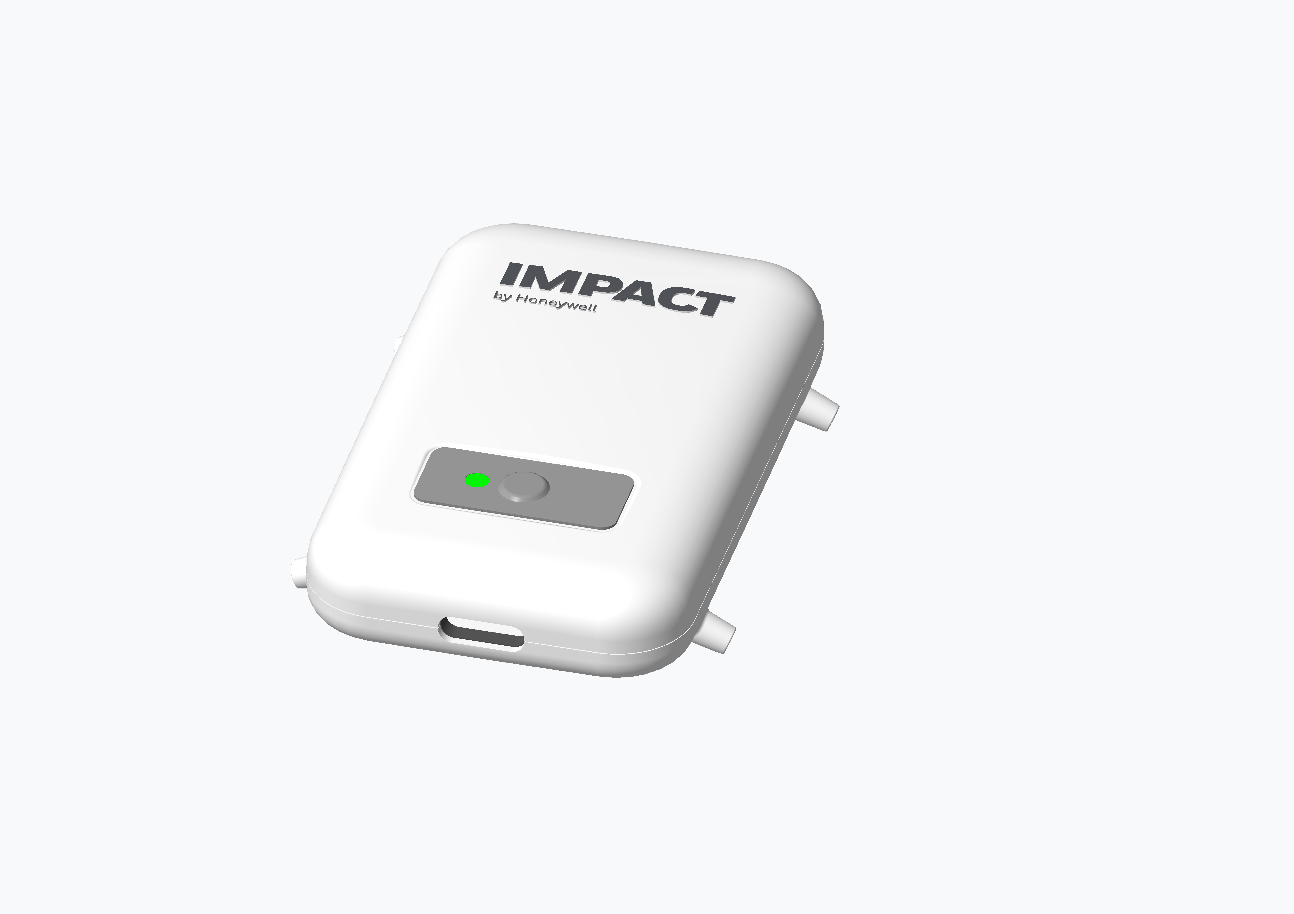
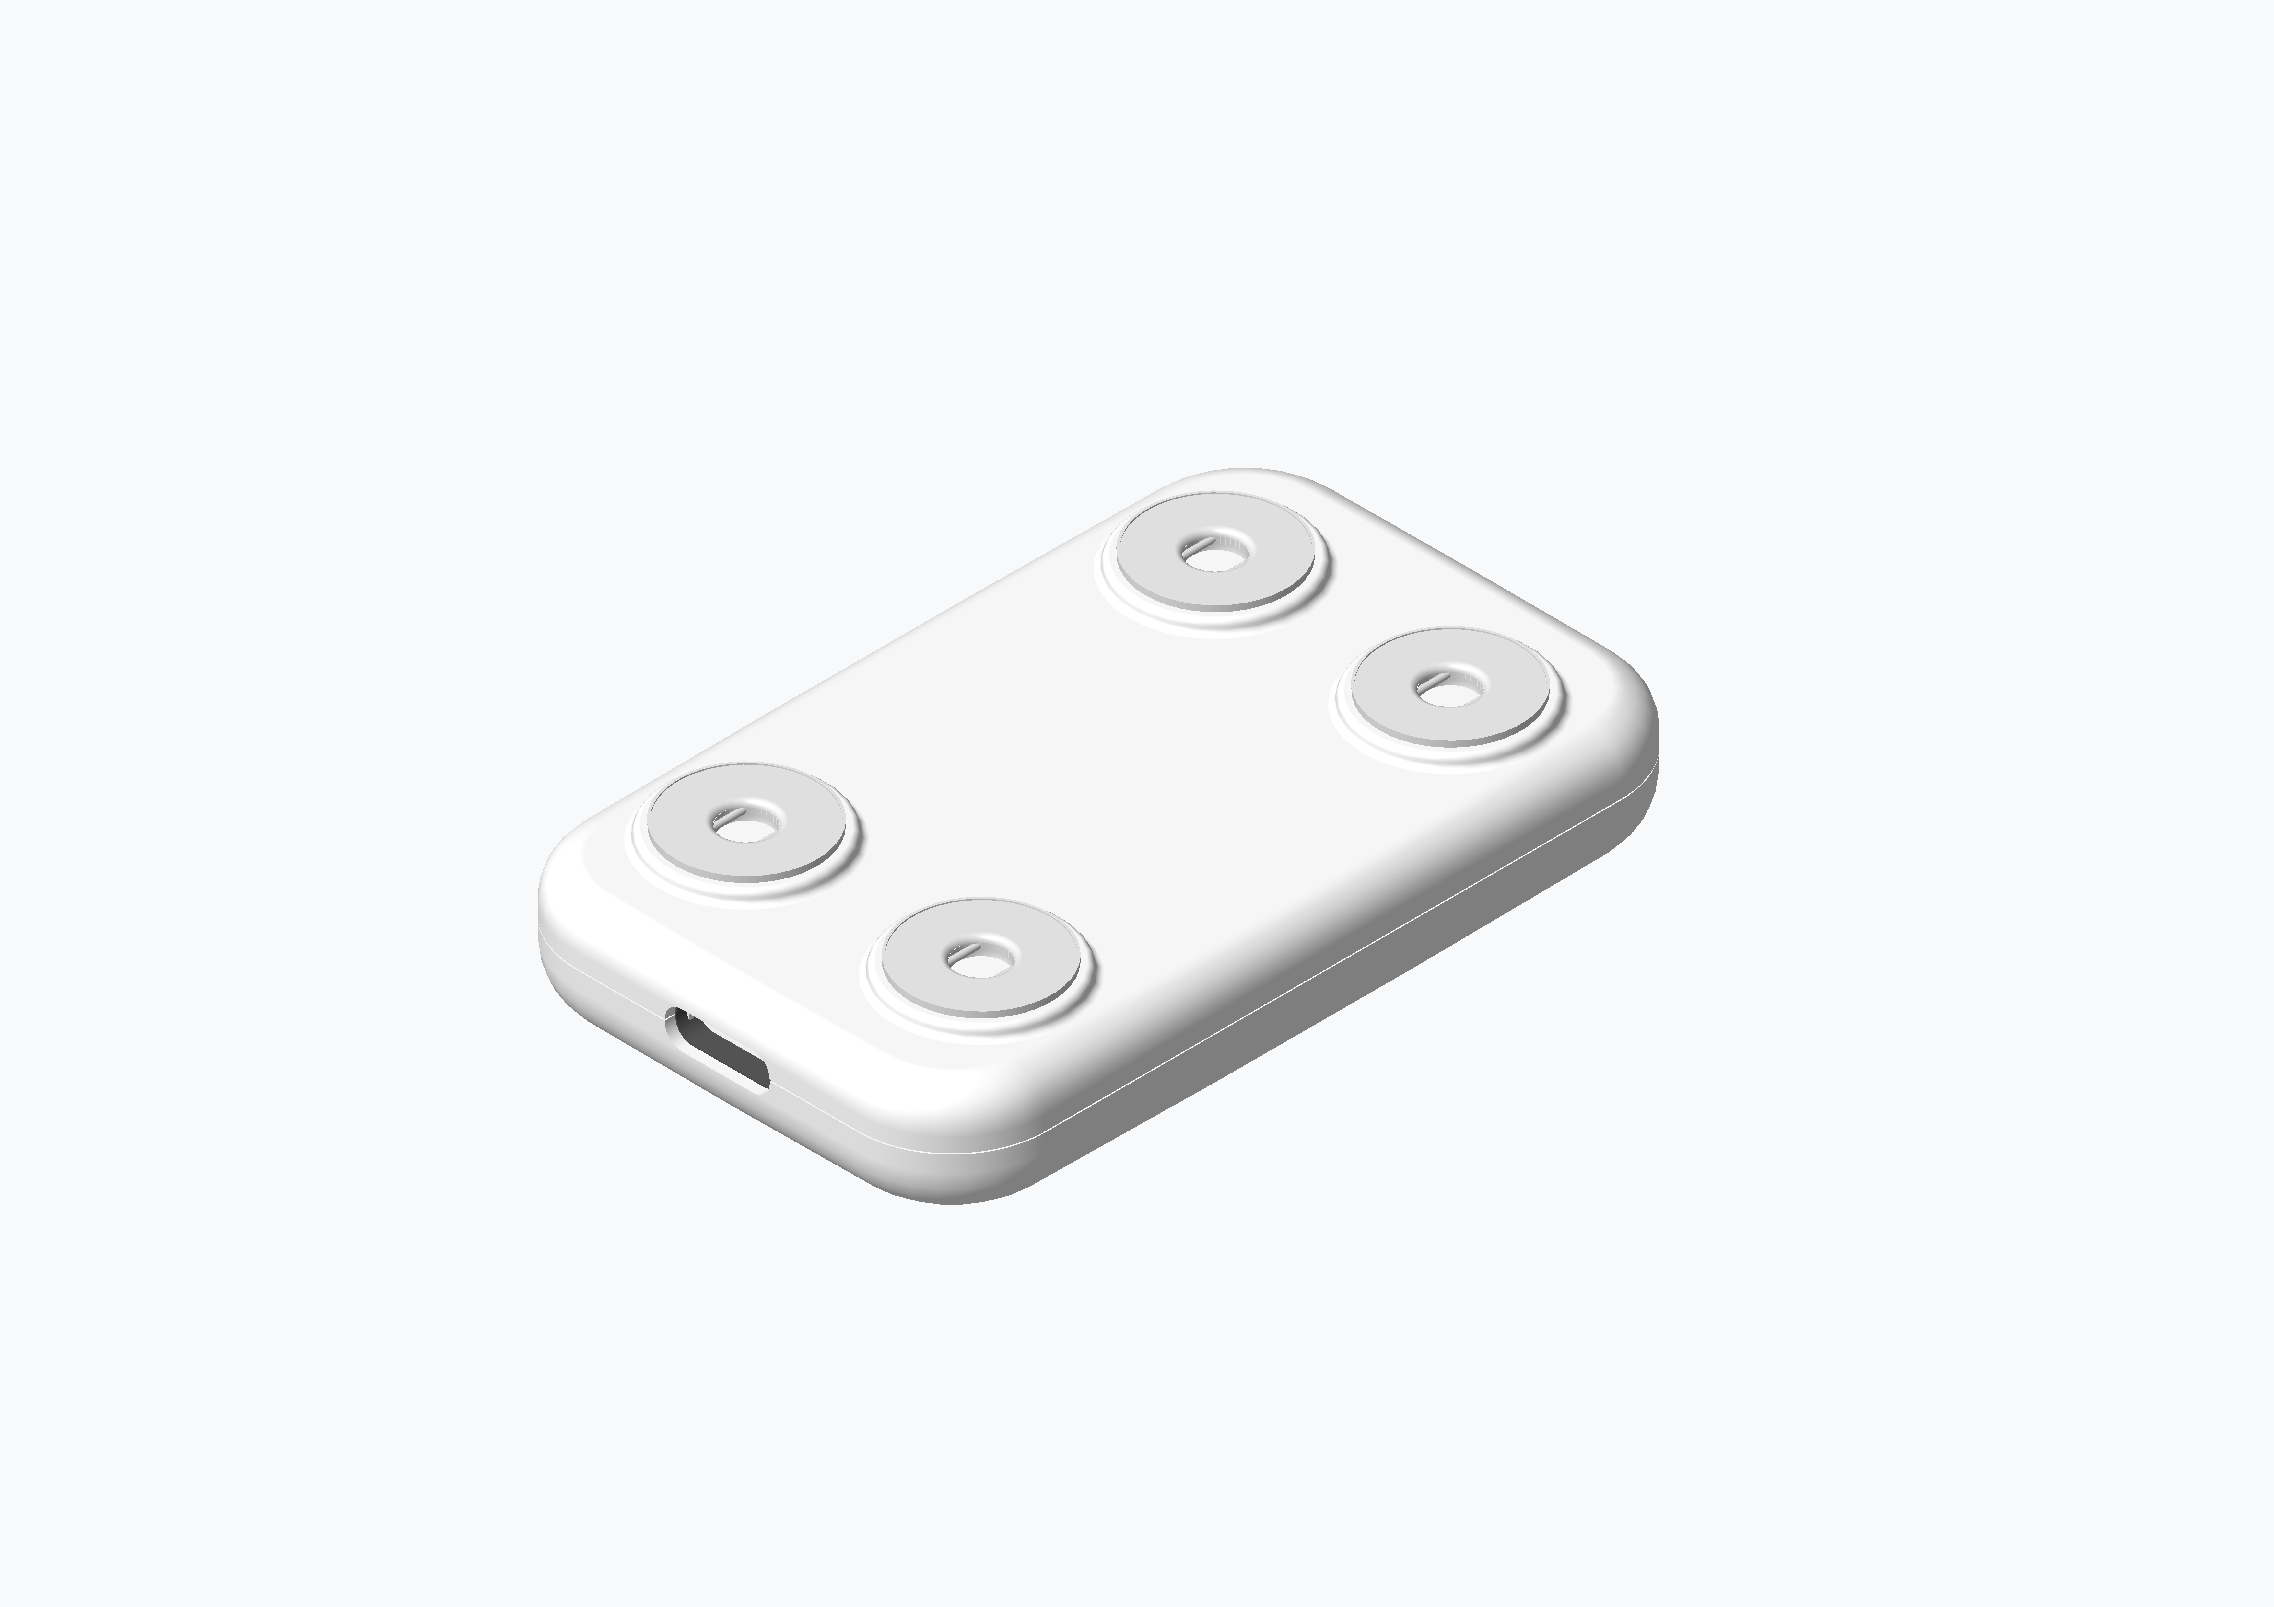
Honeywell
WSP foundation already achieved
Prototype, concept, and hardware visuals already documented
Industrial design render
Prototype kit
Electrode-side concept
Reusable patch housing, LED indication, button, USB-C opening.
Physical WSP unit, ECG cable, charger, and lead interface.
Electrode placement concept for ECG and body-contact sensing.
Source visuals embedded from existing concept and MVO documents
Impact by Honeywell
Technical Architecture Version | India and APAC Innovation Challenge - Phase 2
3

Slide 4
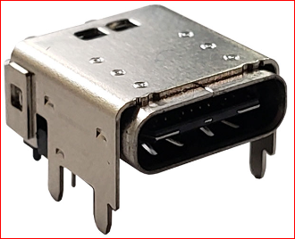
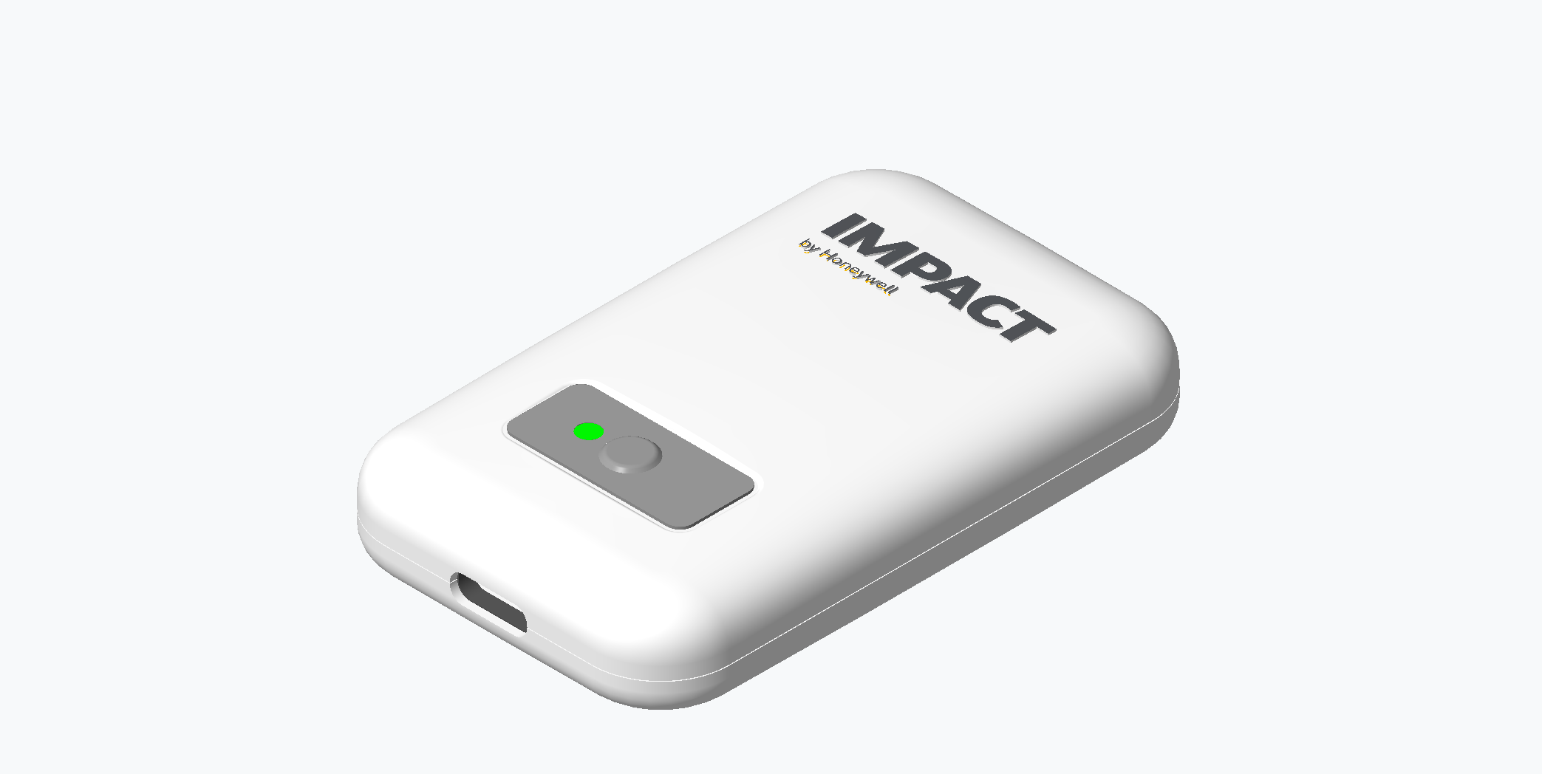
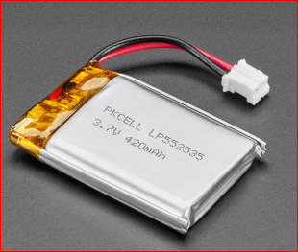
Honeywell
Wearable patch hardware architecture
Current MVO component baseline
ESP32-S3-MINI-1 MCU + Wi-Fi + BLE
MAX30003 ECG AFE
TMP1075 Skin temp
ADXL367 Posture + motion
MAX20356 PMIC Charger + power path + fuel gauge
450 mAh Li-Po Rechargeable battery
USB-C + ECG lead cable Power + data + sensor interface
RGB LED + button Status + wakeup
Debug UART Manufacturing + support
Hardware role
Patient-worn telemetry endpoint for ECG, temperature, posture, movement, derived respiration, device health, and future vitals expansion.
Impact by Honeywell
Technical Architecture Version | India and APAC Innovation Challenge - Phase 2
4

Slide 5
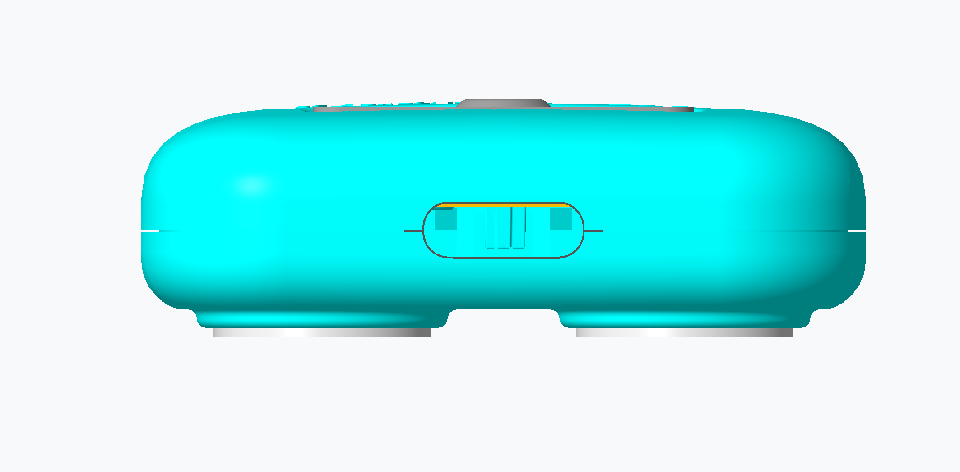
Honeywell
Patch signal pipeline
From body signal to actionable telemetry
Sampling and packet cadence configurable by clinical workflow and battery budget.
Telemetry contains sensor values, timestamp, device ID, battery, RSSI/connectivity state, and firmware/config version.
Edge buffering protects against temporary hospital Wi-Fi disruption.
Platform association links every payload to patient, bed, ward, and care episode.
Body contact ECG/temp/motion
Analog front end filter + sample
MCU processing packetize + status
Wi-Fi/BLE telemetry authenticated send
Edge ingest buffer + normalize
Rules + dashboard alerts + trends
Impact by Honeywell
Technical Architecture Version | India and APAC Innovation Challenge - Phase 2
5

Slide 6
Honeywell
Expanded device ecosystem
Clinical and operational telemetry endpoints
Connected BP + SpO2
Bed state input
Asset tags
Telemetry role
Telemetry role
Telemetry role
Periodic vitals capture during ward rounds and high-risk monitoring.
Occupied, vacant, cleaning, blocked, transfer, discharge-ready, maintenance.
BLE, Wi-Fi, RFID, or UWB tags for pumps, monitors, cylinders, carts, wheelchairs.
Wearable patch
Continuous ECG, HR, temperature, respiration, posture, restlessness.
Unified event model across clinical signals and operations events
Impact by Honeywell
Technical Architecture Version | India and APAC Innovation Challenge - Phase 2
6

Slide 7
Honeywell
Connectivity and edge topology
Hospital-grade connectivity under network variability
Patch + BP + SpO2
Wi-Fi / BLE
Device registry
Bed sensors
BLE / wired input
Honeywell Edge Gateway Auth + buffer + normalize + route
Time-series ingestion
Asset tags
BLE / RFID / UWB
Event bus + rules
Mobile workflows
Tablet / workstation
Command center APIs
Edge resilience
Local buffering, retry logic, time synchronization, device-health monitoring, and controlled reconnect behavior support hospital network variability.
Impact by Honeywell
Technical Architecture Version | India and APAC Innovation Challenge - Phase 2
7

Slide 8
Honeywell
Event-driven data architecture
Telemetry, workflow state, and analytics separation
Raw telemetry store
Sensor payloads, ECG snapshots, vitals values, device metadata, timestamps.
Operational event stream
Bed state changes, asset zone events, assignment changes, alert lifecycle.
Rules outputs
Thresholds, trends, missed-vitals windows, battery/connectivity, bed/asset exceptions.
Workflow tasks
Nurse queue, doctor review, housekeeping queue, biomedical action, transport task.
Analytics aggregates
Ward, hospital, and hospital-chain KPIs for throughput, acuity, utilization, response.
Impact by Honeywell
Technical Architecture Version | India and APAC Innovation Challenge - Phase 2
8

Slide 9
Honeywell
Patient-bed-device assignment model
Avoiding orphan telemetry
Patient
Admission
Bed
Device
Asset
Data keys
Data keys
Data keys
Data keys
Data keys
MRN / episode / demographics
ward / department / care episode
bed ID / state / location
serial / firmware / battery / status
tag ID / class / zone / service state
Assignment service responsibilities
Why it matters
Pair device to patient, patient to bed, asset to zone, and events to care episode with auditability.
Every telemetry point, bed event, and asset event is traceable to the right operational context.
Impact by Honeywell
Technical Architecture Version | India and APAC Innovation Challenge - Phase 2
9

Slide 10
Honeywell
Rules engine and alerting
Clinical and operations logic in one configurable layer
Vitals threshold
Trend detection
Missed vitals
BP, HR, SpO2, temperature, ECG-derived alerts
Change over baseline, repeated abnormalities, escalation windows
Expected observation not received within defined time
Device health
Bed workflow
Asset exception
Battery, RSSI, offline, firmware/config mismatch
Cleaning delay, blocked bed, discharge-ready queue
Missing asset, zone exit, service due, low utilization
Alert lifecycle: generated -> routed -> acknowledged -> resolved -> audited
Impact by Honeywell
Technical Architecture Version | India and APAC Innovation Challenge - Phase 2
10

Slide 11
Honeywell
Bed management technical model
State machine plus workflow queues
Vacant
Occupied
Discharge-ready
Cleaning
Blocked
Maintenance
Transfer
State inputs
Workflow queues
Operational KPIs
ADT feed
Nurse/ward update
Housekeeping update
Maintenance status
Transfer request
Admission queue
Cleaning queue
Transport queue
Maintenance queue
Discharge coordination
Turnaround time
Blocked-bed time
Cleaning cycle time
Occupancy
Transfer bottlenecks
Bed intelligence connects patient acuity, capacity, and hospital flow
Impact by Honeywell
Technical Architecture Version | India and APAC Innovation Challenge - Phase 2
11

Slide 12
Honeywell
Asset tracking architecture
Accuracy tiers matched to operational value
BLE tags
RFID gates
Low cost zone proximity for pumps, wheelchairs, monitors.
Entry/exit control for storerooms, wards, departments.
UWB zones
Wi-Fi tags
Higher precision for critical assets and high-value equipment.
Network-based location where infrastructure supports it.
Asset event model
tag_id, asset_class, zone, timestamp, movement event, utilization state, service state, exception type, assigned department
Impact by Honeywell
Technical Architecture Version | India and APAC Innovation Challenge - Phase 2
12

Slide 13
Honeywell
Hospital integration architecture
API-first, adapter-ready interoperability
Hospital systems HMS / EHR / EMR
Integration adapter FHIR / HL7 / REST
Platform services ADT + assignment + alerts
Applications Dashboards + APIs
Inbound hospital context
Outbound platform events
Mapping controls
ADT, patient demographics, ward, bed, encounter, clinician assignment.
Alerts, vitals summaries, device events, bed-state updates, asset exceptions.
Hospital-specific data dictionaries, interface monitoring, retry/error handling.
Integration pattern supports heterogeneous India and APAC hospital environments
Impact by Honeywell
Technical Architecture Version | India and APAC Innovation Challenge - Phase 2
13

Slide 14
Honeywell
Security and compliance architecture
Controls across device, edge, platform, and users
Device identity
Secure transport
Access control
Provisioning, device registry, serial binding, firmware/config visibility.
Authenticated ingestion, encryption in transit, controlled gateways.
Role-based access for nurse, doctor, biomedical, operations, admin, leadership.
Auditability
Network segmentation
Deployment control
Assignment changes, alert lifecycle, integration events, device actions.
Device, edge, platform, and hospital integration zones separated.
On-premise, private cloud, or hybrid data-retention policies.
Impact by Honeywell
Technical Architecture Version | India and APAC Innovation Challenge - Phase 2
14

Slide 15
Honeywell
Deployment topology
Ward, hospital, and hospital-chain scale
Ward deployment 50-100 beds
Hospital deployment Multiple wards + ops
Chain deployment Multi-site dashboards
Enterprise Analytics
Ward package
Hospital package
Enterprise package
Patch devices, BP/SpO2, BLE gateway, nurse dashboard, basic alerts.
Bed board, asset tags, integration adapter, command-center workflows.
Multi-site KPIs, analytics aggregates, standard deployment template.
Impact by Honeywell
Technical Architecture Version | India and APAC Innovation Challenge - Phase 2
15

Slide 16
Honeywell
Technical non-functional requirements
Architecture guardrails for hospital operations
Reliability
Scalability
Maintainability
Buffered edge telemetry, retry logic, device health monitoring.
Ward-to-chain architecture with event partitioning and modular services.
Device registry, firmware/config visibility, interface monitoring.
Interoperability
Usability
Traceability
FHIR/HL7 where available, REST adapters for local hospital systems.
Role-specific dashboards and exception-first workflows.
Telemetry-to-patient-to-bed-to-event lineage and audit logs.
Impact by Honeywell
Technical Architecture Version | India and APAC Innovation Challenge - Phase 2
16

Slide 17
Honeywell
End-to-end technical demo flow
How the platform demonstrates value
1. Assign
2. Capture
3. Normalize
4. Evaluate
5. Act
6. Analyze
Patient + bed + patch + BP device
ECG, vitals, posture, temperature, device health
Edge authentication, buffering, payload normalization
Risk scores, trends, thresholds, missed vitals, battery, connectivity
Nurse queue, doctor review, bed board, asset map, command center
Ward KPIs, throughput, utilization, enterprise reporting
Demo story: sensor signal becomes risk score, clinical action, and measurable outcome
Impact by Honeywell
Technical Architecture Version | India and APAC Innovation Challenge - Phase 2
17

Slide 18
Honeywell
Technical differentiators
Architecture-led healthcare platform
Honeywell sensing foundation connected to hospital workflow intelligence.
Multi-domain architecture for vitals, bed state, asset tracking, and command-center operations.
Edge resilience for real-world hospital network variability.
Integration-aware design for heterogeneous India and APAC hospital systems.
Scalable event model supporting ward deployment, hospital operations, and chain-level analytics.
From wearable telemetry to whole-hospital technical architecture
Impact by Honeywell
Technical Architecture Version | India and APAC Innovation Challenge - Phase 2
18

Slide 19
Honeywell
What we have already achieved
Wearable Smart Patch
Clinical scope defined
MVO1 requirements captured
Prototype and concepts created
ECG, heart rate, skin temperature, respiration, posture, restlessness, SpO2 expansion, connected vitals workflows.
Narayana Hrudayalaya business overview, reusable rechargeable device, periodic telemetry, API endpoint direction.
Industrial design renders, POC visuals, electrode placement, ECG cable options, USB-C interface, enclosure concepts.
Hardware baseline developed
Deliverables identified
Integration model mapped
ESP32-S3-MINI-1, MAX30003 ECG AFE, TMP1075, ADXL367, MAX20356 PMIC, Li-polymer battery, LED, debug support.
Smart patch device, ECG-USB cable, adhesive samples, user manual, Type-C charger, ECG plotting utility.
Honeywell hardware/firmware/backend responsibilities and NH API, HMS/patient-ID, reporting, alerts, validation roles.
Clinical protocols researched
Business case prepared
MVO expansion path outlined
Pre-surgical, post-cardiac, post-major surgery, emergency chest pain, arrhythmia, ICU/sepsis/shock monitoring.
Bed capacity, launch device assumptions, pricing rationale, lifecycle view, patient-charge positioning, benefit/cost framing.
MVO1 foundation toward respiration rate, HRV, posture, IPX4, and SpO2 expansion.
Impact by Honeywell
Technical Architecture Version | India and APAC Innovation Challenge - Phase 2
19

