Slide 1
Context and problem
2016: the estimated prevalence of CVDs in India was estimated to be 54.5 million
One in 4 deaths in India are because of CVDs with ischemic heart disease with stroke responsible for >80%
Annually, 300000 cardiac procedures are performed in India, i.e. 1 per 4700 people
US: 900000 for a 300 Mn population i.e. 1 per 300 people
Indian cardiac care procedures can grow to 4.2 million/year

Slide 2
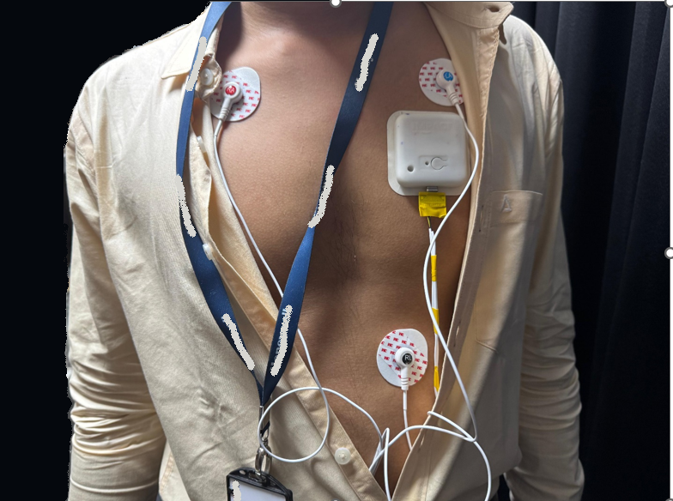
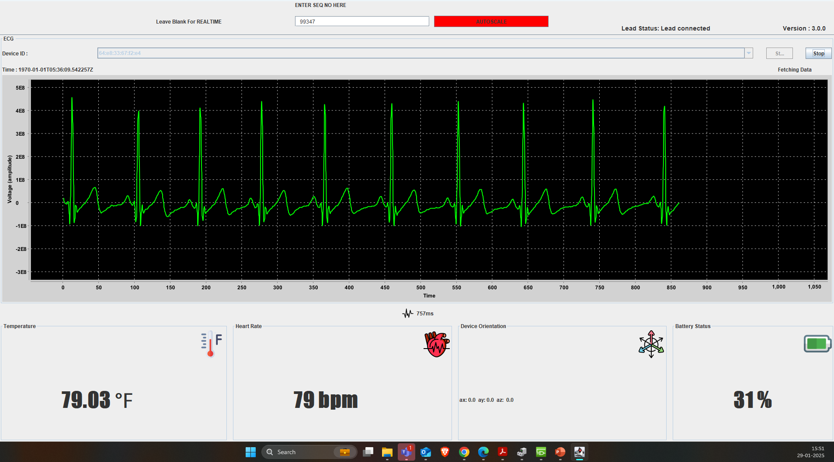
Device Spec
Health parameter monitoring
SPO2 (Blood Oxygen Saturation)
ECG (Electrocardiogram)
Heart Rate
Body Temperature
Posture & restlessness
Hardware
WiFi telemetry
5- day battery life

Slide 3
Key propositions
Unattended monitoring & reduced workload
Continuous monitoring

Slide 4
Questions for doctor
Does the device fit into your current cardiac protocol?
Do you face challenges in efficiently managing ECGs?
Can you identify if there are non-cardio ECGs this device can provide?
How interventional should the device be? How critical are the post-op scenarios?
What framework or tech do you currently use for post-op management?

Slide 5
Protocols using ECG monitoring
Patient Type | ECG Type | Frequency
Pre-Surgical Patients | 12-lead ECG | Once, or more if needed.
Post-Cardiac Surgery | Continuous ECG (Telemetry) | 24–72 hours.
Post-Major Surgery (Non-Cardiac) | 12-lead ECG | Within 24 hours, then as needed.
Emergency Chest Pain | 12-lead ECG | Immediately, then repeated.
Arrhythmia Symptoms | Holter monitor or telemetry | 24–48 hours.
ICU/Severe Sepsis/Shock | Continuous ECG | Until stable.

Slide 6
Factors influencing purchase decision
Competitors & internal requirements such a system
Hier typical purchase chain and stakeholders.
One-time purchase model preferable over recurring.

Slide 7

Narayana Hrudayala - Profile
6186 beds in 39 facilities across 3 heart centres, 18 hospitals and 17 primary care facilities.
Average revenue per occupied bed (ARPOB): Rs. 35.3k/day
Average length of stay: 4.4 days
Rare Indian chain with international operations: 19% sales – 110 bed Health City Cayman Islands
33% case mix from cardiac sciences

Slide 8
Narayana Hrudayala – Business case
WaSPs for 75% of bed capacity: 4500 devices
Revenue @Rs. 20k/device : $1.05 Mn,
at launch [500 devices]: $115k
3Y STRAP: $1.57 Mn
Revenue @Rs. 75k/device : $ 3.9 Mn
at launch [500 devices]: $430k
3Y STRAP: $5.9 Mn
Value drivers
Health City Cayman Islands revenue growing at 11%
NHS tie-up, FDA approval for global reach
Wider cardiac monitoring market: $14 Mn
The device has a 2-year lifecycle, creating recurring revenue from each hospital

Slide 9
Pricing rationale
$500k upfront R&D cost
Low order volume
Higher comparable value with Philips/GE
NH in 2018 with 1000 beds, had daily 40 procedures⁴
At the same efficiency level, daily procedures ~180 over 4500 beds
Patient charge @1500/day is 4% of ARPOB
With daily ~180 procedures and 4-day monitoring, annual revenue from WSP: Rs. 39 crores i.e $ 4.9 Mn
Benefit/cost ratio over 2-year period for 4500 beds: 2.3
Cost breakeven: 10 month
[Rev: $ 9Mn, Cost: $3.9Mn]

Slide 10
Market size - WSP
No. of ICU beds in India : 85000¹
No. of CCU beds (20%): 17000
TAM for all CCU beds @ Rs. 75k: $14.6 Mn
HW market share @ 20%: 3400 beds
SAM @ Rs. 75000 - $2.9M
Y1 SOM @ 700 devices/ ~25 hospitals: $670k
3Y STRAP revenue @ 30% growth: $2.4Mn
[~2800 devices, ~95 hospitals]
If 2-year cloud costs included @Rs. 100k: $3.2 Mn

Slide 11
Hospital revenue proposition
Annual cardiac surgeries India²: 300k
Multispecialty hospitals and colleges with CCU (MSCH): 700³
Avg. yearly procedures in MSCH : 428
Revenue from 3-day procedure monitoring @ Rs. 1500: 19.2 lakhs
Benefit/cost ratio: ~25 …~2.3
Payoff procedures: ~16
Monthly revenue: Rs. 160k

Slide 12
Sources
1. Cardio-Thoracic Surgeon Network – 2021
2. Indian Journal of Cardiac Surgery, PUBMED – 2023
3. Expressions (Journal) - 2020

Slide 13
Feedback
Does the device provide a warning framework for a complete ECG?
How does it integrate into ICU/CCU telemetry systems?
Please chart the diagnostic fall-off against 5 or 12 lead ECGs deployed in typical telemetry systems.
Explore if it can help increase efficiency of existing ECG protocols through software triangulation of underlying conditions
Medium-Sized Hospitals & nursing homes
Daily ECGs: 50–200
Presence of departments like cardiology, pulmonology, and internal medicine.
Multi-specialty & medical colleges
Daily ECGs: 200–500+
High patient volume due to outpatient clinics, emergency rooms, and ICUs.
Specialized cardiac departments performing stress tests, telemetry, and continuous monitoring.
Cardiac-Specific Hospitals or Centers
Daily ECGs: 300–1,000+
High focus on cardiac diagnostics.
Advanced tests like Holter monitoring and stress ECGs can also be explored

