Slide 1
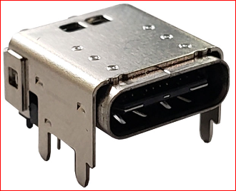
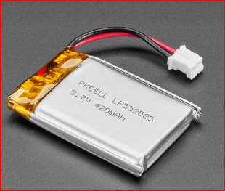
Wearable Smart Patch MVO2 Electrical Architecture
USB 3.2
C-Type
Connector
(ECG leads + Power + USB + Temperature sensor)
MCU
ESP32-S3-MINI-1
(Built in Wi-Fi,
BLE along with on board Antenna)
From USB Connector
I2C0_SCL
TMP1075DGKR
PMIC
Power management
(Battery charger, power path, fuel gauge)
MAX20356
3V3_B
1V8_L
I2C0_SDA
VBUS
3V3_LSW1
GND
3V3_LSW2
I2C1_SCL
I2C1_SDA
SPI_SCK
MAX30003
RA LA VCM
SPI_CS
From USB Connector
SPI_MOSI
From C type
connector
USB D+
SPI_MISO
USB D-
INTB
TVS Diode
I2C0_SCL
Li – Polymer
Battery 450mAh
ADXL367
I2C0_SDA
Push Button
GPIO47
ACC_INT1
ACC_INT2
Debug port
UART_TX
UART_RX
GPIO26
Indication multicolor LED
3V3_B
1V8_L
3V3_LSW1
3V3_LSW2
PCB Outline
WSP Outline

