Slide 1
Product Management System
Team Members: Ghanashyam G, Archi Mehta
Date: 21st Sept, 2025
Batch Details : Batch-34

Slide 2
Problem Statement
Modern organizations often struggle with efficiently managing product-related data due to fragmented systems and manual workflows. Our Product Management System addresses this by offering a centralized web application that streamlines operations like product addition, editing, deletion, and retrieval. It also supports real-time data access, dynamic credential management, and provides visual insights through a rich, interactive dashboard. By integrating backend services with a clean, responsive frontend, the system ensures both operational efficiency and data accuracy across the product lifecycle.

Slide 3
Objective
Centralized Product Management - Enable CRUD operations for product data via a structured and user-friendly web interface.
Dynamic Credential Configuration - Allow runtime authentication to access the database securely without hardcoded credentials.
Data-Driven Decision Making - Provide visual insights through dashboards, KPIs, and product metrics to support better business decisions.
Robust Architecture - Follow best practices with layered architecture (Controller, Service, DAO) for maintainability and scalability.
Data Integrity & Validation - Ensure consistent and accurate data through validation, structured inputs, and backend testing using JUnit.

Slide 4
Tools & Technologies
LAYER | TECHNOLOGY
Backend | Java (JDK 17), JAX-RS (Jersey), JDBC
Frontend | HTML5, CSS3, Bootstrap 5, JS
Database | Oracle SQL Developer
APIs | RESTful APIs using JAX-RS tested via Postman
Testing | JUnit 5
Server | Tomcat
IDE | Eclipse

Slide 5
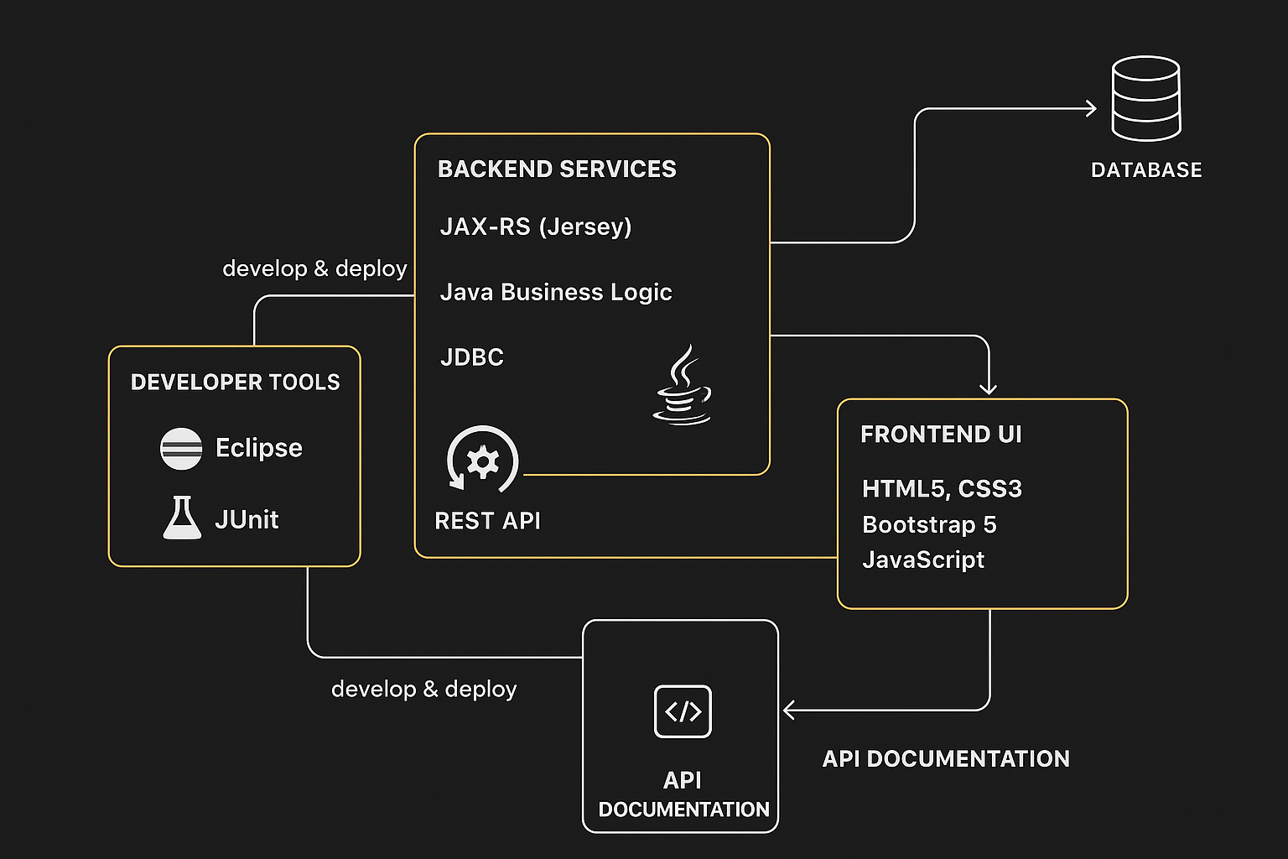
High-level Architecture

Slide 6
Key Components/ Features
Our Product Management System has been designed using a layered and modular architecture that emphasizes scalability, maintainability, and enterprise-grade performance. The following components form the backbone of the application:
Secure Access
Runtime database login with user-provided credentials
Dynamic Frontend
Responsive UI with live data rendering and interactive user experience
Real-time filtering, sorting, and dashboard metrics
RESTful API Layer (JAX-RS with Jersey)
All operations exposed via REST endpoints
Real-Time Dashboard and Reporting
Consolidated view of key product metrics including count, pricing, and release trends
Graphs, badges, and tables enable fast, data-driven decision making

Slide 7
Database Schema
Column Name | Type | Constraints | Description
product_id | INT | PRIMARY KEY | Unique product ID
product_name | VARCHAR | NOT NULL | Name of the product
product_desc | TEXT |  | Description
price | DOUBLE |  | Product price (USD)
product_released_on | DATE |  | Release date

Slide 8
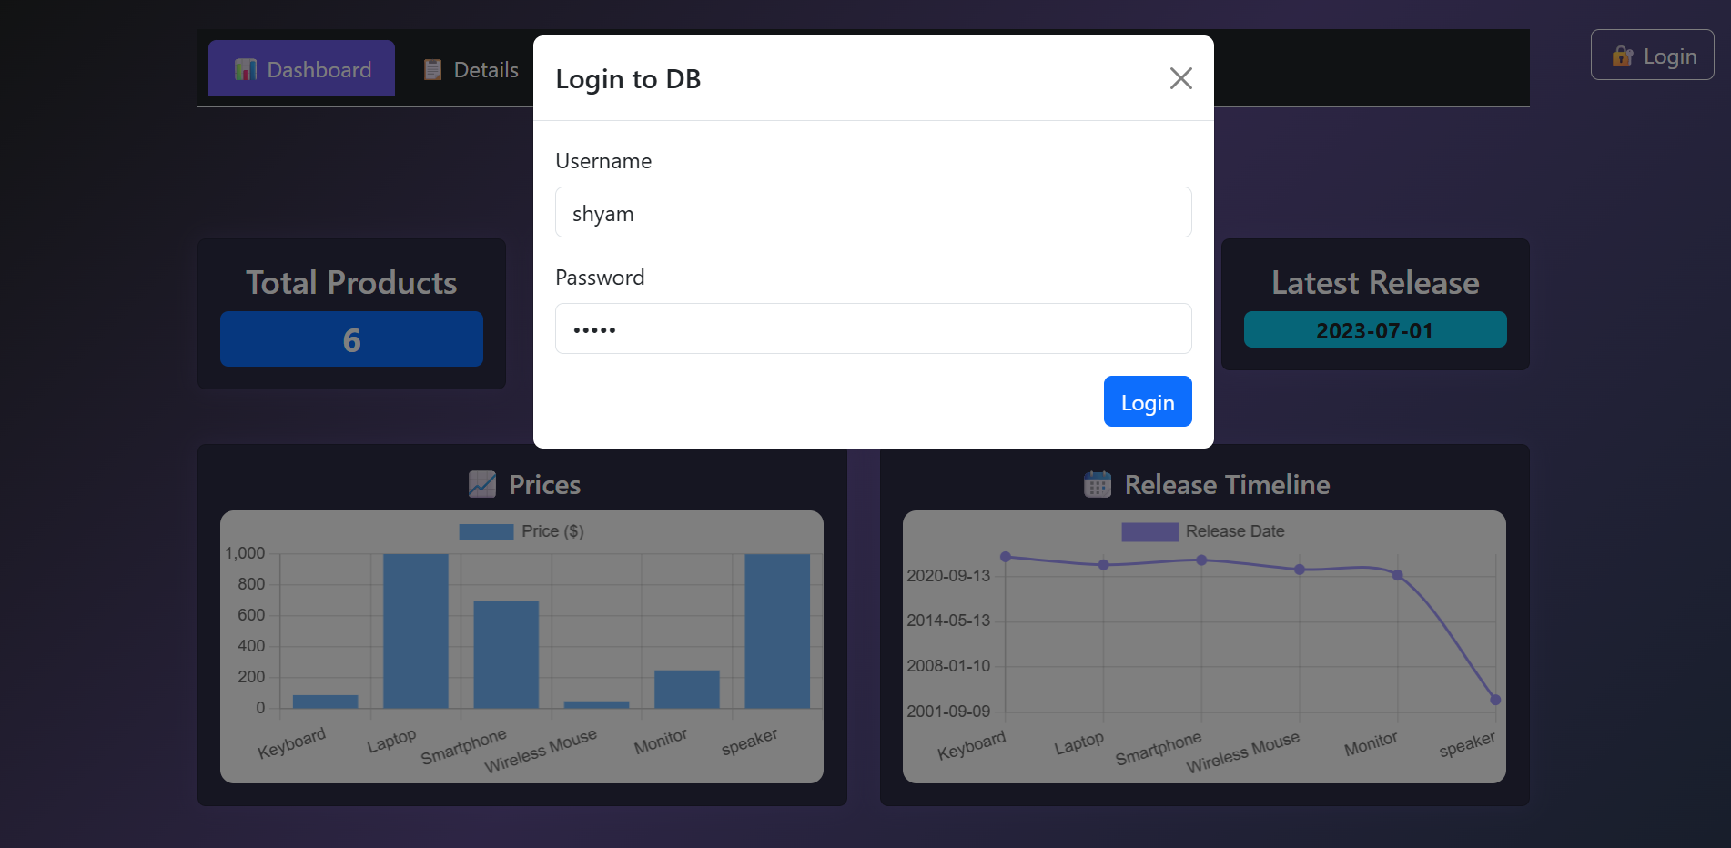
Screenshots of Implementation
Front End (Login Page) -

Slide 9
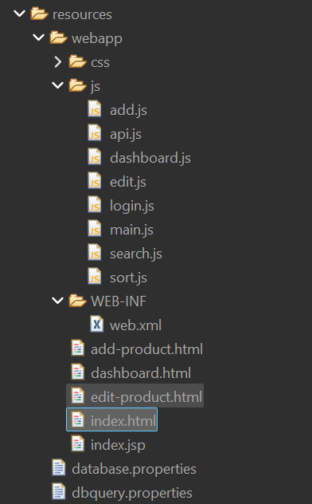
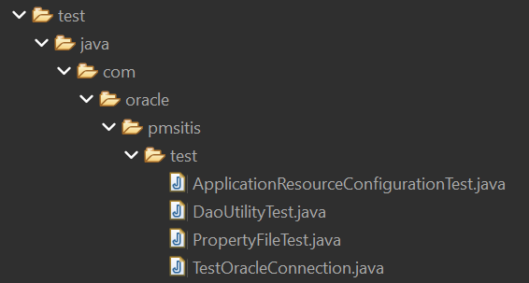
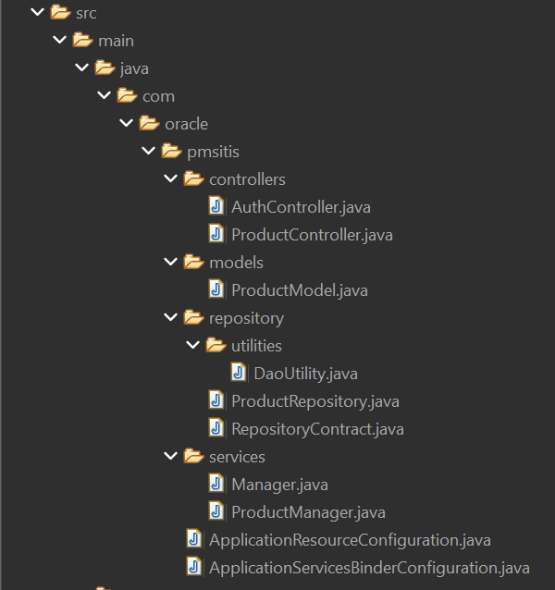
Project Structure
Front End -
Test
Back End -

Slide 10
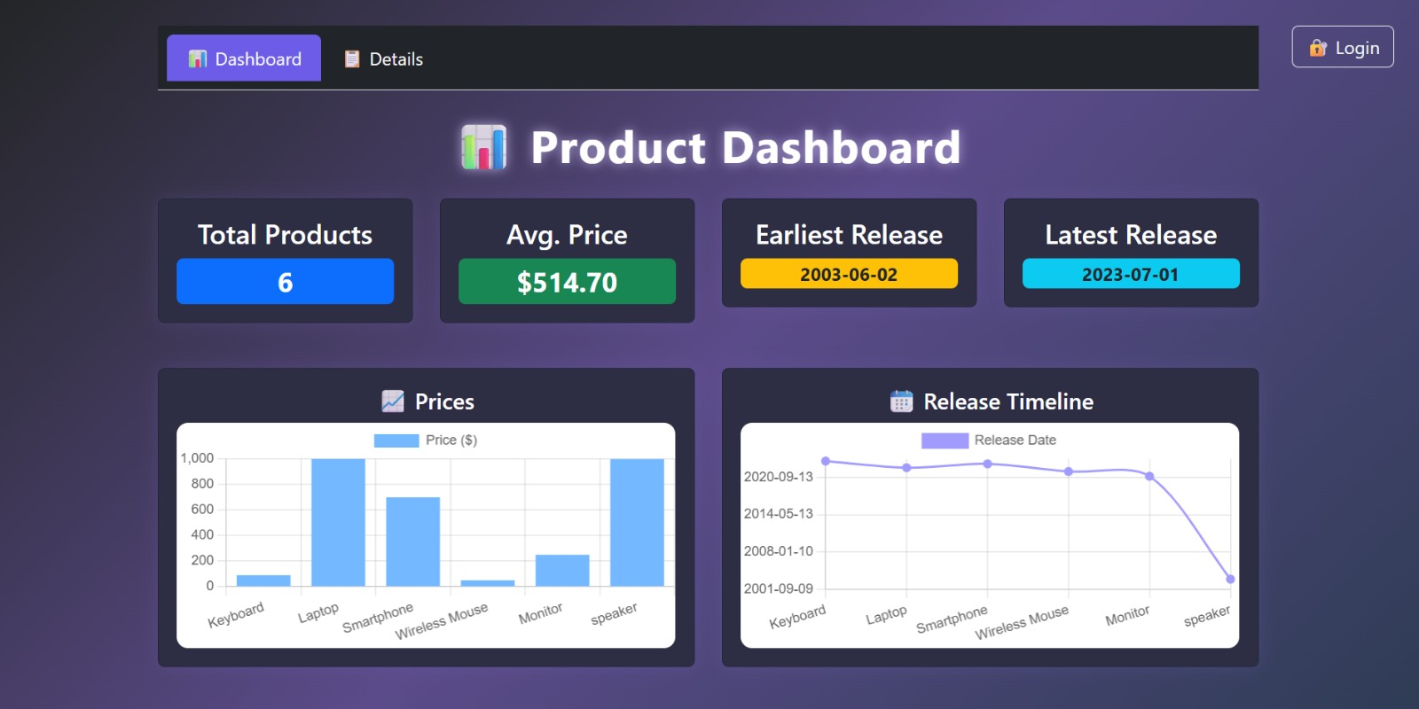
Dashboard

Slide 11
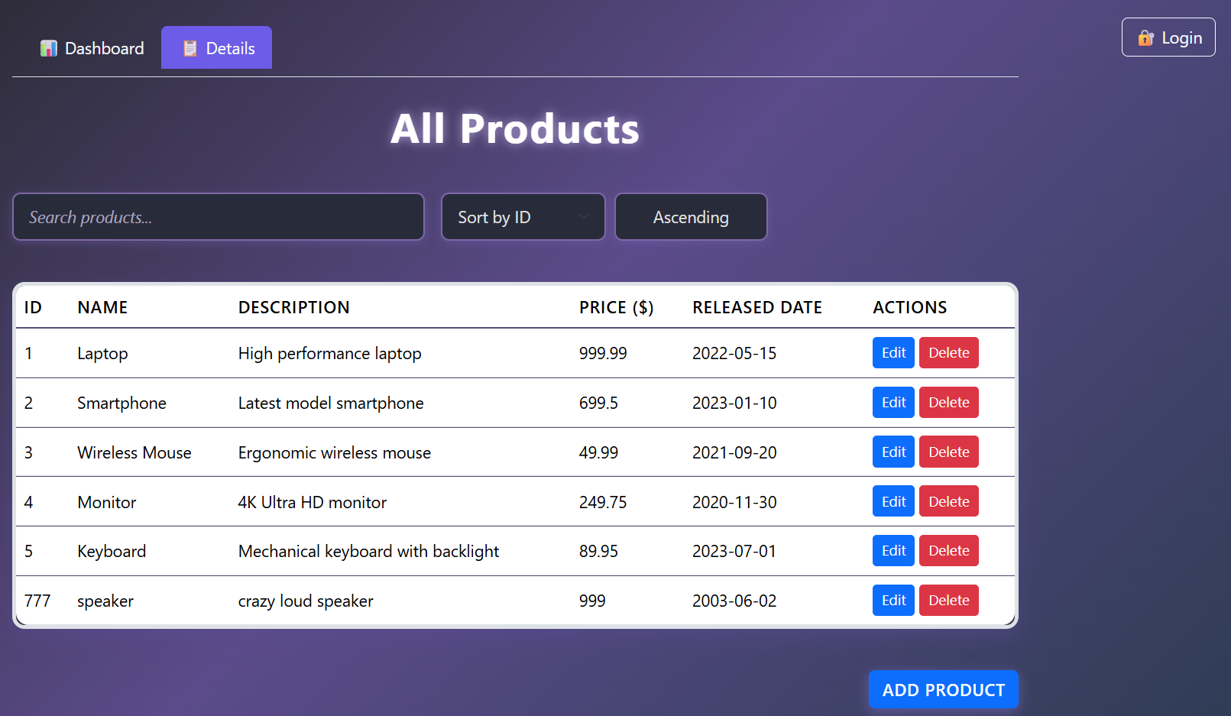
Product Details

Slide 12
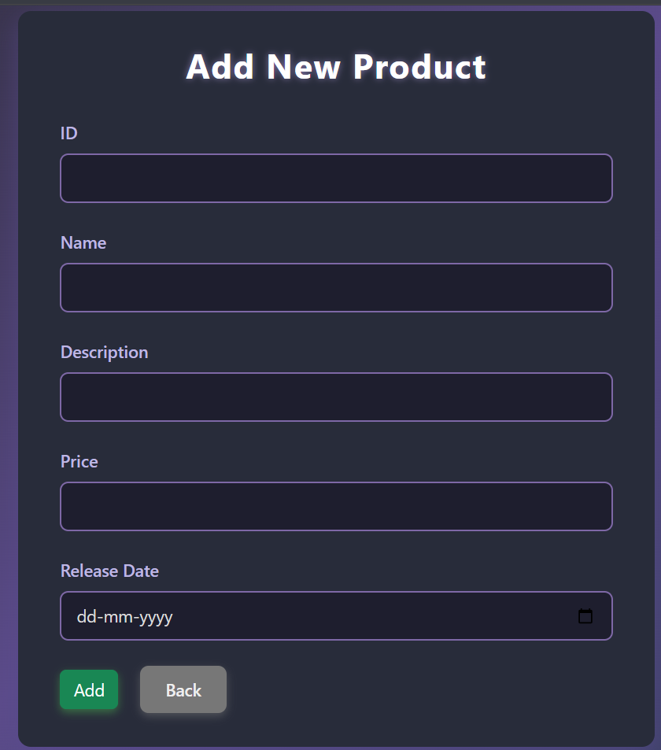
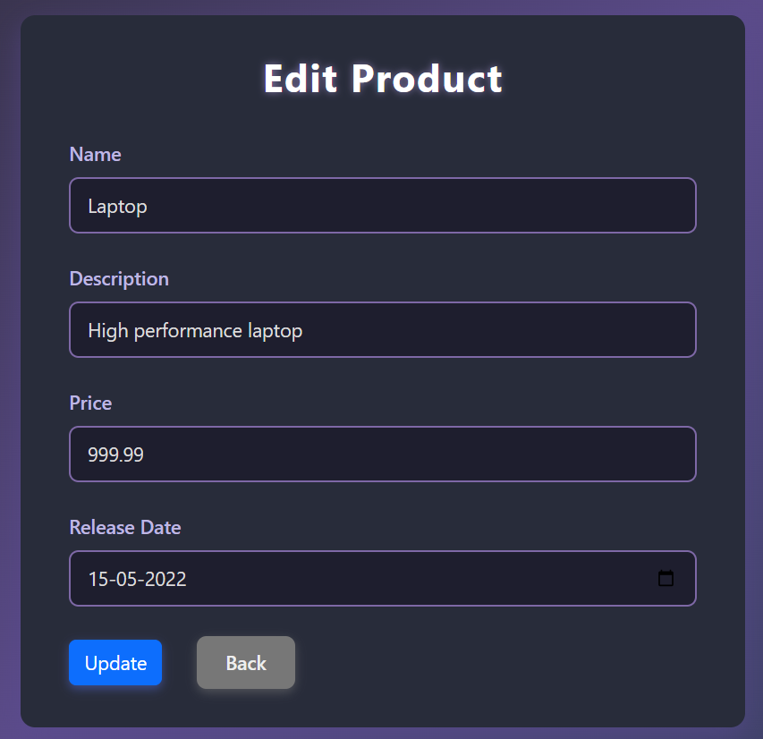
Add Product Dialogue
Edit Product Dialogue

Slide 13
Challenges Faced
Data Consistency
Handle concurrent updates
Ensure reliable transactions
Prevent stale data
User Authorization & Access Control
Role-based permissions (Admin/PM/Team)
Secure authentication (JWT/session)
Prevent unauthorized access
Efficiency & Scalability
Optimize queries & DB access
Use connection pooling & caching
Scale backend for growing users

Slide 14
Learnings & Takeaways
Core Java (JDK 17) : Strengthened object-oriented programming concepts and applied modern Java features in building enterprise-grade applications.
Backend Development (JAX-RS, Jersey, JDBC) : Gained hands-on experience in developing RESTful APIs, structuring layered services, and managing database connectivity with JDBC.
Frontend Development (HTML5, CSS3, Bootstrap 5, JavaScript) : Learned to design responsive UIs, implement client-side logic, and integrate seamlessly with backend APIs.
Database Management (Oracle SQL Developer) : Enhanced skills in designing schemas, writing optimized SQL queries, and maintaining data consistency.
Testing & Quality (JUnit) : Practiced unit testing, ensuring code reliability and validating business logic.
Deployment & Tools (Tomcat, Eclipse IDE) : Acquired experience in deploying applications on Tomcat and managing end-to-end development using Eclipse.

Slide 15

Thank you!

