Slide 1
ANDROID DRIVER MONITORING
DriveSafe
Driver Drowsiness
Detection System
Project presentation
Kotlin | CameraX | MediaPipe Face Landmarker
LOCAL • REAL-TIME • PRIVATE
Built as a phone-based driver safety aid
Notes:
Project overview. The deck follows an academic project sequence and uses the supplied app screenshots as implementation evidence. The sample screenshots are illustrative demonstrations, not a controlled clinical validation study.

Slide 2
01 INTRODUCTION
Introduction and motivation
Driver fatigue can reduce attention and slow a driver’s response. A phone mounted to face the driver can observe visible cues such as eye closure, yawning, head nodding, and whether the face remains in view.
Need
Motivation
Safety role
A practical warning system should track how long the eyes remain closed and how often prolonged episodes occur, while handling missing camera evidence explicitly.
Use a standard phone camera and local processing to provide immediate feedback without sending face images to a server.
DriveSafe is a driver-awareness aid. It does not diagnose fatigue or replace rest, safe driving decisions, or professional validation.
The app presents live measurements and escalating alerts in a compact dashboard.
DriveSafe | Project Presentation
02
Notes:
Project context is based on the reviewed DriveSafe Android source. CameraX provides preview and image analysis use cases [3].

Slide 3
02 BACKGROUND RESEARCH
Background and research gap
Eye Aspect Ratio (EAR)
PERCLOS
Landmark distances summarize eye openness in each frame. Temporal changes help distinguish a short blink from a prolonged closure. EAR is a geometric signal, not a direct measure of alertness [1].
Percentage of eye-closure time over a rolling window provides a time-based cue associated with visual attention lapses [2]. This app computes a valid-observation variant over 30 seconds.
Design gap addressed in this prototype
Single-frame thresholds
One signal is not enough
Can confuse a normal blink with a sustained closure.
Repeated closures, yawns, nods, and face visibility add context.
Fixed thresholds vary by driver
Missing face data is ambiguous
Calibration estimates each eye’s open baseline and thresholds.
Face loss is surfaced separately instead of being counted as closed eyes.
DriveSafe | Project Presentation
03
Notes:
Research context: EAR as an eye-openness feature follows the landmark geometry approach in Soukupová and Čech [1]. PERCLOS is grounded in NHTSA ocular measurement research [2]. The “gap” statements describe design choices in this prototype, not a systematic literature review.

Slide 4
03 OBJECTIVES AND WORK DONE
Objectives and work completed
Measure
Personalize
Escalate
Record
Estimate each eye’s openness and closure duration from face landmarks.
Calibrate per-eye thresholds and retain short closures through brief reopenings.
Combine eye, PERCLOS, yawn, and nod cues into stable monitoring states.
Provide configurable alerts and save aggregate trip analytics locally.
Implemented modules
CameraX preview and frame analysis
MediaPipe Face Landmarker pipeline
EAR, closure tracking, and rolling PERCLOS
Yawn and head-pose event estimators
Alert manager, local audio preferences, and SQLite history
DriveSafe | Project Presentation
04
Notes:
Implementation modules were checked against the repository. The deck does not claim every listed feature is clinically validated.

Slide 5
04 METHODOLOGY
Methodology and system flow
01
02
03
04
05
Front camera
Face landmarks
Feature measures
Temporal logic
Feedback
Preview + latest frame
MediaPipe task
EAR, MAR, pitch
Closure, PERCLOS, events
State, sound, vibration
Frame handling
Privacy and persistence
The analyzer keeps only the latest frame and throttles landmark inference to about 10 frames per second. YUV_420_888 is converted directly to RGB for the vision pipeline.
Vision processing runs on the phone. Session storage contains aggregate numerical telemetry; camera frames and face images are not written to session history.
DriveSafe | Project Presentation
05
Notes:
Pipeline based on MainActivity.kt, YuvBitmapConverter.kt, FaceLandmarkerHelper.kt, and DrowsinessDetector.kt. MediaPipe Face Landmarker reference: [4]. CameraX reference: [3].

Slide 6
04 METHODOLOGY
EAR, calibration, and closure duration
Why calibrate?
EAR = (d₂ + d₃) / (2 × d₁)
Eye shape, camera angle, and face proportions differ. Calibration estimates a personal open-eye baseline, reducing dependence on one global EAR cutoff.
Vertical eyelid distances ÷ horizontal eye width
Computed independently for the left and right eye.
Calibration uses a 3.5-second sample window, at least 20 valid samples per eye, and a near-frontal head pose. It trims low and high outliers, then sets per-eye thresholds at 65% (closed) and 80% (open) of baseline.
< 200 ms
200–500 ms
500–1000 ms
1000–2000 ms
≥ 2000 ms
Normal blink
Monitor
Potential drowsiness
Serious warning
Critical sustained
A reopening shorter than 250 ms does not end the active closure episode. Episode history rolls over 45 seconds.
DriveSafe | Project Presentation
06
Notes:
Implementation values from CalibrationManager.kt and ClosureEpisodeTracker.kt. EAR formulation follows the landmark-ratio concept in [1]. Threshold labels reproduce the app’s DurationCategory values.

Slide 7
04 METHODOLOGY
How the drowsiness score is calculated
Four measures are scaled from 0 to 100, multiplied by their weights, and added together.
40%
Continuous closure duration
Temporary event bonuses
Longer current closure raises this component. A closure of 2 seconds reaches its maximum.
Yawn
+12 for each new event, up to 25.
25%
PERCLOS
Closed-eye time ÷ valid observed eye time in the last 30 seconds. It needs 5 seconds of valid data; unknown gaps are skipped.
Nod
+15 for each new event, up to 30.
20%
Prolonged-closure frequency
Both bonuses fade by 15% per processed frame.
Counts closures of at least 500 ms in a rolling 45-second window: 0→0, 1→30, 2→65, 3 or more→100.
15%
Average closure duration
Final score
Uses recent completed episodes: 150 ms or less maps to 0; 600 ms or more maps to 100, with linear scaling between.
Weighted total plus current event bonuses, capped at 100.
Final score = clamp(0, 100, 0.40 × closure score + 0.25 × PERCLOS score + 0.20 × prolonged-closure frequency score + 0.15 × average episode score + current yawn bonus + current nod bonus)
DriveSafe | Project Presentation
07
Notes:
The four weighted components and event bonuses are implemented in DrowsinessScoringEngine.kt. PERCLOS timing and missing-data behavior are in PerclosCalculator.kt. Prolonged-episode history is in ClosureEpisodeTracker.kt. Each component contributes a weighted amount; yawns and nods add temporary bonuses after the weighted sum. The final score is clamped to 0–100.

Slide 8
04 METHODOLOGY
Alert thresholds and recovery
Either the score threshold or the closure-duration threshold can trigger the higher alert state.
MONITORING
Score < 50 and closure < 1000 ms
No drowsiness alert is active.
DROWSY
Score ≥ 50 or closure ≥ 1000 ms
Raises the amber warning.
CRITICAL
Score ≥ 75 or closure ≥ 2000 ms
Raises the red critical alert.
Escalation and recovery
Escalation happens immediately. Downgrading an alert requires 1.5 seconds of confirmed open-eye observations.
Face loss is separate
After face lock, 1.5 seconds without a visible face triggers its own critical warning. Missing face data does not add to the drowsiness score.
DriveSafe | Project Presentation
08
Notes:
Thresholds and recovery hysteresis are implemented in DrowsinessScoringEngine.kt. Face lock and independent face-loss timing are in FaceVisibilityTracker.kt. Critical alert playback and warning cooldown are coordinated by DrowsinessDetector.kt and AlertManager.kt.

Slide 9
04 METHODOLOGY
Alerts and local trip history
Warning alert
Critical alert
Amber dashboard state with custom warning audio. Requests use a 4-second cooldown. Selected local audio can be previewed and reset in Audio Settings.
Red state with critical audio and optional pulsed vibration. A critical alert bypasses warning cooldown and can repeat while the condition remains eligible.
Audio choices
Trip record
Warning and critical files are configured independently through the system file picker. Selected sounds loop while their alert remains active; built-in tones provide a fallback.
SQLite stores session times, duration, warning and critical plays, longest closure, time-weighted PERCLOS, state durations, yawns, nods, and separate face-loss and drowsiness incidents.
No camera frames, landmarks, or face images are saved in session history.
DriveSafe | Project Presentation
09
Notes:
Alert timing and storage fields were cross-checked in AlertManager.kt, AudioSettingsManager.kt, SessionRepository.kt, SessionDbHelper.kt, and DrivingSession.kt. Alarm playback behavior depends on Android device audio and DND settings.

Slide 10
05 DISCUSSION
Discussion, constraints, and safety
What the design adds
The app supports
Per-eye calibration, duration-aware closure episodes, recovery hysteresis, time-weighted PERCLOS, and independent face-loss handling provide context beyond a single threshold.
interface displays calibration progress, monitoring measurements, alert escalation, configurable sounds, and stored trip summaries.
Limits to communicate
Lighting and camera geometry
Heuristic thresholds
Glasses, head angle, occlusion, and low light can affect landmarks.
Calibration and event rules need broader evaluation across people and phones.
No validated accuracy claim
Use as a warning aid
Screenshots are examples; no labeled test set or sensitivity result is supplied.
A phone alert cannot establish fitness to drive or replace rest.
DriveSafe | Project Presentation
11
Notes:
The provided project evidence contains application screenshots and implementation code but no controlled benchmark, participant count, or sensitivity/specificity data. Avoid describing the prototype as clinically validated.

Slide 11
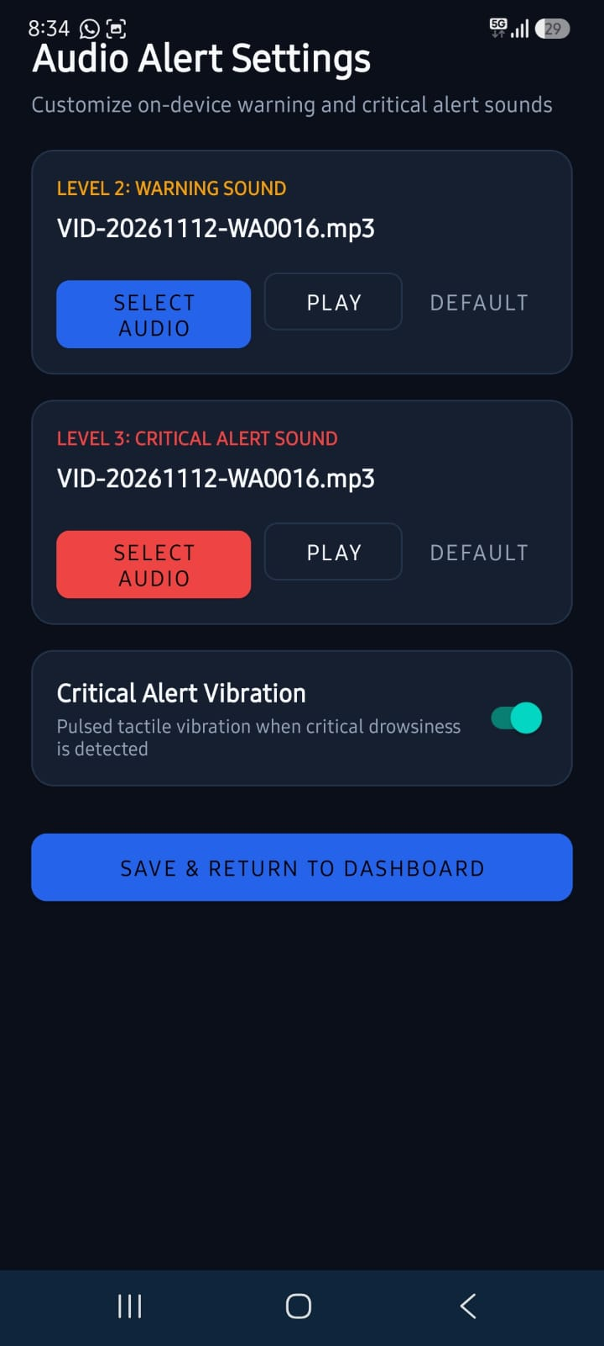
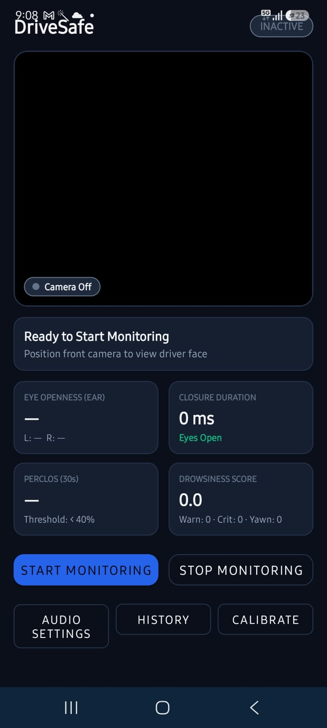
06 Results
App demonstration 01–02
Audio alert settings
Dashboard before monitoring
Warning and critical sounds are selected independently. The screen supports preview, reset to built-in tone, and a toggle for pulsed critical vibration.
Before monitoring starts, EAR and PERCLOS are unavailable. The dashboard is ready for the driver to start the front-camera session.
DriveSafe | Project Presentation
13
Notes:
Source: user-provided app screenshots 1 and 2. Captions describe only visible controls and values. Implementation context: MainActivity.kt, DrowsinessDetector.kt, AudioSettingsActivity.kt, SessionHistoryActivity.kt.

Slide 12
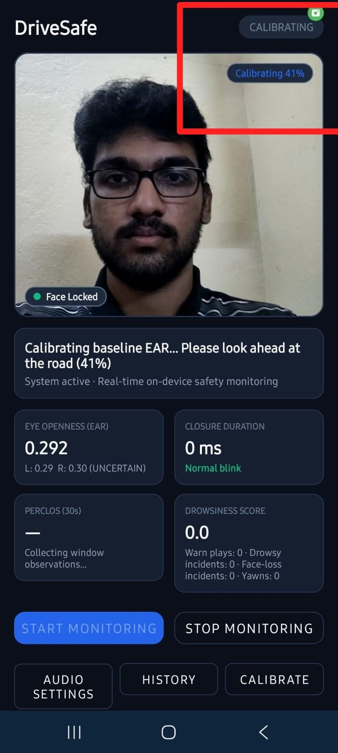
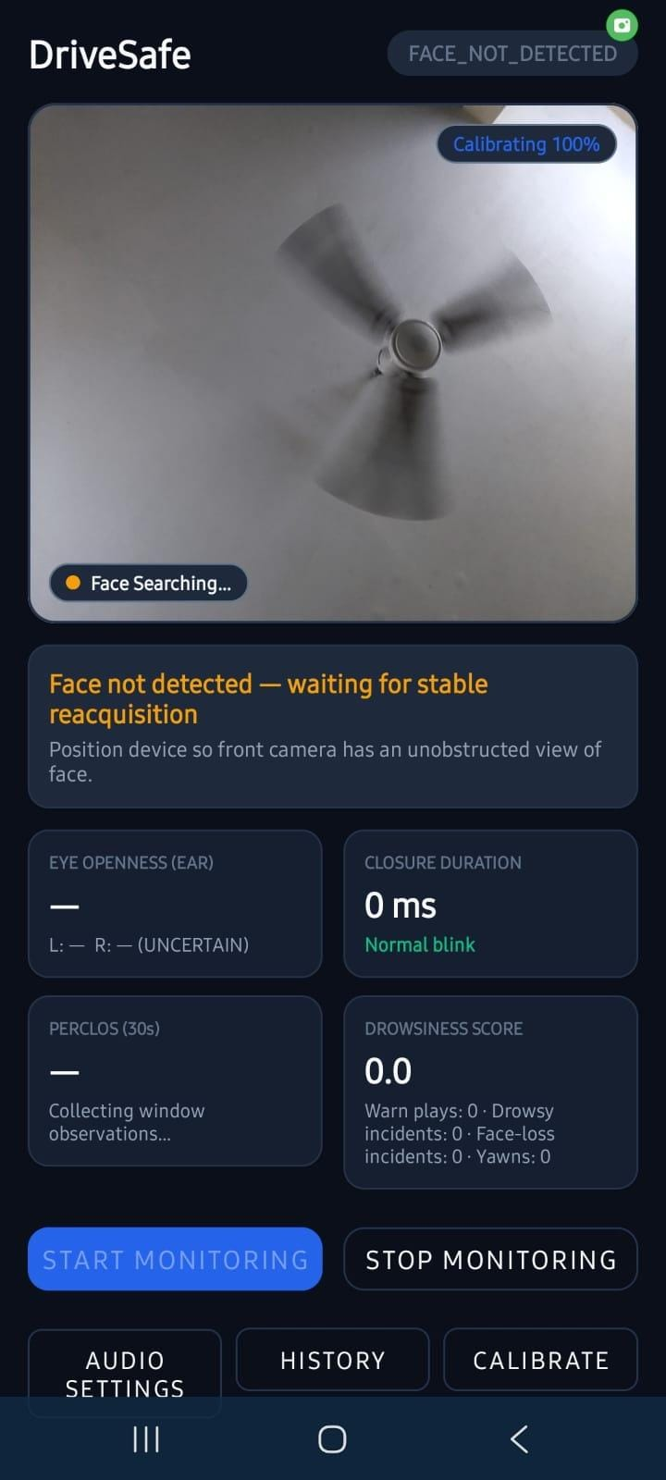
06 Results
App demonstration 03–04
Baseline calibration
Face temporarily unavailable
Calibration collects valid per-eye EAR samples while the face is centered and the head remains near frontal. The progress badge shows 41% completion.
When landmarks cannot be found, eye values are uncertain and PERCLOS pauses. The driver should restore a clear camera view before relying on monitoring.
DriveSafe | Project Presentation
14
Notes:
Source: user-provided app screenshots 3 and 4. Captions describe only visible controls and values. Implementation context: MainActivity.kt, DrowsinessDetector.kt, AudioSettingsActivity.kt, SessionHistoryActivity.kt.

Slide 13
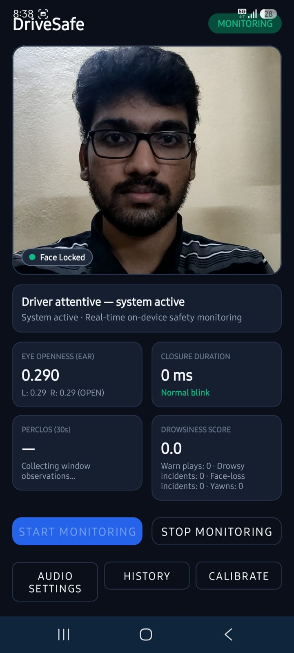
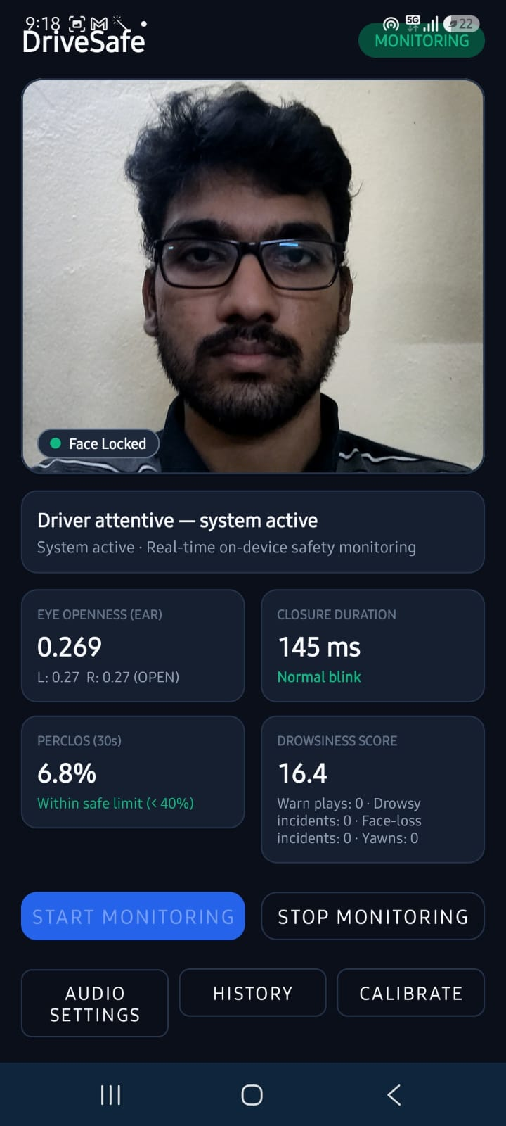
06 Results
App demonstration 05–06
Attentive monitoring
PERCLOS accumulation
With a locked face and open eyes, the sample shows EAR 0.290, zero closure time, and score 0.0. PERCLOS is still collecting its valid window.
The rolling window reports 6.8% after enough valid eye observations, while the displayed score is 16.4. Short closures and other inputs can influence the composite score.
DriveSafe | Project Presentation
15
Notes:
Source: user-provided app screenshots 5 and 6. Captions describe only visible controls and values. Implementation context: MainActivity.kt, DrowsinessDetector.kt, AudioSettingsActivity.kt, SessionHistoryActivity.kt.

Slide 14
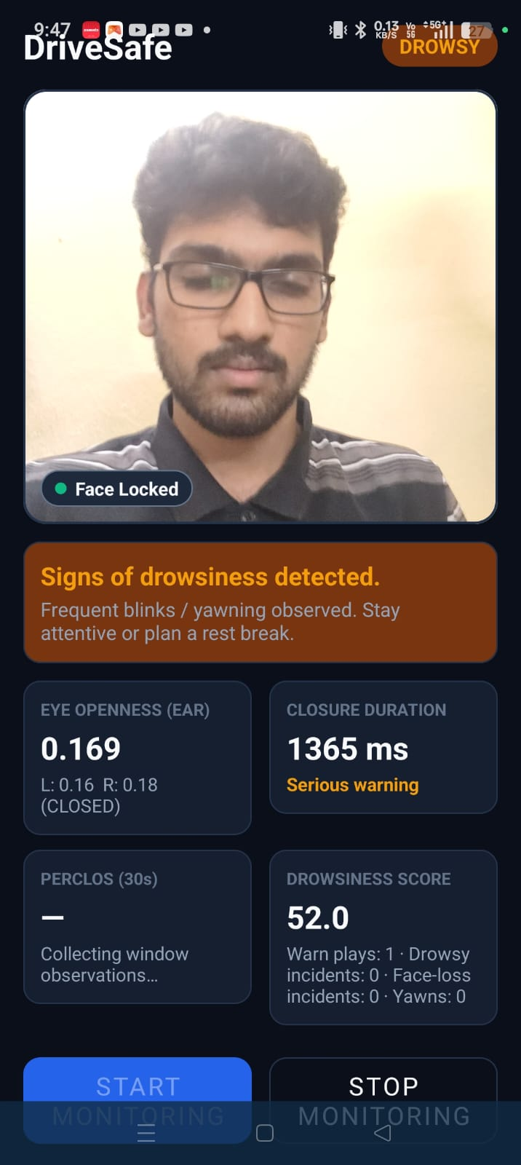
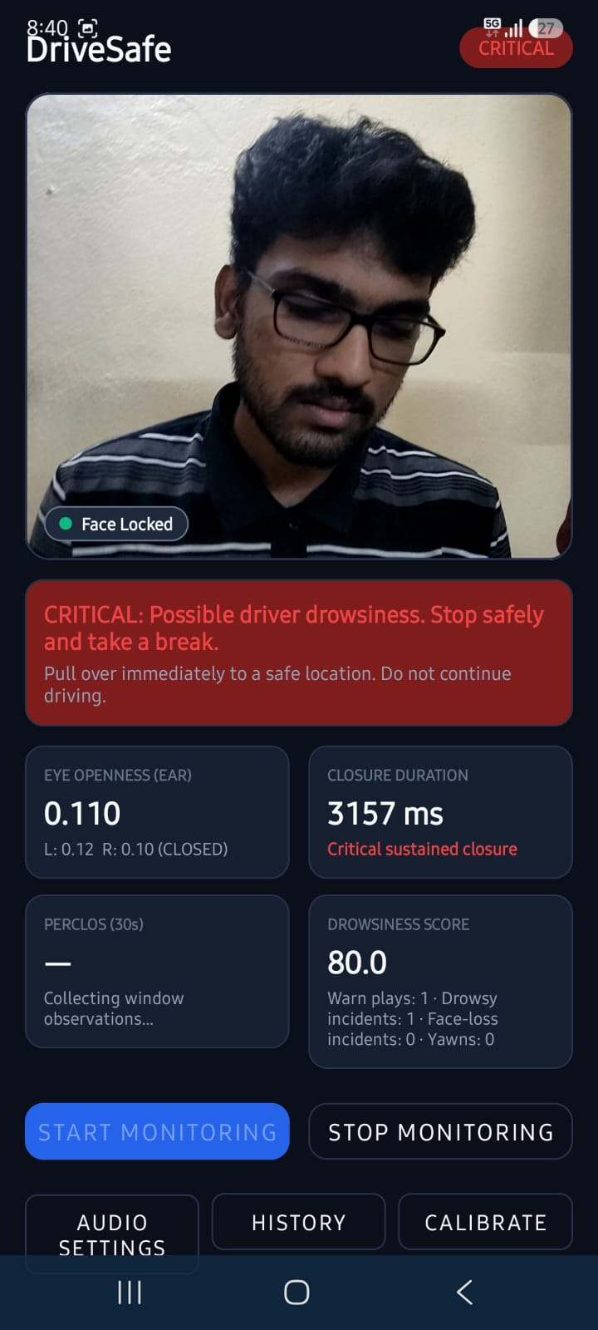
06 Results
App demonstration 07–08
Drowsy warning
Critical sustained closure
A 1365 ms eye closure moves the sample into DROWSY with score 52.0. The amber banner advises attention and a rest break.
A 3157 ms closure exceeds the 2000 ms critical threshold. The score rises to 80 and the red banner instructs the driver to stop safely.
DriveSafe | Project Presentation
16
Notes:
Source: user-provided app screenshots 7 and 8. Captions describe only visible controls and values. Implementation context: MainActivity.kt, DrowsinessDetector.kt, AudioSettingsActivity.kt, SessionHistoryActivity.kt.

Slide 15
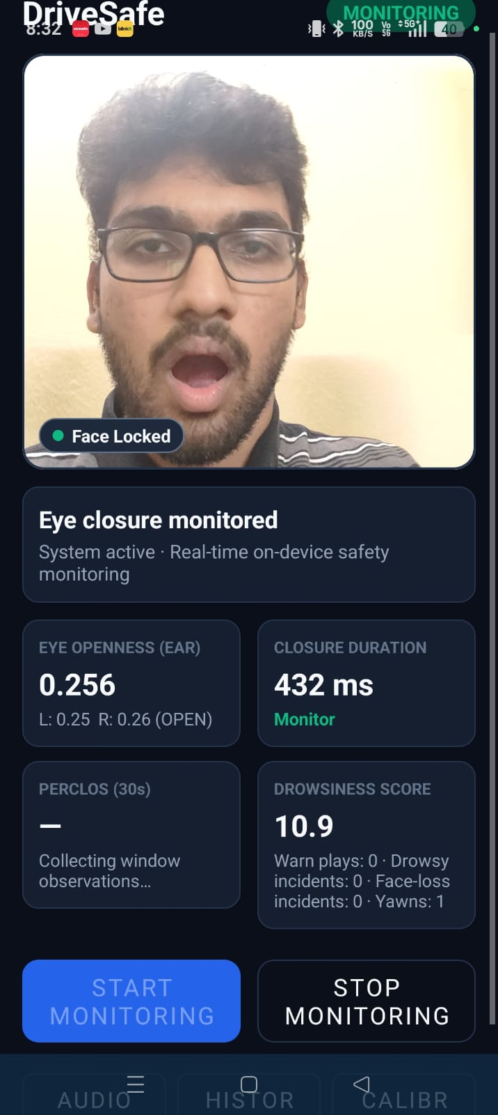
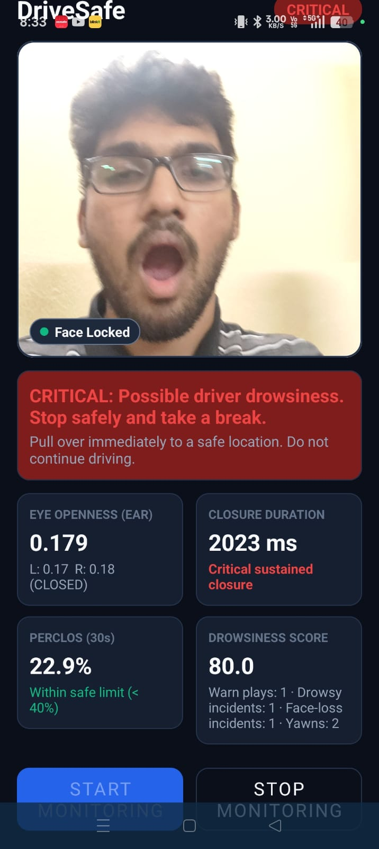
06 Results
App demonstration 09–10
Yawn event
Critical state with PERCLOS context
The yawn counter records a sustained mouth-opening event. This contributes a temporary event bonus to the score, which decays over subsequent frames.
The 2023 ms closure triggers a critical override at score 80. The 22.9% PERCLOS value does not cancel the independent sustained-closure rule.
DriveSafe | Project Presentation
17
Notes:
Source: user-provided app screenshots 9 and 10. Captions describe only visible controls and values. Implementation context: MainActivity.kt, DrowsinessDetector.kt, AudioSettingsActivity.kt, SessionHistoryActivity.kt.

Slide 16
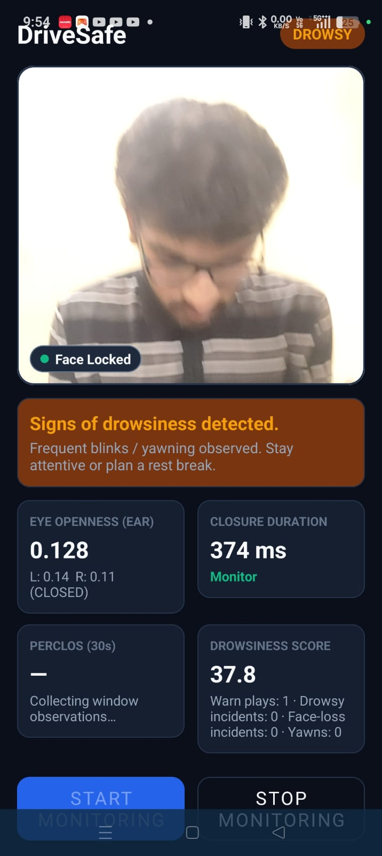
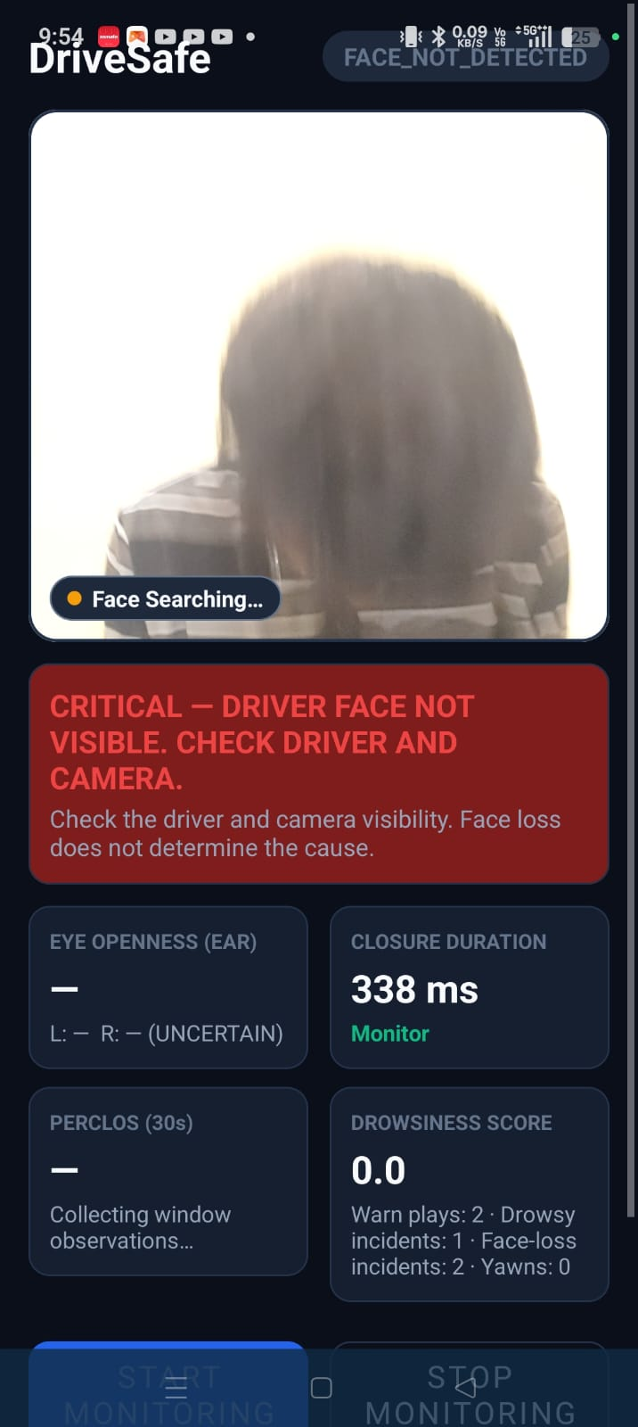
06 Results
App demonstration 11–12
Downward head nod
Critical face-loss alert
A sustained downward pitch can register a nod event. The screenshot shows a nod counter and a temporary score contribution while the current state remains below DROWSY.
After a stable face lock, prolonged loss of visibility raises a separate critical alert. Missing face landmarks are not interpreted as closed eyes or safe eyes.
DriveSafe | Project Presentation
18
Notes:
Source: user-provided app screenshots 11 and 12. Captions describe only visible controls and values. Implementation context: MainActivity.kt, DrowsinessDetector.kt, AudioSettingsActivity.kt, SessionHistoryActivity.kt.

Slide 17
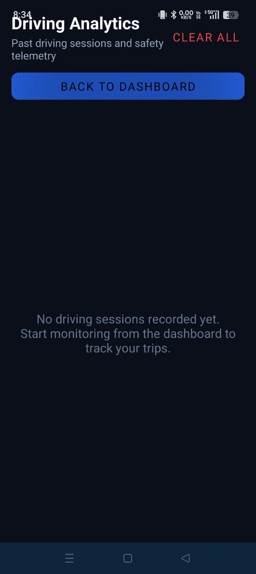
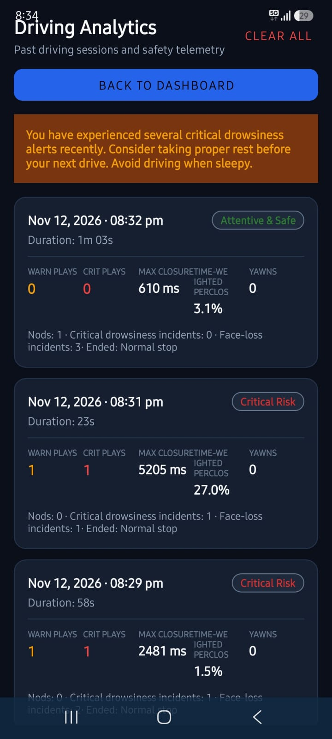
06 Results
App demonstration 13–14
History with no sessions
Saved session analytics
The history screen starts empty and explains that a record appears after a monitoring session has been completed and saved.
Each card summarizes duration, warning and critical plays, longest closure, time-weighted PERCLOS, yawns, nods, and separate incident counts. A rest recommendation appears when thresholds are met.
DriveSafe | Project Presentation
19
Notes:
Source: user-provided app screenshots 13 and 14. Captions describe only visible controls and values. Implementation context: MainActivity.kt, DrowsinessDetector.kt, AudioSettingsActivity.kt, SessionHistoryActivity.kt.

Slide 18
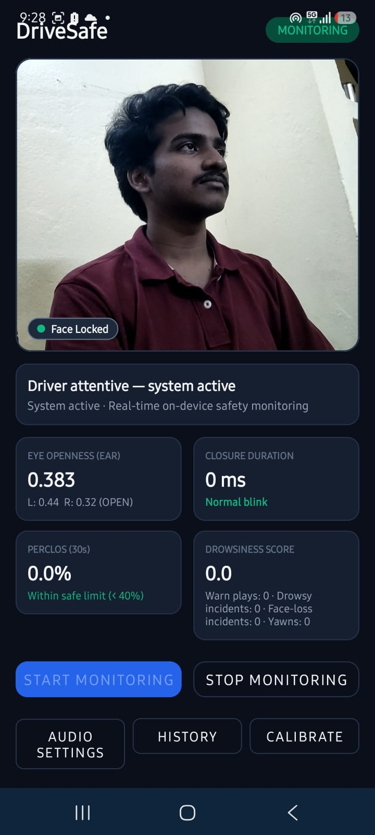
06 Results
App demonstration 15: Driver-side angle
Driver-side camera angle
This side-angle example keeps the face locked while monitoring is active. The dashboard reports EAR 0.383 (left 0.44, right 0.32), PERCLOS 0.0%, and drowsiness score 0.0.
DriveSafe | Project Presentation
21
Notes:
Source: user-provided “driver side angle.jpeg”. Caption values are transcribed from the displayed dashboard. This single screenshot illustrates one side-angle view and is not a camera-angle performance evaluation.

Slide 19
07 CONCLUSION
Conclusion
DriveSafe turns camera-derived facial cues into a duration-aware driver monitoring workflow.
Personalizes eye-closure thresholds through short calibration.
Combines closure duration and PERCLOS with yawn and nod events.
Separates face visibility warnings from drowsiness scoring.
Adds configurable audio, vibration, and local session history.
Next step: evaluate across drivers, devices, lighting, and labeled alert scenarios.
DriveSafe | Project Presentation
12

Slide 20
08 REFERENCES
References
[1] T. Soukupová and J. Čech. “Real-Time Eye Blink Detection using Facial Landmarks.” Computer Vision Winter Workshop, 2016. https://cmp.felk.cvut.cz/ftp/articles/cech/Soukupova-TR-2016-05.pdf
[2] D. F. Dinges, M. M. Mallis, G. Maislin, and J. W. Powell. Evaluation of Techniques for Ocular Measurement as an Index of Fatigue and the Basis for Alertness Management. NHTSA Report DOT HS 808 762, 1998. https://rosap.ntl.bts.gov/view/dot/2518
[3] Android Developers. CameraX overview and image analysis documentation. https://developer.android.com/media/camera/camerax
[4] Google AI Edge. MediaPipe Face Landmarker guide. https://developers.google.com/edge/mediapipe/solutions/vision/face_landmarker
[5] DriveSafe source implementation: CalibrationManager.kt, EyeAspectRatioCalculator.kt, ClosureEpisodeTracker.kt, PerclosCalculator.kt, DrowsinessScoringEngine.kt, FaceVisibilityTracker.kt, MouthAspectRatioCalculator.kt, HeadPoseEstimator.kt, AlertManager.kt, and SessionRepository.kt.
[6] User-provided DriveSafe screenshots. UI states and metrics are presented as illustrative examples, not as a controlled performance evaluation.
DriveSafe | Project Presentation
20
Notes:
Reference [1] supports the EAR landmark ratio concept. Reference [2] supports PERCLOS as an ocular fatigue measure. [3] and [4] document the libraries used. Feature thresholds and score weights are from the DriveSafe code listed in [5].

