Slide 1
Everything you need to know about Middleware in Django
While working on apps it’s very important to understand the ins and outs of Django’s middleware workings.

Slide 2
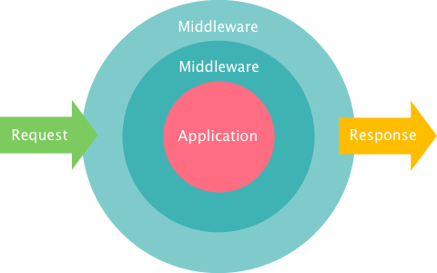

Slide 3
Index:
1. What is Middleware in Django?
2. How does Middleware work?
3. What are the types of Middleware?
4. How to write a custom Middleware in Django?
5. Things to remember when using middleware

Slide 4
1. What is Middleware in Django?
Middleware is a framework of hooks into Django’s request/response processing.
It’s a light, low-level “plugin” system for globally altering Django’s input or output.
Each middleware component is responsible for doing some specific function.

Slide 5
Settings.py
MIDDLEWARE = [ 'django.middleware.security.SecurityMiddleware', 'django.contrib.sessions.middleware.SessionMiddleware', 'django.middleware.common.CommonMiddleware', 'django.middleware.csrf.CsrfViewMiddleware', 'django.contrib.auth.middleware.AuthenticationMiddleware', 'django.contrib.messages.middleware.MessageMiddleware', 'django.middleware.clickjacking.XFrameOptionsMiddleware', ]

Slide 6
2. How does Middleware work?
When a user makes a request from your application, a WSGI handler is instantiated,
which handles the following things:
Imports project’s settings.py file and Django exception classes.
Loads all the middleware classes which are written in MIDDLEWARE tuple located in settings.py file
Builds list of methods which handle processing of request, view, response & exception.
Loops through the request methods in order.
Resolves the requested URL
Loops through each of the view processing methods
Calls the view function
Processes exception methods (if any)
Loops through each of the response methods in the reverse order from request middleware.
Builds a return value and makes a call to the callback function.

Slide 7
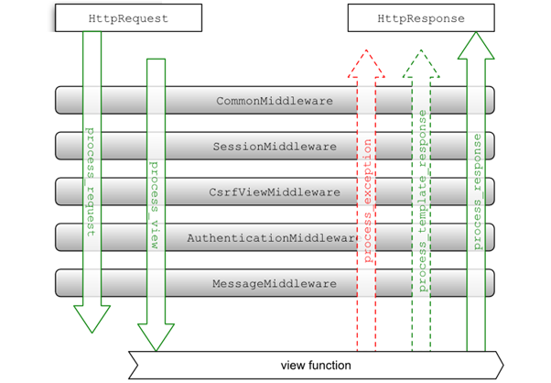

Slide 8
3. What are the types of Middleware ?
There are two types of Middleware in Django:
Built-in Middleware
Custom Middleware
Built-in Middleware are provided by default in Django when you create your project.
You can check the default Middleware in settings.py file of your project.
Custom Middleware — You can write your own middleware which can be used throughout your project. Let’s see how we can do that!

Slide 9
4. How to write a custom Middleware in Django?
Create a file named custom_middleware.py (or anything which you like) and a regular Python function / class in it.
You can write middleware as a function or as a class whose instances are callable.
Function based Middleware
Class based Middleware

Slide 10
class MyMiddleware: def _init_(self, get_response): self.get_response = get_response def _call_(self, request): # Code that is executed in each request before the view is called response = self.get_response(request) # Code that is executed in each request after the view is called return response def process_view(request, view_func, view_args, view_kwargs): # This code is executed just before the view is called def process_exception(request, exception): # This code is executed if an exception is raised def process_template_response(request, response): # This code is executed if the response contains a render() method return response

Slide 11
Now the final step will be to add your custom middleware in MIDDLEWARE List
in settings.py file
MIDDLEWARE = [ … 'your_app.custom_middleware_file.CustomMiddleware_class', ]

Slide 12
5. Things to remember when using middleware:
Order of middleware is important.
A middleware only need to extend from class object.
A middleware is free to implement some of the methods and not implement other methods.
A middleware may implement process_request but may not implement process_response and process_view.

