Slide 1
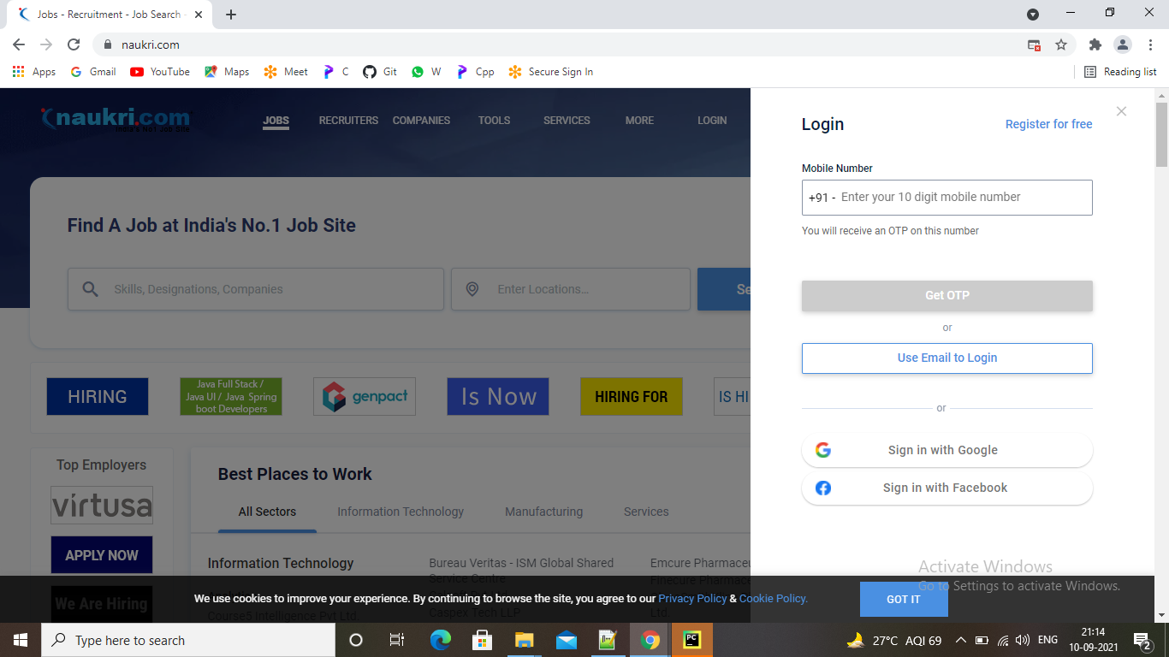

Slide 2
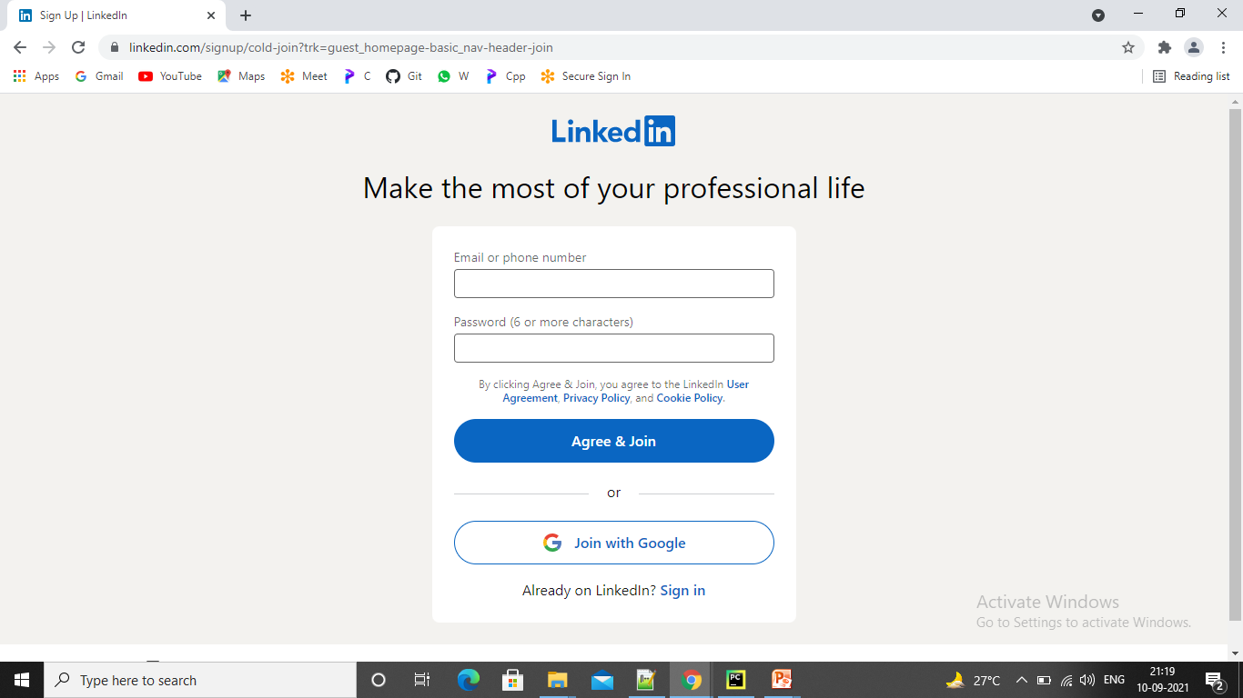

Slide 3
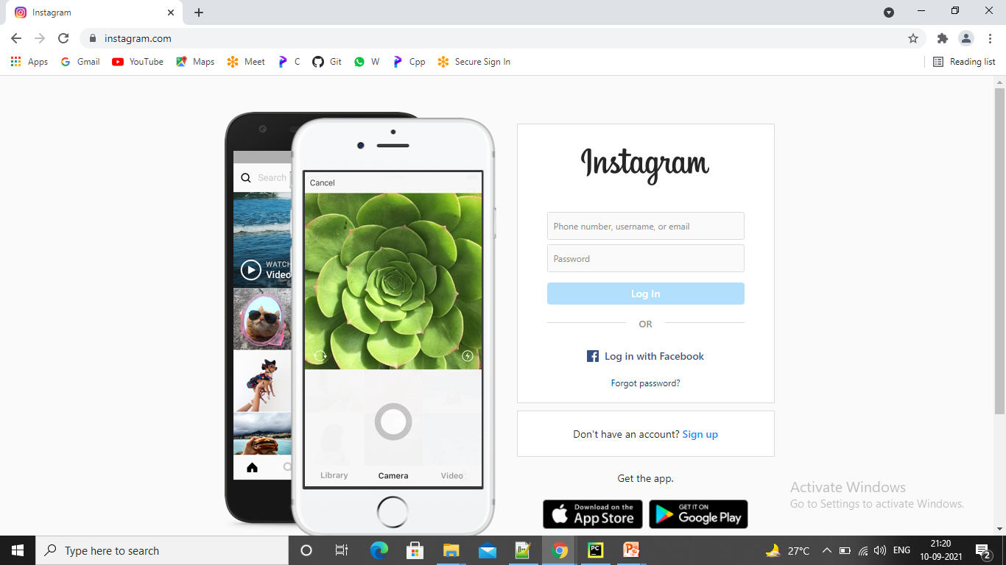

Slide 4
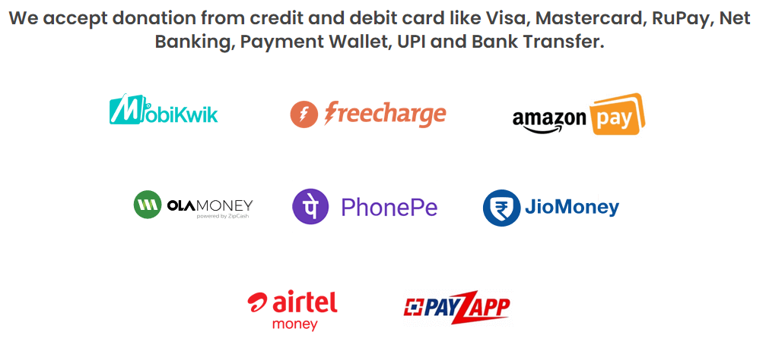

Slide 5
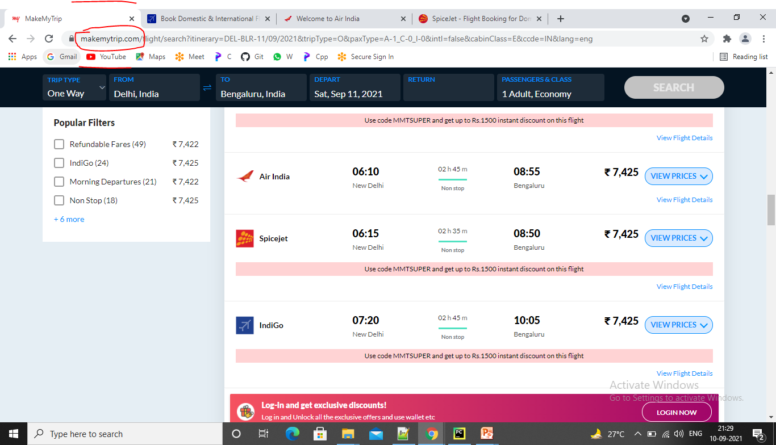

Slide 6
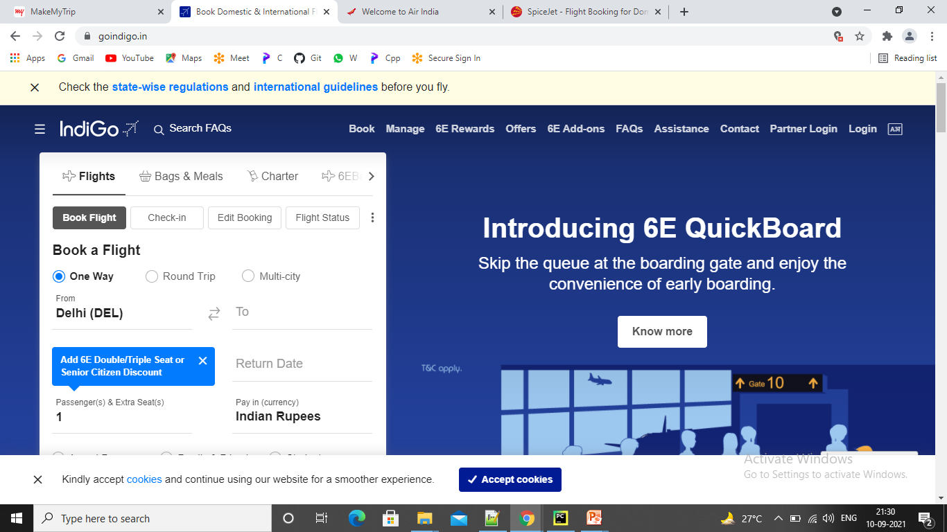

Slide 7
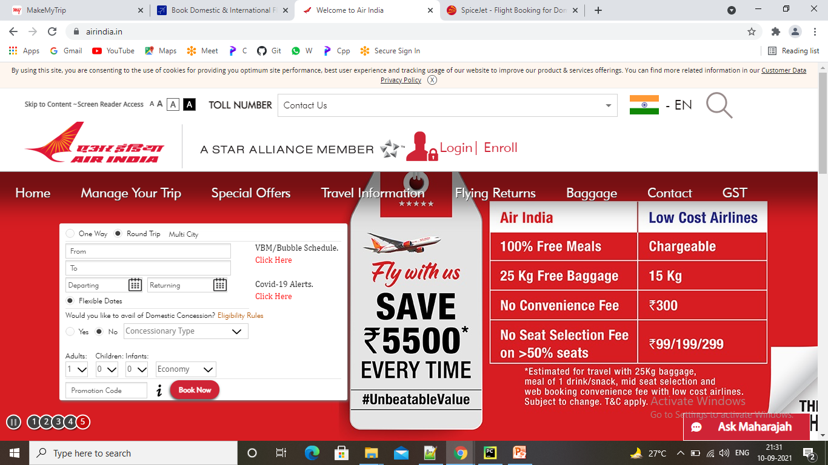

Slide 8
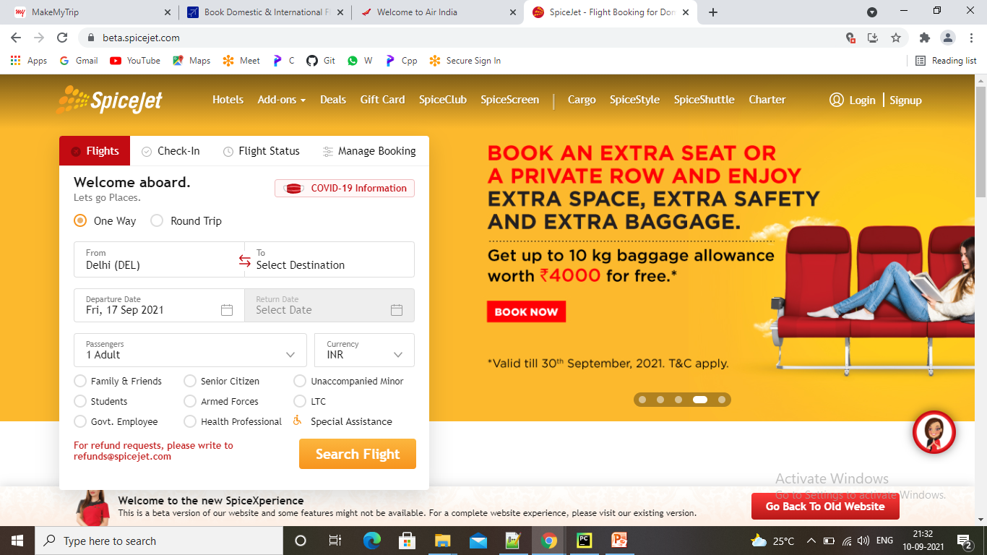

Slide 9
What is an API?
API is an acronym for Application Programming Interface. Two machines use it to communicate with each other.
An API is used by two applications trying to communicate with each other over a network or Internet. With this definition in mind, let’s look at a block diagram.

Slide 10
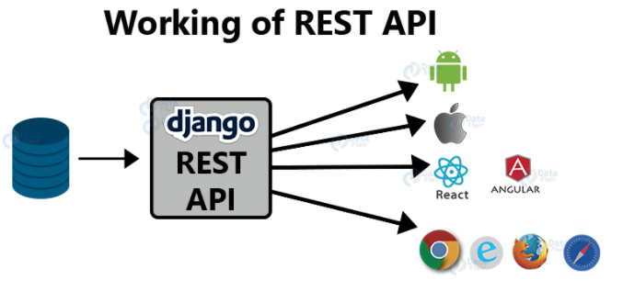

Slide 11
The API acts as a mediator between Django and other applications.
As you can see, other applications can be from Android, iOS, Web apps, browsers, etc.
The API’s main task is to receive data from other applications and provide them to the backend.
This data is usually in JSON format.

Slide 12
What are RESTful APIs?
REST stands for Representational State Transfer.
REST is an architecture on which we develop web services.
Web services can be understood as your device connects to the
internet.
These web services use HTTP to transmit data between machines.
A RESTful API acts as a translator between two machines
communicating over a Web service.
These applications can be web-apps, Android/iOS apps, etc.
RESTful APIs today return JSON files that can be interpreted by
a variety of devices.

Slide 13
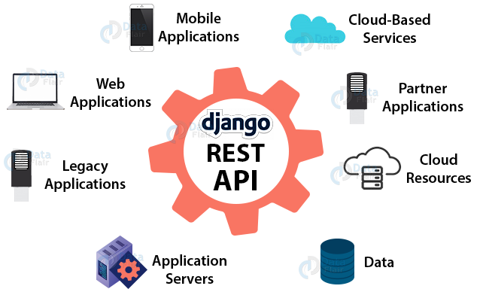

Slide 14
What is Django REST Framework?
DRF is an acronym for Django REST Framework. (stating the obvious) It’s used to
develop REST APIs for Django.
DRF is used to develop RESTful APIs which is both easy and a smart way.
DRF is a framework built upon the Django Framework.
It is not a separate framework.
You can say that it is a tool which alongside Django is used to develop RESTful APIs.
It increases the development speed.
It also addresses various security issues natively.
DRF is an Open Source Software, just like Django.
It is actively developed by various MNCs.

Slide 15
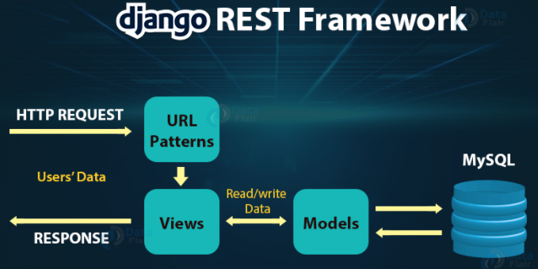

Slide 16
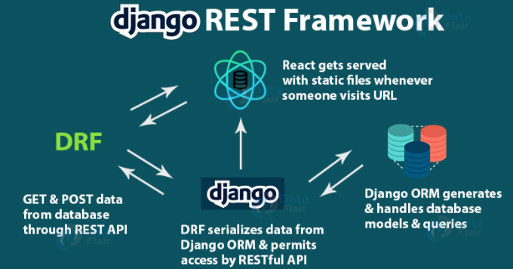
Making a basic api with DRF

Slide 17
Serializers:
Serializers are an important part of DRF
Serializers are used to transform our model instances or objects into JSON.
An API’s end result is always JSON.
API’s communicate with multiple technologies which take JSON as their Input.
JSON stands for JavaScript Object Notation.
It is simply a JavaScript notation.
You can say it’s similar to the Python dictionary.
It’s just a file that is sent/ received by the API to various applications.
That’s what serializers help us do here.
We will be using serializers to get the JSON files for our models.
Serializers can easily create JSON responses from our model instances.
This is one of the magical things DRF can perform.

Slide 18
Implementing Serializers:
To implement serializers in our project, create a new file in the app directory called serializers.py.
Then paste this code in the file app/serializers.py:
from rest_framework import serializers
from app.models import MyModel
class MySerializer(serializers.ModelSerializer):
class Meta:
model = MyModel
fields = '__all__’
The model attribute will input the model for the serializer.
The fields attribute takes a list containing the names of fields.
These are the fields which will be passed as a json file.

Slide 19
