Slide 1
An in-depth comparison
of
Windows Vs. Linux Design

Slide 2
AGENDA
Process Management
Memory Management
Device Driver Architecture
File System
Security

Slide 3
Process Management
DLL Vs Shared libraries
linked to load at particular address in memory.
Shared libraries are compiled to use position independent code.
Faster startup speed. but slower runtime speed.
Lazy binding of functions in shared library.
Efficient process creation Vs Efficient thread creation
fork() vs createProcess()
multiprocess applications translate to multithreaded in windows.
No inherent parent/child relationship.
Notes:
https://technet.microsoft.com/en-us/library/bb496993.aspx
http://stackoverflow.com/questions/47845/why-is-creating-a-new-process-more-expensive-on-windows-than-linux

Slide 4
Process Management (Cont)
OOM Killer! : Low memory situations.
Windows has no Out of Memory Killer.
Daemon Vs Services
Unix : Daemons
A daemon is a process that detaches itself from the terminal and runs disconnected in the background, waiting for requests and responding to them.
Windows : Services :
A service is a special type of application that is available on Windows and runs in the background with special privileges.

Slide 5
Process Management (Cont)
Windows
Two scheduling classes
“Real time” (fixed) - priority 16-31
Dynamic - priority 1-15
Higher priorities are favored
Priorities of dynamic threads get boosted on wakeups
Thread priorities are never lowered
Linux
Has 3 scheduling classes:
Normal – priority 100-139
Fixed Round Robin – priority 0-99
Fixed FIFO – priority 0-99
Lower priorities are favored
Priorities of normal threads go up (decay) as they use CPU
Priorities of interactive threads go down (boost)
Notes:
https://msdn.microsoft.com/en-us/library/windows/desktop/ms685100%28v=vs.85%29.aspx

Slide 6
Process Management (Cont)
31
0
Fixed
Fixed FIFO
Fixed Round-Robin
16
15
99
I/O
Dynamic
100
I/O
Normal
CPU
140
0
Windows
Linux

Slide 7
Linux Scheduling Details
Dynamic priority policy
Threads that block frequently (I/O bound) will have their priority gradually increased
Threads that always exhaust their time slice (CPU bound) will have their priority gradually decreased
Nice()
-20 to +20
Dynamic priority policy threads have static priority zero
Most threads run in variable priority levels
Priorities 1-15;
Threads that complete I/O operations experience priority boosts (but never higher than 15)
A thread’s priority will never be below base priority
SetThreadPriority()
Has MACROS to set priority level within each priority class
Windows will dynamically adjust priorities for non-realtime threads

Slide 8
Scheduling Time Slices
Windows
The thread timeslice (quantum) is 10ms-120ms
When quanta can vary, has one of 2 values
Reentrant and preemptible
Linux
The thread quantum is 10ms-200ms
Default is 100ms
Varies across entire range based on priority, which is based on interactivity level
Reentrant and preemptible
Fixed: 120ms
20ms
Background
10ms
200ms
Foreground: 60ms
100ms

Slide 9
Memory Management
Similarities
System independent hardware abstraction layer
Copy on write
Shadow Paging
Memory mapped files
Inter Process Communication

Slide 10
Window Memory Management
Virtual memory manager (VMM)
Executive component responsible for managing memory
Lazy allocation
Avoid allocating memory until necessary
Prefetching
Move pages from disk to main memory before they are needed
Pagefile
Stores pages that do not fit in main memory
Windows XP supports up to 16 pagefiles

Slide 11

Memory Organization
32-bit virtual address space
Windows 64-Bit Edition has 64-bit address space.
4GB virtual address space per process
User space vs. System space
Process can access only user space
VMM stores page tables and other data in system space
2GB user space, 2GB system space
4KB pages
0
User
2 GB
4 GB
System

Slide 12
Memory Organization
Virtual memory manager (VMM)
Executive component responsible for managing memory
Two-level hierarchical memory map
Page directory table
Page directory entries (PDEs) point to page table
One page directory table per process
Location in page directory register
Page table
Page table entries (PTEs) point to page frames
Page frame
Contains page of data
TLB (translation lookaside buffer) accelerates address translation

Slide 13
Linux Memory Management
Memory manager supports 32- and 64-bit addresses
Also supports NUMA (nonuniform memory access architectures)
To allow Linux to scale from desktops and workstations, to servers and supercomputers

Slide 14

Linux ia-32 Memory Organization
Kernel attempts to reduce overhead due to TLB flushing on context switch
Divides each 4GB address space into a 3GB region for process data and instructions and a 1GB address space for kernel data and instructions
Most of the kernel’s address space is directly mapped to main memory so that it can access information belonging to any process
0
User
3 GB
System
4 GB

Slide 15
Memory Organization
Linux uses paging exclusively
Often implemented using a single page size
On 32-bit systems, kernel can address 4GB of data
On 64-bit systems, the kernel supports up to 2 petabytes of data
Three levels of page tables
Page global directory
Page middle directory
Page tables
On systems that support only two levels of page tables, page middle directory contains exactly one entry
Virtual address space organized into virtual memory areas to group information with same permissions (similar to segments)

Slide 16
Memory Organization
Memory zones
DMA memory: first 16MB of main memory
Kernel attempts to make memory available in this region for legacy hardware
Normal memory: between 16MB and 896MB on the IA-32 architecture
Stores user data and most kernel data
High memory: > 896MB on the IA-32 architecture
Contains memory that the kernel does not permanently map to its address space
Bounce buffer
Allocates low memory temporarily for I/O
Data is “bounced” to high memory after I/O completes

Slide 17
Device Driver Architecture
Both Windows and Linux support addition of device driver modules in runtime
Driver module expose callback routines
Driver Initialization
IO functionality
Device add/remove
Driver unload

Slide 18
Windows Driver Architecture
Two broad classes
Legacy
PnP(Plug and Play)
PnP Driver Characteristics
Loaded On Demand
Does not consume extra resources

Slide 19
Windows Driver Model(WDM)
Standard model specified by Microsoft
The broad classes of WDM Drivers
Functional Driver
Filter Driver
Bus Driver
IO Request Packet(IRP), a standard data structure to enable communication between application-driver and driver-driver

Slide 20
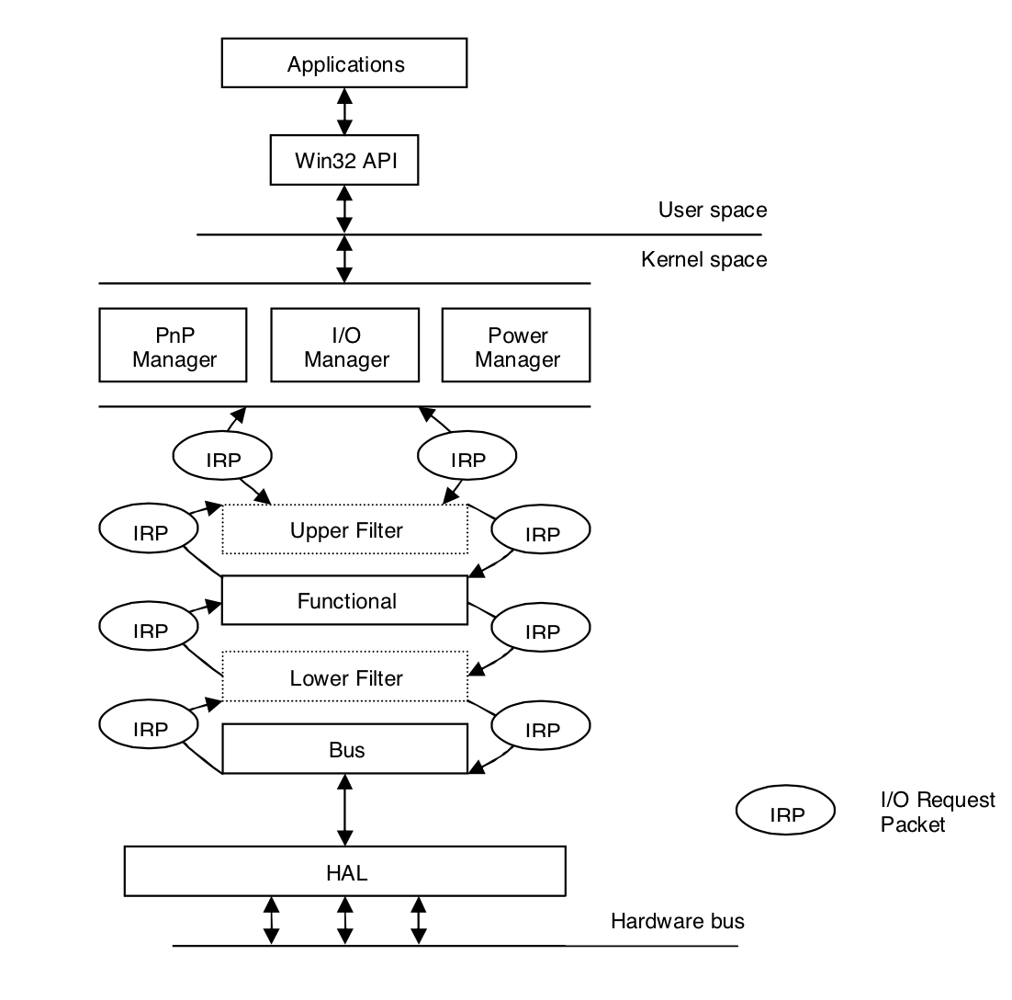
IRP Flow in Windows Driver Stack
Notes:
Photo Credits:
“A Comparison of the Linux and Windows Device Driver Architectures“
By
Melekam Tsegaye
Rhodes University, South Africa g98t4414@campus.ru.ac.za
Richard Foss
Rhodes University, South Africa r.foss@ru.ac.za

Slide 21
WDM Driver Primary callbacks
DriverEntry()
Driver load and resource initialization
AddDevice()
Device Object create and resource allocation
128 GUIDs generated for Device Identifier
Driver registers the GUID for a device
Dispatch()
Handles IO requests(sent as IRP)

Slide 22
WDM IO User-Kernel Space
Three primary ways
Buffered IO
Kernel buffer allocated
OS validates buffer before copying contents
Direct IO
User space locked memory allocated
Memory Descriptor List(MDL) passed on to driver via IRP
Driver initiates DMA to/from buffer using MDL info
Method Neither IO
User space virtual pointer passed to driver

Slide 23
Linux Driver Architecture
Drivers in Linux represented as modules
Communication between modules done using function call
Modules can export public function to a symbol table maintained by kernel
module_init and module_exit macros to initialize/unload driver(analogous to DriverEntry())

Slide 24
Key Features Linux Device Driver
No clear distinction of layered modules(no notion of filter, functional and bus driver as in Windows)
Devices are named using major and minor numbers
major numbers in range 0 to 255
Each driver for a major device number can manage additional 256 minor numbers
At one time, maximum 256 usable devices handles
Possible to gain access to 65536(256 X 256) devices

Slide 25
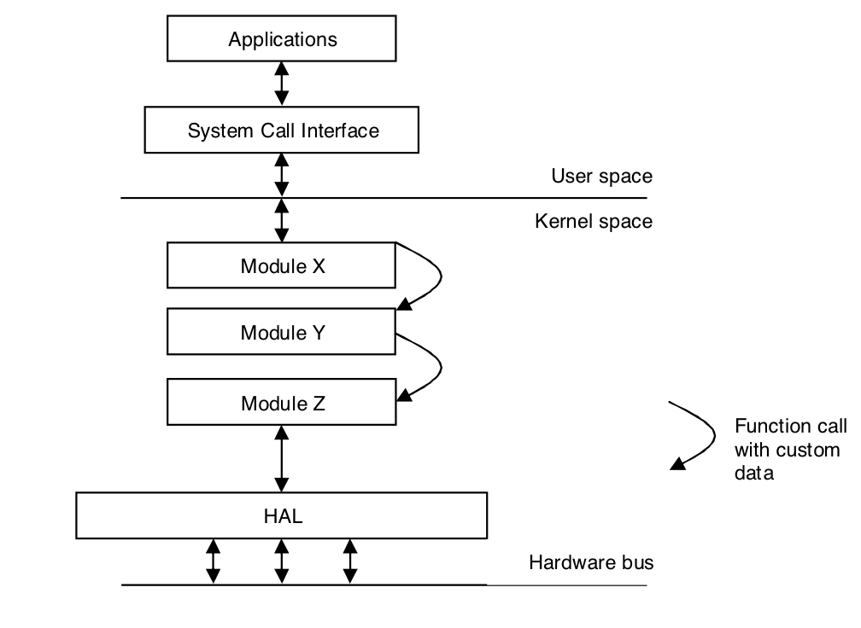
Linux Driver Stack

Slide 26
Linux IO User-Kernel Space
RAM based fs like procfs, sequence files, sysfs
Procfs
info about system components like
CPU
interrupts
meminfo
networking resources
sequence files
Allow data transfer of data which exceeds PAGE_SIZE
sysfs
info about devices, drivers, buses, interconnects

Slide 27
File System
Everything is a file
Inode Vs NTFS
Rename/delete file while its open
Default in linux
NTFS Support : C library fopen FILE_SHARE_DELETE
Boot Process directory sort
Merged program / documentation directories
No per application space for files
Transparent network file system access
Notes:
http://unix.stackexchange.com/questions/49299/what-is-linux-doing-differently-that-allows-me-to-remove-replace-files-where-win
http://blog.httrack.com/blog/2013/10/05/creating-deletable-and-movable-files-on-windows/

Slide 28
Security
Windows
Very flexible security model based on Access Control Lists
Users are defined with
Privileges
Member groups
Security can be applied to any Object Manager object
Files, processes, synchronization objects,
Supports auditing
Linux
Two Modals
Standard UNIX model
Access Control Lists (SELinuxto any Object Manager object
Users are defined with:
Capabilities (privileges)
Member groups
Security is implemented on an object-by-object basis
Has no built-in auditing support
Notes:
https://technet.microsoft.com/en-us/library/dn319078.aspx

