Slide 1
An in-depth comparison
of
Windows Vs. Linux Design

Slide 2
AGENDA

Slide 3
Device Driver Architecture
Both Windows and Linux support addition of device driver modules in runtime
Driver module expose callback routines
Driver Initialization
IO functionality
Device add/remove
Driver unload

Slide 4
Windows Driver Architecture
Two broad classes
Legacy
PnP(Plug and Play)
PnP Driver Characteristics
Loaded On Demand
Does not consume extra resources

Slide 5
Windows Driver Model(WDM)
Standard model specified by Microsoft
The broad classes of WDM Drivers
Functional Driver
Filter Driver
Bus Driver
IO Request Packet(IRP), a standard data structure to enable communication between application-driver and driver-driver

Slide 6
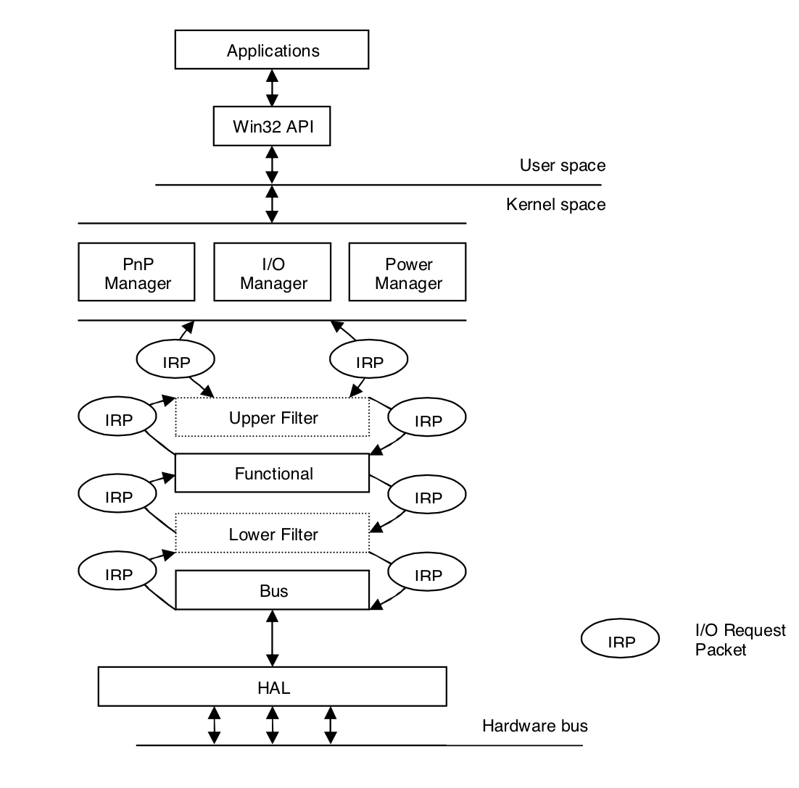
IRP Flow in Windows Driver Stack
Notes:
Photo Credits:
“A Comparison of the Linux and Windows Device Driver Architectures“
By
Melekam Tsegaye
Rhodes University, South Africa g98t4414@campus.ru.ac.za
Richard Foss
Rhodes University, South Africa r.foss@ru.ac.za

Slide 7
WDM Driver Primary callbacks
DriverEntry()
Driver load and resource initialization
AddDevice()
Device Object create and resource allocation
128 GUIDs generated for Device Identifier
Driver registers the GUID for a device
Dispatch()
Handles IO requests(sent as IRP)

Slide 8
WDM IO User-Kernel Space
Three primary ways
Buffered IO
Kernel buffer allocated
OS validates buffer before copying contents
Direct IO
User space locked memory allocated
Memory Descriptor List(MDL) passed on to driver via IRP
Driver initiates DMA to/from buffer using MDL info
Method Neither IO
User space virtual pointer passed to driver

Slide 9
Linux Driver Architecture
Drivers in Linux represented as modules
Communication between modules done using function call
Modules can export public function to a symbol table maintained by kernel
module_init and module_exit macros to initialize/unload driver(analogous to DriverEntry())

Slide 10
Key Features Linux Device Driver
No clear distinction of layered modules(no notion of filter, functional and bus driver as in Windows)
Devices are named using major and minor numbers
major numbers in range 0 to 255
Each driver for a major device number can manage additional 256 minor numbers
At one time, maximum 256 usable devices handles
Possible to gain access to 65536(256 X 256) devices

Slide 11
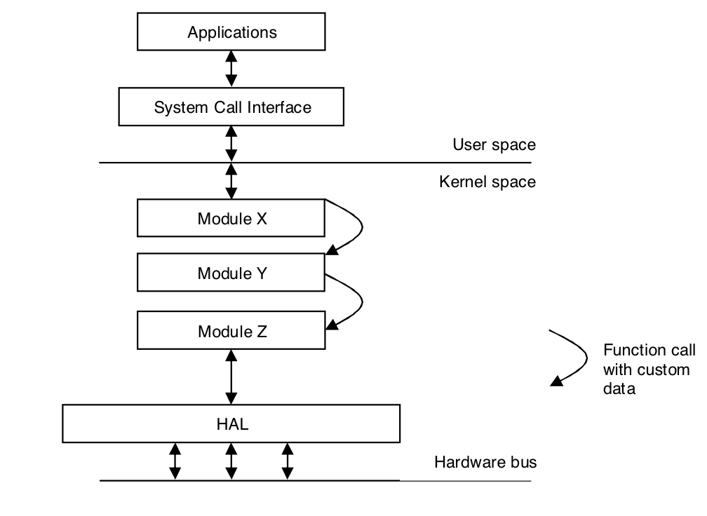
Linux Driver Stack

Slide 12
Linux IO User-Kernel Space
RAM based fs like procfs, sequence files, sysfs
Procfs
info about system components like
CPU
interrupts
meminfo
networking resources
sequence files
Allow data transfer of data which exceeds PAGE_SIZE
sysfs
info about devices, drivers, buses, interconnects

Slide 13
Process Management
DLL Vs Shared libraries
linked to load at particular address in memory.
Shared libraries are compiled to use position independent code.
Faster startup speed. but slower runtime speed.
Lazy binding of functions in shared library.
Efficient process creation Vs Efficient thread creation
fork() vs createProcess()
multiprocess applications translate to multithreaded in windows.
No inherent parent/child relationship.
Notes:
https://technet.microsoft.com/en-us/library/bb496993.aspx
http://stackoverflow.com/questions/47845/why-is-creating-a-new-process-more-expensive-on-windows-than-linux

Slide 14
Process Management (Cont)
OOM Killer! : Low memory situations.
Windows has no Out of Memory Killer.
Daemon Vs Services
Unix : Daemons
A daemon is a process that detaches itself from the terminal and runs disconnected in the background, waiting for requests and responding to them.
Windows : Services :
A service is a special type of application that is available on Windows and runs in the background with special privileges.

Slide 15
Process Management (Cont)
Windows
Two scheduling classes
“Real time” (fixed) - priority 16-31
Dynamic - priority 1-15
Higher priorities are favored
Priorities of dynamic threads get boosted on wakeups
Thread priorities are never lowered
Linux
Has 3 scheduling classes:
Normal – priority 100-139
Fixed Round Robin – priority 0-99
Fixed FIFO – priority 0-99
Lower priorities are favored
Priorities of normal threads go up (decay) as they use CPU
Priorities of interactive threads go down (boost)
Notes:
https://msdn.microsoft.com/en-us/library/windows/desktop/ms685100%28v=vs.85%29.aspx

Slide 16
Process Management (Cont)
31
0
Fixed
Fixed FIFO
Fixed Round-Robin
16
15
99
I/O
Dynamic
100
I/O
Normal
CPU
140
0
Windows
Linux

Slide 17
Linux Scheduling Details
Dynamic priority policy
Threads that block frequently (I/O bound) will have their priority gradually increased
Threads that always exhaust their time slice (CPU bound) will have their priority gradually decreased
Nice()
-20 to +20
Dynamic priority policy threads have static priority zero
Most threads run in variable priority levels
Priorities 1-15;
Threads that complete I/O operations experience priority boosts (but never higher than 15)
A thread’s priority will never be below base priority
SetThreadPriority()
Has MACROS to set priority level within each priority class
Windows will dynamically adjust priorities for non-realtime threads

Slide 18
Scheduling Timeslices
Windows
The thread timeslice (quantum) is 10ms-120ms
When quanta can vary, has one of 2 values
Reentrant and preemptible
Linux
The thread quantum is 10ms-200ms
Default is 100ms
Varies across entire range based on priority, which is based on interactivity level
Reentrant and preemptible
Fixed: 120ms
20ms
Background
10ms
200ms
Foreground: 60ms
100ms

Slide 19
Security
Windows
Very flexible security model based on Access Control Lists
Users are defined with
Privileges
Member groups
Security can be applied to any Object Manager object
Files, processes, synchronization objects,
Supports auditing
Linux
Two Modals
Standard UNIX model
Access Control Lists (SELinuxto any Object Manager object
Users are defined with:
Capabilities (privileges)
Member groups
Security is implemented on an object-by-object basis
Has no built-in auditing support
Notes:
https://technet.microsoft.com/en-us/library/dn319078.aspx

Slide 20
File System
Everything is a file
Inode Vs NTFS
Rename/delete file while its open
Default in linux
NTFS Support : C library fopen FILE_SHARE_DELETE
Boot Process directory sort
Merged program / documentation directories
No per application space for files
Transparent network file system access
Notes:
http://unix.stackexchange.com/questions/49299/what-is-linux-doing-differently-that-allows-me-to-remove-replace-files-where-win
http://blog.httrack.com/blog/2013/10/05/creating-deletable-and-movable-files-on-windows/

