Slide 1
Windows and Some Differences from Linux
Brian Railing
1st Year PhD Student
Previously of
Windows Server Performance Team

Slide 2
Copyright Notice © 2000-2005 David A. Solomon and Mark Russinovich
These materials are part of the Windows Operating System Internals Curriculum Development Kit, developed by David A. Solomon and Mark E. Russinovich with Andreas Polze
Microsoft has licensed these materials from David Solomon Expert Seminars, Inc. for distribution to academic organizations solely for use in academic environments (and not for commercial use)

Slide 3
Further Notices
Original slide deck has modified to reflect updates to Windows since 2005
Mark Russinovich’s 2009 TechEd Talk WCL402: “Windows 7 and Windows Server 2008 R2 Kernel Changes”
Further updates to reflect particular APIs of interest
Being a performance engineer, I only know certain components in great detail
Storage / Networking Stack
Kernel Debugging / Performance Tools
“Fast” Synchronization

Slide 4
Final Notices
This slide deck is
To provide some specific details for developing applications and drivers with Windows
To see some of the implementation decisions and consider trade-offs
To show that Windows, Linux, etc make many similar design choices
This slide deck is not
Meant to judge one between OSes

Slide 5
Takeaways
This slide deck is
Long
What should you look for?
IRQLs
Schedulers are similar. Priorities are different.
Paged vs NonPaged Memory
Wait for objects

Slide 6
Outline
Overview of Windows
IO Processing
Thread Scheduling
Synchronization
Memory
Performance and Debugging
Where to go from here

Slide 7
A Rose by any other Name
Most Operating System decisions are defined by fundamentals of computer science, performance considerations, etc
Virtual Memory Abstraction
Monolithic Kernels
So many of the OS internals reflect two different implementations of similar approaches
read() vs ReadFile()
DLLs vs SharedObjects
Notes:
Most of what is true for one Operating System is true for all. The names of APIs, etc may change but the fundamentals of computer science hold for modern operating systems

Slide 8
Windows Architecture
HAL (Hardware Abstraction Layer):
support for x86 (initial), MIPS (initial), Alpha AXP, PowerPC (NT 3.51), Itanium (Windows XP/2003)
Machine-specific functions located in HAL
Additional functionality found in pci.sys, acpi.sys, etc
At present, two main architectures: x64 and IA64
Allows a degree of focus in implementation
But, cedes certain fields to other OSes

Slide 9
Windows Kernel
Windows is a monolithic but modular system
No protection among pieces of kernel code and drivers
Support for Modularity is somewhat weak:
Windows Drivers allow for dynamic extension of kernel functionality
Windows XP Embedded has special tools / packaging rules that allow coarse-grained configuration of the OS
Windows Drivers are dynamically loadable kernel modules
Significant amount of code run as drivers (including network stacks such as TCP/IP and many services)
Built independently from the kernel
Can be loaded on-demand
Dependencies among drivers can be specified

Slide 10
Comparing Layering, APIs, Complexity
Windows
Kernel exports about 250 system calls (accessed via ntdll.dll)
Layered Windows/POSIX subsystems
Rich Windows API (17 500 functions on top of native APIs)
Linux
Kernel supports about 200 different system calls
Layered BSD, Unix Sys V, POSIX shared system libraries
Compact APIs (1742 functions in Single Unix Specification Version 3; not including X Window APIs)
Notes:
Windows vs Windows kernel

Slide 11
Outline
Overview of Windows
IO Processing
Thread Scheduling
Synchronization
Memory
Performance and Debugging
Where to go from here
Notes:
IO Processing is about two key concepts: IRPs and IRQLs

Slide 12
I/O Processing
An application writes a file to the printer, passing a handle to the file object
Environment subsystem or DLL
User mode
Kernel mode
Services
2)The I/O manager creates an IRP and initializes first stack location
I/O manager
IRP stack location
IRP header
WRITE
parameters
File object
Device object
Driver object
3)The I/O manager uses the driver object to locate the WRITE dispatch routine and calls it, passing the IRP
Dispatch routine(s)
Start I/O
ISR
DPC routine
Device Driver
Notes:
Handling a synchronous I/O to a single-layered driver consists of seven steps:
1. The I/O request passes through a subsystem DLL.
2. The subsystem DLL calls the I/O manager’s read or write service.
3. The I/O manager allocates an IRP describing the request and sends it to the driver (a
device driver in this case) by calling its own IoCallDriver function.
4. The driver transfers the data in the IRP to the device and starts the I/O operation.
5. The driver signals I/O completion by interrupting the CPU.
6. When the device completes the operation and interrupts the CPU, the device driver services
the interrupt.
7. The driver calls the I/O manager’s IoCompleteRequest function to inform it that it has finished
processing the IRP’s request, and the I/O manager completes the I/O request.

Slide 13
IRP data
IRP consists of two parts:
Fixed portion (header):
Type and size of the request
Whether request is synchronous or asynchronous
Pointer to buffer for buffered I/O
State information (changes with progress of the request)
One or more stack locations:
Function code
Function-specific parameters
Pointer to caller‘s file object
While active, IRPs are stored in a thread-specific queue
I/O system may free any outstanding IRPs if thread terminates

Slide 14
Completing an I/O request
Servicing an interrupt:
ISR schedules Deferred Procedure Call (DPC); dismisses int.
DPC routine starts next I/O request and completes interrupt servicing
May call completion routine of higher-level driver
I/O completion:
Record the outcome of the operation in an I/O status block
Return data to the calling thread – by queuing a kernel-mode Asynchronous Procedure Call (APC)
APC executes in context of calling thread; copies data; frees IRP; sets calling thread to signaled state
I/O is now considered complete; waiting threads are released

Slide 15
Flow of Interrupts
0
2
3
Peripheral Device Controller
CPU Interrupt Controller
n
CPU Interrupt Service Table
Notes:
After an I/O device completes a data transfer, it interrupts for service and the Windows kernel,
I/O manager, and device driver are called into action. When a device interrupt occurs, the processor transfers control to the kernel trap handler,
which indexes into its interrupt dispatch table to locate the ISR for the device. ISRs in Windows
typically handle device interrupts in two steps. When an ISR is first invoked, it usually
remains at device IRQL only long enough to capture the device status and then stop the
device’s interrupt. It then queues a DPC and exits, dismissing the interrupt. Later, when the
DPC routine is called, the device finishes processing the interrupt. When that’s done, the
device calls the I/O manager to complete the I/O and dispose of the IRP. It might also start the
next I/O request that is waiting in the device queue.

Slide 16
IRQLs on 64-bit Systems
x64
IA64
15
High/Profile
High/Profile/Power
14
Interprocessor Interrupt/Power
Interprocessor Interrupt
13
Clock
Clock
12
Synch (Srv 2003)
Synch (MP only)
Device n
Device n
.
.
4
.
Device 1
3
Device 1
Correctable Machine Check
2
Dispatch/DPC
Dispatch/DPC & Synch (UP only)
1
APC
APC
0
Passive/Low
Passive/Low

Slide 17
IRQLs on 64-bit Systems
When writing kernel code, five IRQLs matter:
HIGH – Mask all interrupts
DIRQL – IRQL for a particular device
DISPATCH / DPC –
No thread scheduling
No page faults
APC – Run code in a specific thread’s context
PASSIVE – Default

Slide 18
Flow of Interrupts
0
2
3
Peripheral Device Controller
CPU Interrupt Controller
n
CPU Interrupt Service Table
ISR Address
Read from device
Spin Lock
Raise IRQL
Dispatch Code
Grab Spinlock
Acknowledge-Interrupt
Drop Spinlock
Request DPC
Lower IRQL
Interrupt Object
KiInterruptDispatch
Driver ISR
Notes:
After an I/O device completes a data transfer, it interrupts for service and the Windows kernel,
I/O manager, and device driver are called into action. When a device interrupt occurs, the processor transfers control to the kernel trap handler,
which indexes into its interrupt dispatch table to locate the ISR for the device. ISRs in Windows
typically handle device interrupts in two steps. When an ISR is first invoked, it usually
remains at device IRQL only long enough to capture the device status and then stop the
device’s interrupt. It then queues a DPC and exits, dismissing the interrupt. Later, when the
DPC routine is called, the device finishes processing the interrupt. When that’s done, the
device calls the I/O manager to complete the I/O and dispose of the IRP. It might also start the
next I/O request that is waiting in the device queue.

Slide 19
Delivering a DPC
1. Timer expires, kernel queues DPC that will release all waiting threads Kernel requests SW int.
DPC routines can‘t assume what process address space is currently mapped
DPC
Interrupt dispatch table
high
Power failure
2. DPC interrupt occurs when IRQL drops below dispatch/DPC level
3. After DPC interrupt, control transfers to thread dispatcher
DPC
DPC
DPC
Dispatch/DPC
dispatcher
DPC queue
APC
Low
DPC routines can call kernel functions but can‘t call system services, generate page faults, or create or wait on objects
4. Dispatcher executes each DPC routine in DPC queue

Slide 20
I/O Processing
Linux 2.2 had the notion of bottom halves (BH) for low-priority interrupt processing
Fixed number of BHs
Only one BH of a given type could be active on a SMP
Linux 2.4 introduced tasklets, which are non-preemptible procedures called with interrupts enabled
Tasklets are the equivalent of Windows Deferred Procedure Calls (DPCs)

Slide 21
Outline
Overview of Windows
IO Processing
Thread Scheduling
Synchronization
Memory
Performance and Debugging
Where to go from here
Notes:
O(1) scheduling in Windows.
Different scheduling priority system, but same basic concept.
Strong support for threads.

Slide 22
Linux Scheduling
Linux 2.6 has a revamped scheduler that’s O(1) from Ingo Molnar that:
Calculates a task’s priority at the time it makes scheduling decision
Has per-CPU ready queues where the tasks are pre-sorted by priority
Highest-priority
Non-empty Queue
101
103
112
112

Slide 23
Scheduling
Windows NT has always had an O(1) scheduler based on pre-sorted thread priority queues
Server 2003 introduced per-CPU ready queues
Linux load balances queues
Windows does not
Not seen as an issue in performance testing by Microsoft
Applications where it might be an issue are expected to use affinity
Notes:
Usually easier to fix applications that unbalance the scheduler than trying to fine tune the scheduler for that application.

Slide 24
Scheduling Priorities
Windows
Two scheduling classes
“Real time” (fixed) - priority 16-31
Dynamic - priority 1-15
Higher priorities are favored
Priorities of dynamic threads get boosted on wakeups
Thread priorities are never lowered
31
Fixed
16
15
I/O
Dynamic
0
Windows

Slide 25
Windows Scheduling Details
Most threads run in variable priority levels
Priorities 1-15;
A newly created thread starts with a base priority
Threads that complete I/O operations experience priority boosts (but never higher than 15)
A thread’s priority will never be below base priority
The Windows API function SetThreadPriority() sets the priority value for a specified thread
This value, together with the priority class of the thread's process, determines the thread's base priority level
Windows will dynamically adjust priorities for non-realtime threads

Slide 26
Process Management
Windows
Process
Address space, handle table, statistics and at least one thread
No inherent parent/child relationship
Threads
Basic scheduling unit
Fibers - cooperative user-mode threads
Win7: User-Mode Scheduling(UMS)
User scheduled
Kernel supported
Linux
Process is called a Task
Basic Address space, handle table, statistics
Parent/child relationship
Basic scheduling unit
Threads
No threads per-se
Tasks can act like Windows threads by sharing handle table, PID and address space
PThreads – cooperative user-mode threads
Notes:
This slide is from 2005, is this still the Linux support story?

Slide 27
Scheduling Timeslices
Windows
The thread timeslice (quantum) is 10ms-120ms
When quanta can vary, has one of 2 values
Reentrant and preemptible
Linux
The thread quantum is 10ms-200ms
Default is 100ms
Varies across entire range based on priority, which is based on interactivity level
Reentrant and preemptible
Fixed: 120ms
20ms
Background
10ms
200ms
Foreground: 60ms
100ms

Slide 28
Outline
Overview of Windows
IO Processing
Thread Scheduling
Synchronization
Memory
Performance and Debugging
Where to go from here
Notes:
Mutexes, semaphores, and so much more.

Slide 29
Windows Synchronization
Two types of Synchronization:
“Fast”
Protect small amounts of data
Busy waits
“Slow”
Producer / consumer, etc
Scheduler event
Notification of system events
E.G. wait for thread to exit

Slide 30
Windows Synchronization
Uses interrupt masks to protect access to global resources on uniprocessor systems.
Uses spinlocks on multiprocessor systems.
Provides dispatcher objects which may act as mutexes and semaphores.
Dispatcher objects may also provide events. An event acts much like a condition variable.

Slide 31
Queued Spinlocks
Problem: Checking status of spinlock via test-and-set operation creates bus contention
Queued spinlocks maintain queue of waiting processors
First processor acquires lock; other processors wait on processor-local flag
Thus, busy-wait loop requires no access to the memory bus
When releasing lock, the first processor’s flag is modified
Exactly one processor is being signaled
Pre-determined wait order
Notes:
Creates a chain of waiters so that each processor waits on its own data. With basic spinlocks, there can be a storm of bus requests when the lock is released.

Slide 32
Other High-Perf Synchronization
Problem: If the data under synchronization is small, is an interlocked operation sufficient or is a “lock” required
Semaphores: The count can be the data
Test and Set, Swap, etc – Exchange small sets of flags or other simple data
How about a linked list?
Windows SLists or Interlocked Singly Linked Lists
Push Entry
Pop Entry
Flush List

Slide 33
Synchronizing Threads with Kernel Objects
DWORD WaitForSingleObject( HANDLE hObject, DWORD dwTimeout );
DWORD WaitForMultipleObjects( DWORD cObjects, LPHANDLE lpHandles, BOOL bWaitAll, DWORD dwTimeout );
The following kernel objects can be used to synchronize threads:
Processes
Threads
Files
Console input
File change notifications
Mutexes
Events (auto-reset + manual-reset)
Waitable timers
Notes:
The WaitForSingleObject function checks the current state of the specified object. If the object's state is nonsignaled, the calling thread enters the wait state. It uses no processor time while waiting for the object state to become signaled or the time-out interval to elapse.The function modifies the state of some types of synchronization objects. Modification occurs only for the object whose signaled state caused the function to return. For example, the count of a semaphore object is decreased by one.The WaitForSingleObject function can wait for the following objects:
• Change notification
• Console input
• Event
• Job
• Memory resource notification
• Mutex
• Process
• Semaphore
• Thread
• Waitable timer

Slide 34
Wait Functions - Details
WaitForSingleObject():
hObject specifies kernel object
dwTimeout specifies wait time in msec
dwTimeout == 0 - no wait, check whether object is signaled
dwTimeout == INFINITE - wait forever
WaitForMultipleObjects():
cObjects <= MAXIMUM_WAIT_OBJECTS (64)
lpHandles - pointer to array identifying these objects
bWaitAll - whether to wait for first signaled object or all objects
Function returns index of first signaled object
Side effects:
Mutexes, auto-reset events and waitable timers will be reset to non-signaled state after completing wait functions
Notes:
Use caution when calling the wait functions and code that directly or indirectly creates windows. If a thread creates any windows, it must process messages. Message broadcasts are sent to all windows in the system. A thread that uses a wait function with no time-out interval may cause the system to become deadlocked.

Slide 35
Outline
Overview of Windows
IO Processing
Thread Scheduling
Synchronization
Memory
Performance and Debugging
Where to go from here
Notes:
Pool Allocations and Lookaside lists

Slide 36
Virtual Memory Management
Windows
32-bit versions split user-mode/kernel-mode from 2GB/2GB to 3GB/1GB
Demand-paged virtual memory
32 or 64-bits
Copy-on-write
Shared memory
Memory mapped files
Linux
Splits user-mode/kernel-mode from 1GB/3GB to 3GB/1GB
2.6 has “4/4 split” option where kernel has its own address space
Demand-paged virtual memory
32-bits and/or 64-bits
Copy-on-write
Shared memory
Memory mapped files
0
2GB
4GB
User
0
3GB
4GB
User
System
System
Notes:
32bit addressing is either 2/2 split or 3GB to user in Windows.
64bit has far more space and Windows uses it with greater flexibility.

Slide 37
File Caching
Windows
Single global common cache
Virtual file cache
Caching is at file vs. disk block level
Files are memory mapped into kernel memory
Cache allows for zero-copy file serving
Linux
Single global common cache
Virtual file cache
Caching is at file vs. disk block level
Files are memory mapped into kernel memory
Cache allows for zero-copy file serving
File Cache
File Cache
File System Driver
File System Driver
Disk Driver
Disk Driver

Slide 38
Kernel Memory Allocation
Pool Allocations
ExAllocatePoolWithTag(type, size, tag)
Paged vs NonPaged
Size in bytes
Tag identifies allocations for debugging purposes
Allocations for device operations
MmAllocateNonCachedMemory, MmAllocateContiguousMemorySpecifyCache, AllocateCommonBuffer
http://msdn.microsoft.com/en-us/library/aa489507.aspx
Notes:
But what happens when you want a lot of these objects?

Slide 39
Kernel Memory Allocation cont.
When drivers need to work with many kernel allocations
ExXxxLookasideList
Initialize / Allocate / Free
Paged vs NonPaged
System managed list of allocations of specified size
Heuristics for availability of system memory
Frequency of allocation
Faster allocation / free times
Can be per-processor / per-Node

Slide 40
Per-CPU Memory Allocation
Keeping accesses to memory localized to a CPU minimizes CPU cache thrashing
Hurts performance on enterprise SMP workloads
Linux 2.4 introduced per-CPU kernel memory buffers
Windows introduced per-CPU buffers in an NT 4 Service Pack in 1997
Buffer Cache 0
Buffer Cache 1
CPUs
0
1
Notes:
Memory manager uses memory topology as part of managing allocations / frees

Slide 41
Outline
Overview of Windows
IO Processing
Thread Scheduling
Synchronization
Memory
Performance and Debugging
Where to go from here
Notes:
Built-in support for performance testing and kernel debugging.

Slide 42
Performance Testing
Windows Performance Instrumentation
Support for profiling
XPerf – common interface for most instrumentation
Take CPU profiles
Collect instrumented events
Collect stacktraces for (almost) any profile source
Let’s see an example
http://msdn.microsoft.com/en-us/performance/default.aspx
Notes:
XPerf is the major performance tool that Microsoft releases. For most questions of why is Windows running slowly, this tool is good enough to understand the causes.

Slide 43
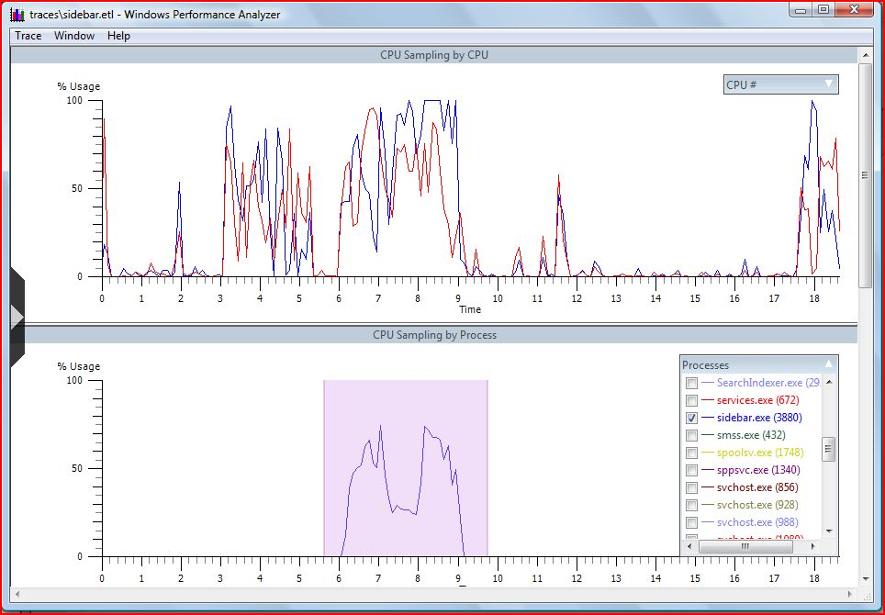
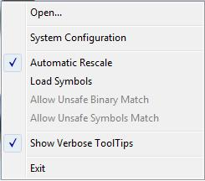
What is CPU Time Spent On?
xperf trace.etl
Notes:
CPU Profile shows both overall CPU usage and breaks it down by process

Slide 44
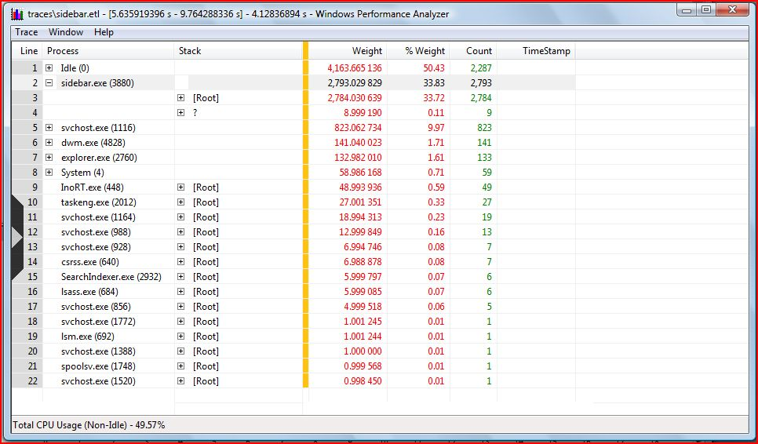
CPU Summary Table
Grouping columns
Aggregated columns
Notes:
Summary of process or CPU or stack or …
How much CPU usage is consumed

Slide 45
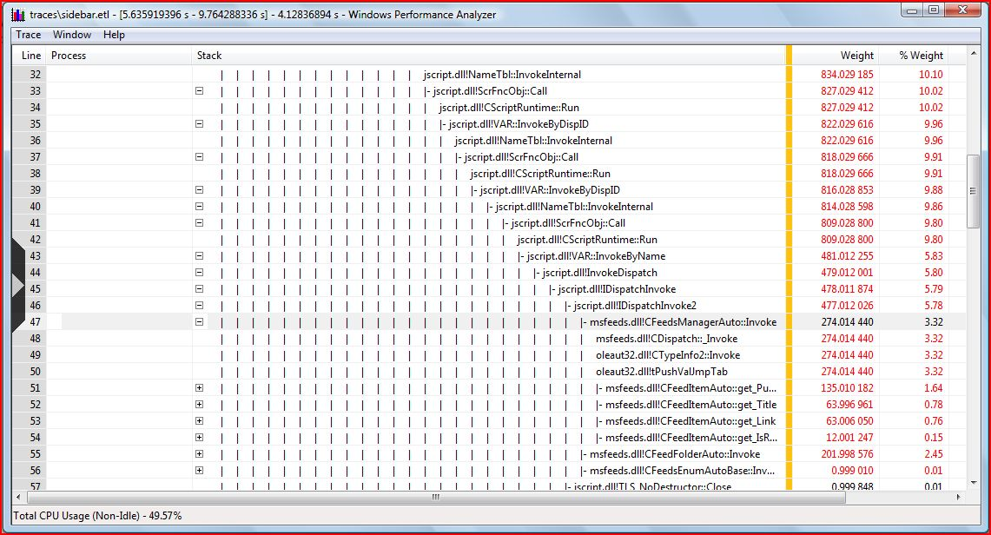
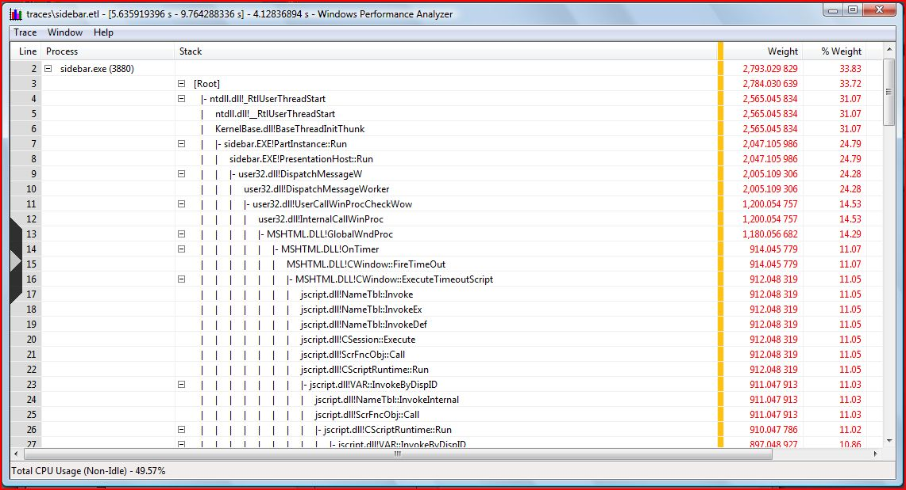
CPU Summary Table
Notes:
Breakdown the stacktrace to find unexpected CPU consumption

Slide 46
Kernel Debugging
Useful for investigating internal system state not available from other tools
Requires 2 computers (host and target)
Target would be halted while host debugger in use
XP & Server 2003 support live local kernel debugging
kd -kl
Technically requires system to be booted /DEBUG to work correctly
You can edit kernel memory on the live system (!)
But, not all commands work
http://www.microsoft.com/whdc/devtools/debugging/default.mspx

Slide 47
Outline
Overview of Windows
IO Processing
Thread Scheduling
Synchronization
Memory
Performance and Debugging
Where to go from here

Slide 48
Where to go from here
Windows Driver Kit:
http://www.microsoft.com/whdc/devtools/WDK/default.mspx
Msdn.microsoft.com
Every function is documented
Many have example code

Slide 49
The Big Picture
XML file
XPerfView
6. CLI trace analysis via actions
5. GUI trace analysis via graphs and summary tables
3. Controls logging sessions and enables/disables providers
Merged ETL file
Action
XPerf
System and Symbol Information
Control/Status
Control/Status
Post Processing
Control/Status
4. Metadata injection
ETW
ETL file
Event Providers
ETW Session
Event Providers
1. Collection of configurable in-memory buffers that is managed by the kernel
2. Any component that has been instrumented with Event Tracing API
Control/Status
Data flow
Notes:
How XPerf does its “magic”

