Slide 1
Device Driver Architecture
Both Windows and Linux support addition of device driver modules in runtime
Driver module expose callback routines
Driver Initialization
IO functionality
Device add/remove
Driver unload

Slide 2
Windows Driver Architecture
Two broad classes
Legacy
PnP(Plug and Play)
PnP Driver Characteristics
Loaded On Demand
Does not consume extra resources

Slide 3
Windows Driver Model(WDM)
Standard model specified by Microsoft
The broad classes of WDM Drivers
Fucntional Driver
Filter Driver
Bus Driver
IO Request Packet(IRP), a standard data structure to enable communication between application-driver and driver-driver

Slide 4
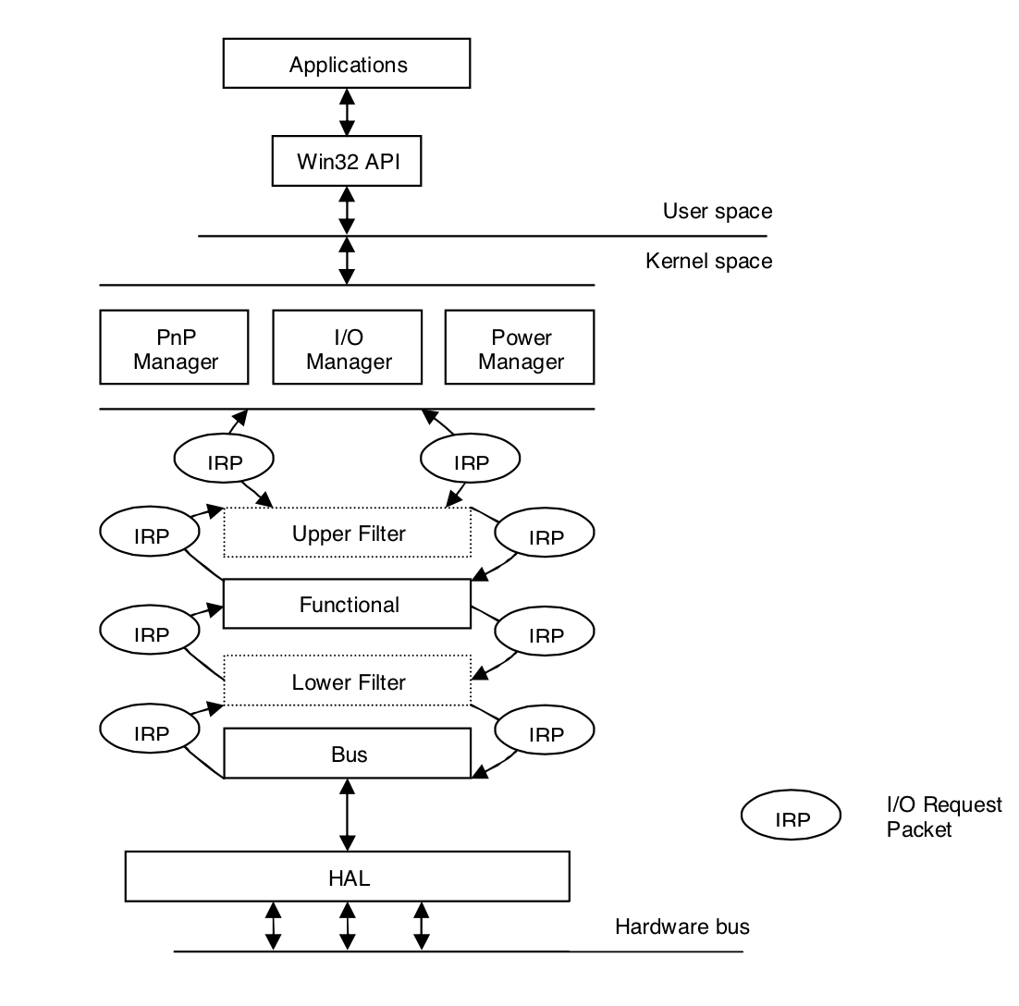
IRP flow in Windows Driver Stack
Notes:
Photo Credits:
“A Comparison of the Linux and Windows Device Driver Architectures“
By
Melekam Tsegaye
Rhodes University, South Africa g98t4414@campus.ru.ac.za
Richard Foss
Rhodes University, South Africa r.foss@ru.ac.za

Slide 5
WDM Driver Primary callbacks
DriverEntry()
Driver load and resource initialization
AddDevice()
Device Object create and resource allocation
128 GUIDs generated for Device Identifier
Driver registers the GUID for a device
Dispatch()
Handles IO requests(sent as IRP)

Slide 6
WDM IO User-Kernel Space
Three primary ways
Buffered IO
Kernel buffer allocated
OS validates buffer before copying contents
Direct IO
User space locked memory allocated
Memory Descriptor List(MDL) passed on to driver via IRP
Driver initiates DMA to/from buffer using MDL info
Method Neither IO
User space virtual pointer passed to driver

Slide 7
Linux Driver Architecture
Drivers in Linux represented as modules
Communication between modules done using function call
Modules can export public function to a symbol table maintained by kernel
module_init and module_exit macros to initialize/unload driver(analogous to DriverEntry())

Slide 8
Key Features Linux Device Driver
No clear distinction of layered modules(no notion of filter, functional and bus driver as in Windows)
Devices are named using major and minor numbers
major numbers in range 0 to 255
Each driver for a major device number can manage additional 256 minor numbers
At one time, maximum 256 usable devices handles
Possible to gain access to 65536(256 X 256) devices

Slide 9
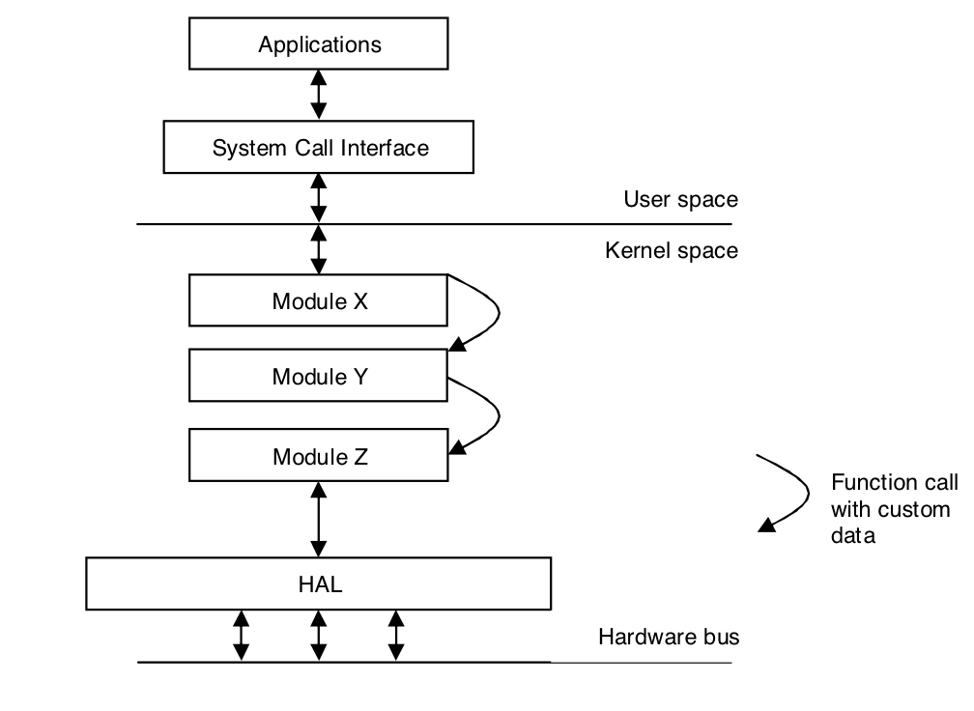
Linux Driver Stack

Slide 10
Linux IO User-Kernel Space
RAM based fs like procfs, sequence files, sysfs
Procfs
info about system components like
CPU
interrupts
meminfo
networking resources
sequence files
Allow data transfer of data which exceeds PAGE_SIZE
sysfs
info about devices, drivers, buses, interconnects

