Slide 1
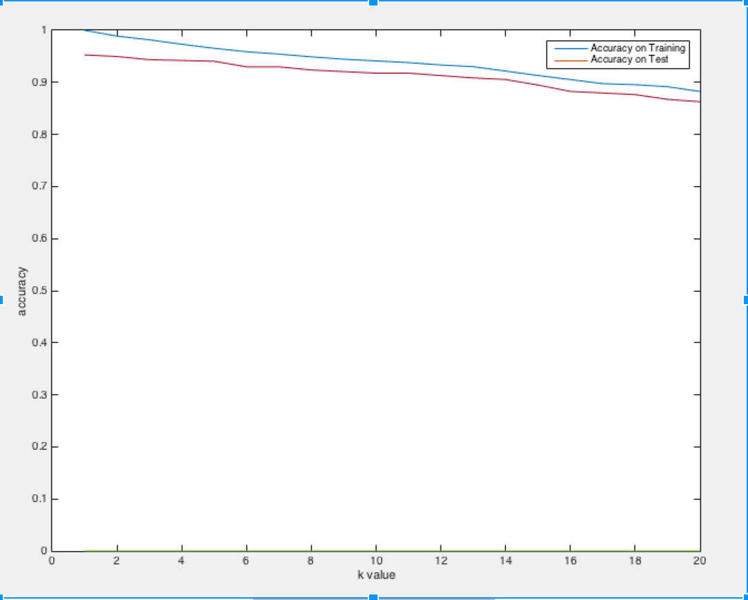
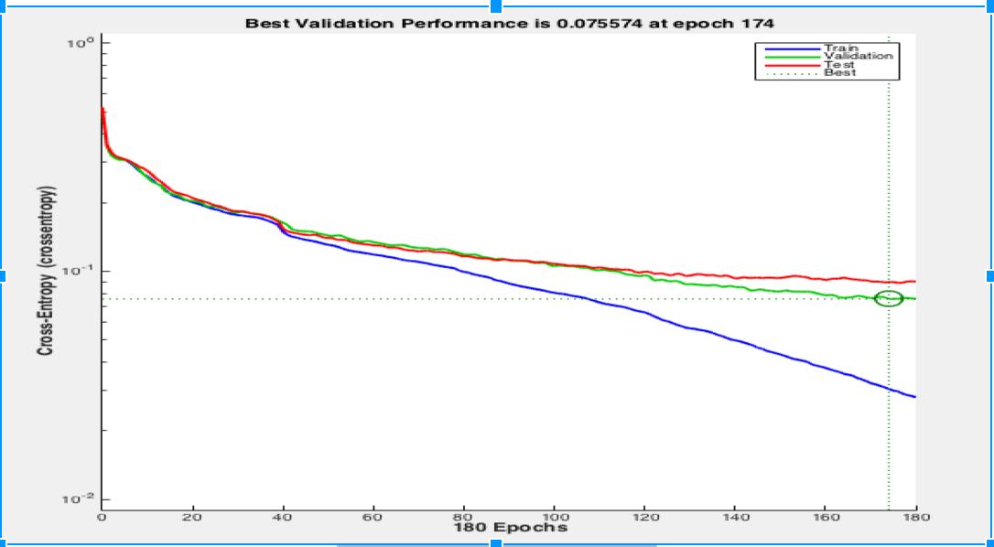
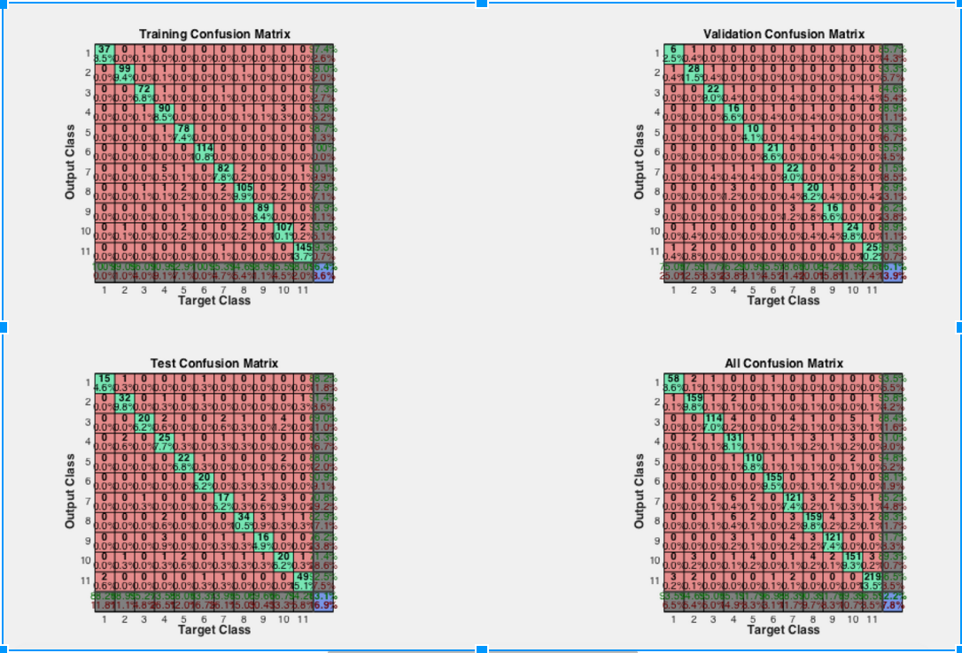
American Sign Language (ASL) Recognition
<names>
Abstract
Procedure
This work is part of a vision based American Sign Language Interpretation (ASL) system for natural human computer interface. It comes under the umbrella of much broader research field of hand gesture recognition. The aim of the paper is to develop a robust system which can interpret the American sign language digits from the static images, as well as video stream inputs. The system involves various important components like Hand segmentation from the background, extracting features of the hand and a classifier for predicting the sign given the features. We also developed an algorithm for extracting the hand sign frames from a video input, which can then be used for classification.
Prior research
There are two major approaches for Hand gesture recognition: Data glove and Vision based. The Data glove approach uses a glove with sensors attached to track finger blending, positioning and orientation. In this paper we have gone ahead with vision based approach, as it is more cost effective and feasible since the user does not have to wear a cumbersome device. In hand based gesture recognition systems, hand tracking and segmentation are the most important and challenging steps towards gesture recognition. Uncontrolled environment, lighting conditions, noisy background, skin color detection and rapid hand movements are some of the challenges that need to be considered while capturing and tracking the hand gestures.
The second major step after Hand segmentation is Shape Feature extraction from the segmented hand. The shape feature extraction can usually be divided into contour based and region based. In our work, we have used contour based method which extracts shape feature information from the boundary of the entity. We have used Fourier descriptor method as it can overcome the effect of noise and boundary variations by analyzing the shape in spectral domain. Furthermore, they are compact, computationally light and there matching is a relatively simple process.
The final step of the process involves training a classifier using the shape features extracted from the training data set collected, and using it to predict or classify a given gesture. In our work we have tried various methods like Neural Networks, K nearest neighbor and PCA for the purpose of classification, and have included the results obtained from each of the methods.
Algorithm
Results
K Nearest Neighbor based Classification:
2200 samples of ASL digits,
training : testing data = 70% : 30%
~ 95% accuracy when k = 1;
Accuracy decreases with increasing k.
Average result obtained around 50-55% ; highest being 65%
Hand Detection
Wrist Cropping
Edge Detection
Largest Boundary Detection
Feature Extraction
Classification
Neural Network based Supervised Learning:
Feed forward neural network with sigmoid transfer function
Back propagation algorithm for learning weights and biases for neurons.
Utilized 64 point Fourier Descriptors features per digit with N’ hidden neurons and 11 output neurons (digits 0 to 10) : N=48 with experimentation for reliable accuracy
1600 samples with 65-70% for training, 15% for validation and rest for test.
Average result : 84% on the testing set, 95% on the training set and 86% on the validation.
70-80% accuracy on random set on average.

