Slide 1
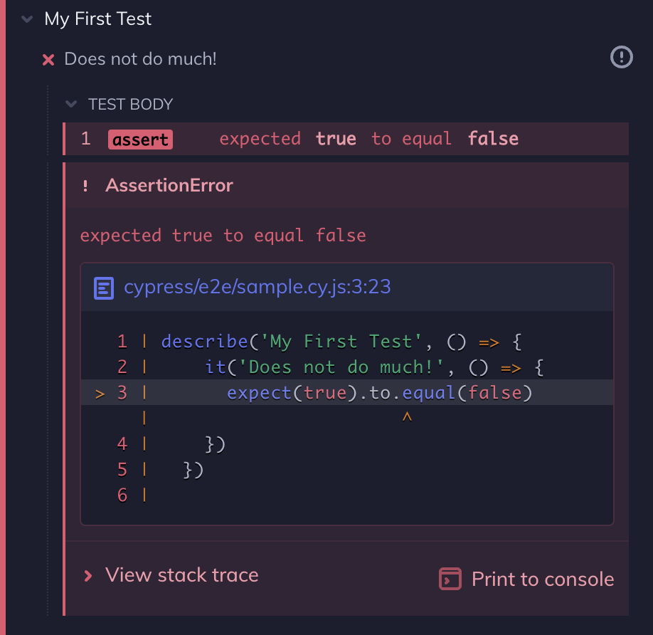


VSTS Cypress Migration
Notes:
testing the code

Slide 2
VSTS Cypress Migration
Notes:
testing the code

Slide 3
VSTS Cypress Migration
Notes:
testing the code

Slide 4
VSTS Cypress Migration
Notes:
testing the code

Slide 5
VSTS Cypress Migration
Notes:
testing the code

Slide 6
VSTS Cypress Migration
Notes:
testing the code

Slide 7
VSTS Cypress Migration
Notes:
testing the code

Slide 8
VSTS Cypress Migration
Notes:
testing the code

Slide 9
VSTS Cypress Migration
Notes:
testing the code

Slide 10
VSTS Cypress Migration
Notes:
testing the code

Slide 11
VSTS Cypress Migration
Notes:
testing the code

Slide 12
VSTS Cypress Migration
Notes:
testing the code

Slide 13
VSTS Cypress Migration
Notes:
testing the code

