Slide 1

SRM INSTITUTE OF SCIENCE AND TECHNOLOGY
Department of Electronics and Communication Engineering
Cross-Layer Intrusion Detection
for ROS 2 Robotic Networks
Detecting command injection and spoofing on unauthenticated DDS/UDP robot networks
Mini Project | Review 2
21ECC402P - Computer Communication and Network Security
Shyam Rithin S
RA2311004010308
Notes:
Good morning. I'm Shyam Rithin. This is Review 2 of my project, a cross-layer intrusion detection system for ROS 2 robots. Since Review 1 the detector runs on a full Gazebo simulation of my robot, with a live monitoring dashboard and Wireshark analysis of the attack traffic, and I will show it blocking attacks live.

Slide 2
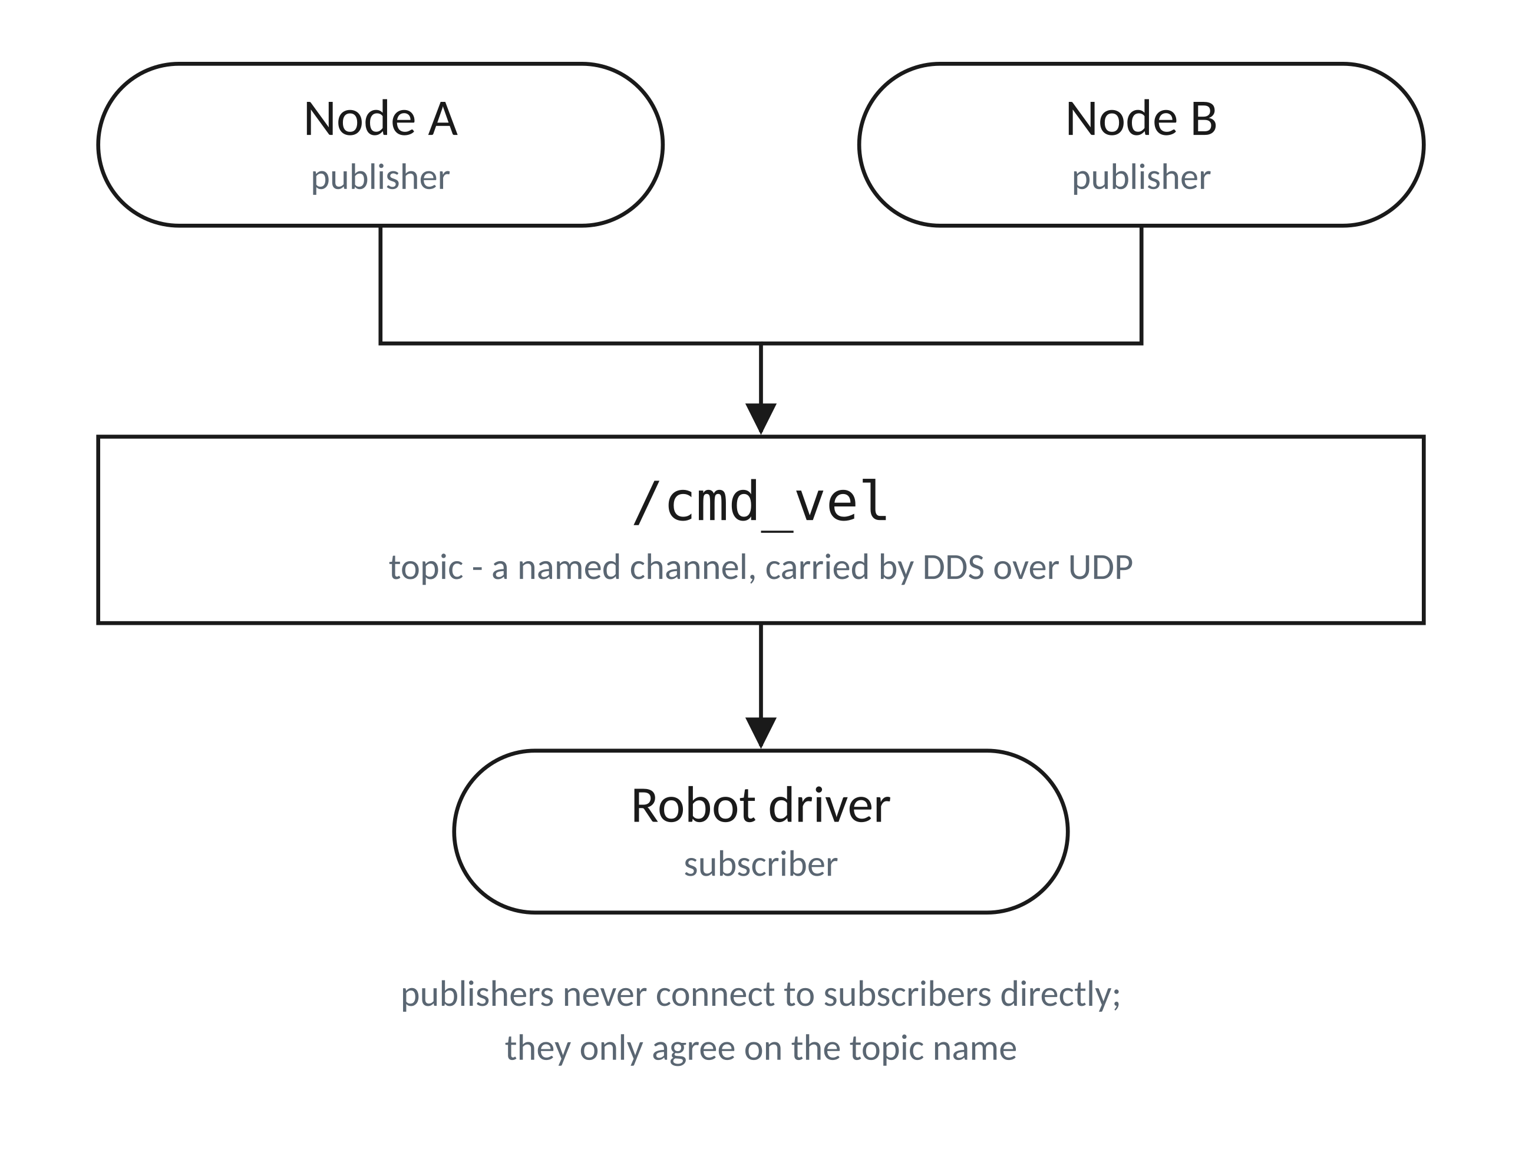
Introduction to ROS2
ROS 2 term | What it is | Networking equivalent
Node | One program doing one job - a navigation planner, a sensor driver, a motor controller. | A process or endpoint on the network.
Topic | A named channel that messages flow on, for example /cmd_vel for velocity commands. | A named multicast channel.
Publisher / Subscriber | A node that sends messages to a topic, and a node that receives them from it. | Many-to-many messaging with no direct connection between the two ends.
DDS | The middleware that actually moves the messages between nodes. | An application-layer protocol running over UDP/IP, ports 7400 + 250 x domain ID (17900-18149 here).
Fig. 2 - Publish / subscribe on a topic.
Putting it together: /cmd_vel is a topic, and the robot's motor driver subscribes to it. Any node that publishes to that topic drives the robot - and DDS does not check which node that is.
21ECC402P | Shyam Rithin S | RA2311004010308
1
Notes:
These are the only four ROS terms in the talk. A node is a program, a topic is a named channel, publishers send and subscribers receive, and DDS is the middleware underneath running on UDP. The line at the bottom is the one that matters: cmd_vel is the topic the robot's motors listen to, and any node can publish to it, because DDS does not check who is sending.

Slide 3
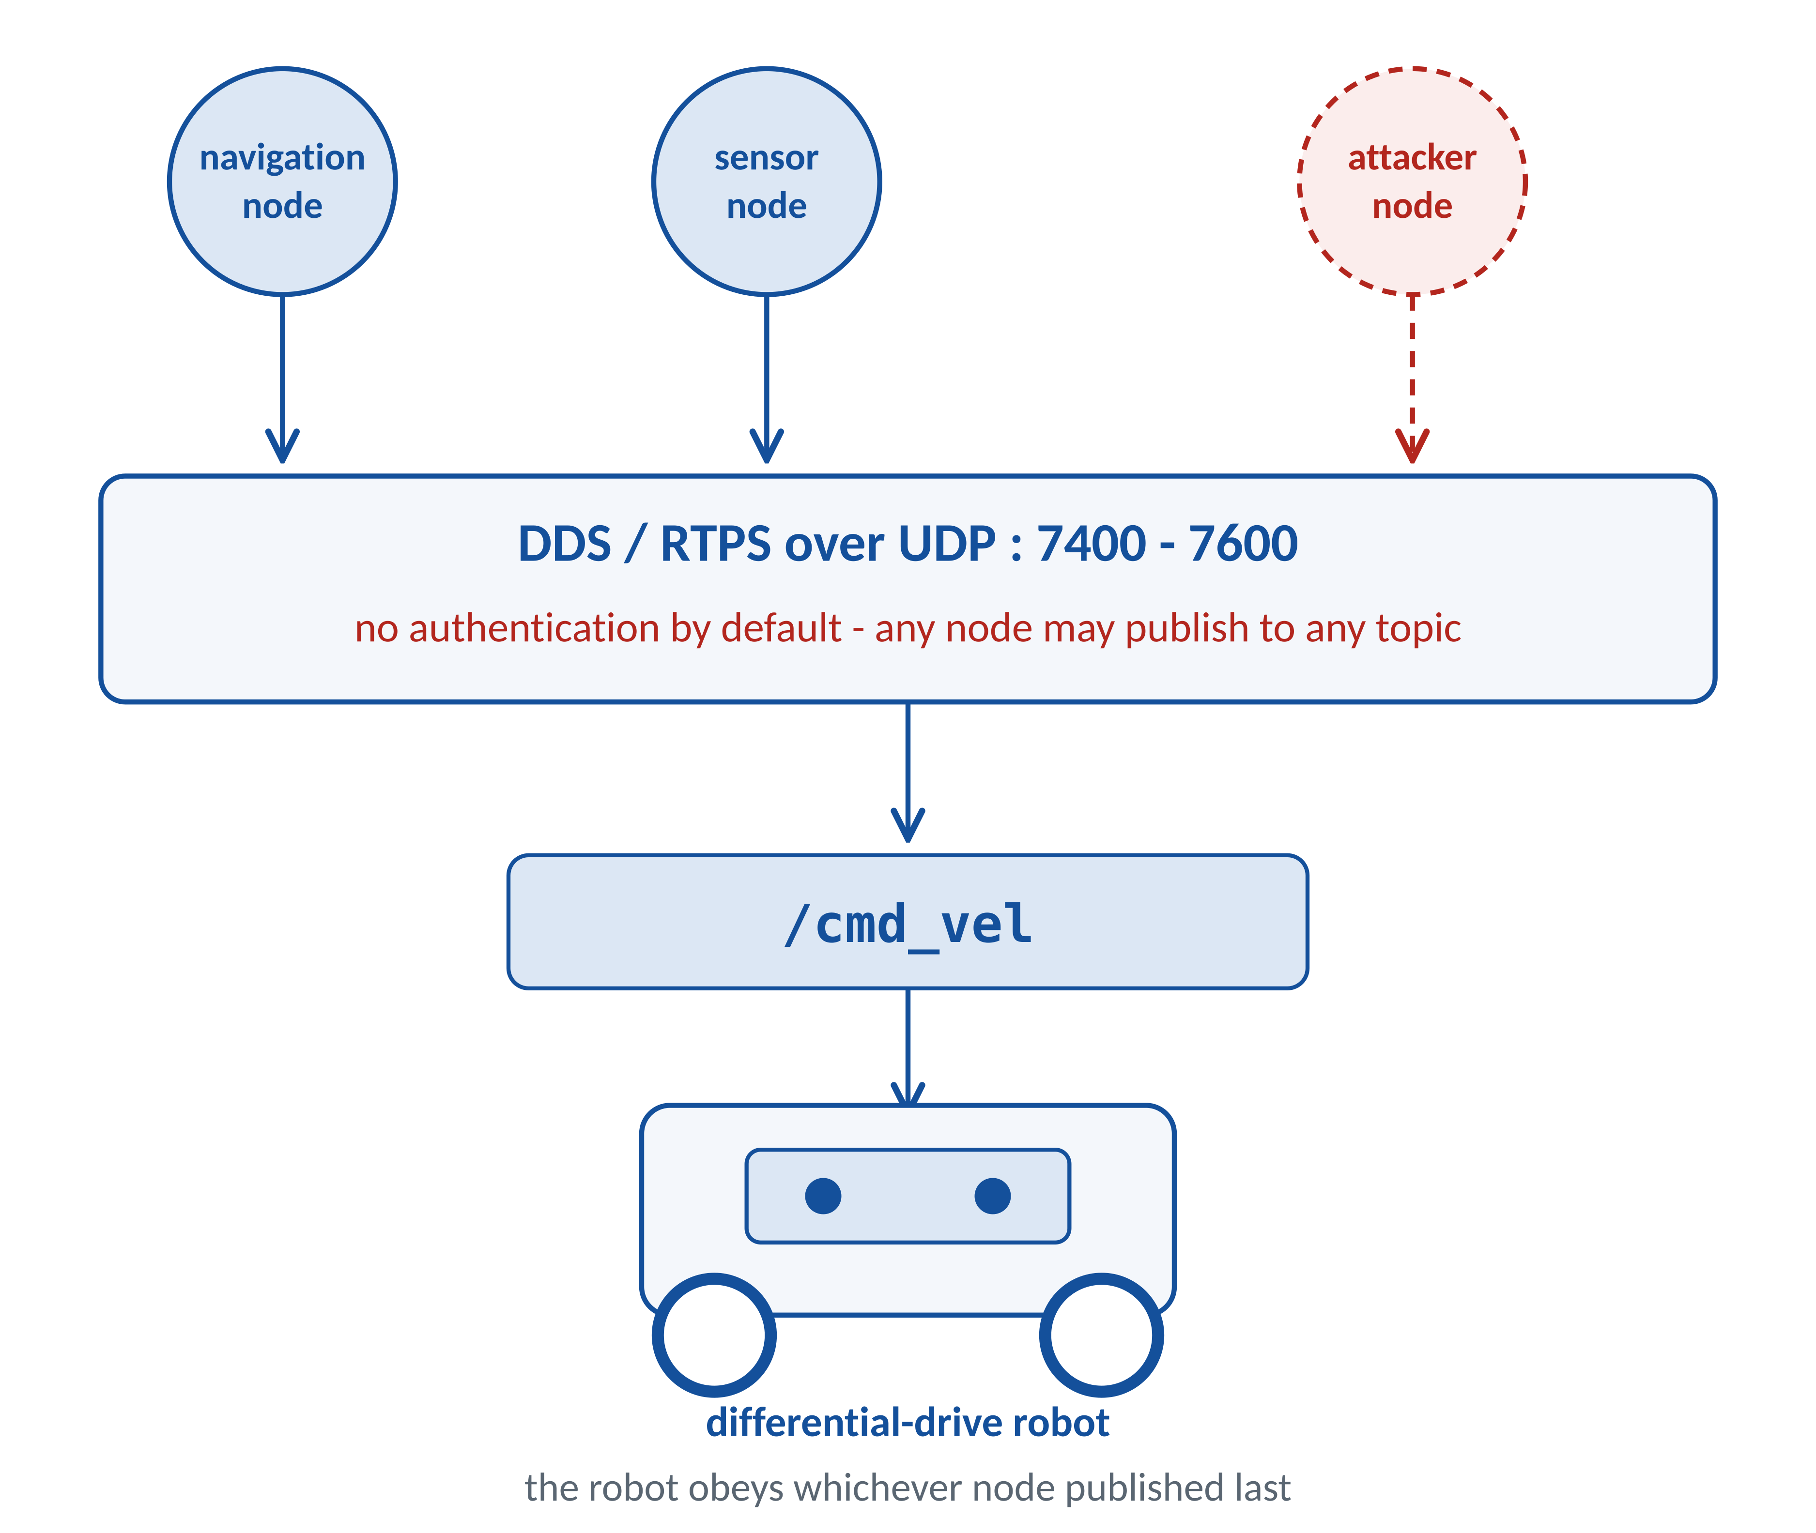
Introduction
ROS 2 is the standard middleware for modern robotics; it does not handle networking itself.
All node-to-node data is carried by DDS (Data Distribution Service), an application-layer publish/subscribe middleware running over UDP/IP, ports 7400 + 250 x domain ID (domain 42: 17900-18149).
Nodes discover each other automatically through multicast - no configuration and no central server.
By default DDS performs no authentication: any node that can reach the network may publish to any topic.
Publishing to /cmd_vel therefore drives the robot, regardless of who sent it.
Robot security is thus a network-layer problem as much as a robotics problem.
Fig. 1 - ROS 2 computational graph over DDS.
21ECC402P | Shyam Rithin S | RA2311004010308
2
Notes:
ROS 2 hands all networking to DDS. DDS is application-layer middleware running on UDP/IP. The critical fact: it is unauthenticated by default. Any node on the network can publish to the velocity command topic and the robot will obey it.

Slide 4
Abstract
ROS 2 carries robot commands over DDS/UDP without authentication, so any node that can reach the network can publish velocity commands, and an injected command is a syntactically valid packet that packet inspection alone cannot tell apart from legitimate traffic. This project proposes a cross-layer intrusion detection system that fuses network-layer evidence, namely publisher identity read live from the ROS 2 computational graph, publisher churn and DDS traffic observed on the wire, with a physics-layer check on the robot's motion: a feasibility test against the velocity and acceleration envelope, and a consistency residual between measured odometry and the motion predicted by the authorized command stream, accumulated by a CUSUM statistic to expose slow, stealthy attacks. The detection threshold is calibrated from benign operation alone, so no labelled attack dataset is required, and an inline safety filter replaces any flagged command with the authorized one, turning detection into prevention. The system is implemented as a ROS 2 Humble package and evaluated on a Gazebo Harmonic digital twin of the articubot_one differential-drive robot against a catalogue of 50 attack profiles, with a live web monitor and Wireshark analysis of the RTPS traffic. Fused detection catches every attack class tested, per-layer ablation shows that each layer is blind to attacks the other detects, and with the safety filter active the peak deviation under a steering hijack falls from 1.94 m to 0.019 m.
Keywords: ROS 2, DDS, intrusion detection, cyber-physical security, CUSUM, command injection, safety filter, Gazebo
21ECC402P | Shyam Rithin S | RA2311004010308
3
Notes:
In one paragraph: the network carries no authentication, so a malicious command looks like a normal packet. I detect it by combining who sent it, from the network layer, with whether the robot is moving the way the authorized controller said, from the physics layer. The threshold comes from benign data only, and the safety filter blocks the attack instead of only reporting it. The headline number: peak deviation drops from 1.94 metres to 0.019 metres with the filter on.

Slide 5
Literature Review
Group A - ROS 2 and DDS security (network-layer work)
# | Paper / Year | Author(s) | Contribution
1 | On the (in)security of secure ROS 2 ACM CCS, 2022 | G. Deng, G. Xu, Y. Zhou, T. Zhang, Y. Liu | Systematic security analysis of SROS 2; identifies three design vulnerabilities allowing unauthorized access to persist even when DDS security is enabled.
2 | SROS2: Usable Cyber Security Tools for ROS 2 2022 | V. Mayoral-Vilches, R. White, G. Caiazza, M. Arguedas | Provides the practical tooling for authentication, encryption and access control in ROS 2 via DDS-Security plugins.
3 | ROSPaCe: Intrusion Detection Dataset for a ROS2-Based CPS Scientific Data, 2024 | T. Puccetti, S. Nardi, C. Cinquilli, T. Zoppi, A. Ceccarelli | First intrusion-detection dataset for ROS 2; monitors three architectural layers - operating system, network, and ROS 2 services - under penetration testing.
21ECC402P | Shyam Rithin S | RA2311004010308
4
Notes:
Group A is the ROS 2 security community, working at the network and middleware level: security analysis of SROS 2, the SROS 2 tooling itself, and the ROSPaCe dataset, which monitors three layers of a ROS 2 system. The overall gap is on the slide after the reviews.

Slide 6
Literature Review
Group A continued - detection and exploitation on ROS 2
# | Paper / Year | Author(s) | Contribution
4 | Implementing a Robot Intrusion Prevention System (RIPS) for ROS 2 2024 | E. Soriano-Salvador, F. Martin-Rico, G. Guardiola Muzquiz | A working intrusion prevention system for ROS 2 that monitors the computational graph and blocks unauthorized activity at runtime.
5 | Supply Chain Exploitation of Secure ROS 2 Systems 2025 | T. H. Sakib, Y. Romano Martinez, C. Brady, S. R. Hasan, T. N. Guo | Demonstrates keystore exfiltration allowing an attacker to rejoin an SROS 2 network as an authenticated participant and publish spoofed control messages, causing forced braking and unwanted acceleration.
6 | Performance Evaluation of Cyber-Physical Intrusion Detection on a Robotic Vehicle IEEE CIT, 2016 | A. Bezemskij et al. | Early demonstration that combining cyber features with physical sensor features improves intrusion detection on a robotic vehicle.
21ECC402P | Shyam Rithin S | RA2311004010308
5
Notes:
Group A continued. RIPS is a working intrusion prevention system for ROS 2. The 2025 supply chain paper shows an attacker can become a fully authenticated participant and send spoofed control messages, and the authors call for runtime semantic validation. Bezemskij et al. combined cyber and physical features, but with supervised learning on a pre-ROS 2 platform.

Slide 7
Literature Review
Group B - control-theoretic attack detection (physics-layer work)
# | Paper / Year | Author(s) | Contribution
7 | Simulation and Real-World Evaluation of Attack Detection Schemes ACC, 2019 | M. Porter, A. Joshi, P. Hespanhol, A. Aswani, M. Johnson-Roberson, R. Vasudevan | Compares chi-squared, CUSUM, MEWMA and Dynamic Watermarking detectors on a real Segway platform performing path following.
8 | CUSUM and Chi-squared Attack Detection of Compromised Sensors IEEE CCA, 2016 | C. Murguia, J. Ruths | Formalises residual-based detection for cyber-physical systems and the trade-off between detection sensitivity and false-alarm rate.
Two communities, two blind spots
Group A monitors the network but never the physical process; Group B monitors the physical process but never the network. The overall research gap follows.
21ECC402P | Shyam Rithin S | RA2311004010308
6
Notes:
Group B is the control theory community. They use the physical process, with CUSUM and chi-squared residual tests, but have no network layer, and a careful attacker can evade them. So Group A has no physics and Group B has no network.

Slide 8
Research Gap
Where the existing work stops, taken across both research communities
Command traffic in ROS 2 is protected, if at all, at the network and middleware layer, while the robot's physical behaviour is checked only by control-theoretic detectors that know nothing about the network. The two communities have developed separately: network-layer work cannot tell whether a perfectly valid command is physically plausible, and physics-layer work cannot tell who sent it. A stolen credential, a spoofed node name or a discovery flood therefore defeats one side or the other. What is missing is a single runtime detector that fuses DDS network evidence with a physical-process consistency check on ROS 2, needs no labelled attack data, and acts on its verdict inline, before a command reaches the motors.
Network-layer security [1-5]
Sees participants, credentials and the ROS 2 graph.
Blind spot: Never sees what the robot physically does; an authenticated but compromised node goes unnoticed.
Control-theoretic detection [7, 8]
Sees the physical residual of the controlled process.
Blind spot: No notion of publishers, topics or discovery traffic; evaded by residual-preserving attacks.
Cyber-physical learning [6]
Combines cyber and physical features.
Blind spot: Needs labelled attack data for training and predates ROS 2 and DDS.
Gap addressed by this project
Fusion of DDS network evidence with a physical-process consistency check on ROS 2, calibrated from benign data alone and acting inline through a safety filter - and an ablation showing that each layer detects attacks the other is blind to.
21ECC402P | Shyam Rithin S | RA2311004010308
7
Notes:
This is the overall research gap, taken across both communities rather than paper by paper. Network security work never looks at the physics, control theory never looks at the network, and the one line of work that combines both needs labelled attack data and predates ROS 2. Nobody has fused the two on ROS 2 with no attack data and inline prevention. That is what this project does.

Slide 9
Objectives
1
To study the ROS 2 and DDS attack surface and to formulate a threat model covering command injection, node and topic spoofing, and discovery-flood denial of service.
2
To develop an attack toolkit that reproducibly generates each attack class against a ROS 2 robot on an isolated laboratory domain.
3
To formulate a closed-form differential-drive feasibility and consistency test whose detection threshold is calibrated from benign data alone, requiring no labelled attack dataset.
4
To realise a cross-layer detector that fuses the physics-layer residual with live network-layer evidence from the ROS 2 computational graph, together with an inline safety layer that rejects commands flagged as malicious and holds the robot on its authorized trajectory.
5
To evaluate detection rate, false-alarm rate, detection latency and computational overhead, with an ablation isolating the contribution of each layer.
21ECC402P | Shyam Rithin S | RA2311004010308
8
Notes:
Five objectives, each phrased as an action. The detector and the safety layer are now one objective, because the safety layer is what turns the detector's verdict into prevention. Objectives one to four are complete; the full evaluation in objective five finishes this week.

Slide 10
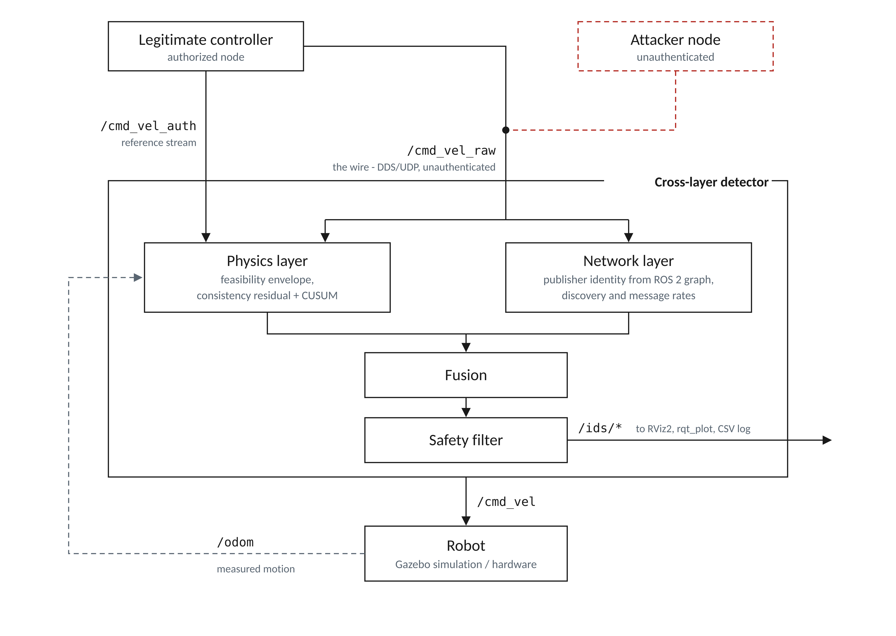
Proposed Model
Cross-layer architecture: the detector sits inline, not alongside
Two design decisions
Two command topics
/cmd_vel_auth carries only the authorized stream; /cmd_vel_raw is the wire the attacker also publishes on. The detector compares measured motion against what the authorized stream predicts, so an injected command is caught even though its packet is perfectly valid.
The detector is inline
Nothing reaches the motors except through it. A flagged command is replaced by the last authorized command, so the robot holds its trajectory instead of merely raising an alarm.
Fig. 3 - System architecture. The detector is placed inline on the command path, so detection can act as prevention.
21ECC402P | Shyam Rithin S | RA2311004010308
9
Notes:
The architecture point that matters: there are two command topics. One carries only what the authorized controller said. The other is the wire, where the attacker also publishes. The detector compares the robot's actual motion against what the authorized stream predicts. That is how an individually valid packet still gets caught. And because the detector is inline, it can block the command, not just report it.

Slide 11
Proposed Model
The two detection layers and their fusion
Network layer
Physics layer
Publisher identity checked against an allowlist, read live from the ROS 2 computational graph.
Publisher churn on the command topic; DDS discovery and traffic rates observed on the wire with tshark / Wireshark.
Catches rogue publishers, node and topic spoofing, and discovery-flood denial of service.
Feasibility: is the command finite and inside the velocity and acceleration envelope of the robot?
Consistency: residual between measured odometry and the motion predicted by the authorized command stream.
A CUSUM statistic accumulates the residual, exposing stealthy attacks that stay feasible.
Fusion: an alarm is raised if either enabled layer fires, and each layer can be disabled at runtime, which is exactly the ablation experiment reported in the results.
Attack-data-free: the threshold is calibrated as mean + 3 sigma of the residual under benign operation only. No labelled attack dataset is required, so attack types never seen during design are still detected.
21ECC402P | Shyam Rithin S | RA2311004010308
10
Notes:
Two physical tests. Feasibility catches the crude attacks instantly. Consistency plus CUSUM catches the slow, careful ones. And the threshold comes from benign data only, so I never need attack examples to train on.

Slide 12
Detection Algorithm
What the detector computes at every control step (20 Hz)
1
Feasibility test
Reject any command that is non-finite or outside the robot's envelope: |v| > v_max, |w| > w_max, or a step change larger than the acceleration limit allows.
catches garbage values and crude high-velocity takeover, instantly
2
Motion prediction
Pass the AUTHORIZED command stream through a first-order drive model to predict what the robot should be doing now.
the reference the measurement is compared against
3
Consistency residual
r(k) = || measured motion - predicted motion || using odometry from the wheel encoders.
grows whenever something other than the authorized controller is driving
4
CUSUM accumulation
S(k) = max ( 0 , S(k-1) + ( r(k) - epsilon ) ) alarm when S(k) > tau
noise decays to zero; a small persistent attack adds up until it fires
5
Fusion and response
Alarm if the network layer OR the physics layer fires; the safety filter then substitutes the last authorized command.
detection becomes prevention
Why CUSUM: a plain threshold either false-alarms on a single noise spike or is evaded by an attacker who stays just below it. The cumulative sum decays on noise but climbs on a small, persistent bias - which is precisely the stealthy attack.
21ECC402P | Shyam Rithin S | RA2311004010308
11
Notes:
This is the detector in five steps. Step one is the fast feasibility check. Steps two and three build the residual: predict from the authorized commands, compare against odometry. Step four is the CUSUM, which catches stealth. Epsilon is calibrated from benign data: 0.024 on the kinematic bench and 0.010 on the Gazebo robot; tau is 3.0. S sub k accumulates how much the residual exceeds epsilon, so noise decays away but a small persistent attack adds up until it alarms.

Slide 13
Tools Used
Hardware
Software
COMPONENT
SPECIFICATION
ROLE IN THIS PROJECT
COMPONENT
VERSION / CONFIGURATION
ROLE
Robot platform
articubot_one differential-drive
target platform
ROS 2 Humble
Ubuntu 22.04 LTS
middleware and node framework
Onboard compute
Raspberry Pi 4, Ubuntu 22.04
runs ROS 2 and the detector
Fast DDS
rmw_fastrtps_cpp, UDP-only profile
the transport under test
Wheel encoders
optical, 510 counts / rev
odometry source for the physics layer
Gazebo
Harmonic
robot simulation environment
Drive geometry
wheel radius 32.5 mm, separation 250 mm
kinematic model parameters
RViz2
marker and odometry display
live alert and trajectory view
Attacker machine
HP Pavilion laptop, Ubuntu 22.04
runs the rogue publisher
Python / rclpy
3.10, stdlib web monitor
detector, attack toolkit, safety filter
Simulation / monitor PC
Acer Nitro ANV15-41, Ubuntu 22.04
Gazebo, RViz2, IDS monitor
Wireshark / tshark
RTPS, UDP 17900-18149
DDS traffic capture
Network
switched Ethernet / Wi-Fi, isolated domain
the DDS domain under attack
NumPy / Matplotlib
offline analysis
evaluation and figure generation
Shaded rows are measured constants used directly by the detector, not catalogue values.
All software is open-source; no fabrication or specialised RF equipment is required.
Scope: all attacks are executed only against the author's own robot on an isolated laboratory DDS domain with a dedicated ROS_DOMAIN_ID.
21ECC402P | Shyam Rithin S | RA2311004010308
12
Notes:
Everything here is already available - nothing needs to be purchased. The robot runs on a Raspberry Pi 4 with Fast DDS restricted to UDP, so every message is visible on the wire. The Gazebo model uses the robot's measured wheel radius and separation, which are the constants in the physics layer's equations. Wireshark captures the domain-42 DDS ports, 17900 to 18149.

Slide 14
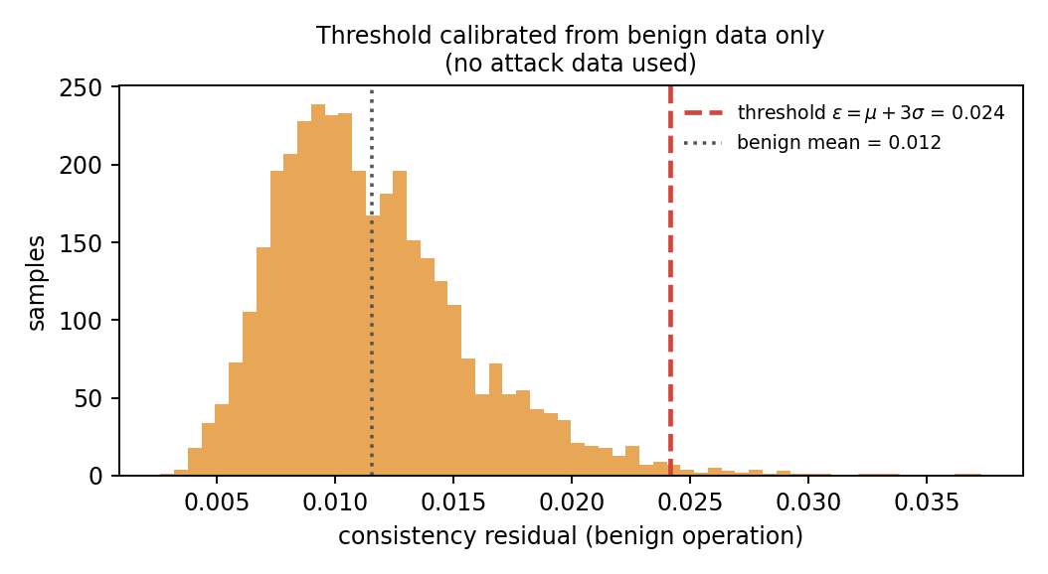
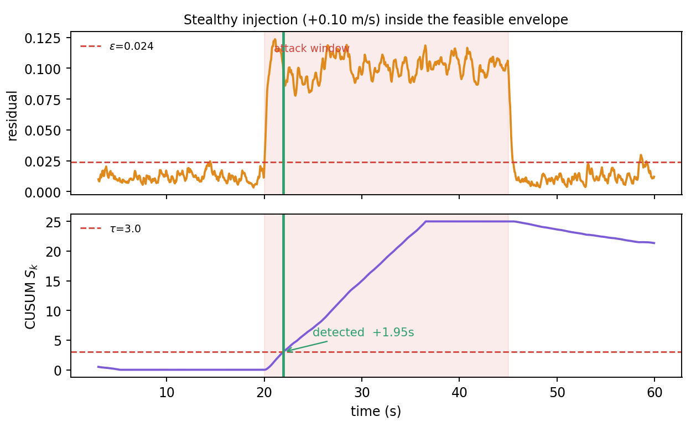
Results - Phase 1
Threshold calibrated from benign data; stealthy attack detected in under 2 seconds
Fig. 4 - Residual distribution under benign operation. The threshold is derived from this data, never from attack data.
0.024
0 / 10
1.95 s
Fig. 5 - Residual and CUSUM through a benign - attack - benign session. Shaded band is the attack window.
calibrated threshold
false alarms
detection latency
mean + 3 sigma, benign data only
benign sessions of 60 s
stealthy +0.10 m/s injection
The injected command stays inside the feasible envelope, so the feasibility test alone stays silent. The CUSUM statistic accumulates the small persistent residual and fires 1.95 s after onset.
21ECC402P | Shyam Rithin S | RA2311004010308
13
Notes:
Two results. Left: the threshold is not guessed, it is calibrated from benign data as mean plus three sigma. Right: a stealthy injection that stays physically feasible is caught in under two seconds by the CUSUM. Zero false alarms across ten benign runs.

Slide 15
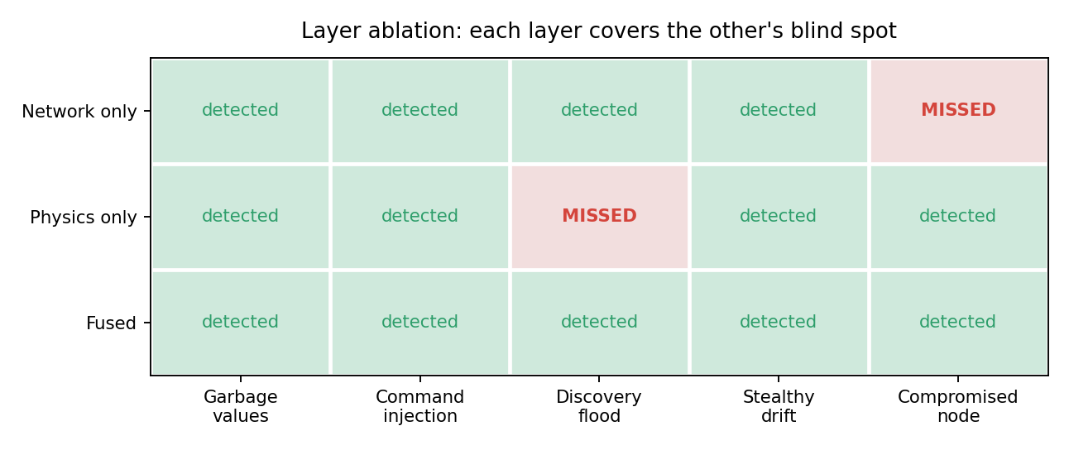
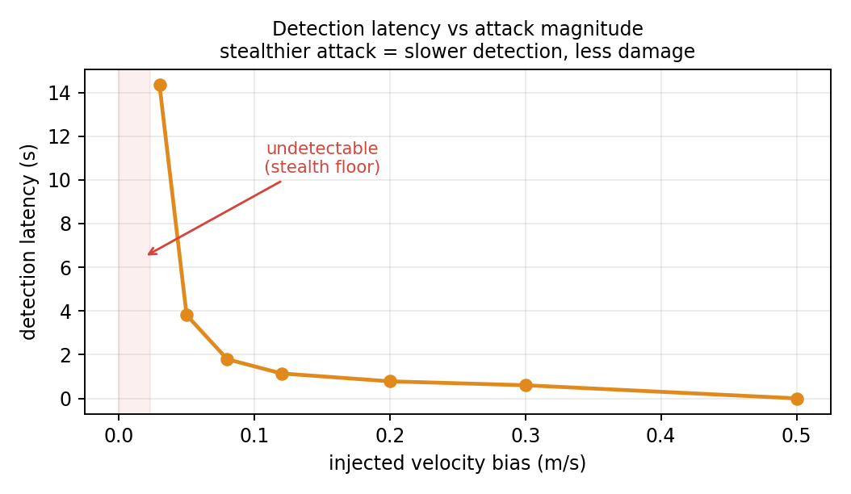
Results - Layer Ablation
The central finding: each layer covers the other's blind spot
Fig. 7 - Detection latency against injected velocity bias.
Detection latency falls as attack magnitude rises. Below roughly 0.02 m/s the attack is undetectable - but it also barely moves the robot. This is a stated limitation, not a hidden one.
Fig. 6 - Per-layer ablation across five attack classes. Same detector, one layer disabled at a time.
Discovery flood physics layer is blind
the robot keeps driving perfectly normally, so its motion is never inconsistent - caught by the network layer
Compromised authorized node network layer is blind
the publisher name is legitimate, so identity and rate checks see nothing wrong - caught by the physics layer
Neither layer alone is sufficient. Fusion detects all five attack classes tested.
21ECC402P | Shyam Rithin S | RA2311004010308
14
Notes:
This is the most important slide. A discovery flood leaves the robot driving perfectly normally, so the physics layer misses it entirely and the network layer catches it. A compromised authorized node uses a legitimate publisher name, so the network layer sees nothing wrong and the physics layer catches it. Neither layer alone is enough. That is the scientific justification for fusing them.

Slide 16
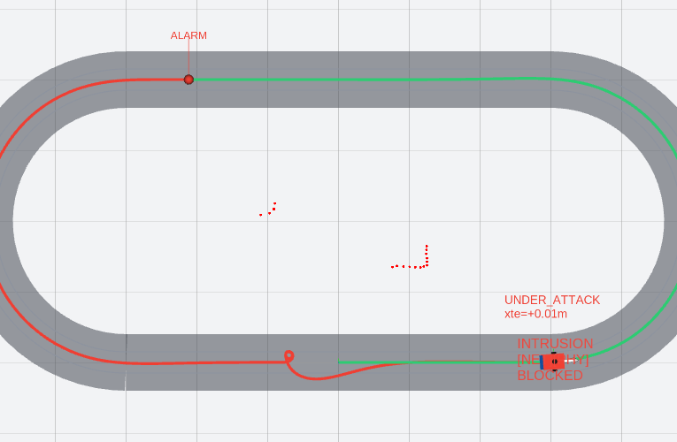
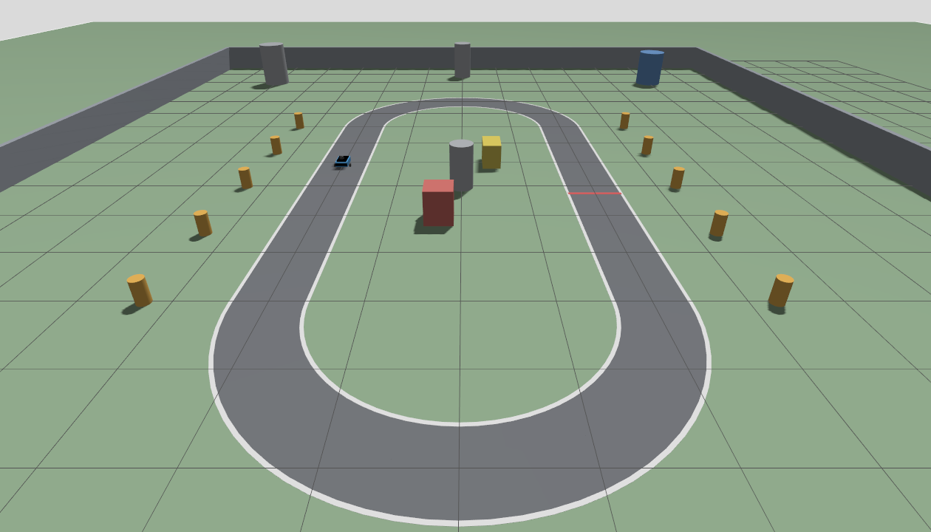
Results - Gazebo Bench
Hard-spin injection caught by both layers, blocked, and the robot returned to the line
Fig. 8 - RViz2 during the hard-spin injection: red trail while under attack, green after the safety filter restored control.
Fig. 9 - Gazebo Harmonic arena: oval track, walls and obstacles, robot with the real wheel geometry.
Attack: w = 4.0 rad/s published on /cmd_vel_raw at 100 Hz while the authorized controller commanded 0.18 rad/s. The network layer flagged the rogue publisher, the physics layer flagged the infeasible command and the CUSUM crossed tau, and the safety filter forwarded the authorized command until the wire was consistent again. Threshold calibrated in 20 s of benign driving.
2 / 2
Blocked
0.007 m
layers fired
safety filter
odometry drift
rogue writer; |w| 4.0 > 2.5 rad/s
authorized command forwarded
was 3.8 m before the rebuild
21ECC402P | Shyam Rithin S | RA2311004010308
15
Notes:
This is the new result for Review 2, on the Gazebo simulation of my robot. I injected a hard spin, 4 radians per second, at 100 hertz on the command wire. Both layers fired: the network layer saw a publisher that is not on the allowlist, and the physics layer saw a command outside the robot's envelope, with the CUSUM crossing its limit. The safety filter forwarded the authorized command, and the robot came back to the racing line by itself - you can see the red trail turn green. The third number is a fidelity check: after rebuilding the simulation, wheel odometry stays within 7 millimetres of Gazebo's ground truth, where it had drifted 3.8 metres before.

Slide 17
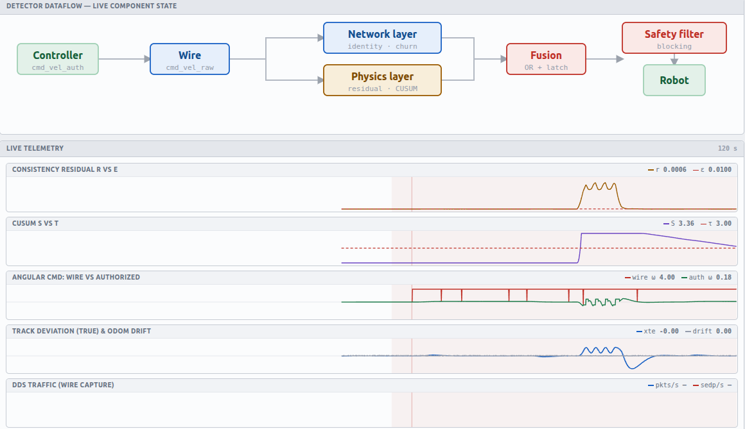
Results - Live Monitoring
The same attack on the operator dashboard and at packet level
50
attack profiles
20 injection, 11 spoofing, 8 discovery, 11 network
100x
lower peak deviation
0.019 m with the safety filter vs 1.94 m without
0.02 s
network-layer detection
rogue publisher on the command wire
In Wireshark the attacker's participant and publisher announcements appear during discovery, followed by a second writer interleaving commands on rt/cmd_vel_raw with the controller's 20 Hz stream. The monitor logs every sample to CSV for the report.
Fig. 10 - IDS monitor during the injection: network and physics layers lit, safety filter blocking, wire vs authorized command, CUSUM and track deviation.
21ECC402P | Shyam Rithin S | RA2311004010308
16
Notes:
This is the operator view of the same attack. The dataflow shows which layer fired and that the safety filter is blocking; the charts show the attacker's command on the wire separating from the authorized one while the robot's track deviation stays small. Fifty attack profiles can be launched from here, the safety filter and each layer can be switched off live for the ablation, and in Wireshark the attacker is visible at packet level: its discovery announcements and a second writer on the command topic. The 100x and 0.02 s figures are from the kinematic bench; the Gazebo episode table is exported from this dashboard for the final report.

Slide 18
Conclusion
Completed
Remaining (by 27 Oct 2026)
Threat model and attack taxonomy defined for ROS 2 / DDS.
Cross-layer detector with an inline safety filter, implemented as a ROS 2 package.
Gazebo Harmonic digital twin with ground-truth-coupled RViz2 and a 50-profile attack catalogue.
Live web monitor and Wireshark RTPS analysis of the attack traffic.
Ablation shows each layer catches attacks the other misses; the safety filter cuts peak deviation 100x.
Deploy the detector on the physical articubot_one (Raspberry Pi 4).
Measure CPU / memory overhead and end-to-end detection latency on hardware.
Full evaluation over the attack catalogue: detection rate, false alarms, latency.
Quantify false alarms under real wheel slip and sensor noise.
Release the attack catalogue, monitor and dataset with the report (3 Nov).
Contribution
Physics-based attack detection is established. Network intrusion detection for ROS 2 is established. Fusing them on ROS 2 has not been done - and this project shows each layer detects attacks the other is blind to, which is the reason the fusion is necessary rather than merely convenient.
21ECC402P | Shyam Rithin S | RA2311004010308
17
Notes:
Completed: the detector, the safety filter, a full Gazebo bench of the robot, fifty attack profiles, the live monitor and the Wireshark analysis. Remaining for completion on Tuesday: hardware deployment and the full evaluation. To be clear about what is new: physics-based detection exists and ROS 2 intrusion detection exists; fusing them on ROS 2, and showing that each layer is blind to something the other catches, is the contribution.

Slide 19
Time Frame
Phase | Milestone | Work | Target | Status
Review 1 | Design and simulation | Literature review, threat model, detector core, attack toolkit, simulation results and ablation | Sep 2026 | Complete
Review 2 | Gazebo bench and live monitoring | Gazebo Harmonic digital twin with ground-truth RViz2; 50-profile attack console; web monitor; Wireshark RTPS analysis; safety filter on / off evaluation | Sat 24 Oct 2026 | Complete
Completion | Hardware and full evaluation | Deployment on articubot_one (Raspberry Pi 4); detection rate, false-alarm rate, latency and overhead across the catalogue; complete ablation | Tue 27 Oct 2026 | In progress
Report | Final submission | Technical report, demonstration video, attack catalogue and dataset | Tue 3 Nov 2026 | Planned
Review 2 on Saturday 24 Oct 2026; project completed by Tuesday 27 Oct; report submitted on Tuesday 3 Nov 2026.
21ECC402P | Shyam Rithin S | RA2311004010308
18
Notes:
Design and simulation were complete for Review 1. Today, Review 2, covers the Gazebo bench and the live monitoring. The project is completed by Tuesday the 27th with hardware deployment and the full evaluation, and the report is submitted a week later, on the 3rd of November.

