Slide 1
WELCOME
to
wONDER WORLD

Slide 2
Wonder world
Taj mahal
Great wall of china
Charist the redeemer
petra

Slide 3
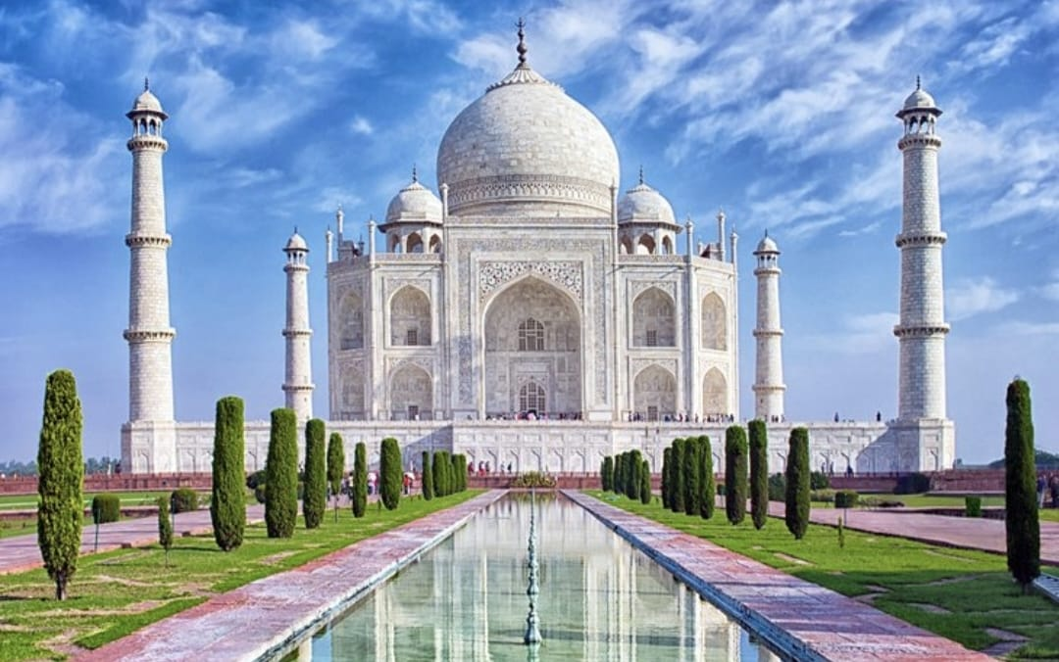
1. Taj mahal
The Taj Mahal was designated as a UNESCO World Heritage Site in 1983 for being “the jewel of Muslim art in India and one of the universally admired masterpieces of the world's heritage”. It is regarded by many as the best example of Mughal architecture and a symbol of India's rich history.

Slide 4
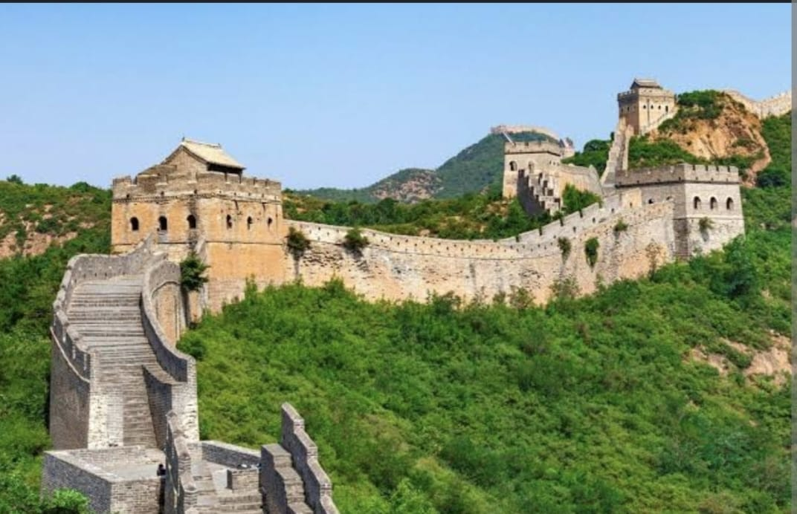
2. Great wall of china
The Great Wall of China is a series of fortifications that were built across the historical northern borders of ancient Chinese states and Imperial China as protection against various nomadic groups from the Eurasian Steppe

Slide 5
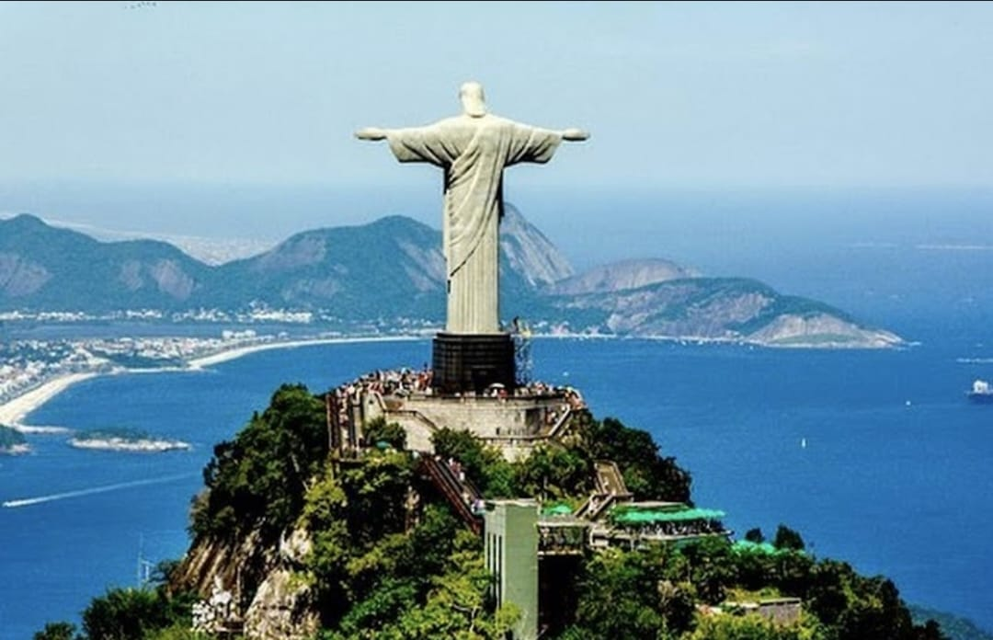
3. Charist the redeemer
Christ The Redeemer is an Art Deco statue of Jesus Christ in Rio de Janeiro, Brazil, created by French sculptor Paul Landowski and built by Brazilian engineer Heitor da Silva Costa, in collaboration with French engineer Albert Caquot. Romanian sculptor Gheorghe Leonida sculpted the face

Slide 6
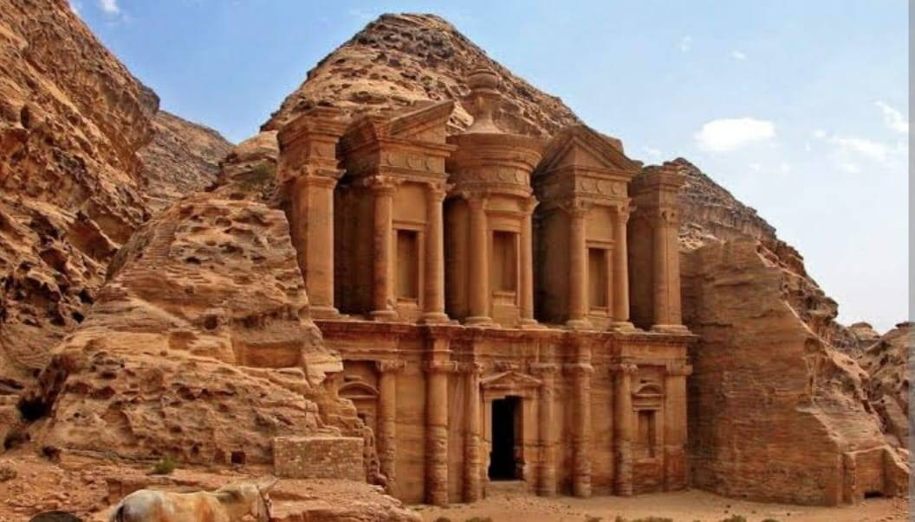
4. petra
Petra is a famous archaeological site in Jordan's southwestern desert. Dating to around 300 B.C., it was the capital of the Nabatean Kingdom. Accessed via a narrow canyon called Al Siq, it contains tombs and temples carved into pink sandstone cliffs, earning its nickname, the "Rose City.

Slide 7
Thank you

