Slide 1


Unit – 1
Trees & Spanning Trees
B.Tech., B.Sc.(H) CS $→5$^{th} Semester
Graph theory(2301CS595)
CO1:
At the end of this unit, students will be able to
apply the properties of trees and spanning trees
Prof. Punit Vadher
Department of Humanities & Science
punit.vadher@darshan.ac.in
9662443859

Slide 2

Topics of Unit 1
  Brief Introduction of Unit
  Introduction to Trees
    Definition
    Properties
  Pendent Vertices, Distance and Center in Trees
  Introduction to Spanning Trees
    Definition
    Properties
  Fundamental Circuits
  Finding all Spanning Trees of Graphs
Looping

Slide 3
Brief Introduction

Slide 4
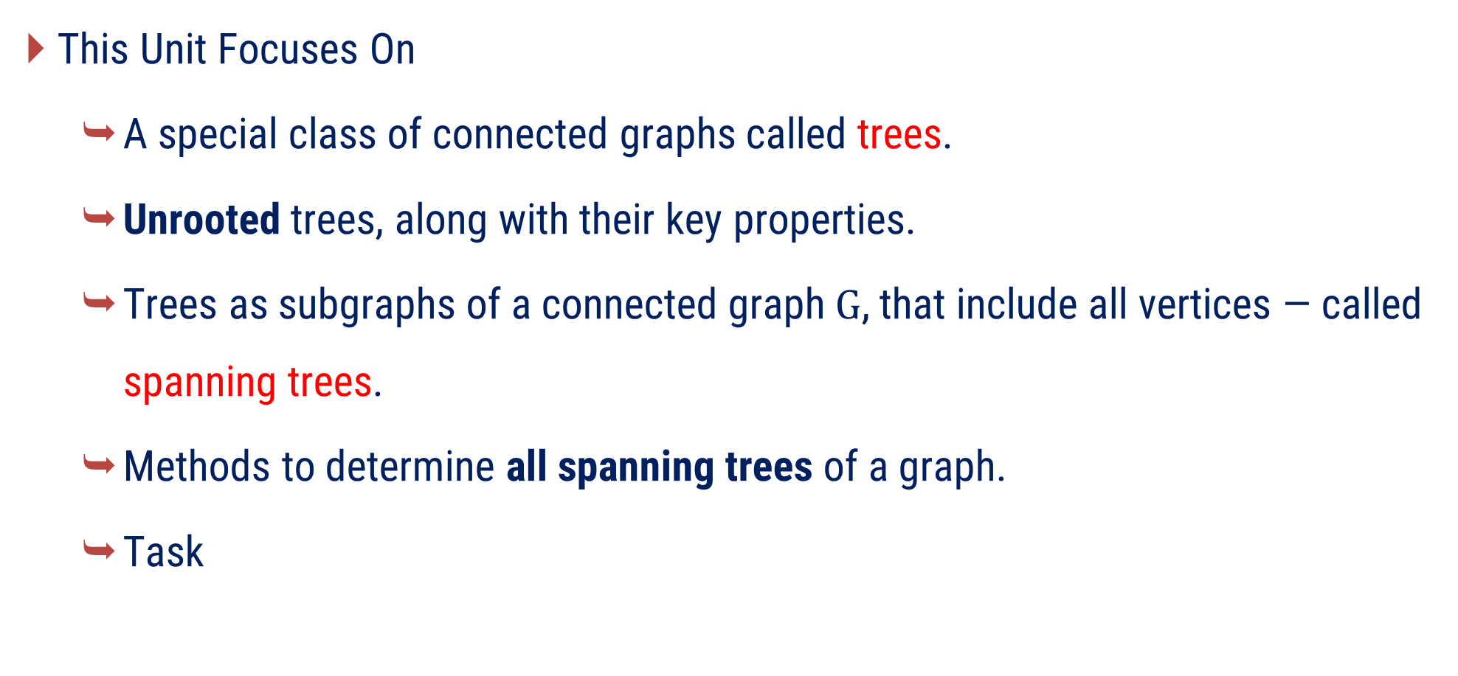
Unit Overview
This Unit Focuses On
  A special class of connected graphs called trees.
  Unrooted trees, along with their key properties.
  Trees as subgraphs of a connected graph $G$, that include all vertices — called spanning trees.
  Methods to determine all spanning trees of a graph.
  Task

Slide 5
Method – 1
Introduction to Trees

Slide 6
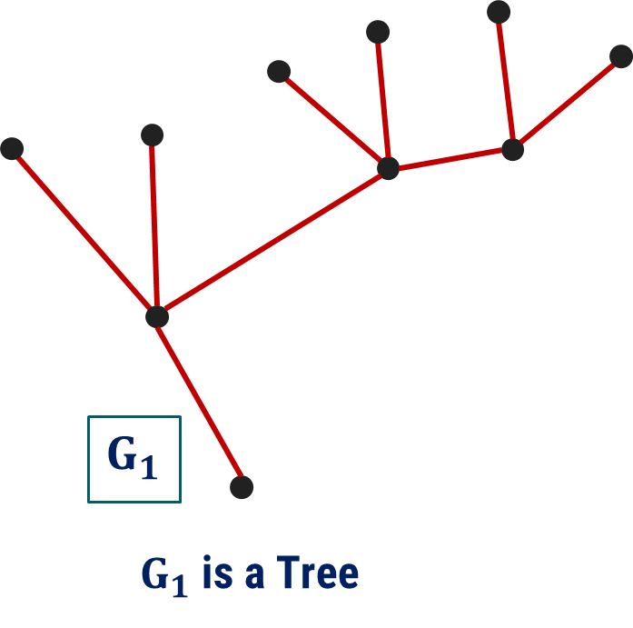
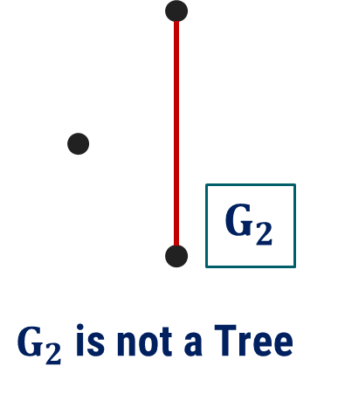
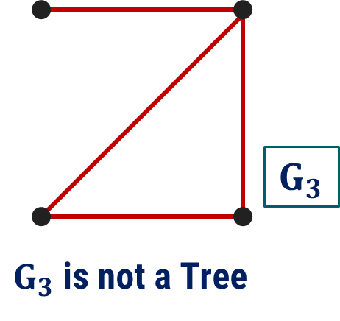
Tree
Definition: A tree is a connected graph with no cycles.
(Disconnected Graph)
(Graph with circuit)

Slide 7
Remarks on Trees
Some authors allow a null tree (no vertices).
In this course, we consider finite trees with at least one vertex.
A tree is a simple graph.
We will not discuss rooted trees in this course, as you have already studied them in Data Structures.
Any unrooted tree can be converted into a rooted tree by choosing any vertex as root.
Applications of Trees:
  Trees used in data structures (searching, sorting).
  Hierarchical real-world systems.

Slide 8
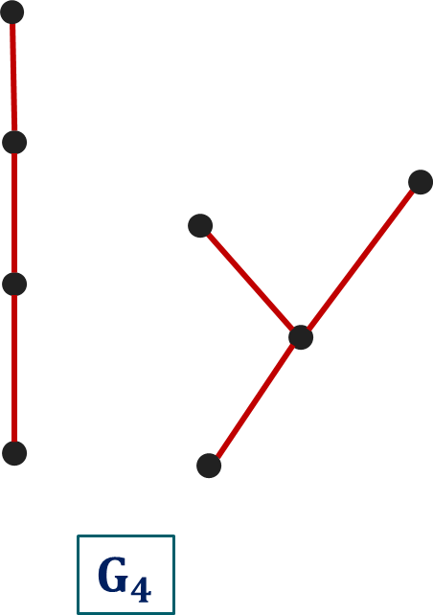

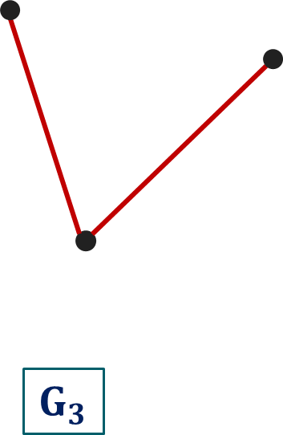

Trees with one, two, three, and four vertices
How many different trees are possible? (Non-isomorphic)

Slide 9
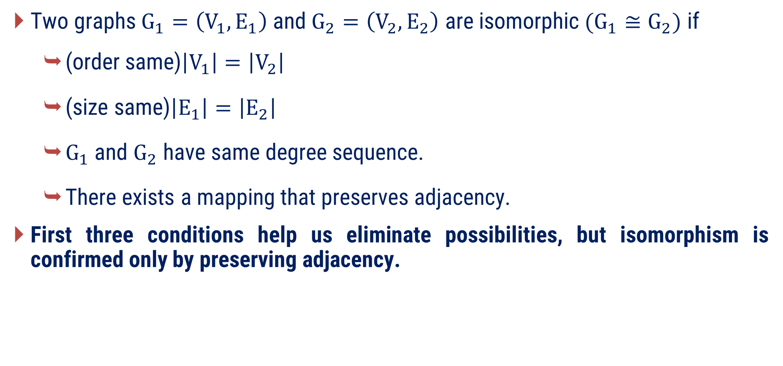
Recall: Graph Isomorphism
Two graphs $G_{1}=\left(V_{1}, E_{1}\right)$ and $G_{2}=\left(V_{2}, E_{2}\right)$ are isomorphic$(G_{1}≅G_{2})$ if
  (order same)$\left|V_{1}\right|=\left|V_{2}\right|$
  (size same)$\left|E_{1}\right|=\left|E_{2}\right|$
  $G_{1}$ and $G_{2}$ have same degree sequence.
  There exists a mapping that preserves adjacency.
First three conditions help us eliminate possibilities, but isomorphism is confirmed only by preserving adjacency.

Slide 10
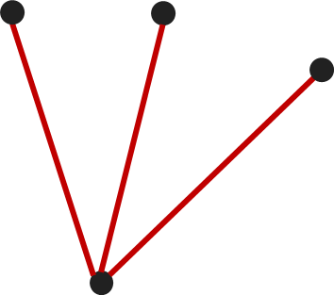
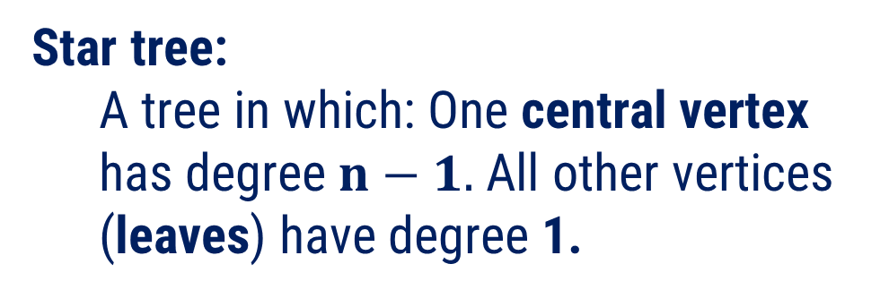
Special type tree
Path tree:
A tree in which: All internal vertices have degree 2. End vertices (leaves) have degree 1
Star tree:
  A tree in which: One central vertex has degree$n−1.$ All other vertices (leaves) have degree 1.
Internal vertices
leaves
central vertex
leaves

Slide 11
Examples of Special Trees
Path tree where:
  Internal vertices have degree 2
  End vertices (leaves) have degree 1
Structure: Linear chain of vertices
Construct: Path Tree (9 vertices) and Star Tree (10 vertices)

Slide 12
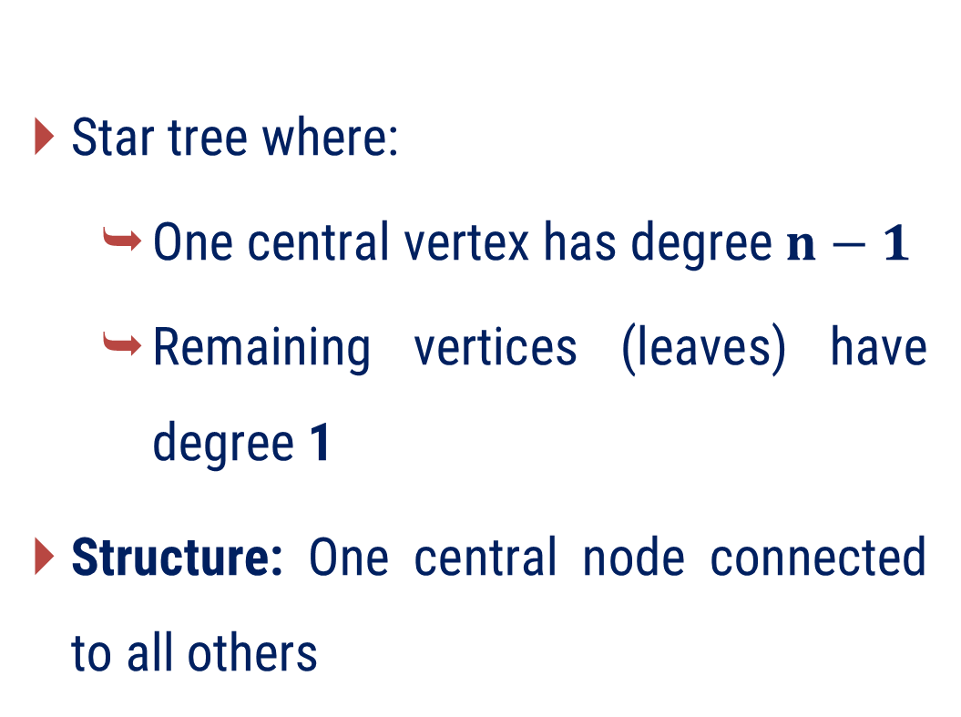
Examples of Special Trees
Star tree where:
  One central vertex has degree$n−1$
  Remaining vertices (leaves) have degree 1
Structure: One central node connected to all others
Construct: Path Tree (9 vertices) and Star Tree (10 vertices)

Slide 13
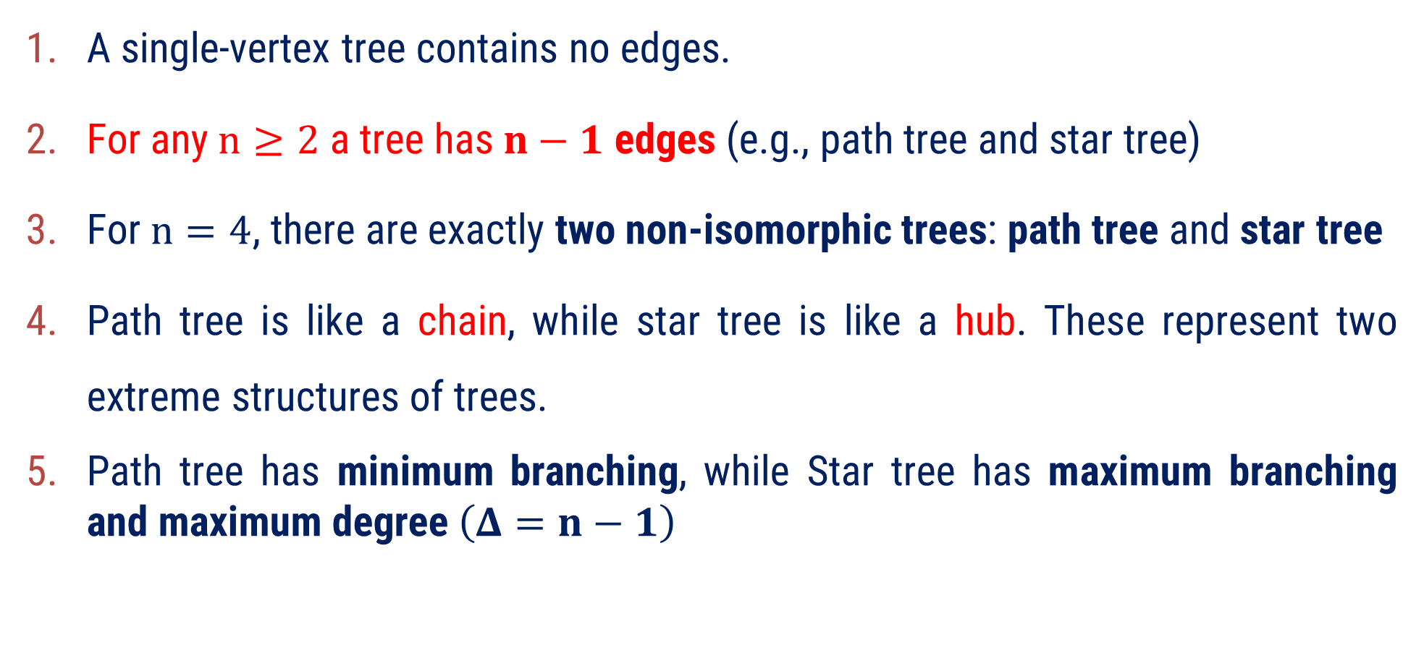
Observation
A single-vertex tree contains no edges.
For any$n≥2$ a tree has$n−1$ edges (e.g., path tree and star tree)
For $n=4$, there are exactly two non-isomorphic trees: path tree and star tree
Path tree is like a chain, while star tree is like a hub. These represent two extreme structures of trees.
Path tree has minimum branching, while Star tree has maximum branching and maximum degree$\left(Δ=n−1\right)$

Slide 14
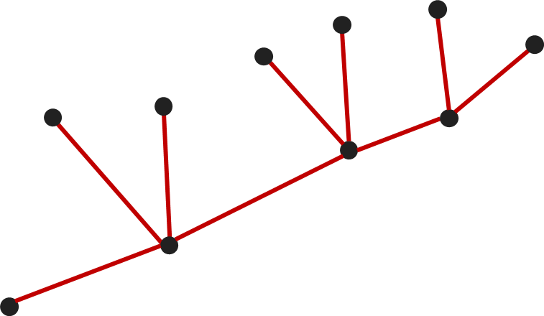
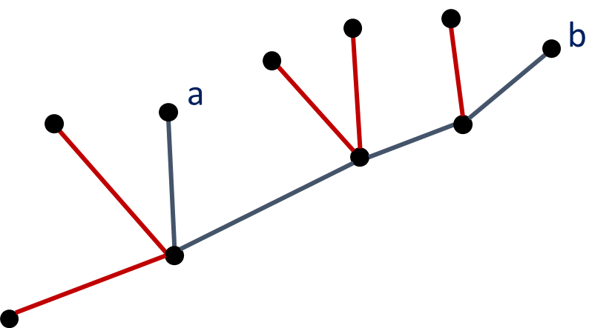
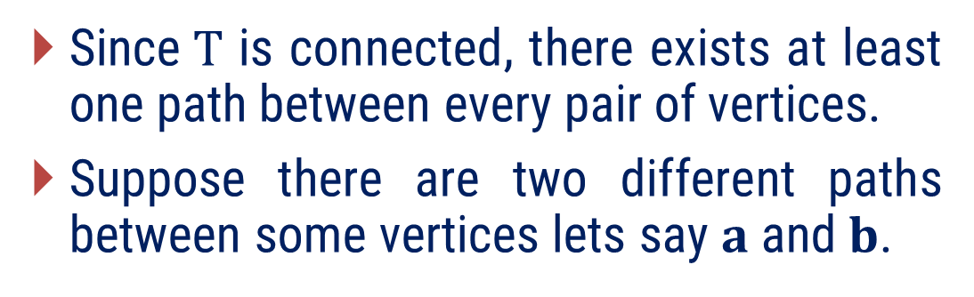
Property 1
In a tree T, there exactly one path between every pair of vertices.
Proof
Since$T$ is connected, there exists at least one path between every pair of vertices.
Suppose there are two different paths between some vertices lets say $a$ and$b$.
Then these paths form a cycle. But a tree has no cycles.
This contradicts the assumption that T is a tree.
Therefore, there is exactly one path between every pair of vertices.

Slide 15
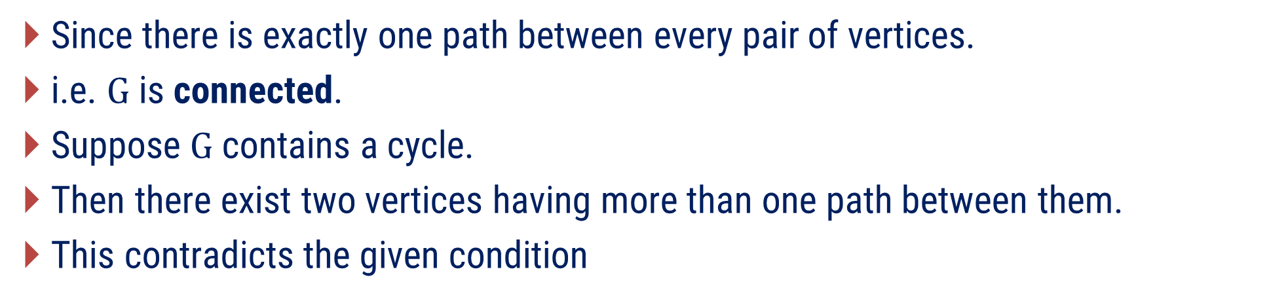
Property 2
If in a graph G, there is exactly one path between every pair of vertices, then G is a tree.
Proof
Since there is exactly one path between every pair of vertices.
i.e. $G$ is connected.
Suppose $G$ contains a cycle.
Then there exist two vertices having more than one path between them.
This contradicts the given condition

Slide 16
Minimally connected graph
A minimally connected graph is a connected graph in which removing any edge disconnects the graph.
Minimally connected
Not Minimally connected
Note: A minimally connected graph does not contain any cycles.

Slide 17
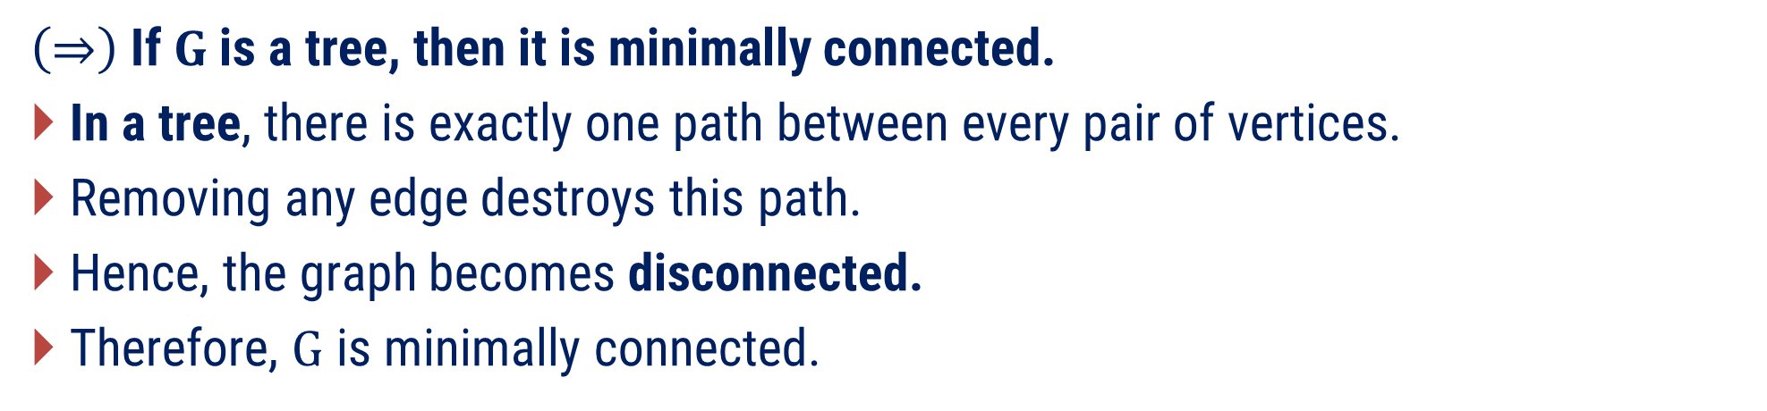
Property 3
A graph is a tree if and only if it is minimally connected.
Proof
$\left(⇒\right)$ If$G$ is a tree, then it is minimally connected.
In a tree, there is exactly one path between every pair of vertices.
Removing any edge destroys this path.
Hence, the graph becomes disconnected.
Therefore, $G$ is minimally connected.

Slide 18
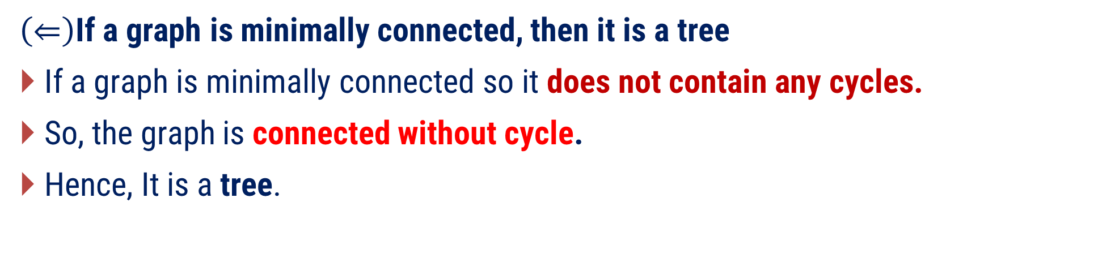
Property 3(Cont.)
A graph is a tree if and only if it is minimally connected.
Proof
$\left(⇐\right)$If a graph is minimally connected, then it is a tree
If a graph is minimally connected so it does not contain any cycles.
So, the graph is connected without cycle.
Hence, It is a tree.

Slide 19

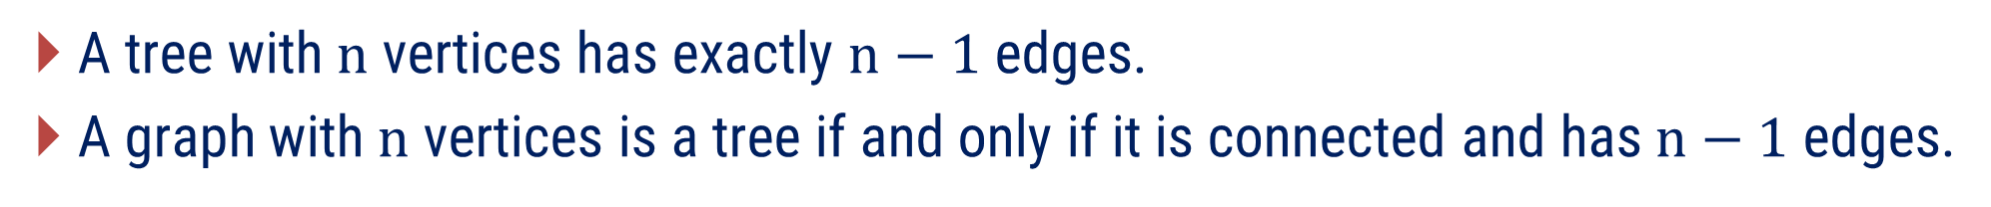
Key Results
A tree with$n$ vertices has exactly $n−1$ edges.
A graph with$n$ vertices is a tree if and only if it is connected and has $n−1$ edges.
These conditions allow us to identify a tree without checking cycles explicitly

Slide 20
Examples of Method-1

Slide 21
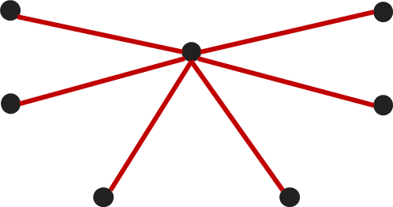
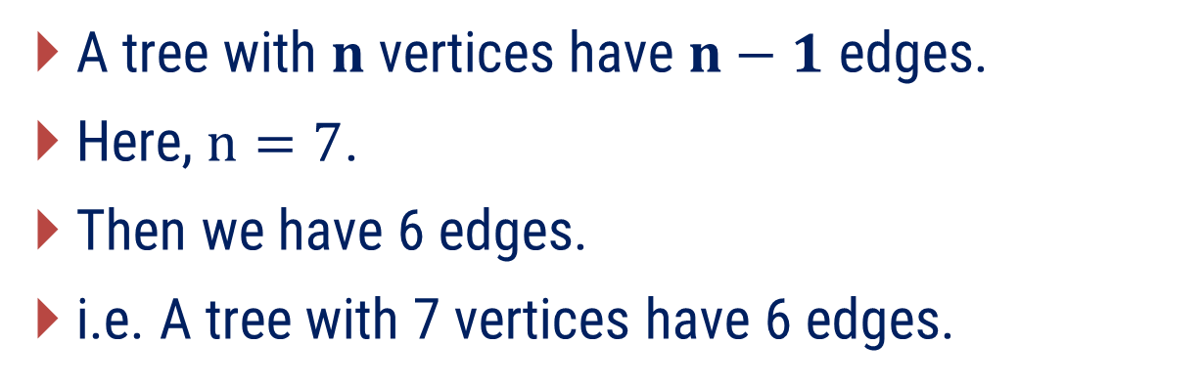
Method 1 ⇝ Example 1
How many edges does a tree with 7 vertices have? Construct such tree.
Solution
A tree with $n$ vertices have $n−1$ edges.
Here, $n=7$.
Then we have 6 edges.
i.e. A tree with 7 vertices have 6 edges.

Slide 22
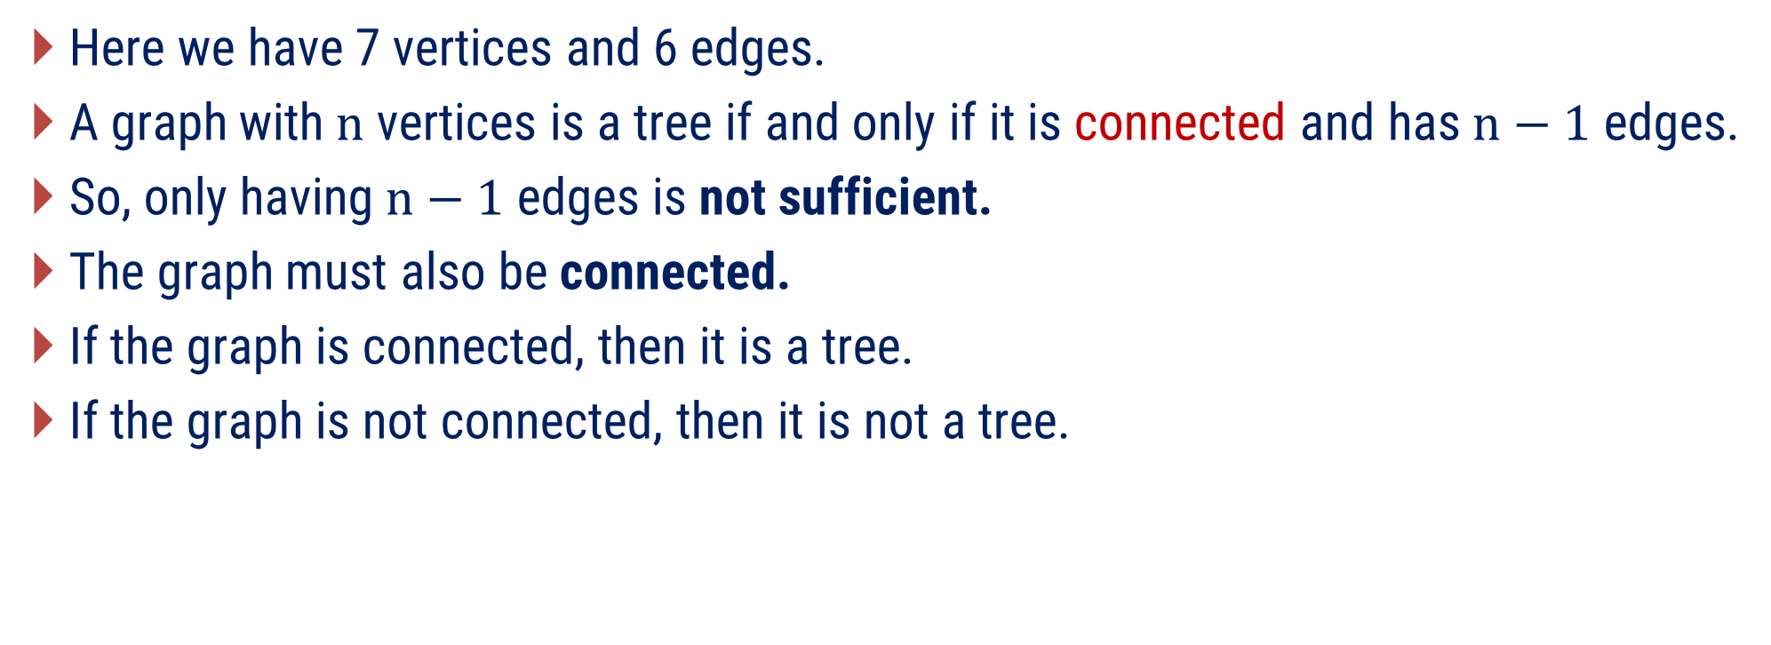
Method 1 ⇝ Example 2
A graph has 7 vertices and 6 edges. Is it a tree? Justify.
Solution
Here we have 7 vertices and 6 edges.
A graph with$n$ vertices is a tree if and only if it is connected and has $n−1$ edges.
So, only having$n−1$ edges is not sufficient.
The graph must also be connected.
If the graph is connected, then it is a tree.
If the graph is not connected, then it is not a tree.

Slide 23
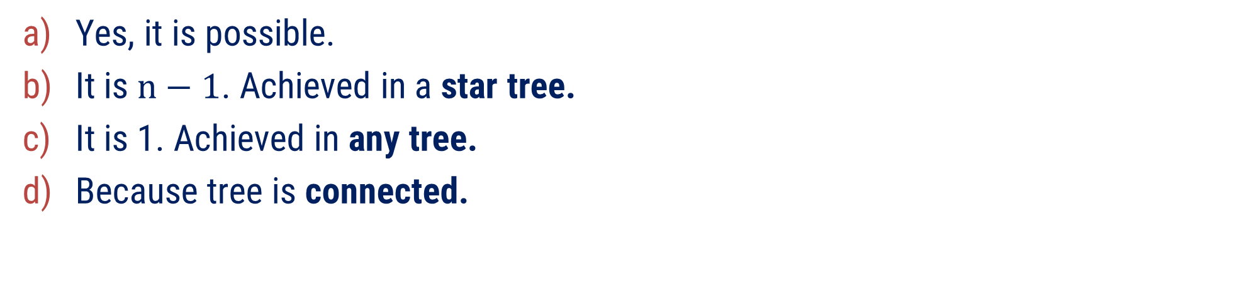
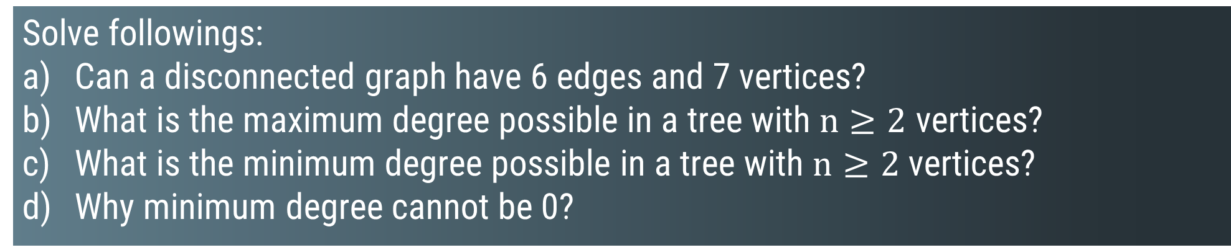
Method 1 ⇝ Example 3
Solve followings:
Can a disconnected graph have 6 edges and 7 vertices?
What is the maximum degree possible in a tree with $n≥2$ vertices?
What is the minimum degree possible in a tree with $n≥2$ vertices?
Why minimum degree cannot be 0?
Solution
Yes, it is possible.
It is $n−1$. Achieved in a star tree.
It is 1. Achieved in any tree.
Because tree is connected.

Slide 24
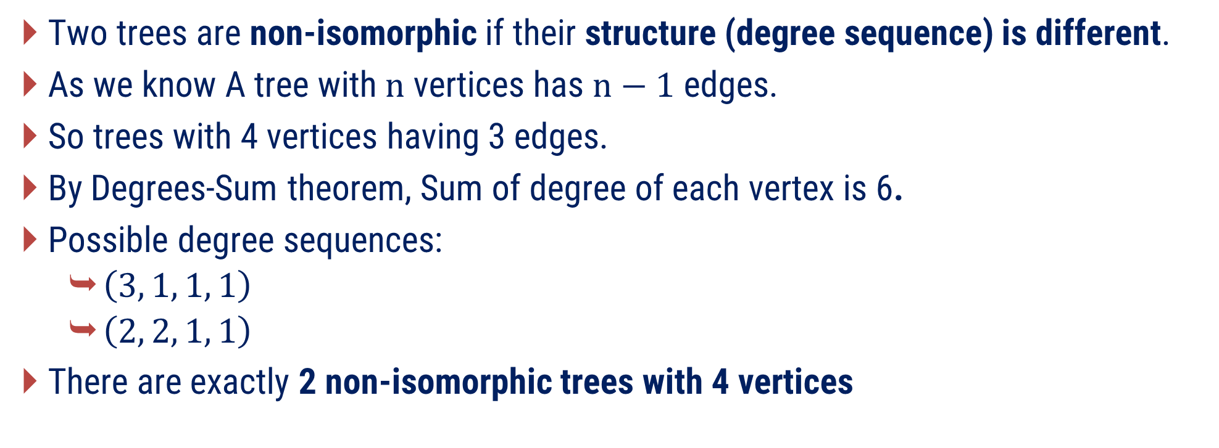
Method 1 ⇝ Example 4
Find all non-isomorphic trees with 4 vertices.
Solution
Two trees are non-isomorphic if their structure (degree sequence) is different.
As we know A tree with$n$ vertices has $n−1$ edges.
So trees with 4 vertices having 3 edges.
By Degrees-Sum theorem, Sum of degree of each vertex is 6.
Possible degree sequences:
  $\left(3, 1, 1, 1\right)$
  $\left(2, 2, 1, 1\right)$
There are exactly 2 non-isomorphic trees with 4 vertices

Slide 25
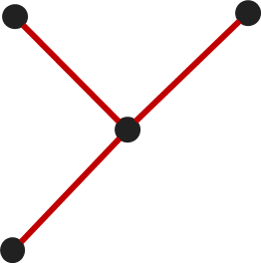
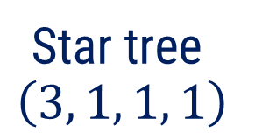
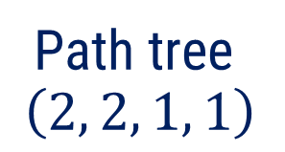
Method 1 ⇝ Example 4(Conti.)
Find all non-isomorphic trees with 4 vertices.
Solution
Path tree
$$\left(2, 2, 1, 1\right)$$
Star tree
$$\left(3, 1, 1, 1\right)$$

Slide 26
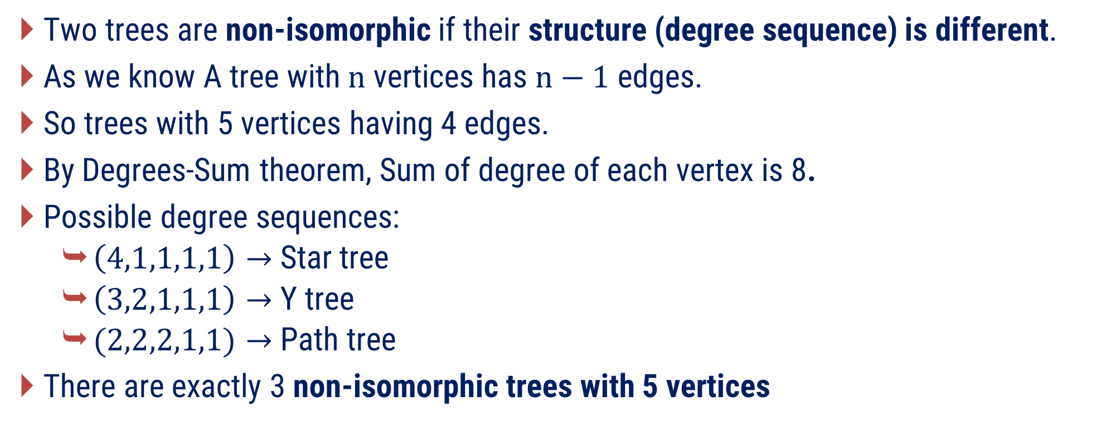
Method 1 ⇝ Example 5
Find all non-isomorphic trees with 5 vertices.
Solution
Two trees are non-isomorphic if their structure (degree sequence) is different.
As we know A tree with$n$ vertices has $n−1$ edges.
So trees with 5 vertices having 4 edges.
By Degrees-Sum theorem, Sum of degree of each vertex is 8.
Possible degree sequences:
  $\left(4,1,1,1,1\right)→$Star tree
  $\left(3,2,1,1,1\right)→$Y tree
  $(2,2,2,1,1)→$Path tree
There are exactly 3 non-isomorphic trees with 5 vertices

Slide 27


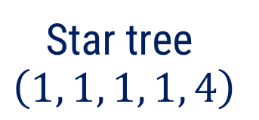
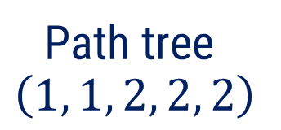
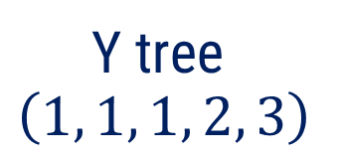
Method 1 ⇝ Example 5(Conti.)
Find all non-isomorphic trees with 5 vertices.
Solution
Path tree
$$\left(1, 1, 2, 2, 2\right)$$
Star tree
$$\left(1, 1, 1, 1, 4\right)$$
Y tree
$$\left(1, 1, 1, 2, 3\right)$$

Slide 28
?
A tree has 12 vertices. Exactly one vertex has degree 5. Exactly two vertices have degree 3. All remaining vertices are leaves. Determine whether such a tree can exist. If yes, draw one example. If no, prove that it is impossible.

Slide 29
Method – 2
Pendent Vertices, Distance and Center in Trees

Slide 30
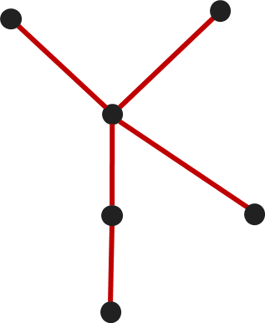
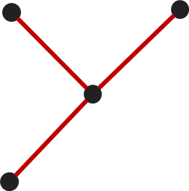
Pendent Vertices (leaf/leaves) in Trees
Definition: A pendant vertex is defined as a vertex with degree one.
2 pendant vertices
3 pendant vertices
4 pendant vertices
Observation: Is any tree with$n≥2$ vertices always has at least two leaves ?

Slide 31
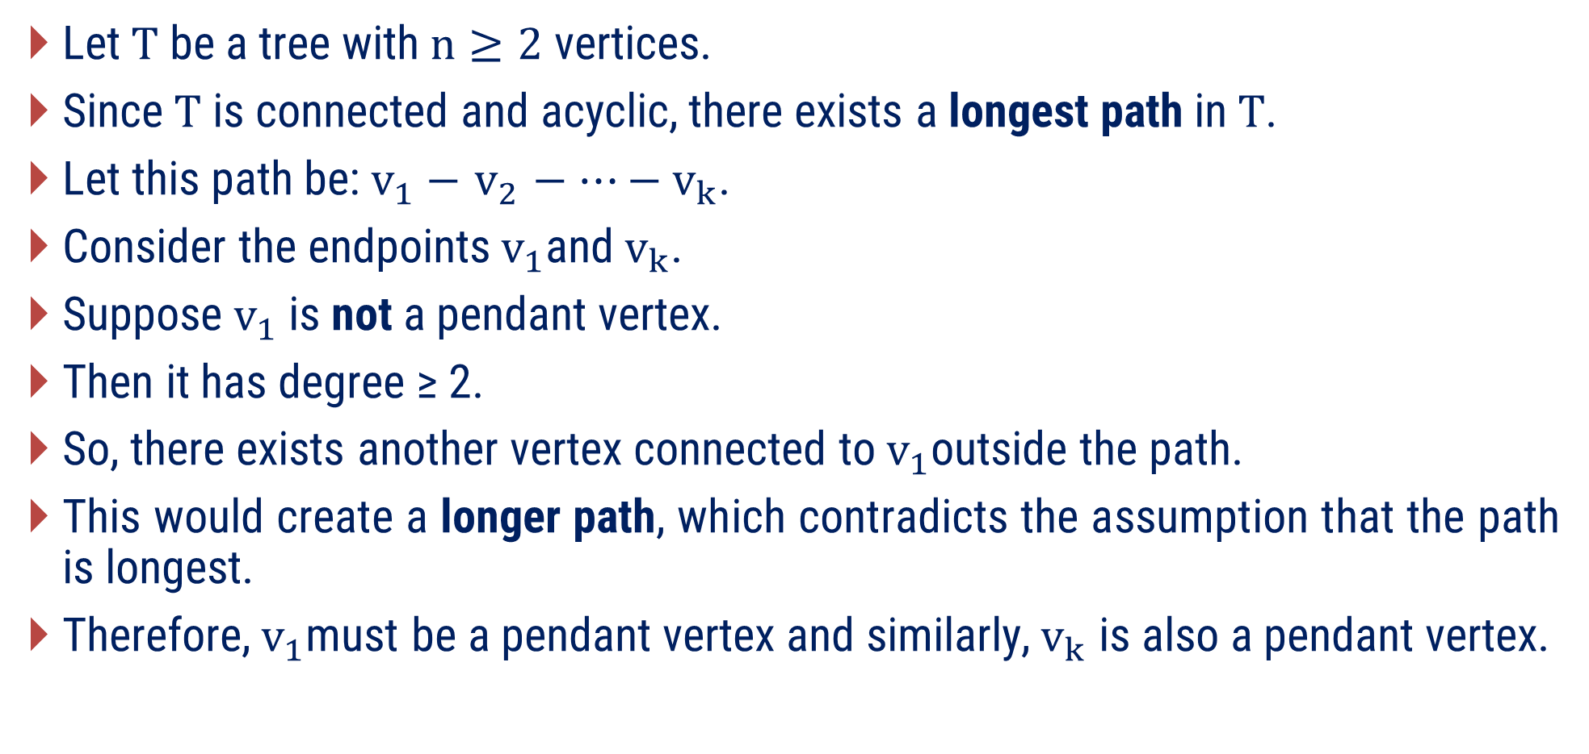
Any tree with$n≥2$ vertices always has at least two leaves.
Let$T$ be a tree with$n≥2$vertices.
Since$T$ is connected and acyclic, there exists a longest path in$T$.
Let this path be:$v_{1}− v_{2} −⋯−v_{k}$​.
Consider the endpoints$v_{1}$and$v_{k}$.​
Suppose $v_{1}$is not a pendant vertex.
Then it has degree ≥ 2.
So, there exists another vertex connected to$v_{1}$​outside the path.
This would create a longer path, which contradicts the assumption that the path is longest.
Therefore,$v_{1}$must be a pendant vertex and similarly,${ v}_{k}$ is also a pendant vertex.

Slide 32
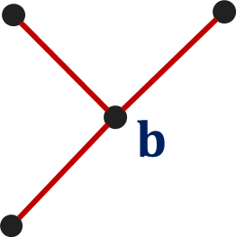
Centers of Tree
Here we have tree with four vertices.
If you look at it, vertex b appears to be more “central” than the other three vertices.
Is the center of a tree always unique?
Can a tree have more than one center?
What happens in: A path with odd length? A path with even length?
The center of a tree can be found using two methods:
  Distance Method (theoretical & formula-based)
  Leaf Pruning Method (intuitive & visual)

Slide 33
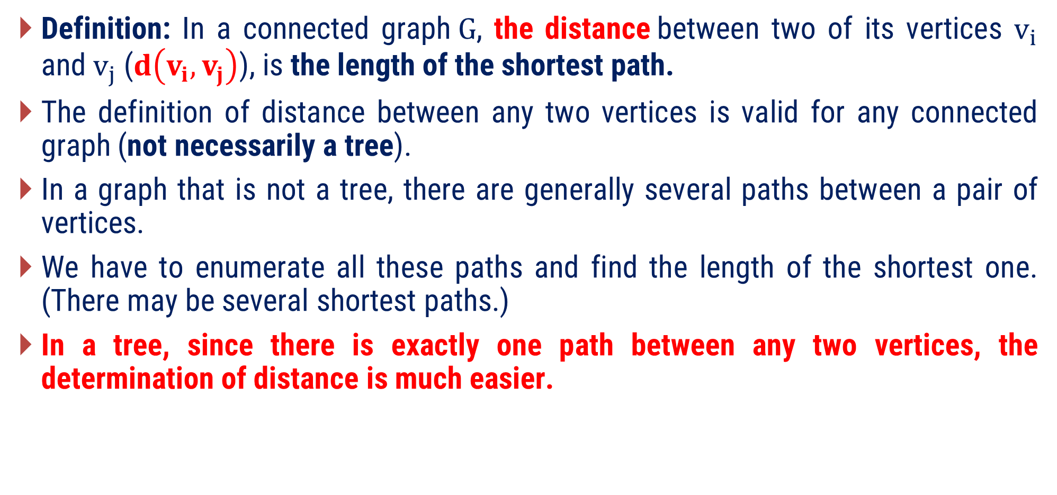
Distance And Centers in Tree
Definition: In a connected graph$G$, the distance between two of its vertices $v_{i}$ and$v_{j}$ ($d\left(v_{i}, v_{j}\right)$), is the length of the shortest path.
The definition of distance between any two vertices is valid for any connected graph (not necessarily a tree).
In a graph that is not a tree, there are generally several paths between a pair of vertices.
We have to enumerate all these paths and find the length of the shortest one. (There may be several shortest paths.)
In a tree, since there is exactly one path between any two vertices, the determination of distance is much easier.

Slide 34
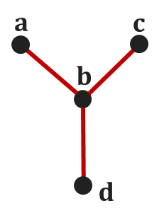

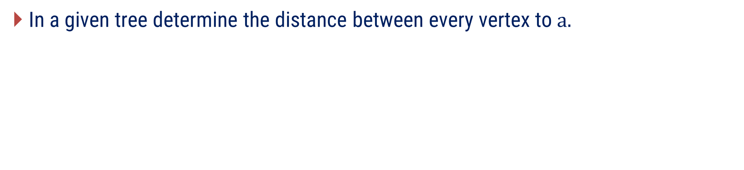



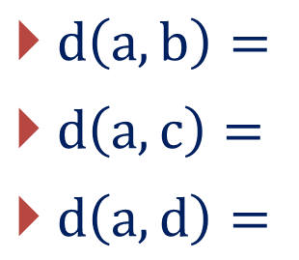
Example : Distance in a tree
In a given tree determine the distance between every vertex to$a.$
$$a$$
$$c$$
$$b$$
$$d$$
$d\left(a, b\right)=$
$d\left(a, c\right)=$
$d\left(a, d\right)=$
1
2
2

Slide 35
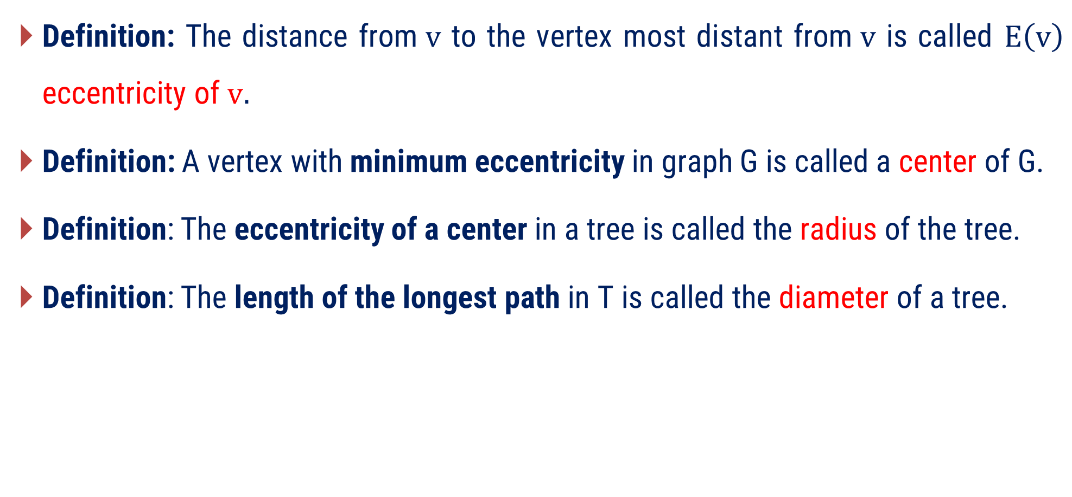
Important terms
Definition: The distance from$v$ to the vertex most distant from$v$ is called $E\left(v\right)$ eccentricity of $v.$
Definition: A vertex with minimum eccentricity in graph G is called a center of G.
Definition: The eccentricity of a center in a tree is called the radius of the tree.
Definition: The length of the longest path in T is called the diameter of a tree.

Slide 36
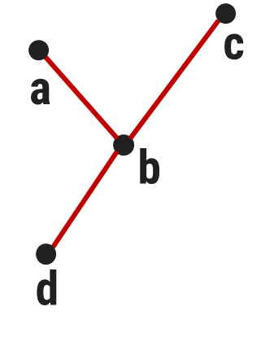










Example
In the given tree,
Center of tree =
Radius of tree =
Diameter of tree =
$$E\left(a\right)=$$
$$2,$$
$$E\left(b\right)=$$
$$1,$$
$$E\left(c\right)=$$
$$2,$$
$$E\left(d\right)=$$
$$2$$
$$d\left(a,b\right)=1, d\left(a,c\right)=2, d\left(a,d\right)=2$$
$$d\left(b,c\right)=1, d\left(b,d\right)=1$$
$$d\left(c,d\right)=2$$
b (vertex with minimum eccentricity)
1 (eccentricity of center)
2 (maximum of eccentricity)

Slide 37
Leaf Pruning Method (intuitive & visual)
The center of a tree is found by removing leaves layer by layer.
Steps:
Remove all pendant vertices.
Repeat the process on the remaining tree.
Continue until:
  Only 1 vertex remains → 1 center
  Or 2 vertices remain → 2 centers

Slide 38
Find Center of tree using algorithm
  We use iterative leaf pruning for finding center of tree
l
  Step 1: Remove all pendant vertices
  Step 2 : Repeat the process on the remaining tree.
  So, d is center of tree.
m
k
g
j
n
a
b
c
d
e
f
i
h

Slide 39
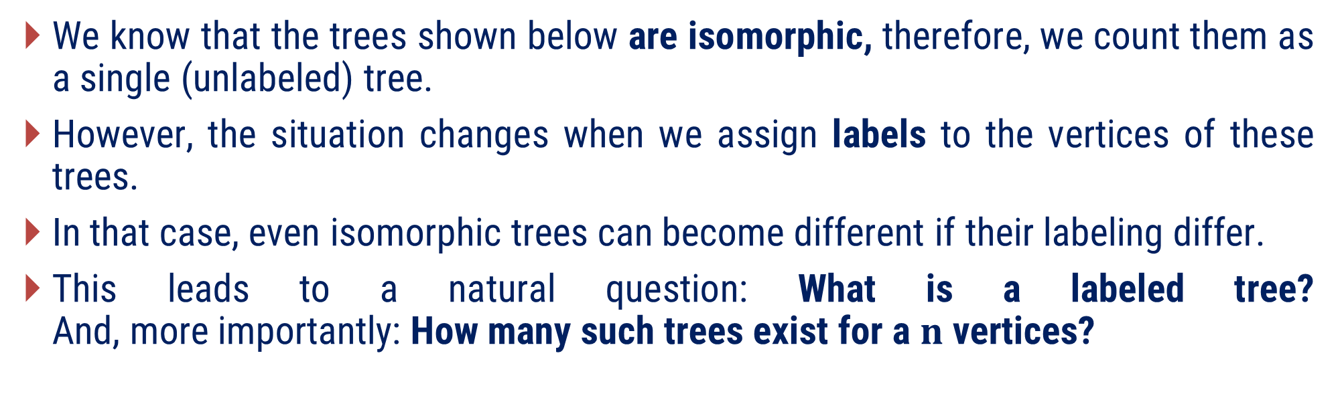
ON COUNTING TREES
We know that the trees shown below are isomorphic, therefore, we count them as a single (unlabeled) tree.
However, the situation changes when we assign labels to the vertices of these trees.
In that case, even isomorphic trees can become different if their labeling differ.
This leads to a natural question: What is a labeled tree?
And, more importantly: How many such trees exist for a $n$ vertices?
B
D
D
B
C
A
C
A

Slide 40
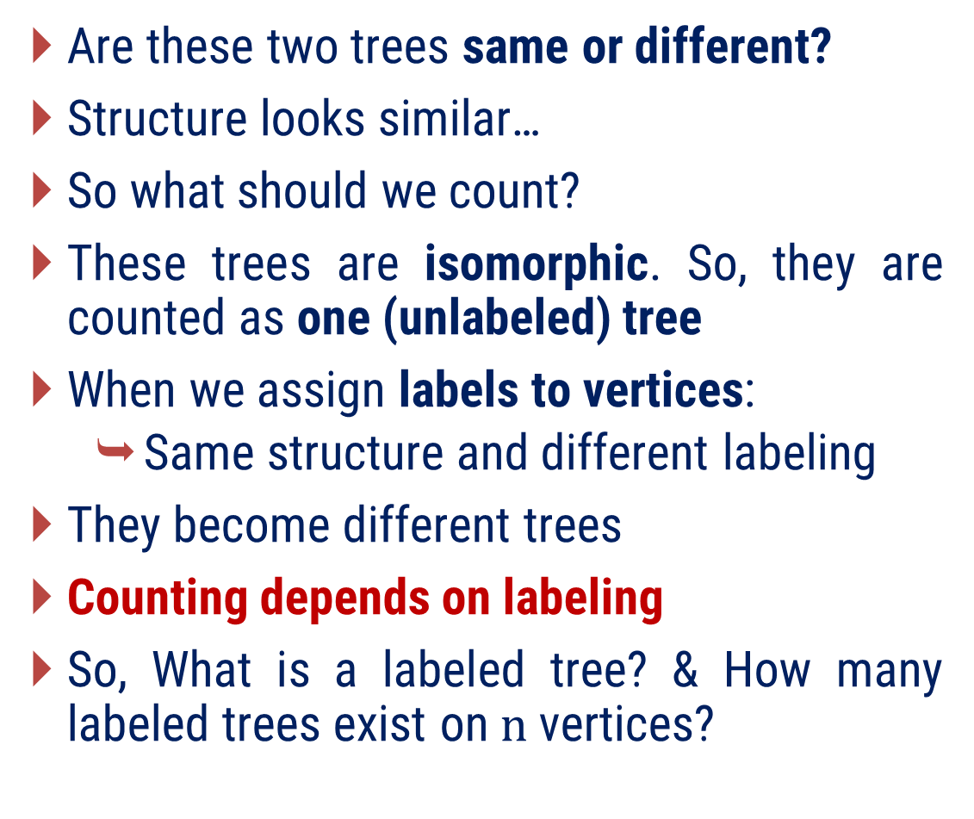
ON COUNTING TREES
Are these two trees same or different?
Structure looks similar…
So what should we count?
These trees are isomorphic. So, they are counted as one (unlabeled) tree
When we assign labels to vertices:
  Same structure and different labeling
They become different trees
Counting depends on labeling
So, What is a labeled tree? & How many labeled trees exist on$n$ vertices?
D
B
D
B
C
A
C
A

Slide 41
ON COUNTING TREES
A graph in which each vertex has a unique label (no two vertices have the same label) is called a labeled graph.
Difference between: Labeled graph & Unlabeled graph is very important in counting graphs
We now study a fundamental result for counting trees:
Cayley’s Theorem: The number of labeled trees with$n$ vertices$(n≥2)$ is$n^{n−2}$.

Slide 42

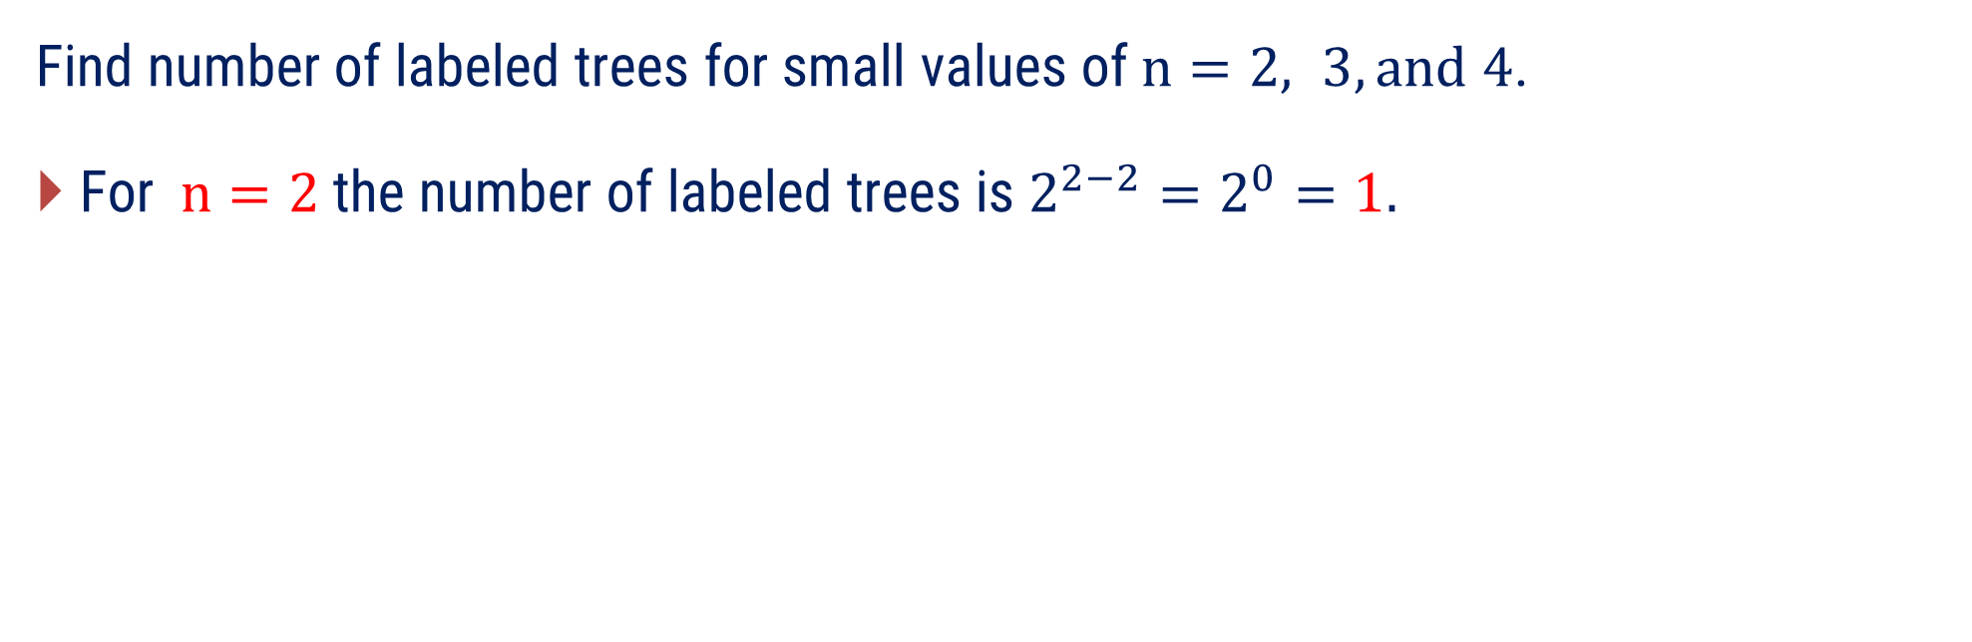
Counting Labeled Trees
Find number of labeled trees for small values of$n=2, 3, and 4$.
For$n=2$ the number of labeled trees is $2^{2−2}=2^{0}=1.$
$$n=2⇒\text{number} \text{of} \text{labeled} \text{trees}=1$$
A
B

Slide 43


Counting Labeled Trees
Find number of labeled trees for small values of$n=2, 3, and 4$.
For$n=3$ the number of labeled trees is $3^{3−2}=3^{1}=3.$
$$n=3⇒\text{number} \text{of} \text{labeled} \text{trees}=3$$
A
B
A
B
A
B
C
C
C

Slide 44
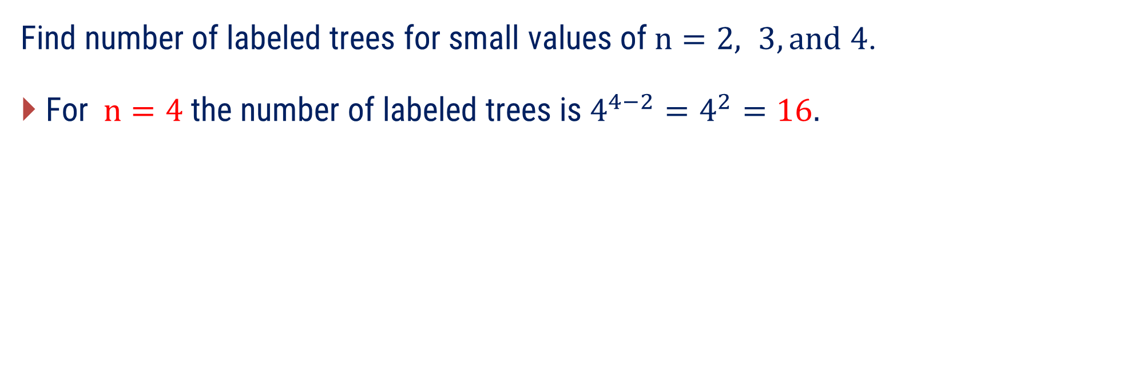
Counting Labeled Trees
Find number of labeled trees for small values of$n=2, 3, and 4$.
For$n=4$ the number of labeled trees is $4^{4−2}=4^{2}=16.$

Slide 45
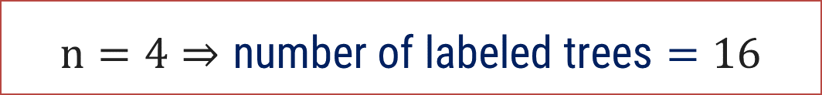
$$\text{Counting} \text{Labeled} \text{Trees}$$
$$n=4⇒\text{number} \text{of} \text{labeled} \text{trees}=16$$
A
B
A
B
A
B
A
B
C
D
C
D
C
D
C
D
A
B
A
B
A
B
A
B
C
D
C
D
C
D
C
D

Slide 46
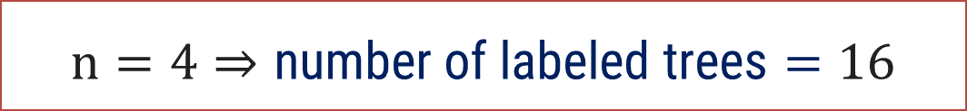
$$\text{Counting} \text{Labeled} \text{Trees}$$
$$n=4⇒\text{number} \text{of} \text{labeled} \text{trees}=16$$
A
B
A
B
A
B
A
B
C
D
C
D
C
D
C
D
A
B
A
B
A
B
A
B
C
D
C
D
C
D
C
D

Slide 47
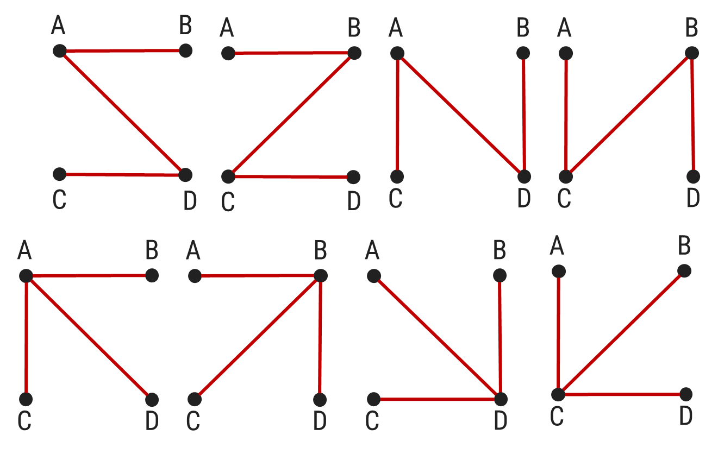
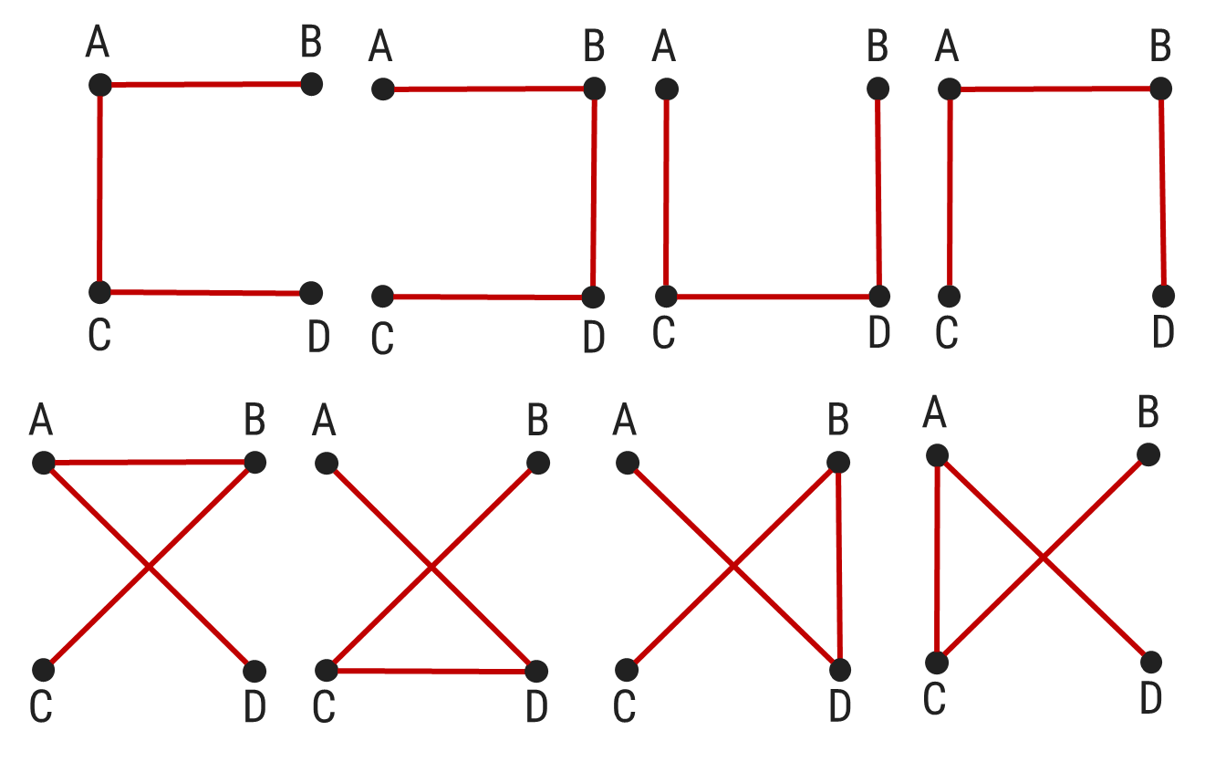
$$\text{Counting} \text{Labeled} \text{Trees}$$
$$n=4⇒\text{number} \text{of} \text{labeled} \text{trees}=16$$

Slide 48
Examples of Method-2

Slide 49
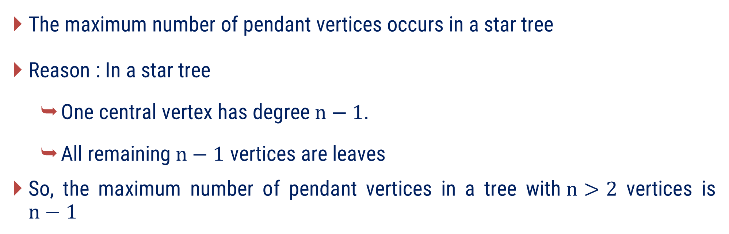
Method 2 ⇝ Example 1
What is the maximum number of pendant vertices in a tree with$n>2$ vertices? justify
Solution
The maximum number of pendant vertices occurs in a star tree
Reason : In a star tree
  One central vertex has degree$n−1$.
  All remaining$n−1$ vertices are leaves
So, the maximum number of pendant vertices in a tree with$n>2$ vertices is $n−1$

Slide 50










































Method 2 ⇝ Example 2
For following tree find the distance between two vertices, Eccentricity, Radius, Diameter, Center.
Solution
$$d\left(a,b\right)$$
$$=4$$
$$d\left(a,c\right)$$
$$=1$$
$$d\left(a,d\right)$$
$$=3$$
$$d\left(a,e\right)$$
$$=3$$
$$d\left(a,f\right)$$
$$=2$$
$$d\left(a,g\right)$$
$$=3$$
$$d\left(b,c\right)$$
$$=3$$
$$d\left(b,d\right)$$
$$=1$$
$$d\left(b,e\right)$$
$$=3$$
$$d\left(b,f\right)$$
$$=2$$
$$d\left(b,g\right)$$
$$=3$$
$$d\left(c,d\right)$$
$$d\left(c,e\right)$$
$$d\left(c,f\right)$$
$$d\left(c,g\right)$$
g
d
b
$$=2$$
$$=2$$
$$=1$$
$$=2$$
$$d\left(d,e\right)$$
$$=2$$
$$d\left(d,f\right)$$
$$=1$$
$$d\left(d,g\right)$$
$$=2$$
c
f
$$d\left(e,f\right)$$
$$=1$$
$$d\left(e,g\right)$$
$$=2$$
$$d\left(f,g\right)$$
$$=1$$
a
e

Slide 51









Method 2 ⇝ Example 3
For following tree find the distance between two vertices, Eccentricity, Radius, Diameter, Center.
Solution
$$d\left(a,b\right)$$
$$=4$$
$$d\left(a,c\right)$$
$$=1$$
$$d\left(a,d\right)$$
$$=3$$
$$d\left(a,e\right)$$
$$=3$$
$$d\left(a,f\right)$$
$$=2$$
$$d\left(a,g\right)$$
$$=3$$
$$d\left(b,c\right)$$
$$=3$$
$$d\left(b,d\right)$$
$$=1$$
$$d\left(b,e\right)$$
$$=3$$
$$d\left(b,f\right)$$
$$=2$$
$$d\left(b,g\right)$$
$$=3$$
$$d\left(c,d\right)$$
$$=2$$
$$d\left(c,e\right)$$
$$=2$$
$$d\left(c,f\right)$$
$$=1$$
$$d\left(c,g\right)$$
$$=2$$
$$d\left(d,e\right)$$
$$=2$$
$$d\left(d,f\right)$$
$$=1$$
$$d\left(d,g\right)$$
$$=2$$
$$d\left(e,f\right)$$
$$=1$$
$$d\left(e,g\right)$$
$$=2$$
$$d\left(f,g\right)$$
$$=1$$
$$e\left(a\right)=$$ | $$e\left(b\right)=$$ | $$e\left(c\right)=$$ | $$e\left(d\right)=$$ | $$e\left(e\right)=$$ | $$e\left(f\right)=$$ | $$e\left(g\right)=$$
$$4$$
$$4$$
$$3$$
$$3$$
$$3$$
$$2$$
$$3$$

Slide 52





Method 2 ⇝ Example 3 (Conti.)
For following tree find the distance between two vertices, Eccentricity, Radius, Diameter, Center.
Solution
$$e\left(a\right)=4$$ | $$e\left(b\right)=4$$ | $$e\left(c\right)=3$$ | $$e\left(d\right)=3$$ | $$e\left(e\right)=3$$ | $$e\left(f\right)=2$$ | $$e\left(g\right)=3$$
A vertex with minimum eccentricity is a center of G.
  So, $f$ is center.
  Radius$\left(r\right)$ of tree is eccentricity of center.
  So, $e\left(f\right)=r=2$.
  Diameter$\left(D\right)$ of tree is maximum of eccentricity.
  So, $e\left(a\right)=D=4$.

Slide 53

Method 2 ⇝ Example 4
Give a counterexample to show that radius is not necessarily half of the diameter in a tree.
Solution
  Let’s consider a tree where
  $$radius ≠\frac{diameter}{2}$$

Slide 54

















































Method 2 ⇝ Example 4(Cont.)
Solution
Here, we have
$$d\left(a,b\right)$$
$$=1$$
$$d\left(a,c\right)$$
$$=2$$
$$d\left(a,d\right)$$
$$=3$$
$$d\left(a,e\right)$$
$$=3$$
$$d\left(a,f\right)$$
$$=4$$
$$d\left(a,g\right)$$
$$=5$$
$$d\left(b,c\right)$$
$$=1$$
$$d\left(b,d\right)$$
$$=2$$
$$d\left(b,e\right)$$
$$=2$$
$$d\left(b,f\right)$$
$$=3$$
$$d\left(b,g\right)$$
$$=4$$
$$d\left(c,d\right)$$
$$=1$$
$$d\left(c,e\right)$$
$$=1$$
$$d\left(c,f\right)$$
$$=2$$
$$d\left(c,g\right)$$
$$=3$$
$$d\left(d,e\right)$$
$$=2$$
$$d\left(d,f\right)$$
$$=3$$
$$d\left(d,g\right)$$
$$=4$$
$$d\left(e,f\right)$$
$$=1$$
$$d\left(e,g\right)$$
$$=2$$
$$d\left(f,g\right)$$
$$=1$$
$$e\left(a\right)=$$ | $$e\left(b\right)=$$ | $$e\left(c\right)=$$ | $$e\left(d\right)=$$ | $$e\left(e\right)=$$ | $$e\left(f\right)=$$ | $$e\left(g\right)=$$
$$5$$
$$4$$
$$3$$
$$4$$
$$3$$
$$4$$
$$5$$

Slide 55













Method 2 ⇝ Example 3
Solution
$$e\left(a\right)=$$ | $$e\left(b\right)=$$ | $$e\left(c\right)=$$ | $$e\left(d\right)=$$ | $$e\left(e\right)=$$ | $$e\left(f\right)=$$ | $$e\left(g\right)=$$
$$5$$
$$4$$
$$3$$
$$4$$
$$3$$
$$4$$
$$5$$
  So, c and e are center.
  Radius$\left(r\right)$ of tree is eccentricity of center.
  So, $e\left(c\right)=e\left(e\right)=r=3$.
  Diameter$\left(D\right)$ of tree is maximum of eccentricity.
  So, $e\left(a\right)=e\left(g\right)=D=5$.
  Hence , $r≠\frac{D}{2}$
FYI:$r=\left\lceil \frac{D}{2}\right\rceil ,$ where$D$ is diameter.

Slide 56
?
A tree has 100 vertices. Which of the following is impossible?
A. 2 leaves, B. 25 leaves, C. 99 leaves, D. 1 leaf
You are given a tree with 1 million vertices. Finding the center by calculating all pairwise distances is too expensive. How can you find the center efficiently?
A. Always 1, B. Always 2, C. Either 1 or 2, D. Cannot be determined
A tree has diameter 11. How many centers can it have?
  A. 0, B. 1, C. 2, D. 11
A tree has 100 vertices and exactly 99 vertices of odd degree. Is this possible?
A tree T has exactly 20 vertices. Can T have: exactly 19 leaves? exactly 18 leaves? Justify your answer.
A tree has 100 vertices. Every vertex has degree either 1 or 3. How many leaves does the tree have?

Slide 57
?
A tree has exactly three leaves. Which statement is always true?
  A) Diameter passes through all three leaves
  B) One leaf is not an endpoint of any diameter
  C) Tree has two centers
  D) Radius equals diameter
Let T be a tree with diameter D and radius R. Which statement is always true?
  A) D = 2R
  B) D = 2R−1
  C) D ∈ {2R−1, 2R}
  D) D ≤ R
Let T be a tree. Remove all leaves simultaneously and repeat until one or two vertices remain. The number of rounds required equals _____________.
A tree T has 100 vertices. After one round of leaf pruning, 60 vertices remain. After the second round, 20 remain. After the third round, only 2 adjacent vertices remain. What is the diameter of T?

Slide 58
Method – 3
Introduction to Spanning Trees and Properties

Slide 59
Spanning Trees
We have learned about trees and their properties as separate graphs .
Now, we will look at trees that are part of a bigger graph (as subgraphs).
A graph can have many subgraphs, and some of them will be trees.
Among these trees, we are mainly interested in special ones called spanning trees.
Definition: A tree T is said to be a spanning tree of a connected graph G if T is a subgraphs of G and T contains all vertices of G.

Slide 60



Spanning Trees
Definition: A tree$T$ is said to be a spanning tree of a connected graph$G$ if$T$ is a subgraphs of$G$ and$T$ contains all vertices of$G$.
Spanning tree

Slide 61
Spanning tree
Remarks:
Spanning trees are the largest trees among all trees in G.
Spanning tree is defined only for a connected graph.
A connected graph G can have at least one spanning tree.
All possible spanning trees of graph G, have the same number of edges and vertices.

Slide 62
Method: Cycle Removal (Edge Deletion Method)
Steps :
Check for circuits (loops)
If the graph G has no circuits, it is already a spanning tree.
If the graph G contains circuit, select any one edge from circuit and remove it.
Repeat the process
Stop when no circuits remain
The resulting graph is connected and acyclic.

Slide 63
Find a spanning tree of a connected graph G.
Given graph is connected, contain cycles so apply Cycle Removal method for finding spanning tree of a connected graph
3
2
1
If the graph G contains circuit, select any one edge from circuit and remove it.

Slide 64
Find a spanning tree of a connected graph G.
Given graph is connected, contain cycles so apply Cycle Removal method for finding spanning tree of a connected graph
3
1
2
If the graph G contains circuit, select any one edge from circuit and remove it.

Slide 65
Find a spanning tree of a connected graph G.
Given graph is connected, and contain no cycle so graph itself is a spanning tree
Given graph is disconnected, so graph does not have a spanning tree

Slide 66

Important Term
Definition: An edge in a spanning tree T is called a branch.
Definition: An edge of G that is not in a spanning tree T is called a chord.
A connected graph of$n$ vertices and$e$edges has$n − 1$ branches.
A connected graph of$n$ vertices and$e$ edges has$e − n + 1$ chords.
Rank of a connected graph $G=n−1=$ Total number of branches
Nullity of a connected graph$G=e−n+1=$ Total number of chords
Rank + Nullity$=e=$ Total number of edges

Slide 67







Example
  Consider Graph of order $n=7$and size $e=13$ with its Spanning Tree
  (Highlighted in Green)
Branch:$\left\{c, b,h,i,j,l\right\}$
Chord:$\left\{a, d, e, f, g, k, m\right\}$
Rank of $G=7−1=6$
Nullity of$G=13−7+1=7$
Rank + Nullity$=6+7=13=e$

Slide 68
Examples of Method-3

Slide 69





Method 3 ⇝ Example 1
Find a spanning tree from the following graph.
$$G_{1}$$
$$G_{2}$$
$$G_{3}$$
Solution
For $G_{1}$
It has no circuits. $G_{1}$itself is a spanning tree.

Slide 70
Method 3 ⇝ Example 1(Cont.)
Find a spanning tree from the following graph.
$$G_{1}$$
$$G_{2}$$
$$G_{3}$$
Solution
For $G_{1}$
It has no circuits. $G_{1}$itself is a spanning tree.

Slide 71


Method 3 ⇝ Example 1(Cont.)
Solution
For $G_{2}$
  Given graph is connected, contain cycles so apply Cycle Removal method for finding spanning tree of a connected graph
If the graph G contains circuit, select any one edge from circuit and remove it.
1
Spanning tree

Slide 72



Method 3 ⇝ Example 1(Cont.)
Solution
For $G_{3}$
Given graph is connected, contain cycles so apply Cycle Removal method for finding spanning tree of a connected graph
2
1
3
Spanning tree

Slide 73










Method 3 ⇝ Example 2
For each of the following standard graphs with$n$ vertices, find the rank and nullity.
Complete graph$K_{n}$
Cycle graph$C_{n}$
Path graph$P_{n}$
Star tree$S_{n}$
Solution
According to formula Rank of connected graph G with n vertices is$n−1$
Graph
$K_{n}$
$$C_{n}$$
$$P_{n}$$
$$S_{n}$$
Rank
Number of edges
$$n−1$$
$$\frac{n\left(n−1\right)}{2}$$
$$n−1$$
$$n$$
$$n−1$$
$$n−1$$
$$n−1$$
$$n−1$$

Slide 74















Method 3 ⇝ Example 2(Cont.)
Solution
Graph | Nullity ($e−n+1$)
$$K_{n}$$
$$\frac{n\left(n−1\right)}{2}−n+1$$
$$=\frac{n^{2}−n−2n−2}{2}$$
$$=\frac{n^{2}−3n−2}{2}$$
$$=\frac{\left(n−2\right)\left(n−1\right)}{2}$$
$$C_{n}$$
$$n−n+1$$
$$=1$$
$$P_{n}$$
$$n−1−n+1$$
$$=0$$
$$S_{n}$$
$$n−1−n+1$$
$$=0$$

Slide 75













Method 3 ⇝ Example 2(Cont.)
Solution
Graph | Rank | Nullity ($e−n+1$)
$$\frac{\left(n−2\right)\left(n−1\right)}{2}$$
$$K_{n}$$
$$n−1$$
$$C_{n}$$
$$n−1$$
$$1$$
$$P_{n}$$
$$n−1$$
$$0$$
$$S_{n}$$
$$n−1$$
$$0$$

Slide 76

Method 3 ⇝ Example 3
For given graph find branch and chord with respect to spanning tree of your choice.
Solution
b
First we take spanning tree.
Consider Graph of order $n=5$ and size $e=8$ with its Spanning Tree (Highlighted in Green)
Braches: $\left\{h, c, b, d\right\}$
Chord: $\left\{a,e,f,g\right\}$
c
a
e
h
f
d
g

Slide 77


Method 3 ⇝ Example 4
Find the rank and nullity of the following graph.
Solution
Here order $n=7$and size $e=13$.
Rank$=n−1=7−1=6$
Nullity$=e−n+1=12−7+1=6$

Slide 78
Method – 4
Fundamental Circuits &
Finding all Spanning Trees of Graphs

Slide 79


Fundamental Circuits
Definition: A circuit, formed by adding a chord to a spanning tree, is called a fundamental circuit.
Consider graph with spanning tree$\left\{c, b, h, i, j, l\right\}$.
Here Branches are$c, b, h, I, j, l$ and chords are$a, d, e, f, g, m, k$.
i
k
i
k
j
j
h
h
b
f
g
l
m
f
g
l
m
b
a
e
a
e
c
c
d
d
Fundamental Circuit
$$\left\{b,c, a\right\}$$

Slide 80

Fundamental Circuits
Definition: A circuit, formed by adding a chord to a spanning tree, is called a fundamental circuit.
Consider graph with spanning tree$\left\{c, b, h, i, j, l\right\}$.
Here Branches are$c, b, h, I, j, l$ and chords are$a, d, e, f, g, m, k$.
i
k
i
k
j
j
h
h
b
f
g
l
m
f
g
l
m
b
a
e
a
e
c
c
d
d
Fundamental Circuit
$$\left\{l, j, h, b, c, d\right\}$$

Slide 81


Fundamental Circuits
How many fundamental circuits does a graph have?
  Exactly as many as the number of chords$.$
  We have eight chords: 𝐚, d, 𝐞, 𝐟, 𝐠, 𝐦, and 𝐤.
  Therefore, there are only eight fundamental circuits.
  Each fundamental circuits formed by one chord together with the branches of the tree.

Slide 82
Fundamental Circuits
Keep in mind:
A circuit is a fundamental circuit only with respect to a given spanning tree.
A given circuit may be fundamental with respect to one spanning tree, but not with respect to other spanning tree of the same graph.
Although the number of fundamental circuits in a graph is fixed.
The circuits that become fundamental change with the spanning trees.

Slide 83
FINDING ALL SPANNING TREES OF A GRAPH
In a given connected graph there are a large number of spanning trees:
To find the exact number of spanning trees, Kirchhoff's Matrix-Tree Theorem (The determinant of that minor of the Laplacian matrix is the number of spanning trees).
Here instead of this theorem we will use following procedure for finding all spanning tree of a graph.

Slide 84




PROCEDURE: Finding All Spanning Trees Of A Graph
Step 1: Start with any spanning tree of the graph. Let's say the tree is $T_{1}=\left\{e, c, h, d\right\}$.
Step 2: Add a chord to the tree. For example, add edge g. This will create a fundamental circuit — $(e, h, g, d)$.
Step 3: Remove one branch from this fundamental circuit. For example, remove edge h.
Step 4: The result is a new spanning tree, called $T_{2}$.
This method of creating a new spanning tree from an existing one by adding a chord and removing one branch from the resulting fundamental circuit is called a cyclic interchange or an elementary tree transformation.
b
c
a
e
h
f
d
g
$$T_{1}$$
$$T_{2}$$

Slide 85
Examples of Method-4

Slide 86

Method 4 ⇝ Example 1
Find any fundamental circuit with respect to spanning tree of your choice and how many such fundamental circuits following graph have.
Solution
Step 1: Start with any spanning tree of the graph.
Let's say the tree is $\left\{e, h, c,g,a\right\}$ and chord are$\left\{b,d,f,i\right\}$.
Add any chord to spanning tree we get fundamental circuit. For example add$b$ to$\left\{e, h, c,g,a\right\}$.
i.e. $\left(e,h,c,a,g,b\right)$ is fundamental circuit with respect to spanning tree $\left\{e, h, c,g,a\right\}$.
Total 4 fundamental circuits graph have.
e
f
h
i
c
d
g
a
b

Slide 87


Method 4 ⇝ Example 2
Generate any 2 spanning tree using procedure of finding all spanning tree for following graph.
Solution
Start with any spanning tree of the graph.
Let's say the tree is $\left\{e, h, c,g,a\right\}$ with chord are$\left\{b,d,f,i\right\}$ and branches are $\left\{e, h, c, g, a\right\}$.
Add a chord to the tree. For example, add edge $b$. This will create a fundamental circuit — (e, h, c, g, a, b).
Remove one branch from this fundamental circuit. For example, remove edge$a$.
The result is a new spanning tree, $\left\{\text{e}\text{, }\text{h}\text{, }\text{c}\text{, }\text{g}\text{, }\text{b}\right\}$.
e
f
h
i
c
d
g
a
b

Slide 88

Method 4 ⇝ Example 1
Generate any 2 spanning tree using procedure of finding all spanning tree for following graph.
Solution
For another spanning tree,
We add chord$d$ to spanning tree and remove branch $c$ from it.
By this cyclic interchange we get another spanning tree, $\left\{e, h, d, g, a\right\}.$
e
f
h
i
c
d
g
a
b

Slide 89
?
A connected graph G has 12 vertices and 18 edges. How many chords does any spanning tree of G contain? A. 6 B. 7 C. 8 D. 18
Suppose a connected graph has 15 edges and nullity 4. Find the rank.
  A. 10 B. 11 C. 12 D. 13
A spanning tree of a graph contains 20 branches. How many vertices does the original graph have? A. 19 B. 20 C. 21 D. Cannot be determined
A connected graph has 10 vertices and 14 edges. How many fundamental circuits are produced with respect to any spanning tree? A. 4 B. 5 C. 10 D. 14
Let T be a tree with 10 vertices. The sum of the degrees of all the vertices in T is___________.

Slide 90
?
A connected graph has 8 vertices and exactly 8 edges. Which statement must be true?
A. Graph is a tree. B. Graph contains exactly one chord with respect to any spanning tree. C. Graph contains exactly two cycles. D. Graph is complete.
A connected graph has 25 edges and 18 fundamental circuits with respect to a spanning tree. How many vertices does the graph have?
A. 7 B. 8 C. 9 D. 10
A connected graph G has exactly one spanning tree. How many fundamental circuits does G have?
A. 0 B. 1 C. n−1 D. Cannot be determined
A connected graph has 25 spanning tree branches and 10 chords. How many vertices and edges does the graph contain?

Slide 91

?
A student claims: "There exists a connected graph with 12 vertices and 40 fundamental circuits. "Is the claim possible?
There exists a connected graph with 20 vertices. Exactly 5 edges must be removed to obtain any spanning tree. How many edges does the graph contain?
A. 24
B. 25
C. 26
D. 27
A connected graph G has$n$ vertices and$2n−2$edges. For any spanning tree T, what is the ratio $\frac{Number of Branches}{Number of Chords}$​ ?

Slide 92
?
In a BGMI map, 10 safe houses are connected by underground tunnels. The game designer wants: Every safe house reachable from every other safe house. Minimum number of tunnels. No circular routes. Later, the designer adds 3 secret tunnels for special events.
Questions:
  What graph structure represents the original tunnel system?
  How many tunnels must exist initially?
  What are the 3 secret tunnels called with respect to the original structure?
  When one secret tunnel is opened, what new structure appears in the map?
  Find Rank and Nullity of this Graph.

Slide 93
Solution
Questions with solution:
  What graph structure represents the original tunnel system?
  Spanning Tree.
  How many tunnels must exist initially?
  9 tunnels
  What are the 3 secret tunnels called with respect to the original structure?
  3 Chords
  When one secret tunnel is opened, what new structure appears in the map?
  Fundamental Circuit

Slide 94
?
A crew plans a city-wide heist. The city contains 15 important locations. To avoid police detection, the crew wants: Every location reachable. Minimum number of roads used. No unnecessary loops. During the heist, police block one road. A hacker reveals a hidden road not originally used.
Questions:
  What graph structure represents the original heist plan?
  What happens when police block one road?

Slide 95
Solution
Questions with solution:
  What graph structure represents the original heist plan?
  Spanning Tree
  What happens when police block one road?
  The network becomes disconnected.

Slide 96
?
Consider a connected, simple graph G(V, E) representing a communication network with n = 8 vertices and e = 12 edges. To optimize routing, the network administrator extracts a sub graph T that spans all vertices of G.
The administrator claims that sub graph T is "minimally connected". Based on this property alone, calculate the exact number of edges in T. Explain how the "minimally connected" property theoretically guarantees that T is a tree without needing to explicitly check for the absence of cycles.
Suppose the extracted tree T has exactly 4 pendant (leaf) vertices and its diameter is 4. Determine if T has a single unique center or two centers (bi-centers). Furthermore, calculate the radius of T.
With respect to the spanning tree T, calculate the rank and nullity of the original network graph G. Deduce the exact number of tree branches and chords present in this configuration.
Determine the exact number of fundamental circuits that can be formed in G with respect to the spanning tree T.

Slide 97
Solution
A minimally connected graph on n vertices is a tree. For n = 8 vertices, T must have exactly n - 1 = 7 edges. Removing any edge from a minimally connected graph disconnects it, which means there is exactly one path between any pair of vertices; this unique path property ensures no cycles exist, effectively proving it is a tree without explicitly checking for cycles.
R=2, single center
Rank=7=Branch, Nullity=5=Chord
Since the nullity is 5, there are exactly 5 fundamental circuits.

Slide 98

B.Tech. $→5$^{th} Semester
Graph Theory (2301HS301)
THANK YOU
Prof. Punit Vadher
Department of Humanities & Science
punit.vadher@darshan.ac.in
9662443859

