Slide 1
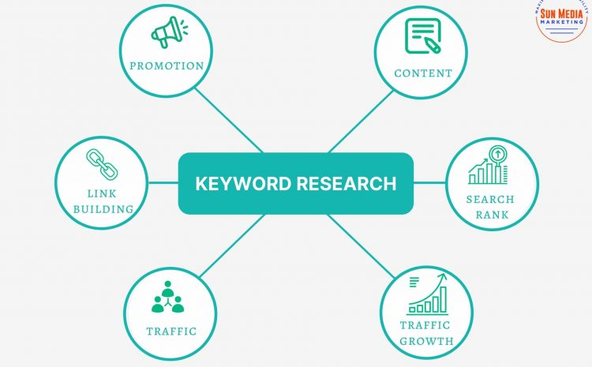
EduKeySearch
DFA-Optimized Keyword Search Engine for Intelligent Tutoring Systems Developed by Shyam Raj D, IT Department.
Name: Shyam Raj D Department: Information Technology Student ID: 7376222IT254

Slide 2


Why This Project?
With the rapid growth of online learning, educational platforms are flooded with resources.
Students often face difficulty locating specific content they need, even if it's already available.
Traditional search methods (like substring search) can be slow, inaccurate, and context-blind.
The Need
To build a smarter search system that:
Supports fast and accurate keyword detection,
Helps students instantly find relevant learning materials,
And enhances the usability and effectiveness of tutoring platforms.

Slide 3
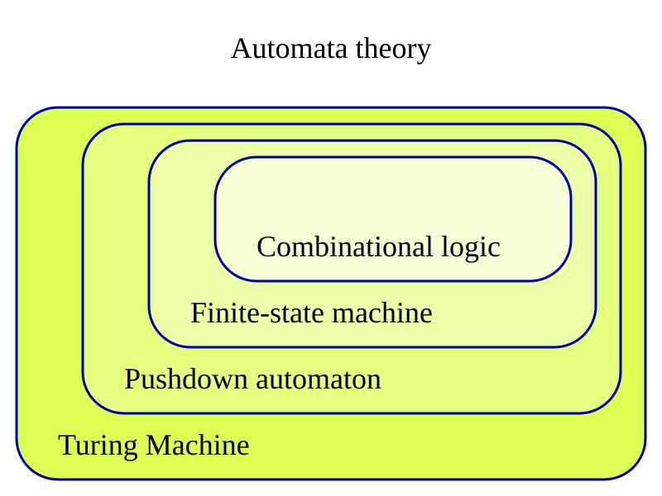
What is DFA and How is it Used?
DFA (Deterministic Finite Automaton) is a state machine-based algorithm used for pattern recognition in strings.
It processes input character by character, transitioning between predefined states to determine if a pattern exists.
How We Use DFA in This App
For each keyword a user enters, the app constructs a custom DFA.
It then scans each course title using this DFA to quickly detect keyword presence.
This method ensures consistent time complexity, regardless of input size.

Slide 4

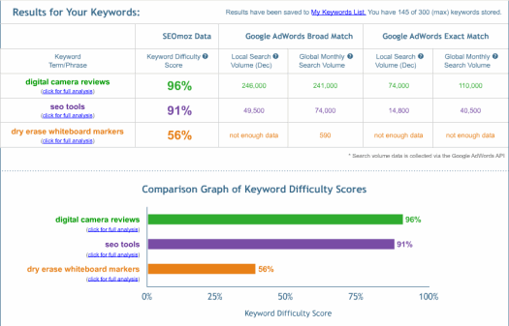
Key Highlights of EduKeySearch
Real-time keyword matching powered by DFA (Deterministic Finite Automaton) for fast and precise content discovery.
Courses are displayed using a clean and responsive card layout, each accompanied by a relevant image to enhance visual understanding.
Supports searching with one or multiple keywords, improving the accuracy and flexibility of the search results.
The interface is optimized for clarity, responsiveness, and overall learning experience, making it easy to use on both desktop and mobile devices.

Slide 5
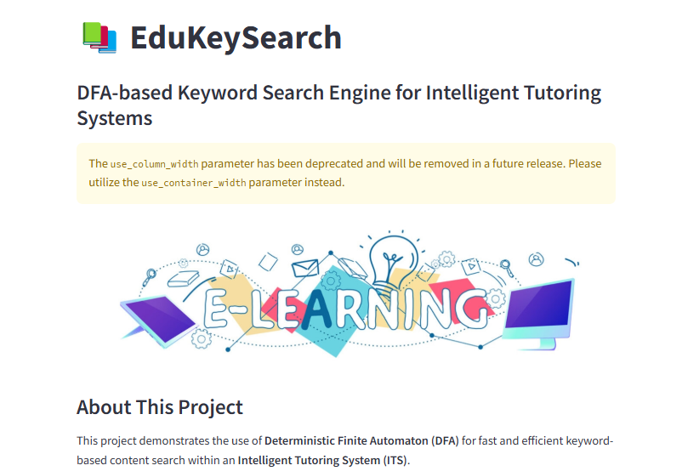
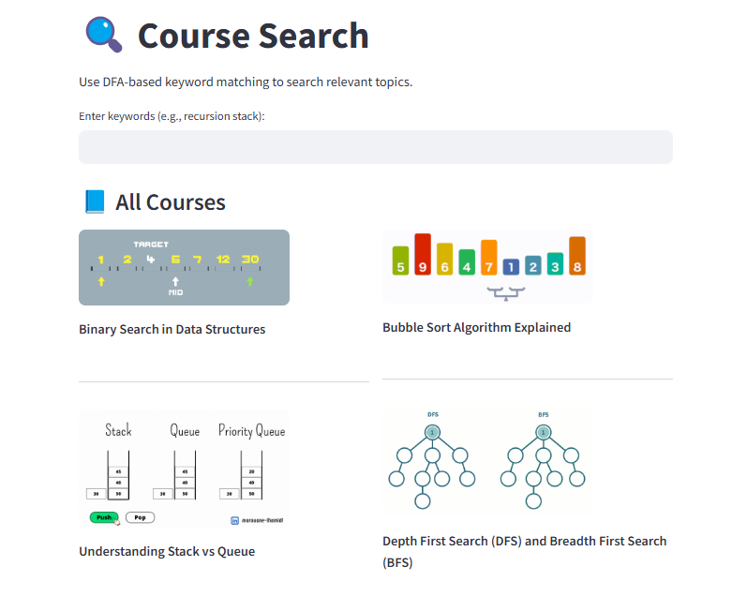
Live Project :
Link : Live_Demo
GitHub Repo : Link
Technologies Used:
Python – Core logic and backend development
Streamlit – Web app framework for building interactive Uis
PIL (Pillow) – Image processing and rendering
Requests – Fetching and displaying images from online sources
DFA Algorithm – Efficient keyword-based search using Deterministic Finite Automaton

Slide 6

Conclusion:
EduKeySearch redefines how learners discover educational content in Intelligent Tutoring Systems.By leveraging a DFA-based keyword search engine, the system offers a fast, lightweight, and intuitive way for students to access relevant materials in real time.It’s designed to be responsive, accurate, and user-centric — ideal for modern digital learning environments.
Developer Information:
Name: Shyam Raj D
Department: Information Technology
Student ID: 7376222IT254

