Slide 1
AI Platform — Sequence Diagrams
Developer Experience & RCM Domain Orchestration Flows
12 Sequence Diagrams • 6 Dev-Experience • 6 RCM Domain Workflows
Microsoft Agent Framework • Azure Container Apps • Cosmos DB • Azure OpenAI

Slide 2
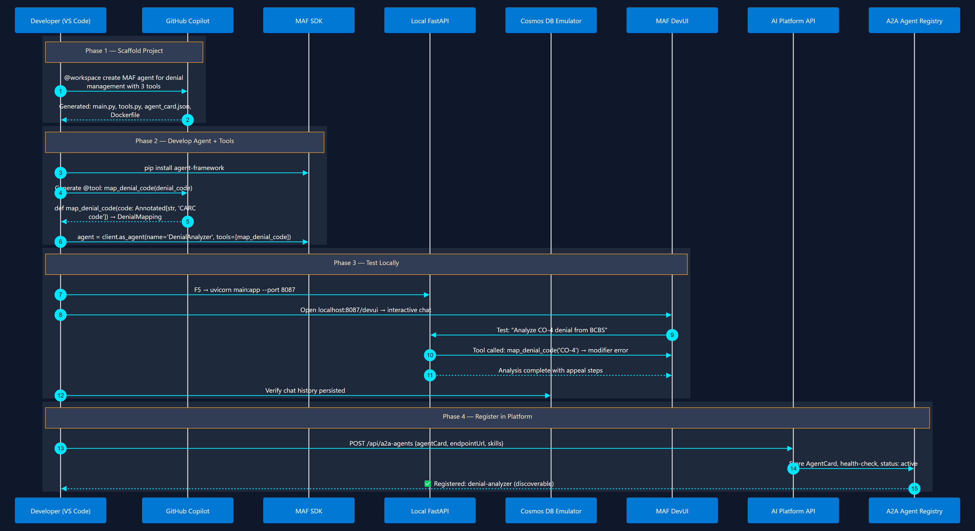
1
Agent Development Lifecycle
Scaffold → Code → Test → Register
From empty folder to a registered, discoverable A2A agent

Slide 3
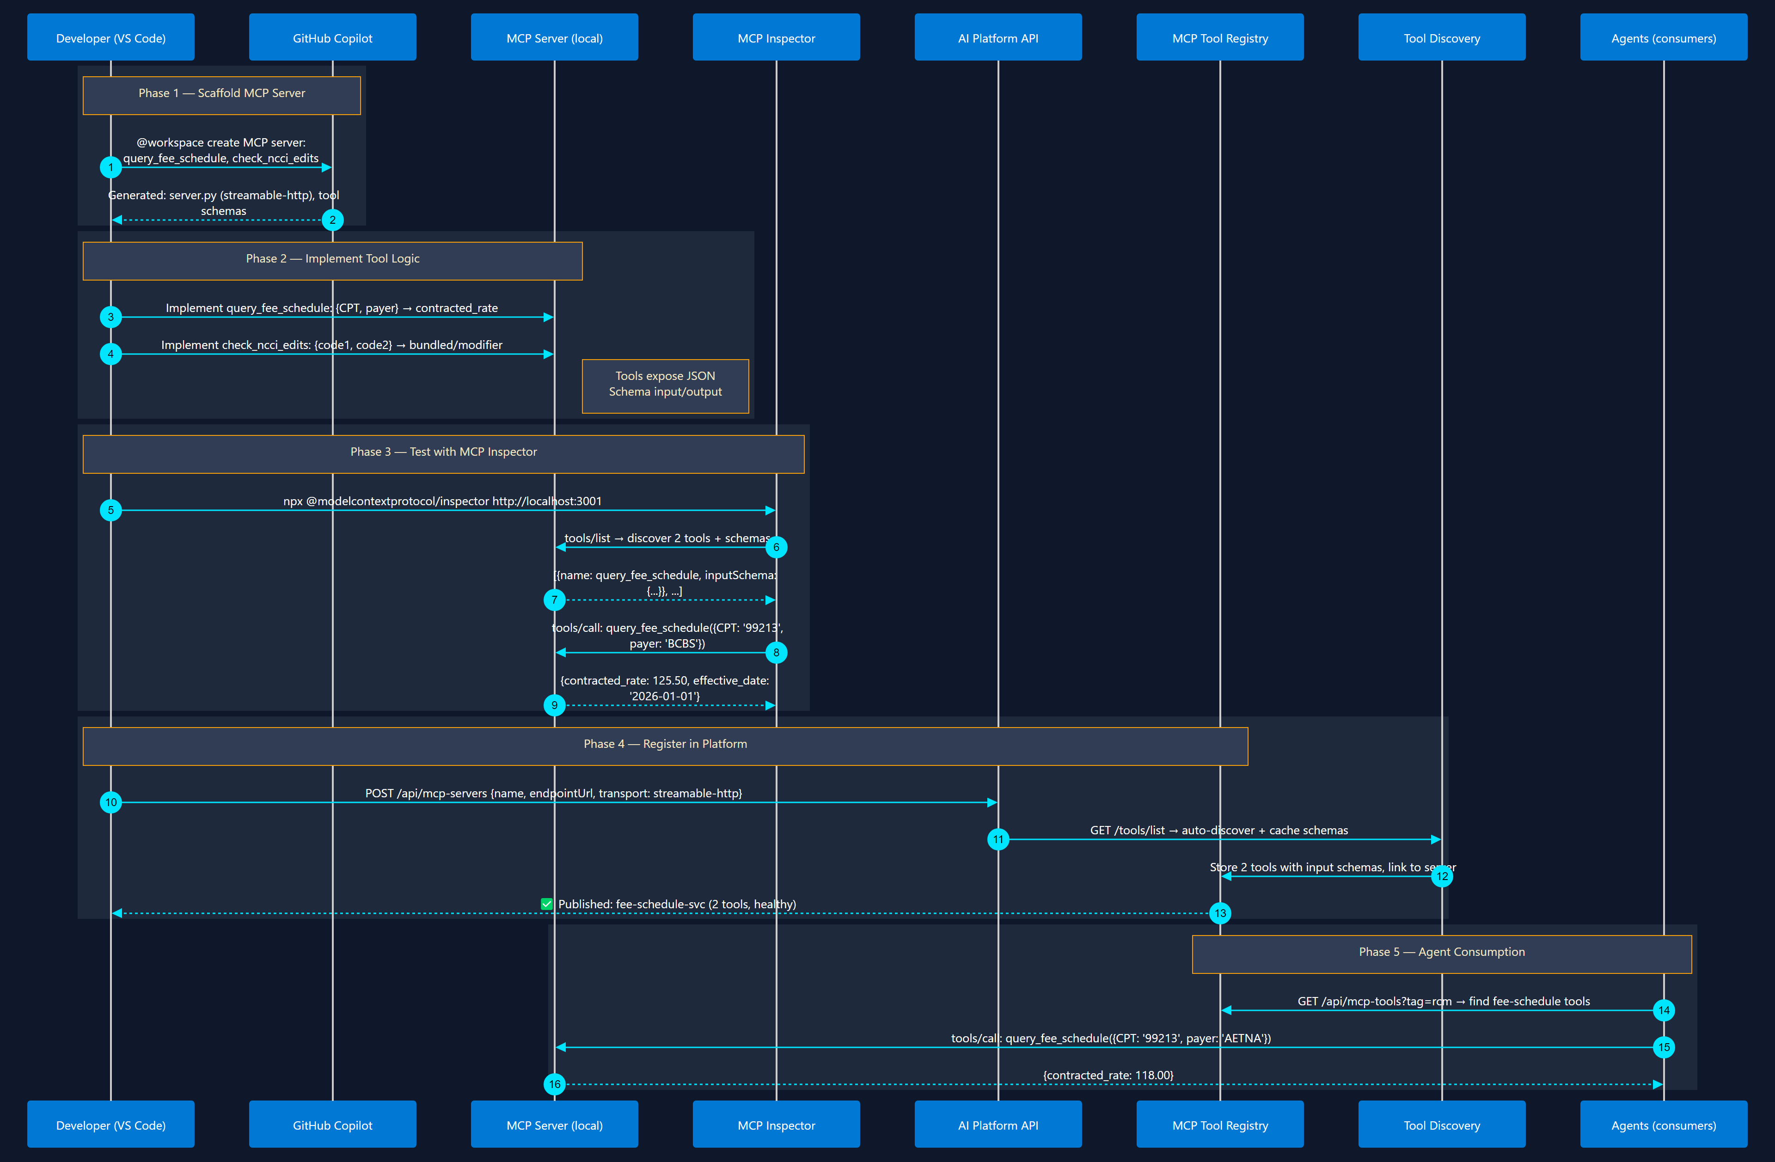
2
MCP Tool Development & Registration
Build → Test → Publish → Discover
Build tool server → test schema → publish to registry → agents discover it

Slide 4
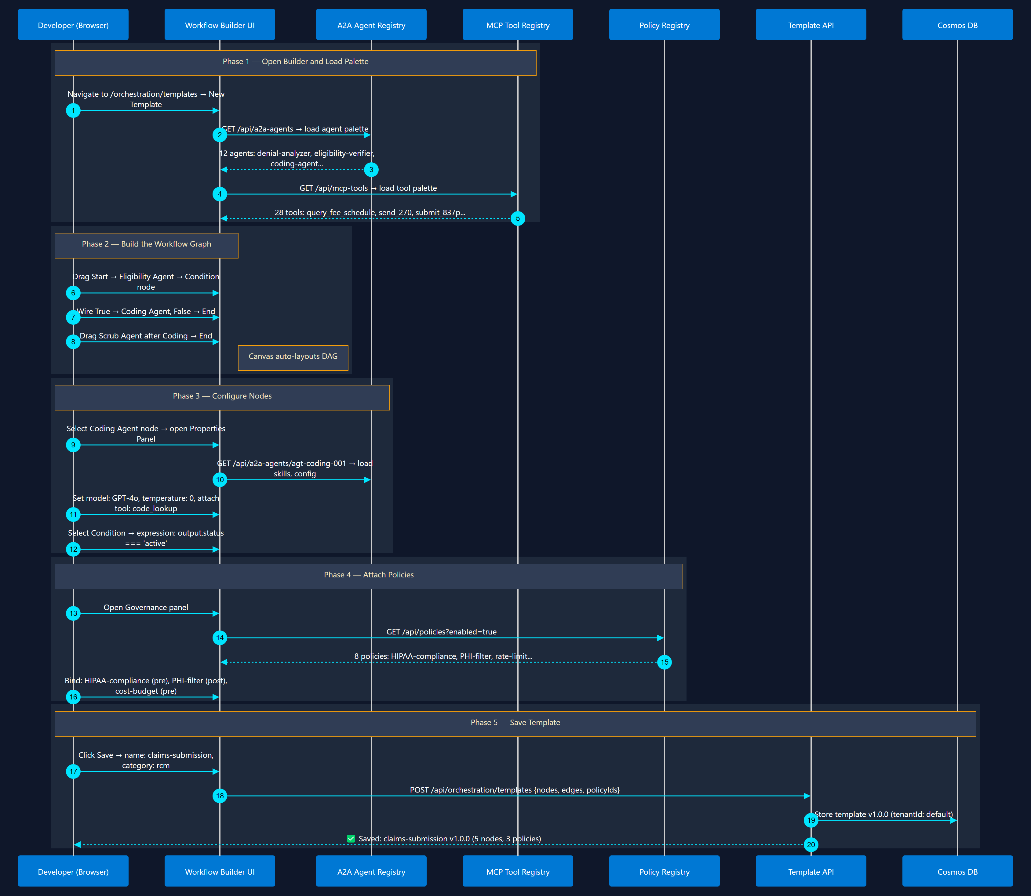
3
Orchestration Template Design
Visual Builder in Marketplace Web UI
Visual workflow builder → select agents → wire edges → attach policies → save

Slide 5
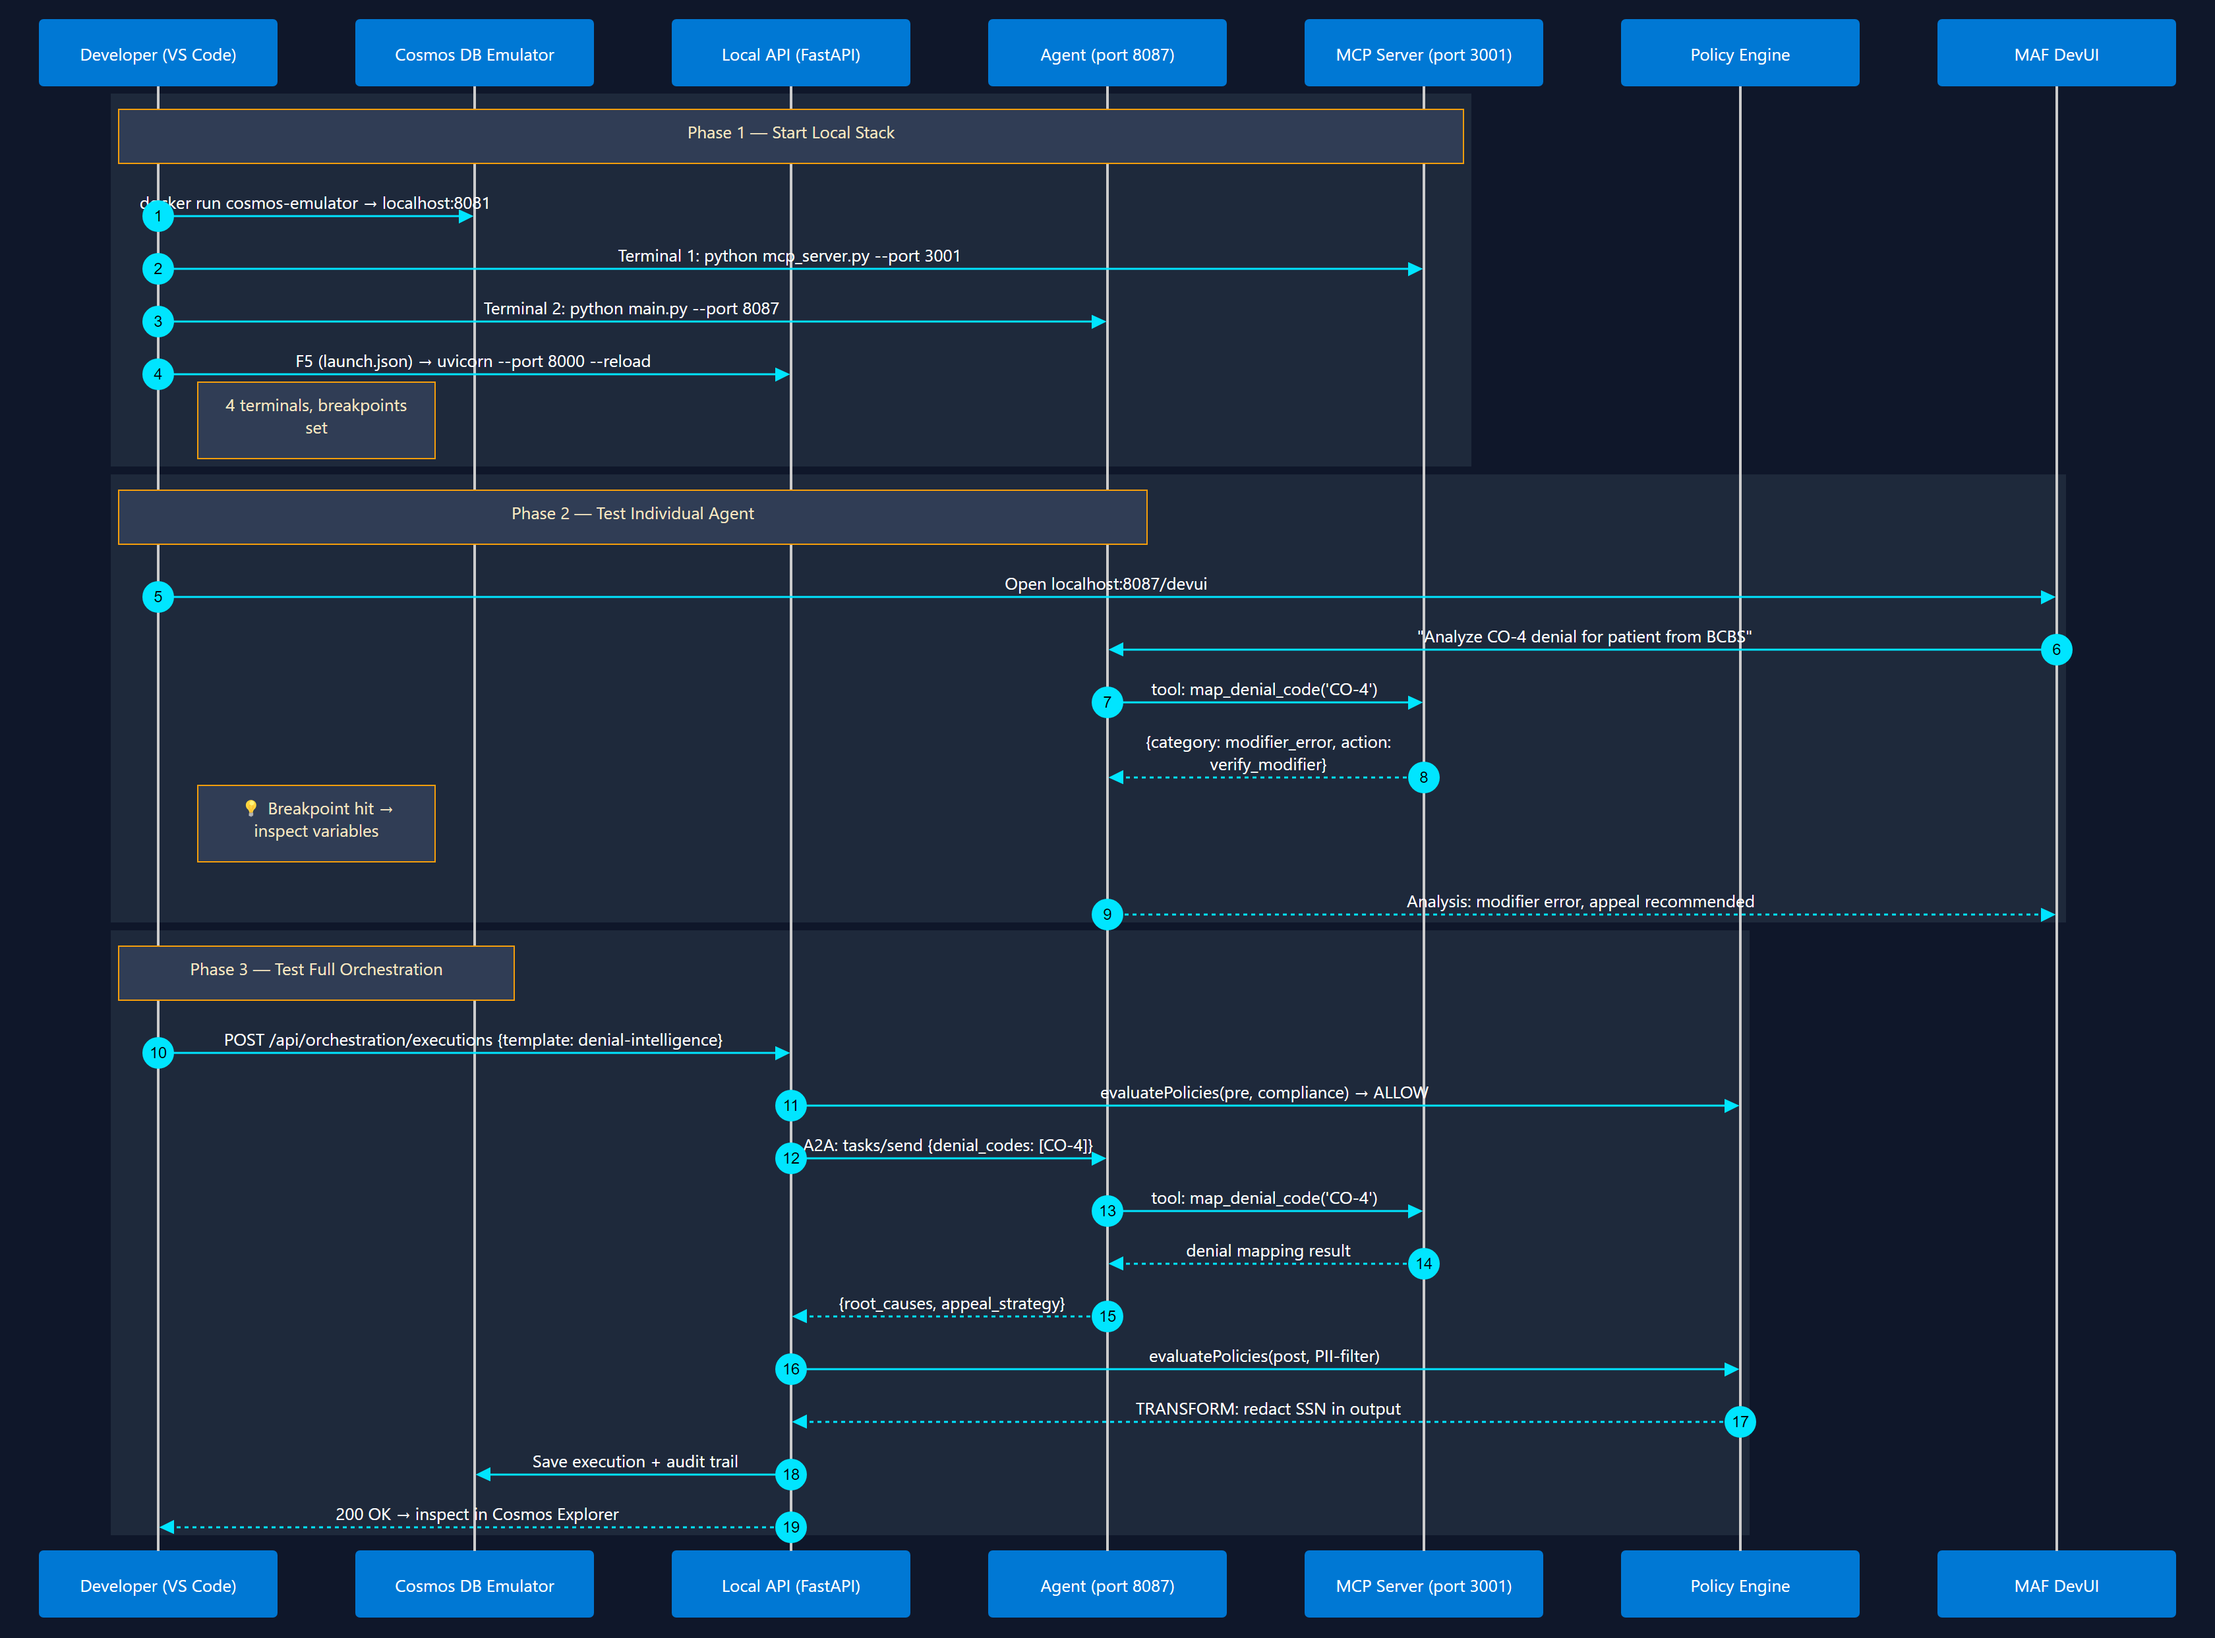
4
Local Testing & Debugging
VS Code Debug + Emulators
Cosmos Emulator → F5 debug → test orchestration → inspect policy decisions

Slide 6
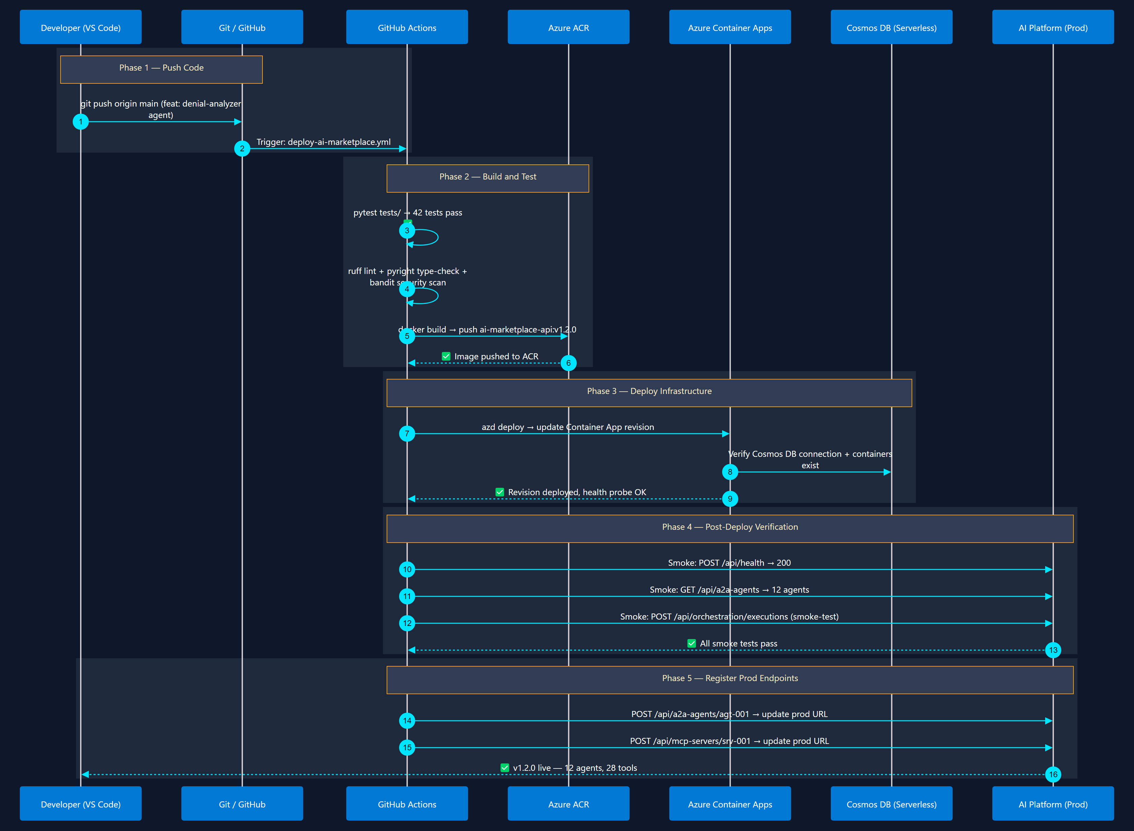
5
CI/CD Pipeline & Deployment
azd up + GitHub Actions
Git push → GitHub Actions → build container → deploy to Container Apps → verify

Slide 7
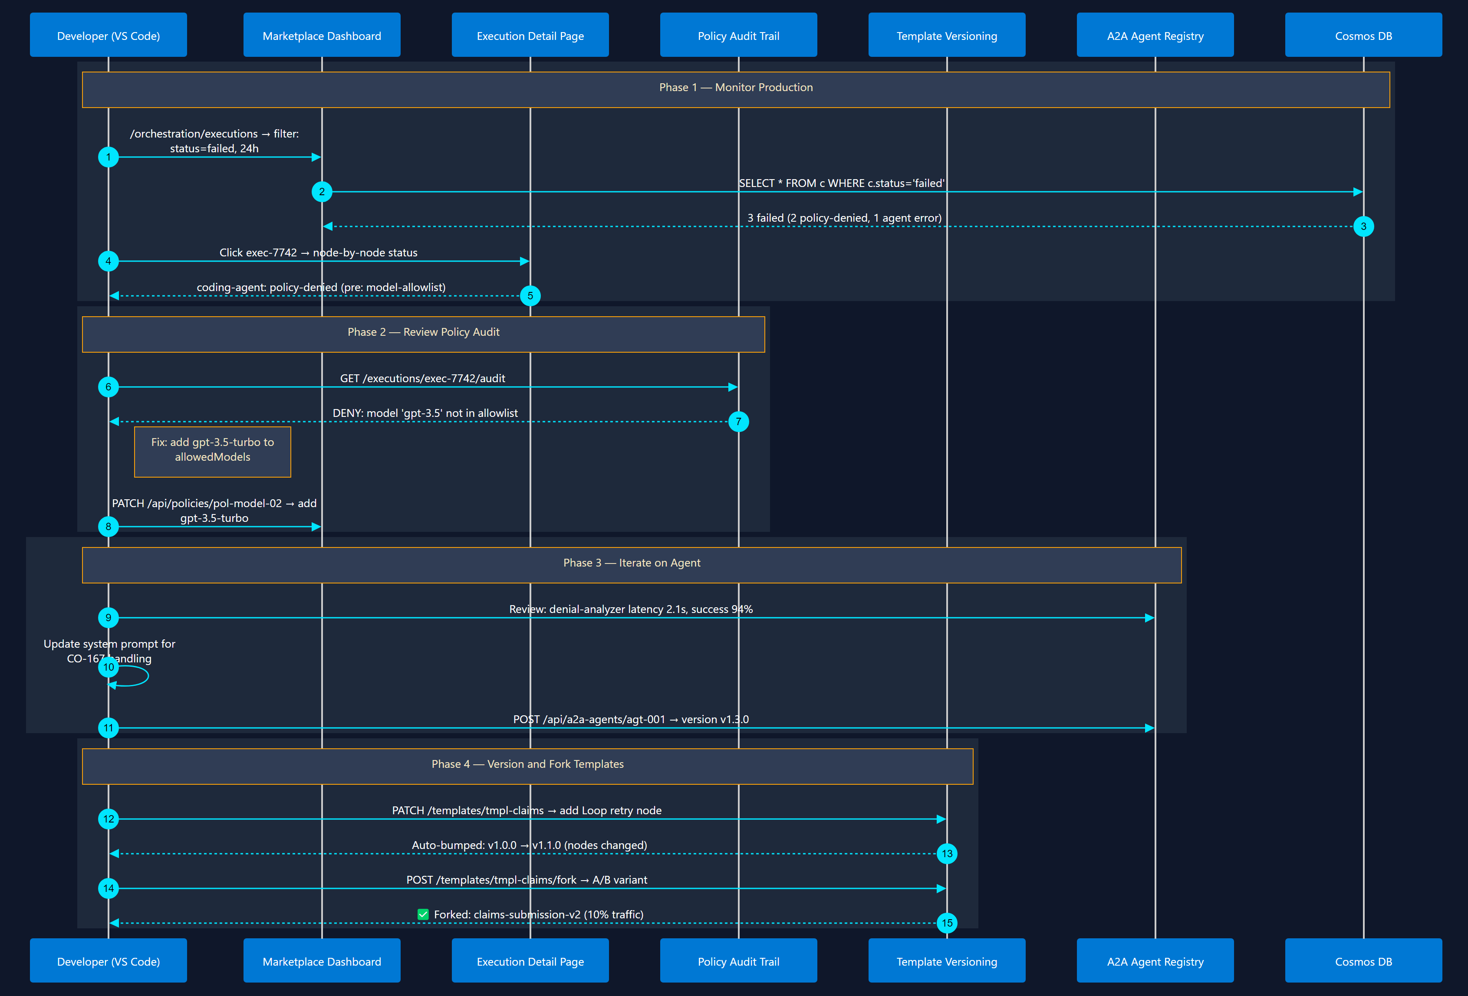
6
Day-2: Monitor, Iterate & Version
Observe → Refine → Ship
Monitor executions → review policy violations → update agents → version templates

Slide 8
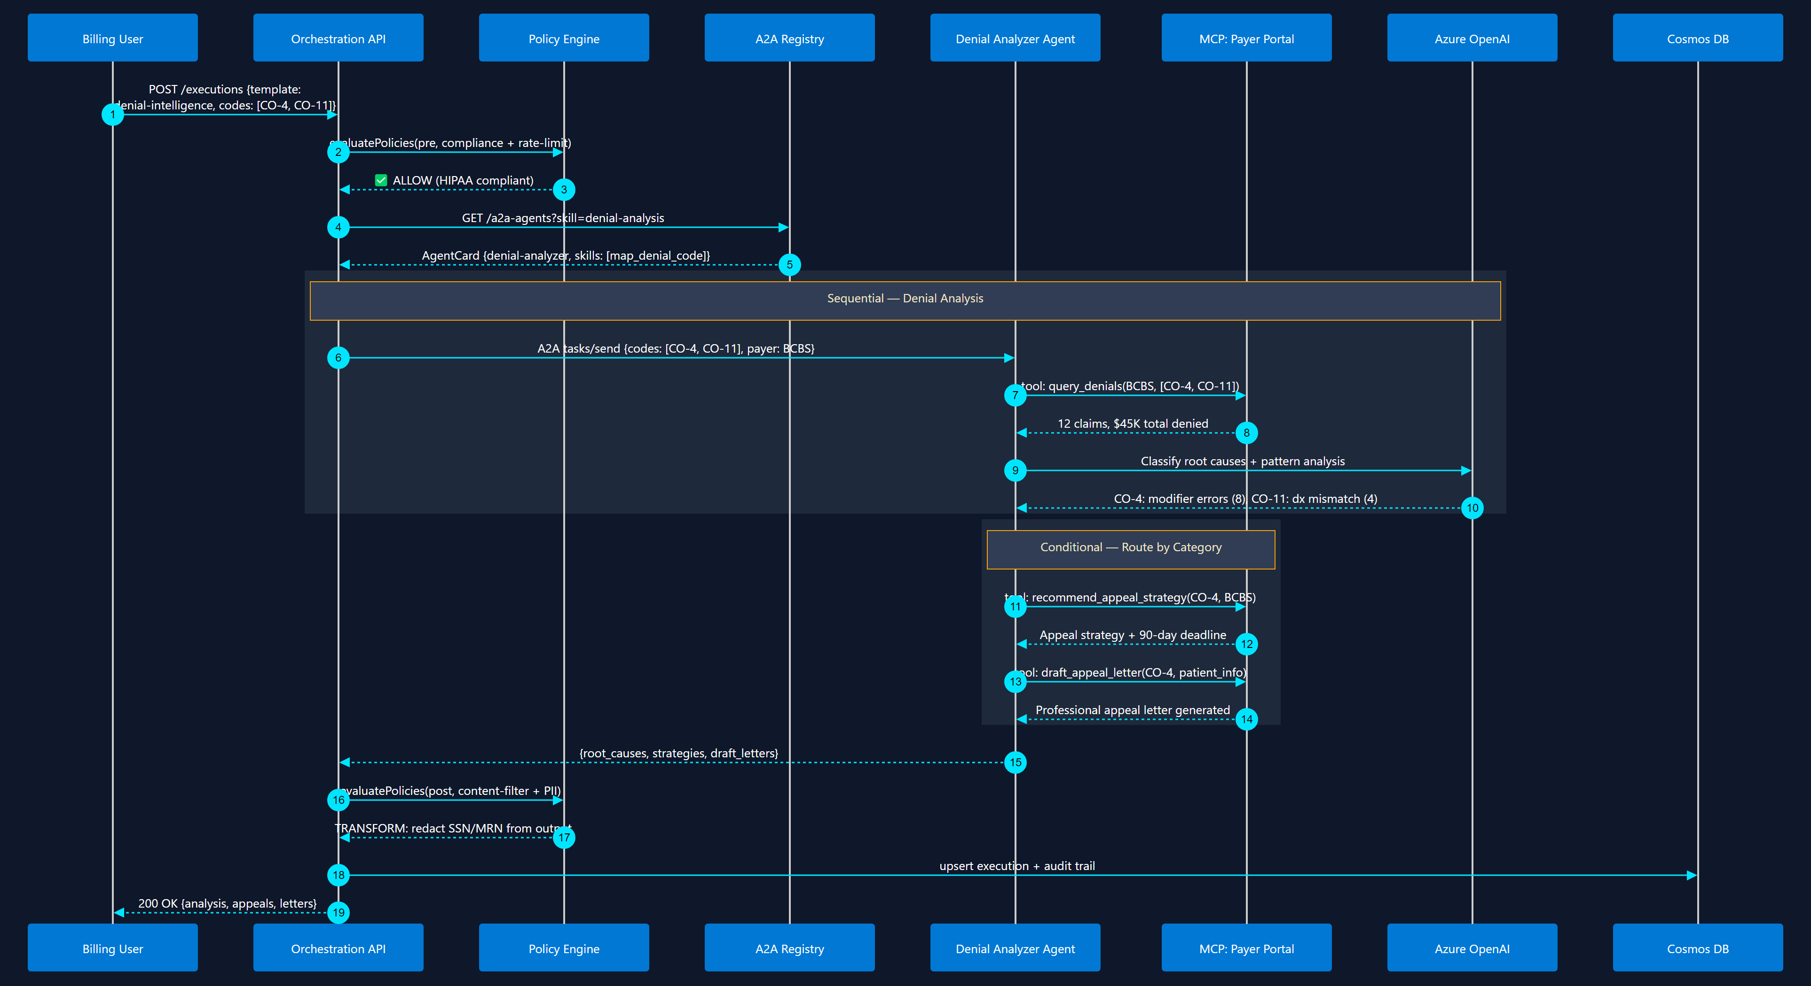
7
Denial Intelligence Workflow
Conditional Router + Supervisor
Analyze denials → classify root cause → recommend appeal strategy

Slide 9
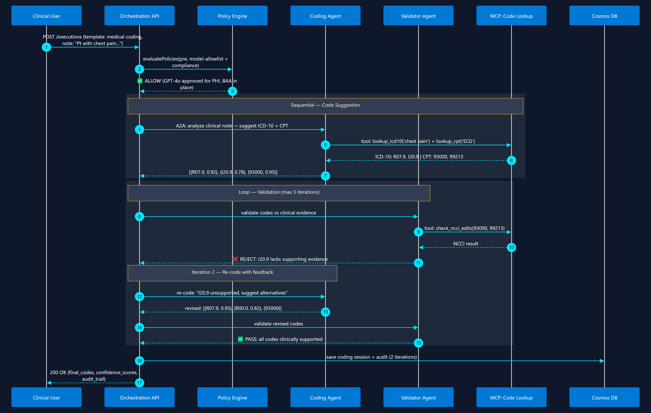
8
Automated Medical Coding
Sequential + Loop (Writer-Critic)
Clinical note → ICD-10/CPT suggestion → validation loop → final codes

Slide 10
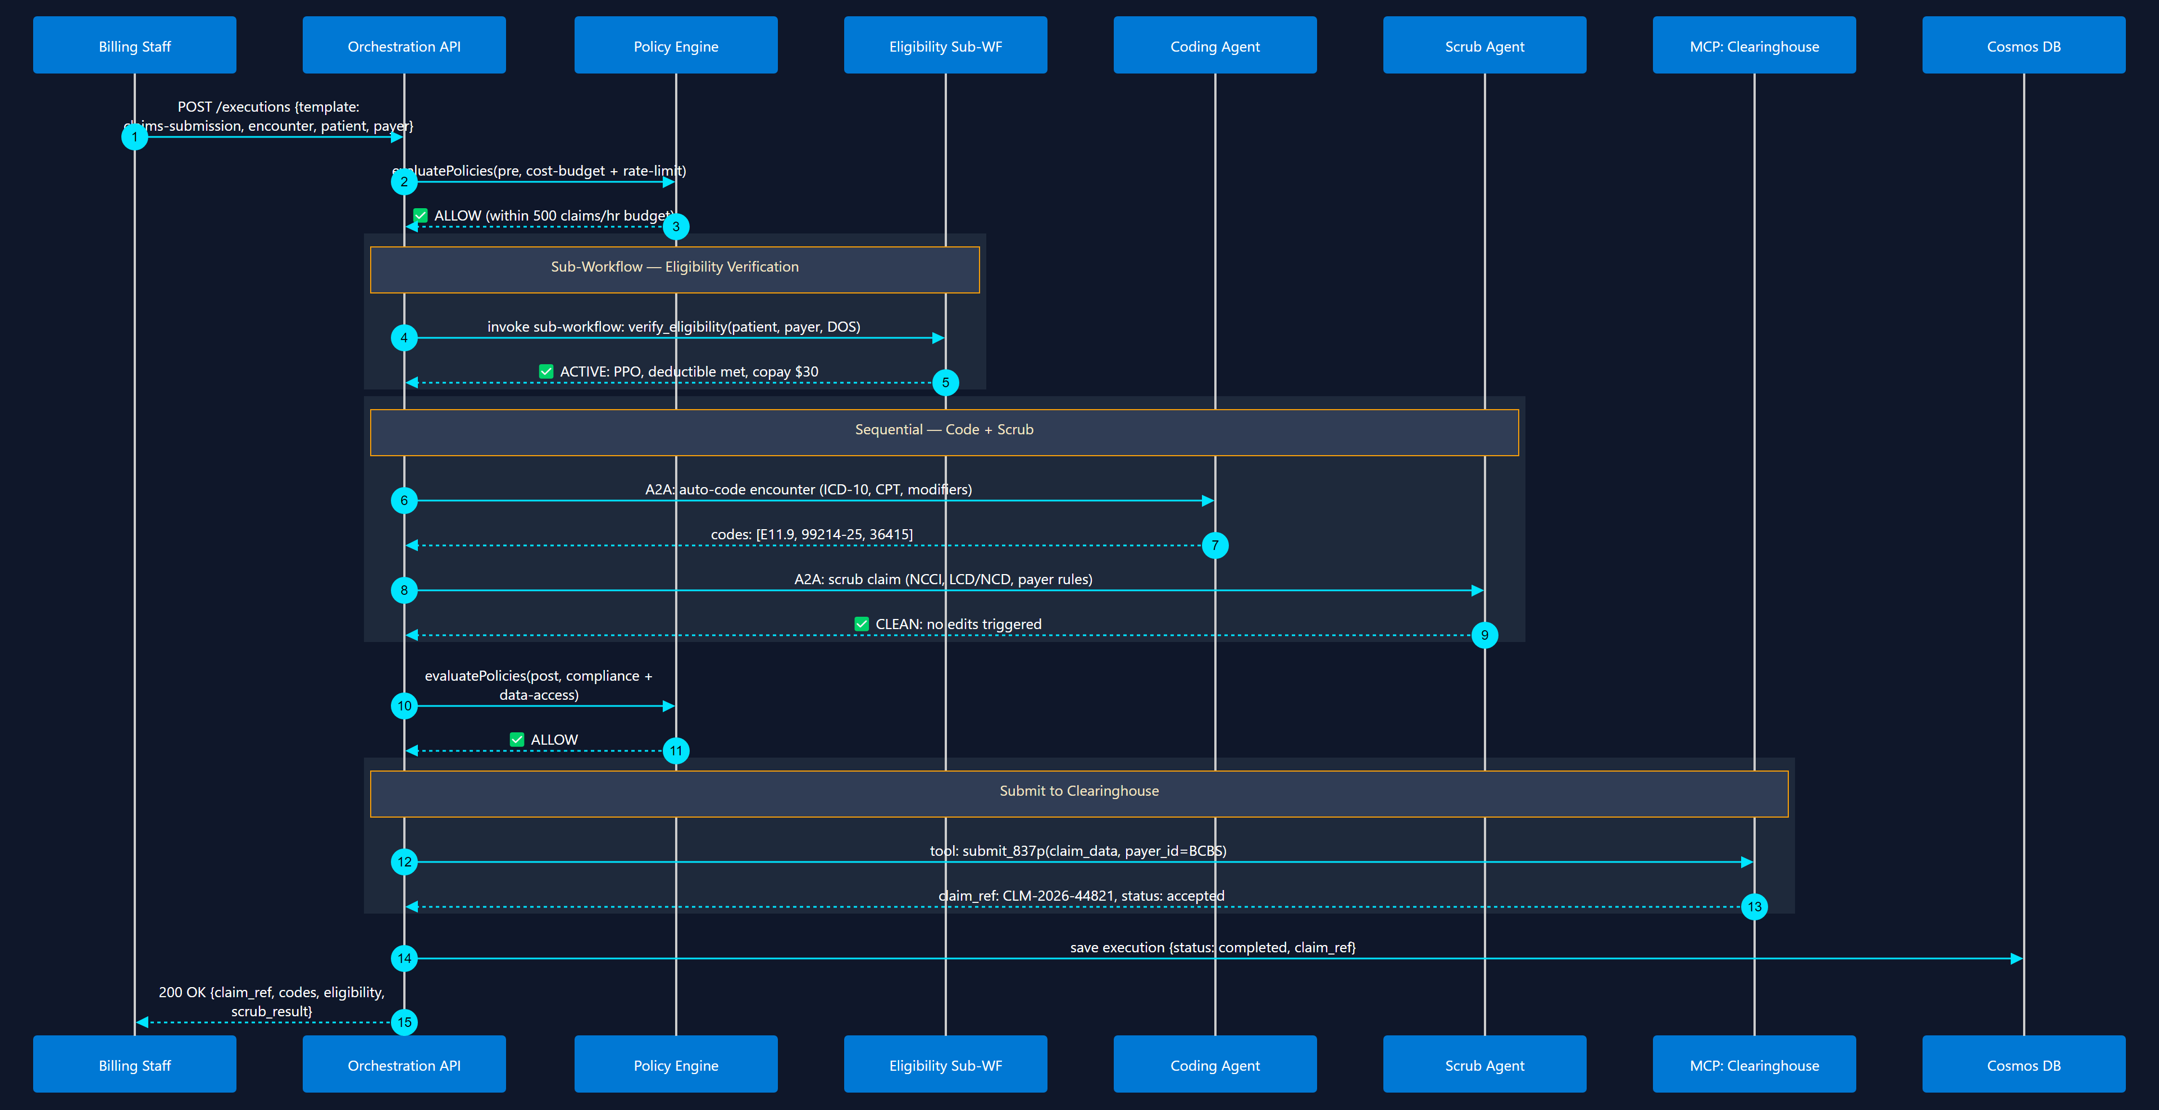
9
Claims Submission Pipeline
Sub-Workflow + Sequential
Eligibility → Coding → Scrub → Submit to Clearinghouse

Slide 11
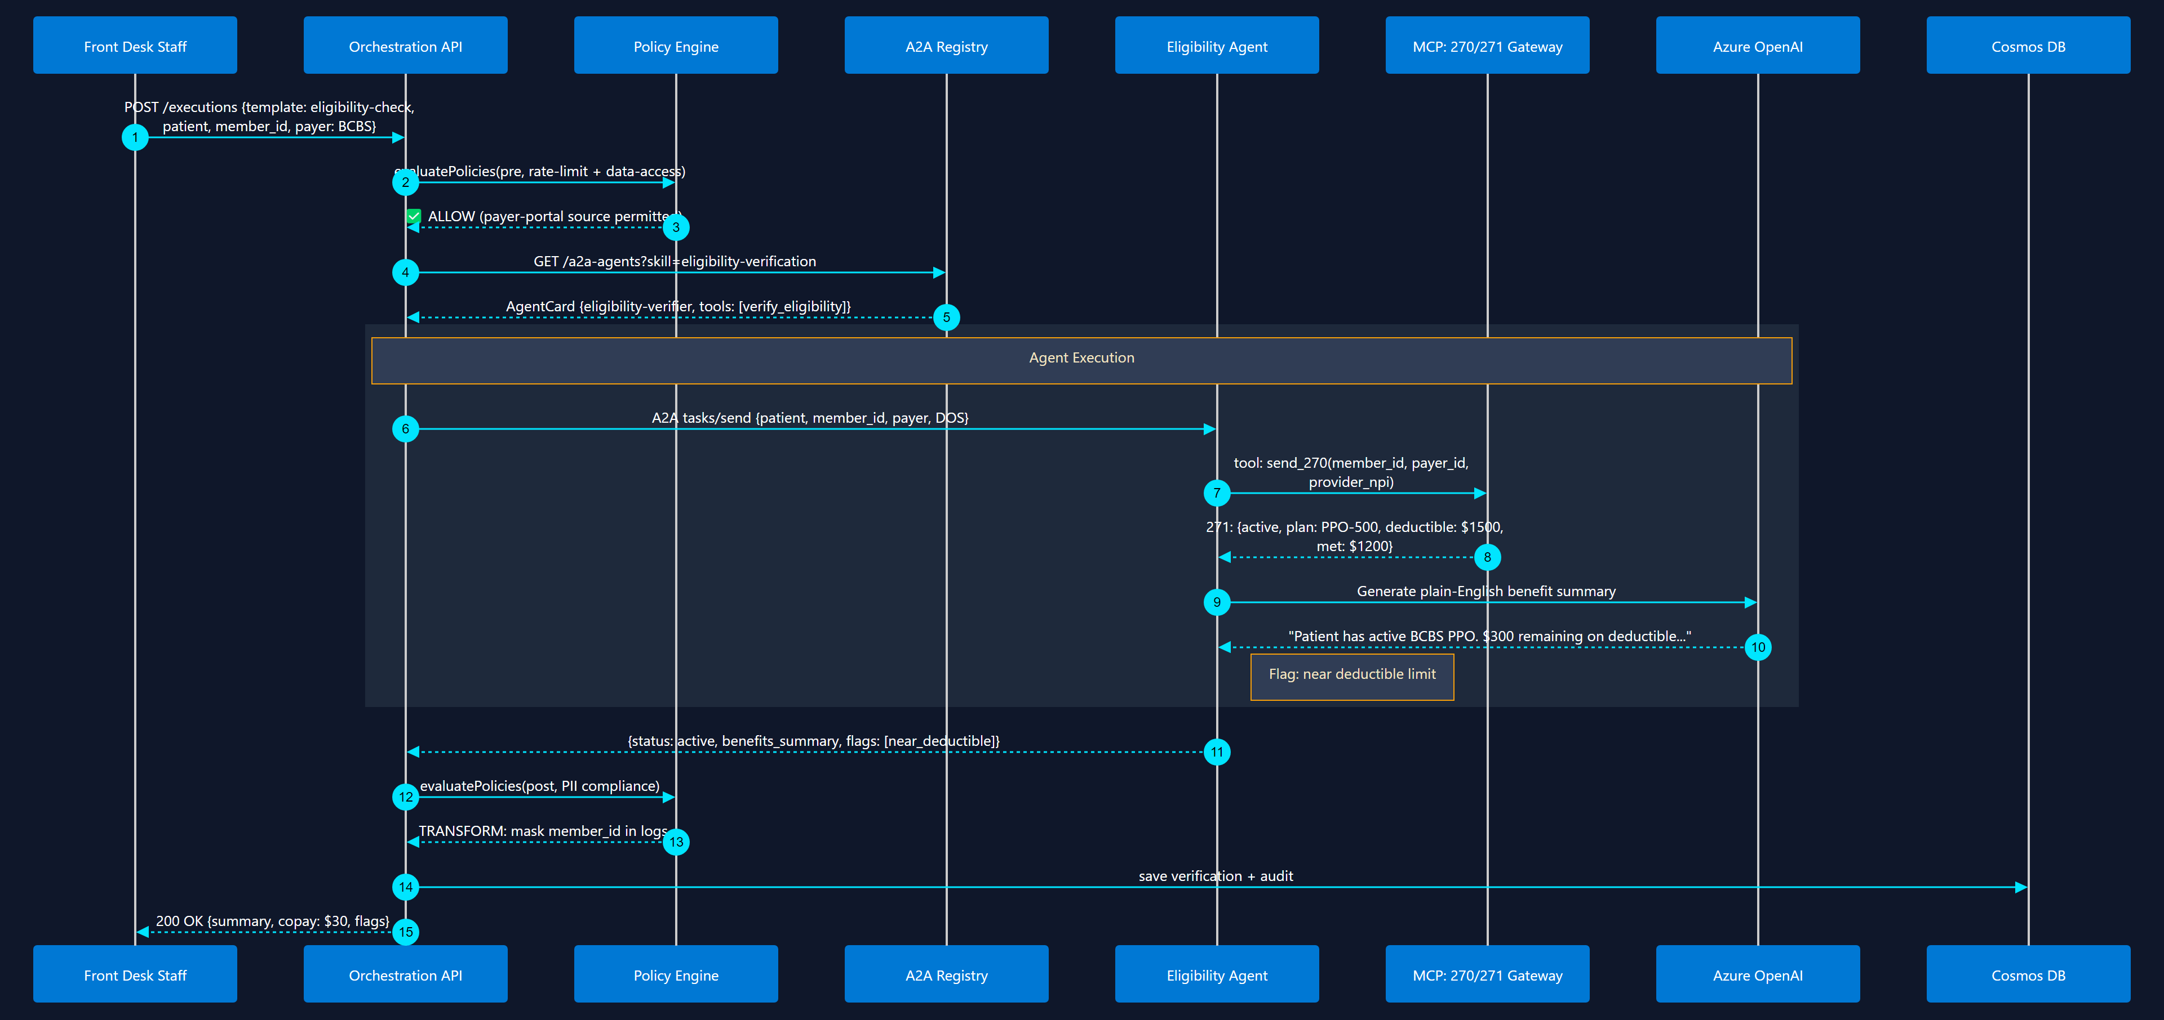
10
Eligibility Verification
Sequential + MCP Tool Call
Real-time 270/271 check via MCP tool + AI benefit summary

Slide 12
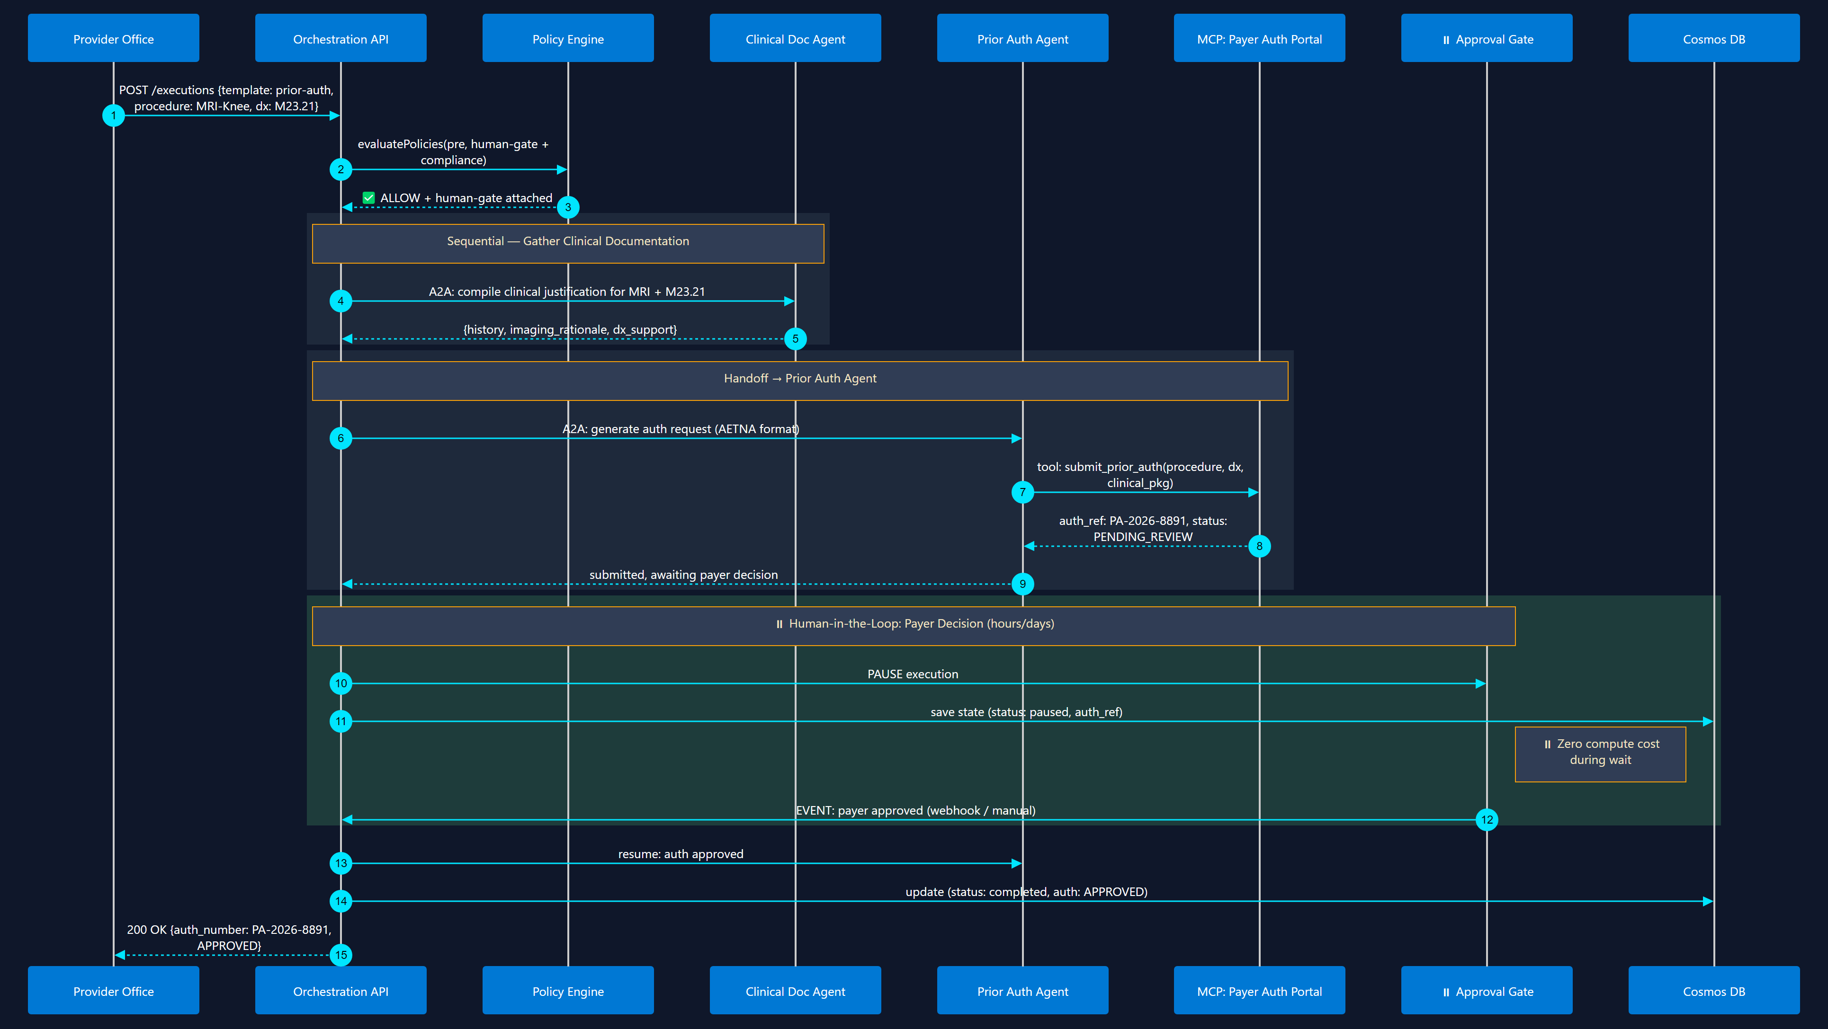
11
Prior Authorization Workflow
Human-in-the-Loop + Handoff
Generate auth request → submit → pause for payer decision → resume

Slide 13
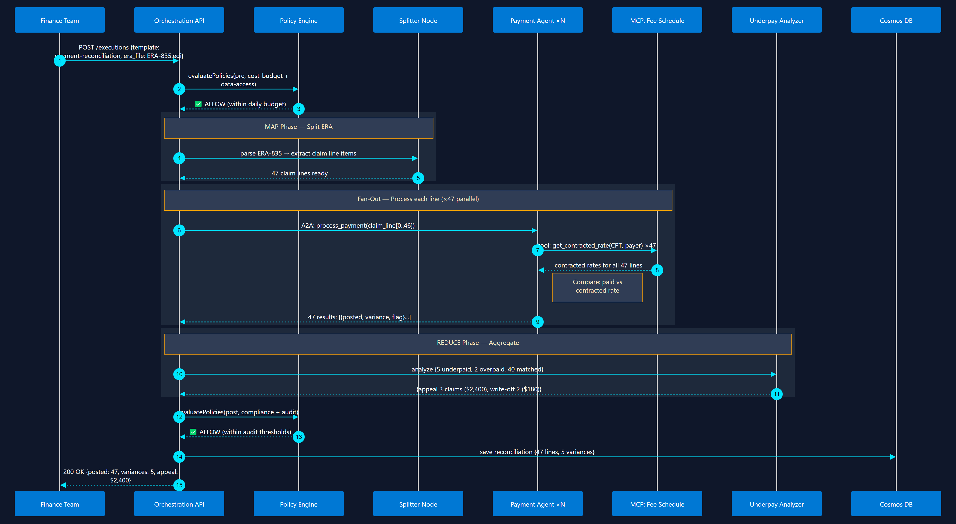
12
Payment Posting & Reconciliation
Map-Reduce + Fan-Out / Fan-In
Batch ERA (835) → map each claim line → detect underpayments → reconcile

