Slide 1
AI Platform — Architecture
Capabilities, Architecture and Dev Experience
Microsoft Agent Framework • Azure Container Apps • Cosmos DB • Azure OpenAI

Slide 2
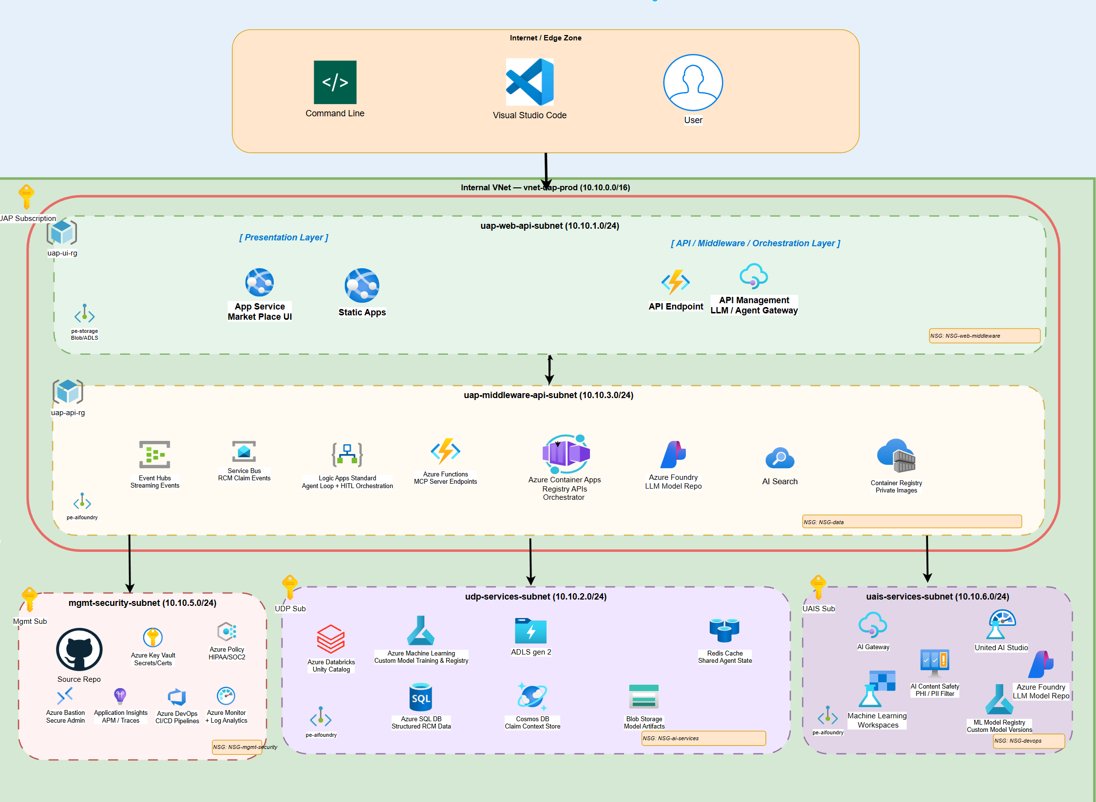
Unified Platform – UAP, UAIS and UDP
Unified AI Platform components

Slide 3
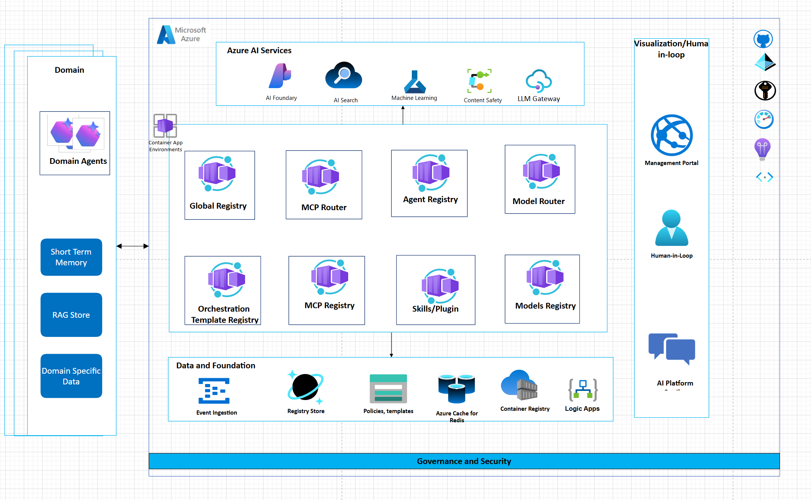
AI Platform Solution
Unified AI Platform components

Slide 4
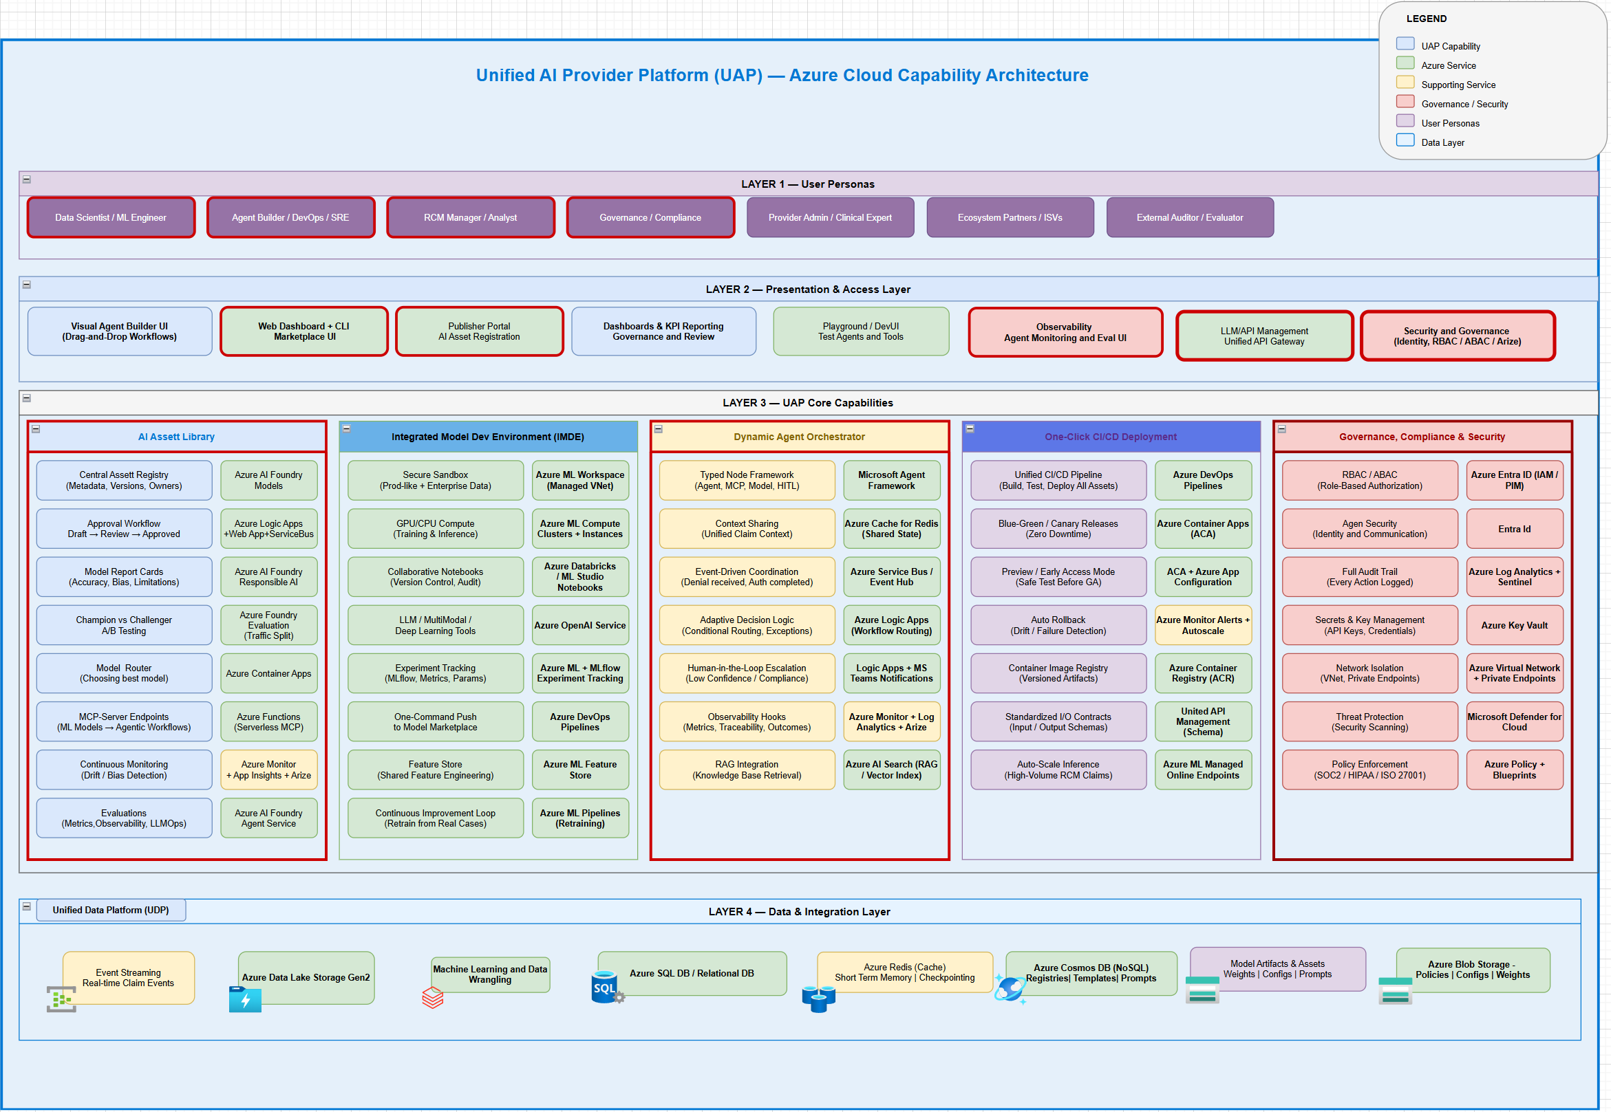
AI Platform Capabilities
Unified AI Platform components

Slide 5
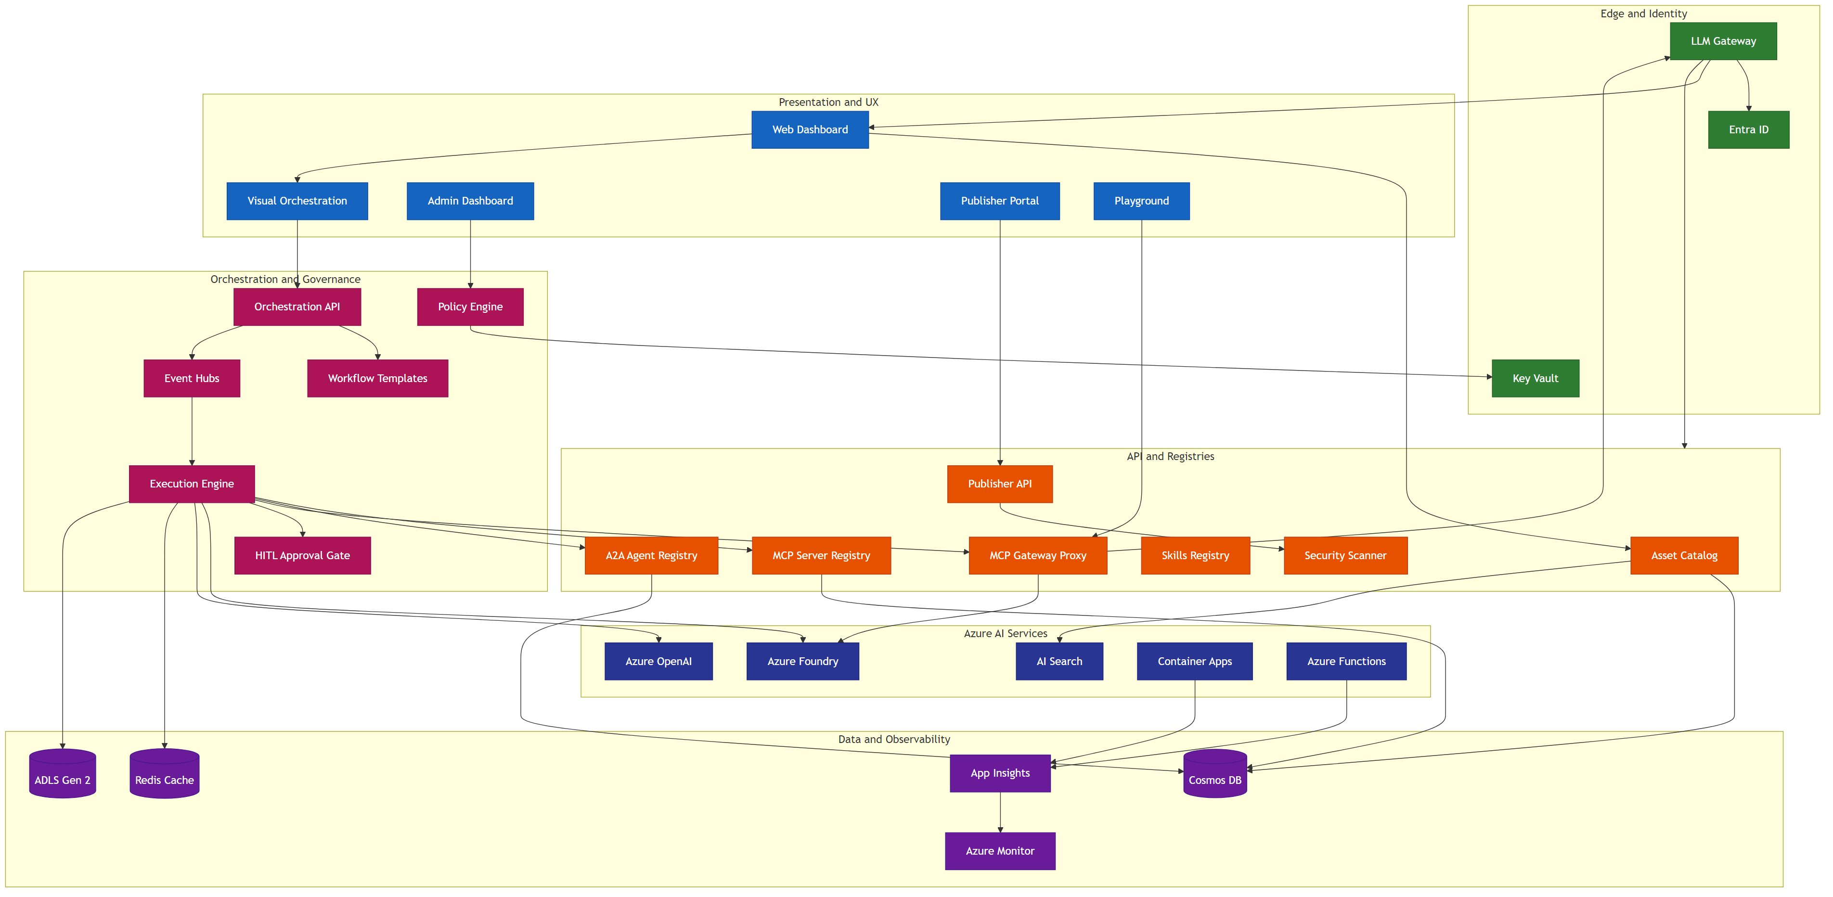
AI Marketplace app architecture
Enterprise grade scalable platform

Slide 6
AI Marketplace — Architecture Features (1–8)
#
Feature
Components
Data Flow
Key Differentiator
1
Enterprise Security
LLM GW, Entra ID, Key Vault, Scanner
LLM GW → Entra (token) → KV (secrets via MI)
Zero-trust, VNet isolation, PHI redaction, HIPAA-ready
2
Plan-Based Orchestration
Execution Engine, Workflow Templates, Registries
Engine → Templates → Registries (bind) → GW Proxy
Declarative plans, Delegation Envelope, step polymorphism
3
Semantic Discovery
AI Search, Asset Catalog, MCP/A2A Registries
Catalog → AI Search (vector) ← NL query → ranked
Vector-indexed search, .well-known crawl, federation
4
Human-in-the-Loop
HITL Gate, Execution Engine, Admin Dashboard
Engine → HITL Gate → Admin UI → Engine (resume)
First-class step type, not bolted on; audit provenance
5
Three-Tier Memory
Redis, Cosmos DB, ADLS Gen 2
Engine → Redis (short) → Cosmos (episodic) → ADLS
Summary-first flush, no raw PHI, episode records
6
Multi-Protocol Tools
MCP GW Proxy, MCP Registry, A2A Registry, Foundry
GW Proxy → MCP servers; A2A Registry → peer agents
MCP + A2A + Foundry + SaaS in one gateway
7
Governance
Policy Engine, Publisher API, Scanner, Admin UI
Publisher → Scanner → Policy → Admin → Catalog
Dual enforcement (publish + execute), full audit trail
8
Observability
App Insights, Azure Monitor, ACA, Functions
ACA + Functions → App Insights → Monitor (alerts)
OpenTelemetry e2e, trace_id propagation, per-episode
All 16 features map to architecture components • AI Asset Marketplace • Azure-Native Enterprise Platform

Slide 7
AI Marketplace — Architecture Features (9–16)
#
Feature
Components
Data Flow
Key Differentiator
9
Azure-Native Not Locked
MCP GW Proxy, A2A Registry, Foundry, ACA
GW routes to any MCP (ACA, SaaS, on-prem)
Open protocols, federation, optional Foundry
10
Production Infra
ACA, Functions, EventHub, LLM Gateway, Cosmos DB
ACA (stateless) + Functions (event) + LLM Gateway (edge)
Subnet isolation, scale-to-zero, Bicep IaC
11
Intelligent Tool Finder
AI Search, MCP Registry, Azure OpenAI
Registry → Cosmos → AI Search (FAISS) ← NL query
FAISS vector matching — agents self-discover tools
12
Dynamic Invocation
Execution Engine, MCP GW Proxy, AI Search
Engine → Search (find) → Registry (schema) → GW
Discover → resolve → call in one turn, no pre-config
13
Load Balancing
LLM Gateway, ACA, MCP GW Proxy
LLM GW → GW Proxy → ACA (scaling + probes)
Health-aware routing across MCP server replicas
14
IDE Integration
MCP Registry, Asset Catalog, LLM Gateway
Registry → export mcp.json → VS Code / Cursor
One-click IDE setup from marketplace registry
15
JWT Token Vending
Entra ID, Key Vault, LLM Gateway
Agent → Entra (creds) → JWT → LLM GW → GW Proxy
M2M scoped tokens for autonomous agent auth
16
Context-Aware Perms
Policy Engine, Entra ID, LLM Gateway
Engine → Policy (claims + context) → allow/deny
Dynamic scope eval per invocation, not just RBAC
All 16 features map to architecture components • AI Asset Marketplace • Azure-Native Enterprise Platform

Slide 8
General Orchestrator Workflow
#
Step
Component
Description
1
Client Request
LLM Gateway
Request enters via domain LLM Gateway with Entra auth
2
Classify Intent
Azure Foundry /classify
Determine intent, phase, and domain routing
3
Governance Pre-flight
Policy Engine + Entra
Check entitlements, PHI class, budgets, HITL rules
4
Select Domain + Plan
AI Search + Registries
Query plan registry and domain orchestrator registry
5
Resolve + Bind Tools
MCP/A2A Registries
Bind agents via A2A, tools via MCP from registries
6
Delegation Envelope
Orchestration API
Create least-privilege envelope with plan + constraints
7
Domain Execution
Event Hubs + Engine
Fan-out via Event Hubs, step loop in Execution Engine
8
Memory + Evidence
Redis + Cosmos DB
Short-term state in Redis, episodic memory in Cosmos
9
Post-flight Checks
Content Safety + Policy
PHI redaction, compliance, channel HITL
10
Normalize + Respond
LLM Gateway
Standard schema + provenance + trace_id, return result
Global orchestrator manages intent classification, governance, plan selection, domain delegation, and post-flight normalization

Slide 9
LangGraph vs MAF — Capability Comparison
#
Capability
LangGraph
MAF
Rebuild in LangGraph
1
Graph-based orchestration
StateGraph DAG
WorkflowBuilder DAG
—
2
Central shared state
StateGraph
Intentionally absent
Session/state isolation
3
Step-level checkpointing
Checkpointers
Workflow checkpoints
—
4
Pause / resume execution
Via checkpoints
Via workflow runtime
—
5
Time-travel / replay
Checkpoint history
Partial (telemetry)
Full replay tooling
6
Agent statelessness
Stateful by design
Enforced
State discipline
7
Typed message contracts
Dict-based
Strong typing
Validation + schema
8
Workflow execution waves
Super-steps
Supersteps
—
9
Human-in-the-loop
Interrupts + edits
First-class
—
10
Built-in observability
Requires LangSmith
OTel native
Azure telemetry
11
Workflow-level spans
No
Executor spans
Deep tracing
12
Azure Monitor integration
No
Native
Full APM
13
Managed identity support
No
Native
Identity mgmt
14
Compliance logging
No
Native hooks
Audit trail
15
Dev / prod parity
Platform-dependent
Designed-in
Env isolation
16
Enterprise RBAC
No
Platform-level
RBAC enforcement
LangGraph excels at graph orchestration; MAF leads on enterprise compliance, observability, and Azure integration

Slide 10
LangGraph vs MAF — Compliance Comparison
#
Requirement
LangGraph on Azure
MAF on Azure
1
PHI / PII handling
Custom-built
Native hooks
2
Audit trails
LangSmith / custom
Native workflow events
3
Deterministic replay
Yes
Partial
4
Execution provenance
Graph-level
Executor-level
5
Role-based access
App-level
Platform-level
6
Azure AD integration
Manual
Native
7
Managed Identity
Manual
Native
8
Secrets management
App-managed
Platform-managed
9
Logging retention
Custom
Azure Monitor
10
Incident forensics
Hard
Straightforward
11
Security review friction
High
Low
Side-by-side comparison for enterprise healthcare compliance requirements

Slide 11
1
Global Orchestrator Pattern
Compose workflows hierarchically — a domain workflow as a step in a parent workflow
Parent Workflow
Child Workflow (Nested)
📥 Input
🤖 Pre-process
🤖 Step A
🤖 Step B
🤖 Step C
🤖 Post-process
📤
MAF Code Pattern
When to Use
• Reusable workflow modules (e.g., ‘claim check' sub-workflow)
• Team-owned sub-workflows composed into larger pipelines
• Isolate complex logic into testable sub-units
• Recursive workflows: a workflow can contain itself
• A2A: cross-service workflow composition
# Sub-workflow as executor child_wf = Workflow() child_wf.add_executor('step_a', agent_a) child_wf.add_executor('step_b', agent_b) child_wf.add_edge('step_a', 'step_b') parent_wf = Workflow() parent_wf.add_executor('preprocess', pre_agent) parent_wf.add_executor('child', child_wf.as_executor()) parent_wf.add_edge('preprocess', 'child')
Key Characteristics
• MAF: sub_workflow_basics — wrap Workflow as executor via .as_executor(); supports kwargs propagation, request interception, checkpointing

Slide 12
AI Platform — Sequence Diagrams
Developer Experience & RCM Domain Orchestration Flows
12 Sequence Diagrams • 6 Dev-Experience • 6 RCM Domain Workflows
Microsoft Agent Framework • Azure Container Apps • Cosmos DB • Azure OpenAI

Slide 13
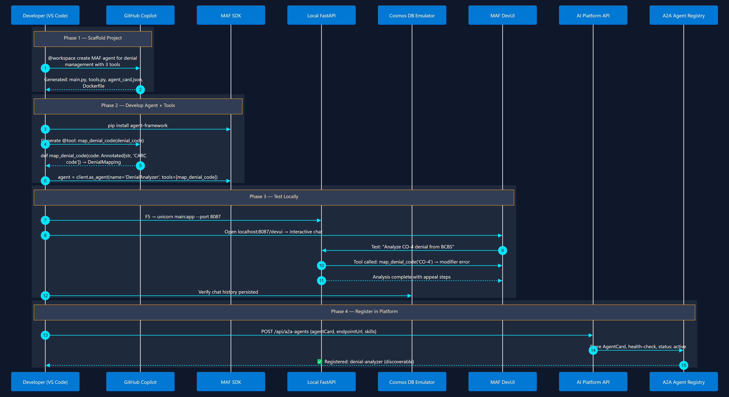
1
Agent Development Lifecycle
Scaffold → Code → Test → Register
From empty folder to a registered, discoverable A2A agent

Slide 14
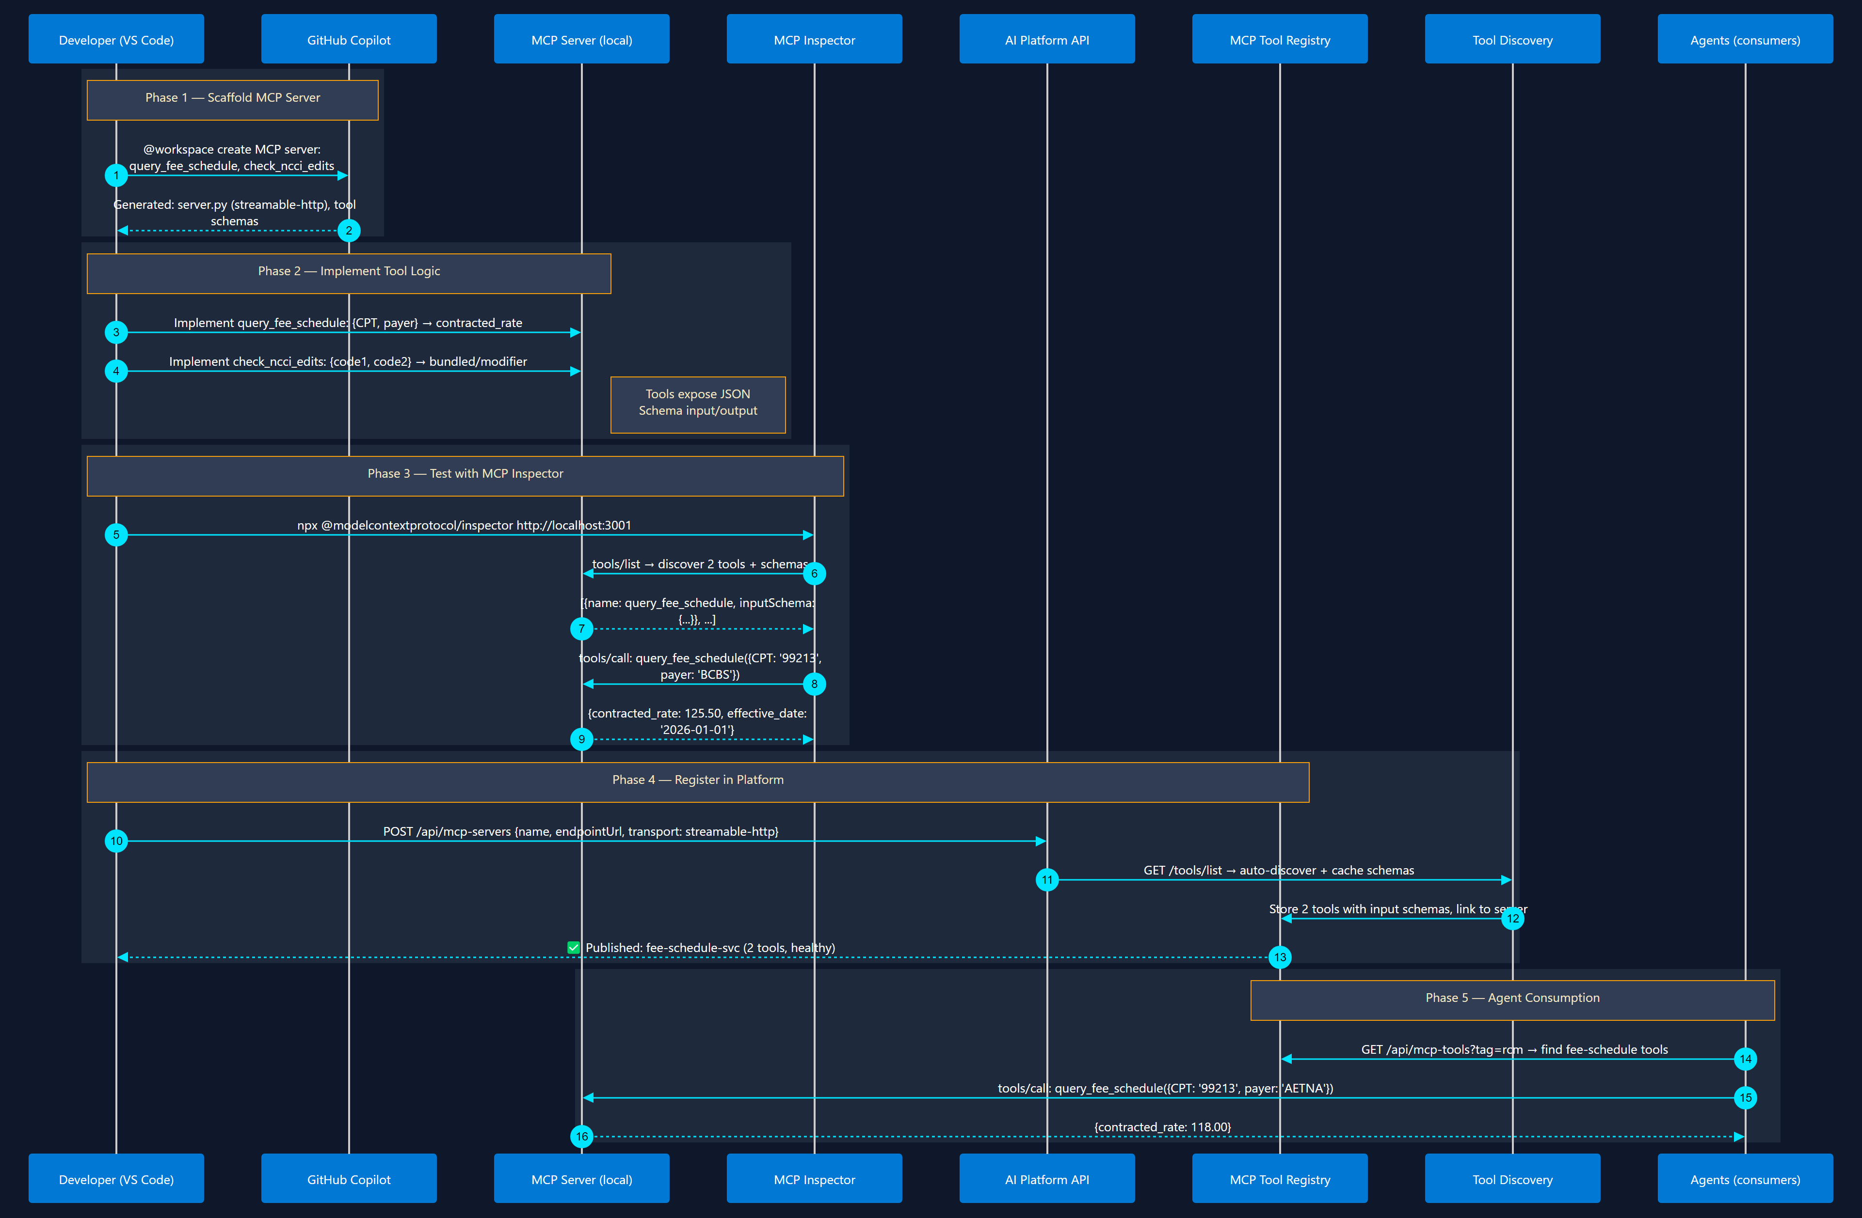
2
MCP Tool Development & Registration
Build → Test → Publish → Discover
Build tool server → test schema → publish to registry → agents discover it

Slide 15
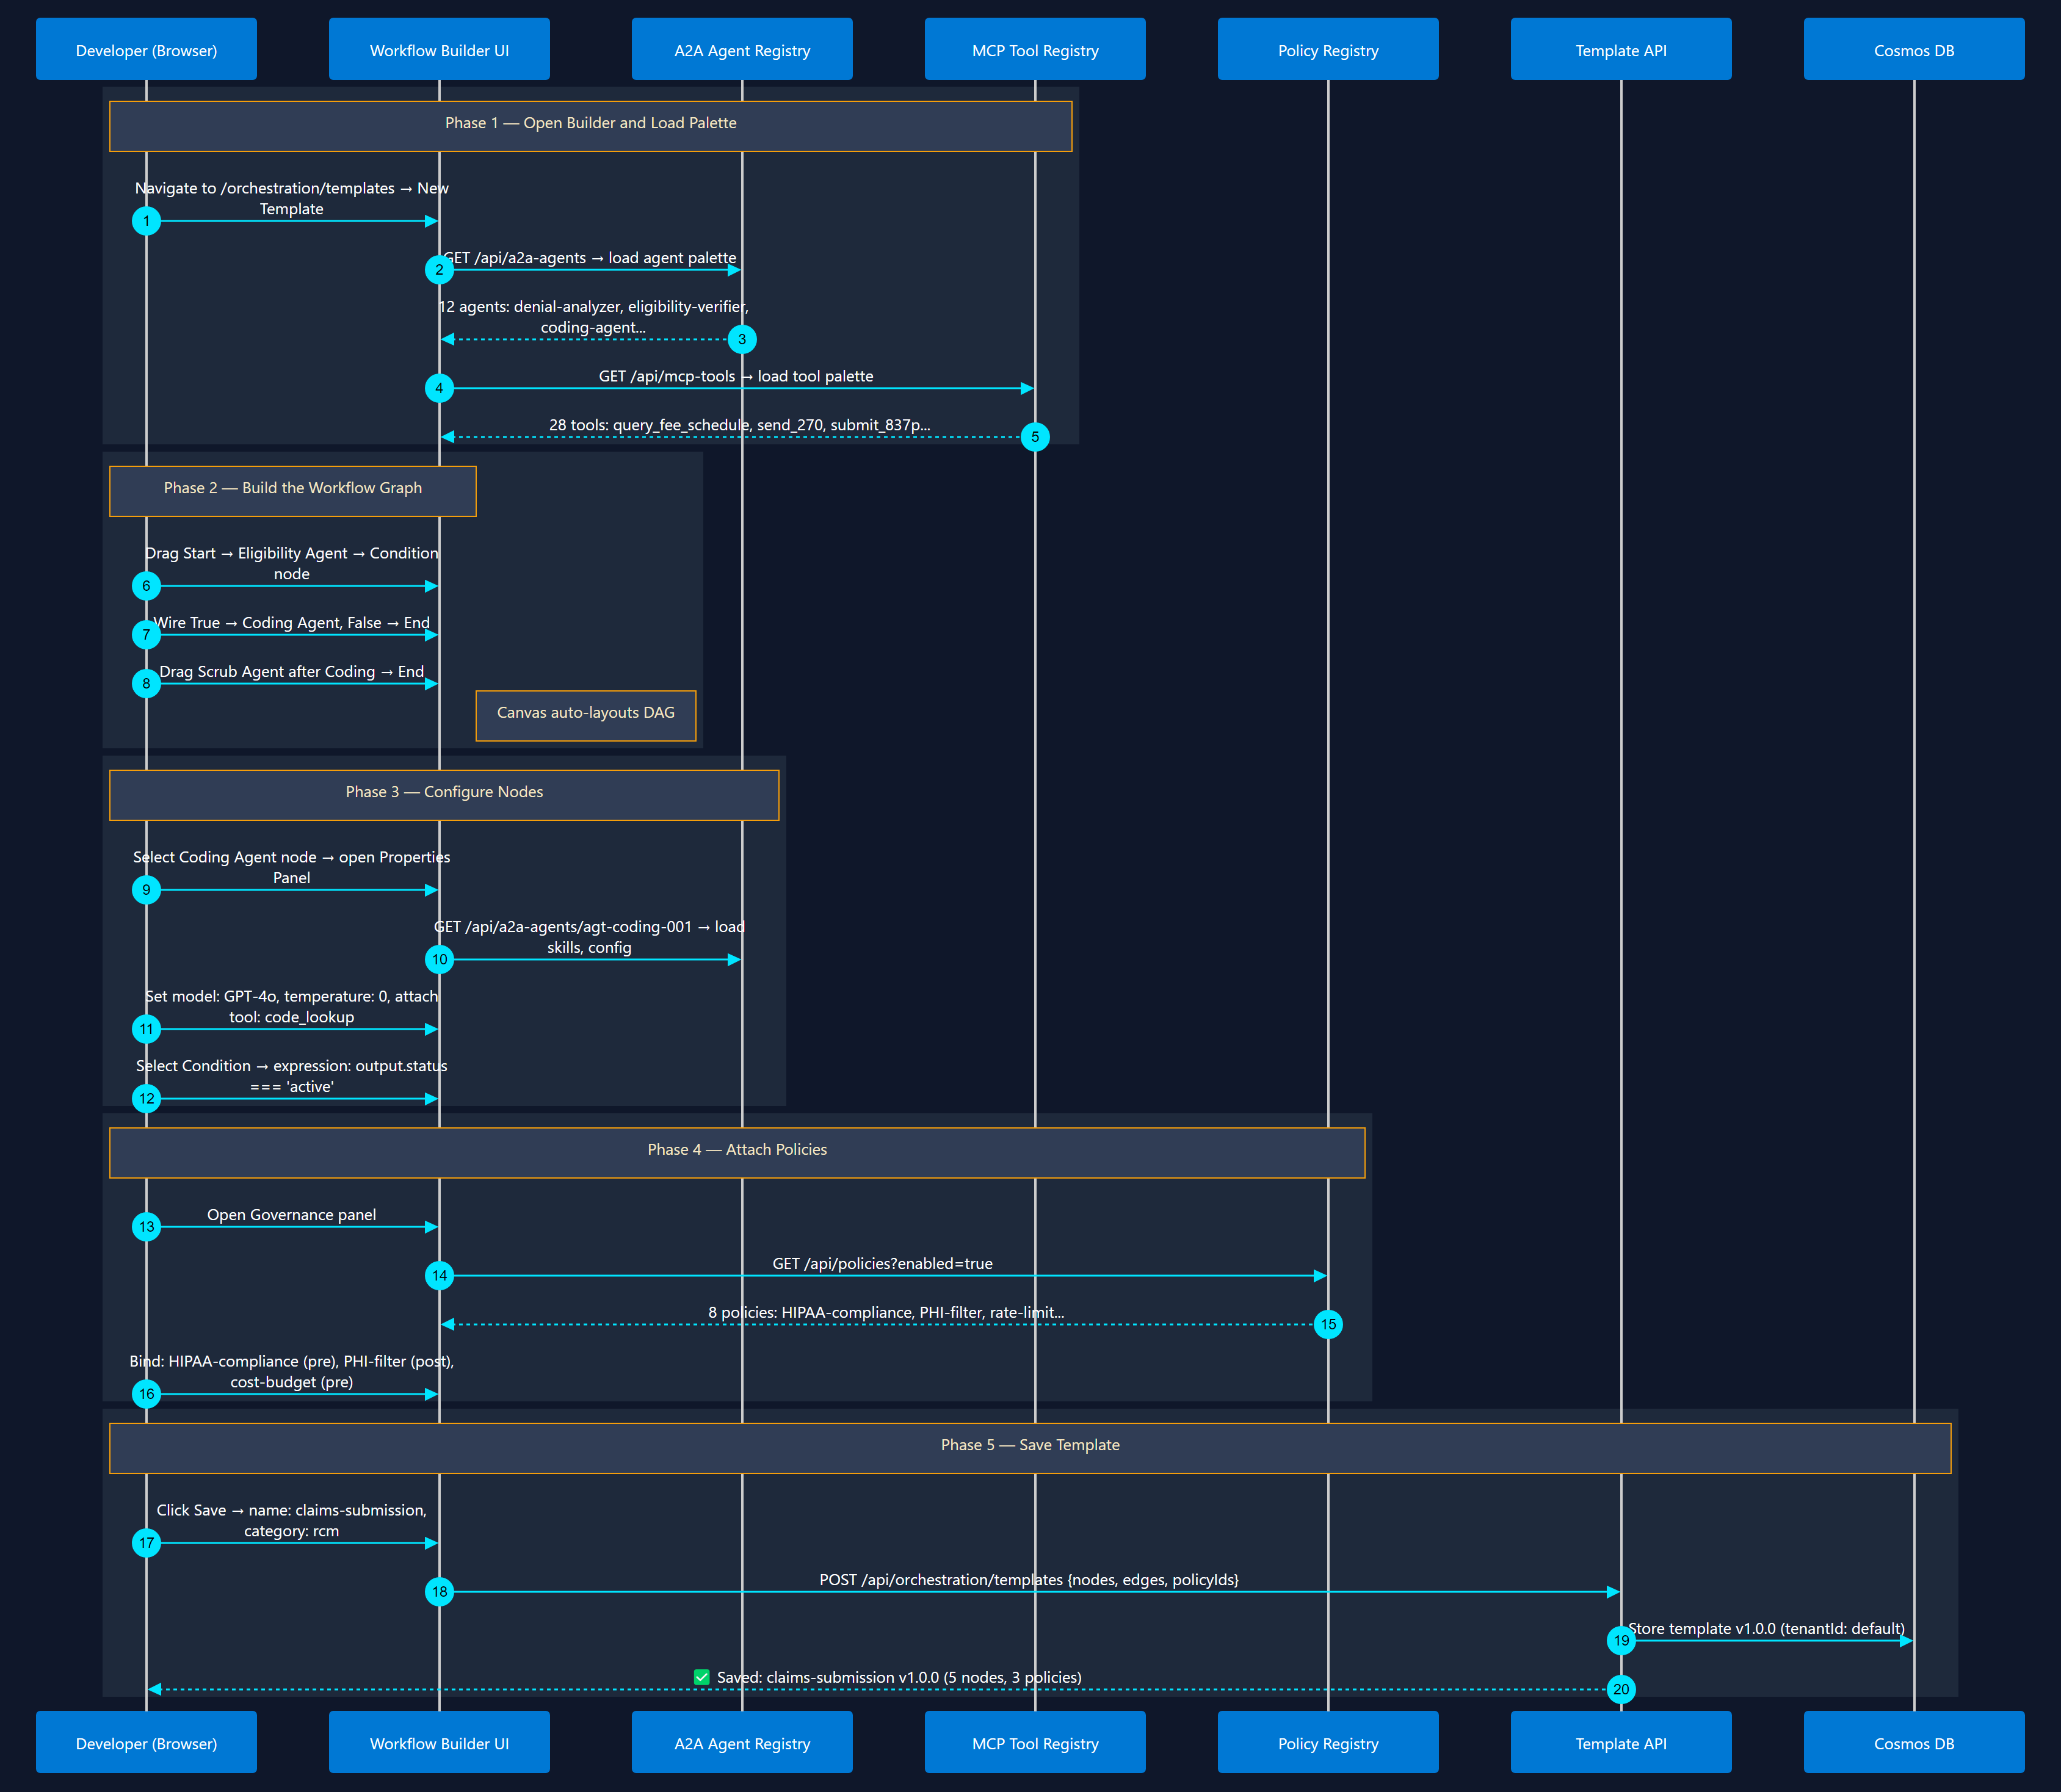
3
Orchestration Template Design
Visual Builder in Marketplace Web UI
Visual workflow builder → select agents → wire edges → attach policies → save

Slide 16
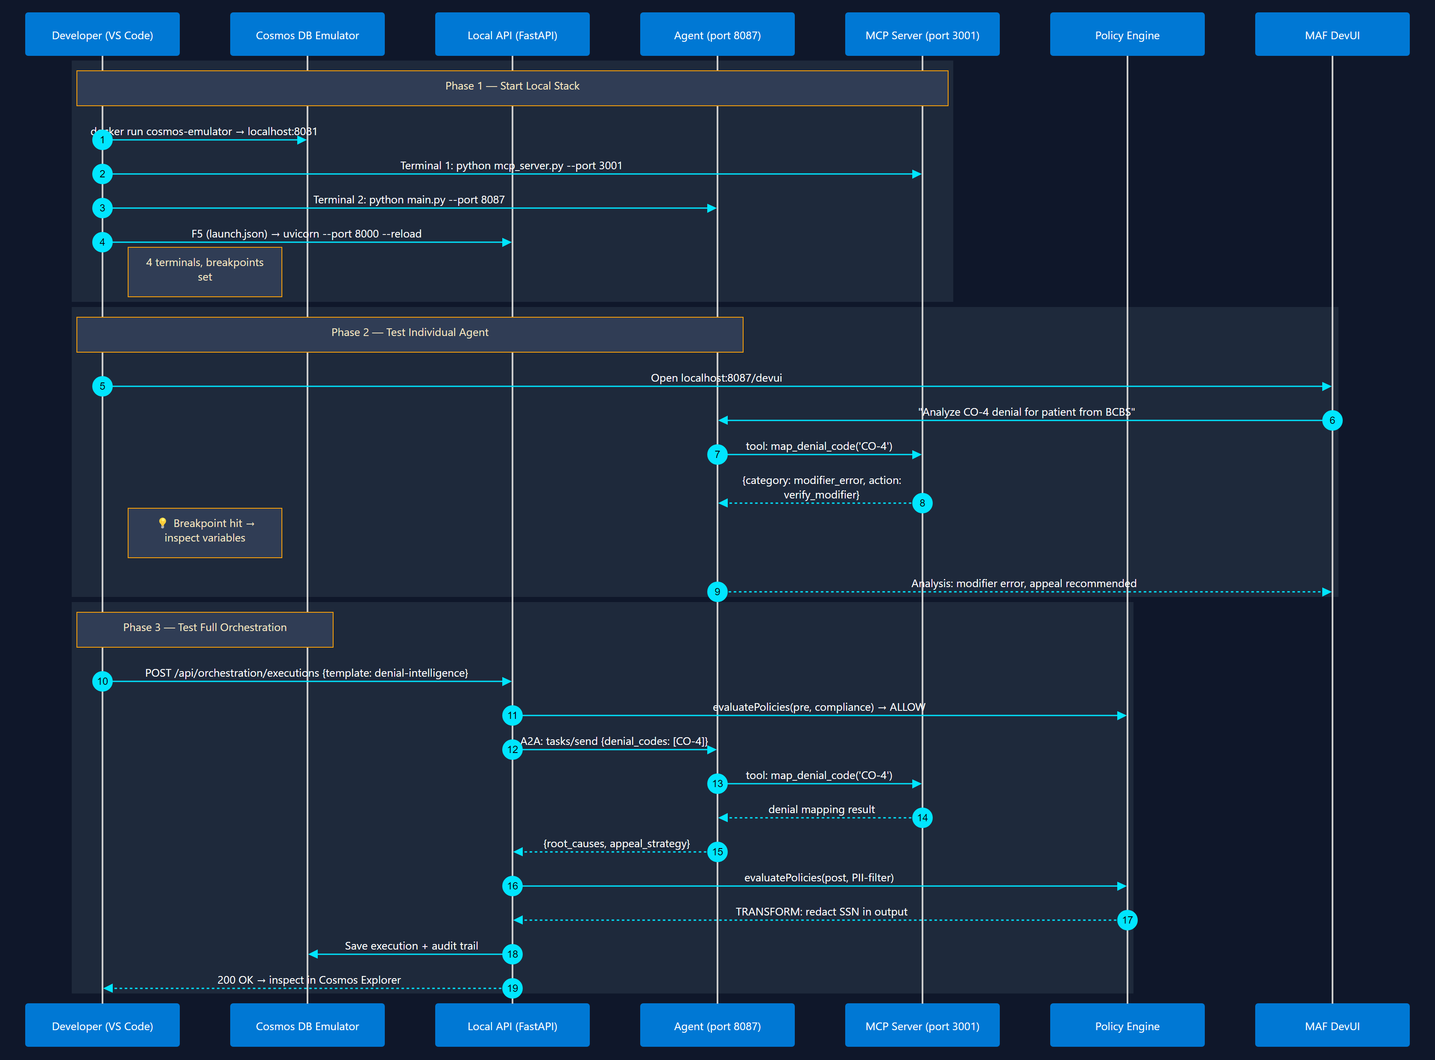
4
Local Testing & Debugging
VS Code Debug + Emulators
Cosmos Emulator → F5 debug → test orchestration → inspect policy decisions

Slide 17
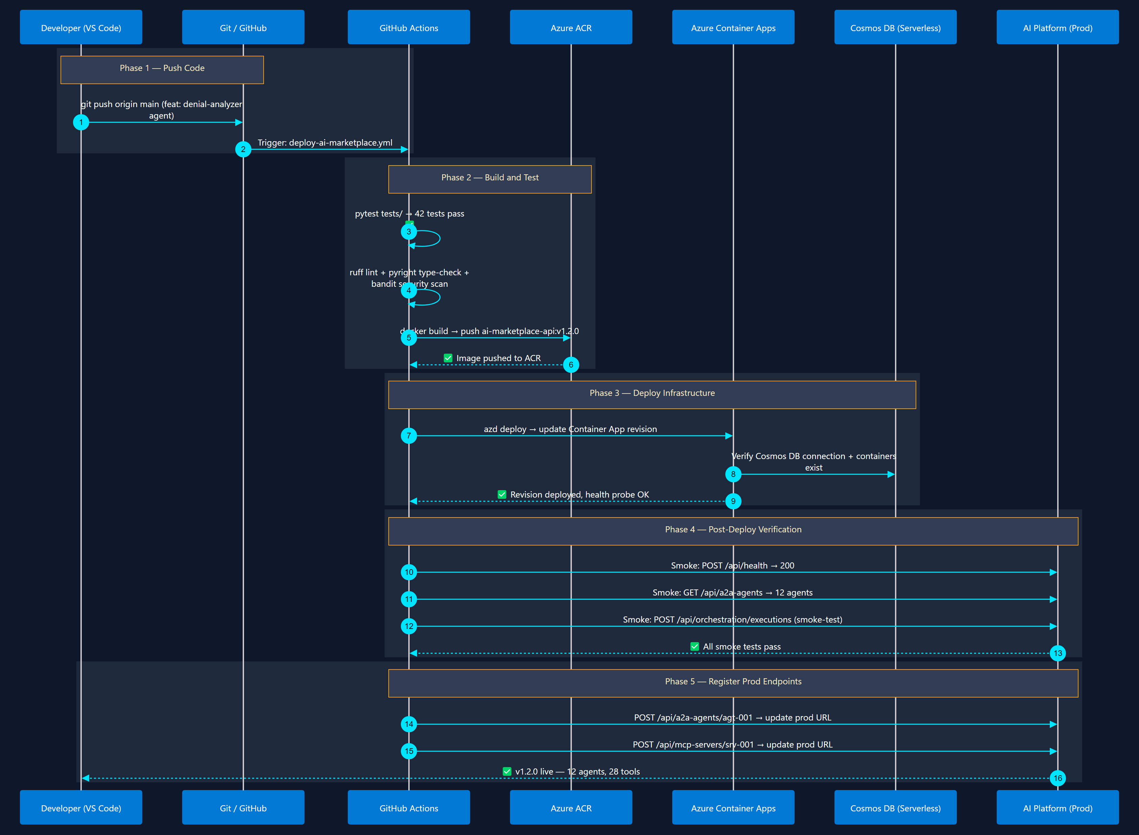
5
CI/CD Pipeline & Deployment
azd up + GitHub Actions
Git push → GitHub Actions → build container → deploy to Container Apps → verify

Slide 18
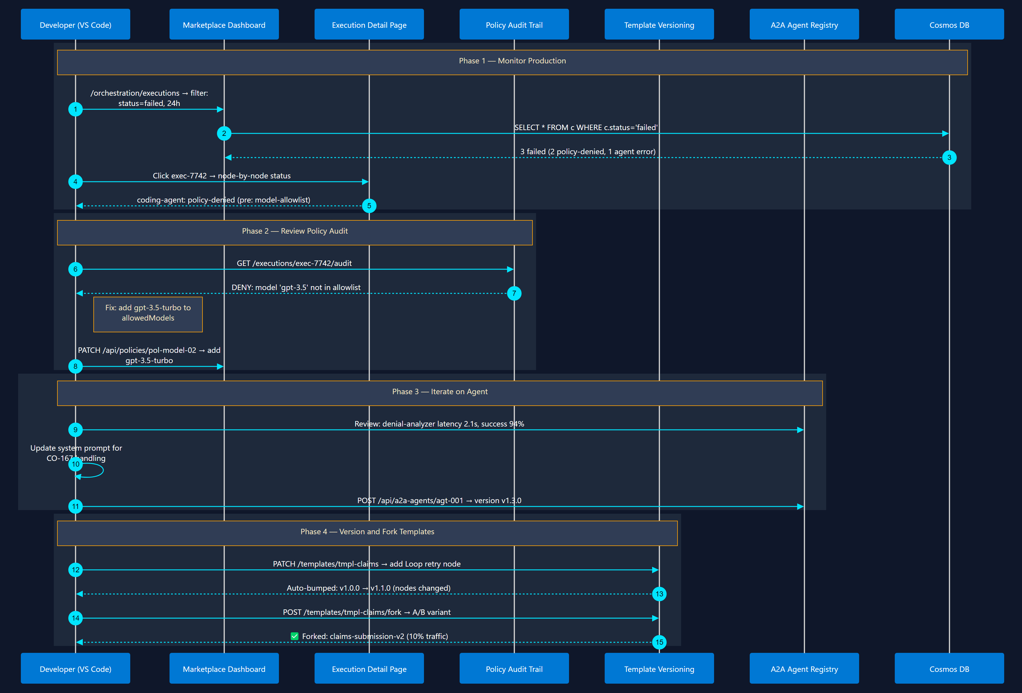
6
Day-2: Monitor, Iterate & Version
Observe → Refine → Ship
Monitor executions → review policy violations → update agents → version templates

Slide 19
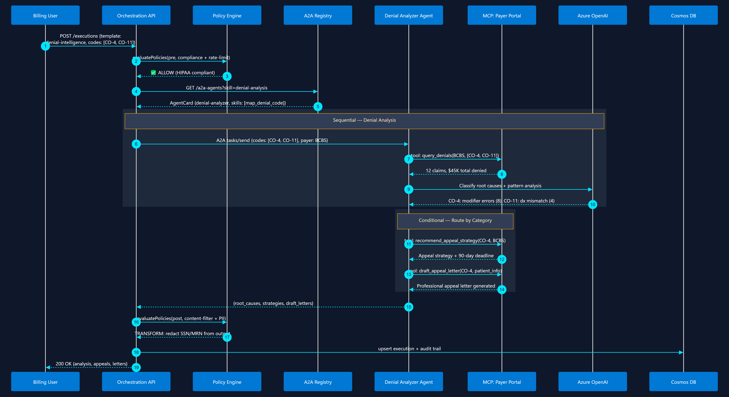
7
TBC - Denial Intelligence Workflow
Conditional Router + Supervisor
Analyze denials → classify root cause → recommend appeal strategy

Slide 20
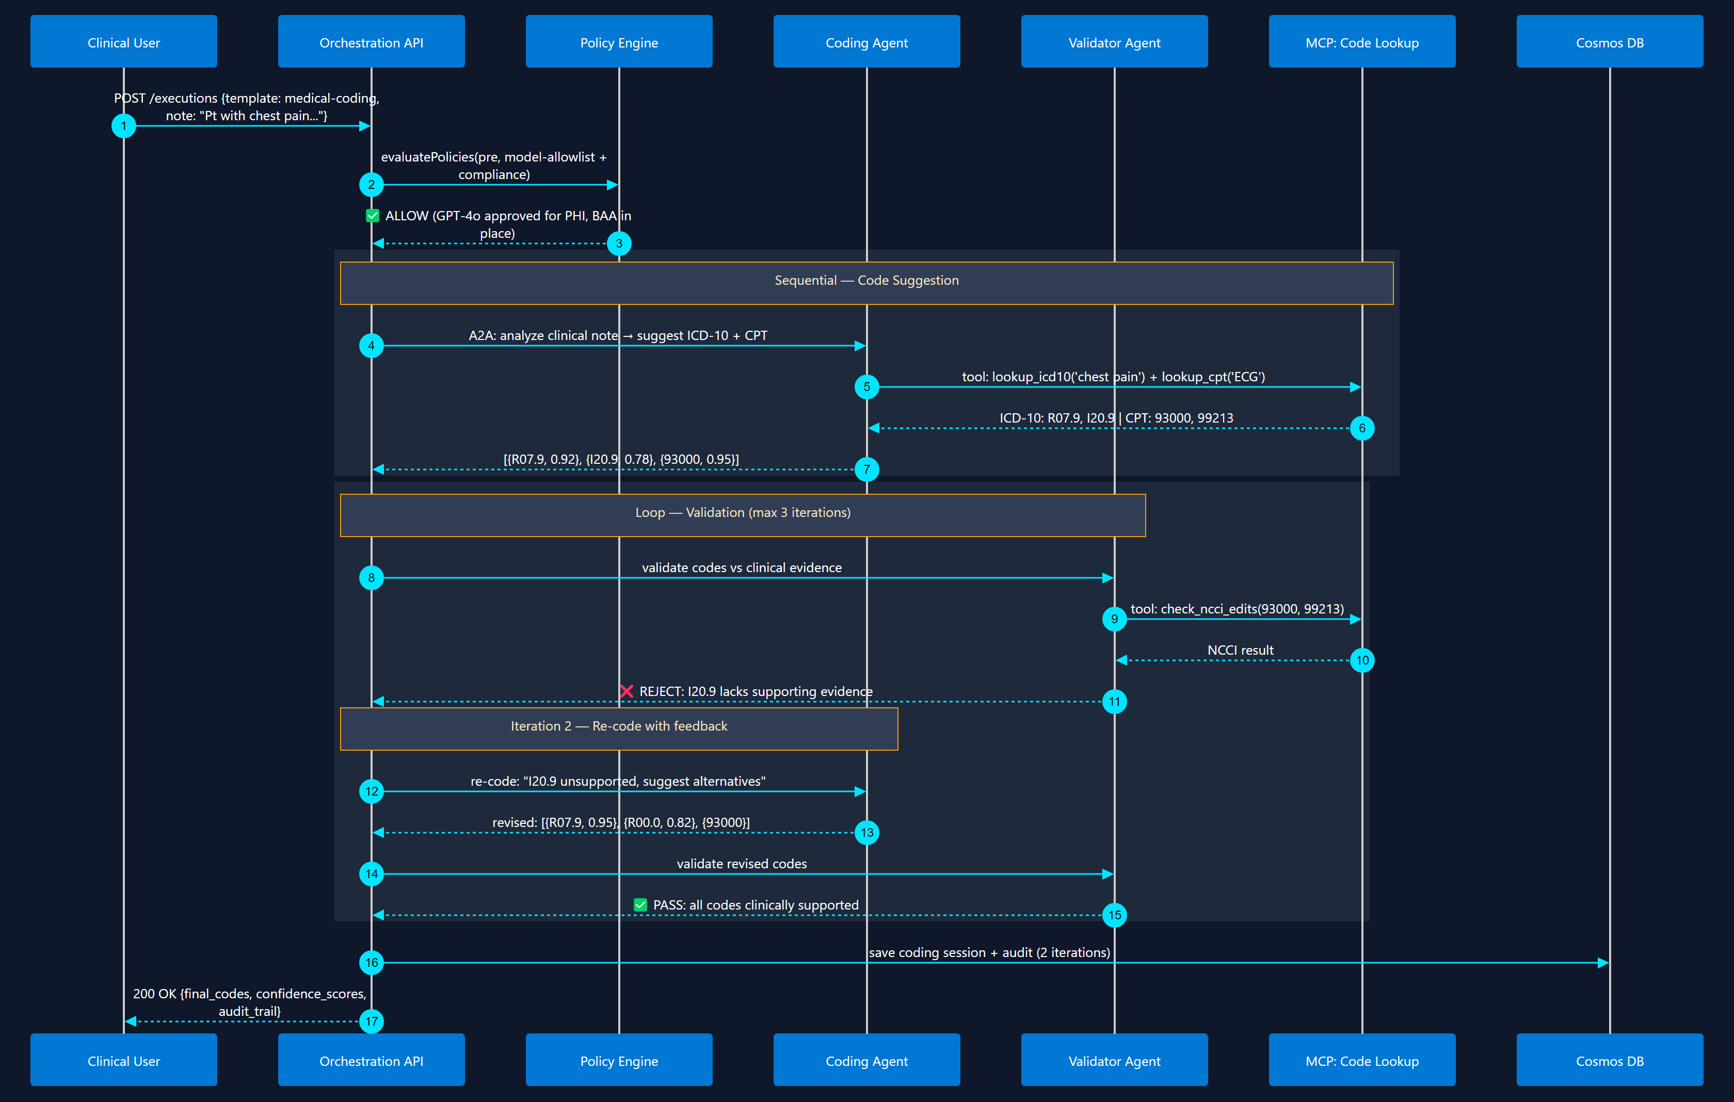
8
TBC - Automated Medical Coding
Sequential + Loop (Writer-Critic)
Clinical note → ICD-10/CPT suggestion → validation loop → final codes

Slide 21
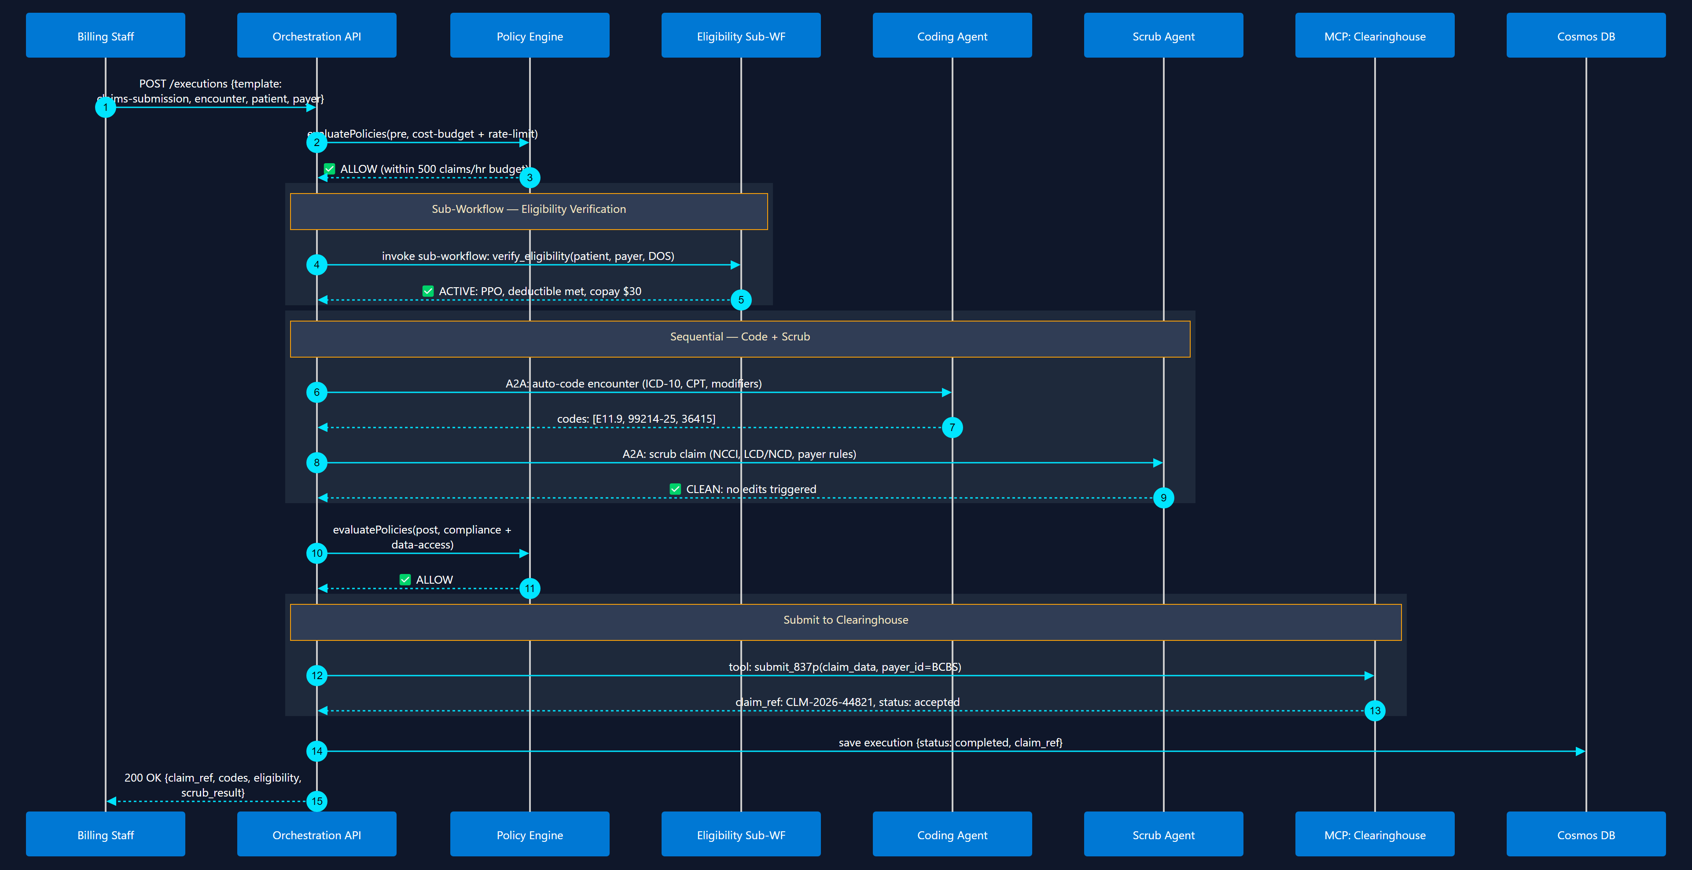
9
TBC - Claims Submission Pipeline
Sub-Workflow + Sequential
Eligibility → Coding → Scrub → Submit to Clearinghouse

Slide 22
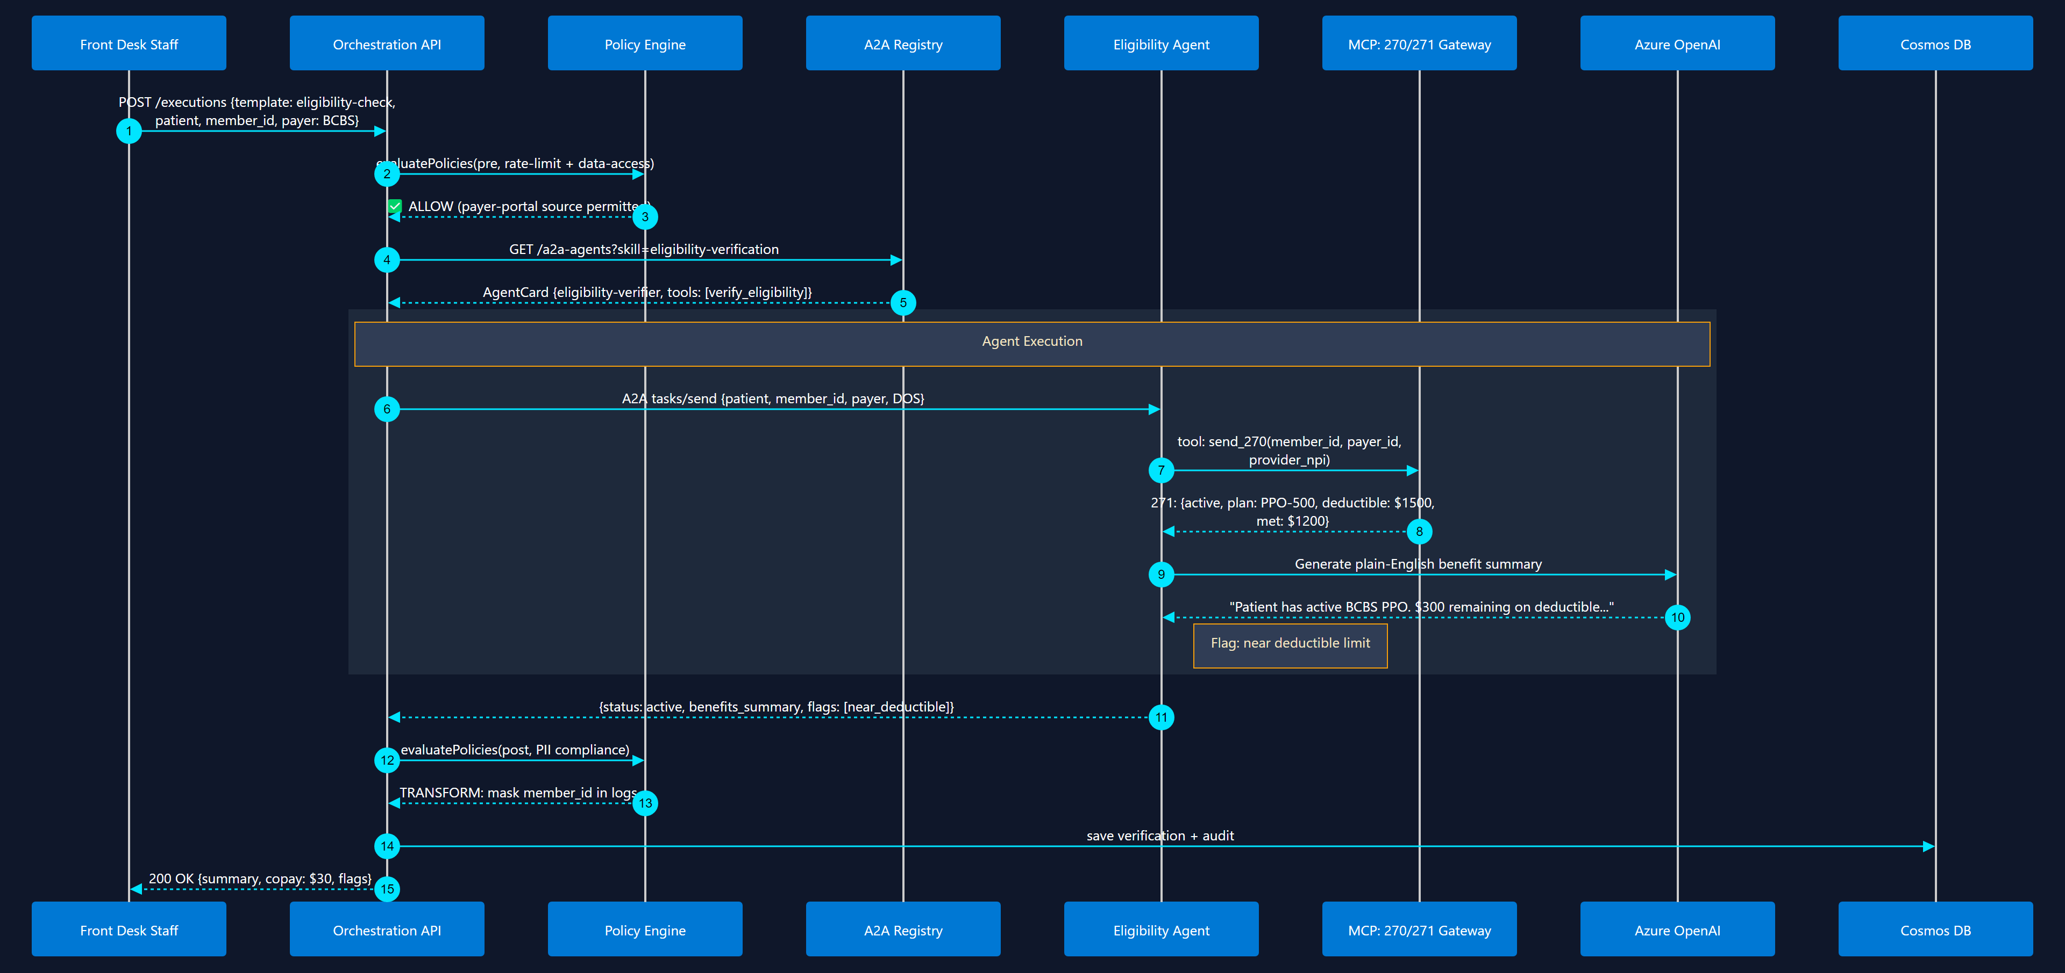
10
Eligibility Verification
Sequential + MCP Tool Call
Real-time 270/271 check via MCP tool + AI benefit summary

Slide 23
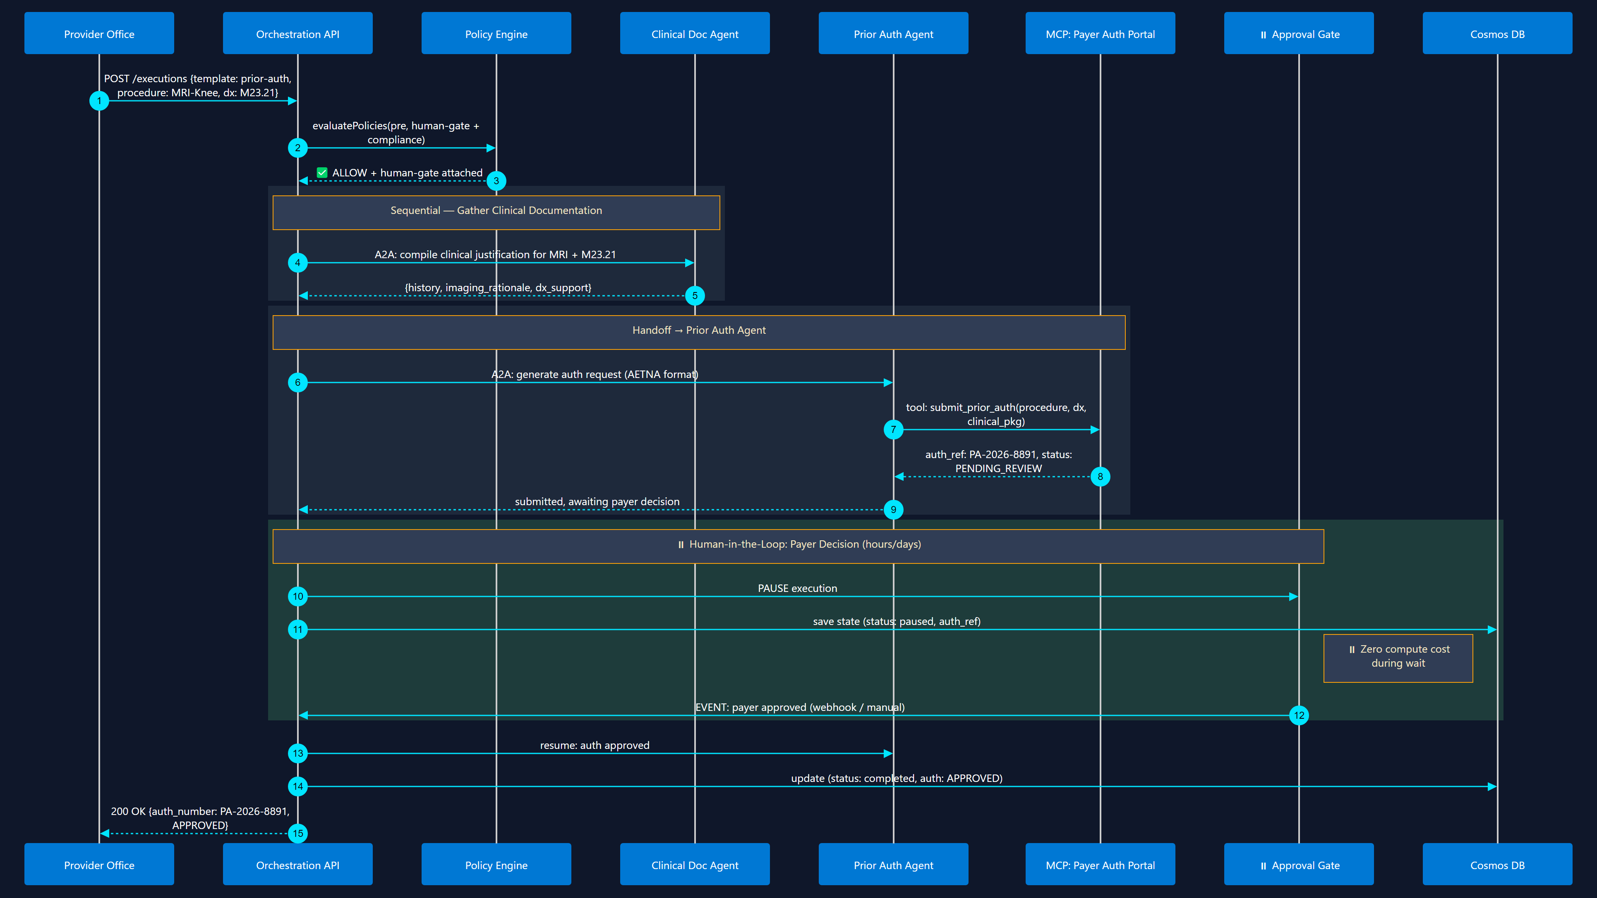
11
TBC - Prior Authorization Workflow
Human-in-the-Loop + Handoff
Generate auth request → submit → pause for payer decision → resume

Slide 24
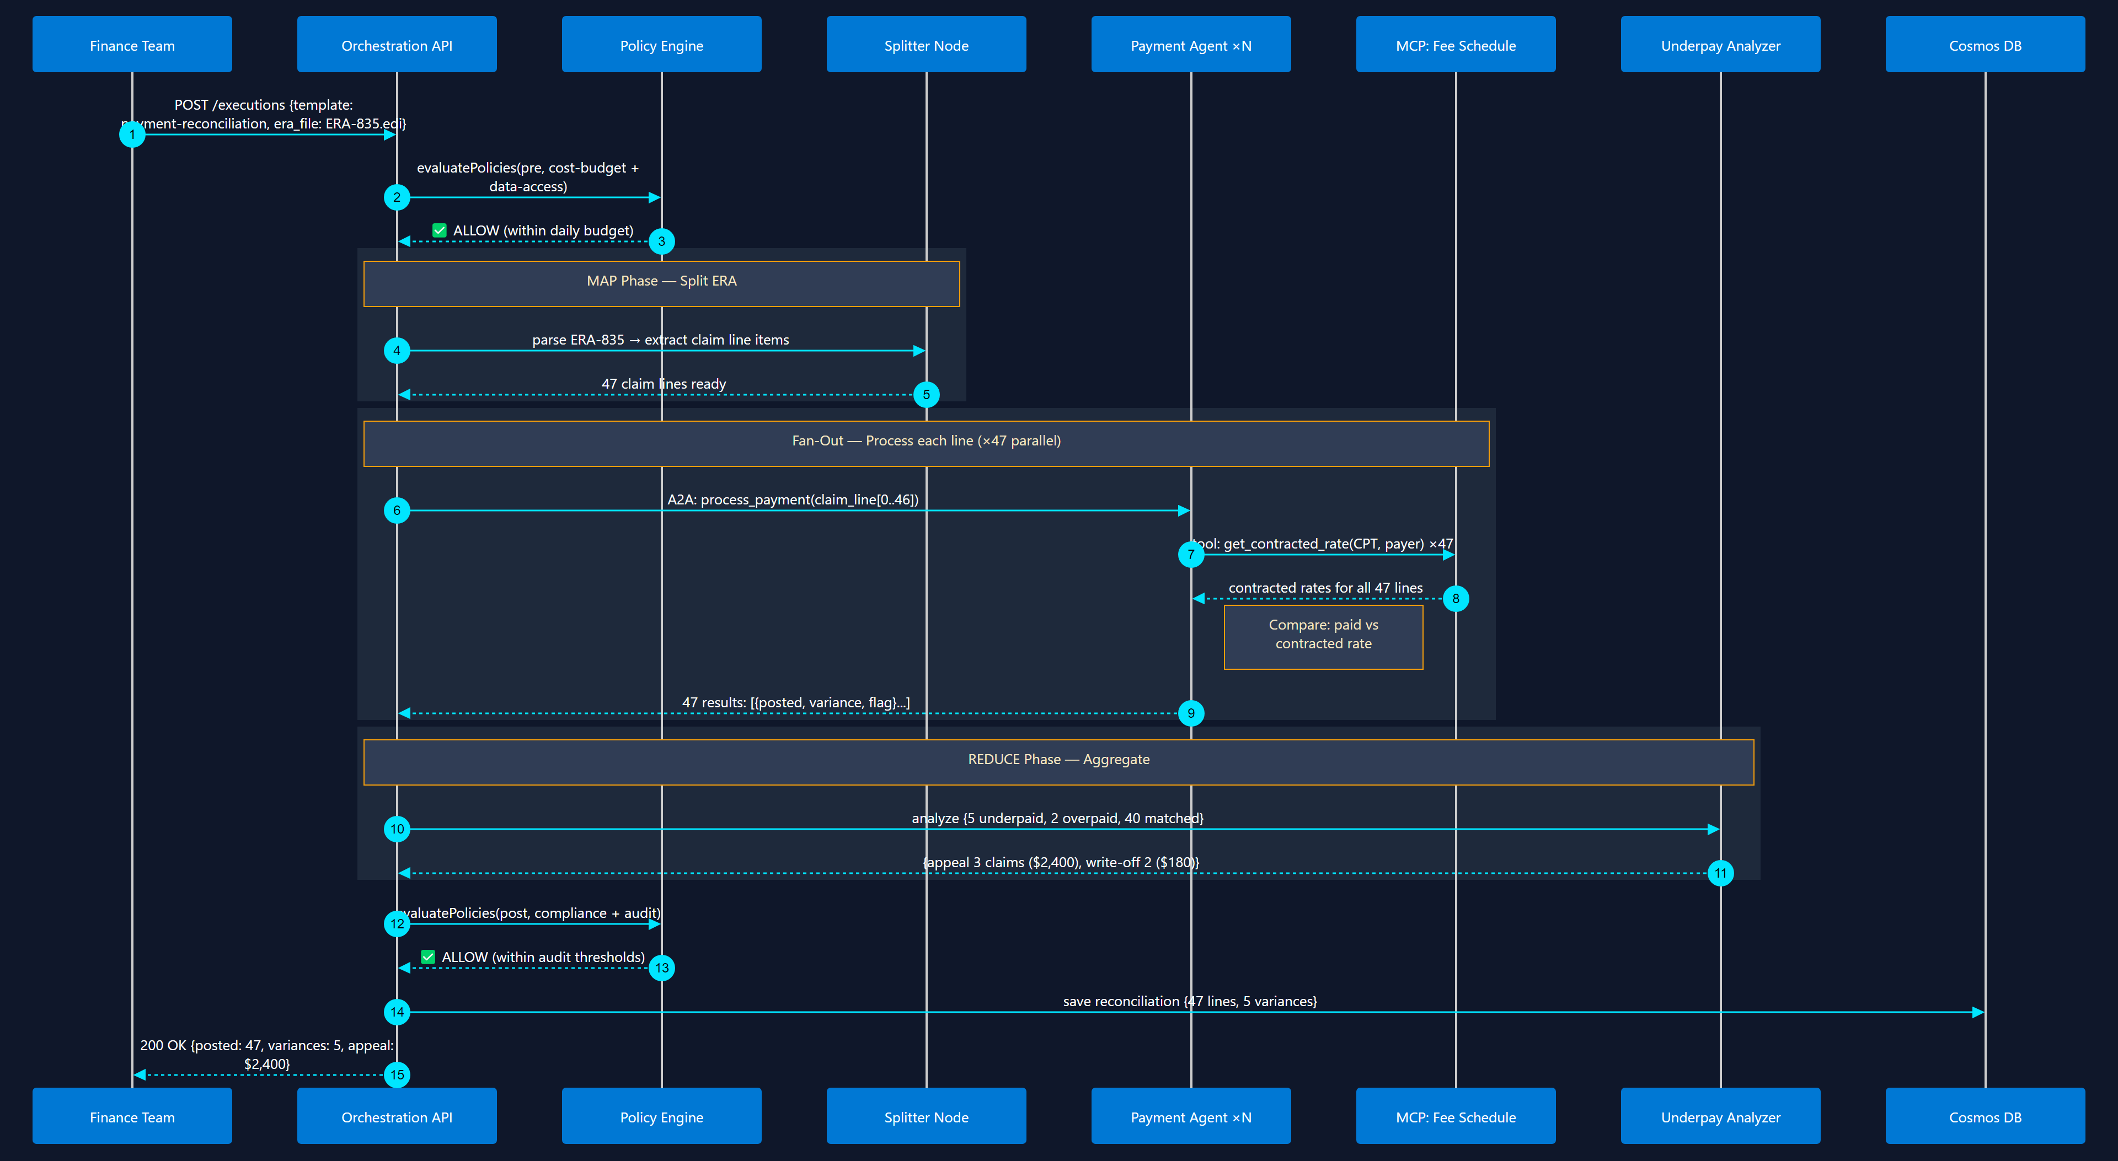
12
TBC - Payment Posting & Reconciliation
Map-Reduce + Fan-Out / Fan-In
Batch ERA (835) → map each claim line → detect underpayments → reconcile

Slide 25
10 Orchestration Patterns
with Microsoft Agent Framework
AI Marketplace — Architecture & Design Series
Sequential
Fan-Out / Fan-In
Conditional Router
Loop / Iteration
Human-in-the-Loop
Supervisor
Map-Reduce
Handoff
Group Chat
Sub-Workflow
Hosted on Azure Container Apps • Cosmos DB • Azure OpenAI • Python + FastAPI

Slide 26
1
Sequential Pipeline
Agents execute in strict order — each output feeds the next
📥 Start
🤖 Agent A Analyze
🤖 Agent B Enrich
🤖 Agent C Summarize
📤 End
MAF Code Pattern
When to Use
• Step-by-step data processing (ETL, claim workflows)
• Each agent needs the previous agent's output
• Order matters — can't parallelize
• Document review → Extraction → Validation → Enrichment
from agent_framework.orchestrations import SequentialBuilder workflow = ( SequentialBuilder() .add_agent(analyzer_agent) .add_agent(enricher_agent) .add_agent(summarizer_agent) .build() ) result = await workflow.as_agent().run(input_text)
Key Characteristics
• MAF Builder: SequentialBuilder — one-liner chaining
• Data flow: shared conversation context passed through each agent
• State: each agent sees all prior messages; AgentSession persists across turns
• Streaming: every agent can stream tokens to the client via event handlers

Slide 27
2
Parallel Fan-Out / Fan-In
Dispatch to N agents simultaneously, aggregate results
🤖 Tech Analysis
📥 Input
⚡ Dispatch
🤖 Market Analysis
🔀 Aggregate
📤 Output
🤖 Risk Analysis
MAF Code Pattern
When to Use
• Independent sub-tasks that can run in parallel
• Multi-perspective analysis (technical + market + risk)
• Latency matters — total time = slowest branch, not sum
• Translation to multiple languages simultaneously
from agent_framework.orchestrations import ConcurrentBuilder workflow = ( ConcurrentBuilder() .add_agent(tech_agent) .add_agent(market_agent) .add_agent(risk_agent) .with_aggregator(summary_agent) # optional LLM merge .build() )
Key Characteristics
• MAF Builder: ConcurrentBuilder — fan-out with default or custom aggregator
• Join strategies: wait-all (default), custom aggregator callback, LLM-based merge
• Reduces total latency from O(n) sequential to O(max) parallel

Slide 28
3
Conditional Router
Dynamic edge routing — branch execution based on data or classifier output
billing
🤖 Billing Agent
📥 Input
🧠 Classifier
tech
🤖 Tech Support
📤 Output
other
🤖 General Agent
MAF Code Pattern
When to Use
• Intent classification → route to specialist agent
• If/else logic based on previous agent output
• Switch-case: multiple exclusive branches
• Multi-selection: one input triggers multiple targets
# Edge conditions in MAF workflow wf = Workflow() wf.add_executor('classifier', classifier_fn) wf.add_executor('billing', billing_agent) wf.add_executor('tech', tech_agent) wf.add_edge('classifier', 'billing', condition=lambda msg: msg.intent == 'billing') wf.add_edge('classifier', 'tech', condition=lambda msg: msg.intent == 'tech')
Key Characteristics
• MAF: edge_condition, switch_case_edge_group, multi_selection_edge_group — all built-in
• Only matched branch executes (others skipped); supports both function-based and agent-based classifiers
• Declarative YAML variant: conditional_workflow with nested if/elif/else blocks

Slide 29
4
Loop / Iteration
Repeat agent execution until a condition is met or max iterations reached
↺ not good
📥 Input
🤖 Writer Agent
🧠 Judge Agent
✓ pass
📤 Output
MAF Code Pattern
When to Use
• Writer-Critic pattern: generate → evaluate → refine
• Iterative improvement until quality threshold met
• Self-correction: agent retries after feedback
• Code generation → test → fix → retest loop
• Max iterations prevent infinite loops (safety boundary)
# Feedback loop with conditional edge wf = Workflow() wf.add_executor('writer', writer_agent) wf.add_executor('judge', judge_fn) wf.add_edge('writer', 'judge') wf.add_edge('judge', 'writer', condition=lambda msg: msg.verdict != 'PASS') wf.add_edge('judge', '__end__', condition=lambda msg: msg.verdict == 'PASS')
Key Characteristics
• MAF: simple_loop sample — judge agent decides ABOVE / BELOW / MATCHED to control iteration
• Writer-Critic in _StartHere samples: iterative refinement with quality gates + max iteration safety
• Quality threshold + max iterations prevent infinite loops; each iteration persisted via checkpoints
• Supports both agent-based judges and simple function conditions

Slide 30
5
Human-in-the-Loop (Approval Gate)
Pause execution for human review, resume on approval
✅ Approved
🤖 Next Agent
🤖 Agent Generates
📋 Review Pending
❌ Rejected
🔄 Revise
MAF Code Pattern
When to Use
• Content approval before publishing
• Financial transaction review above $ threshold
• Tool call approval (sensitive actions)
• Medical/legal review before agent proceeds
• Compliance gate: human reviews PII detection results
# Human-in-the-loop via ctx.request_info() async def review_executor(ctx, msg): result = await ctx.request_info( RequestInfoMessage( content=f'Approve? {msg.text}', request_id='approval-1' ) ) if result.approved: return ApprovedMessage(msg.text) return RejectedMessage(result.feedback)
Key Characteristics
• MAF: ctx.request_info() pauses workflow, emits request event, resumes when response arrives
• Checkpointing: checkpoint_with_human_in_the_loop — save state, shut down, resume later (even days/weeks)
• Tool Approval: .with_tool_approval() on builders — auto-gate all tool calls for human review
• Zero compute cost during wait (Flex Consumption / Container Apps min-replicas=0)

Slide 31
6
Supervisor / Hierarchical
Manager agent reviews child outputs and re-routes or overrides
🧑‍💼 Supervisor Agent (Manager / Magentic)
delegates
reports back
🤖 Research Agent
🤖 Writing Agent
🤖 Review Agent
MAF Code Pattern
When to Use
• Manager agent decides which sub-agent to invoke next
• Quality control: supervisor reviews all child outputs
• Reflection pattern: agent reviews its own output
• Research → Synthesize → Review orchestration
• Customer routing: triage → specialist selection
from agent_framework.orchestrations import MagenticBuilder workflow = ( MagenticBuilder() .add_agent(research_agent, name='Researcher') .add_agent(writer_agent, name='Writer') .add_agent(reviewer_agent, name='Reviewer') .with_manager(manager_agent) # decides next .build() )
Key Characteristics
• MAF Builder: MagenticBuilder — supervisor agent creates plan, assigns tasks, reviews results
• Supports human plan review (magentic_human_plan_review) and checkpoint resume

Slide 32
7
Fan-out and Fan-in
Apply same agent to each item in a collection, then reduce results
🤖 Item 1
📄 Collection [items]
MAP
🤖 Item 2
REDUCE
🔀 Aggregate
📤 Output
🤖 Item 3
🤖 Item N
MAF Code Pattern
When to Use
• Batch processing: analyze each claim in a batch
• Multi-document summarization (1 agent per document)
• Process each row of a dataset with same logic
• Chunk-by-chunk processing of large documents
# Map-Reduce via fan_out_fan_in_edges.py chunks = split_document(large_doc) wf = Workflow() wf.add_executor('splitter', split_fn) for i in range(len(chunks)): wf.add_executor(f'worker_{i}', process_agent) wf.add_edge('splitter', f'worker_{i}') wf.add_edge(f'worker_{i}', 'reducer') wf.add_executor('reducer', aggregate_fn)
Key Characteristics
• MAF: map_reduce_and_visualization sample — fan-out/fan-in with diagram export
• Dynamic fan-out: generate N worker executors at runtime based on collection size
• Reduce: custom aggregator function, or LLM-based summarization of parallel results

Slide 33
8
Handoff (Agent-to-Agent Routing)
Agents transfer control to specialists via tool-call handoff
handoff()
💰 Billing Specialist
🧑‍💼 Triage Agent (Router)
🔧 Tech Specialist
👤 User
📦 Shipping Specialist
MAF Code Pattern
When to Use
• Customer service: triage → specialist agent routing
• Agent realizes it lacks expertise, transfers to another
• Autonomous mode: specialists iterate independently
• Multi-tier: specialist can handoff to sub-specialists
from agent_framework.orchestrations import HandoffBuilder workflow = ( HandoffBuilder() .set_triage_agent(triage_agent) .add_agent(billing_agent, name='Billing') .add_agent(tech_agent, name='TechSupport') .add_handoff('TechSupport', ['Billing']) # T→B .with_autonomous_mode() # agents iterate .build() )
Key Characteristics
• MAF Builder: HandoffBuilder — triage agent routes via tool calls, specialists can cross-handoff
• Autonomous mode: specialist runs until done or explicitly invokes handoff tool (no user round-trip)
• Full history preserved across handoffs with additional_properties for routing metadata

Slide 34
9
Group Chat (Multi-Agent Debate)
Multiple agents discuss in rounds, managed by a moderator
🧑‍⚖️ Moderator
🤖 Summarizer
🤖 Pro Agent
🔄 Round-Robin or LLM-Selected
🤖 Ethicist
🤖 Con Agent
🤖 Analyst
MAF Code Pattern
When to Use
• Multi-perspective debate (ethics, technical, business)
• Brainstorming with diverse agent personas
• Code review: author + reviewer + security agent
• Philosophical debate with structured moderation
• Board simulation: CEO, CTO, CFO discuss strategy
from agent_framework.orchestrations import GroupChatBuilder workflow = ( GroupChatBuilder() .add_agent(pro_agent, name='Advocate') .add_agent(con_agent, name='Critic') .add_agent(analyst_agent, name='Analyst') .with_orchestrator(agent=moderator_agent) .with_max_turns(10) .build() )
Key Characteristics
• MAF Builder: GroupChatBuilder — agent manager selects next speaker via LLM or simple function selector
• Supports max_turns, tool approval, request_info for human steering mid-debate

Slide 35
10
Sub-Workflow / Nesting
Compose workflows hierarchically — a workflow as a step in a parent workflow
Parent Workflow
Child Workflow (Nested)
📥 Input
🤖 Pre-process
🤖 Step A
🤖 Step B
🤖 Step C
🤖 Post-process
📤
MAF Code Pattern
When to Use
• Reusable workflow modules (e.g., 'KYC Check' sub-workflow)
• Team-owned sub-workflows composed into larger pipelines
• Isolate complex logic into testable sub-units
• Recursive workflows: a workflow can contain itself
• A2A: cross-service workflow composition
# Sub-workflow as executor child_wf = Workflow() child_wf.add_executor('step_a', agent_a) child_wf.add_executor('step_b', agent_b) child_wf.add_edge('step_a', 'step_b') parent_wf = Workflow() parent_wf.add_executor('preprocess', pre_agent) parent_wf.add_executor('child', child_wf.as_executor()) parent_wf.add_edge('preprocess', 'child')
Key Characteristics
• MAF: sub_workflow_basics — wrap Workflow as executor via .as_executor(); supports kwargs propagation, request interception, checkpointing

Slide 36
Pattern Summary — Quick Reference
#
Pattern
MAF Primitive
Use Case
Status
1
Sequential Pipeline
SequentialBuilder
ETL, claim processing
✅ Built-in
2
Fan-Out / Fan-In
ConcurrentBuilder
Multi-perspective analysis
✅ Built-in
3
Conditional Router
edge_condition
Intent classification
✅ Built-in
4
Loop / Iteration
simple_loop / edges
Writer-Critic refinement
✅ Built-in
5
Human-in-the-Loop
ctx.request_info()
Approval gates, compliance
✅ Built-in
6
Supervisor / Hierarchical
MagenticBuilder
Manager-worker delegation
✅ Built-in
7
Map-Reduce
fan_out_fan_in_edges
Batch / chunk processing
✅ Built-in
8
Handoff
HandoffBuilder
Customer service routing
✅ Built-in
9
Group Chat
GroupChatBuilder
Multi-agent debate
✅ Built-in
10
Sub-Workflow
wf.as_executor()
Reusable workflow modules
✅ Built-in
All 10 patterns are available today in Microsoft Agent Framework (Python + .NET) • Hosted on Azure Container Apps • Cosmos DB state • Azure OpenAI

