Slide 1
AI Platform — Architecture
Capabilities, Architecture and Dev Experience
12 Sequence Diagrams • 6 Dev-Experience • 6 RCM Domain Workflows
Microsoft Agent Framework • Azure Container Apps • Cosmos DB • Azure OpenAI

Slide 2
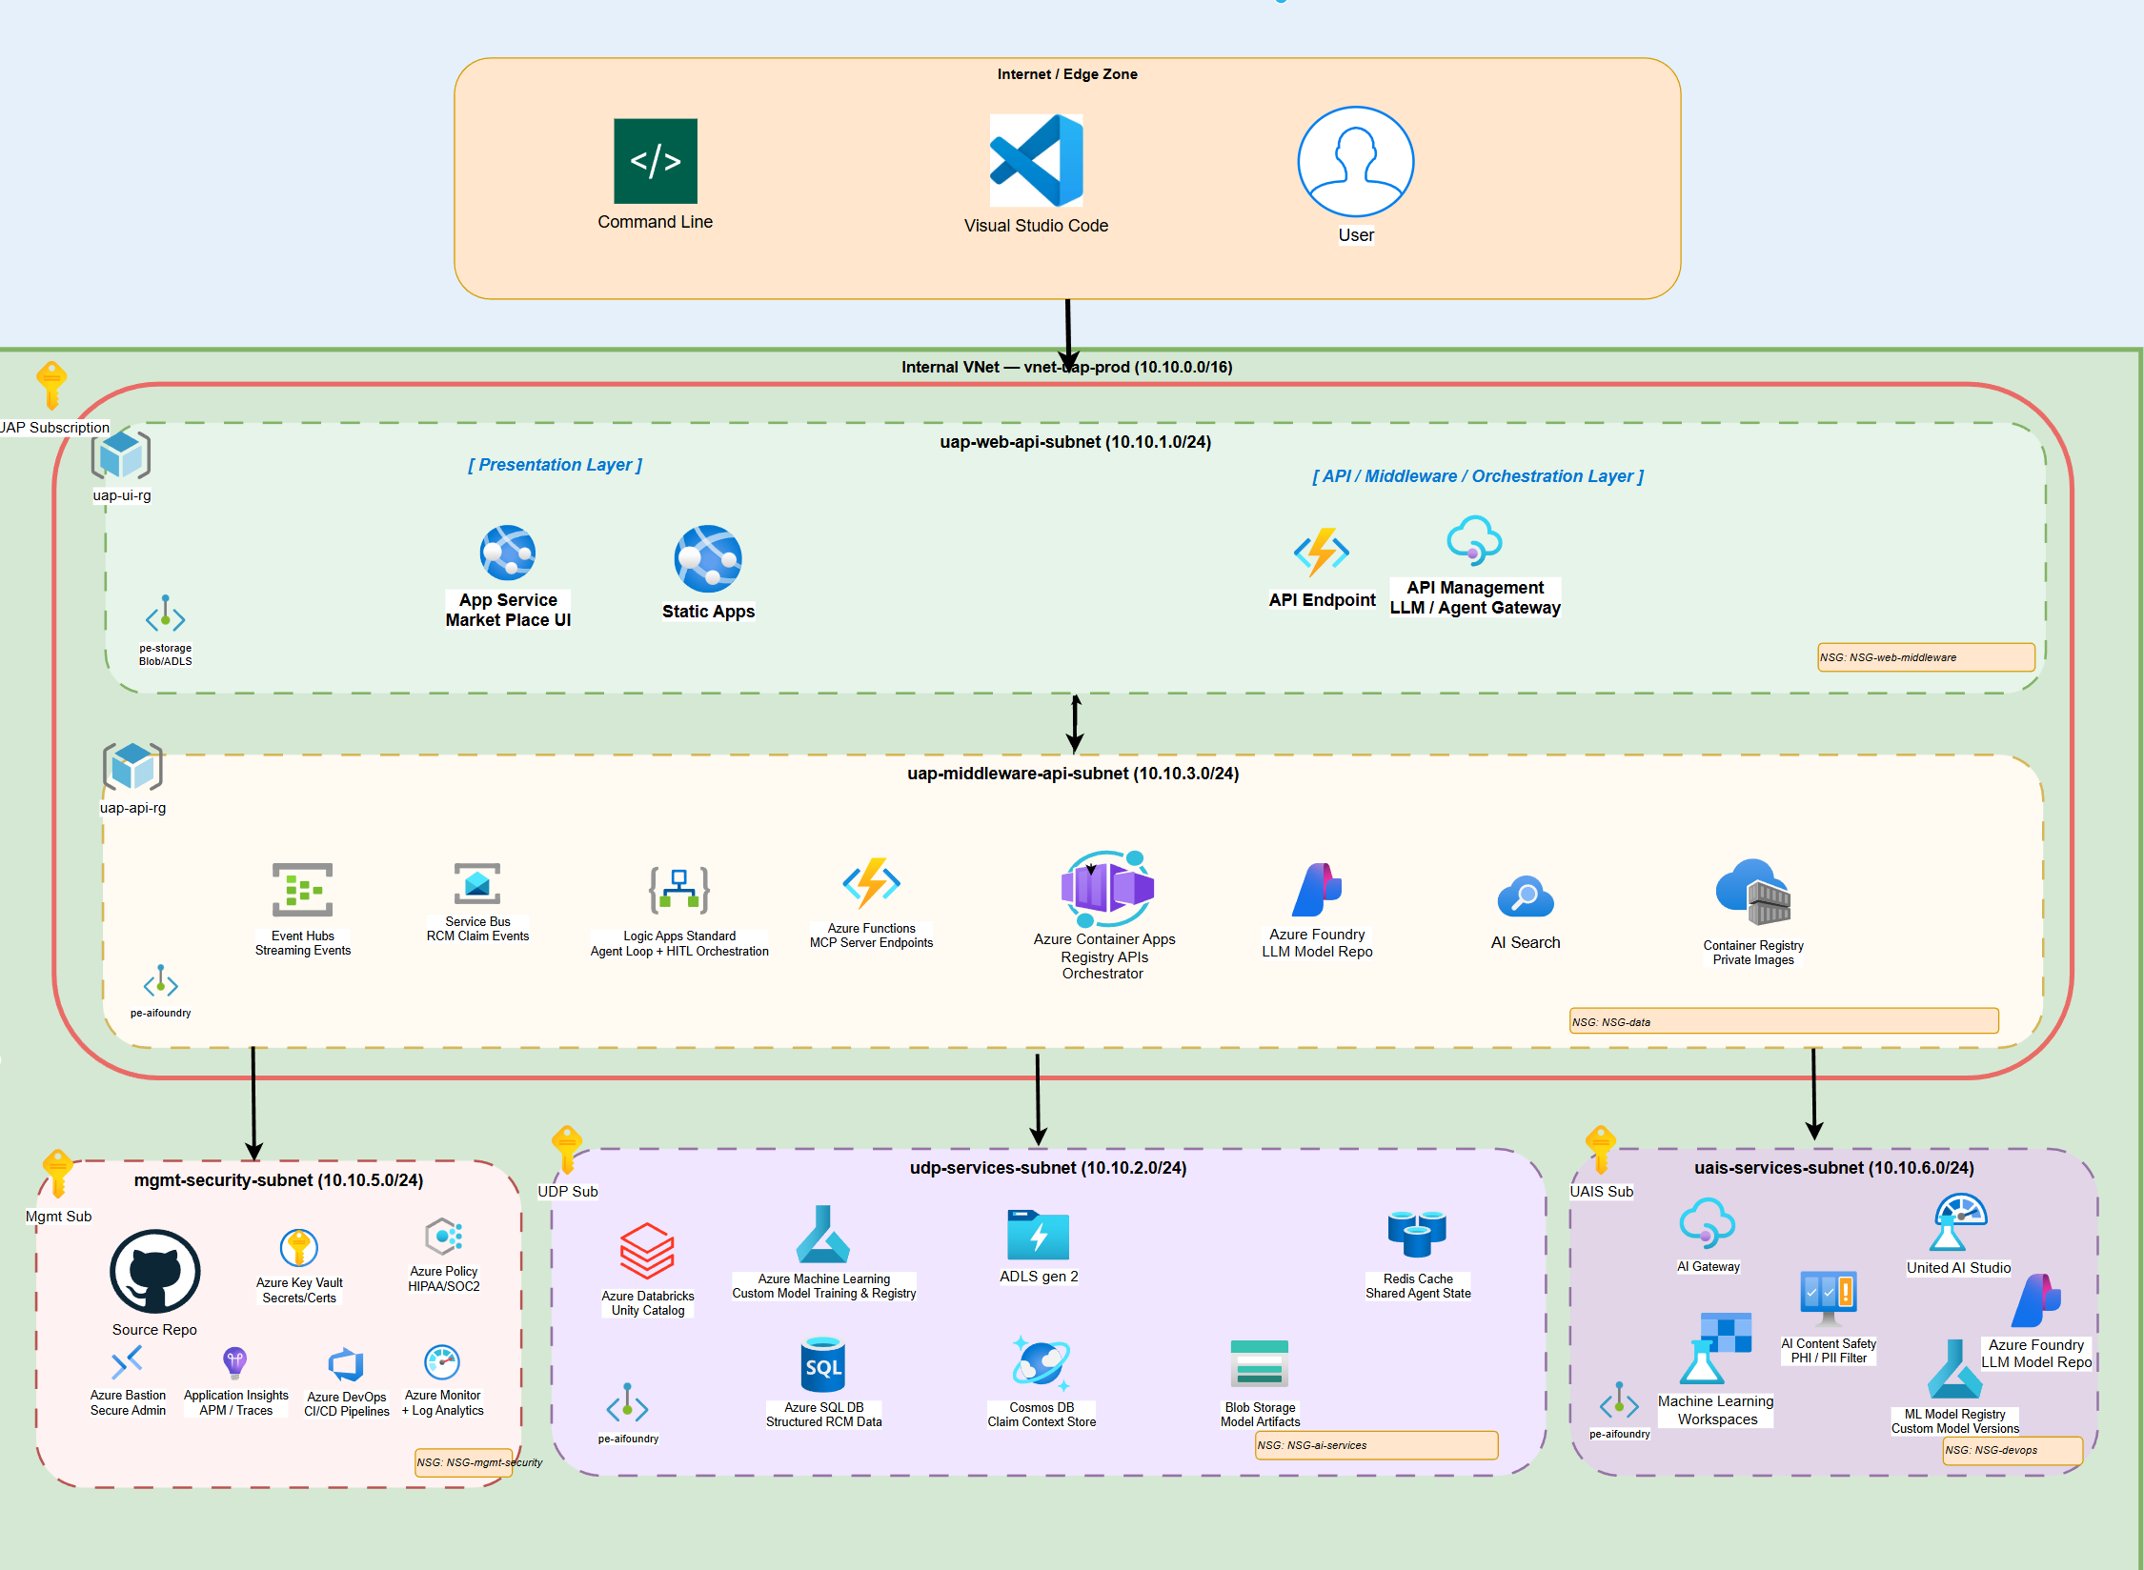
Unified Platform – UAP, UAIS and UDP
Unified AI Platform components

Slide 3
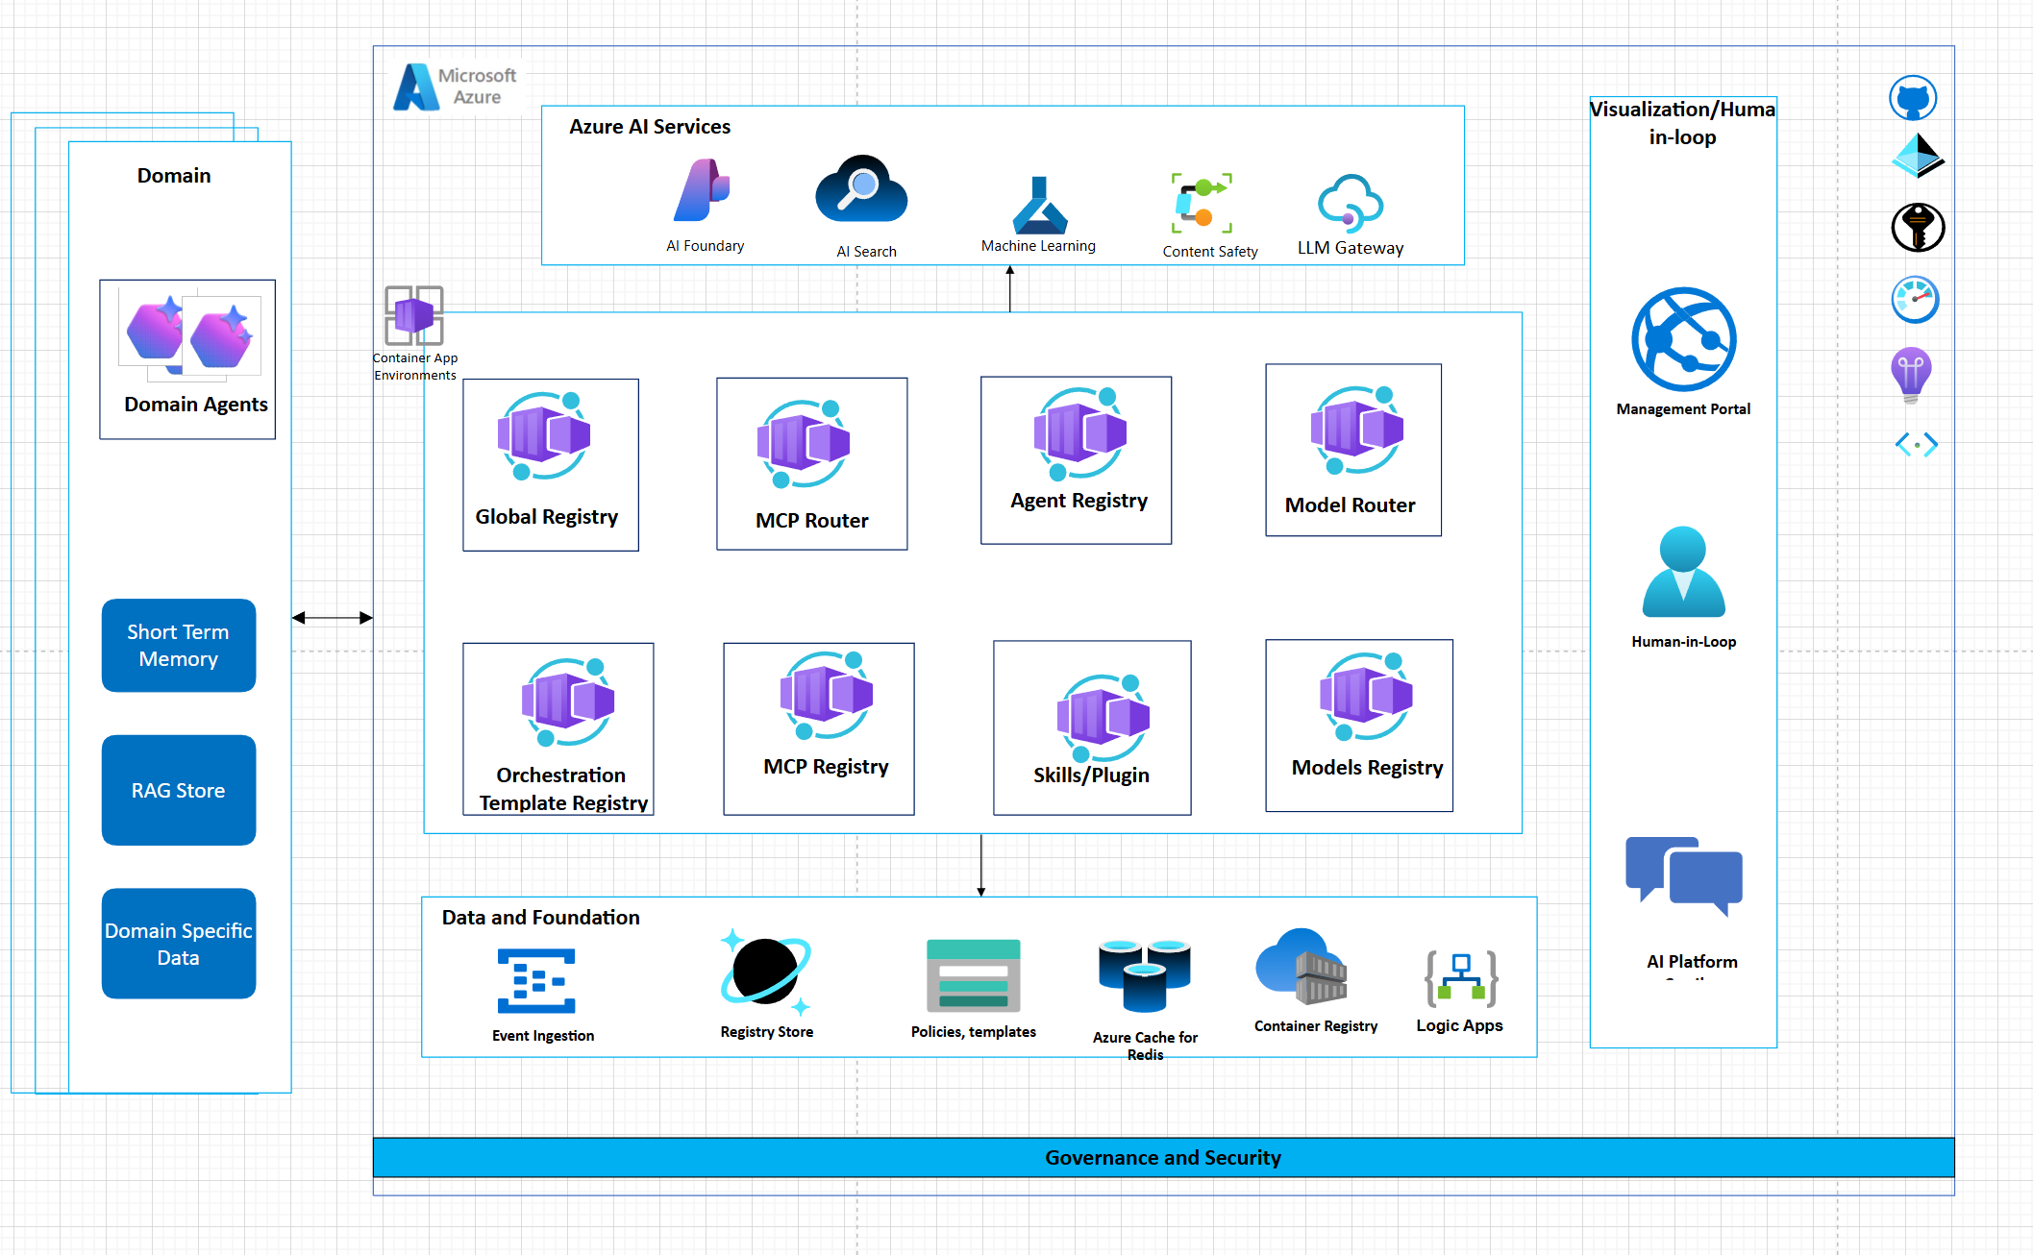
AI Platform Solution
Unified AI Platform components

Slide 4
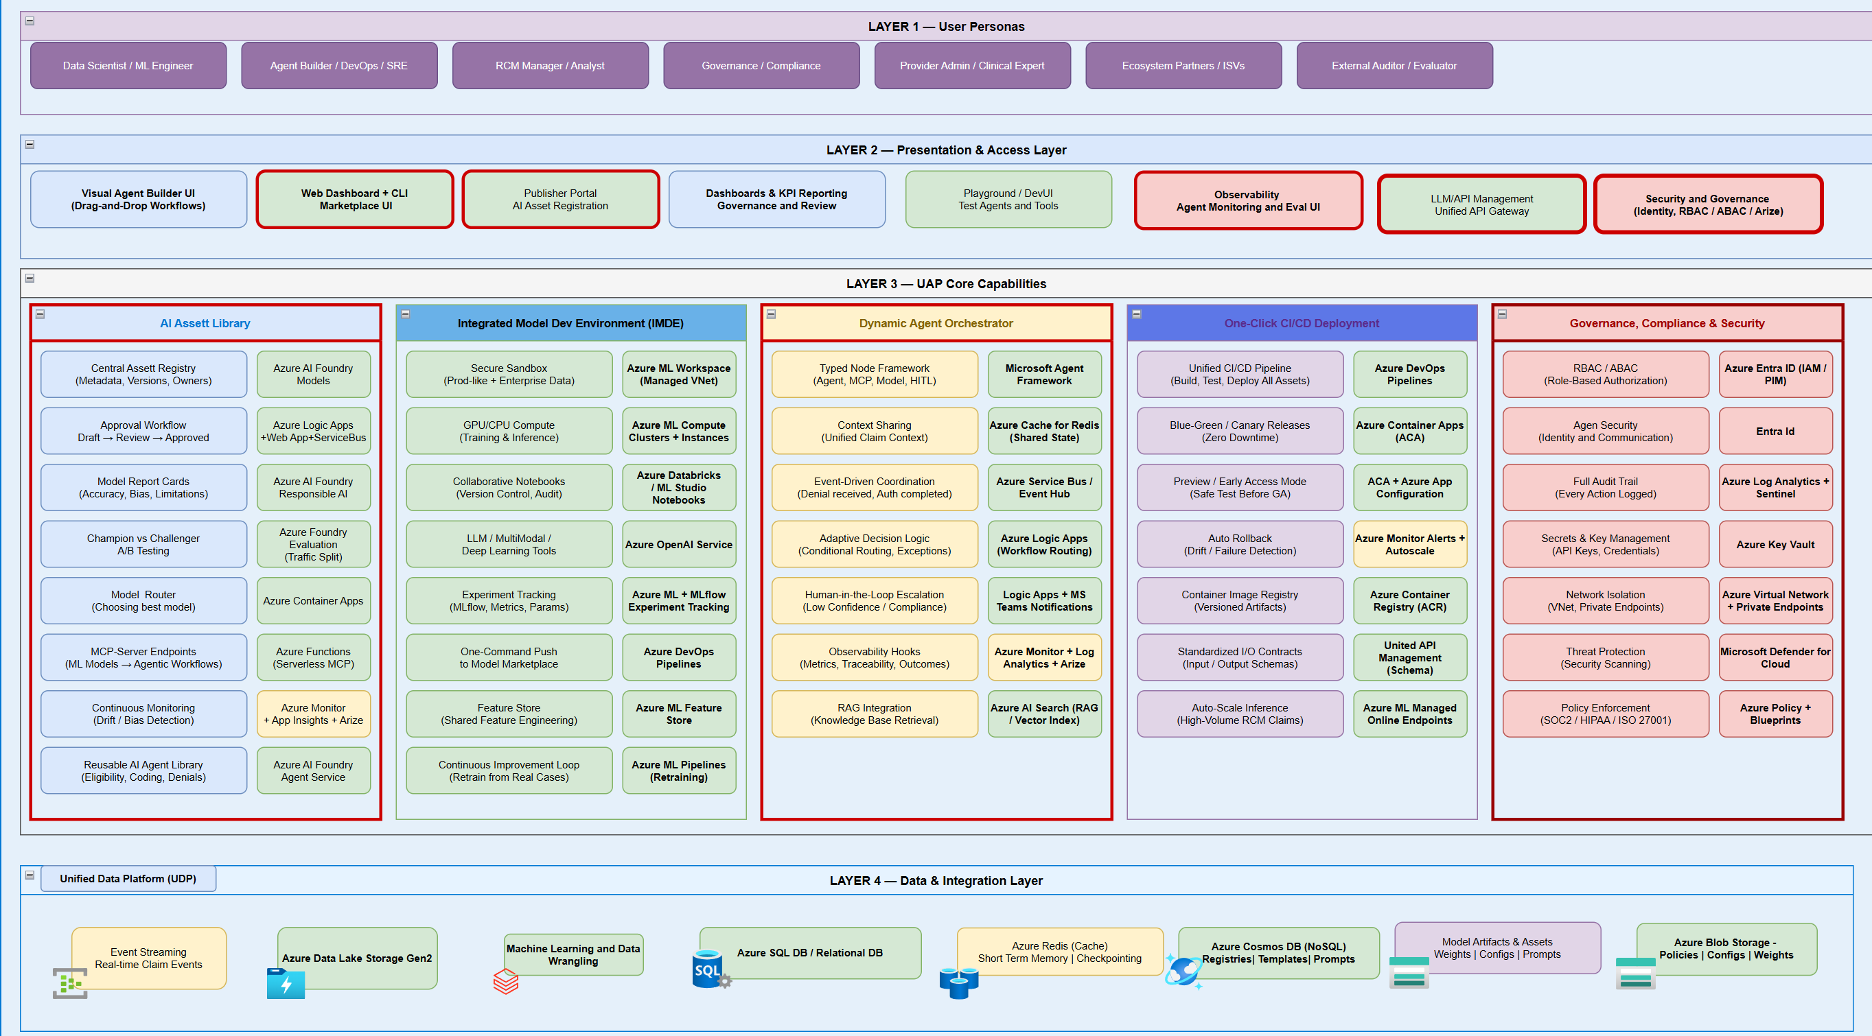
AI Platform Capabilities
Unified AI Platform components

Slide 5
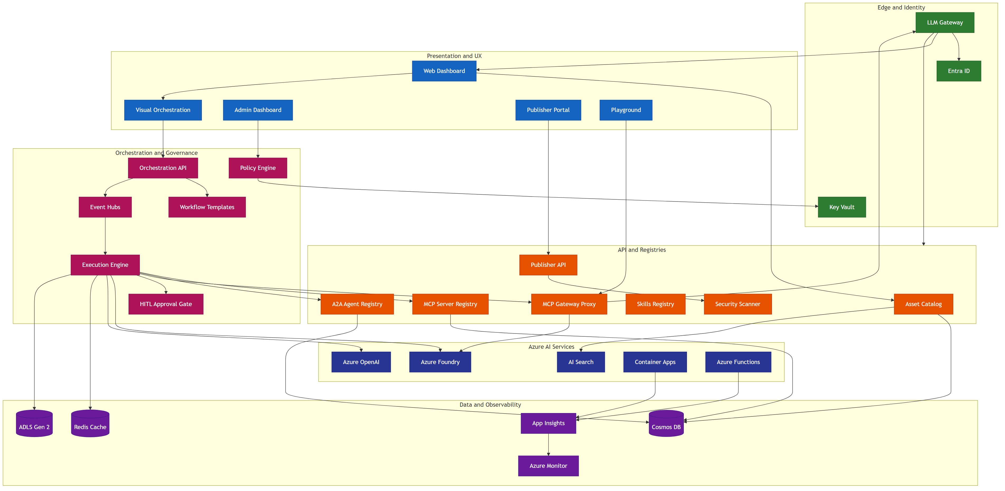
AI Marketplace app architecture
Enterprise grade scalable platform

Slide 6
AI Marketplace — Architecture Features (1–8)
#
Feature
Components
Data Flow
Key Differentiator
1
Enterprise Security
LLM GW, Entra ID, Key Vault, Scanner
LLM GW → Entra (token) → KV (secrets via MI)
Zero-trust, VNet isolation, PHI redaction, HIPAA-ready
2
Plan-Based Orchestration
Execution Engine, Workflow Templates, Registries
Engine → Templates → Registries (bind) → GW Proxy
Declarative plans, Delegation Envelope, step polymorphism
3
Semantic Discovery
AI Search, Asset Catalog, MCP/A2A Registries
Catalog → AI Search (vector) ← NL query → ranked
Vector-indexed search, .well-known crawl, federation
4
Human-in-the-Loop
HITL Gate, Execution Engine, Admin Dashboard
Engine → HITL Gate → Admin UI → Engine (resume)
First-class step type, not bolted on; audit provenance
5
Three-Tier Memory
Redis, Cosmos DB, ADLS Gen 2
Engine → Redis (short) → Cosmos (episodic) → ADLS
Summary-first flush, no raw PHI, episode records
6
Multi-Protocol Tools
MCP GW Proxy, MCP Registry, A2A Registry, Foundry
GW Proxy → MCP servers; A2A Registry → peer agents
MCP + A2A + Foundry + SaaS in one gateway
7
Governance
Policy Engine, Publisher API, Scanner, Admin UI
Publisher → Scanner → Policy → Admin → Catalog
Dual enforcement (publish + execute), full audit trail
8
Observability
App Insights, Azure Monitor, ACA, Functions
ACA + Functions → App Insights → Monitor (alerts)
OpenTelemetry e2e, trace_id propagation, per-episode
All 16 features map to architecture components • AI Asset Marketplace • Azure-Native Enterprise Platform

Slide 7
AI Marketplace — Architecture Features (9–16)
#
Feature
Components
Data Flow
Key Differentiator
9
Azure-Native Not Locked
MCP GW Proxy, A2A Registry, Foundry, ACA
GW routes to any MCP (ACA, SaaS, on-prem)
Open protocols, federation, optional Foundry
10
Production Infra
ACA, Functions, EventHub, LLM Gateway, Cosmos DB
ACA (stateless) + Functions (event) + LLM Gateway (edge)
Subnet isolation, scale-to-zero, Bicep IaC
11
Intelligent Tool Finder
AI Search, MCP Registry, Azure OpenAI
Registry → Cosmos → AI Search (FAISS) ← NL query
FAISS vector matching — agents self-discover tools
12
Dynamic Invocation
Execution Engine, MCP GW Proxy, AI Search
Engine → Search (find) → Registry (schema) → GW
Discover → resolve → call in one turn, no pre-config
13
Load Balancing
LLM Gateway, ACA, MCP GW Proxy
LLM GW → GW Proxy → ACA (scaling + probes)
Health-aware routing across MCP server replicas
14
IDE Integration
MCP Registry, Asset Catalog, LLM Gateway
Registry → export mcp.json → VS Code / Cursor
One-click IDE setup from marketplace registry
15
JWT Token Vending
Entra ID, Key Vault, LLM Gateway
Agent → Entra (creds) → JWT → LLM GW → GW Proxy
M2M scoped tokens for autonomous agent auth
16
Context-Aware Perms
Policy Engine, Entra ID, LLM Gateway
Engine → Policy (claims + context) → allow/deny
Dynamic scope eval per invocation, not just RBAC
All 16 features map to architecture components • AI Asset Marketplace • Azure-Native Enterprise Platform

Slide 8
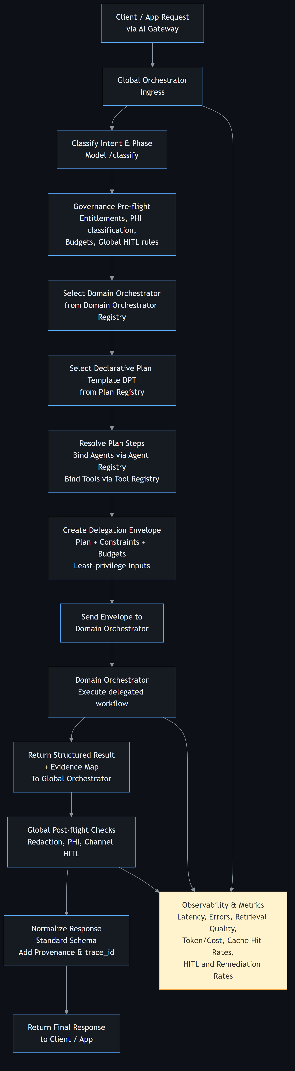
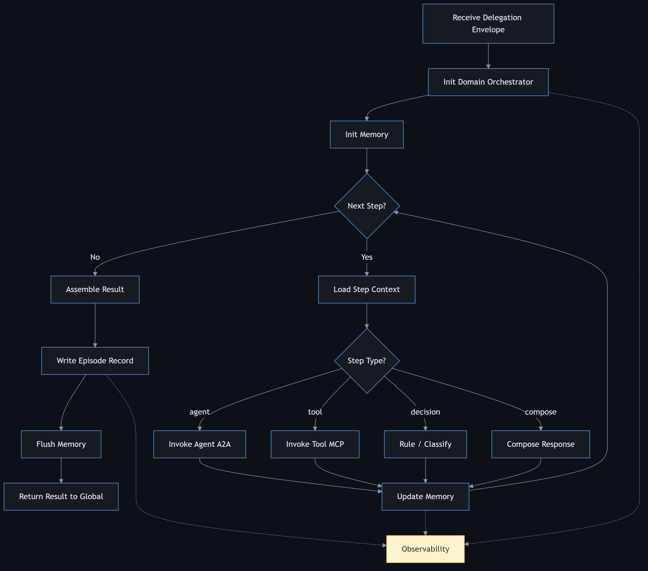
General Orchestrator Workflow

Slide 9
Langgraph vs MAF
Requirement | LangGraph on Azure | MAF on Azure
PHI / PII handling | Custom‑built | Native hooks
Audit trails | LangSmith / custom | Native workflow events
Deterministic replay | ✅ | ⚠️ Partial
Execution provenance | ⚠️ Graph‑level | ✅ Executor‑level
Role‑based access | App‑level | Platform‑level
Azure AD integration | Manual | Native
Managed Identity | Manual | Native
Secrets management | App‑managed | Platform‑managed
Logging retention | Custom | Azure Monitor
Incident forensics | Hard | Straightforward
Security review friction | High | Low

Slide 10
Langgraph vs MAF capabilities
LangGraph capability | Native in LangGraph | Native in MAF | What you must rebuild in LangGraph (to match MAF)
Graph‑based orchestration | ✅ StateGraph DAG | ✅ WorkflowBuilder DAG | —
Central shared state | ✅ StateGraph | ❌ (intentional) | Session/state isolation model
Step‑level checkpointing | ✅ Checkpointers | ✅ Workflow checkpoints | —
Pause / resume execution | ✅ Via checkpoints | ✅ Via workflow runtime | —
Time‑travel / replay | ✅ Checkpoint history | ⚠️ Partial (via telemetry) | Full replay tooling
Agent statelessness | ❌ (stateful by design) | ✅ Enforced | State discipline & isolation
Typed message contracts | ❌ (dict‑based) | ✅ Strong typing | Validation & schema enforcement
Workflow execution waves | ✅ (super‑steps) | ✅ (supersteps) | —
Human‑in‑the‑loop | ✅ Interrupts + edits | ✅ First‑class | —
Built‑in observability | ⚠️ Requires LangSmith | ✅ OpenTelemetry native | Azure‑grade telemetry pipeline
Workflow‑level spans | ❌ | ✅ executor / edge spans | Deep execution tracing
Azure Monitor integration | ❌ | ✅ Native | Full APM integration
Managed identity support | ❌ | ✅ Native | Identity & secret management
Compliance logging | ❌ | ✅ Native hooks | Audit trail pipeline
Dev / prod parity | ⚠️ Platform‑dependent | ✅ Designed‑in | Environment isolation
Enterprise RBAC | ❌ | ✅ Platform‑level | RBAC enforcement

Slide 11
1
Global Orchestrator Pattern
Compose workflows hierarchically — a domain workflow as a step in a parent workflow
Parent Workflow
Child Workflow (Nested)
📥 Input
🤖 Pre-process
🤖 Step A
🤖 Step B
🤖 Step C
🤖 Post-process
📤
MAF Code Pattern
When to Use
• Reusable workflow modules (e.g., ‘claim check' sub-workflow)
• Team-owned sub-workflows composed into larger pipelines
• Isolate complex logic into testable sub-units
• Recursive workflows: a workflow can contain itself
• A2A: cross-service workflow composition
# Sub-workflow as executor child_wf = Workflow() child_wf.add_executor('step_a', agent_a) child_wf.add_executor('step_b', agent_b) child_wf.add_edge('step_a', 'step_b') parent_wf = Workflow() parent_wf.add_executor('preprocess', pre_agent) parent_wf.add_executor('child', child_wf.as_executor()) parent_wf.add_edge('preprocess', 'child')
Key Characteristics
• MAF: sub_workflow_basics — wrap Workflow as executor via .as_executor(); supports kwargs propagation, request interception, checkpointing

Slide 12
AI Platform — Sequence Diagrams
Developer Experience & RCM Domain Orchestration Flows
12 Sequence Diagrams • 6 Dev-Experience • 6 RCM Domain Workflows
Microsoft Agent Framework • Azure Container Apps • Cosmos DB • Azure OpenAI

Slide 13
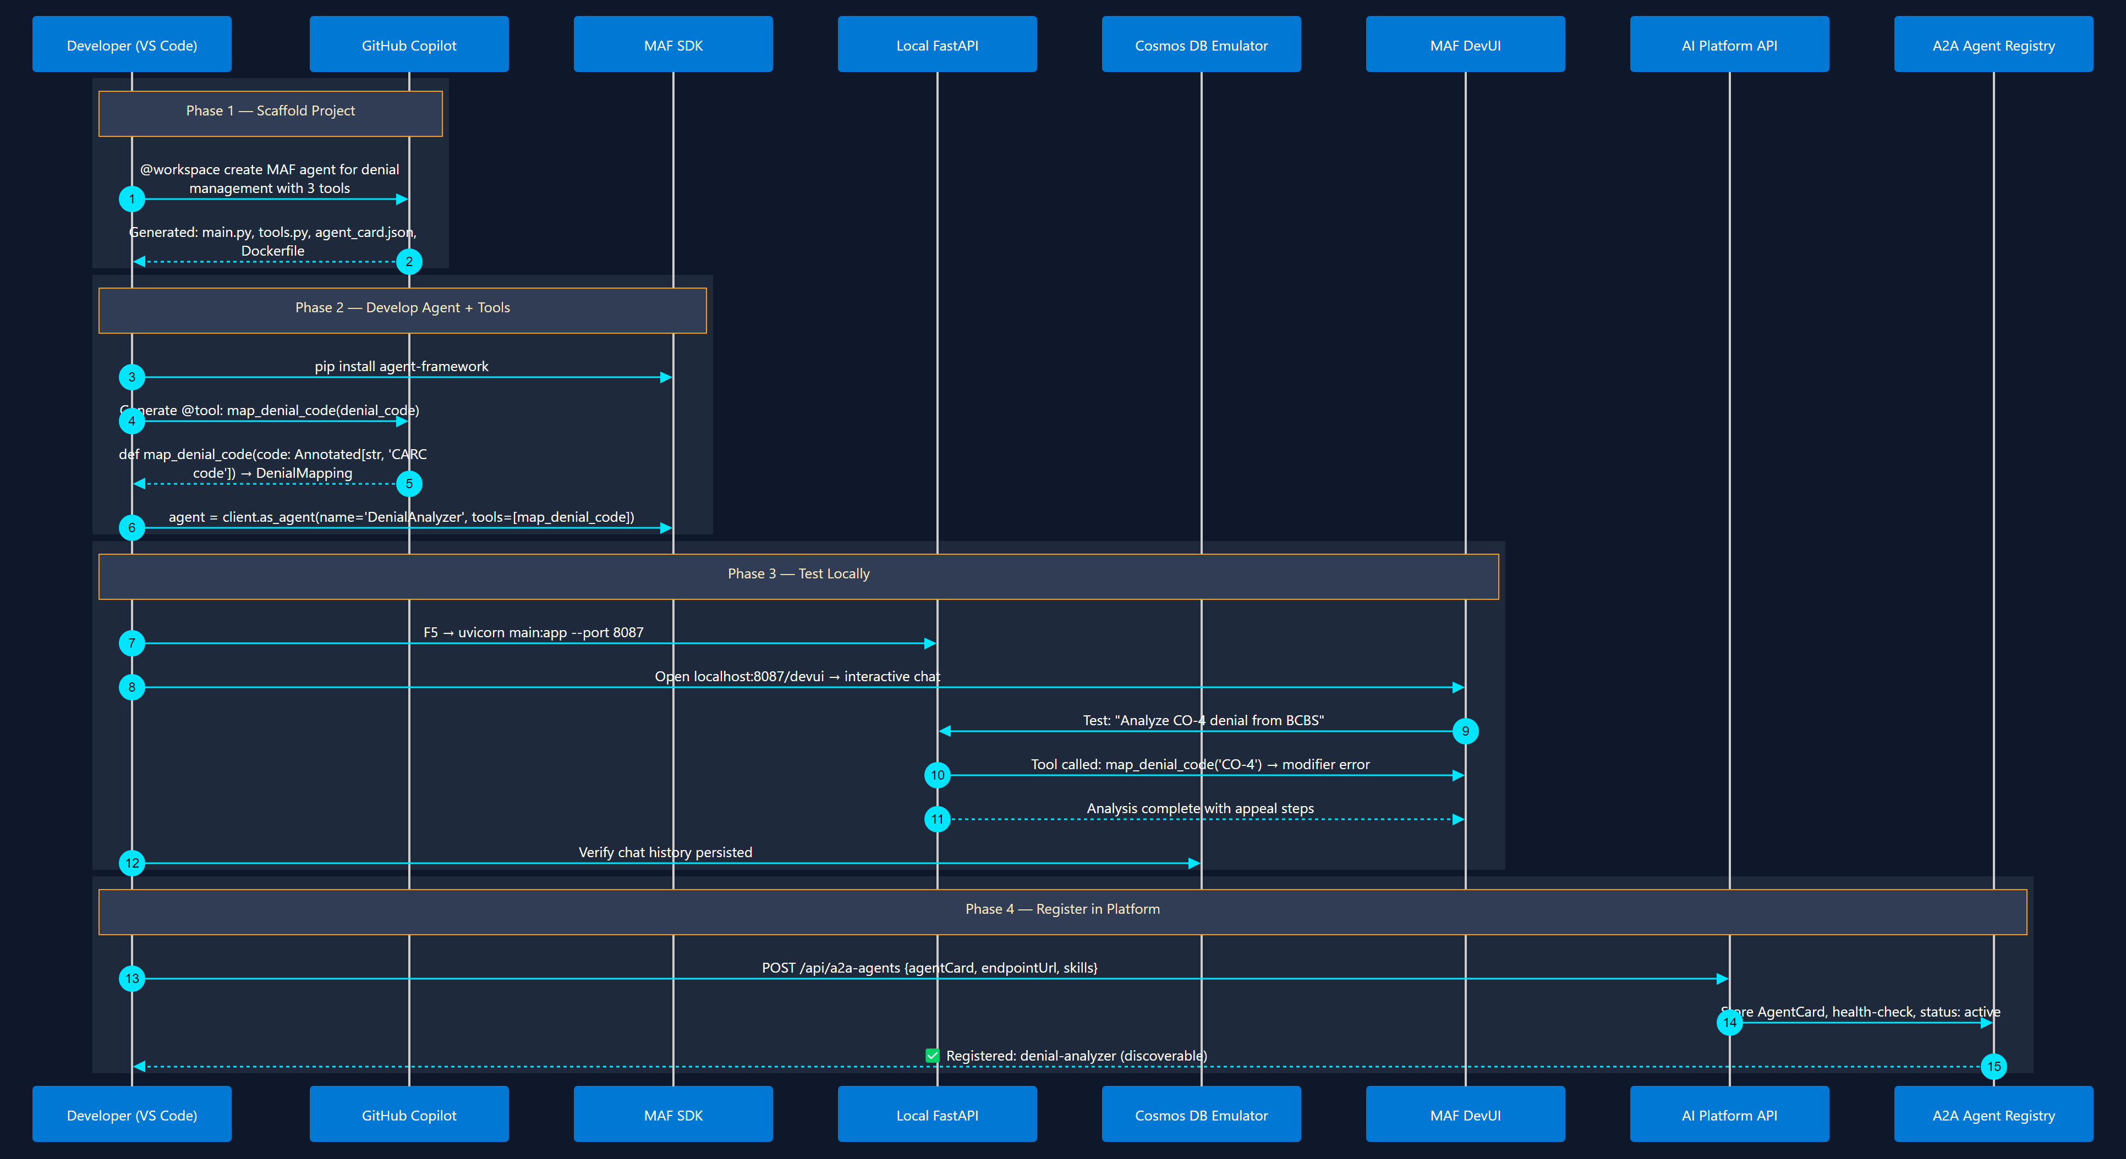
1
Agent Development Lifecycle
Scaffold → Code → Test → Register
From empty folder to a registered, discoverable A2A agent

Slide 14
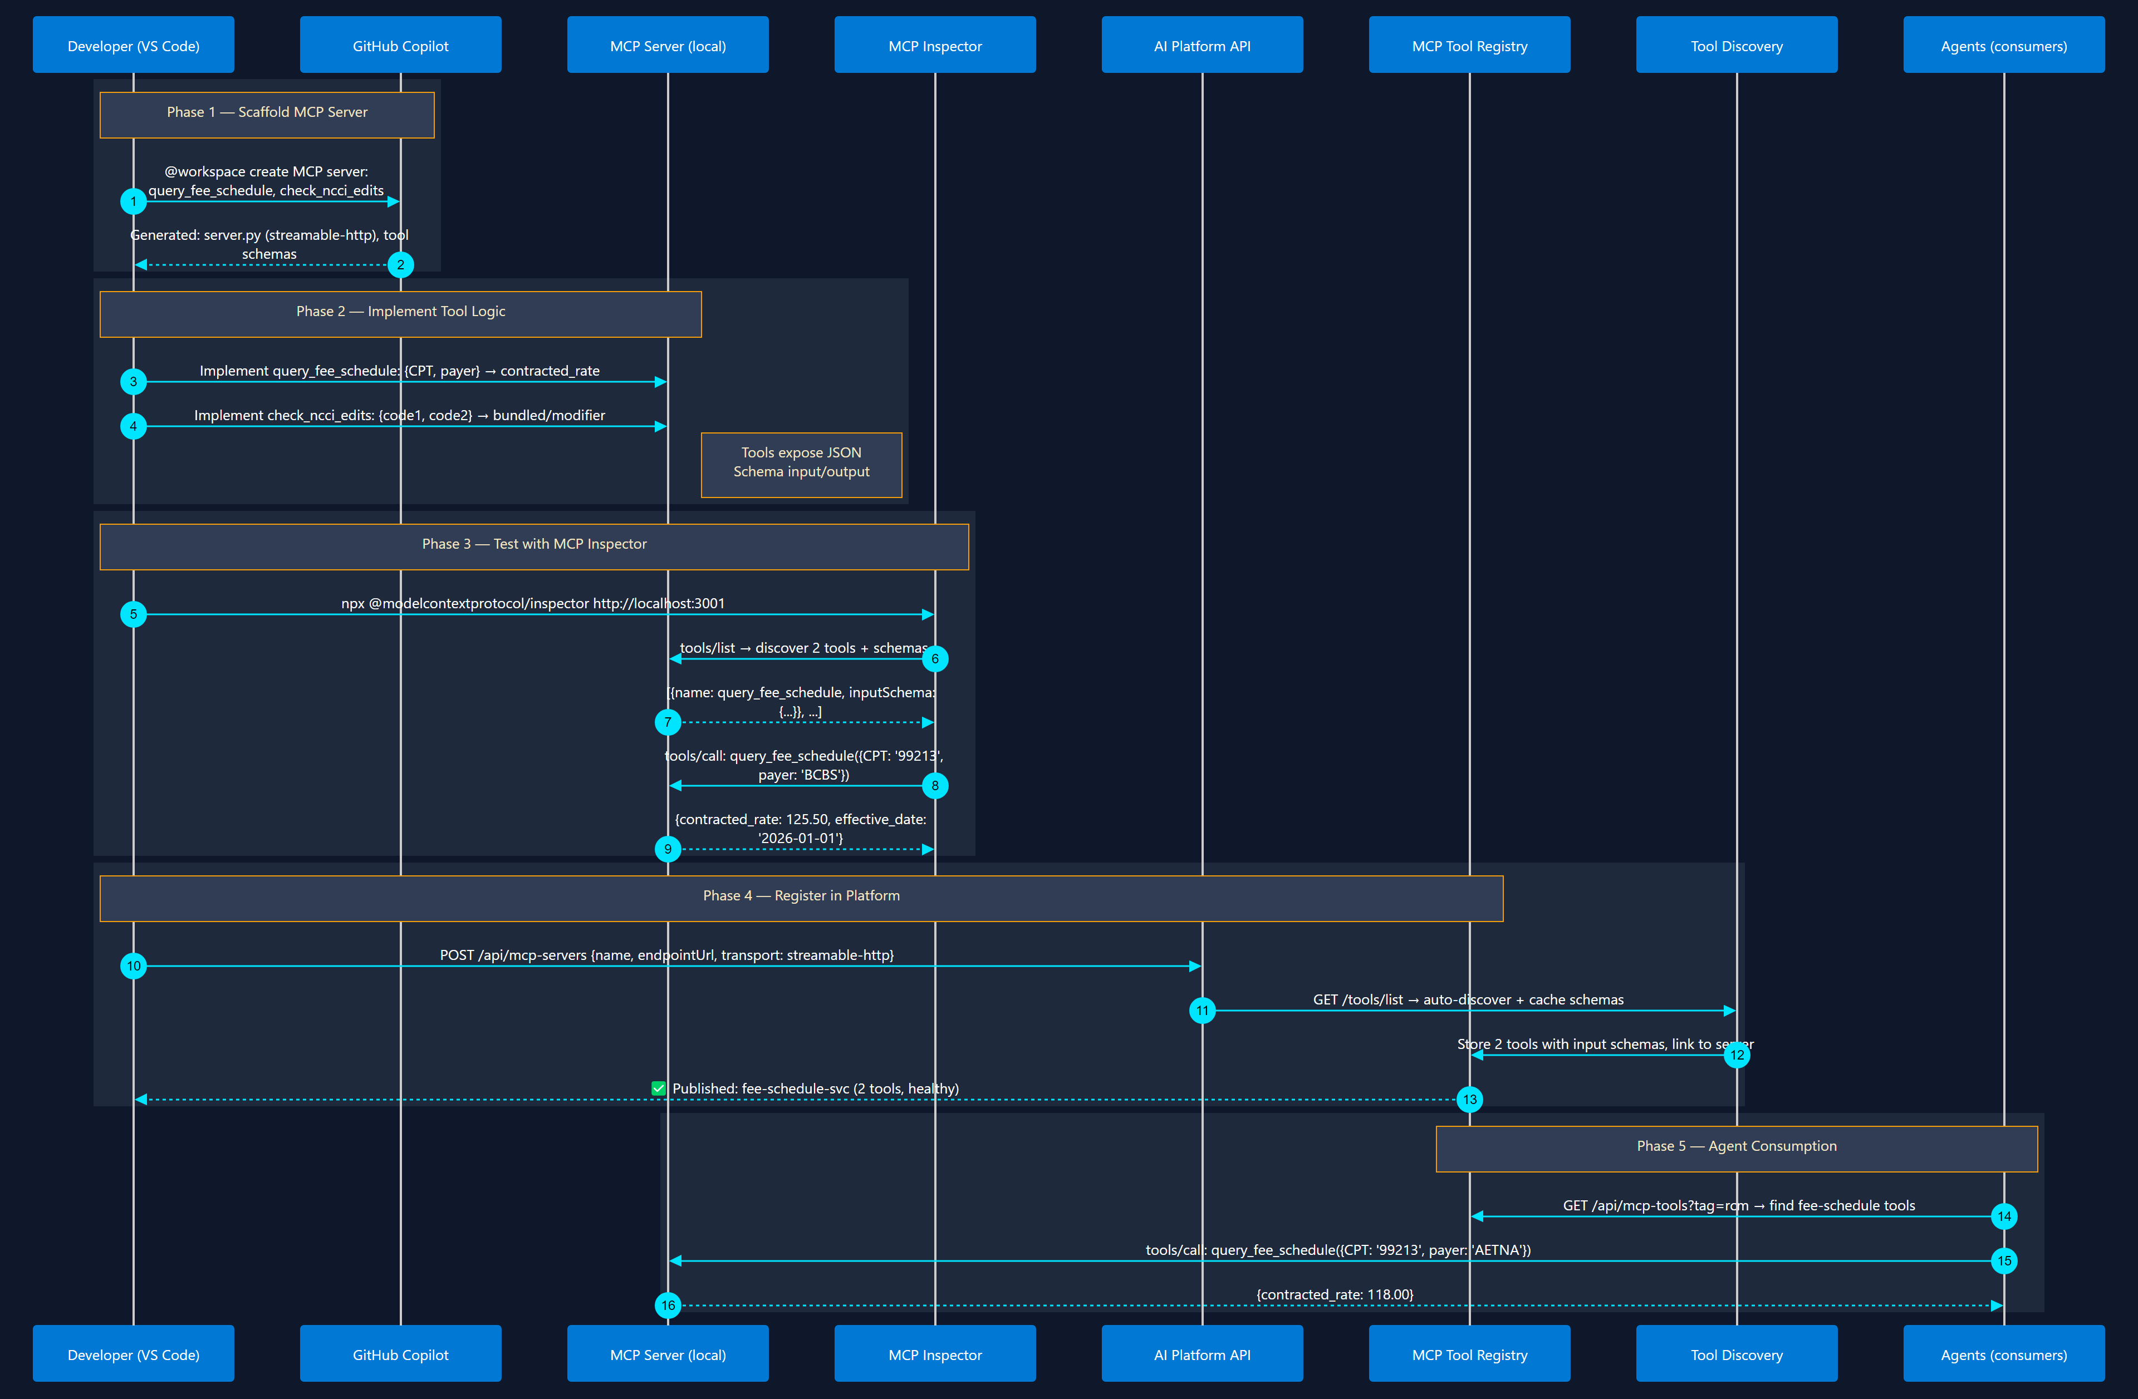
2
MCP Tool Development & Registration
Build → Test → Publish → Discover
Build tool server → test schema → publish to registry → agents discover it

Slide 15
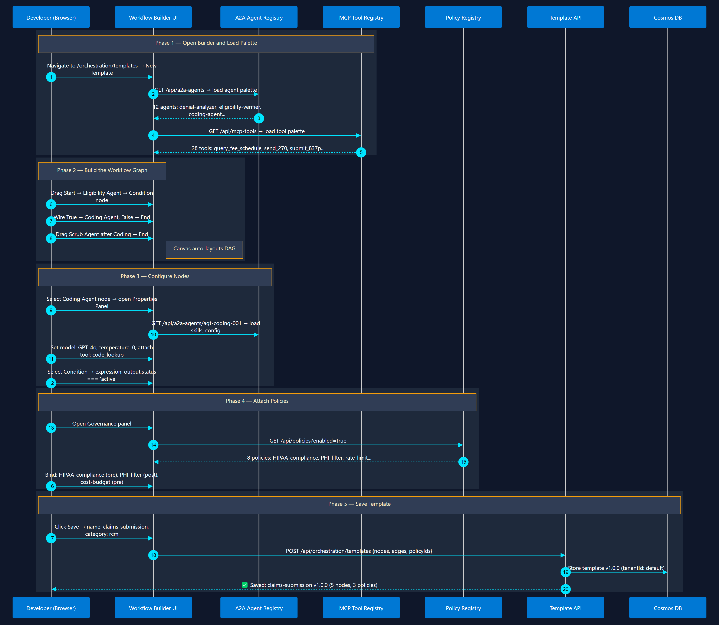
3
Orchestration Template Design
Visual Builder in Marketplace Web UI
Visual workflow builder → select agents → wire edges → attach policies → save

Slide 16
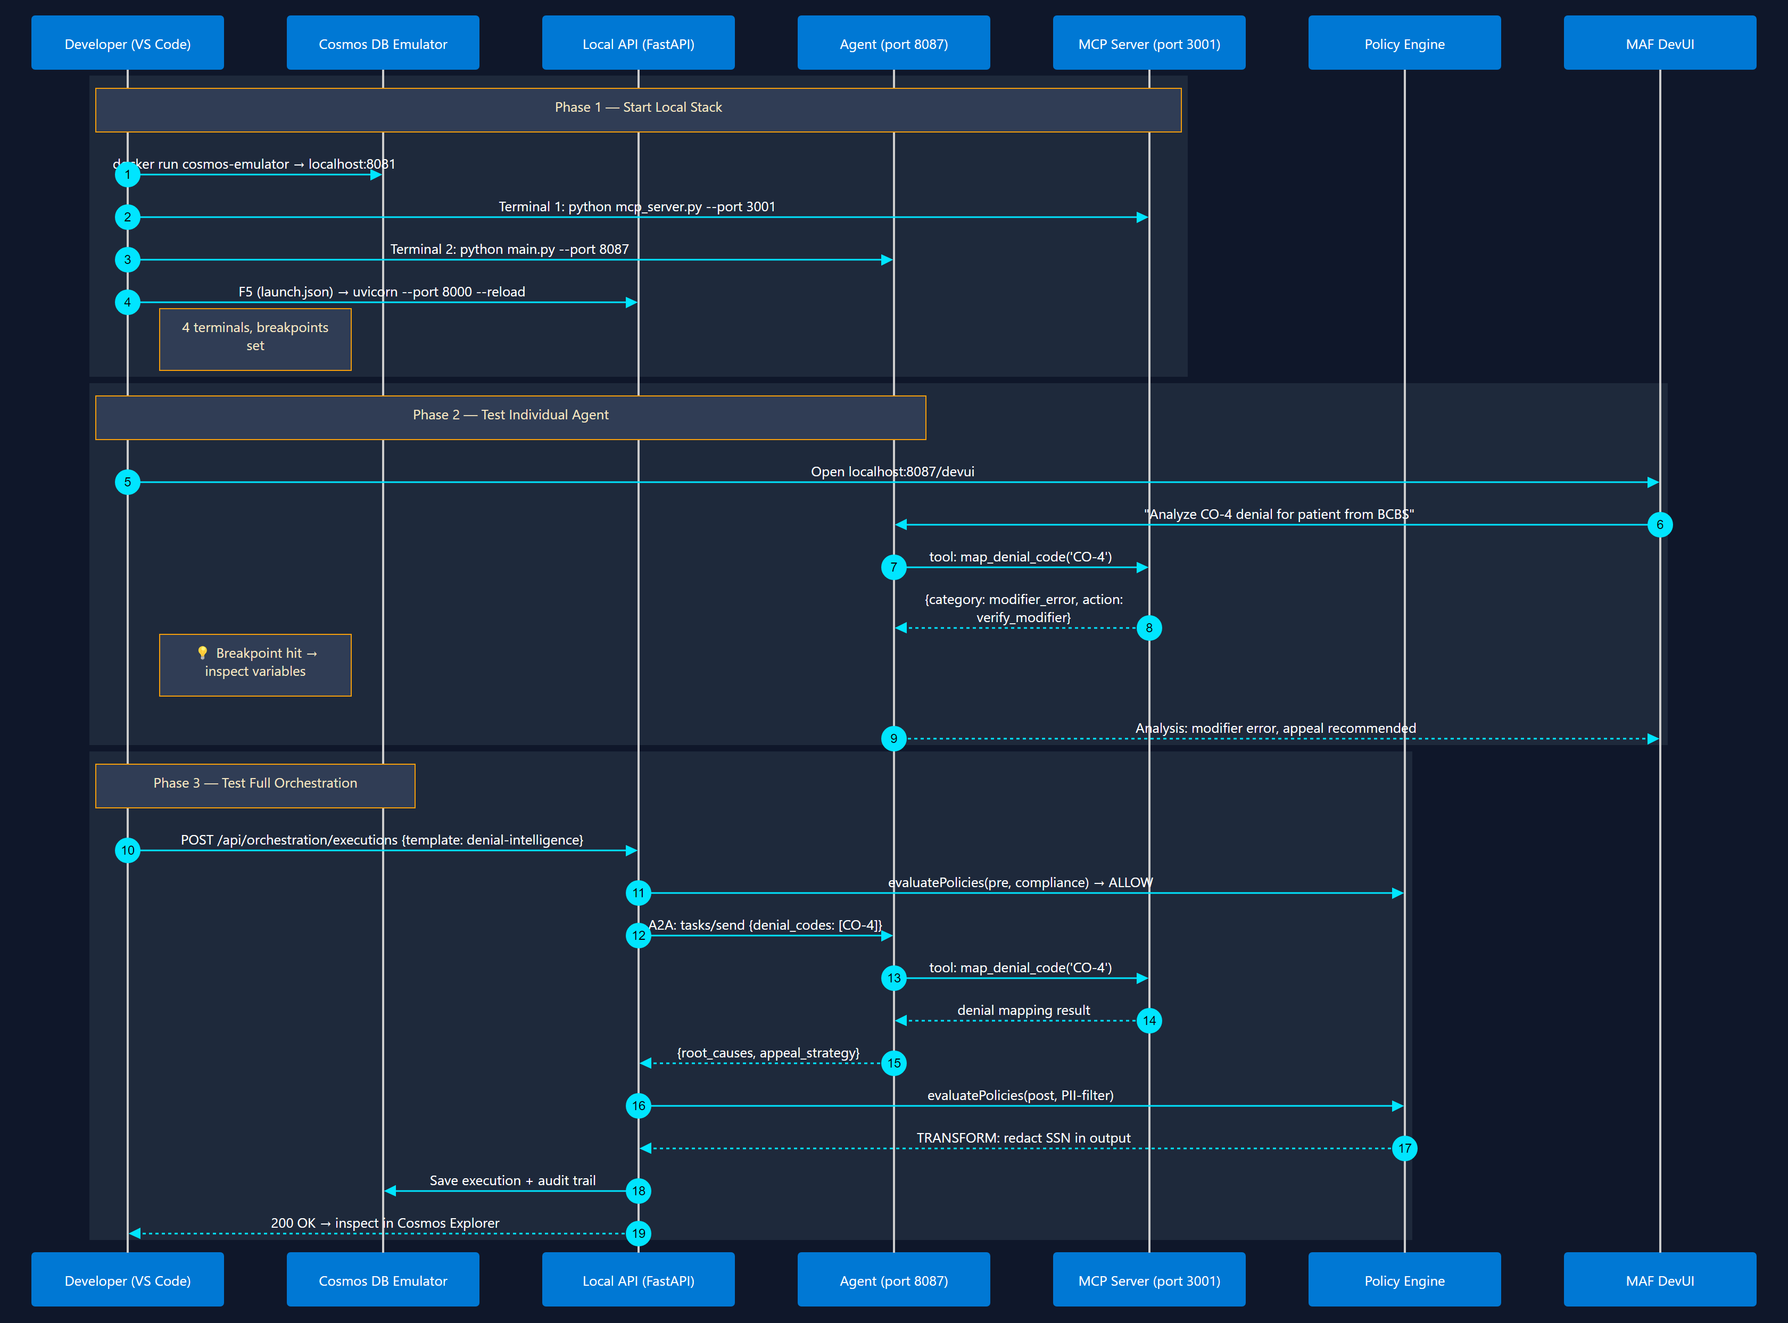
4
Local Testing & Debugging
VS Code Debug + Emulators
Cosmos Emulator → F5 debug → test orchestration → inspect policy decisions

Slide 17
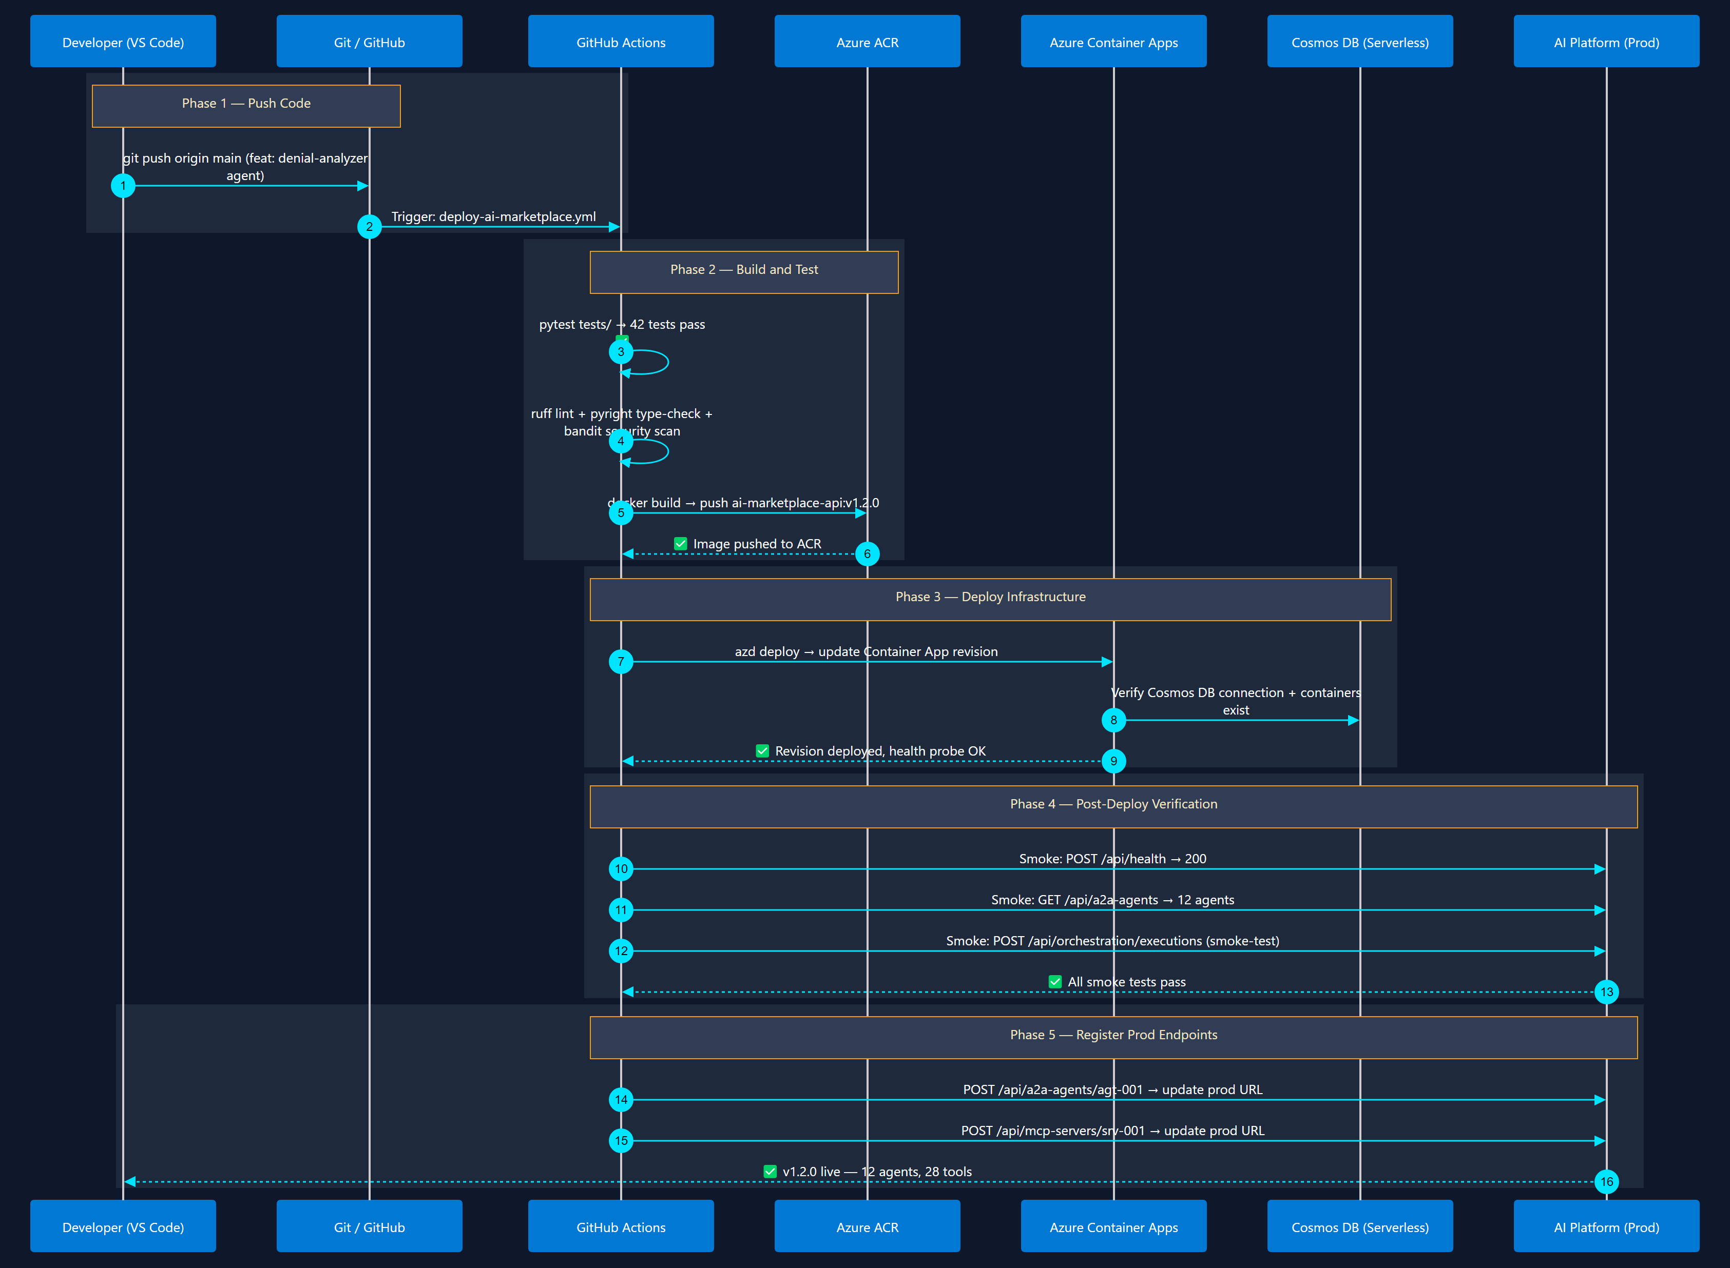
5
CI/CD Pipeline & Deployment
azd up + GitHub Actions
Git push → GitHub Actions → build container → deploy to Container Apps → verify

Slide 18
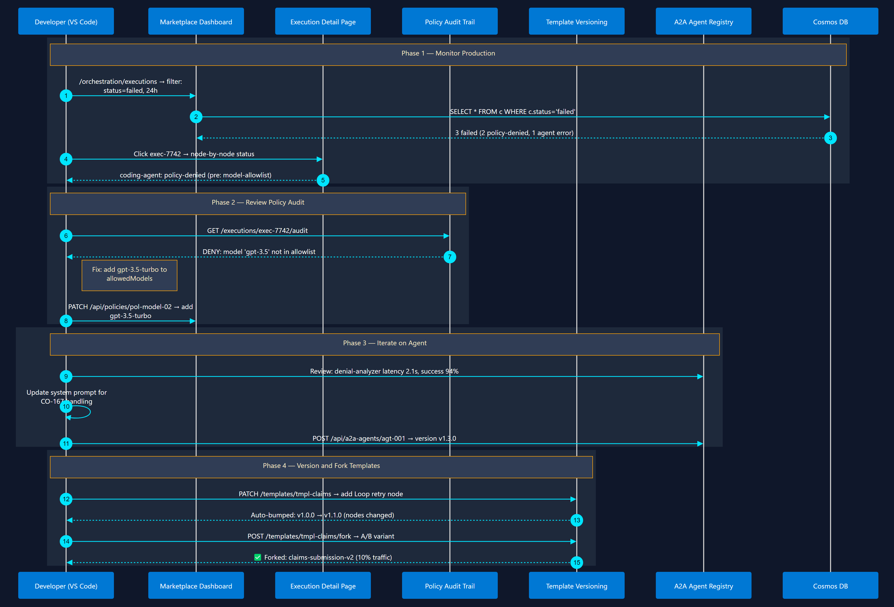
6
Day-2: Monitor, Iterate & Version
Observe → Refine → Ship
Monitor executions → review policy violations → update agents → version templates

Slide 19
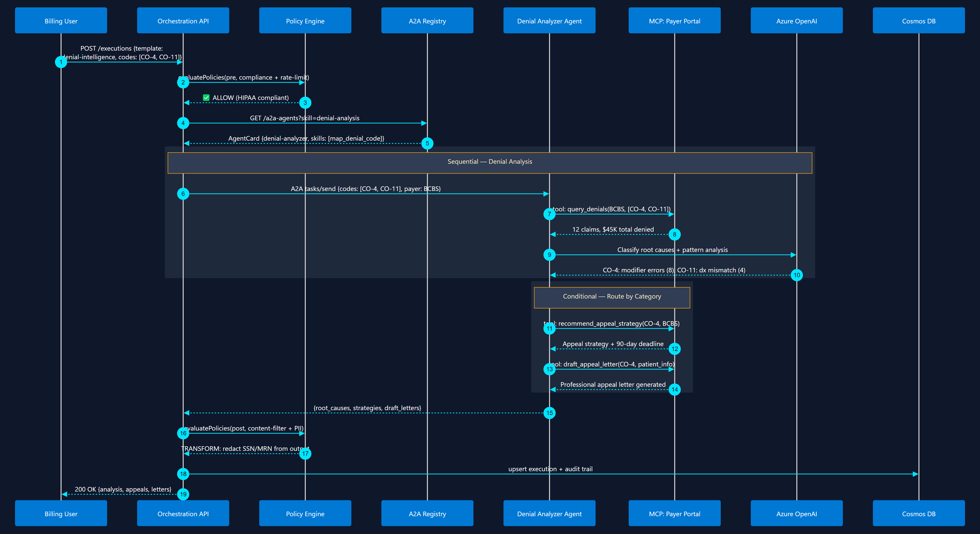
7
TBC - Denial Intelligence Workflow
Conditional Router + Supervisor
Analyze denials → classify root cause → recommend appeal strategy

Slide 20
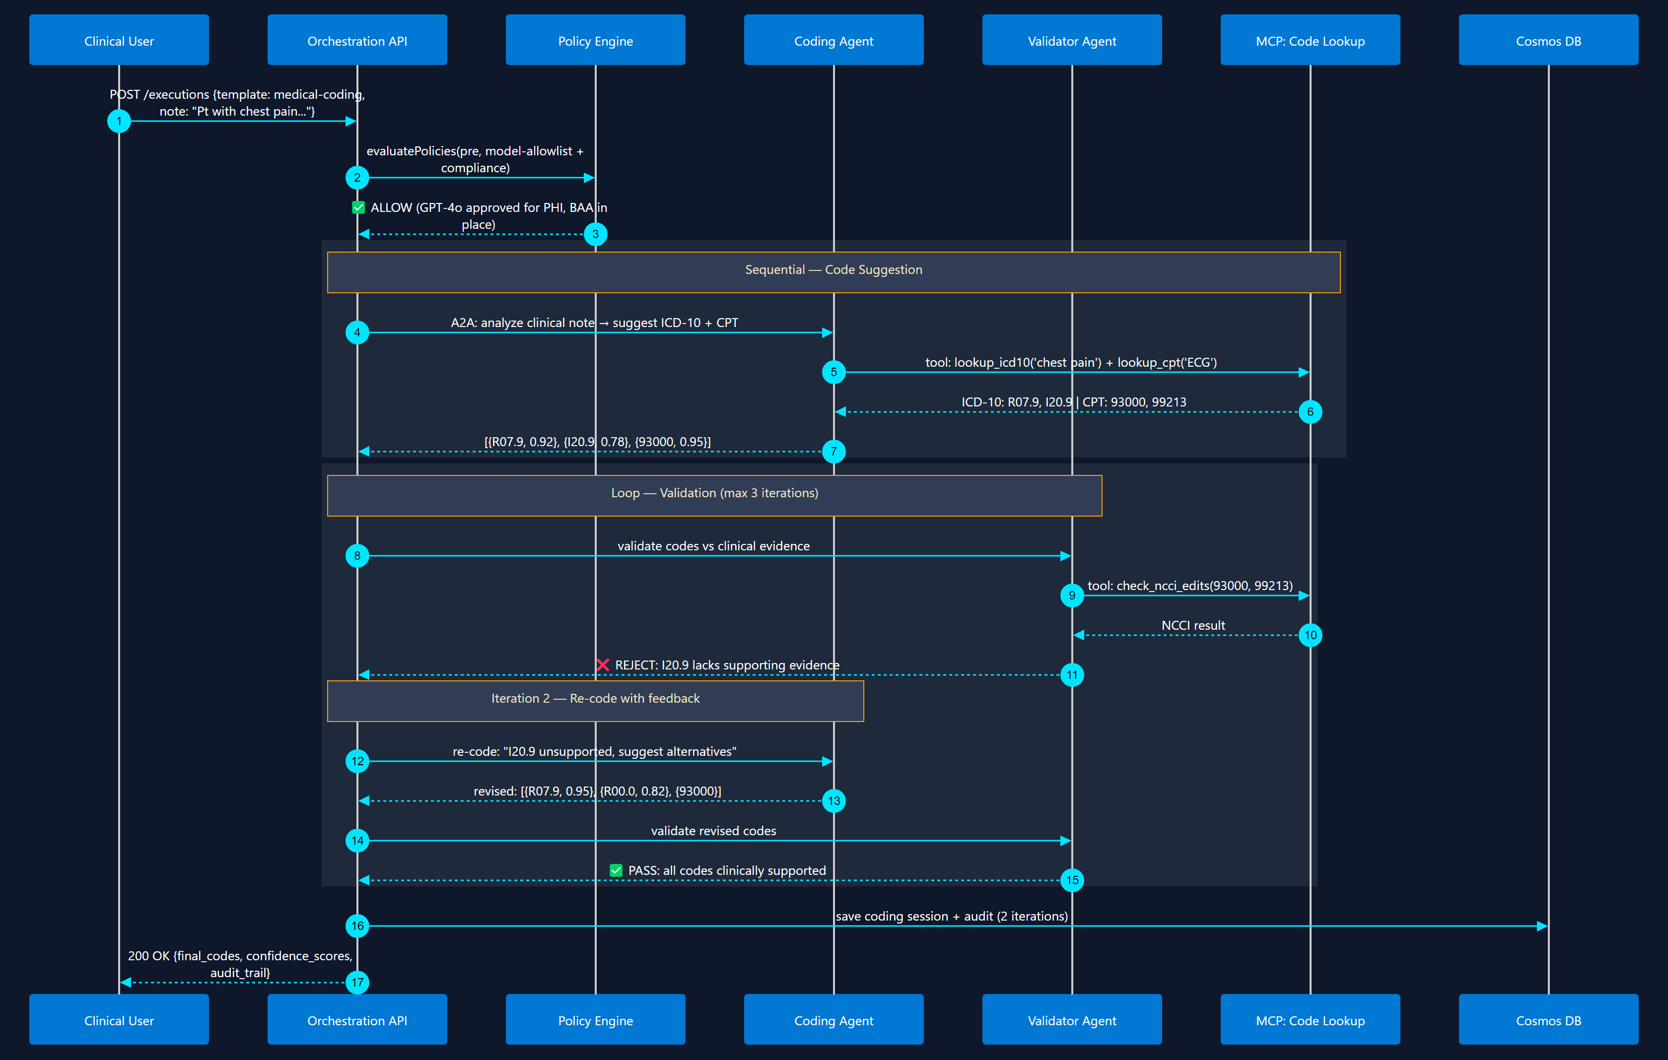
8
TBC - Automated Medical Coding
Sequential + Loop (Writer-Critic)
Clinical note → ICD-10/CPT suggestion → validation loop → final codes

Slide 21
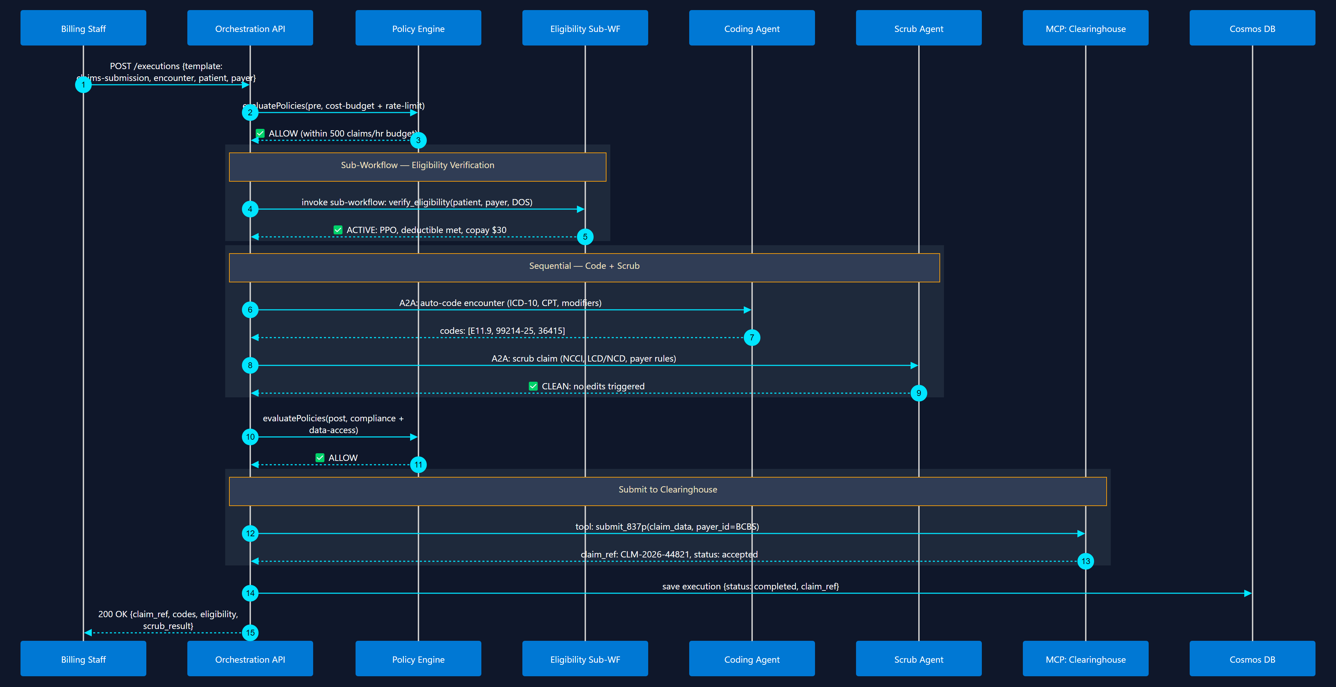
9
TBC - Claims Submission Pipeline
Sub-Workflow + Sequential
Eligibility → Coding → Scrub → Submit to Clearinghouse

Slide 22
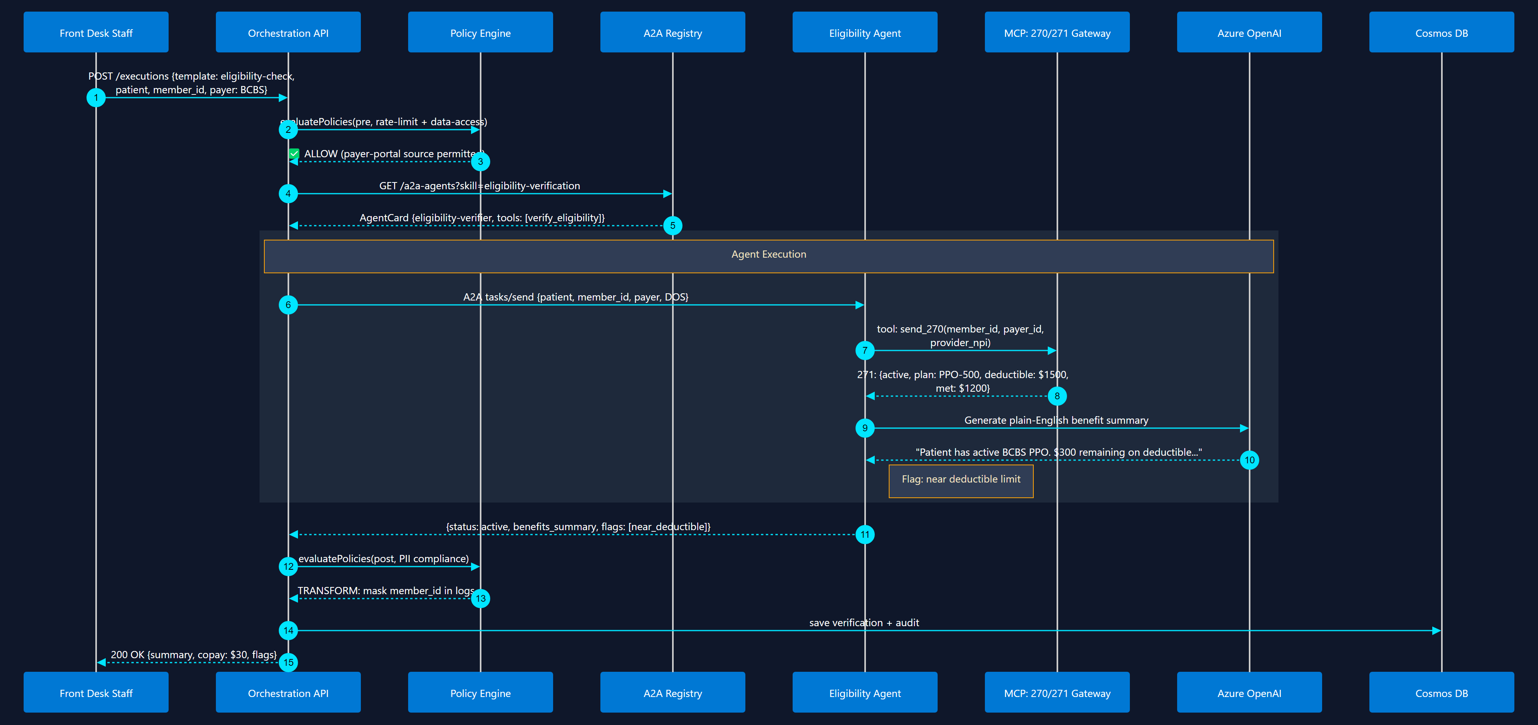
10
Eligibility Verification
Sequential + MCP Tool Call
Real-time 270/271 check via MCP tool + AI benefit summary

Slide 23
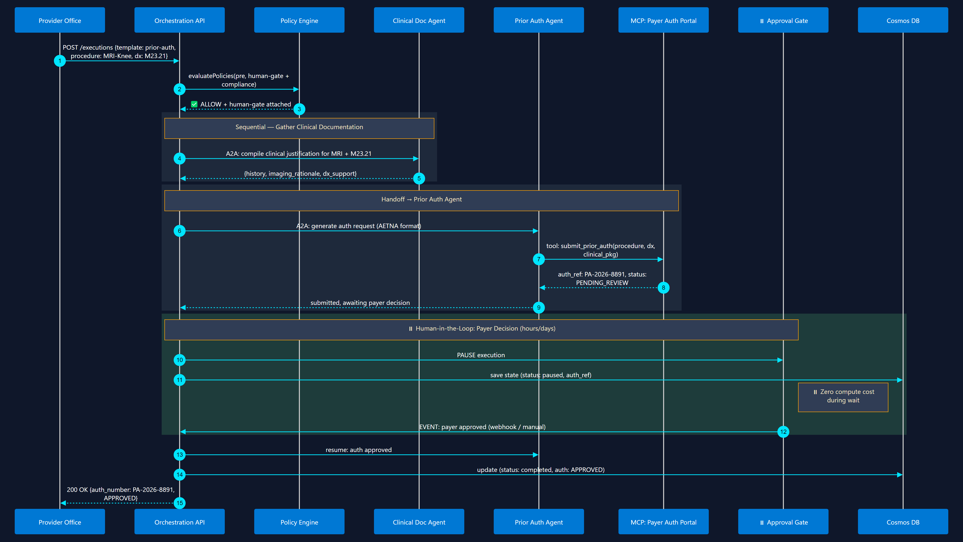
11
TBC - Prior Authorization Workflow
Human-in-the-Loop + Handoff
Generate auth request → submit → pause for payer decision → resume

Slide 24
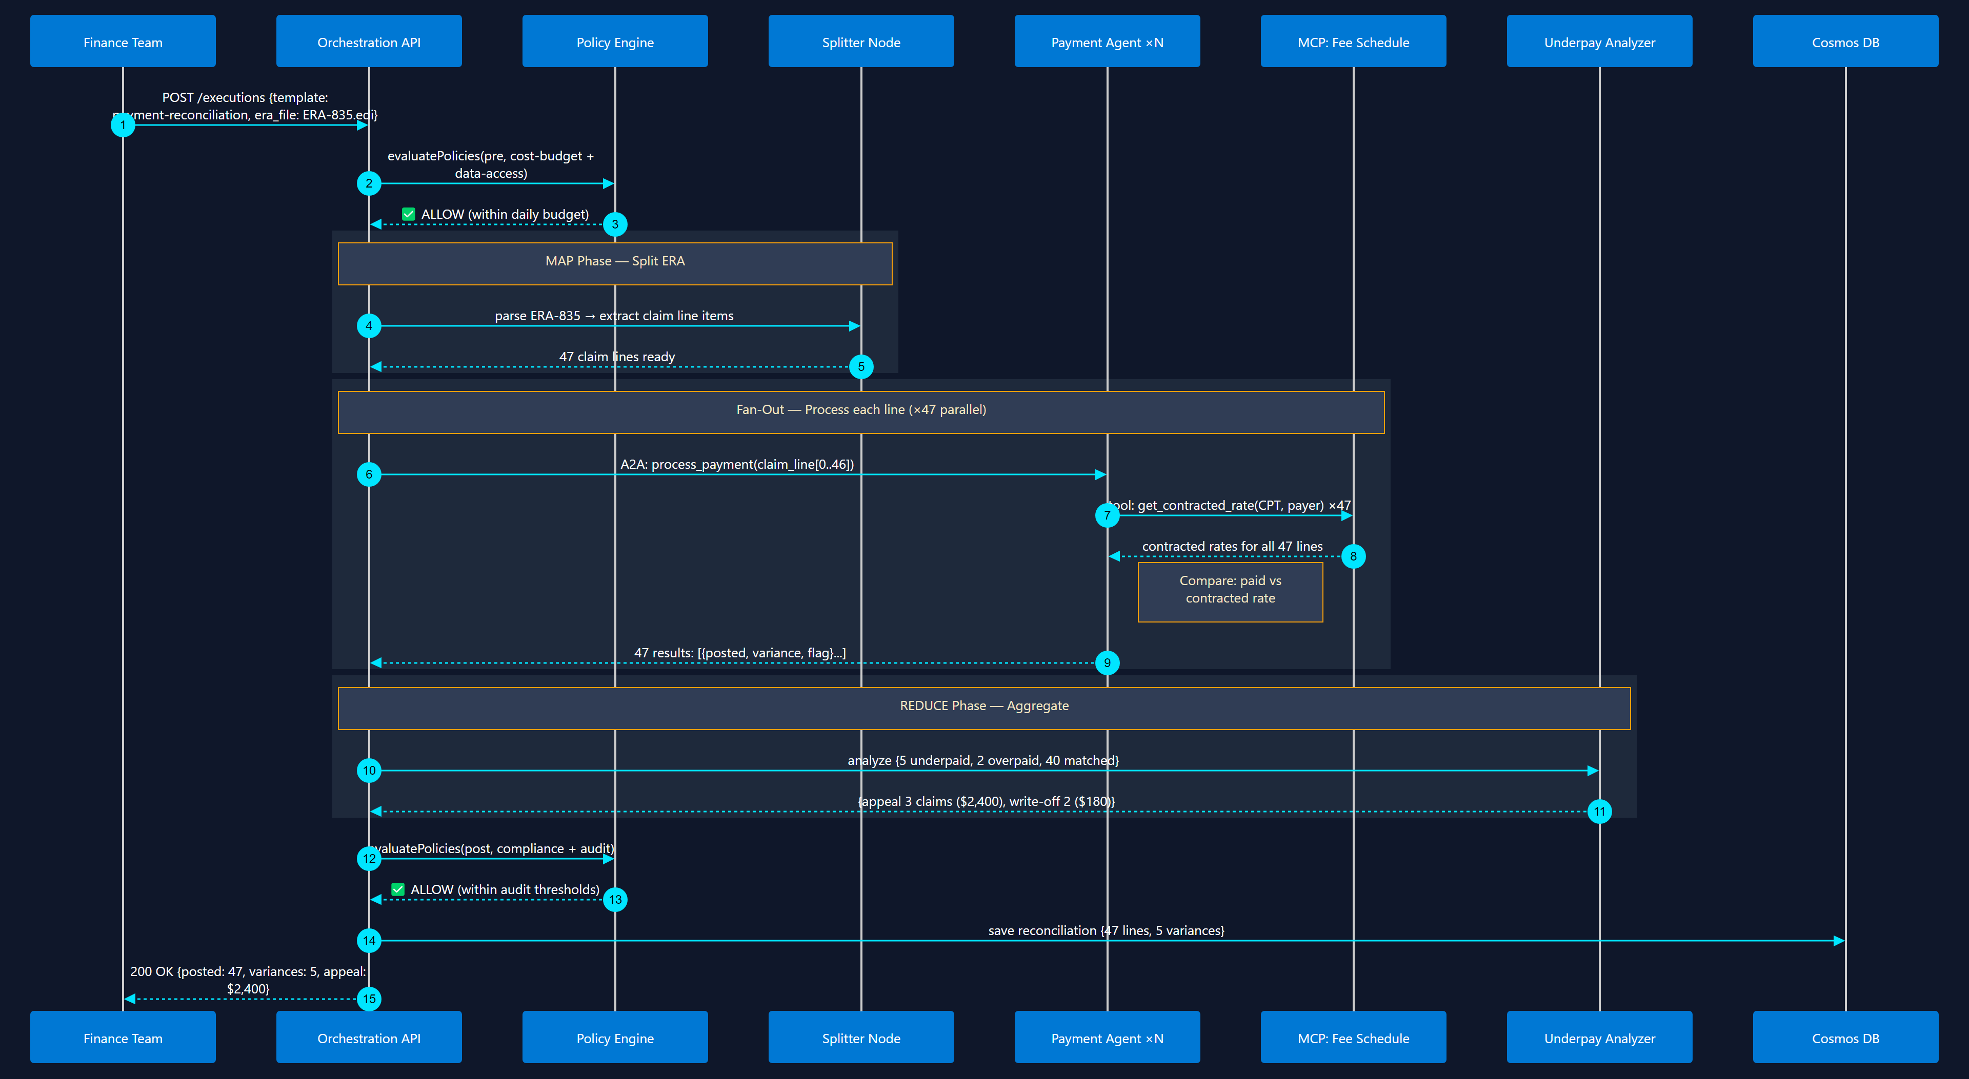
12
TBC - Payment Posting & Reconciliation
Map-Reduce + Fan-Out / Fan-In
Batch ERA (835) → map each claim line → detect underpayments → reconcile

Slide 25
10 Orchestration Patterns
with Microsoft Agent Framework
AI Marketplace — Architecture & Design Series
Sequential
Fan-Out / Fan-In
Conditional Router
Loop / Iteration
Human-in-the-Loop
Supervisor
Map-Reduce
Handoff
Group Chat
Sub-Workflow
Hosted on Azure Container Apps • Cosmos DB • Azure OpenAI • Python + FastAPI

Slide 26
1
Sequential Pipeline
Agents execute in strict order — each output feeds the next
📥 Start
🤖 Agent A Analyze
🤖 Agent B Enrich
🤖 Agent C Summarize
📤 End
MAF Code Pattern
When to Use
• Step-by-step data processing (ETL, claim workflows)
• Each agent needs the previous agent's output
• Order matters — can't parallelize
• Document review → Extraction → Validation → Enrichment
from agent_framework.orchestrations import SequentialBuilder workflow = ( SequentialBuilder() .add_agent(analyzer_agent) .add_agent(enricher_agent) .add_agent(summarizer_agent) .build() ) result = await workflow.as_agent().run(input_text)
Key Characteristics
• MAF Builder: SequentialBuilder — one-liner chaining
• Data flow: shared conversation context passed through each agent
• State: each agent sees all prior messages; AgentSession persists across turns
• Streaming: every agent can stream tokens to the client via event handlers

Slide 27
2
Parallel Fan-Out / Fan-In
Dispatch to N agents simultaneously, aggregate results
🤖 Tech Analysis
📥 Input
⚡ Dispatch
🤖 Market Analysis
🔀 Aggregate
📤 Output
🤖 Risk Analysis
MAF Code Pattern
When to Use
• Independent sub-tasks that can run in parallel
• Multi-perspective analysis (technical + market + risk)
• Latency matters — total time = slowest branch, not sum
• Translation to multiple languages simultaneously
from agent_framework.orchestrations import ConcurrentBuilder workflow = ( ConcurrentBuilder() .add_agent(tech_agent) .add_agent(market_agent) .add_agent(risk_agent) .with_aggregator(summary_agent) # optional LLM merge .build() )
Key Characteristics
• MAF Builder: ConcurrentBuilder — fan-out with default or custom aggregator
• Join strategies: wait-all (default), custom aggregator callback, LLM-based merge
• Reduces total latency from O(n) sequential to O(max) parallel

Slide 28
3
Conditional Router
Dynamic edge routing — branch execution based on data or classifier output
billing
🤖 Billing Agent
📥 Input
🧠 Classifier
tech
🤖 Tech Support
📤 Output
other
🤖 General Agent
MAF Code Pattern
When to Use
• Intent classification → route to specialist agent
• If/else logic based on previous agent output
• Switch-case: multiple exclusive branches
• Multi-selection: one input triggers multiple targets
# Edge conditions in MAF workflow wf = Workflow() wf.add_executor('classifier', classifier_fn) wf.add_executor('billing', billing_agent) wf.add_executor('tech', tech_agent) wf.add_edge('classifier', 'billing', condition=lambda msg: msg.intent == 'billing') wf.add_edge('classifier', 'tech', condition=lambda msg: msg.intent == 'tech')
Key Characteristics
• MAF: edge_condition, switch_case_edge_group, multi_selection_edge_group — all built-in
• Only matched branch executes (others skipped); supports both function-based and agent-based classifiers
• Declarative YAML variant: conditional_workflow with nested if/elif/else blocks

Slide 29
4
Loop / Iteration
Repeat agent execution until a condition is met or max iterations reached
↺ not good
📥 Input
🤖 Writer Agent
🧠 Judge Agent
✓ pass
📤 Output
MAF Code Pattern
When to Use
• Writer-Critic pattern: generate → evaluate → refine
• Iterative improvement until quality threshold met
• Self-correction: agent retries after feedback
• Code generation → test → fix → retest loop
• Max iterations prevent infinite loops (safety boundary)
# Feedback loop with conditional edge wf = Workflow() wf.add_executor('writer', writer_agent) wf.add_executor('judge', judge_fn) wf.add_edge('writer', 'judge') wf.add_edge('judge', 'writer', condition=lambda msg: msg.verdict != 'PASS') wf.add_edge('judge', '__end__', condition=lambda msg: msg.verdict == 'PASS')
Key Characteristics
• MAF: simple_loop sample — judge agent decides ABOVE / BELOW / MATCHED to control iteration
• Writer-Critic in _StartHere samples: iterative refinement with quality gates + max iteration safety
• Quality threshold + max iterations prevent infinite loops; each iteration persisted via checkpoints
• Supports both agent-based judges and simple function conditions

Slide 30
5
Human-in-the-Loop (Approval Gate)
Pause execution for human review, resume on approval
✅ Approved
🤖 Next Agent
🤖 Agent Generates
📋 Review Pending
❌ Rejected
🔄 Revise
MAF Code Pattern
When to Use
• Content approval before publishing
• Financial transaction review above $ threshold
• Tool call approval (sensitive actions)
• Medical/legal review before agent proceeds
• Compliance gate: human reviews PII detection results
# Human-in-the-loop via ctx.request_info() async def review_executor(ctx, msg): result = await ctx.request_info( RequestInfoMessage( content=f'Approve? {msg.text}', request_id='approval-1' ) ) if result.approved: return ApprovedMessage(msg.text) return RejectedMessage(result.feedback)
Key Characteristics
• MAF: ctx.request_info() pauses workflow, emits request event, resumes when response arrives
• Checkpointing: checkpoint_with_human_in_the_loop — save state, shut down, resume later (even days/weeks)
• Tool Approval: .with_tool_approval() on builders — auto-gate all tool calls for human review
• Zero compute cost during wait (Flex Consumption / Container Apps min-replicas=0)

Slide 31
6
Supervisor / Hierarchical
Manager agent reviews child outputs and re-routes or overrides
🧑‍💼 Supervisor Agent (Manager / Magentic)
delegates
reports back
🤖 Research Agent
🤖 Writing Agent
🤖 Review Agent
MAF Code Pattern
When to Use
• Manager agent decides which sub-agent to invoke next
• Quality control: supervisor reviews all child outputs
• Reflection pattern: agent reviews its own output
• Research → Synthesize → Review orchestration
• Customer routing: triage → specialist selection
from agent_framework.orchestrations import MagenticBuilder workflow = ( MagenticBuilder() .add_agent(research_agent, name='Researcher') .add_agent(writer_agent, name='Writer') .add_agent(reviewer_agent, name='Reviewer') .with_manager(manager_agent) # decides next .build() )
Key Characteristics
• MAF Builder: MagenticBuilder — supervisor agent creates plan, assigns tasks, reviews results
• Supports human plan review (magentic_human_plan_review) and checkpoint resume

Slide 32
7
Fan-out and Fan-in
Apply same agent to each item in a collection, then reduce results
🤖 Item 1
📄 Collection [items]
MAP
🤖 Item 2
REDUCE
🔀 Aggregate
📤 Output
🤖 Item 3
🤖 Item N
MAF Code Pattern
When to Use
• Batch processing: analyze each claim in a batch
• Multi-document summarization (1 agent per document)
• Process each row of a dataset with same logic
• Chunk-by-chunk processing of large documents
# Map-Reduce via fan_out_fan_in_edges.py chunks = split_document(large_doc) wf = Workflow() wf.add_executor('splitter', split_fn) for i in range(len(chunks)): wf.add_executor(f'worker_{i}', process_agent) wf.add_edge('splitter', f'worker_{i}') wf.add_edge(f'worker_{i}', 'reducer') wf.add_executor('reducer', aggregate_fn)
Key Characteristics
• MAF: map_reduce_and_visualization sample — fan-out/fan-in with diagram export
• Dynamic fan-out: generate N worker executors at runtime based on collection size
• Reduce: custom aggregator function, or LLM-based summarization of parallel results

Slide 33
8
Handoff (Agent-to-Agent Routing)
Agents transfer control to specialists via tool-call handoff
handoff()
💰 Billing Specialist
🧑‍💼 Triage Agent (Router)
🔧 Tech Specialist
👤 User
📦 Shipping Specialist
MAF Code Pattern
When to Use
• Customer service: triage → specialist agent routing
• Agent realizes it lacks expertise, transfers to another
• Autonomous mode: specialists iterate independently
• Multi-tier: specialist can handoff to sub-specialists
from agent_framework.orchestrations import HandoffBuilder workflow = ( HandoffBuilder() .set_triage_agent(triage_agent) .add_agent(billing_agent, name='Billing') .add_agent(tech_agent, name='TechSupport') .add_handoff('TechSupport', ['Billing']) # T→B .with_autonomous_mode() # agents iterate .build() )
Key Characteristics
• MAF Builder: HandoffBuilder — triage agent routes via tool calls, specialists can cross-handoff
• Autonomous mode: specialist runs until done or explicitly invokes handoff tool (no user round-trip)
• Full history preserved across handoffs with additional_properties for routing metadata

Slide 34
9
Group Chat (Multi-Agent Debate)
Multiple agents discuss in rounds, managed by a moderator
🧑‍⚖️ Moderator
🤖 Summarizer
🤖 Pro Agent
🔄 Round-Robin or LLM-Selected
🤖 Ethicist
🤖 Con Agent
🤖 Analyst
MAF Code Pattern
When to Use
• Multi-perspective debate (ethics, technical, business)
• Brainstorming with diverse agent personas
• Code review: author + reviewer + security agent
• Philosophical debate with structured moderation
• Board simulation: CEO, CTO, CFO discuss strategy
from agent_framework.orchestrations import GroupChatBuilder workflow = ( GroupChatBuilder() .add_agent(pro_agent, name='Advocate') .add_agent(con_agent, name='Critic') .add_agent(analyst_agent, name='Analyst') .with_orchestrator(agent=moderator_agent) .with_max_turns(10) .build() )
Key Characteristics
• MAF Builder: GroupChatBuilder — agent manager selects next speaker via LLM or simple function selector
• Supports max_turns, tool approval, request_info for human steering mid-debate

Slide 35
10
Sub-Workflow / Nesting
Compose workflows hierarchically — a workflow as a step in a parent workflow
Parent Workflow
Child Workflow (Nested)
📥 Input
🤖 Pre-process
🤖 Step A
🤖 Step B
🤖 Step C
🤖 Post-process
📤
MAF Code Pattern
When to Use
• Reusable workflow modules (e.g., 'KYC Check' sub-workflow)
• Team-owned sub-workflows composed into larger pipelines
• Isolate complex logic into testable sub-units
• Recursive workflows: a workflow can contain itself
• A2A: cross-service workflow composition
# Sub-workflow as executor child_wf = Workflow() child_wf.add_executor('step_a', agent_a) child_wf.add_executor('step_b', agent_b) child_wf.add_edge('step_a', 'step_b') parent_wf = Workflow() parent_wf.add_executor('preprocess', pre_agent) parent_wf.add_executor('child', child_wf.as_executor()) parent_wf.add_edge('preprocess', 'child')
Key Characteristics
• MAF: sub_workflow_basics — wrap Workflow as executor via .as_executor(); supports kwargs propagation, request interception, checkpointing

Slide 36
Pattern Summary — Quick Reference
#
Pattern
MAF Primitive
Use Case
Status
1
Sequential Pipeline
SequentialBuilder
ETL, claim processing
✅ Built-in
2
Fan-Out / Fan-In
ConcurrentBuilder
Multi-perspective analysis
✅ Built-in
3
Conditional Router
edge_condition
Intent classification
✅ Built-in
4
Loop / Iteration
simple_loop / edges
Writer-Critic refinement
✅ Built-in
5
Human-in-the-Loop
ctx.request_info()
Approval gates, compliance
✅ Built-in
6
Supervisor / Hierarchical
MagenticBuilder
Manager-worker delegation
✅ Built-in
7
Map-Reduce
fan_out_fan_in_edges
Batch / chunk processing
✅ Built-in
8
Handoff
HandoffBuilder
Customer service routing
✅ Built-in
9
Group Chat
GroupChatBuilder
Multi-agent debate
✅ Built-in
10
Sub-Workflow
wf.as_executor()
Reusable workflow modules
✅ Built-in
All 10 patterns are available today in Microsoft Agent Framework (Python + .NET) • Hosted on Azure Container Apps • Cosmos DB state • Azure OpenAI

