Slide 1
UAP - AI Platform — Architecture
Capabilities, Architecture and Dev Experience
Capabilities, Architecture and Features
Microsoft Agent Framework • Azure Container Apps • Cosmos DB • Azure OpenAI

Slide 2
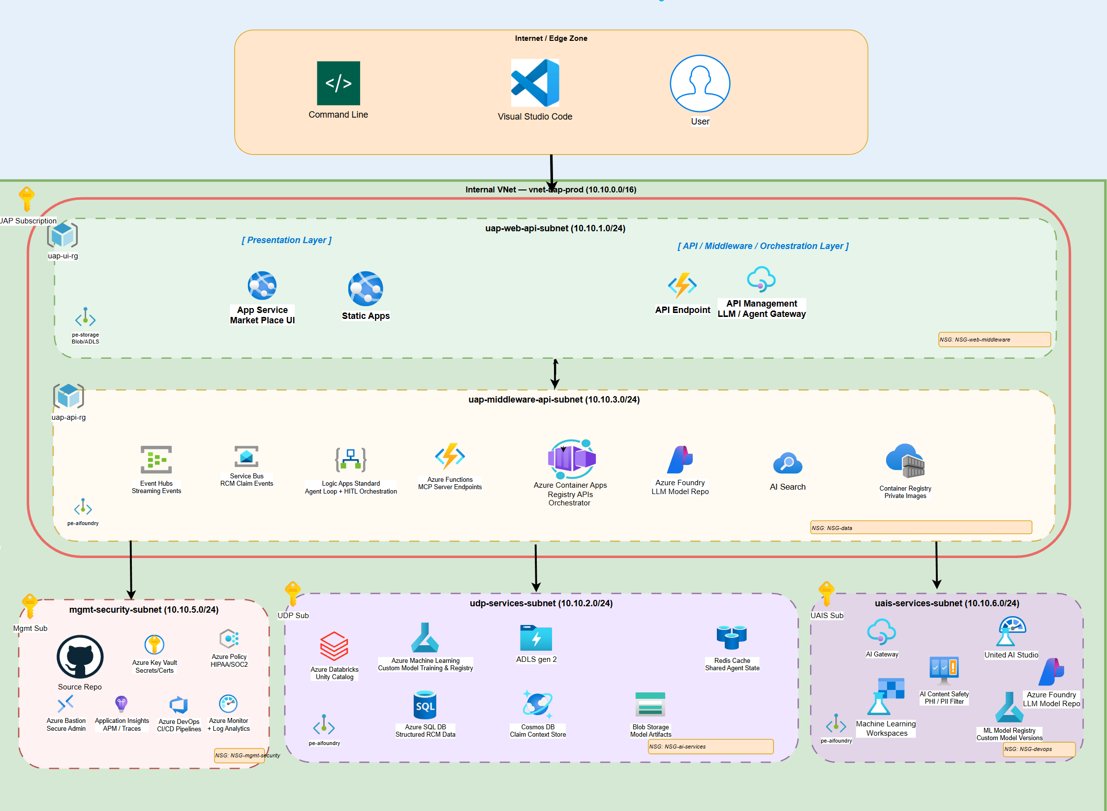
Unified Platform – UAP, UAIS and UDP
Unified AI Platform components
Unified AI Platform (UAP)
The overarching platform that ties together all AI capabilities — asset catalog, orchestration, governance, and developer experience — into a single, cohesive surface for enterprise teams.
Unified Data Platform (UDP)
The persistence and observability backbone. Cosmos DB (partitioned by tenantId) stores catalog metadata, workflow state, execution history, and audit logs. Application Insights + Azure Monitor supply real-time metrics, distributed traces, and alerting.
Unified AI Services (UAIS)
A middleware layer that normalises access to Azure AI Foundry, Azure OpenAI, MCP servers, and A2A agents. It provides consistent authentication (Entra ID), retry/circuit-breaker policies, and telemetry collection so every upstream consumer sees the same contract.

Slide 3
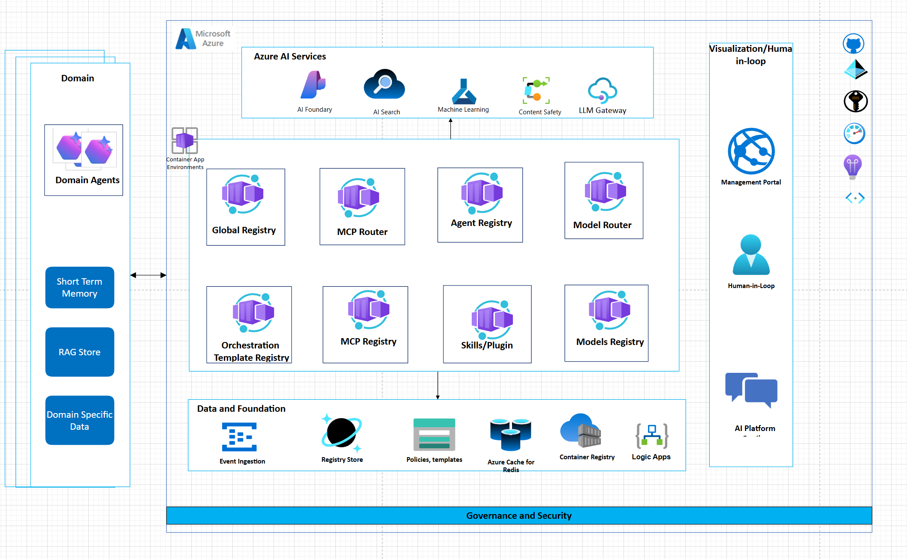
AI Platform Solution
Unified AI Platform components
Presentation Layer
Next.js 15 frontend served from Azure Container Apps. Includes the Marketplace catalog, Visual Orchestration canvas (React Flow), Publisher Portal, Admin Dashboard, and Playground. Azure Front Door provides edge caching and global routing.
API & Registry Layer
Azure Container Apps(Python/FastAPI) expose RESTful APIs: Asset Catalog CRUD, MCP Server Registry, A2A Agent Registry, Skills Registry, Publisher Submission API, and Security Scanner. Each registry stores data in Cosmos DB with tenantId partition key.
Orchestration & Governance
The Execution Engine (MAF) interprets workflow graphs — dispatching calls to agents, tools, and models. The Policy Engine enforces guardrails (entitlements, risk ratings, budget). Human-in-the-Loop approval gates pause automation for manual review when risk is high.
Azure AI Services
Azure AI Foundry hosts model deployments and agent runtimes. Azure OpenAI provides GPT endpoints. Azure AI Search powers semantic discovery across the catalog. All services integrate via Managed Identity for zero-secret authentication.
Data & Observability
Cosmos DB is the single NoSQL store (2 MB item limit, hierarchical partition keys). Application Insights + Log Analytics capture distributed traces, custom metrics, and KQL-queryable logs. Redis Cache accelerates hot reads (sessions, lookup data).
Note: Cosmos DB may be replaced with Mongo DB

Slide 4
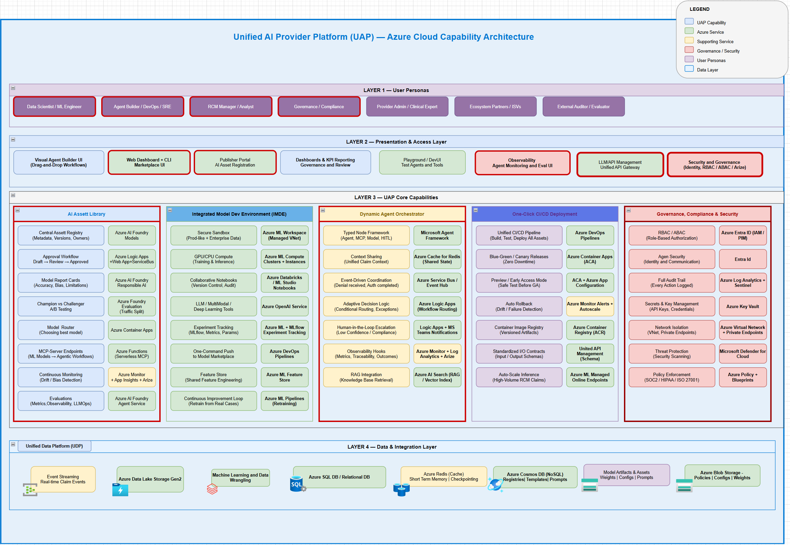
AI Platform Capabilities
Unified AI Platform components
Note: Capabilites bounded by red boxes are planned to be implemented in next 180 days

Slide 5
Summary of Capabilities — Next 180 Days
22 capabilities across 4 layers targeted for implementation (red-boxed on Slide 4)
LAYER 1 — Presentation & UX
LAYER 3 — Orchestration & Governance
▸ Visual Orchestration Canvas — Drag-and-drop workflow composition with React Flow
▸ Workflow Templates — Reusable orchestration blueprints with node structures and approval steps
▸ Admin Dashboard — Governance console — health, submissions, approvals, policy violations
▸ Execution Engine — Graph interpreter — dispatches to agents/tools/models, retries, fan-out/fan-in
▸ Publisher Portal — End-to-end asset submission lifecycle: draft → submit → review → publish
▸ Human-in-the-Loop Gate — Pauses automation for manual review; captures decision provenance
▸ Playground — Interactive sandbox to test agents and tools before deployment
▸ IAM & RBAC — Entra ID + Managed Identity — role-based view/submit/approve/execute/admin access
▸ DevUI — Microsoft Agent Framework debugging and prompt tuning surface
▸ Compensation Logic (Saga) — Multi-step rollback coordination for distributed workflows
LAYER 2 — API & Registries
LAYER 4 — Data & Observability
▸ Asset Catalog — CRUD + versioning for agents, MCP servers, tools, models, skills
▸ Audit Log — Immutable records in Cosmos DB with TTL — who did what, when, outcome
▸ MCP Server & Tool Registry — Register/discover MCP endpoints with auth, schemas, health
▸ Metrics & OTLP — OpenTelemetry → App Insights — counters, latency, failure rates, cost
▸ Agent Skills Registry — Versioned, governed skill definitions discoverable across workflows
▸ Projects & Workspace — Team-owned work areas with saved workflows, drafts, collaboration
▸ Publisher & Submission API — Validates metadata/packages, drives review queue and approval states
▸ Ratings & Reviews — Community quality signals for discovery ranking and publisher feedback
▸ Security Scanner — Static + runtime scanning — risky patterns, missing metadata, dependency checks
▸ Execution History — Run outcomes, inputs/outputs, trace IDs for debugging and audit
Not in scope: Web Dashboard (already shipping) · Layer 5 Azure Services (provisioned via Bicep IaC independently)

Slide 6
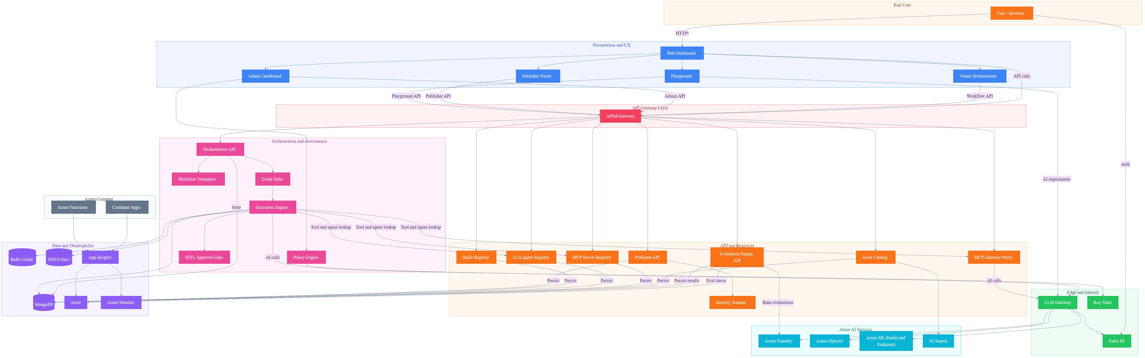
AI Marketplace — App Architecture
User → Web Dashboard (direct) | API Gateway (APIM) in front of registries | LLM Gateway → AI services only | MongoDB replaces Cosmos DB

Slide 7
AI Marketplace — Architecture Features (1–8)
#
Feature
Components
Data Flow
Key Differentiator
1
Enterprise Security
LLM GW, Entra ID, Key Vault, Scanner
LLM GW → Entra (token) → KV (secrets via MI)
Zero-trust, VNet isolation, PHI redaction, HIPAA-ready
2
Plan-Based Orchestration
Execution Engine, Workflow Templates, Registries
Engine → Templates → Registries (bind) → GW Proxy
Declarative plans, Delegation Envelope, step polymorphism
3
Semantic Discovery
AI Search, Asset Catalog, MCP/A2A Registries
Catalog → AI Search (vector) ← NL query → ranked
Vector-indexed search, .well-known crawl, federation
4
Human-in-the-Loop
HITL Gate, Execution Engine, Admin Dashboard
Engine → HITL Gate → Admin UI → Engine (resume)
First-class step type, not bolted on; audit provenance
5
Three-Tier Memory
Redis, Cosmos DB, ADLS Gen 2
Engine → Redis (short) → Cosmos (episodic) → ADLS
Summary-first flush, no raw PHI, episode records
6
Multi-Protocol Tools
MCP GW Proxy, MCP Registry, A2A Registry, Foundry
GW Proxy → MCP servers; A2A Registry → peer agents
MCP + A2A + Foundry + SaaS in one gateway
7
Governance
Policy Engine, Publisher API, Scanner, Admin UI
Publisher → Scanner → Policy → Admin → Catalog
Dual enforcement (publish + execute), full audit trail
8
Observability
App Insights, Azure Monitor, ACA, Functions
ACA + Functions → App Insights → Monitor (alerts)
OpenTelemetry e2e, trace_id propagation, per-episode
All 16 features map to architecture components • AI Asset Marketplace • Azure-Native Enterprise Platform

Slide 8
AI Marketplace — Architecture Features (9–16)
#
Feature
Components
Data Flow
Key Differentiator
9
Azure-Native Not Locked
MCP GW Proxy, A2A Registry, Foundry, ACA
GW routes to any MCP (ACA, SaaS, on-prem)
Open protocols, federation, optional Foundry
10
Production Infra
ACA, Functions, EventHub, LLM Gateway, Cosmos DB
ACA (stateless) + Functions (event) + LLM Gateway (edge)
Subnet isolation, scale-to-zero, Bicep IaC
11
Intelligent Tool Finder
AI Search, MCP Registry, Azure OpenAI
Registry → Cosmos → AI Search (FAISS) ← NL query
FAISS vector matching — agents self-discover tools
12
Dynamic Invocation
Execution Engine, MCP GW Proxy, AI Search
Engine → Search (find) → Registry (schema) → GW
Discover → resolve → call in one turn, no pre-config
13
Load Balancing
LLM Gateway, ACA, MCP GW Proxy
LLM GW → GW Proxy → ACA (scaling + probes)
Health-aware routing across MCP server replicas
14
IDE Integration
MCP Registry, Asset Catalog, LLM Gateway
Registry → export mcp.json → VS Code / Cursor
One-click IDE setup from marketplace registry
15
JWT Token Vending
Entra ID, Key Vault, LLM Gateway
Agent → Entra (creds) → JWT → LLM GW → GW Proxy
M2M scoped tokens for autonomous agent auth
16
Context-Aware Perms
Policy Engine, Entra ID, LLM Gateway
Engine → Policy (claims + context) → allow/deny
Dynamic scope eval per invocation, not just RBAC
All 16 features map to architecture components • AI Asset Marketplace • Azure-Native Enterprise Platform

Slide 9
General Orchestrator Workflow
#
Step
Component
Description
1
Client Request
LLM Gateway
Request enters via domain LLM Gateway with Entra auth
2
Classify Intent
Azure Foundry /classify
Determine intent, phase, and domain routing
3
Governance Pre-flight
Policy Engine + Entra
Check entitlements, PHI class, budgets, HITL rules
4
Select Domain + Plan
AI Search + Registries
Query plan registry and domain orchestrator registry
5
Resolve + Bind Tools
MCP/A2A Registries
Bind agents via A2A, tools via MCP from registries
6
Delegation Envelope
Orchestration API
Create least-privilege envelope with plan + constraints
7
Domain Execution
Event Hubs + Engine
Fan-out via Event Hubs, step loop in Execution Engine
8
Memory + Evidence
Redis + Cosmos DB
Short-term state in Redis, episodic memory in Cosmos
9
Post-flight Checks
Content Safety + Policy
PHI redaction, compliance, channel HITL
10
Normalize + Respond
LLM Gateway
Standard schema + provenance + trace_id, return result
Global orchestrator manages intent classification, governance, plan selection, domain delegation, and post-flight normalization

Slide 10
LangGraph vs MAF — Capability Comparison
#
Capability
LangGraph
MAF
Rebuild in LangGraph
1
Graph-based orchestration
StateGraph DAG
WorkflowBuilder DAG
—
2
Central shared state
StateGraph
Intentionally absent
Session/state isolation
3
Step-level checkpointing
Checkpointers
Workflow checkpoints
—
4
Pause / resume execution
Via checkpoints
Via workflow runtime
—
5
Time-travel / replay
Checkpoint history
Partial (telemetry)
Full replay tooling
6
Agent statelessness
Stateful by design
Enforced
State discipline
7
Typed message contracts
Dict-based
Strong typing
Validation + schema
8
Workflow execution waves
Super-steps
Supersteps
—
9
Human-in-the-loop
Interrupts + edits
First-class
—
10
Built-in observability
Requires LangSmith
OTel native
Azure telemetry
11
Workflow-level spans
No
Executor spans
Deep tracing
12
Azure Monitor integration
No
Native
Full APM
13
Managed identity support
No
Native
Identity mgmt
14
Compliance logging
No
Native hooks
Audit trail
15
Dev / prod parity
Platform-dependent
Designed-in
Env isolation
16
Enterprise RBAC
No
Platform-level
RBAC enforcement
LangGraph excels at graph orchestration; MAF leads on enterprise compliance, observability, and Azure integration

Slide 11
LangGraph vs MAF — Compliance Comparison
#
Requirement
LangGraph on Azure
MAF on Azure
1
PHI / PII handling
Custom-built
Native hooks
2
Audit trails
LangSmith / custom
Native workflow events
3
Deterministic replay
Yes
Partial
4
Execution provenance
Graph-level
Executor-level
5
Role-based access
App-level
Platform-level
6
Azure AD integration
Manual
Native
7
Managed Identity
Manual
Native
8
Secrets management
App-managed
Platform-managed
9
Logging retention
Custom
Azure Monitor
10
Incident forensics
Hard
Straightforward
11
Security review friction
High
Low
Side-by-side comparison for enterprise healthcare compliance requirements

Slide 12
1
Global Orchestrator Pattern
Compose workflows hierarchically — a domain workflow as a step in a parent workflow
Parent Workflow
Child Workflow (Nested)
📥 Input
🤖 Pre-process
🤖 Step A
🤖 Step B
🤖 Step C
🤖 Post-process
📤
MAF Code Pattern
When to Use
• Reusable workflow modules (e.g., ‘claim check' sub-workflow)
• Team-owned sub-workflows composed into larger pipelines
• Isolate complex logic into testable sub-units
• Recursive workflows: a workflow can contain itself
• A2A: cross-service workflow composition
# Sub-workflow as executor child_wf = Workflow() child_wf.add_executor('step_a', agent_a) child_wf.add_executor('step_b', agent_b) child_wf.add_edge('step_a', 'step_b') parent_wf = Workflow() parent_wf.add_executor('preprocess', pre_agent) parent_wf.add_executor('child', child_wf.as_executor()) parent_wf.add_edge('preprocess', 'child')
Key Characteristics
• MAF: sub_workflow_basics — wrap Workflow as executor via .as_executor(); supports kwargs propagation, request interception, checkpointing

Slide 13
Azure Foundry GA Features — East US / East US 2
Capability | GA Status | VNet / PE | Usage
Foundry Projects & Portal | ✅ GA | ✅ PE supported | Define agents, tools, data connections
Agent Service — Core Agents | ✅ GA | ✅ VNet + PE | Prompt/tool agents via Responses API
Threads, Runs, Messages | ✅ GA | ✅ Same as Agent Svc | Multi-step conversation state
File Search & Vector Stores | ✅ GA | ✅ Storage + Search PE | RAG via agent File Search
Models (Azure OpenAI & partners) | ✅ GA | ✅ Model PE | Responses / Foundry Models APIs
AI Search as Tool | ✅ GA | ✅ PE supported | RAG / search-heavy agent tool
MCP Tools (self-hosted) | ✅ GA pattern | ✅ ACA/AppSvc PE | Expose internal systems as tools
Private Networking (Standard) | ✅ GA | ✅ BYO VNet + PE + DNS | All traffic private by default
Entra ID / RBAC / MI | ✅ GA | ✅ With PE | Managed Identity for tools
Multi-Agent Patterns | ✅ Supported | ✅ Same as core | Orchestrator delegates to specialists
Multi-Agent Workflows | ⚠️ Preview parts | ✅ VNet isolated | Visual/YAML with HITL — verify flags
Hosted Agents (containers) | ❌ Preview | ⚠️ VNet but preview | Avoid for GA-only deployments
Foundry → MAF Integration | ✅ Supported | ✅ ACA → Agent Svc PE | MAF in your compute, Foundry backend
Foundry → LangGraph | ✅ Supported | ✅ ACA → Foundry PE | LangGraph orchestrator + Foundry agents
✅ GA = Production-ready with SLA | ⚠️ Preview elements | ❌ Preview = Avoid for GA-only | Region: East US 2 (Tier-1)

Slide 14
Next Steps

Slide 15
Appendix – Work in Progress
Microsoft Agent Framework • Azure Container Apps • Cosmos DB • Azure OpenAI

Slide 16
AI Platform — Sequence Diagrams
Developer Experience & RCM Domain Orchestration Flows
12 Sequence Diagrams • 6 Dev-Experience • 6 RCM Domain Workflows
Microsoft Agent Framework • Azure Container Apps • Cosmos DB • Azure OpenAI

Slide 17
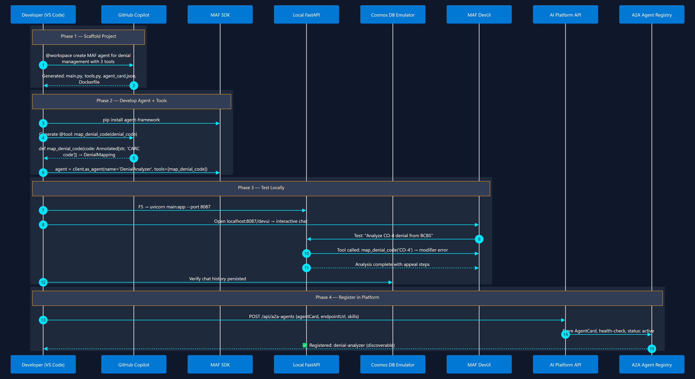
1
Agent Development Lifecycle
Scaffold → Code → Test → Register
From empty folder to a registered, discoverable A2A agent

Slide 18
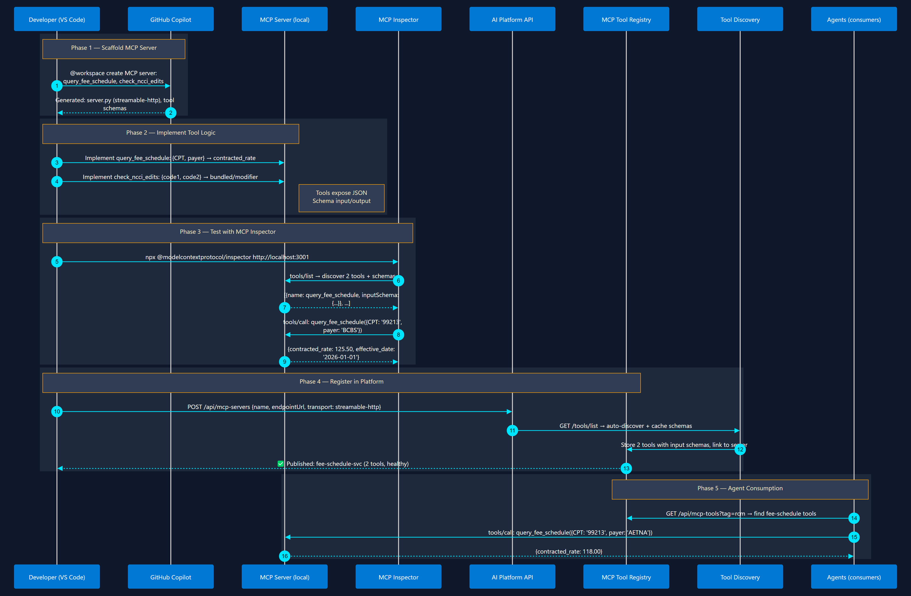
2
MCP Tool Development & Registration
Build → Test → Publish → Discover
Build tool server → test schema → publish to registry → agents discover it

Slide 19
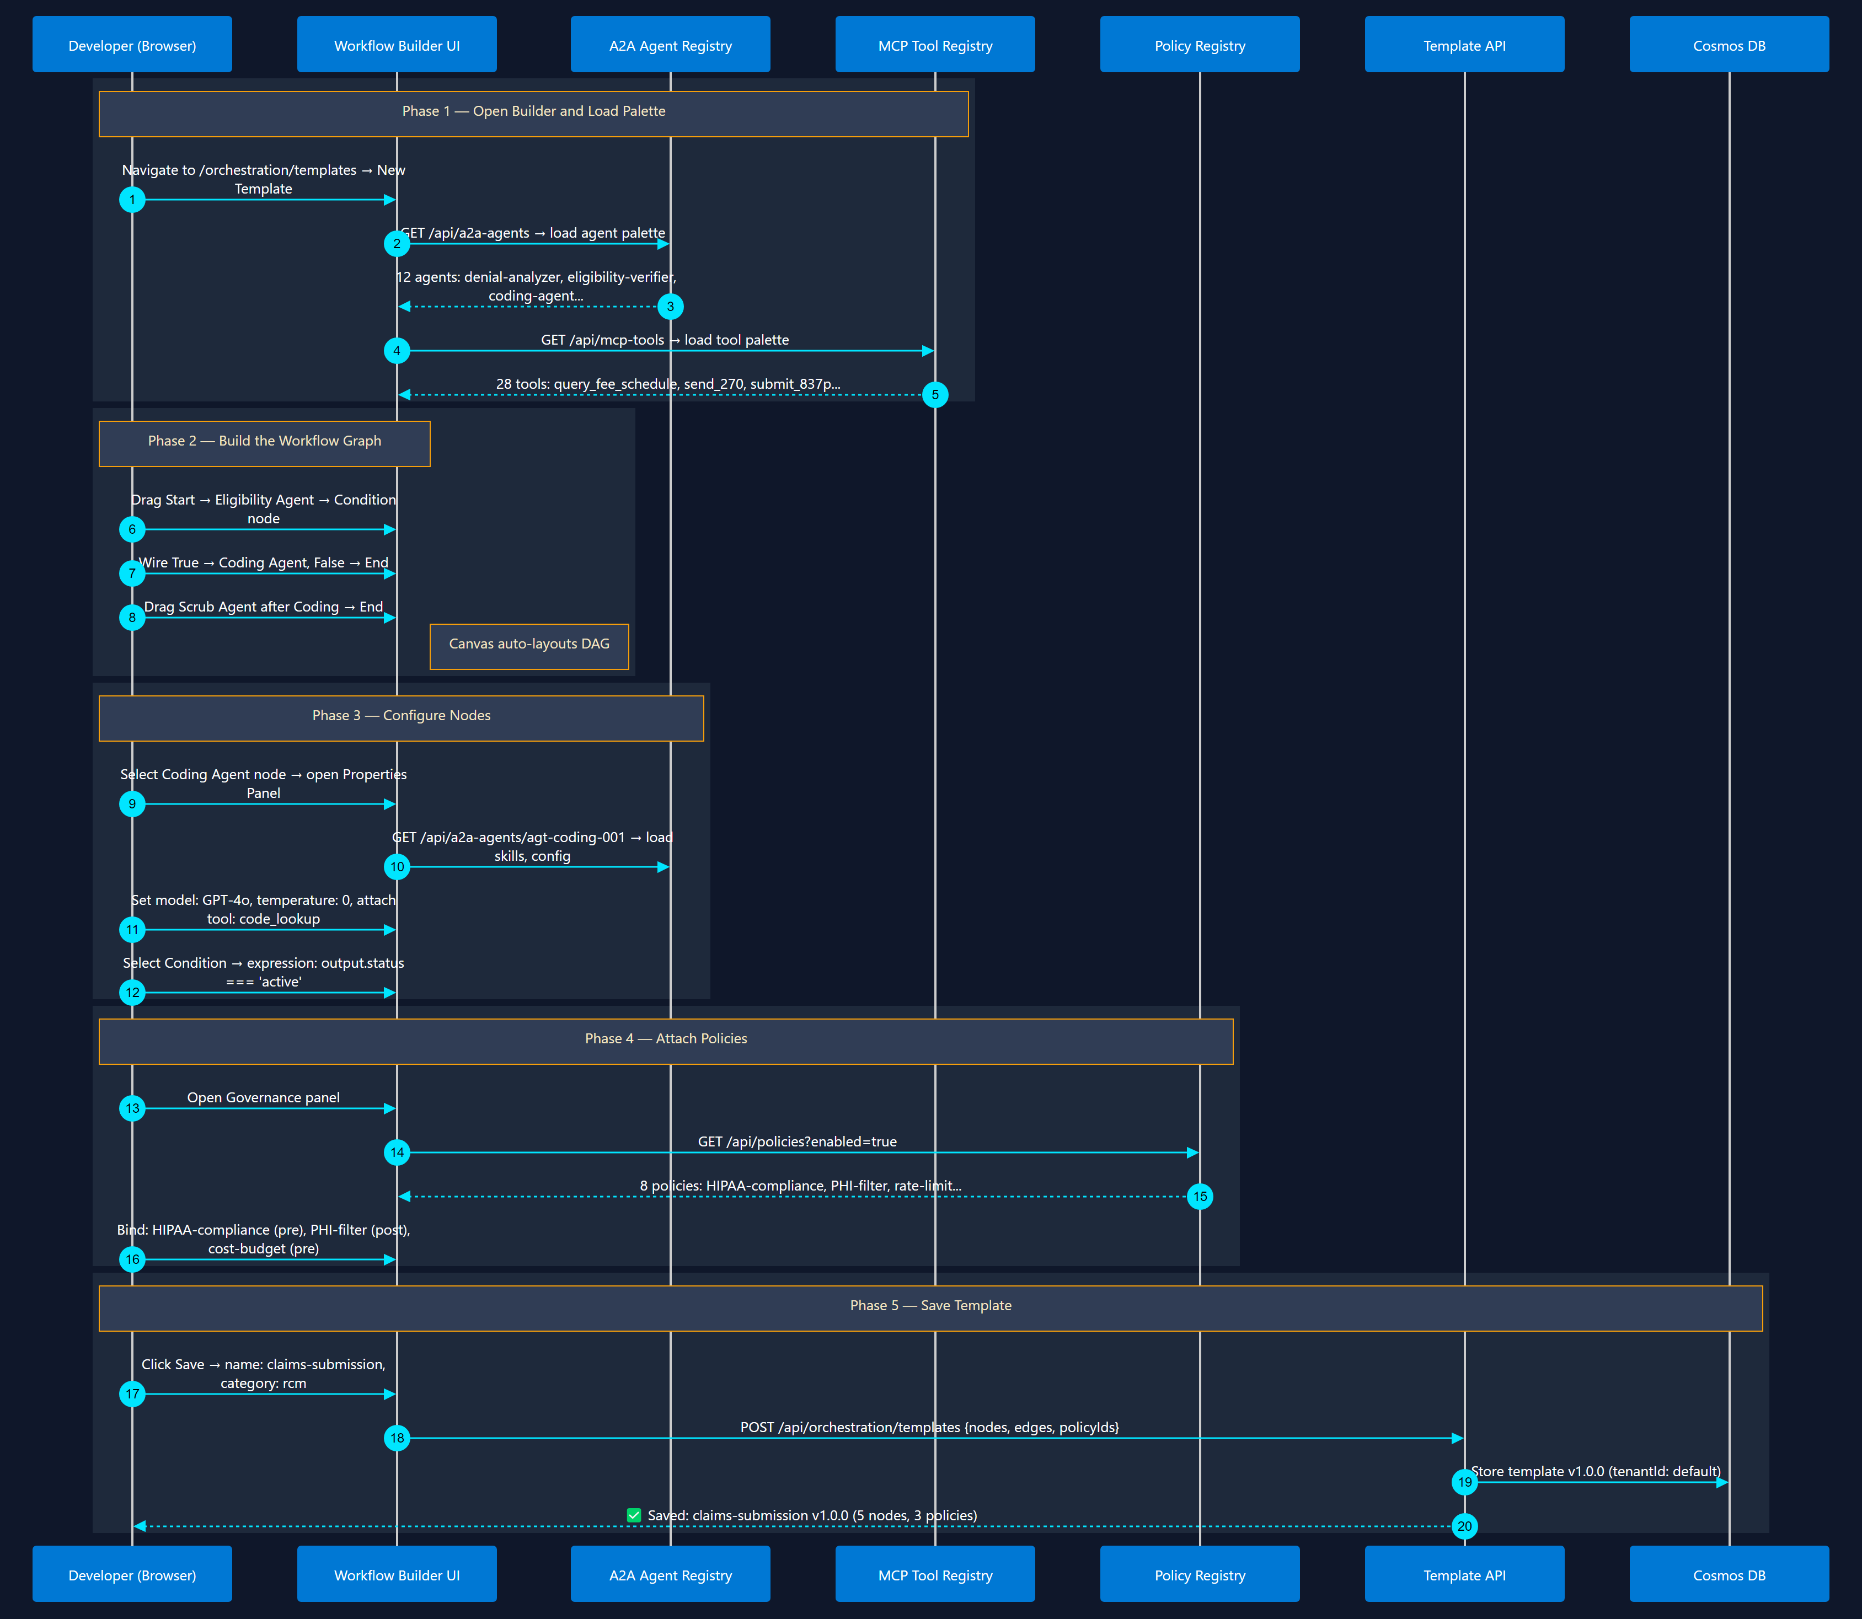
3
Orchestration Template Design
Visual Builder in Marketplace Web UI
Visual workflow builder → select agents → wire edges → attach policies → save

Slide 20
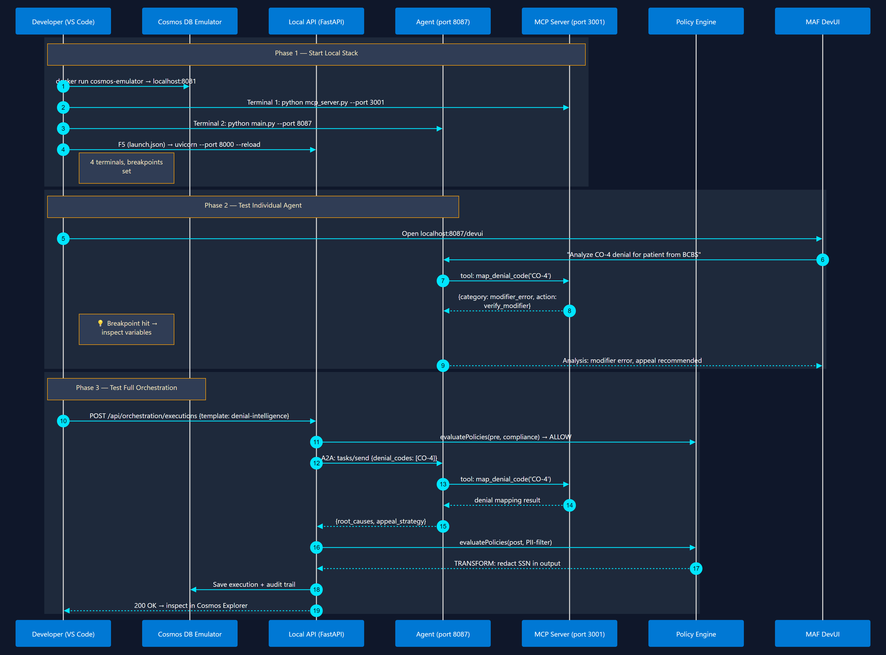
4
Local Testing & Debugging
VS Code Debug + Emulators
Cosmos Emulator → F5 debug → test orchestration → inspect policy decisions

Slide 21
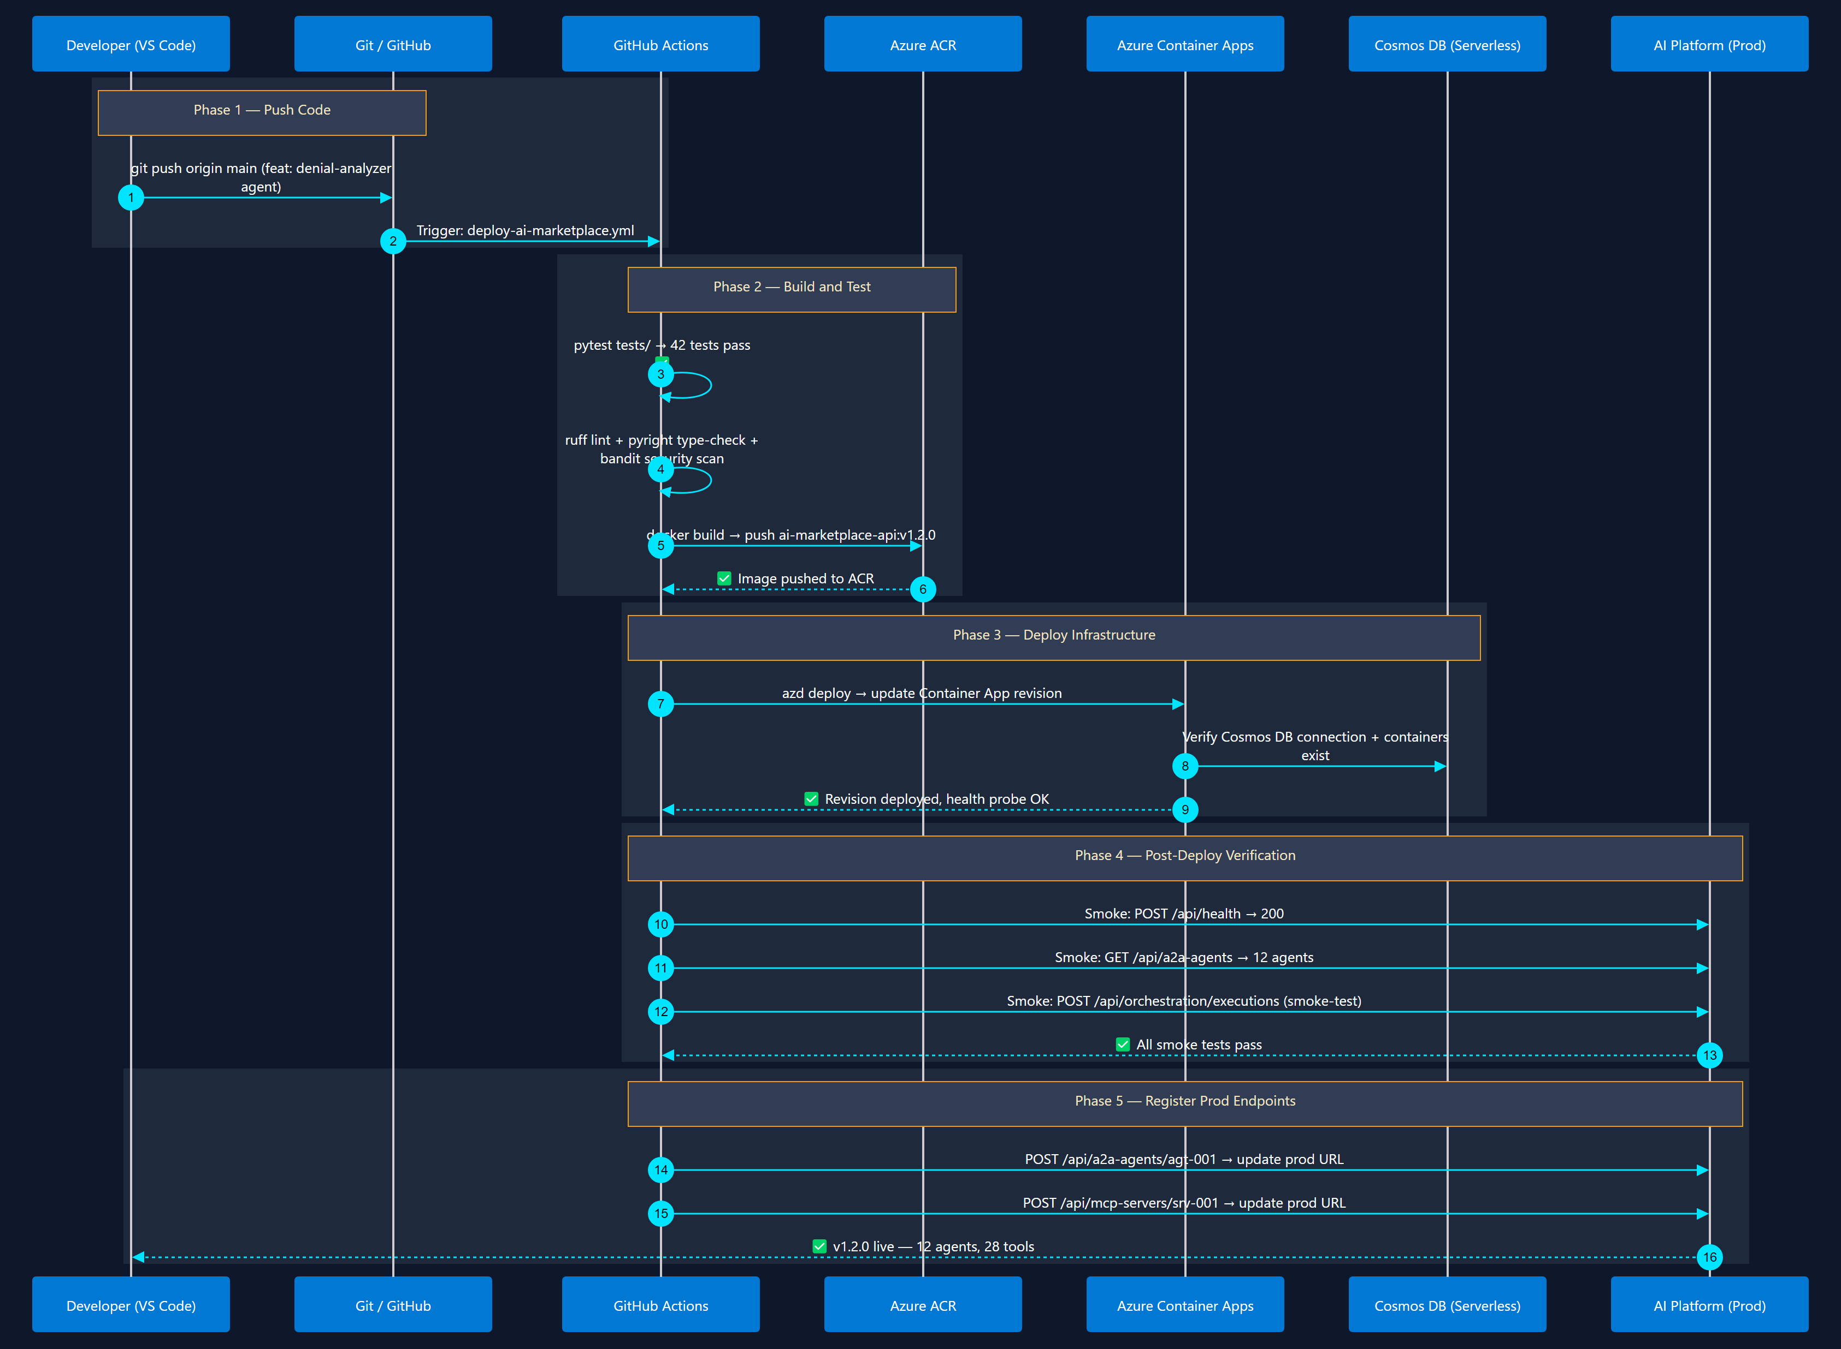
5
CI/CD Pipeline & Deployment
azd up + GitHub Actions
Git push → GitHub Actions → build container → deploy to Container Apps → verify

Slide 22
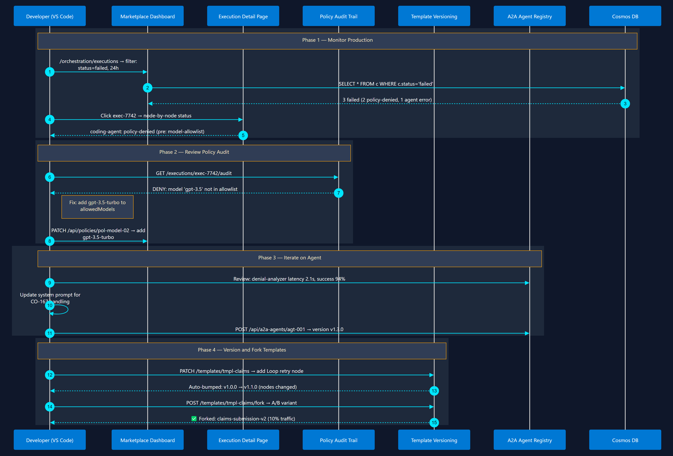
6
Day-2: Monitor, Iterate & Version
Observe → Refine → Ship
Monitor executions → review policy violations → update agents → version templates

Slide 23
180-Day Implementation Roadmap — Red Bounding Boxes
Slide 4 diagram: Red-outlined components are targeted for the next 180-day implementation cycle
■
□
= Targeted for 180-day implementation
= Already built or out of scope for this cycle
GROUP 1 — Core Platform (Left Red Boxes)
GROUP 2 — Governance & Publisher (Right Red Boxes)
Layer 1 — Presentation & UX
Layer 1 — Presentation & UX
▸ Web Portal /CLI (Discovery(React Flow drag-drop)
▸ Publisher Portal (submission lifecycle)
▸ Admin Dashboard (governance, health, approvals)
▸ Playground (interactive agent/tool testing)
Layer 2 — API & Registries
▸ DevUI (MAF agent debugging surface)
▸ AI Asset Catalog (CRUD, versioning, search)
Layer 2 — API & Registries
▸ MCP Server & Tool Registry
▸ Agent Skills Registry
Layer 3 — Orchestration & Governance
▸ Publisher & Submission API
▸ Workflow Templates (reusable patterns)
▸ Security Scanner (static + runtime validation)
▸ Execution Engine (graph dispatch, retries, fan-out)
Layer 3 — Orchestration & Governance
Layer 4 — Data & Observability
▸ Human-in-the-Loop Approval Gate
▸ Audit Log (immutable, TTL, Cosmos DB)
▸ IAM & RBAC Access Control (Entra ID)
▸ Metrics & OTLP (OpenTelemetry → App Insights)
▸ Compensation Logic / Saga (rollback coordination)
Layer 4 — Data & Observability
▸ Projects & Workspace (team-owned work areas)
▸ Ratings & Reviews (community feedback)
▸ Execution History (run outcomes, traces)
Not red-boxed: Web Dashboard (already shipping) • Layer 5 Azure Services (provisioned via Bicep IaC independently)

Slide 24
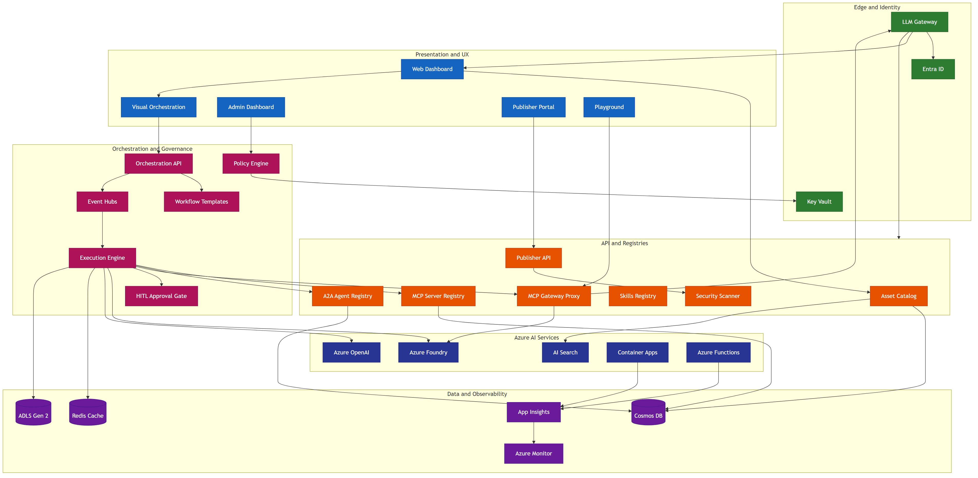
AI Marketplace app architecture
Enterprise grade scalable platform

