Slide 1
XN Final Deliverables
ALY 6980 - Capstone
Northeastern University - College of Professional Studies
Professor: Dr. Ajit Appari
Prepared by Shyamsundar Nandakumar

Slide 2
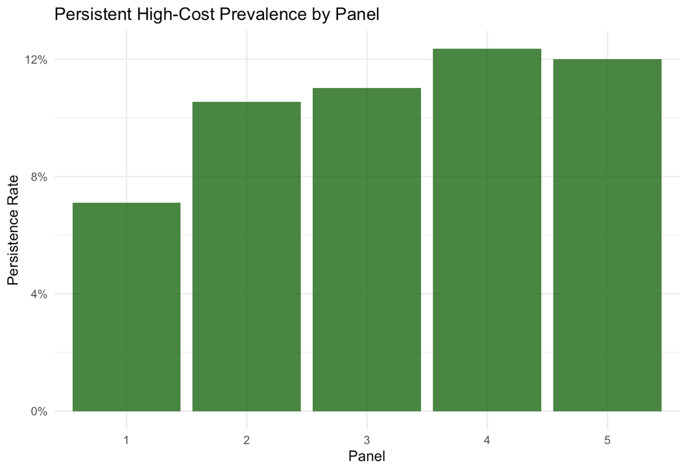
Introduction
Healthcare expenditure in the U.S. is highly concentrated
A small proportion of individuals account for a major share of costs
Persistent high-cost patients are often linked to:
Chronic conditions
Continuous healthcare utilization
Early identification is critical for:
Cost control
Efficient resource allocation
Improved patient outcomes
OBJECTIVE
Develop a predictive model to identify persistent high-cost individuals (top 10%) over 2 years
Persistent High-Cost Prevalence by Panel

Slide 3
Research Design
Research Question
Data
Data Cleaning
Can we accurately predict individuals who will remain in the top 10% of healthcare expenditure over time?
Key goal: Early identification of persistently high-cost patients using survey-weighted predictive modeling.
Source: MEPS Longitudinal Data
Multi-panel dataset (multiple years)
Features include:
Demographics
Insurance status
Chronic conditions
Healthcare expenditure
Handled missing values
Recoded categorical variables
Created derived variables:
Total 2-year expenditure
Log-transformed expenditure
Adjusted survey weights for pooled panels

Slide 4
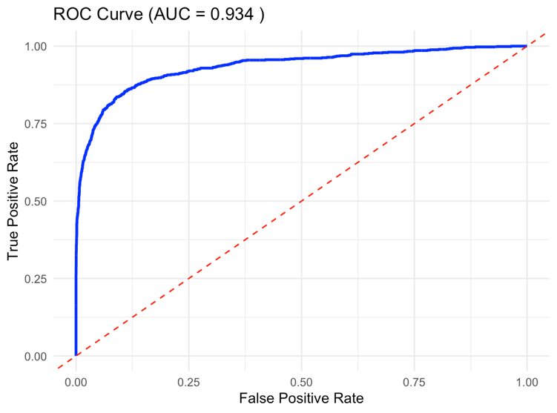
Modeling Approach
MODEL
Survey-weighted Logistic Regression
Handles: Stratification • Clustering • Sampling weights
VALIDATION STRATEGY
Temporal Split
Train → Panels 1–4 Test → Panel 5
AUC
Sensitivity
Specificity
Accuracy
F1 Score also evaluated for balanced performance assessment
ROC Curve (AUC = 0.934)

Slide 5
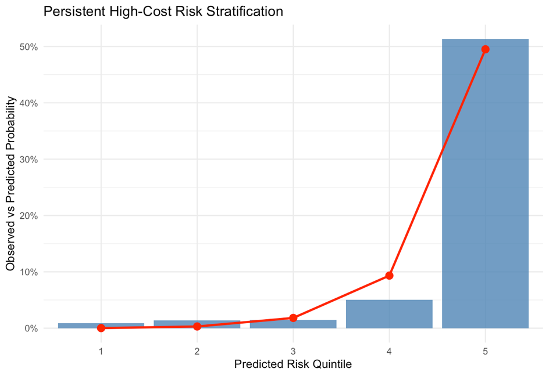
Model Performance & Risk Segmentation
0.934
90.1%
80.8%
81.9%
AUC
Sensitivity
Specificity
Accuracy
Excellent model performance
Captures most high-risk patients
Balanced classification
Overall correctness
RISK STRATIFICATION INSIGHT
Top risk group (Quintile 5)
>50% are persistent high-cost individuals
Lowest risk group (Quintile 1)
<1% are persistent high-cost individuals
Strong separation across quintiles
Enables actionable, targeted interventions
Persistent High-Cost Risk Stratification by Quintile

Slide 6
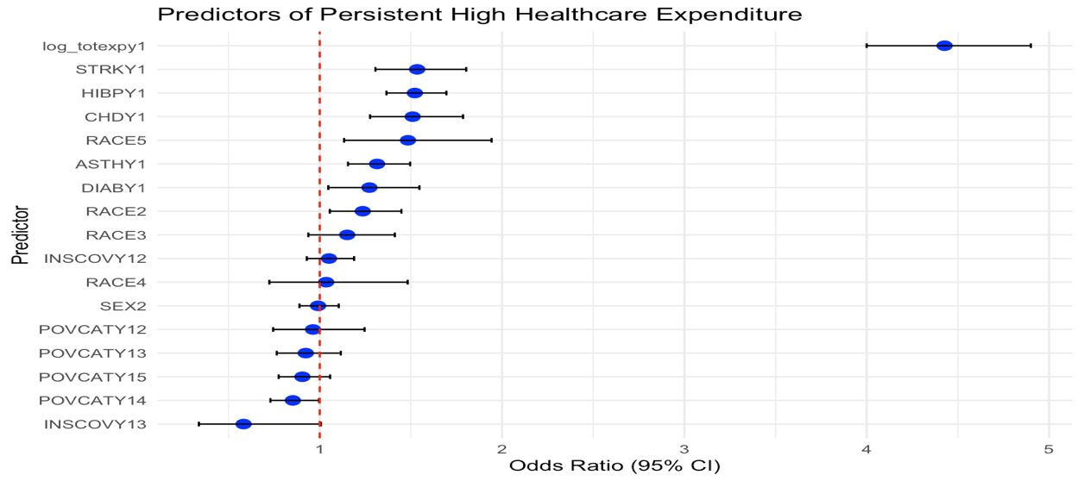
Key Drivers of High Costs
★ STRONGEST PREDICTOR
Prior Healthcare Expenditure
SIGNIFICANT FACTORS
Hypertension
Diabetes
Heart Disease
Stroke
Asthma
INTERPRETATION
Chronic conditions significantly increase long-term costs
Model is interpretable → useful for real healthcare decisions
Odds Ratio Plot (Predictors of Persistent High Expenditure)

Slide 7
Conclusion & Impact
Developed a robust and interpretable predictive model
Successfully identified high-cost individuals with high accuracy
Model supports:
Early intervention
Targeted care management
Efficient resource allocation
FUTURE WORKS
Use advanced ML models to improve performance
Add behavioral and socioeconomic features
Deploy in real-time healthcare decision systems
FINAL INSIGHT
Predictive analytics can significantly improve healthcare decision-making and cost management

Slide 8
EFERENCES
Agency for Healthcare Research and Quality. (2020). Medical Expenditure Panel Survey (MEPS) HC-210: 2017–2018 longitudinal data file. https://www.meps.ahrq.gov
Bates, D. W., Saria, S., Ohno-Machado, L., Shah, A., & Escobar, G. (2014). Big data in health care: Using analytics to identify and manage high-risk patients. Health Affairs, 33(7), 1123–1131. https://doi.org/10.1377/hlthaff.2014.0041
Cohen, S. B., & Yu, W. (2012). The concentration and persistence in the level of health expenditures over time: Estimates for the U.S. population, 2008–2009. Statistical Brief (Medical Expenditure Panel Survey No. 354). Agency for Healthcare Research and Quality.
Diehr, P., Yanez, D., Ash, A., Hornbrook, M., & Lin, D. Y. (1999). Methods for analyzing health care utilization and costs. Annual Review of Public Health, 20, 125–144. https://doi.org/10.1146/annurev.publhealth.20.1.125
Hwang, W., Weller, W., Ireys, H., & Anderson, G. (2001). Out-of-pocket medical spending for care of chronic conditions. Health Affairs, 20(6), 267–278. https://doi.org/10.1377/hlthaff.20.6.267
Johnson, T. L., Rinehart, D. J., Durfee, J., Brewer, D., Batal, H., Blum, J., Oronce, C. I. A., & Melinkovich, P. (2015). For many patients, high-cost care is a temporary state. Health Affairs, 34(8), 1312–1319. https://doi.org/10.1377/hlthaff.2014.1186
Newhouse, J. P. (1992). Medical care costs: How much welfare loss? Journal of Economic Perspectives, 6(3), 3–21. https://doi.org/10.1257/jep.6.3.3
Wang, L., & Alexander, C. A. (2015). Big data analytics in healthcare systems. International Journal of Mathematical, Engineering and Management Sciences, 1(1), 1–13.
Zhu, Y., Zhang, L., & Lee, H. (2020). Identifying high-cost patients using machine learning techniques. BMC Health Services Research, 20, 1–10. https://doi.org/10.1186/s12913-020-05688-3

