Slide 1
Secure Passwords with Hidden Information and
Non-Exposure
Team Details
S Sai Kumar(20EG105346)
V Chandan Teja(20EG105353)
M Shyamsunder(20EG105360)
Project Supervisor
Dr.T.Shyam Prasad
Assistant Professor

Slide 2
Introduction
SPHINX is an innovative password management system designed for heightened security, even in the event of the password manager being compromised. The stored information on the device remains independent of the user's master password, ensuring an added layer of protection. Notably, the master password is never exposed in plaintext during device interaction, preventing potential leaks to attackers. SPHINX generates high-entropy passwords and mandates users to register them with web services, effectively thwarting online guessing attacks and offline dictionary attacks upon service compromise.

Slide 3
Problem Statement
An attacker breaking into a server can mount an offline attack that uses information stored on the server to test the different passwords in the dictionary. Such offline dictionary attacks are an increasingly important concern, especially in light of frequent attacks against major commercial vendors, as recently experienced, e.g., by PayPal, LinkedIn, Blizzard and Gmail. The offline attacks are particularly devastating as a single server break in may lead to extraordinary numbers of compromised passwords

Slide 4
Problem Statement
Numerous approaches have been proposed by researchers and practitioners to improve the security of passwords from the client-side or user-side alone (i.e., without making any changes to a persistent server that uses traditional password-based authentication). One broad class of such approaches is referred to as password managers and forms the central focus of this project.

Slide 5
Problem Statement
Dependency on Device:
Passwords stored locally on a device may lead to issues if the device is lost, stolen, or compromised.
Lack of synchronization across devices can result in inconvenience for users.
Single Point of Failure:
In the event of a master password breach, the entire password vault becomes vulnerable.
Trust in Third-Party Providers:
Users may be tricked into entering master passwords, compromising the entire password repository.
Limited Protection Against Phishing:
Users must trust the security practices of the chosen password manager provider.

Slide 6
Proposed Method
SPHINX is a compelling application of DE-PAKE. It is a password manager, transparent to any existing service that deploys password authentication in which, U registers a hardened randomized password rwd with S, but only remembers a memorable password pwd that could be the same for multiple accounts (we use the terms master password and memorable password interchangeably).For each server S with which the user U has an account, the device D stores a unique key k. The key is used to map the pwd into a randomized password rwd = Fk(pwd|domain) using the (oblivious) PRF Fk. pwd and rwd are never stored in C and neither rwd nor pwd is ever stored in or exposed to D. Instead, D and C run the PTR protocol to obliviously compute rwd at the login time. SPHINX offers several key security guarantees simultaneously (individually as well as combined).

Slide 7
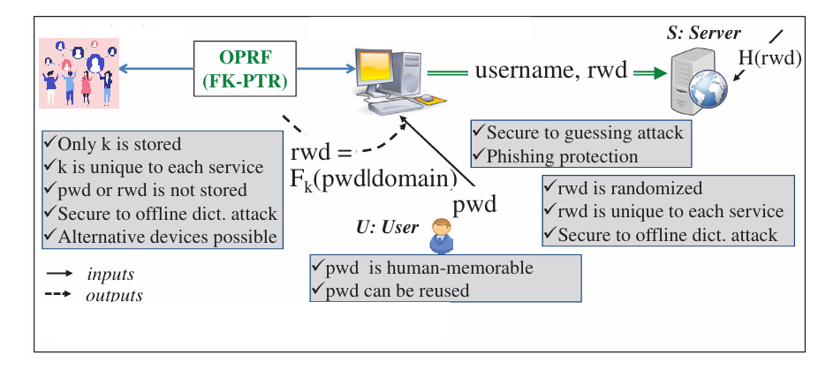
Proposed Method

Slide 8
Proposed Method
Application Overview:
SPHINX is a password manager leveraging DE-PAKE (Distributed Enhanced Password Authenticated Key Exchange).
It operates transparently across various services employing password authentication.
User Registration:
During registration, User U establishes a hardened randomized password (rwd) with the server S.
The user only needs to remember a memorable password (pwd), which could be the same for multiple accounts.
Unique Key Mapping:
For each server S, the device D stores a unique key (k).
Oblivious Computation:
At login time, D and C engage in the PTR (Password-Transparent to the Referee) protocol to obliviously compute rwd.

Slide 9
Proposed Method
5. Key Security Guarantees:
SPHINX offers simultaneous security guarantees:
Password Privacy: Neither rwd nor pwd is stored in or exposed to D.
Key Confidentiality: Unique keys for each server ensure confidentiality.
Resistance to Server Compromise: Even if a server is compromised, individual passwords remain secure.
6.Advantages:
Enhanced Security: Leveraging DE-PAKE ensures robust password management.
3. Privacy Protection: The protocol ensures that sensitivepassword information is never stored or exposed.
:

Slide 10
Experiment Environment
Front End: HTML, CSS, Java Script.
Back End: Python, Django
Database: PostreSQL
IDE: Visual Studio
Visual Studio provides a comprehensive IDE with features tailored for Java development. It offers tools for coding, debugging, refactoring, and project management, streamlining the development process.
Visual Studio has built-in support for version control systems like Git, enabling you to manage code changes, collaborate with team members, and track project history effectively.

Slide 11
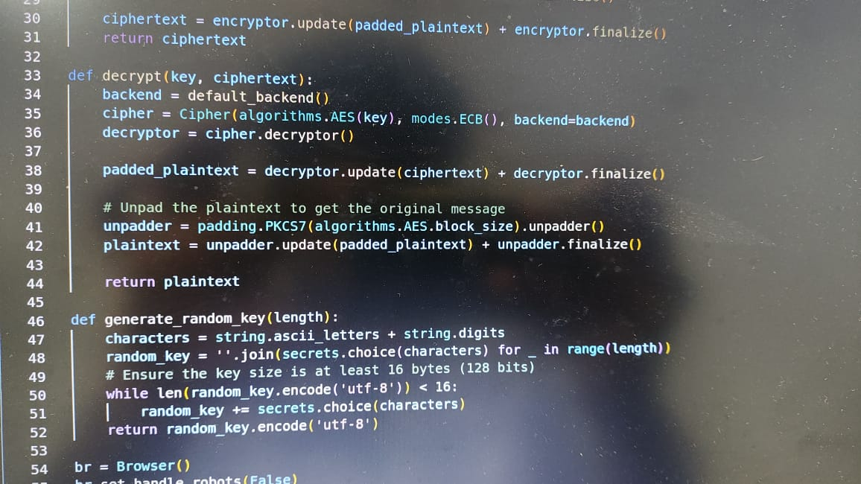
Experiment Screenshorts

Slide 12
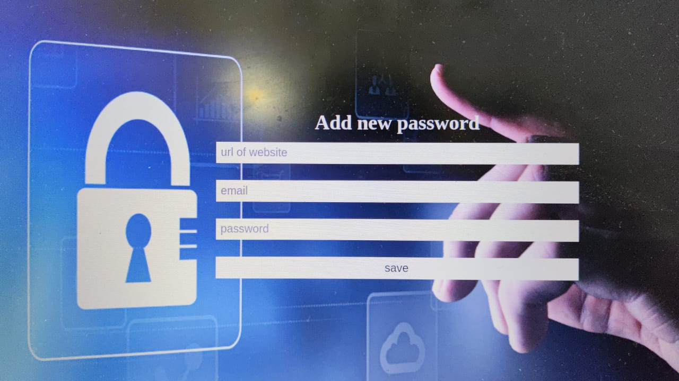
Experiment Results

Slide 13
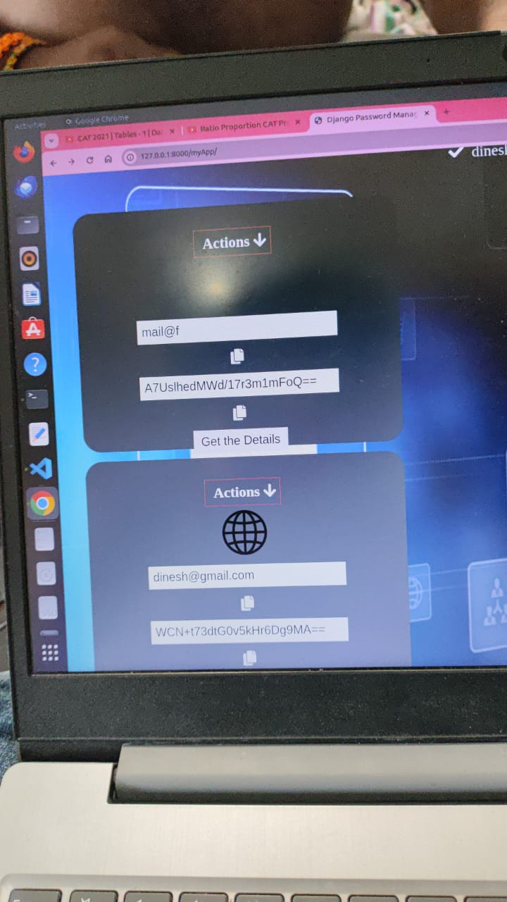
Experiment Results

Slide 14
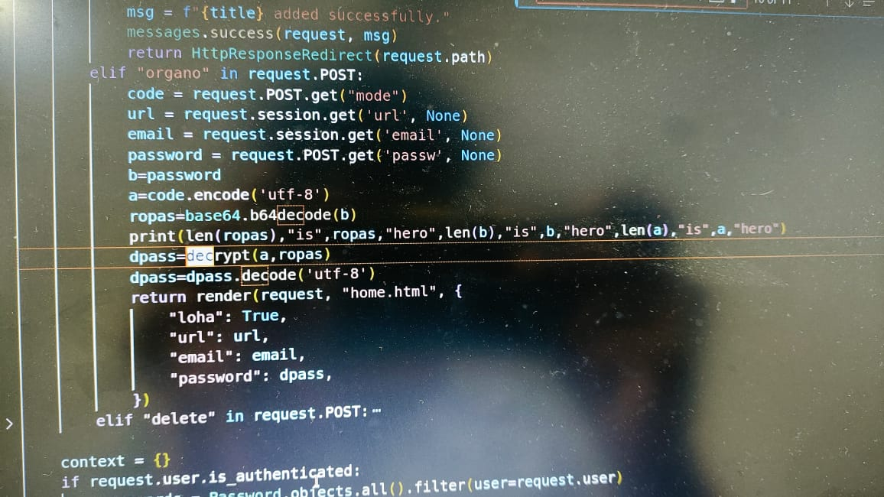
Experiment Results

Slide 15
Finding
Offline Attacks: Vulnerable to offline dictionary attacks.
Dependency on Device: Risks if device lost.
Single Point of Failure: Breach compromises entire vault.
Trust in Providers: Vulnerable to phishing attacks.
Limited Protection: Relies on provider's security practices.

Slide 16
Justification
1. Parameters Improved by Your Method:
Encryption Strength: Utilization of AES encryption with randomly generated keys enhances the encryption strength.
Key Storage Method: Adoption of a distinct email-based key storage method improves security by providing an additional layer of protection.
2. Mathematical Formulas for Calculating Parameter Values:
AES Encryption Strength: The Advanced Encryption Standard (AES) operates with various key lengths, including 128-bit, 192-bit, and 256-bit. The formula for calculating encryption strength can be represented as: Encryption Strength=Key LengthEncryption Strength=Key Length.

Slide 17
Justification
3. Why Your Parameter Values Improved:
Enhanced Encryption: AES encryption with randomly generated keys significantly improves security by utilizing a robust encryption algorithm and ensuring that keys are not predictable.
Unique Key Storage: The email-based key storage method adds an extra layer of security by diversifying the access points required to retrieve encryption keys, reducing the risk of unauthorized access to the password vault.

