Slide 1
EY Group -03 Open AI training hackathon EY Financial Advisor AI chat bot

Slide 2
Problem statement and solution
As an EY consultant , often when we want to pitch for new client engagements where we struggle to find the relevant financials and asset related information from large datasets . Consultants require Realtime retrieval of the information based on their questions .
As a solution we developed a Financial advisor chat bot ,which can accept the files related to the engagement . Using RAG architecture, the files converted to embedding and stored in vector database . Then retrieve the relevant information based on the input .
Notes:
2

Slide 3
Data collection
The data collected from public government website which is shows the company data.
(https://www.sec.gov/edgar/sec-api-documentation)
Data related – US company filing

Slide 4
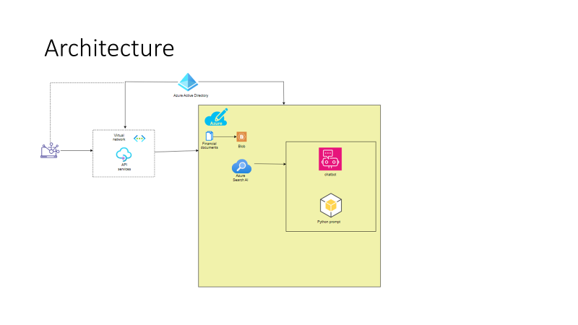
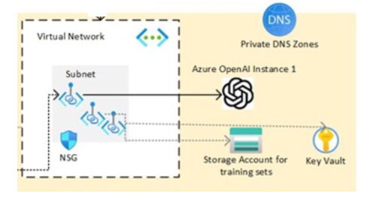
Architecture

Slide 5
Prompt Engineering
#show me the financial trend over the time for TKO GROUP HOLDINGS, INC
Based on the retrieved documents, here are some key financial trends for TKO GROUP HOLDINGS, INC. over the period from 2022-12-31 to 2023-09-30:
Accounts Payable, Current increased from 16,842,000 USD to 20,898,000 USD 1 .
Accounts Receivable, after Allowance for Credit Loss, Current increased significantly from 45,448,000 USD to 195,773,000 USD 1 .
Accrued Liabilities, Current more than

Slide 6
Prompt Engineering
#2-show me the financial trend over the time for TKO GROUP HOLDINGS, INC
Based on the retrieved documents, the available financial information for TKO GROUP HOLDINGS, INC. includes:
Accounts Payable, Current as of 2022-12-31: 16,842,000 USD and as of 2023-09-30: 20,898,000 USD 1 .
Accounts Receivable, after Allowance for Credit Loss, Current as of 2022-12-31: 45,448,000 USD and as of 2023-09-30: 195,773,000 USD 1 .
Accrued Liabilities, Current as of 2022-12-31: 108,189,000 USD and as of 2023-09-30: 244,716,000 USD 1 .
Accrued Professional Fees, Current as of 2022-12-31: 2,915,000 USD and as of 2023-09-30: 25,932,000 USD 1 . Please note that these figures are based on the data available in the retrieved documents and may not represent the current financial status of the company. Always consult with a financial advisor or conduct comprehensive research before making any investment decisions.

Slide 7
Prompt Engineering
#6-based on Account Receivable where do you advice me to do my investment is in MAPLEBEAR INC or TKO GROUP HOLDINGS, INC
Response: Based on the Accounts Receivable data from the retrieved documents, as of the end of Q3 2023, MAPLEBEAR INC. had an Accounts Receivable of 841,000,000 USD [doc2], while TKO GROUP HOLDINGS, INC. had an Accounts Receivable of 195,773,000 USD [doc1]. Accounts Receivable represents the amount of money owed to a company by its customers for goods or services that have been delivered or used but not yet paid for. A higher Accounts Receivable can indicate more sales, but it can also indicate that a company is not collecting the money it's owed quickly enough, which could impact its cash flow. While Accounts Receivable is a significant factor, it should not be the sole determinant for investment decisions. Other financial metrics and factors such as the company's overall financial health, profitability, growth prospects, the industry in which the company operates, and risk tolerance should also be considered. Please consult with a financial advisor or conduct further research before making any investment decisions.

Slide 8
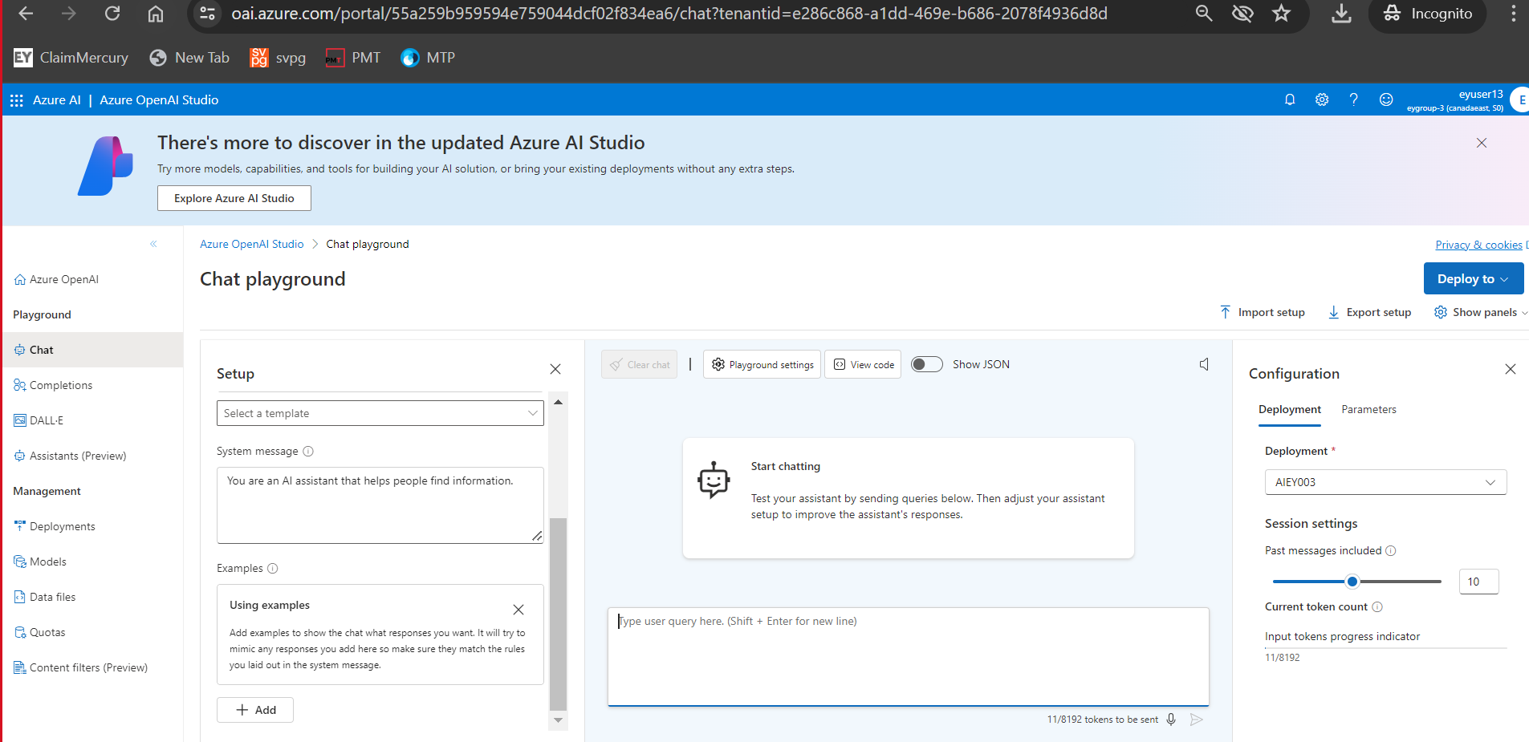
Model Deployment

Slide 9
Code Repo link

Slide 10
Web application to use the financial advisor
[4:31 PM] Mayur Bhavlal Patil
https://ey-financials-advisor.azurewebsites.net/

