Slide 1
Grocery Store Managment
Mysql project:1
k.Ramakrishna
Sk.Allabakshu
B.Shyam kishore

Slide 2



Team
Ramakrishna
Allabakshu
Shyam kishore
DA
DA
DA

Slide 3
Introduction
In this project, I developed and analyzed a comprehensive Grocery Store Management System using MySQL to uncover key insights into store operations. It provides a structured way to manage suppliers, product categories, customers, employees, and orders. The database tracks product details, supplier information, customer purchases, and employee activities while maintaining relationships through primary and foreign keys. The system supports the analysis of sales trends, customer behavior, category performance, and supplier contributions, offering valuable insights for inventory planning, revenue optimization, and data-driven decision-making.

Slide 4


Objective :
The objective of the Grocery Store Management System using MySQL is to design and implement a relational database that efficiently stores, manages, and retrieves information about suppliers, products, customers, employees, and orders. This project aims to maintain data integrity and consistency through the use of SQL constraints and relationships, while automating key store processes such as order tracking, billing, and inventory management. By providing accurate, real-time reports and insights through SQL queries, the system supports effective decision-making for store managers and owners. Additionally, it ensures security and controlled access to sensitive data, thereby improving operational efficiency and customer satisfaction.

Slide 5
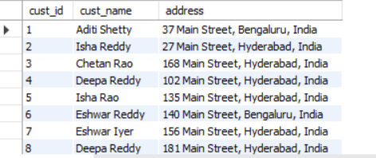
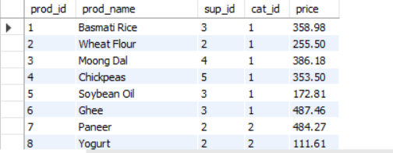
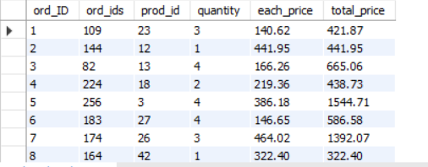
Tables
Customers
Products
Orders

Slide 6
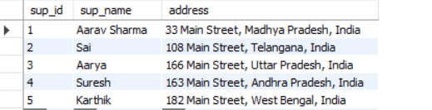
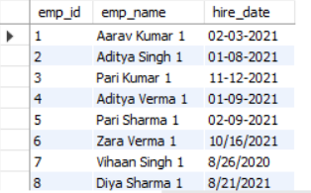
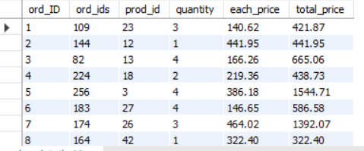
Tables
Suppliers
Store Employees
Order Details

Slide 7
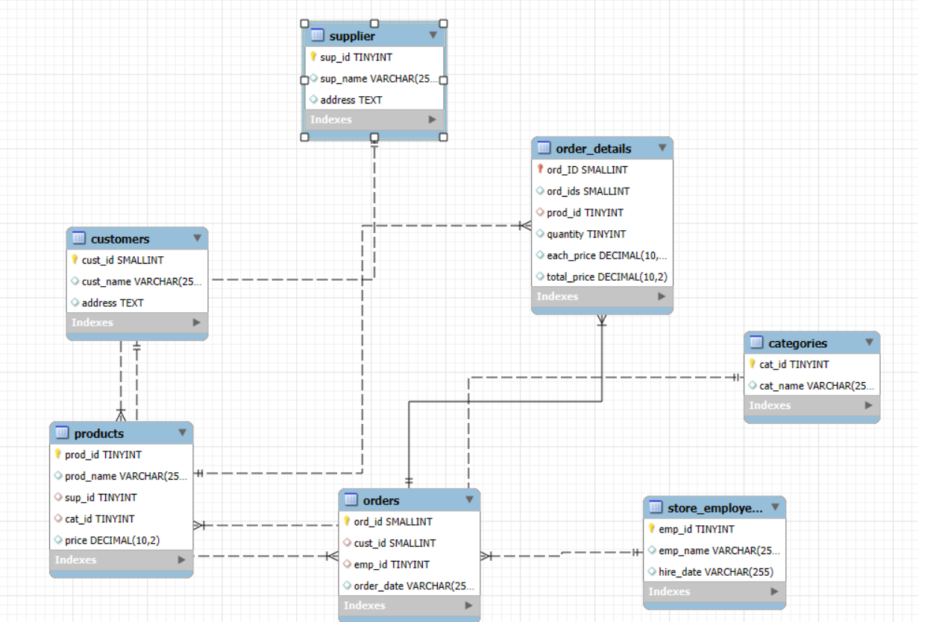
ER Diagram

Slide 8
BASIC INTERMEDIATE ADVANCED QUERIES

Slide 9


Queries
How many unique customers have placed orders?
Notes:
(These don’t have designer IDs since they were based off the default master slides already in the deck.

Slide 10
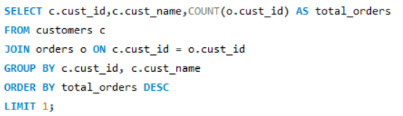

Queries
Which customers have placed the highest number of orders?
Notes:
(These don’t have designer IDs since they were based off the default master slides already in the deck.

Slide 11
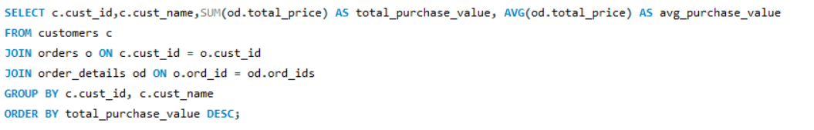
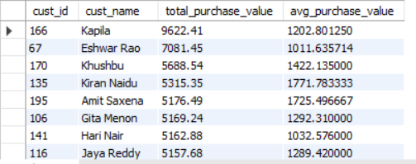
Queries
What is the total and average purchase value per customer?
Notes:
(These don’t have designer IDs since they were based off the default master slides already in the deck.

Slide 12
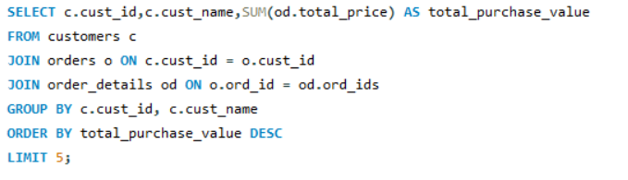
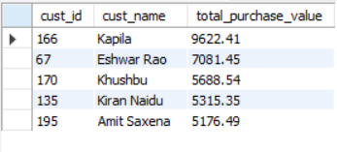
Queries
Who are the top 5 customers by total purchase amount?
Notes:
(These don’t have designer IDs since they were based off the default master slides already in the deck.

Slide 13

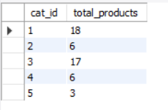
Queries
How many products exist in each category?
Notes:
(These don’t have designer IDs since they were based off the default master slides already in the deck.

Slide 14
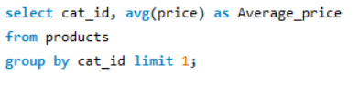

Queries
What is the average price of products by category?
Notes:
(These don’t have designer IDs since they were based off the default master slides already in the deck.

Slide 15
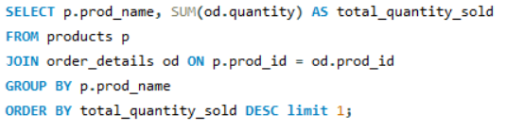

Queries
Which products have the highest total sales volume (by quantity)?
Notes:
(These don’t have designer IDs since they were based off the default master slides already in the deck.

Slide 16
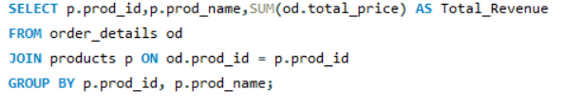
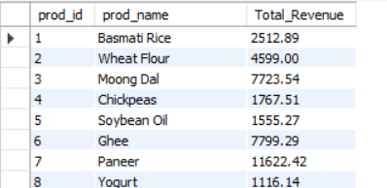
Queries
What is the total revenue generated by each product?
Notes:
(These don’t have designer IDs since they were based off the default master slides already in the deck.

Slide 17
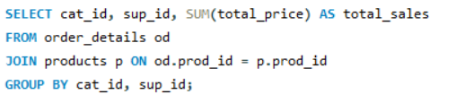
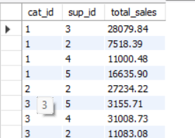
Queries
How do product sales vary by category and supplier?
Notes:
(These don’t have designer IDs since they were based off the default master slides already in the deck.

Slide 18


Queries
How many orders have been placed in total?
Notes:
(These don’t have designer IDs since they were based off the default master slides already in the deck.

Slide 19

Queries
What is the average value per order?
Notes:
(These don’t have designer IDs since they were based off the default master slides already in the deck.

Slide 20
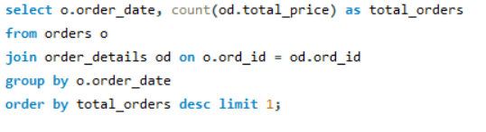

Queries
On which dates were the most orders placed?
Notes:
(These don’t have designer IDs since they were based off the default master slides already in the deck.

Slide 21
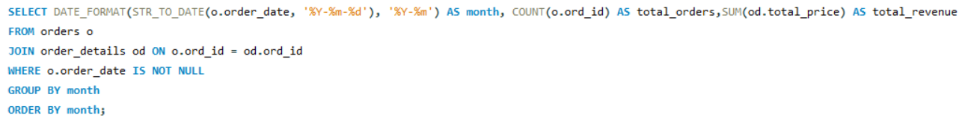
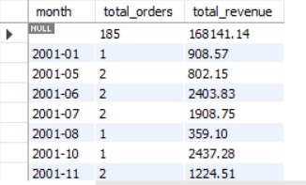
Queries
What are the monthly trends in order volume and revenue?
Notes:
(These don’t have designer IDs since they were based off the default master slides already in the deck.

Slide 22


Queries
How many suppliers are there in the database?
Notes:
(These don’t have designer IDs since they were based off the default master slides already in the deck.

Slide 23
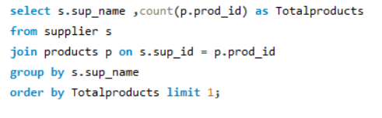

Queries
Which supplier provides the most products?
Notes:
(These don’t have designer IDs since they were based off the default master slides already in the deck.

Slide 24
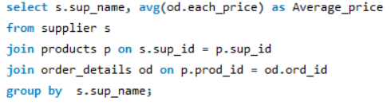
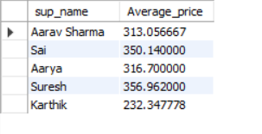
Queries
What is the average price of products from each supplier?
Notes:
(These don’t have designer IDs since they were based off the default master slides already in the deck.

Slide 25
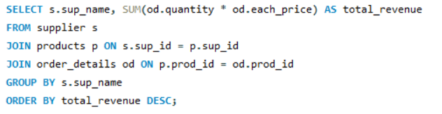
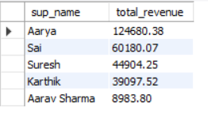
Queries
Which suppliers contribute the most to total product sales (by revenue)?
Notes:
(These don’t have designer IDs since they were based off the default master slides already in the deck.

Slide 26
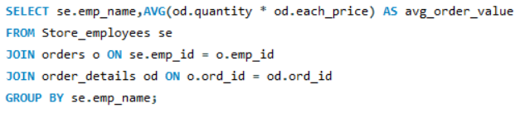
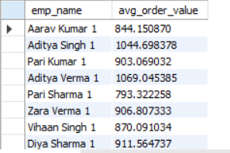
Queries
What is the average order value handled per employee?
Notes:
(These don’t have designer IDs since they were based off the default master slides already in the deck.

Slide 27
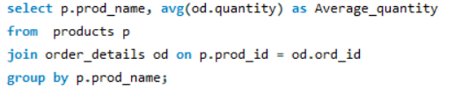
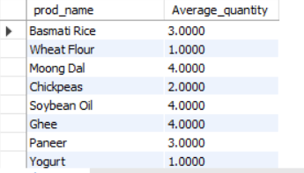
Queries
What is the average quantity ordered per product?
Notes:
(These don’t have designer IDs since they were based off the default master slides already in the deck.

Slide 28

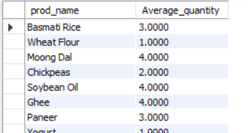
Queries
What is the average quantity ordered per product?
Notes:
(These don’t have designer IDs since they were based off the default master slides already in the deck.

Slide 29
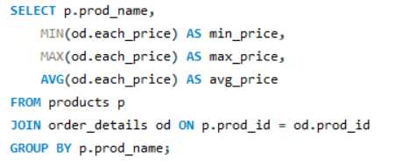
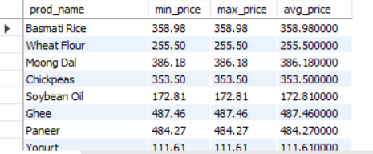
Queries
How does the unit price vary across products and orders?
Notes:
(These don’t have designer IDs since they were based off the default master slides already in the deck.

Slide 30


Conclusion :
This project demonstrated how SQL can be leveraged to collect, clean, and analyze operational data within a grocery store management system. By applying structured queries across multiple tables, we transformed raw transactional data into meaningful insights on sales trends, customer behaviour, supplier performance, and employee productivity. These analyses enable evidence-based decisions that improve inventory planning, pricing strategies, and overall store efficiency, highlighting the critical role of data analytics in driving business performance.

Slide 31


Challenges:
Data Integrity & Accuracy Ensuring no duplicate records for customers, products, suppliers, and orders by using primary keys, unique constraints, and careful data entry.
Data Security & Privacy Protecting sensitive customer and supplier details (addresses, contact info, pricing) through controlled access and role-based privileges in the database.
Complex Relationships Managing multiple tables (Customers, Orders, Products, Suppliers, Employees) by defining clear primary–foreign key relationships and using ER diagrams to visualise connections.
Handling Foreign Keys & Cascading Updates/Deletes Maintaining referential integrity by setting ON UPDATE CASCADE and ON DELETE CASCADE so that related records remain consistent when parent data changes.
Inventory & Sales Management Calculating total sales, average order values, and stock movement after each order to keep the system updated and accurate for decision-making.

Slide 32

Thank you
K.Ramakrishna
SK.Allabakshu
B.Shyam kishore

