Slide 1

Analyzing Online Articles using Data Mining
Under the supervision of
Dr. Yogita
Assistant Professor
Department of Computer Science and Engineering
NIT Meghalaya
Submitted by:-
Satyaveer Nayak (B15CS032)
Shyam Sundar Kumawat (B15CS038)

Slide 2
Agenda
Introduction
Raw Data and Data Preprocessing.
Data labeling
Data Representation
Data labeling
Feature Extraction
Similarity Measurement
Classification
Results
Conclusion
References

Slide 3
Introduction
Today , most of the data is stored in text format and the exponential growth of data triggers data mining research work a lot.
An article may contains a lot meaning information which can be extracted using data mining algorithms.
In this project, these articles are collection of news articles collected from BBC News[1].
Analyzing these online news articles can be defined as classifying these articles and comparing the similarities among these articles and etc.

Slide 4
Raw data and it’s Acquisition
Data pre-processing
Data labelling.
Feature Extraction
Classification
Similarity measure
Conclusion

Slide 5
Raw Data Acquisition
Raw Data is primarily unstructured or unformatted repository data which may contain meaningful information.
Raw data may be available in different formats like i.e. files, articles, visual image, database records or etc.
Process of collecting this unstructured data is called raw data acquisition.
In this project we collected dataset from BBC News which contain mainly different news articles which belong to five category of news.
These five categories are Business, Entertainment, Politics, Sports, and Technical .

Slide 6
Data Preprocessing
It is one of the critical process in data mining which deals with the preparation and transformation of the raw data for further processing.
It improves the quality of data and also removes the redundant data.
Preprocessing Techniques
  Tokenization
  Stop-word Removing
  Stemming
  Chunking
  Named Entity Extraction
  Data Integration

Slide 7
Tokenization
A sentence can be defined as a complete set of words. These words are separated by white spaces.
The process to splitting sentence into words is called tokenization[5].
A article is a collection of more then one sentences, so first, it is required to split whole article into sentences.
These sentences can be splitted into words which are defined as tokens.
The basic regular expression can be used for tokenization is [\w]+ or r’\w{1,}.

Slide 8
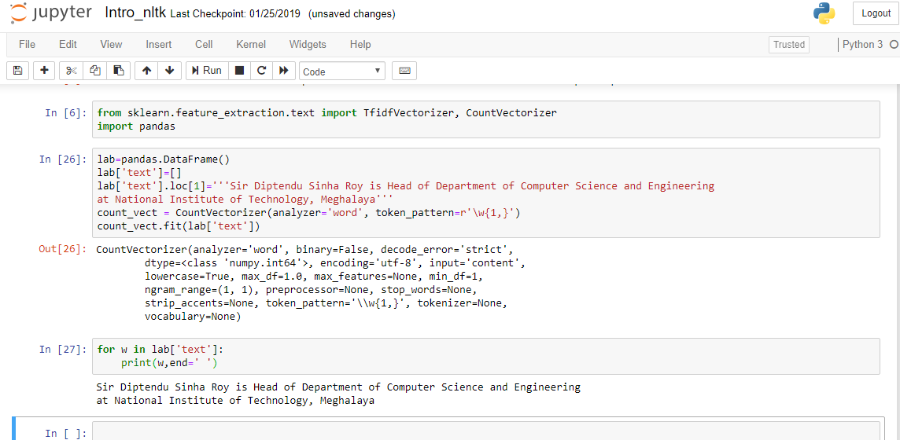
Figure 1: Tokenization example

Slide 9
Stop Word Removing
A dataset may contains lot of words which are commonly used or belong to language grammar are called stop words.
These stop words are required to remove which makes data less redundant and efficient for further processing.
Stop word removing is a data cleaning process.
Ex. Tokens: [`“`, `A`, `sentence`, `can`, `be`, `defined`, `as`, `a`, `complete`, `set`, `of`, `words`, `”`].
After cleaning : [`sentence`, `defined`, `complete`, `set`, `words`].

Slide 10
Stemming and Lemmatization
Stemming and Lemmatization are Text Normalization techniques.
Stemming[8] is the process of reducing inflection in words to their root forms such as mapping a group of words to the same stem even if the stem itself is not a valid word in the Language.
Lemmatization[8], unlike Stemming, reduces the inflected words properly ensuring that the root word belongs to the language. In Lemmatization root word is called Lemma.
Example: “My depression is worse than ever.”
Stemmed sentence
  “ My depress is wors than ever . ”
Lemmatized sentence
  “My depress is worse than ever”

Slide 11
Chunking
The process of tagging part of speech is called chunking[6].
From the collection of words it’s quite difficult to recapture the sentence.
Each chunk contains info about respective word in the sentence.
Chunking is used to recapture the sentence which is broken in chunks.
There are 36 tags but 8 are main chunks in a sentence.
Ex. “Everything to permit us”.
POS [('Everything', NN),('to', TO), ('permit', VB), ('us', PRP)].

Slide 12
Chunking
Eight main tags in a sentence could be.
Noun
Interjection
Pronoun
Preposition
Parts of speech
Verb
Conjunction
Adverb
Adjective
Figure 2: Chunks

Slide 13
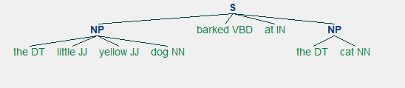
Conti.
Ex. sentence = “the little yellow dog barked at the cat”.
Figure 3. Tags in a sentence

Slide 14
Named Entity Extraction
Recognition of objects in an article is called Named Entity Extraction.
These entities can be people, location, organization, job title, percentages, date and time and etc.
Ex. ''She is a professor at NIT Meghalaya ''‘.
(S She/PRP is/VBZ a/DT professor/NN at/IN (ORGANIZATION NIT/NNP Meghalaya/NNP))

Slide 15
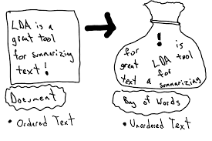
Data Integration
After preprocessing of the raw data it is required to integrate the whole preprocessed data.
This whole collection of data is represented by bag of words.
Figure 4: Bag of words

Slide 16
Data representation
After preprocessing it is required to represent the data for further processing.
Data representation models
I. Vector space representation.
II. Graph space representation.
In vector space representation the whole article is represented by a single vector.
Each index of vector contain a term of the text document/article.

Slide 17
Data labeling
Data labeling is a process which assigns a class label to a data element.
Data labeling plays a vital role in the validation of a classifier.

Slide 18
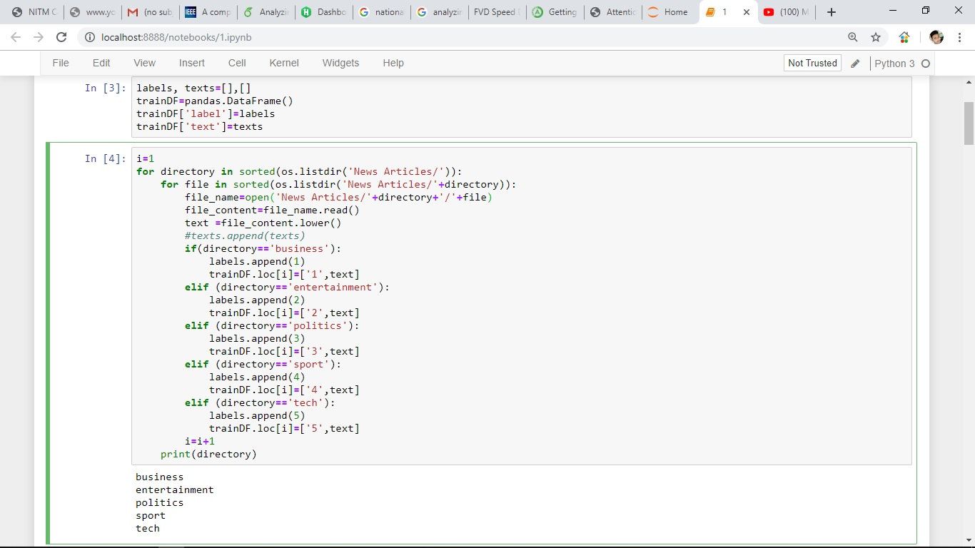
Figure 5: Data Frame to store articles with respective label.

Slide 19
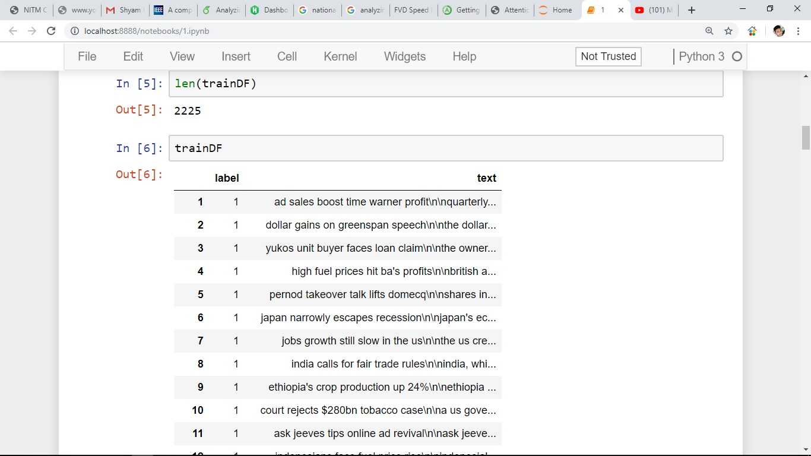
Figure 6: Labeled Articles

Slide 20
Feature Extraction
Feature selection and extraction is the key part for the further processing. Each feature has its different applications so selection of appropriate feature plays a vital role.
It is the transformation of the original data to a data set with a reduced number of variables, which contains the most discriminatory information.
Features.
Weight matrix using Term Frequency (TF)
Weight matrix using Term Frequency-Inverse Document Frequency (TF-IDF).

Slide 21
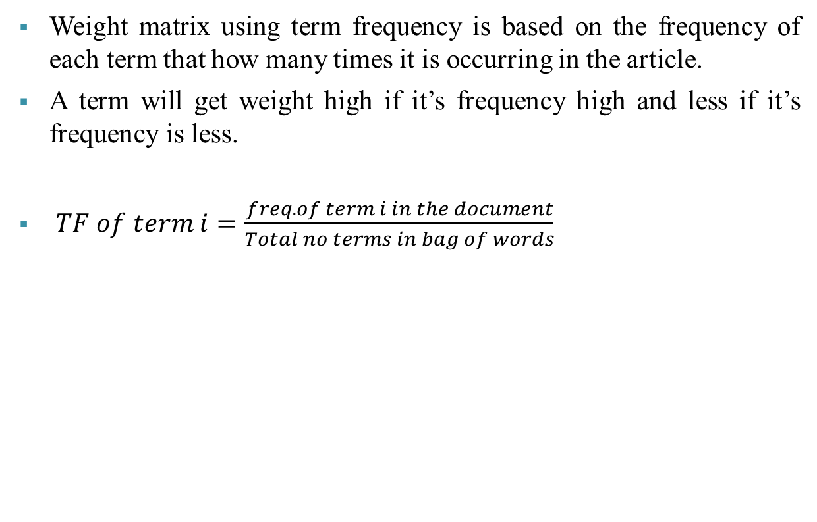
Weight Matrix Using TF
Weight matrix using term frequency is based on the frequency of each term that how many times it is occurring in the article.
A term will get weight high if it’s frequency high and less if it’s frequency is less.
$TF of term i=\frac{freq.of term i in the document}{Total no terms in bag of words}$

Slide 22
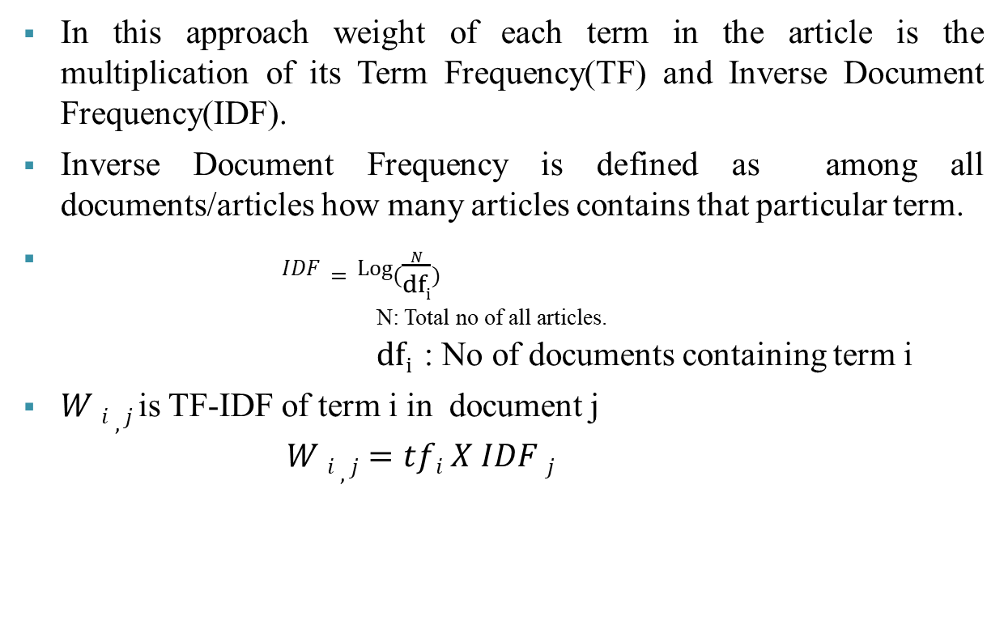
Weight Matrix Using TF-IDF
In this approach weight of each term in the article is the multiplication of its Term Frequency(TF) and Inverse Document Frequency(IDF).
Inverse Document Frequency is defined as among all documents/articles how many articles contains that particular term.
$IDF=Log⁡(\frac{N}{dfi})$
_{N: Total no of all articles.}
$dfi$ : No of documents containing term i
$W i , j$is TF-IDF of term i in document j
$W i , j=tfi X IDF j$

Slide 23
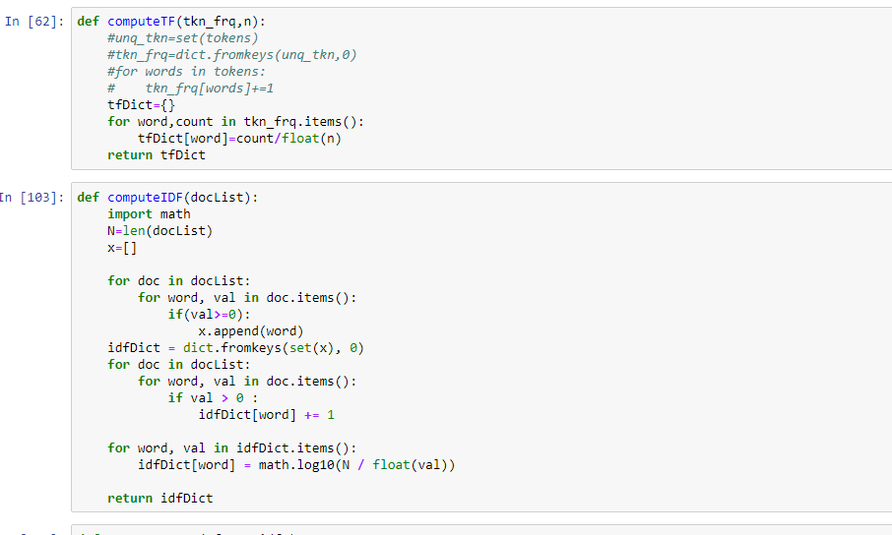
Figure 7: TF-IDF computation

Slide 24
TF-IDF at word level
TF-IDF at word level considers a list of word and assigns weight to each word. In the article data set we have to take single word at a time from each and calculate the TF-IDF.
It requires both TF and IDF need to be calculated separately to get the final weight.

Slide 25
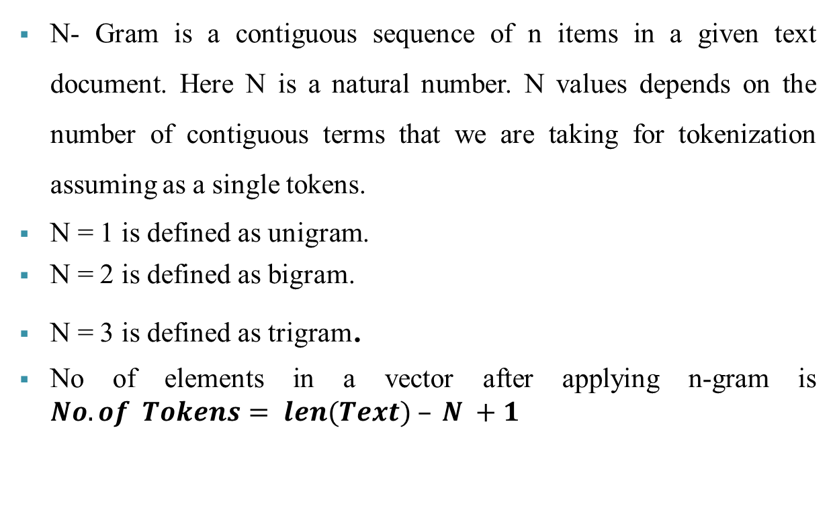
Weight Matrix Using N-Gram

Slide 26
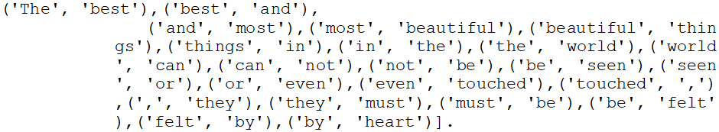
Continue
Example: “The best and most beautiful things in the world cannot be seen or even touched, they must be felt by heart”.
N=1 unigrams = [ `The`, `best`, `and`, `most`, `beautiful`, `things`, `in`, `the`, `world`, `can`, `not`, `be`, `seen`, `or`, `even`, `touched`, , `they`, `must`, `be`, `felt`, `by`, `heart`].
N=2 bigrams =

Slide 27
Similarity Measure
  This measure reflects the degree of closeness or separation of the target objects and should correspond to the characteristics that are believed to distinguish the clusters embedded in the data.
  Similarity Measure Techniques.
    String based.
    Distance based
  Ex. cosine similarity, Euclidean similarity

Slide 28
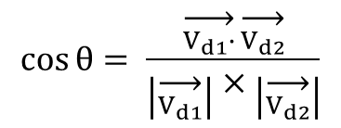
Cosine Similarity
Cosine is a mathematical approach which is used to find angle between two vectors that can be considered as similarity values.
Figure : cosine similarity between two vector2[7].
$$\cos{θ}= \frac{\overset{→}{V_{d1}∙}\overset{→}{V_{d2}}}{\left|\overset{→}{V_{d1}}\right|×\left|\overset{→}{V_{d2}}\right|}$$

Slide 29
Document A
Document B
Terms collection
Create a vector space on a selected feature.
Compute similarity using cosine similarity formula
Similarity value

Slide 30
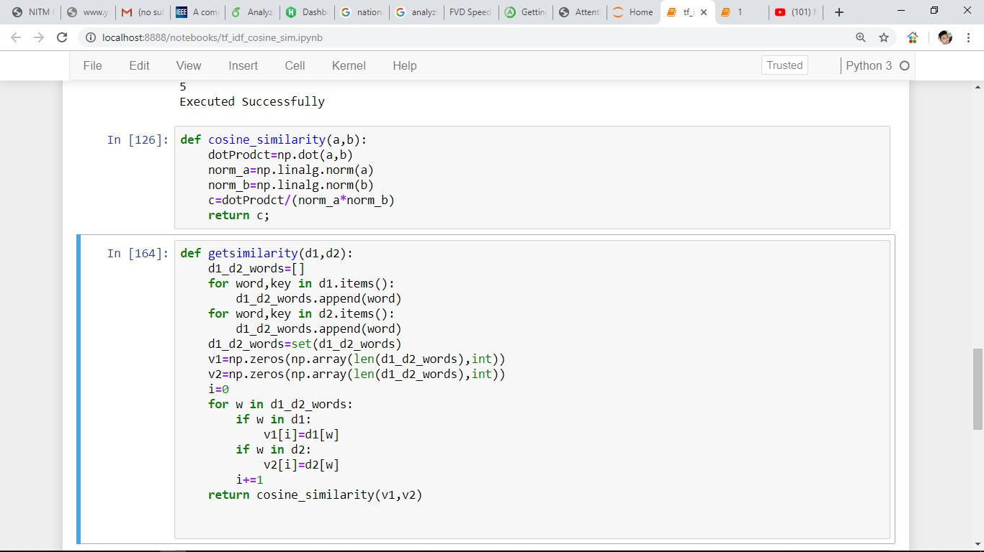
Figure 8: Cosine Similarity

Slide 31
Classification
Classification of text data or Text classification is a way to automatically categorize uncategorized data into several predefined categories.
Classification is a supervised learning based approach.
In supervised learning, classification model is trained with class level information.
In this project classification models are trained on the news article data set which contain five classes.
Two classification algorithms were implemented.
  Logistic Regression
  Naïve Bayes classifier.

Slide 32
Logistic Regression
Regression can be defined as prediction.
Logistic regression is linear regression based approach which is of three type which are binomial, multinomial and ordinal.
Binomial is used for two class classification.
Multinomial is used for more than two class classification.
Multinomial logistic regression used softmax function to calculate probabilistic value for each target class.
Softmax function requires the logits (score) for each class.
w: weight matrix
X: feature vector

Slide 33
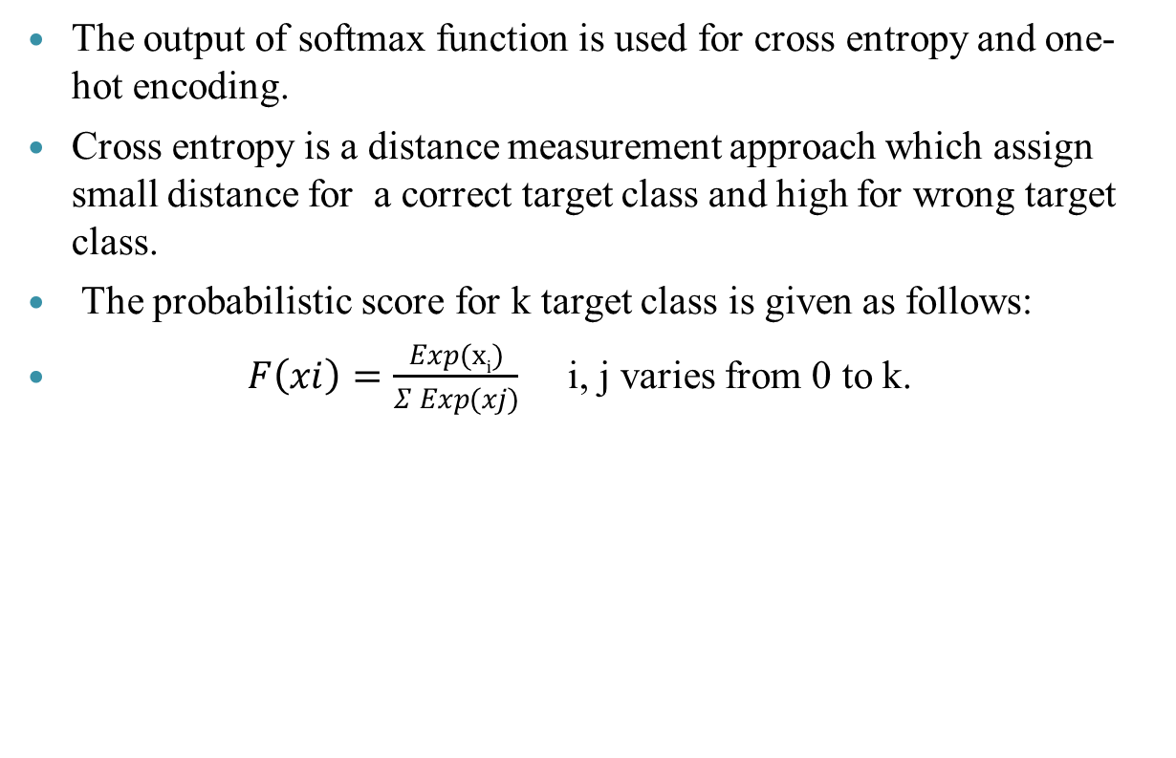
Cont.
The output of softmax function is used for cross entropy and one-hot encoding.
Cross entropy is a distance measurement approach which assign small distance for a correct target class and high for wrong target class.
The probabilistic score for k target class is given as follows:
$F\left(xi\right)=\frac{Exp(xi)}{Σ Exp(xj)}$ i, j varies from 0 to k.

Slide 34
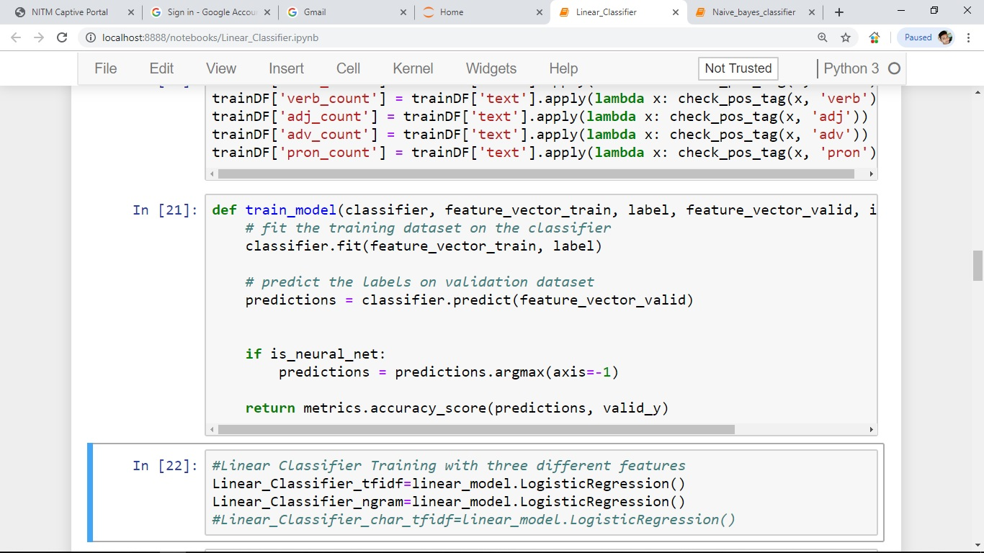
Figure 9: Logistic Regression

Slide 35
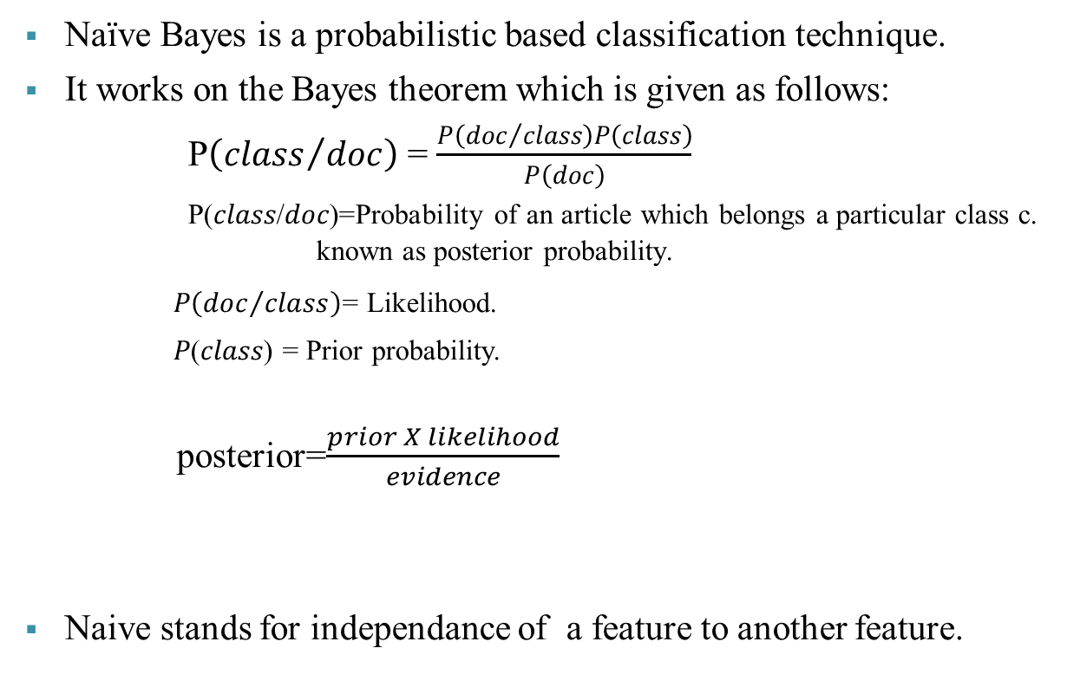
Naive Bayes Classification
Naïve Bayes is a probabilistic based classification technique.
It works on the Bayes theorem which is given as follows:
P$\left({class}/{doc}\right)$ = $\frac{P\left({doc}/{class}\right)P\left(class\right)}{P\left(doc\right)}$ P(𝑐𝑙𝑎𝑠𝑠/𝑑𝑜𝑐)=Probability of an article which belongs a particular class c. known as posterior probability.
𝑃$\left({doc}/{class}\right)$= Likelihood.
𝑃(𝑐𝑙𝑎𝑠𝑠) = Prior probability.
posterior=$\frac{prior X likelihood}{evidence}$
Naive stands for independance of a feature to another feature.

Slide 36
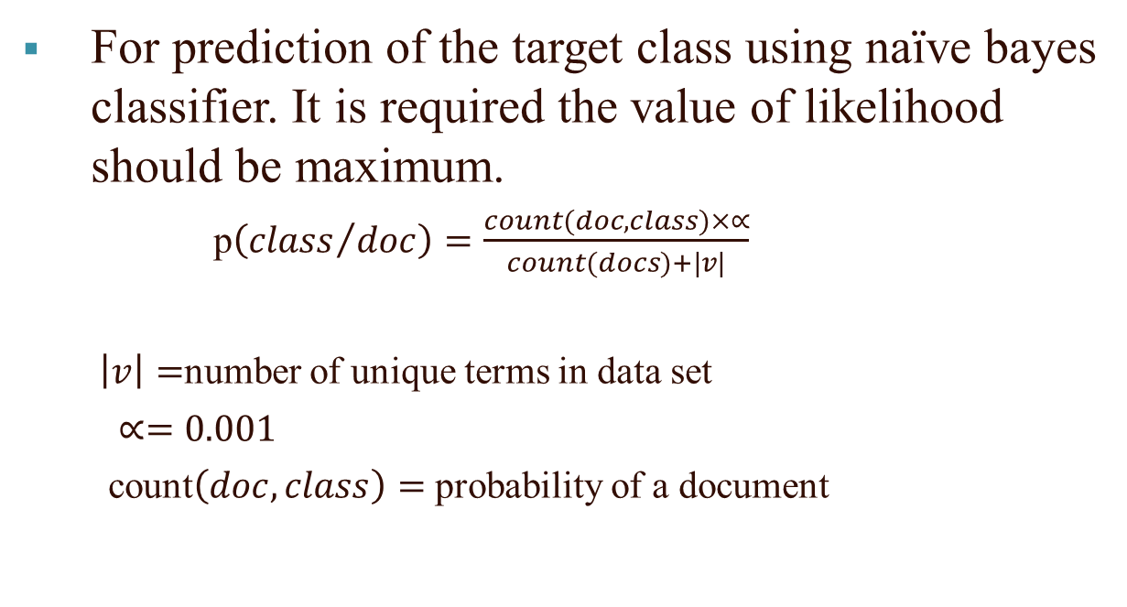
For prediction of the target class using naïve bayes classifier. It is required the value of likelihood should be maximum.
p$\left({class}/{doc}\right)=\frac{count(doc,class)×∝}{count(docs)+|v|}$
$\left|v\right|=$number of unique terms in data set
$∝=0.001$
count$\left(doc,class\right)=$probability of a document

Slide 37
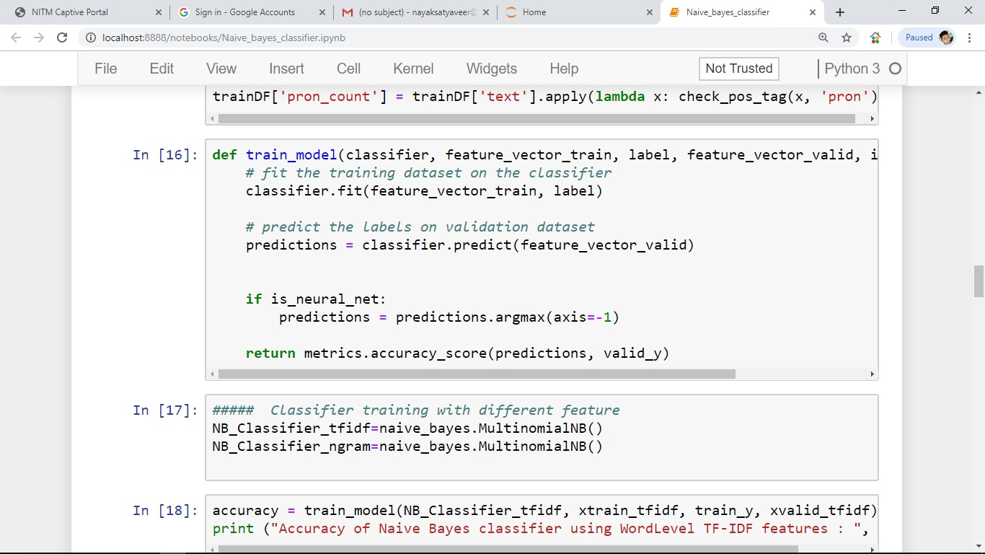
Figure 10: Naïve Bayes Classifier

Slide 38
Result
The cosine similarity among the blogs using term frequency is calculated. The maximum similarity between the articles by Benjamin.txt and wheaton.txt is 0.90260938440267.
On average the similarity values on the large BBC News dataset using TF is 0.463923 and using TF-IDF is 0.829467.

Slide 39
The cosine similarities among the Articles
S. No. | Doc1 | Doc2 | Cosine Similarity
1 | Benjamin.txt | Humpries.txt | 0.8481566461309088
2 | Benjamin.txt | wheaton.txt | 0.9026093844026722
3 | Humpries.txt | wheaton.txt | 0.8584297334173029
4 | Dying to live.txt | Humpries.txt | 0.8324191794512513
5 | Dying to live.txt | Karen Kaiser.txt | 0.7842654981676214
6 | Humpries.txt | Karen Kaiser.txt | 0.6946267093239189
7 | Dying to live.txt | wearing a mask.txt | 0.8596955650363534
8 | Dying to live.txt | Sarah Fader.txt | 0.8351941503700233
9 | wearing a mask.txt | Sarah Fader.txt | 0.8605026230099089

Slide 40
Classification accuracies using different classifier are as follows:
S. No | Features Vector | Classifier | Accuracy
1 | Word Level TF-IDF | Naïve Bayes Classifier | 0.9610778443113772
2 | n-gram level TF-IDF | Naïve Bayes Classifier | 0.9236526946107785
3 | Word Level TF-IDF | Logistic Regression | 0.9730700179533214
4 | n-gram level TF-IDF | Logistic Regression | 0.9461400359066428

Slide 41
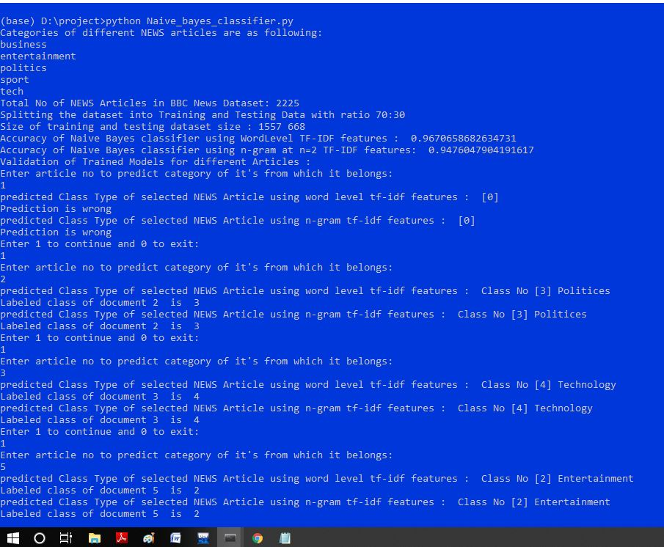
Figure 11: Naïve Bayes Results

Slide 42
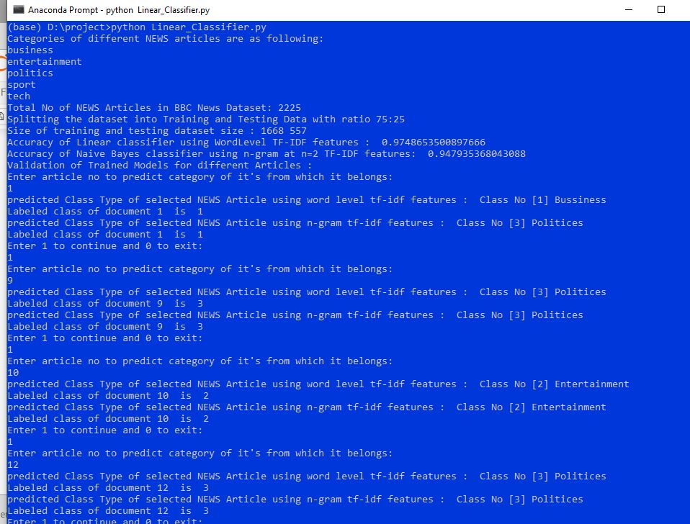
Figure 12: Logistic Regression Results

Slide 43
Conclusion
Study of various literatures concluded that the similarity measure can be achieved more accurately using TF-IDF.
Cosine Similarity among articles is achieved better by applying TF-IDF in compare to TF only.
Classification is achieved using Naïve Bayes and Logistic Regression with optimal accuracy.

Slide 44
References
[1]. BBC News Dataset from Kagglle,
“https://www.kaggle.com/antoniobap/datamining-bbc-news/data”
[2]. Preprocessing techniques, “http://www.iasri.res.in/ebook/win_school_aa/notes/Data_Preprocessing.pdf”
[3]. TF-IDF tutorial pdf,
  “ https://nlp.stanford.edu/IR-book/pdf/06vect.pdf”
[4]. Weight matrix using TF-IDF,
  “https://www.google.com/search?q=tf+idf+formula+example&source=lnms&tbm=isch&sa=X&ved=0ahUKEwiQ5t3yv6HhAhU0juYKHd8_AQ0Q_AUIDigB&biw=1366&bih=667#imgrc=TKFQm5sdIgKkJM:”
[5]. Tokenization,
  “http://blog.kaggle.com/2017/08/25/data-science-101-getting-started-in-nlp-tokenization-tutorial/”
[6]. Chunking from NLP Point,
  “https://nlpforhackers.io/text-chunking/”
[7]. Techniques of Data Mining In Healthcare (J. Han and M. Kamber,
“Data mining: concepts and techniques”, 2nd ed. The Morgan Kaufmann Series, (2006). )
[8]. Stemming and lemmatization,
“https://www.datacamp.com/community/tutorials/stemming-lemmatization-python”
[9]. "Natural Language Processing for Hackers,
" [Online]. Available: https://nlpforhackers.io/text- chunking/.
[10]. "stanford cse,
" [Online]. Available: https://nlp.stanford.edu/IR-book/pdf/06vect.pdf.
[11]. R. K. R. J. K. Sahoo,
"Modified TF-IDF Term Weighting Strategies for Text Categorization," in 14th IEEE India Council International Conference, OCT 2018
[12] D. Singh, "Intra News Category Classification using N-gram TF-IDF Features and Decision Tree Classifier," IJSART, vol. 4, no. 3, p. 7
[13] D. Pool, "Dataaspirants,
" [Online]. Available: http://dataaspirant.com/2017/03/14/multinomial-logistic-regression-model-works-machine-learning/.

Slide 45
Thank You

