Slide 1

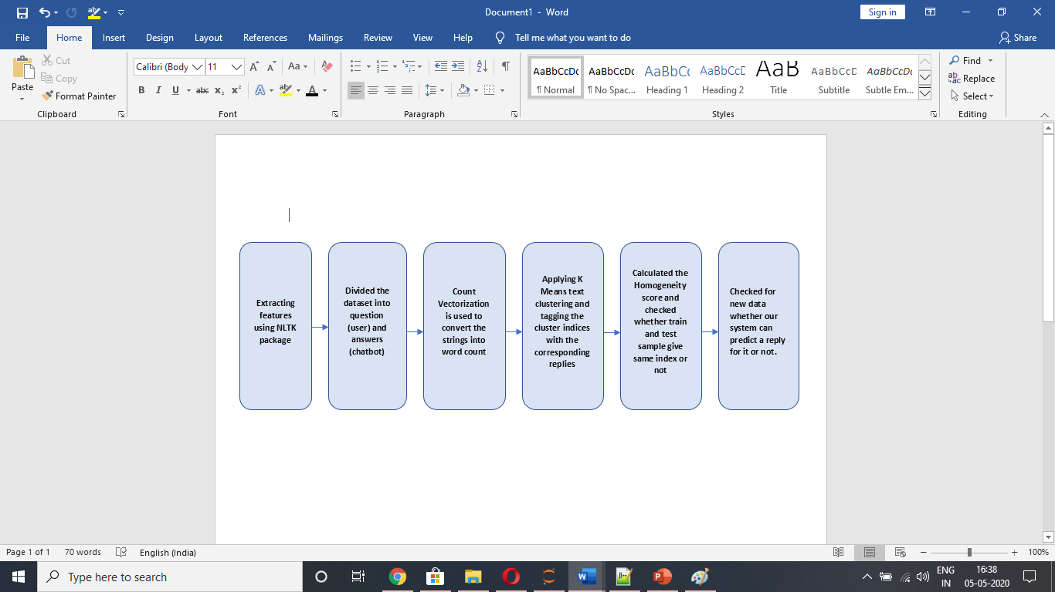
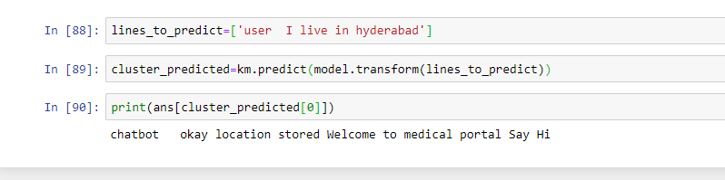
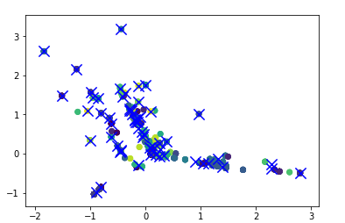
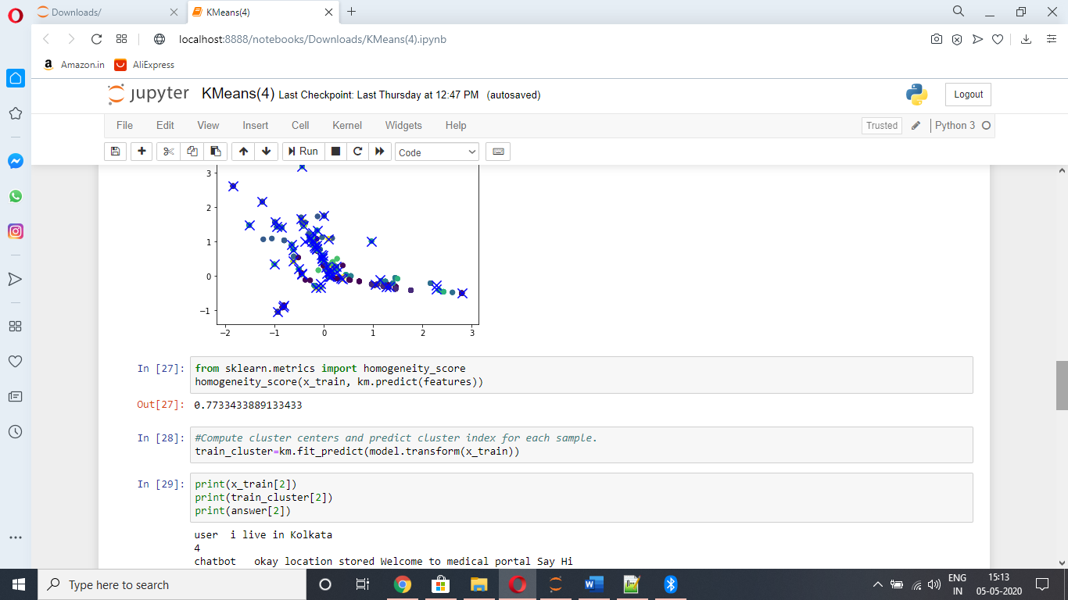
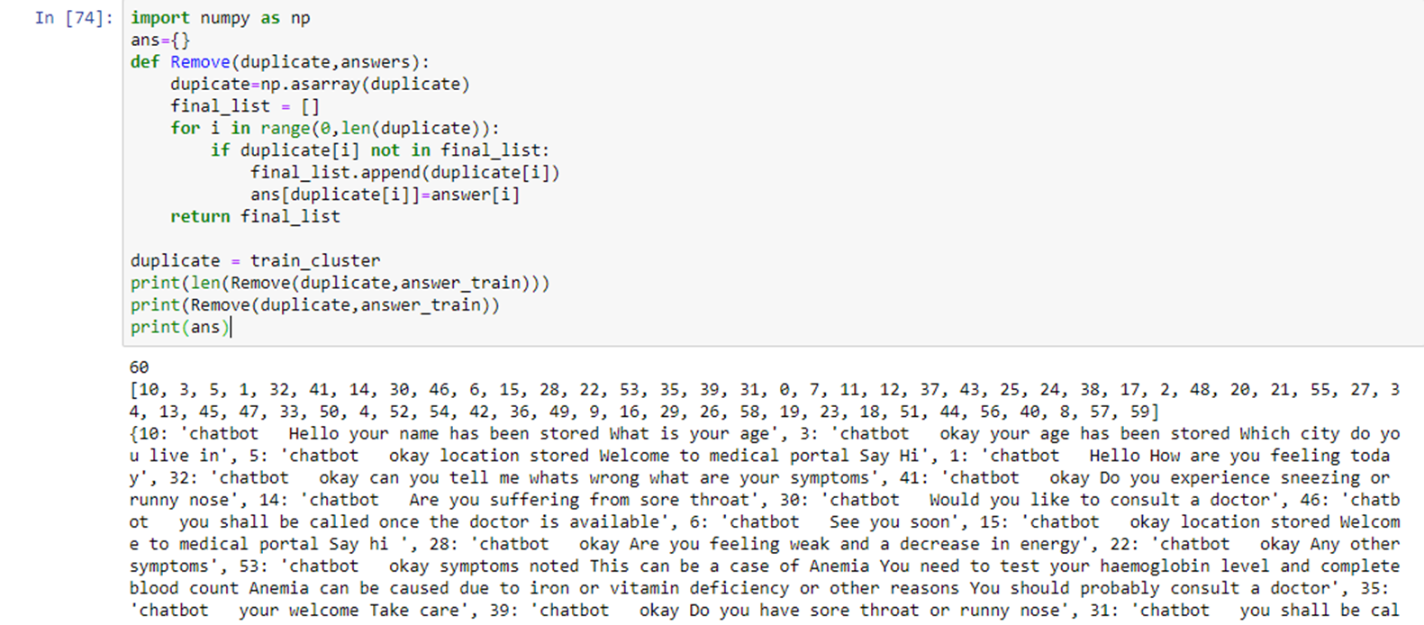
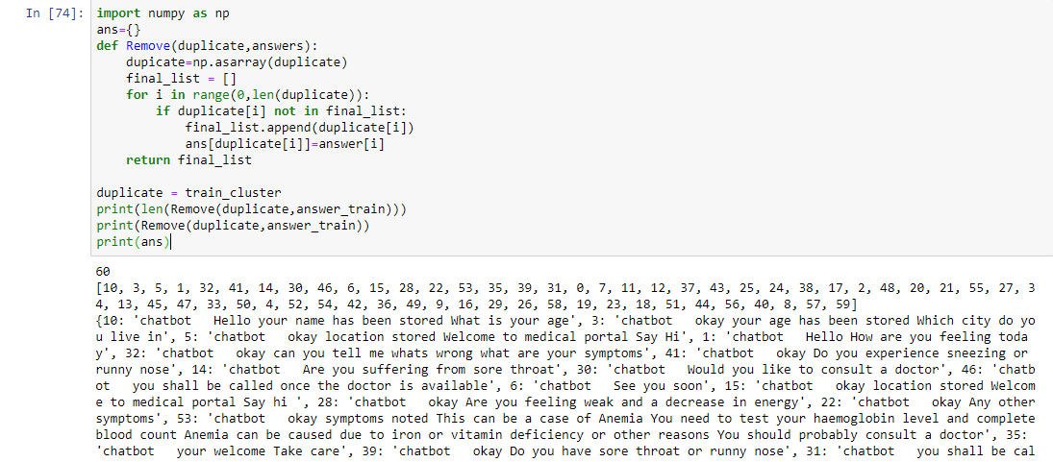
Healthcare Chatbot using Artificial Technology
Healthcare Chatbot using Artificial Intelligence
Team ID:11 Supervisor: Prof. Anupam Mondal
Introduction
A chatbot (also known as a talkbot, chatterbot, Bot, IMbot, interactive agent, or ArtificialConversationalEntity ) is a computer program which conducts a conversation via auditory or textual methods.
The chatbot will collect certain relevant information such as age, sex and a list of the symptoms.
The system would remember the previous responses and would progressively ask for more relevant questions to obtain a good diagnosis.
Fig 5: New sample data for testing – shows cluster index and corresponding reply
Fig 1: Steps followed during the above approach
Discussion
Results
Since it is not feasible for a patient to always consult a doctor. For this , a chatbot is created using K Means Clustering algorithm. We have a dataset of diseases and their corresponding symptoms. This chatbot temporarily solves the patient’s problem by checking the symptoms.
Challenges
Since we couldn’t find the dataset online we had to manually create the dataset ourselves with the diseases and symptoms
Future Work
Our Approach
In Future, Chatbot can be connected using messaging apps through a simple desktop, tablet and smart mobile etc. The smartness and intelligence of the chatbot can be increased by conducting more study and increasing the database so that Chabot could answer all type of question about every type of disease. Audio system can also be included in this system to make this Chabot more interactive.
We Extracted the features Using Natural Language Toolkit (nltk) package
We Divided the dataset into questions (user query) and answers (from chatbot)
We performed a train test split for both the questions and answers.
We used Count Vectorizer to convert the strings into a word count
We used K means clustering algorithm with 60 clusters and visualized the graph for the algorithm
We calculated the Homogeneity Score
We checked if a sample from training set and same sample from test set gives the same cluster index
We tagged the cluster indices of the samples with the appropriate chatbot replies using python dictionary.
We checked for new data whether our system could predict it or not
Fig 2:Visualization of the K Means Clustering algorithm
Fig 3: The Homogeneity score
References
[1] Saurav Kumar Mishra, Dhirendra Bharti, Nidhi Mishra,” Dr. Vdoc: A Medical Chatbot that Acts as a Virtual Doctor”
[2] Divya Madhu, Neeraj Jain C. J, Elmy Sebastain, Shinoy Shaji, Anandhu Ajayakumar,” A Novel Approach for Medical Assistance Using Trained Chatbot (ICICCT 2017).
Eg:
Fig 4: Tagging cluster index with corresponding chatbot replies

