Slide 1

A HEALTHCARE CHATBOT USING ARTIFICIAL INTELLIGENCE

Slide 2
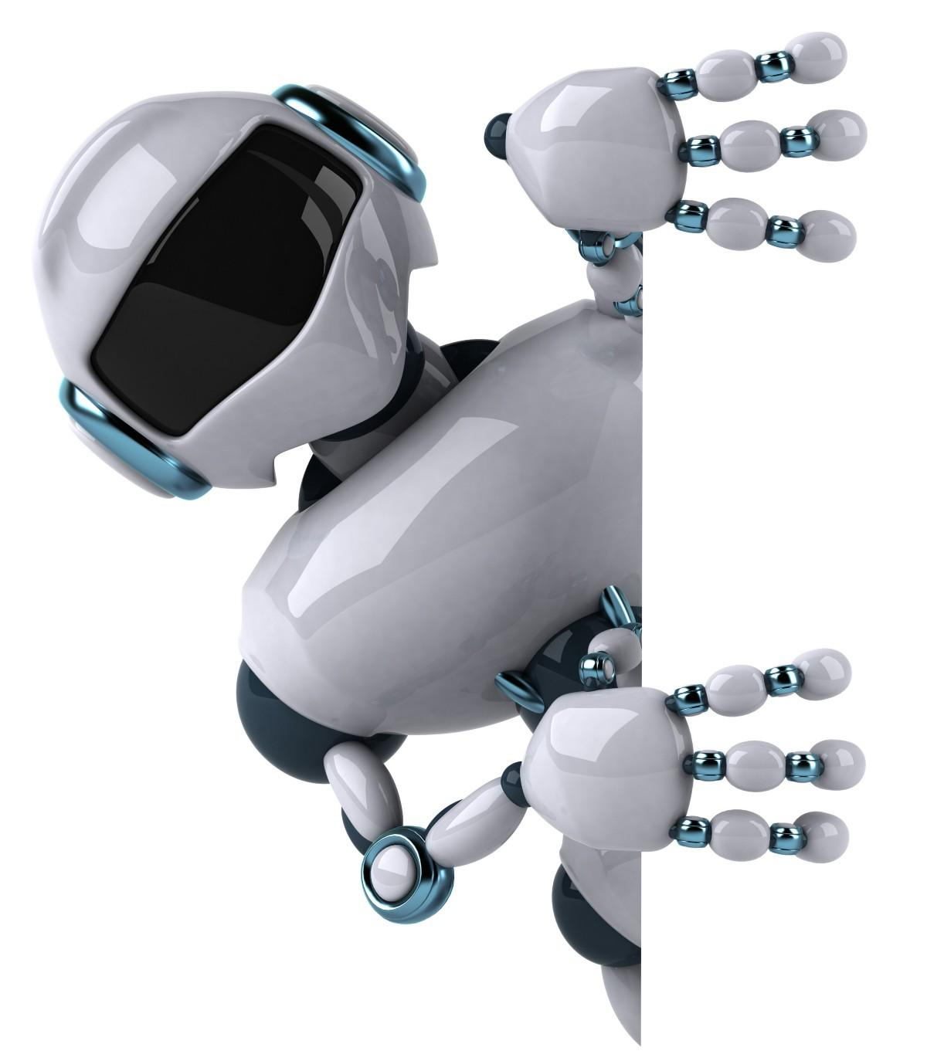
OVERVIEW OF THIS PRESENTATION
What is a Chatbot ?
Types of Chatbots
How does a Chatbot work?
Motivation
Previous Work
Proposed System
Methodology
Results
Conclusion

Slide 3
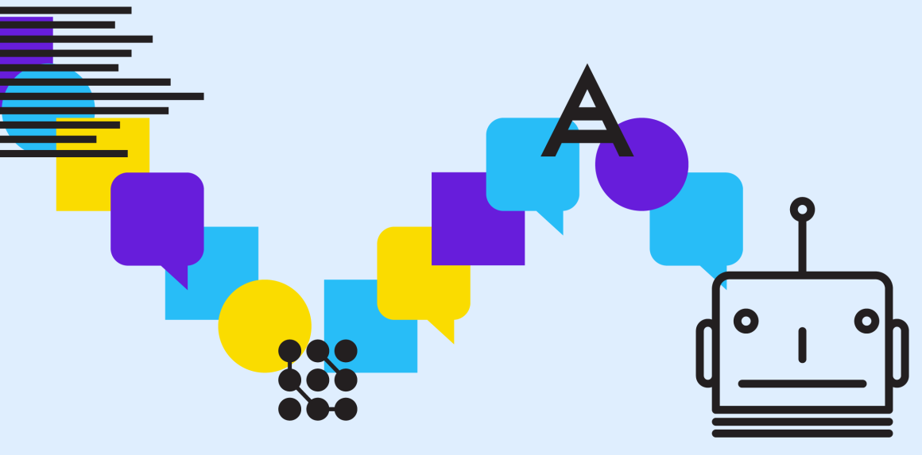
What Is A Chatbot ?
A chatter robot (chatbot) is a type of conversational agent, a computer program designed to simulate an intelligent conversation with one or more human users in natural language via auditory or textual methods.

Slide 4

Types Of Chatbots
There are mainly two types of chatbots, one function-based on a set of rules, and the other more advanced
version uses machine learning.
Chatbot that functions based on rules:
This bot is very limited. It can only respond to very specific commands. If the questions or the
query of the user does not match with any keywords of the Chatbot’s dataset then the chatbot will not
understand anything and will not respond.
Chatbot that functions using machine learning:
This bot has an artificial brain (artificial intelligence). It can understand language, not just commands.
This bot continuously gets smarter as it learns from the conversations it has with the different user.

Slide 5
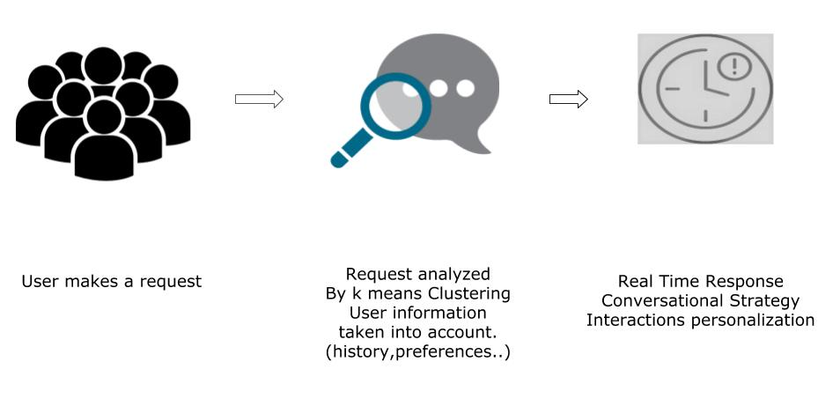
How Does a Chatbot Work ?

Slide 6
Motivation
To develop a healthcare chatbot system which provides a virtual assistant
To develop an automated system which gives a reply to a user query on behalf of a human for the healthcare system.
Normally, doctors are not available at all times. With this system, the patient will get a diagnosis based on their symptoms, in the absence of a doctor at the time being.
To provide a personalized diagnosis to patients with detailed explanations regarding their condition by natural language processing. The system would remember the previous responses and would progressively ask for more relevant questions to obtain a good diagnosis.

Slide 7
Previous Work
Simon Hoermann in a paper discusses about the feasibility and effectiveness of online one-on-one mental health interventions that use text-based synchronous chat. Synchronous written conversations (or “chats”) are becoming popular as web-based mental health interventions. This review is based on an evaluation of individual synchronous Web-based chat technologies.
Saurav Kumar Mishra in another paper says that the chatbot will act as a virtual doctor and makes it possible for the patient to interact with the virtual doctor. Natural language processing and pattern matching algorithm are used for the development of this chatbot.

Slide 8
Previous Work (Cont.)
Divya Madhu proposed in her paper an idea in which the AI can predict the diseases based on the symptoms and give the list of available treatments If a person’s body is analysed periodically, it is possible to predict any possible problem even before they start to cause any damage to the body.
Benilda Eleonor V. Comendador introduces a Pharmabot, which is a conversational chatbot that is designed to prescribe, suggest and give information on generic medicines for children.
Gillian Cameron in his paper proposed an idea to design a chatbot to be used within mental health counselling.

Slide 9
Proposed System
We take a dataset of more than 2000 chatbot-user conversations regarding symptoms and their corresponding diseases and treatment.
Next, we go onto using NLTK library for text preprocessing. In this step we remove the punctuations and stopwords and return a cleaned text as a list of words.
The enlargement of NLP function is quite tough because computers usually need humans to "speak" with them in certain programming language. Human language is not accurate as it includes on a lot of composite variables. NLP permits users to ask a query. The machine understands the important elements from users’ speech, that may relate to particular features in a data set, and gives an answer.

Slide 10
Proposed System (Cont.)
4. The sklearn.feature_extraction module can be used to extract features in a format supported by machine learning algorithms from datasets consisting of formats such as text.
5. CountVectorizer implements both tokenization and occurrence counting in a single class. Using that, we count the word occurrences of the corpus of the text document.
6. Lastly, we have implemented K-Means algorithm to perform clustering on the user queries and predicted the cluster indices for each sample and tagged the indices with the appropriate replies from the chatbot using a dictionary.

Slide 11
Methodology
We have created a dataset consisting of conversations between a chatbot and user where the user is asking questions and stating his/her symptoms and the chatbot, based on those symptoms identifies the disease and gives temporary treatment, before consulting the doctor when he is available.
After creating the dataset, we use regular expressions to eliminate unnecessary digits and characters like ‘ : ‘ or ‘ - ‘ from the dataset. Now the dataset only contains streams of words and some punctuations.
Then, using NLTK library available in python, we use lemmatisation to convert words into their dictionary form and remove unnecessary digits and punctuations. It returns a cleaned text as a list of strings (sentences). The dataset is then divided into questions(user) and answers (chatbot).

Slide 12
Methodology (Cont.)
We then performed a train test split for both the questions and answers.
The sklearn.feature_extraction module can be used to extract features. CountVectorization is used to tokenize and find the count of word occurrences in that list of strings.
Next we cluster the questions (user) with the K-Means clustering algorithm.
We predict the cluster indices for the training dataset samples and using a dictionary data structure, we tagged the indices with the appropriate chatbot replies.
To check whether our algorithm is working or not we then test it with the test samples and found out that the results are similar.

Slide 13
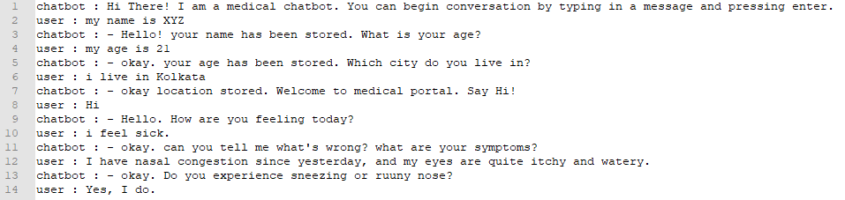
Results
The original dataset consisted of words, stopwords, characters, digits and punctuations. A snippet is shown below.

Slide 14
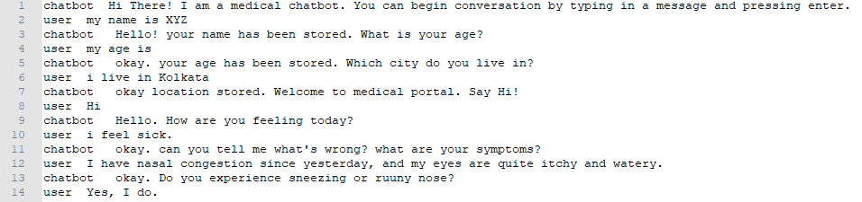
Results (cont.)
After using regular expressions to remove special characters and digits the dataset gets modified to just a stream of tokens and punctuations.

Slide 15
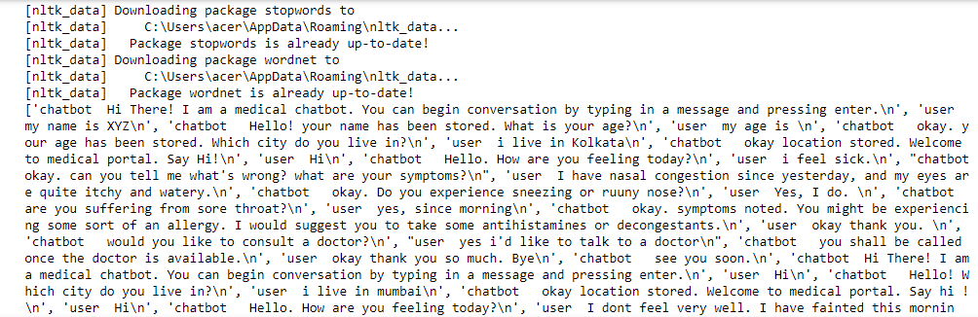
Results (cont.)
Using NLTK library, we remove digits and punctuations to return a cleaned text as a list of sentences which will look like this:

Slide 16
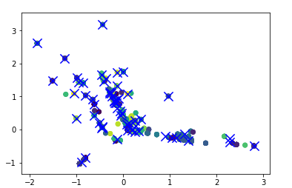
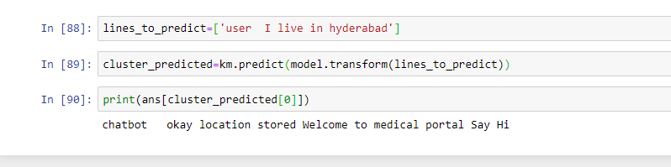
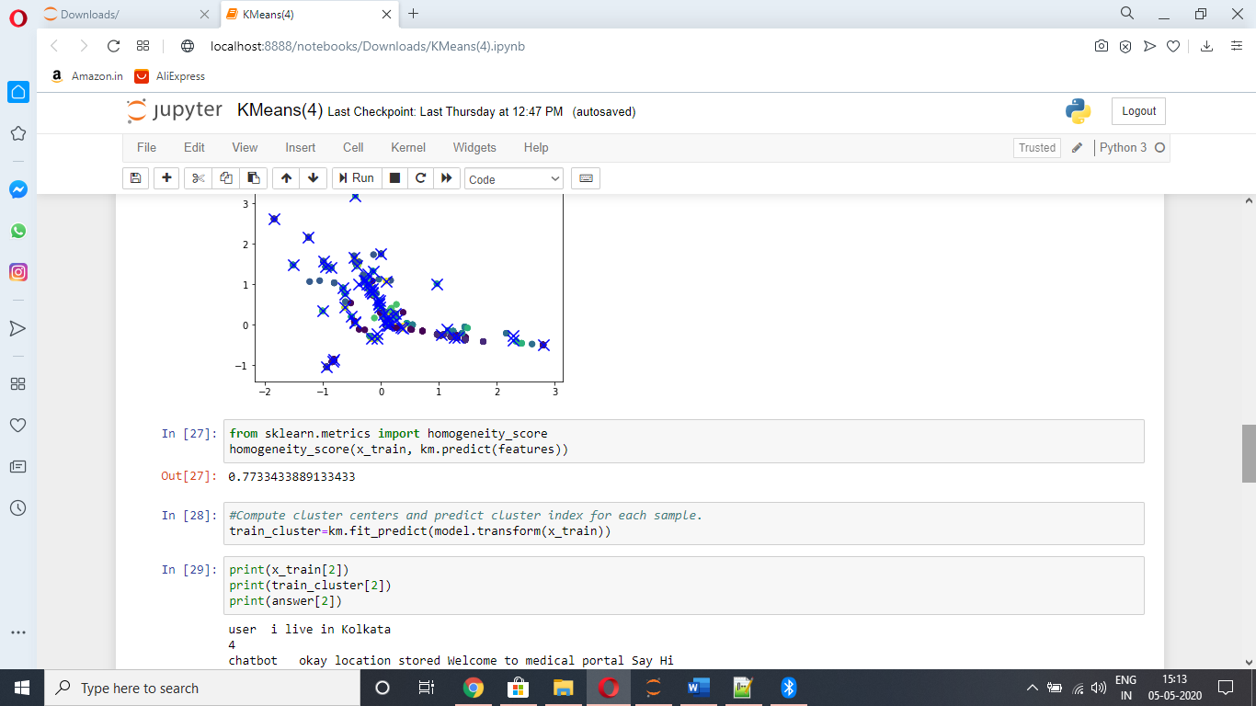
Results (cont.)
In this project, we have used K means clustering algorithm on the features. The graph for the K Means Algorithm, homogeneity score and the final result for a new data sample is shown below:

Slide 17
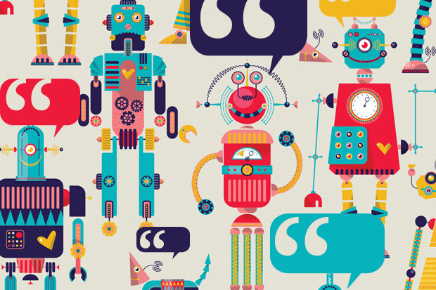
CONCLUSION
In our project we have thought of using python language and a clustering algorithm for implementing this Natural Language Processing problem. We have a dataset of user queries (containing personal information and symptoms) and the chatbot replies. It is not possible for a doctor to always be available. Nor is it feasible for a patient to always consult someone if he/ she has some problems. For this, a chatbot is created for solving the patient’s problems temporarily by checking the symptoms.

Slide 18
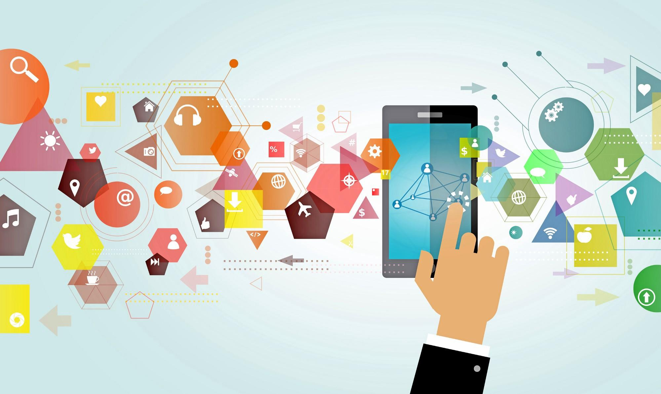
THANK YOU!

