Slide 1
Rainier Benefits Database Project
By Doug Anderson, Shyawn Karim,
Eric Sergio, and Greg Thoreson

Slide 2
Today’s Agenda
Mission
Objectives
Design
Prototypes
Next steps

Slide 3
Database Mission
The purpose of the database, for Rainier Benefits, is to manage current and prospective customers, benefit plans, services, and agent activities.

Slide 4
Objectives
How does an agent see a contact’s information and view a log of all previous interactions with them?
How does an agent see their scheduled follow up appointments?
How does an agent see their total commissions?
How does an agent know who to contact at a specific insurance carrier?

Slide 5
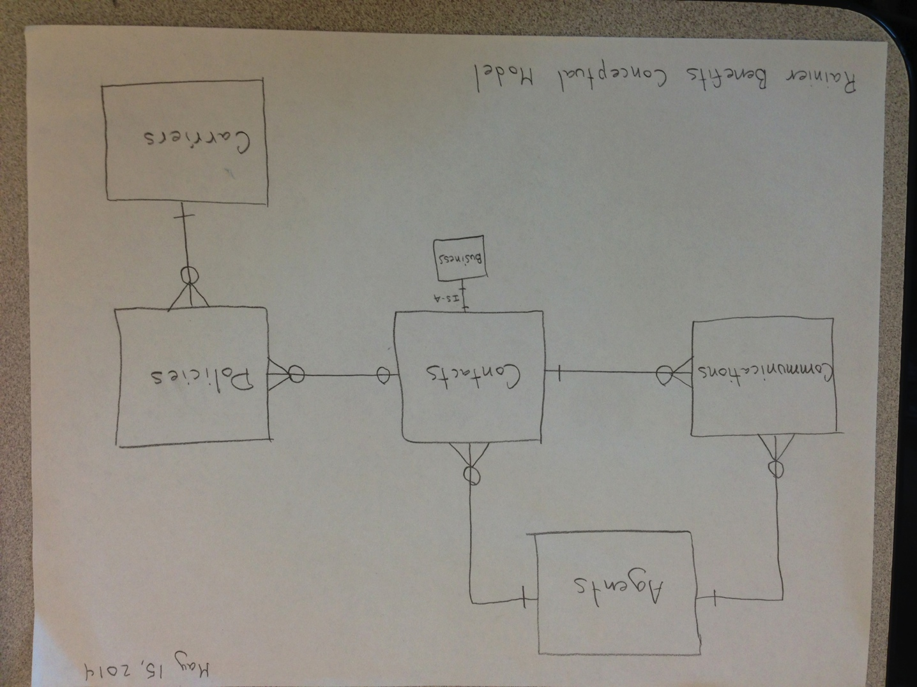
Conceptual Model

Slide 6
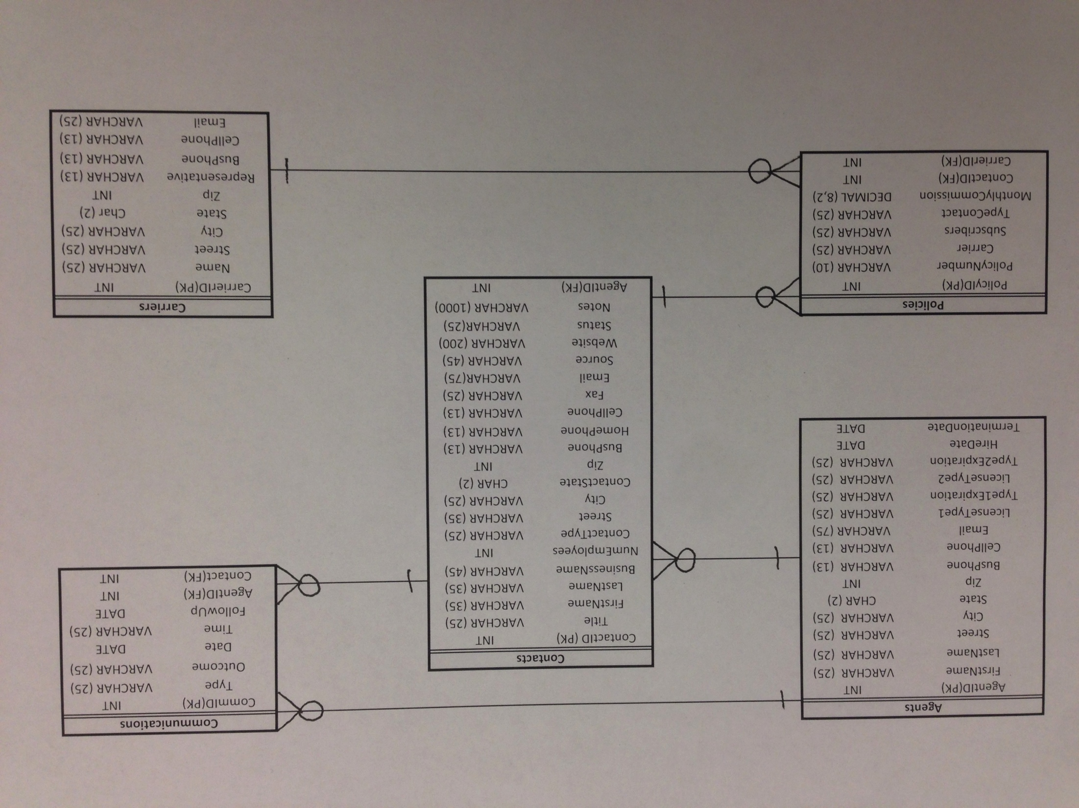

Slide 7
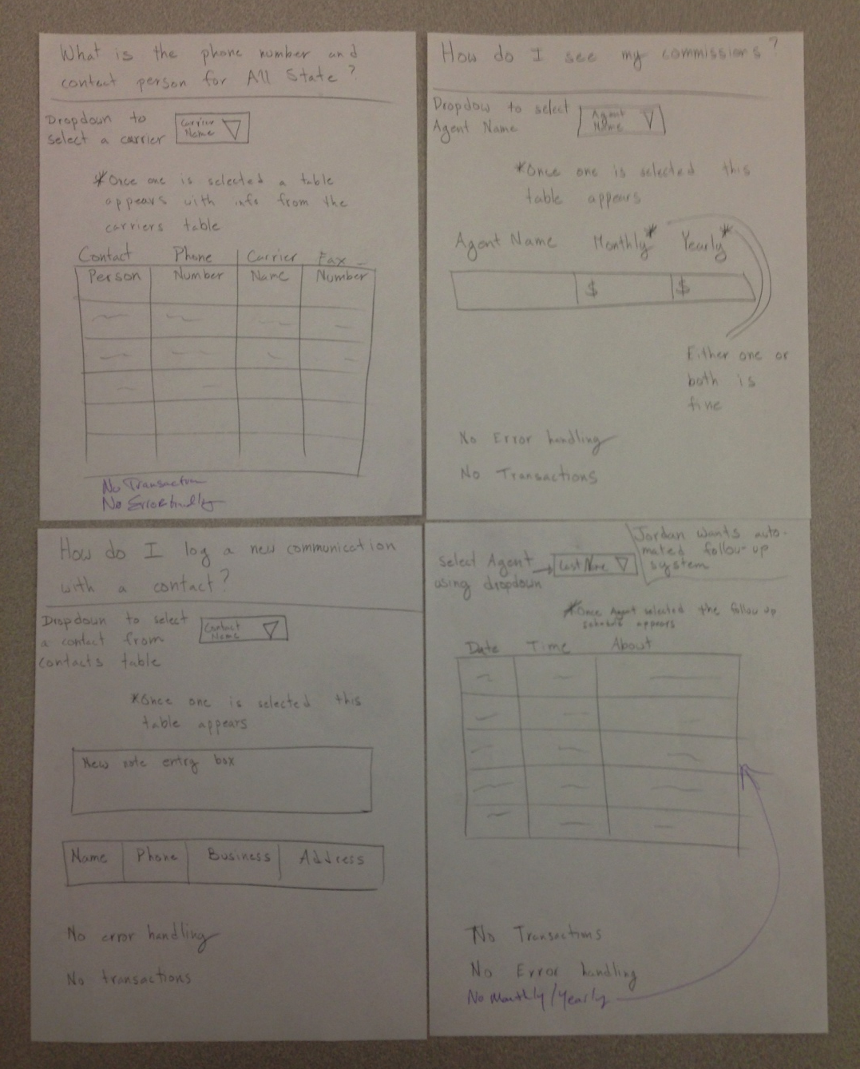
Prototype sketches

Slide 8
Prototype Demonstration

Slide 9
Next Steps
Database is currently a prototype
Documentation is clear for development
Good code with notes in place
Prototypes currently in place
Data Entry is requirement for the next phase in development
Next logical step is to roll-out development with an intern

Slide 10
Thank You
Team Rainier Media would like to thank Jordan for the opportunity
Jordan’s clear communication was a huge benefit
He was insightful and because of his clear vision on the project it allowed us to have a clear end goal

