Slide 1





Pizza Sales Analysis
PIZZA IS ONE OF THE FAVORITE FOODS OF ALMOST EVERYONE IN THE WORLD.
50%
DISCOUNT

Slide 2
Project Description:
This project uses SQL to analyze the dataset of an Pizza Sales. .The objective of the project is to gain valuable insights into the sales operations, Customer Segmentation, trends, sales growth, customer interest and money spent by customer. .The goal of the project is to answer a set of questions about the pizza sales business performance and help in its growth by making better decisions.
ToolUsed:
MySQL
Tables Used:
Pizza_Sales
Project Overview
The primary objectives of this project are:
To determine the most profitable days and times. To identify the average order values and revenue contributions by pizza categories. To understand customer preferences for different pizza sizes. To track monthly revenue growth. To identify the most popular and most expensive pizzas
·
·
·
·
·

Slide 3
QUERIES OF THE PROJECT:
Retrieve the total number of orders placed. Calculate the total revenue generated from pizza sales. Identify the highest-priced pizza. Identify the most common pizza size ordered. List the top 5 most ordered pizza types along with their quantities. Intermediate: Join the necessary tables to find the total quantity of each pizza category ordered. Determine the distribution of orders by hour of the day. Join relevant tables to find the category-wise distribution of pizzas. Group the orders by date and calculate the average number of pizzas ordered per day. Determine the top 3 most ordered pizza types based on revenue. Calculate the percentage contribution of each pizza type to total revenue. Analyze the cumulative revenue generated over time. Determine the top 3 most ordered pizza types based on revenue for each pizza category.

Slide 4
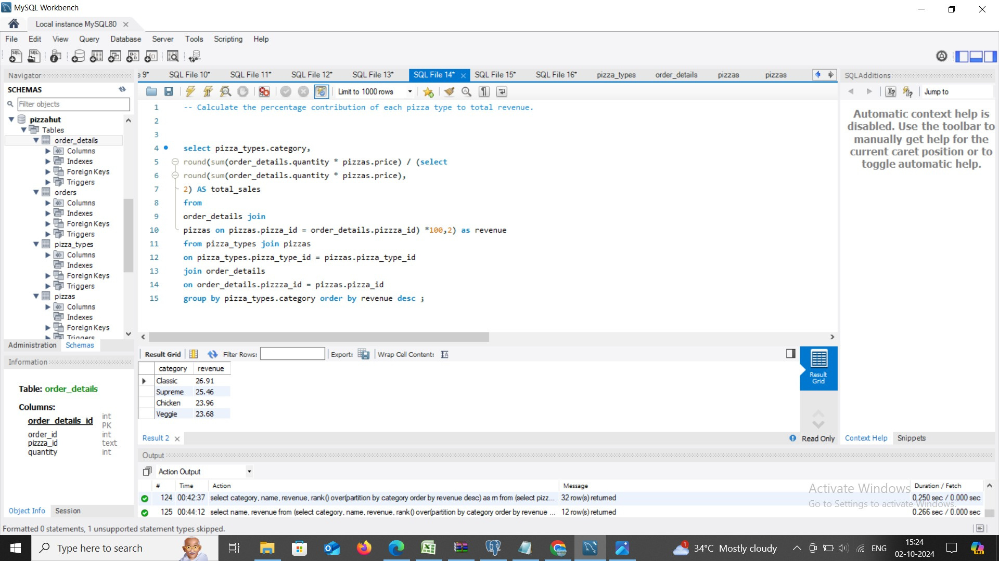

Slide 5
