Slide 1
An Introduction to Support Vector Machines
CSE 573 Autumn 2005
Henry Kautz
based on slides stolen from Pierre Dönnes’ web site

Slide 2
Main Ideas
Max-Margin Classifier
  Formalize notion of the best linear separator
Lagrangian Multipliers
  Way to convert a constrained optimization problem to one that is easier to solve
Kernels
  Projecting data into higher-dimensional space makes it linearly separable
Complexity
  Depends only on the number of training examples, not on dimensionality of the kernel space!

Slide 3
Tennis example
Temperature
Humidity
= play tennis
= do not play tennis

Slide 4
Linear Support Vector Machines
Data: <x_{i},y_{i}>, i=1,..,l
x_{i} ∈ R^{d}
y_{i} ∈ {-1,+1}
x2
=+1
=-1
x1

Slide 5
Linear SVM 2
Data: <x_{i},y_{i}>, i=1,..,l
x_{i} ∈ R^{d}
y_{i} ∈ {-1,+1}
f(x)
=-1
=+1
All hyperplanes in R^{d} are parameterize by a vector (w) and a constant b.
Can be expressed as w•x+b=0 (remember the equation for a hyperplane
from algebra!)
Our aim is to find such a hyperplane f(x)=sign(w•x+b), that
correctly classify our data.

Slide 6
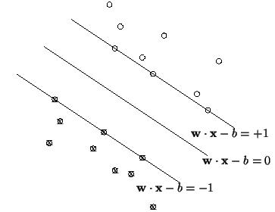
Definitions
Define the hyperplane H such that:
x_{i}•w+b ≥ +1 when y_{i} =+1
x_{i}•w+b ≤ -1 when y_{i} =-1
H1
H1 and H2 are the planes:
H1: x_{i}•w+b = +1
H2: x_{i}•w+b = -1
The points on the planes H1 and H2 are the Support Vectors
H2
d⁺
d⁻
H
d+ = the shortest distance to the closest positive point
d- = the shortest distance to the closest negative point
The margin of a separating hyperplane is d⁺ + d⁻.

Slide 7
Maximizing the margin
We want a classifier with as big margin as possible.
H1
H
H2
Recall the distance from a point(x₀,y₀) to a line:
Ax+By+c = 0 is|A x₀ +B y₀ +c|/sqrt(A²+B²)
d+
d-
The distance between H and H1 is:
|w•x+b|/||w||=1/||w||
The distance between H1 and H2 is: 2/||w||
In order to maximize the margin, we need to minimize ||w||. With the
condition that there are no datapoints between H1 and H2:
x_{i}•w+b ≥ +1 when y_{i} =+1
x_{i}•w+b ≤ -1 when y_{i} =-1 Can be combined into yi(x_{i}•w) ≥ 1

Slide 8
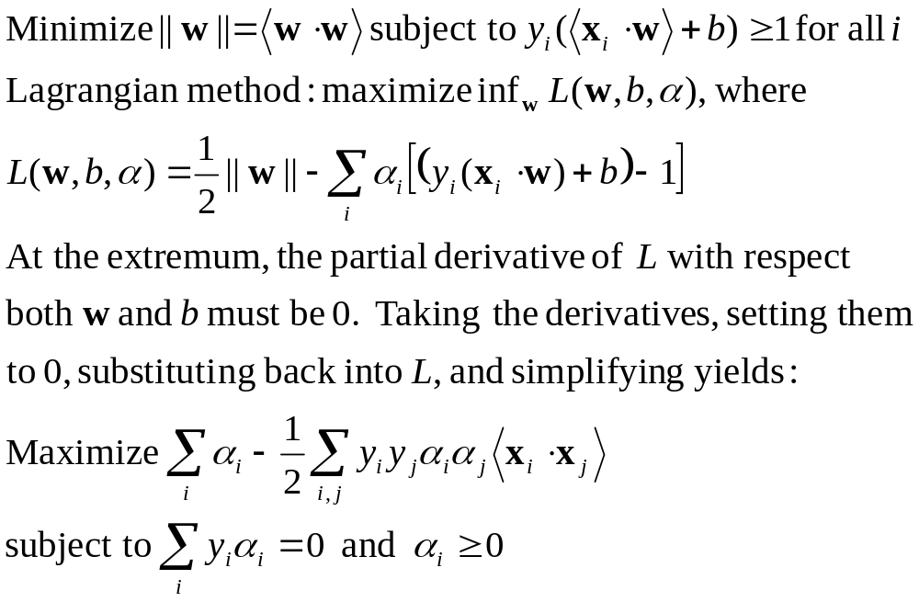
Constrained Optimization Problem

Slide 9
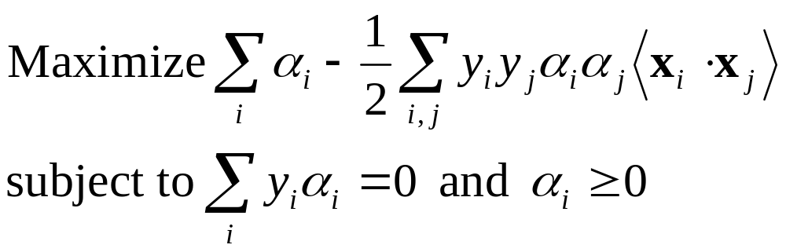
Quadratic Programming
Why is this reformulation a good thing?
The problem
is an instance of what is called a positive, semi-definite programming problem
For a fixed real-number accuracy, can be solved in O(n log n) time = O(|D|² log |D|²)

Slide 10
Problems with linear SVM
=-1
=+1
What if the decision function is not a linear?

Slide 11
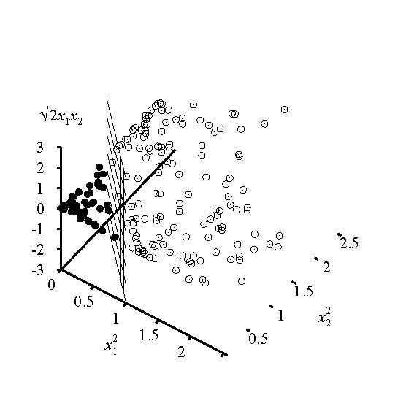
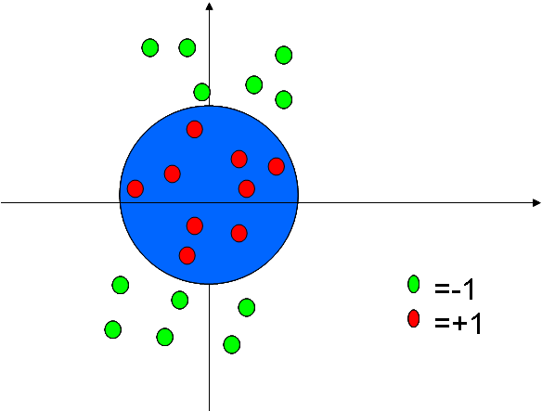
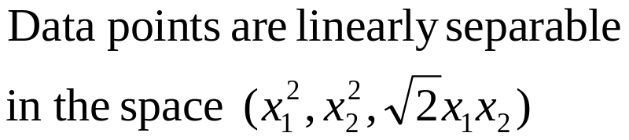
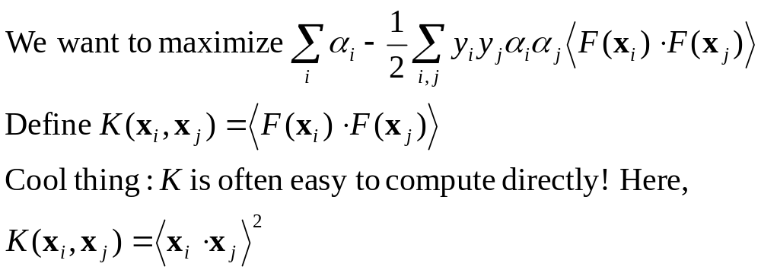
Kernel Trick

Slide 12
Other Kernels
The polynomial kernel
K(x_{i},x_{j}) = (x_{i}•x_{j} + 1)^{p}, where p is a tunable parameter.
Evaluating K only require one addition and one exponentiation
more than the original dot product.
Gaussian kernels (also called radius basis functions)
K(x_{i},x_{j}) = exp(||x_{i}-x_{j} ||²/2σ²)

Slide 13
Overtraining/overfitting
A well known problem with machine learning methods is overtraining.
This means that we have learned the training data very well, but
we can not classify unseen examples correctly.
An example: A botanist really knowing trees.Everytime he sees a new tree,
he claims it is not a tree.
=-1
=+1

Slide 14
Overtraining/overfitting 2
A measure of the risk of overtraining with SVM (there are also other
measures).
It can be shown that: The portion, n, of unseen data that will be missclassified is bounded by:
n ≤ Number of support vectors / number of training examples
Ockham´s razor principle: Simpler system are better than more complex ones.
In SVM case: fewer support vectors mean a simpler representation of the hyperplane.
Example: Understanding a certain cancer if it can be described by one gene
is easier than if we have to describe it with 5000.
Notes:
Example with a gardener.

Slide 15
A practical example, protein localization
Proteins are synthesized in the cytosol.
Transported into different subcellular locations where they carry out their functions.
Aim: To predict in what location a certain protein will end up!!!

Slide 16
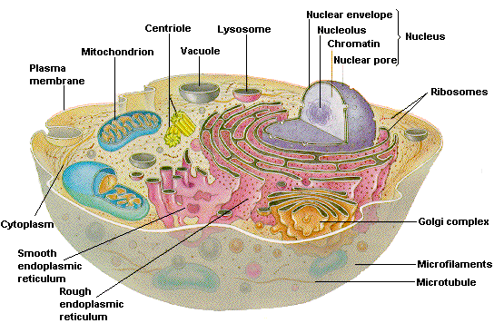
Subcellular Locations

Slide 17
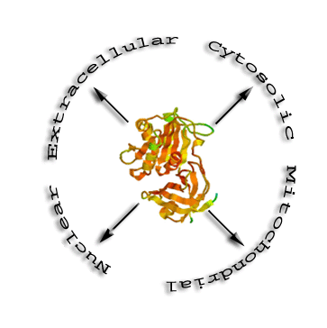
Method
Hypothesis: The amino acid composition of proteins from different compartments should differ.
Extract proteins with know subcellular location from SWISSPROT.
Calculate the amino acid composition of the proteins.
Try to differentiate between: cytosol, extracellular, mitochondria and nuclear by using SVM

Slide 18
Input encoding
Prediction of nuclear proteins:
Label the known nuclear proteins as +1 and all others as –1.
The input vector xi represents the amino acid composition.
Eg xi =(4.2,6.7,12,….,0.5)
A , C , D,….., Y)
Nuclear
SVM
Model
All others

Slide 19
Cross-validation
Cross validation: Split the data into n sets, train on n-1 set, test on the set left
out of training.
1
Nuclear
1
Test set
1
2
3
2
1
All others
Training set
3
2
2
3
3

Slide 20
Performance measurments
Test data
Predictions
TP
Model
FP
+1
TN
-1
=+1
=-1
FN
SP = TP /(TP+FP), the fraction of predicted +1 that actually are +1.
SE = TP /(TP+FN), the fraction of the +1 that actually are predicted as +1.
In this case: SP=5/(5+1) =0.83
SE = 5/(5+2) = 0.71

Slide 21




A Cautionary Example
Image classification of tanks. Autofire when an enemy tank is spotted.
Input data: Photos of own and enemy tanks.
Worked really good with the training set used.
In reality it failed completely.
Reason: All enemy tank photos taken in the morning. All own tanks in dawn.
The classifier could recognize dusk from dawn!!!!

Slide 22
References
http://www.kernel-machines.org/
http://www.support-vector.net/
AN INTRODUCTION TO SUPPORT VECTOR MACHINES
(and other kernel-based learning methods)
N. Cristianini and J. Shawe-Taylor
Cambridge University Press
2000 ISBN: 0 521 78019 5
Papers by Vapnik
C.J.C. Burges: A tutorial on Support Vector Machines. Data Mining and Knowledge Discovery 2:121-167, 1998.

