Slide 1
CSE 219: Digital Logic & Computer Design
Tamanna Haque Nipa
Assistant Professor
Dept. of CSE
Stamford University Bangladesh

Slide 2
Combinational and Sequential Circuits
Types of Logic Circuits:
Combinational Circuits: A combinational circuit consists of logic gates whose outputs at any time are determined from only the present combination of inputs and they have no memory.
Sequential Circuits: A sequential circuit consists of logic gates whose outputs at any time are determined from both the present combination of inputs and previous output. That means sequential circuits use memory elements to store the value of previous output.

Slide 3
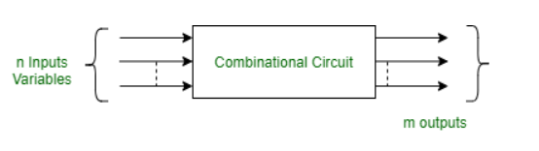
Combinational Circuits
A combinational circuit consists of input variables and output variables. Since these circuits are not dependent upon previous input to generate any output, so are combinational logic circuits. A combinational circuit can have an n number of inputs and m number of outputs.

Slide 4
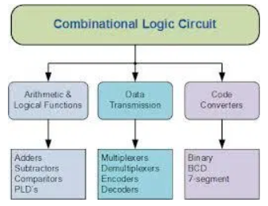
Type of Combinational Circuit

Slide 5
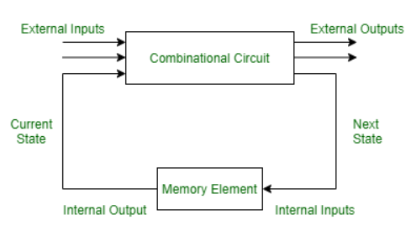
Sequential Circuits
A sequential circuit is specified by a time sequence of inputs, outputs, and internal states. The output of a sequential circuit depends not only the combination of present inputs but also on the previous outputs. Unlike combinational circuits, sequential circuits include memory elements with combinational circuits.

Slide 6
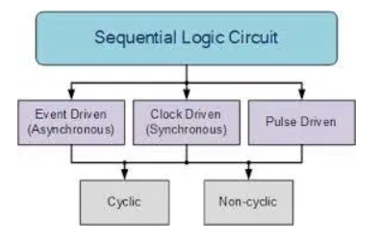
Types of Sequential Circuit

Slide 7
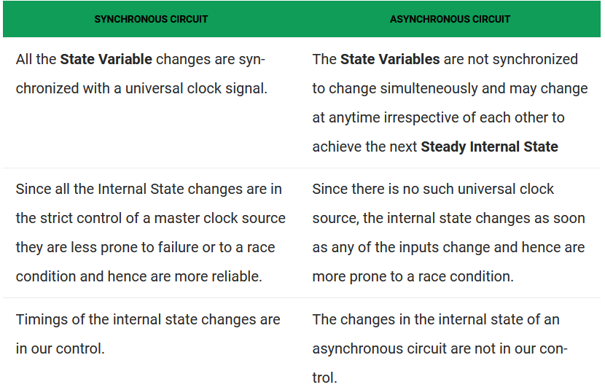
Synchronous and Asynchronous Circuit

Slide 8
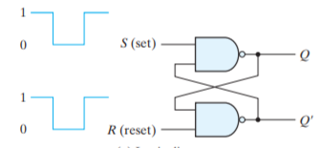
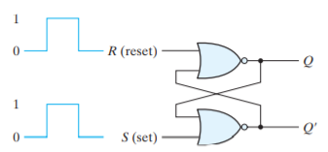
STORAGE ELEMENTS: Latches
SR Latch
NAND Latch
NOR Latch

Slide 9
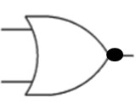
S-R Latch (NOR gate)
1
R
1
/0
A | B | F=(A+B)⁰
0 | 0 | 1
0 | 1 | 0
1 | 0 | 0
1 | 1 | 0
S | R
0 | 0
0 | 1
1 | 0
1 | 1
Q | Q⁰
0 | 1
Q
0
S
Q⁰
NOR Gate
0
/0
/1

Slide 10
S-R Latch (NOR gate)
1
R
0
/0
A | B | F=(A+B)⁰
0 | 0 | 1
0 | 1 | 0
1 | 0 | 0
1 | 1 | 0
S | R
0 | 0
0 | 1
1 | 0
1 | 1
Q | Q⁰
0 | 1
Q
0
S
Q⁰
NOR Gate
1
/1
/1

Slide 11
S-R Latch (NOR gate)
0
R
0
/1
A | B | F=(A+B)⁰
0 | 0 | 1
0 | 1 | 0
1 | 0 | 0
1 | 1 | 0
S | R
0 | 0
0 | 1
1 | 0
1 | 1
Q | Q⁰
0 | 1
1 | 0
Q
1
S
Q⁰
NOR Gate
1
/0
/0

Slide 12
S-R Latch (NOR gate)
0
R
0
/0
A | B | F=(A+B)⁰
0 | 0 | 1
0 | 1 | 0
1 | 0 | 0
1 | 1 | 0
S | R
0 | 0
0 | 1
1 | 0
1 | 1
Q | Q⁰
NC | NC
0 | 1
1 | 0
Q
0
S
Q⁰
NOR Gate
1
/1
/1

Slide 13
S-R Latch (NOR gate)
0
R
1
/1
A | B | F=(A+B)⁰
0 | 0 | 1
0 | 1 | 0
1 | 0 | 0
1 | 1 | 0
S | R
0 | 0
0 | 1
1 | 0
1 | 1
Q | Q⁰
NC | NC
0 | 1
1 | 0
Q
0
S
Q⁰
NOR Gate
0
/0
/0

Slide 14
S-R Latch (NOR gate)
1
R
0
/0
A | B | F=(A+B)⁰
0 | 0 | 1
0 | 1 | 0
1 | 0 | 0
1 | 1 | 0
S | R
0 | 0
0 | 1
1 | 0
1 | 1
Q | Q⁰
NC | NC
0 | 1
1 | 0
0 | 0
Q
1
S
Q⁰
NOR Gate
1
/0
/0

Slide 15
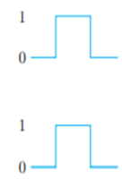
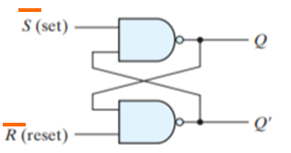
S-R Latch (NAND gate)
S | R | Q | Q⁰
0 | 0 | 1 | 1
0 | 1 | 1 | 0
1 | 0 | 0 | 1
1 | 1 | NC | NC
S | R | Q | Q⁰
0 | 0 | NC | NC
0 | 1 | 0 | 1
1 | 0 | 1 | 0
1 | 1 | 0 | 0

Slide 16
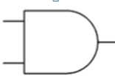
S-R Flip Flop (NOR gate)
R
0
0
1
S | R | Q | Q⁰
0 | 0 | NC | NC
0 | 1 | 0 | 1
1 | 0 | 1 | 0
1 | 1 | I* | I*
Q
1
CLK /EN
1
I* =Indeterminate
Q⁰
1
S
1

Slide 17
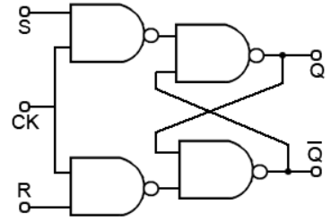
S-R Flip Flop (NAND gate)
S | R | Q | Q⁰
0 | 0 | NC | NC
0 | 1 | 0 | 1
1 | 0 | 1 | 0
1 | 1 | I* | I*
I* =Indeterminate

Slide 18
J-K Flip Flop
1
1
J | K | Q | Q⁰
0 | 0 | NC | NC
0 | 1 | 0 | 1
1 | 0 | 1 | 0
1 | 1 | T* | T*
K
1
/0
1
Q
1
CLK /EN
Q⁰
1
0
J
/0
/1
I* =Toggle
0
0
A | B | F=(A+B)⁰
0 | 0 | 1
0 | 1 | 0
1 | 0 | 0
1 | 1 | 0
NOR Gate

Slide 19
J-K Flip Flop(cont…)
0
1
J | K | Q | Q⁰
0 | 0 | NC | NC
0 | 1 | 0 | 1
1 | 0 | 1 | 0
1 | 1 | T* | T*
K
0
/0
1
Q
1
CLK /EN
Q⁰
1
1
J
/1
/1
I* =Toggle
0
0
A | B | F=(A+B)⁰
0 | 0 | 1
0 | 1 | 0
1 | 0 | 0
1 | 1 | 0
NOR Gate

Slide 20
J-K Flip Flop(cont…)
0
1
J | K | Q | Q⁰
0 | 0 | NC | NC
0 | 1 | 0 | 1
1 | 0 | 1 | 0
1 | 1 | T* | T*
K
0
/1
1
Q
1
CLK /EN
Q⁰
1
1
J
/0
/0
I* =Toggle
1
1
A | B | F=(A+B)⁰
0 | 0 | 1
0 | 1 | 0
1 | 0 | 0
1 | 1 | 0
Toggle Condition
NOR Gate

Slide 21
J-K Flip Flop(cont…)
1
1
J | K | Q | Q⁰
0 | 0 | NC | NC
0 | 1 | 0 | 1
1 | 0 | 1 | 0
1 | 1 | T* | T*
K
1
/0
1
Q
1
CLK /EN
Q⁰
1
0
J
/0
/1
I* =Toggle
1
0
A | B | F=(A+B)⁰
0 | 0 | 1
0 | 1 | 0
1 | 0 | 0
1 | 1 | 0
Toggle Condition
NOR Gate

Slide 22
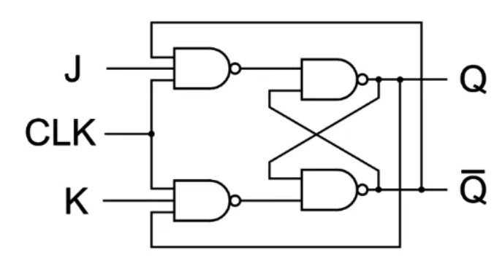
J-K flip Flop (NAND)
J | K | Q | Q⁰
0 | 0 | NC | NC
0 | 1 | 0 | 1
1 | 0 | 1 | 0
1 | 1 | T* | T*

Slide 23
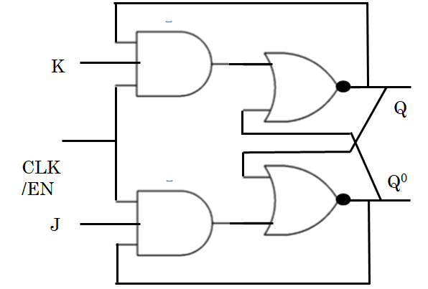
J-K Flip Flop
J
Q
J-K Flip Flop
CLK
Q⁰
K

Slide 24
T Flip Flop (Toggle)
J | K | Q | Q⁰
0 | 0 | NC | NC
0 | 1 | 0 | 1
1 | 0 | 1 | 0
1 | 1 | T* | T*
J
T
Q
J-K Flip Flop
CLK
Q⁰
K
T
0
1
Q | Q⁰
NC | NC
Toggle | Toggle
Applications:
Registers
Counters
Event Detectors
Data Synchronizers
Frequency Divider

Slide 25

D Flip Flop (Data)
J | K | Q | Q⁰
0 | 0 | NC | NC
0 | 1 | 0 | 1
1 | 0 | 1 | 0
1 | 1 | T* | T*
J
D
Q
J-K Flip Flop
CLK
Q⁰
K
D
0
1
Q | Q⁰
0 | 1
1 | 0
Applications:
Data storage registers.
Data transferring as shift registers.
Frequency division circuits.

Slide 26
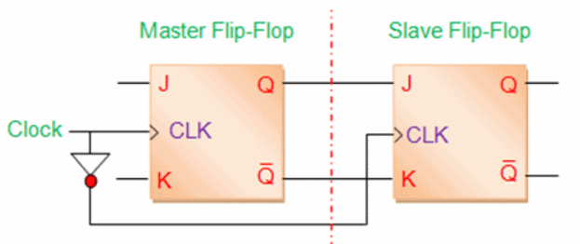
Master-Slave J-K Flip Flop
The Master-Slave Flip-Flop is basically two gated SR flip-flops connected together in a series configuration with the slave having an inverted clock pulse.
The outputs from “Slave” flip-flop are fed back to the inputs of the “Master” with the outputs of the “Master” flip flop being connected to the two inputs of the “Slave” flip flop.
The master-slave flip-flop eliminates all the timing problems
J | K | Q | Q⁰
0 | 0 | NC | NC
0 | 1 | 0 | 1
1 | 0 | 1 | 0
1 | 1 | T* | T*

Slide 27
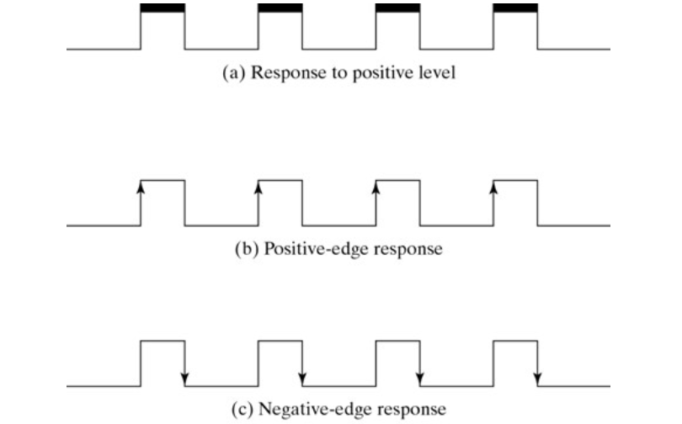
Edge Triggered & Level Triggered

Slide 28
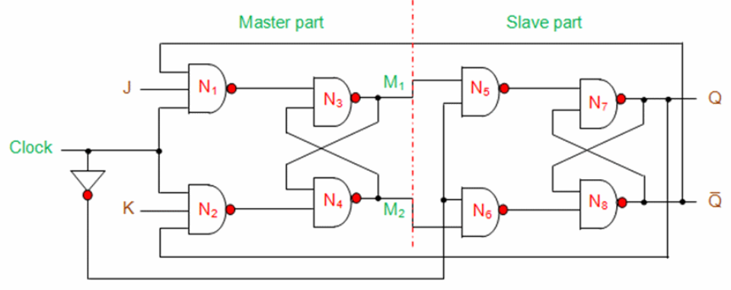
Master-Slave J-K Flip Flop(NAND)

Slide 29
Master-Slave J-K Flip Flop (NOR)
1
K
Q
Q⁰
1
J

