Slide 1
CSE 219: Digital Logic & Computer Design
Tamanna Haque Nipa
Assistant Professor
Dept. of CSE
Stamford University Bangladesh

Slide 2
Counter
Types
Asynchronous Counter
Synchronous Counter
Applications of Counter
Frequency counters
Digital clocks
Analog to digital convertors.
Frequency divider circuits. (The frequency divider circuit is that which divides the input frequency exactly by ‘2’.)
For calculating time or timers

Slide 3
Asynchronous Counter (ripple counter)
An asynchronous counter is one in which the flip-flops (FF) within the counter do not change states at exactly the same time because they do not have a common clock pulse.
Propagation delay is higher than that of synchronous counters. [Propagation delay is the length of time taken for a signal to reach its destination. ]
These are slow in operation.
Less number of logic gates required.
Low cost
Complex to design
Standard logic packages are not available

Slide 4
3 bit Asynchronous Up Counter
Q₀
Q₁
Q₂
Q2 | Q1 | Q0
0 | 0 | 0
0 | 0 | 1
0 | 1 | 0
0 | 1 | 1
1 | 0 | 0
1 | 0 | 1
1 | 1 | 0
1 | 1 | 1
Start and repeat
VCC
Q
Q
Q
J₀
J₁
J₂
T Flip Flop
T Flip Flop
T Flip Flop
Q⁰
Q⁰
Q⁰
K₀
K₁
K₂
CLK

Slide 5
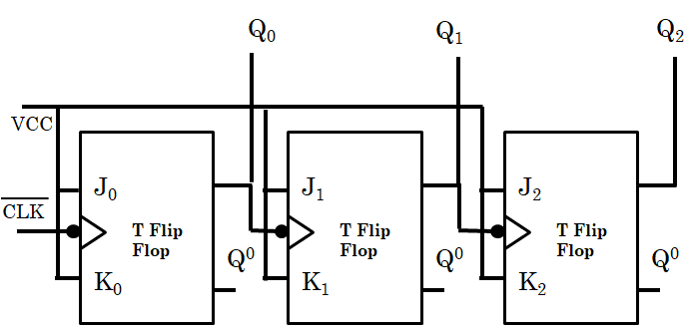
3 bit Asynchronous Up Counter
0
/1
/0
/1
/0
/1
/0
/1
0
/1
/0
/1
0
/1
1
1
0
1
0
Q2 | Q1 | Q0
0 | 0 | 0
Q2 | Q1 | Q0
1 | 0 | 0
0 | 0 | 1
1 | 0 | 1
0 | 1 | 0
1 | 1 | 0
0 | 1 | 1
1 | 1 | 1

Slide 6
3 bit Asynchronous Down Counter
Q
Q
Q
J₀
J₁
J₂
T Flip Flop
T Flip Flop
T Flip Flop
Q⁰
Q⁰
Q⁰
K₀
K₁
K₂
1
Q0⁰
Q1⁰
Q2⁰
0
Q2 | Q1 | Q0
0 | 0 | 0
Q2⁰ | Q1⁰ | Q0⁰
1 | 1 | 1
Q2 | Q1 | Q0
Q2⁰ | Q1⁰ | Q0⁰
1 | 0 | 0
0 | 1 | 1
0 | 0 | 1
1 | 1 | 0
1 | 0 | 1
0 | 1 | 0
0 | 1 | 0
1 | 0 | 1
1 | 1 | 0
0 | 0 | 1
0 | 1 | 1
1 | 0 | 0
1 | 1 | 1
0 | 0 | 0

Slide 7
4 bit Asynchronous Up Counter
Q₃
1
J₃
T Flip Flop
1
Q⁰
K₃
0
1
0
It counts 0000 to 1111.

Slide 8
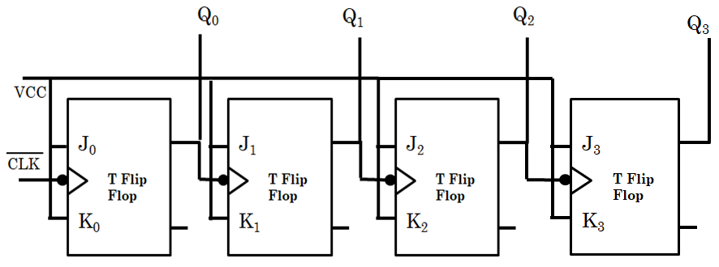

Asynchronous MOD 13 Counter
MOD 13 mean it will count 0000 to 1100 (0 to 12)
13 = (1101)₂
Q3 | Q2 | Q1 | Q0
1 | 1 | 0 | 1
CLR

Slide 9
Asynchronous MOD 10 Counter
MOD 10 mean it will count 0000 to 1001 (0 to 9)
10 = (1010)₂
Q3 | Q2 | Q1 | Q0
1 | 0 | 1 | 0
Asynchronous Decade Counter
CLR

Slide 10
Synchronous Counter
A synchronous counter is one in which all the flip-flops in the counter are clocked at the same time by a common clock pulse
The propagation delay is very low
These are faster than that of ripple counters.
Large number of logic gates are required to design
High cost
Synchronous circuits are easy to design.
Standard logic packages available for synchronous.

Slide 11
3 bit Synchronous Up Counter
Q₀
Q₁
Q₂
Q2 | Q1 | Q0
0 | 0 | 0
0 | 0 | 1
0 | 1 | 0
0 | 1 | 1
1 | 0 | 0
1 | 0 | 1
1 | 1 | 0
1 | 1 | 1
VCC
J₀
J₁
J₂
CLK
T Flip Flop
T Flip Flop
T Flip Flop
K₀
K₁
K₂

Slide 12
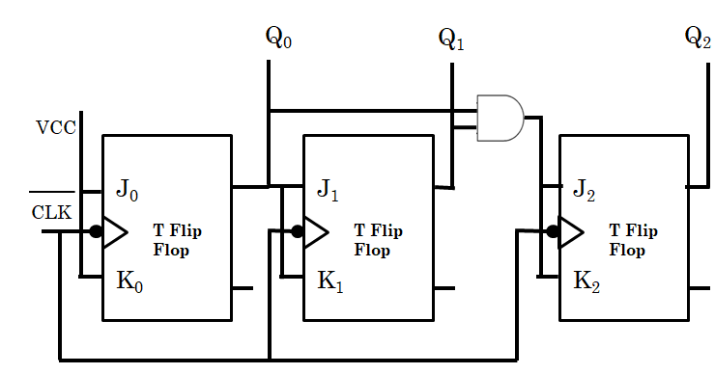
3 bit Synchronous Up Counter
0
/1
/0
/1
/0
/1
/0
/1
0
/0
/1
/0
/0
/1
/1
/0
/0
/1
0
/0
/1
/1
/1
/1
Q2 | Q1 | Q0
0 | 0 | 0
Q2 | Q1 | Q0
1 | 0 | 0
0 | 0 | 1
1 | 0 | 1
0 | 1 | 0
1 | 1 | 0
0 | 1 | 1
1 | 1 | 1

Slide 13
4 bit Synchronous Up Counter
Q₃
J₃
T Flip Flop
K₃

Slide 14
Johnson Counter– 3 bit
Q₀
Q₁
Q₂
/1
/1
/1
0
/0
/0
/0
/1
/1
/1
/0
0
/0
/1
0
/0
/1
/1
Q2 | Q1 | Q0
0 | 0 | 0
D₀
D₁
D₂
CLK
0 | 0 | 1
D Flip Flop
D Flip Flop
D Flip Flop
0 | 1 | 1
1
/0
1 | 1 | 1
1 | 1 | 0
1 | 0 | 0
0 | 0 | 0
Input n bit so output 2n bit.
(3 bit input so it can count 2x3=6 values)
Applications(read yourself)

Slide 15
Ring Counter– 3 bit
Q₀
Q₁
Q₂
/1
/0
/0
0
/1
/0
/1
/0
/0
0
/0
/1
0
/0
/0
Q2 | Q1 | Q0
0 | 0 | 0
1
/0
D₀
D₁
D₂
CLK
0 | 0 | 1
D Flip Flop
D Flip Flop
D Flip Flop
0 | 1 | 0
1 | 0 | 0
0 | 0 | 1
Input n bit so output n bit.
(3 bit input so it can count 3 values)
Applications(read yourself)

Slide 16
Exercise
Synchronous Down Counter
Synchronous MOD Counter

