Slide 1
CSE 219: Digital Logic & Computer Design
Tamanna Haque Nipa
Assistant Professor
Dept. of CSE
Stamford University Bangladesh

Slide 2
Introduction to Digital Logic Basics
Digital electronic circuits operate with voltages of two logic levels namely Logic Low and Logic High.
Logic Low is represented with ‘0’
Similarly, Logic High is represented with ‘1’.
Digital electronic circuits/ hardware consists of a few simple building blocks, are called logic gates.
Logic gates are built using transistors
We can classify these Logic gates into the following three categories.
Basic gates
Universal gates
Special gates

Slide 3

Basic Gates- AND, OR & NOT gates.
AND gate:
Equation: F = A.B =AB
A | B | F=A.B
0 | 0 | 0
0 | 1 | 0
1 | 0 | 0
1 | 1 | 1
Truth Table:
Symbol:
[Similarly, if there are ‘n’ inputs, then the output of AND gate will be ‘1’, when all the ‘n’ inputs are ‘1’.]

Slide 4

Basic Gates- AND, OR & NOT gates.
OR gate:
Equation: F = A+B
A | B | F=A+B
0 | 0 | 0
0 | 1 | 1
1 | 0 | 1
1 | 1 | 1
Truth Table:
Symbol:
[Similarly, if there are ‘n’ inputs, then the output of OR gate will be ‘1’, when any one of the ‘n’ inputs is/are ‘1’.]

Slide 5

Basic Gates- AND, OR & NOT gates.
NOT gate: (inverter)
Equation: F = A⁰ / A’ / A (not/ prime/ bar)
A | Y=A⁰
0 | 1
1 | 0
Truth Table:
Symbol:
[Always NOT gate has one input variable]

Slide 6

Universal gates- NAND & NOR gates.
NAND gate: (NAND = AND + NOT)
Equation: F = (A.B)⁰ =(AB)⁰
A | B | F=(AB)⁰
0 | 0 | 1
0 | 1 | 1
1 | 0 | 1
1 | 1 | 0
Truth Table:
Symbol:
[Similarly, if there are ‘n’ inputs, then the output of NAND gate will be ‘0’, when all the ‘n’ inputs are ‘1’.]

Slide 7
Universal gates- NAND & NOR gates.
NOR gate: (NOR=OR+NOT )
Equation: F = (A+B)⁰
A | B | F=(A+B)⁰
0 | 0 | 1
0 | 1 | 0
1 | 0 | 0
1 | 1 | 0
Truth Table:
Symbol:
[Similarly, if there are ‘n’ inputs, then the output of NOR gate will be ‘0’, when any one of the ‘n’ inputs is/are ‘1’.]

Slide 8
Universal gates- NAND & NOR gates.
A universal gate is a gate which can implement any Boolean function without need to use any other gate type.
The NAND and NOR gates are universal gates.
In practice, this is advantageous since
NAND and NOR gates are economical
Easier to fabricate the basic gates used in digital logic design.

Slide 9


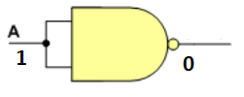
Implementing a NOT Gate Using only NAND Gate
A | B | F=(AB)⁰
0 | 0 | 1
0 | 1 | 1
1 | 0 | 1
1 | 1 | 0
A | Y=A⁰
0 | 1
1 | 0

Slide 10


Implementing an AND Gate Using only NAND Gate

Slide 11
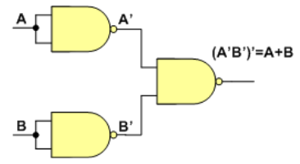
Implementing an OR Gate Using only NAND Gate
0
1
A | B | F=(AB)⁰
0 | 0 | 1
0 | 1 | 1
1 | 0 | 1
1 | 1 | 0
A | B | F=A+B
0 | 0 | 0
0 | 1 | 1
1 | 0 | 1
1 | 1 | 1
0
0
1
0
1
1
1
0

Slide 12

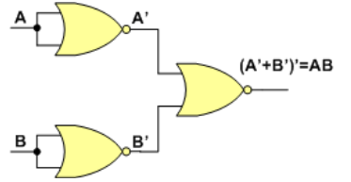

Implementing Basic Gates Using only NOR Gate
NOT
AND
OR

Slide 13
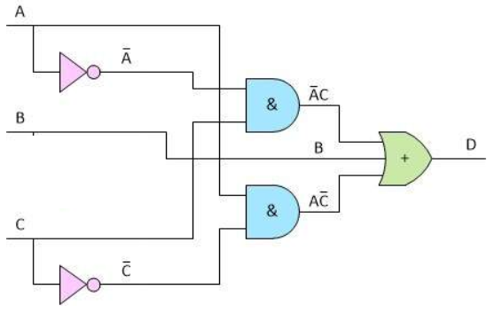

Example- Circuit implementation using only NAND Gates

Slide 14
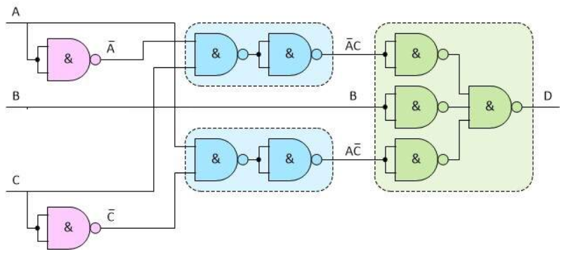
Example

Slide 15
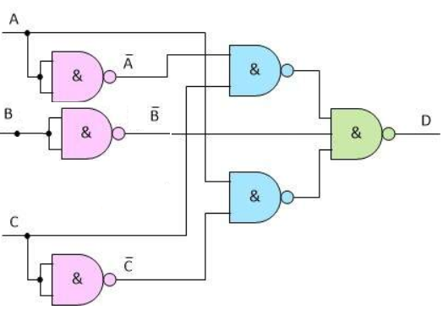
Example

Slide 16

Special gates- XOR & XNOR gates.
XOR / Ex-OR / Exclusive-OR gate:
Equation: F=A⊕B = A⁰B +AB⁰
A | B | F=A⊕B
0 | 0 | 0
0 | 1 | 1
1 | 0 | 1
1 | 1 | 0
Truth Table:
A⁰B
AB⁰
Symbol:
[Similarly, if there are ‘n’ inputs, then the output of XOR gate will be ‘1’, when number of 1 in ‘n’ inputs are ‘odd’.]

Slide 17
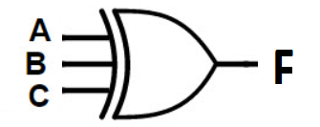
Special gates- XOR & XNOR gates.
XOR / Ex-OR / Exclusive-OR gate:
Equation: F=A⊕B ⊕C
A | B | C | F=A⊕B ⊕C
0 | 0 | 0 | 0
0 | 0 | 1 | 1
0 | 1 | 0 | 1
0 | 1 | 1 | 0
1 | 0 | 0 | 1
1 | 0 | 1 | 0
1 | 1 | 0 | 0
1 | 1 | 1 | 1
Truth Table:
Symbol:
[Similarly, if there are ‘n’ inputs, then the output of XOR gate will be ‘1’, when number of 1 in ‘n’ inputs are ‘odd’.]

Slide 18
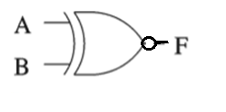
Special gates- XOR & XNOR gates.
XNOR / Ex-NOR / Exclusive-NOR gate:
Equation: F=A⊙B = A⁰B⁰+ AB = (A⁰B +AB⁰)⁰ = (A⊕B)⁰
A | B | F=A⊙B
0 | 0 | 1
0 | 1 | 0
1 | 0 | 0
1 | 1 | 1
Truth Table:
A⁰B⁰
Symbol:
AB
[Similarly, if there are ‘n’ inputs, then the output of XNOR gate will be ‘1’, when number of 1 in ‘n’ inputs are ‘even or zero’.]

Slide 19
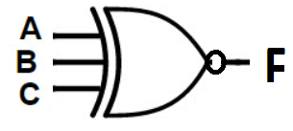
Special gates- XOR & XNOR gates.
XNOR / Ex-NOR / Exclusive-NOR gate:
Equation: F=A ⊙ B ⊙ C
A | B | C | F=A⊙B ⊙C
0 | 0 | 0 | 1
0 | 0 | 1 | 0
0 | 1 | 0 | 0
0 | 1 | 1 | 1
1 | 0 | 0 | 0
1 | 0 | 1 | 1
1 | 1 | 0 | 1
1 | 1 | 1 | 0
Truth Table:
Symbol:
[Similarly, if there are ‘n’ inputs, then the output of XNOR gate will be ‘1’, when number of 1 in ‘n’ inputs are ‘even or zero’.]

