Slide 1
CSE 219: Digital Logic & Computer Design
Tamanna Haque Nipa
Assistant Professor
Dept. of CSE
Stamford University Bangladesh

Slide 2
Logic Circuit Design Process
Problem specification
Truth table derivation
Derivation of logical expression
Simplification of logical expression
Implementation

Slide 3



Deriving Logical Expressions
A
B
C
A | B | C | F
0 | 0 | 0 | 0
0 | 0 | 1 | 0
0 | 1 | 0 | 0
0 | 1 | 1 | 1
1 | 0 | 0 | 0
1 | 0 | 1 | 1
1 | 1 | 0 | 1
1 | 1 | 1 | 1
A⁰BC
F
AB⁰C
ABC⁰
ABC
F = A⁰BC + AB⁰C + ABC⁰ + ABC
(011 101 110 111)
F(a, b, c) = Σ (3, 5, 6, 7)
Sum-of-products (SOP) form

Slide 4
Deriving Logical Expressions (cont..)
Derivation of logical expressions from truth tables can be done by 2 ways
Sum-of-products (SOP) form
Write an AND term for each input combination that produces a 1 output
OR the AND terms to get the final expression
Product-of-sums (POS) form
Write an OR term for each input combination that produces a 0 output
AND the OR terms to get the final expression

Slide 5




Laws of Boolean Algebra
Commutative Laws

Slide 6

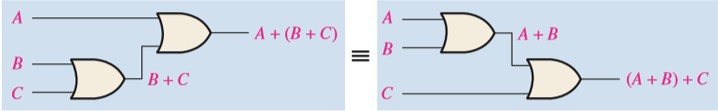

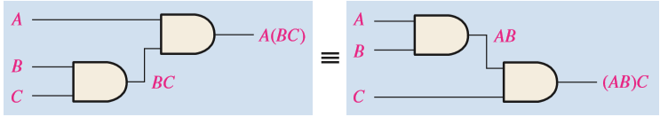
Laws of Boolean Algebra
Associative Laws : A+(B+C) = (A+B)+C = B+(A+C) = A+B+C

Slide 7

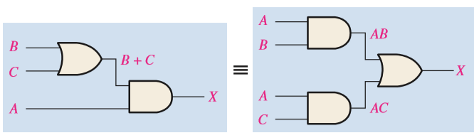
Laws of Boolean Algebra
Distributive Law

Slide 8
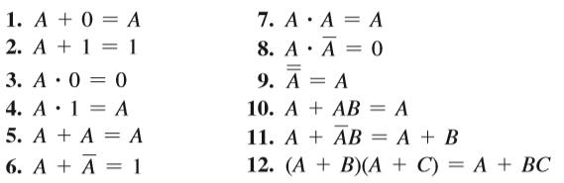
Rules of Boolean Algebra

Slide 9
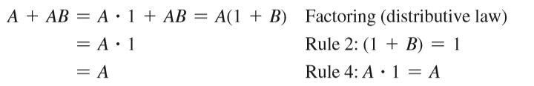
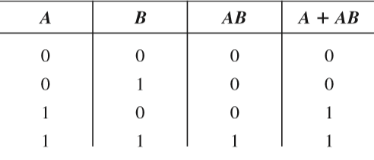
Rule 10: A + AB = A

Slide 10
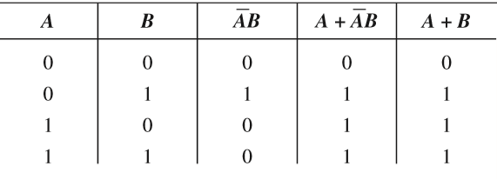
Rule 11: A +A⁰B = A + B

Slide 11
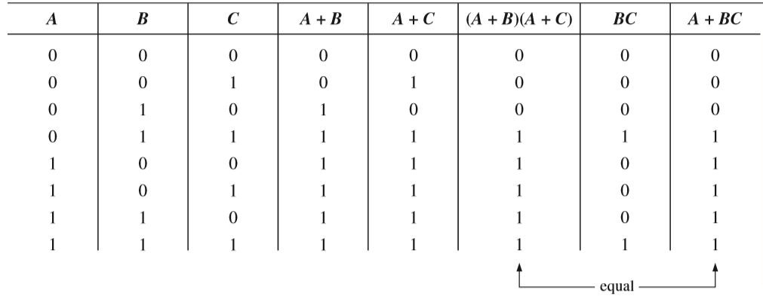
Rule 12: (A + B)(A + C) = A + BC

Slide 12




DeMorgan’s Theorems
The complement of two or more ANDed variables
The complement of two or more ORed variables

Slide 13





Applying DeMorgan’s Theorems

Slide 14

Logical Expression Simplification
F = A⁰BC + AB⁰C + ABC⁰ + ABC
= C(A⁰B + AB⁰) + AB(C⁰ + C)
A
B
C
= C(A ⊕ B) + AB
A
B
C
F

Slide 15
Logical Expression Simplification
Three basic methods
Algebraic manipulation 
Use Boolean laws to simplify the expression
Difficult to use 
Don’t know if you have the simplified form
Karnaughmap(K-map)method
Graphical method and easy to use for 3 and 4 variable
Can be used to simplify logical expressions with a few variables
Tabular Method(Quine-McCluskey)
Complex but can simplify when variable is more than 4 or 5
Can be used to simplify logical expressions with a few variables

Slide 16
Logic Simplification Using Boolean Algebra-EXAMPLE 4.9
AB + A(B + C) + B(B + C)
= AB + AB + AC + BB + BC
= AB + AB + AC + B + BC
= AB + AC + B(1 + C)
= AB + AC + B
= B(A+1) + AC
=B + AC
Simplify the Boolean expression: AB⁰ + A(B + C)⁰ + B(B + C)⁰

Slide 17
Logic Simplification Using Boolean Algebra-EXAMPLE 4.10
[AB⁰(C + BD) + A⁰B⁰]C
= [AB⁰C + AB⁰BD + A⁰B⁰]C
= [AB⁰C + A⁰B⁰]C … B⁰B = 0 and A.D.0 = 0
= AB⁰CC + A⁰B⁰C
= AB⁰C + A⁰B⁰C
= B⁰C(A + A⁰)
= B⁰C
Simplify the Boolean expression [AB(C + (BD)⁰) + (AB)⁰]CD

Slide 18
Logic Simplification Using Boolean Algebra-EXAMPLE 4.11
A⁰BC + AB⁰C⁰ + A⁰B⁰C⁰ + AB⁰C + ABC
=BC(A⁰ + A) + B⁰C⁰ (A+ A⁰) + AB⁰C
=BC + B⁰C⁰ + AB⁰C
=(B ⊙ C)+ AB⁰C
Simplify the Boolean expression: ABC⁰ + A⁰B⁰C + A⁰BC + A⁰B⁰C⁰

Slide 19
Logic Simplification Using Boolean Algebra-EXAMPLE 4.12
(AB + AC)⁰ + A⁰B⁰C
=(AB)⁰(AC)⁰ + A⁰B⁰C
=(A⁰ +B⁰)(A⁰+C⁰) + A⁰B⁰C
=A⁰A⁰ + A⁰ B⁰ + B⁰C⁰ + A⁰ C⁰ + A⁰B⁰C
=A⁰ + A⁰ B⁰ + B⁰C⁰ + A⁰ C⁰ + A⁰B⁰C
=A⁰ (1+ B⁰)+ B⁰C⁰ + A⁰ C⁰ + A⁰B⁰C
=A⁰+ B⁰C⁰ + A⁰ C⁰ + A⁰B⁰C
=A⁰(1+C⁰)+ B⁰C⁰ +A⁰B⁰C
=A⁰+ B⁰C⁰ +A⁰B⁰C
=A⁰(1 + B⁰C)+ B⁰C⁰
=A⁰+ B⁰C⁰
Simplify the Boolean expression: (AB)⁰ + (AC)⁰ + A⁰B⁰C⁰

Slide 20
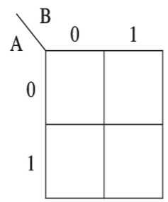
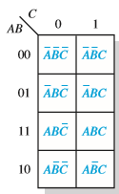
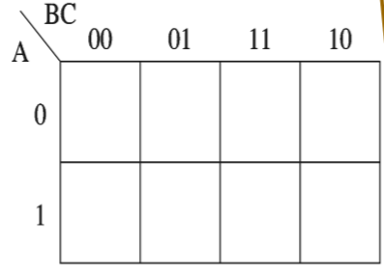
Karnaugh Map(K-Map) Method
2 variable
3 variable
A⁰B⁰
A⁰B
AB⁰
AB

Slide 21
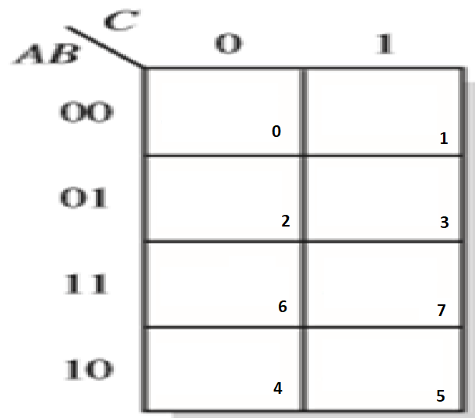
Karnaugh Map(K-Map) Method
3 variable

Slide 22
Example
F(A,B,C)=Σ(1,2,4,6) = A⁰B⁰C+A⁰BC⁰+AB⁰C⁰+ABC⁰
Grouping is done by 1, 2, 4, 8, 16…..
C⁰
C
A⁰B⁰
0
1
= BC⁰
+ AC⁰
+ A⁰B⁰C
A⁰B
1
0
AB
1
0
AB⁰
1
0

Slide 23
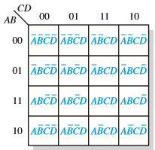
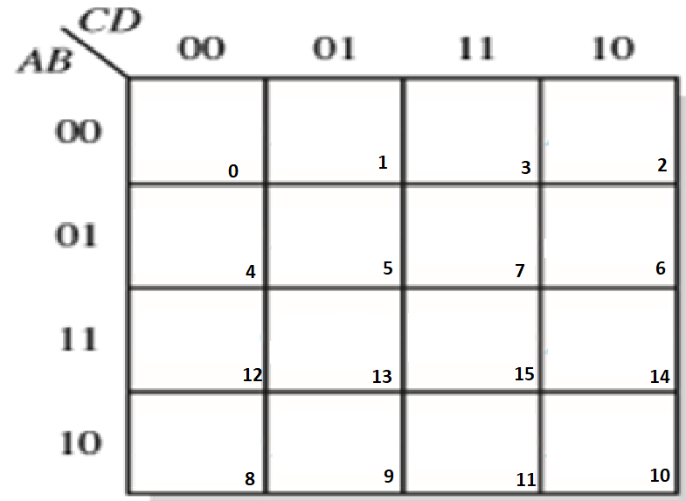
Karnaugh Map(K-Map) Method
4 variable

Slide 24
Example
F=Σ(0,1,4,5,7,9,11,13,14)
C⁰D⁰
C⁰D
CD
CD⁰
A⁰B⁰
1
1
0
0
=A⁰C⁰+C⁰D+A⁰BD+ABCD⁰+AB⁰D
A⁰B
1
1
1
0
AB
0
1
0
1
AB⁰
0
1
1
0

Slide 25
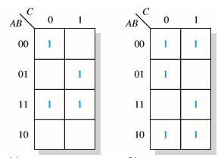
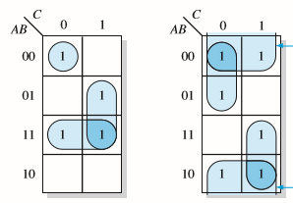
3 Variable Grouping

Slide 26
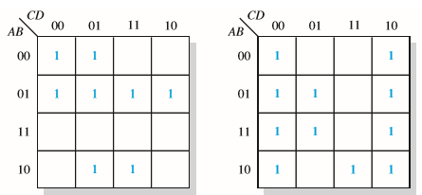
4 Variable Grouping

Slide 27
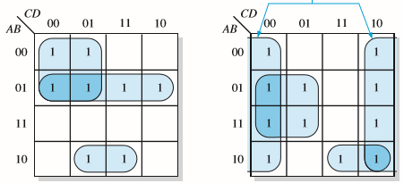
4 Variable Grouping

Slide 28
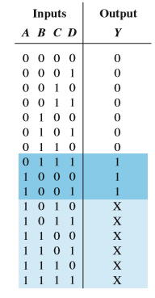
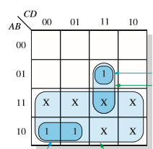
Don’t Care
F=Σ(7,8,9) don’t care(10-15)

Slide 29
Example
F(W,X,Y,Z)=Σ(1,3,4,5,9,11) DC(12,13,14,15)
Y⁰Z⁰
Y⁰Z
YZ
YZ⁰
W⁰X⁰
0
1
1
0
= XY⁰ + X⁰Z
W⁰X
1
1
0
0
WX
X
X
X
X
WX⁰
0
1
1
0

