Slide 1
CSE 219: Digital Logic & Computer Design
Tamanna Haque Nipa
Assistant Professor
Dept. of CSE
Stamford University Bangladesh

Slide 2


Half-Adder
A
B
Two inputs A & B
Two outputs C_{out} & Sum
A | B | C_{out} | Sum
0 | 0 | 0 | 0
0 | 1 | 0 | 1
1 | 0 | 0 | 1
1 | 1 | 1 | 0
Sum
A⁰B
C_{out}
AB⁰
AB
0 + 0 = 0
Equations:
0 + 1 = 1
1 + 0 = 1
Sum= A⁰B +AB⁰ = A ⊕ B
1 + 1 = 1 0
C_{out}= AB

Slide 3
Full-Adder
Three inputs A, B & C_{in}
Two outputs C_{out} & Sum
A 0
A | B | C_{in}
0 | 0 | 0
0 | 0 | 1
0 | 1 | 0
0 | 1 | 1
1 | 0 | 0
1 | 0 | 1
1 | 1 | 0
1 | 1 | 1
C_{out} | Sum
B 0
0 | 0
C_{in} 1
0 | 1
1
0 | 1
A 0
A 1
1 | 0
B 1
B 1
0 | 1
C_{in} 1
C_{in} 1
1 | 0
1 0
1 1
1 | 0
1 | 1

Slide 4
Full-Adder
A | B | C_{in} | C_{out} | Sum
0 | 0 | 0 | 0 | 0
0 | 0 | 1 | 0 | 1
0 | 1 | 0 | 0 | 1
0 | 1 | 1 | 1 | 0
1 | 0 | 0 | 0 | 1
1 | 0 | 1 | 1 | 0
1 | 1 | 0 | 1 | 0
1 | 1 | 1 | 1 | 1
A⁰B⁰C_{in}
A⁰BC⁰_{in}
A⁰BC_{in}
AB⁰C⁰_{in}
AB⁰C_{in}
ABC⁰_{in}
ABC_{in}
ABC_{in}
Sum = A⁰B⁰C_{in} + A⁰BC⁰_{in} + AB⁰C⁰_{in} + ABC_{in}
Cout = A⁰BC_{in} + AB⁰C_{in} + ABC⁰_{in} + ABC_{in}

Slide 5

Full-Adder
Sum = A ⊕ (B ⊕ C_{in})
= (A ⊕ B )⊕ C_{in}
C_{out} = C_{in}(A ⊕ B) + AB
A
B
C_{in}
Sum
C_{out}

Slide 6
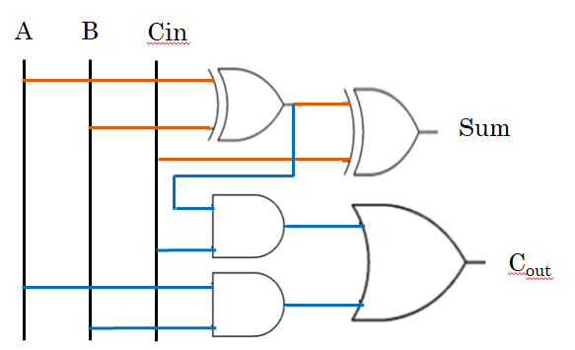
4 bit Parallel Adder
B
A
Full Adder
C_{out}
C_{in}
Cin =0
Sum
A3 A2 A1 A0
B3 B2 B1 B0
Cout
S3 S2 S1 S0

Slide 7
4 bit Parallel Adder
B3
A3
B2
A2
B1
A1
B0
A0
FA 3
FA 2
FA 1
FA 0
Cout
Cin = 0
S3
S2
S1
S0

Slide 8
4 bit Parallel Adder
B3
A3
B2
A2
B1
A1
B0
A0
FA 3
FA 2
FA 1
FA 0
Cout
Cin = 0
S3
S2
S1
S0

Slide 9
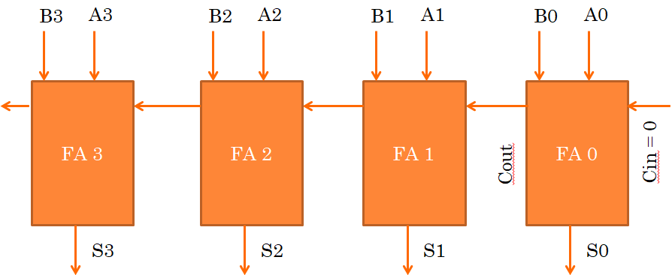
4 bit Parallel Adder (Ripple Adder)
B₃ B₂ B₁ B₀
A₃ A₂ A₁ A₀
4 bit Full Adder
Cout
Cin = 0
S₃ S₂ S₁ S₀
Cin =0
1
1
1
Cin =0
A3 A2 A1 A0
0 1 0 1 = 5
B3 B2 B1 B0
0 1 1 1 = 7
Cout
S3 S2 S1 S0
1 1 0 0 = 12
Cout = 0

Slide 10







Half-Subtractor
A
Two inputs A & B
Two outputs B_{in} & Difference
A | B | B_{in} | Diff
0 | 0 | 0 | 0
0 | 1 | 1 | 1
1 | 0 | 0 | 1
1 | 1 | 0 | 0
A⁰B
A⁰B
AB⁰

Slide 11
Full-Subtractor
Three inputs A, B & B_{out} (Borrow out)
Two outputs B_{in} (Borrow in) & Difference
A 0
+10
8 3
1 5
A | B | B_{out}
0 | 0 | 0
0 | 0 | 1
0 | 1 | 0
0 | 1 | 1
1 | 0 | 0
1 | 0 | 1
1 | 1 | 0
1 | 1 | 1
B_{in} | Diff
B 0
1+
0 | 0
+
B_{out} 1
6
8
1 | 1
1
1
1 | 1
A 0
A 0
1 | 0
B 1
B 1
B_{out} 0
B_{out} 1
1 1
1 0

Slide 12
Full-Subtractor
Three inputs A, B & B_{out} (Borrow out)
Two outputs B_{in} (Borrow in) & Difference
A 1
+10
8 3
1 5
A | B | B_{out}
0 | 0 | 0
0 | 0 | 1
0 | 1 | 0
0 | 1 | 1
1 | 0 | 0
1 | 0 | 1
1 | 1 | 0
1 | 1 | 1
B_{in} | Diff
B 0
1+
0 | 0
B_{out} 0
6
8
1 | 1
0 1
1 | 1
A 1
A 1
+2
1 | 0
B 0
B 1
2
0 | 1
B_{out} 1
B_{out} 1
0 | 0
0 0
1 1
0 | 0
1 | 1

Slide 13
Full-Subtractor
A | B | B_{out} | B_{in} | Diff
0 | 0 | 0 | 0 | 0
0 | 0 | 1 | 1 | 1
0 | 1 | 0 | 1 | 1
0 | 1 | 1 | 1 | 0
1 | 0 | 0 | 0 | 1
1 | 0 | 1 | 0 | 0
1 | 1 | 0 | 0 | 0
1 | 1 | 1 | 1 | 1
A⁰B⁰B_{out}
A⁰B⁰B_{out}
A⁰BB⁰_{out}
A⁰BB⁰_{out}
A⁰BB_{out}
AB⁰B⁰_{out}
ABB_{out}
ABB_{out}
Diff = A⁰B⁰B_{out} + A⁰BB⁰_{out} + AB⁰B⁰_{out} + ABB_{out}
B_{in} = A⁰B⁰B_{out} + A⁰BB⁰_{out} + A⁰BB_{out} + ABB_{out}

Slide 14

Full-Subtractor
Diff = A ⊕ (B ⊕ B_{out})
B_{in}= A⁰(B ⊕ B_{out}) + BB_{out}
A
B
B_{out}
Diff
B_{in}

Slide 15
adder-subtractor
Subtraction: F = A-B = A + (-B) = A + B⁰ + 1
Example: -9
9 = 1001 X
9 = 01001 – 5 bit
Negative values are represented by 2’s complement method
2 Steps: a) 1’s complement of 9 --- 10110 = (9)⁰
b) add 1 with it --- 10111 (-9)
-B = B⁰ + 1
-8 | 4 | 2 | 1
1 | 0 | 0 | 1
= -8+1 = -7
-16 | 8 | 4 | 2 | 1
0 | 1 | 0 | 0 | 1
= 8+1 = 9

Slide 16
adder-subtractor
Addition: F = A + B
Subtraction: F = A-B = A + (-B) = A + B⁰ + 1
Cin =0
1
1
1
Cin =0
A3 A2 A1 A0
0 1 0 1 = 5
B3 B2 B1 B0
0 1 1 1 = 7
Cout
S3 S2 S1 S0
1 1 0 0 = 12
Cout = 0
Cin =1
0
0
1
Cin =1
A3 A2 A1 A0
0 1 0 1 = 5
(B3 B2 B1 B0)⁰
1 0 0 0 = (7)⁰
Cout
S3 S2 S1 S0
1 1 1 0 = -2
Cout = 0

Slide 17
adder-subtractor Circuit
How to implement B⁰ ?
0 1 1 1 = 7
A | B | F=A⊕B
0 | 0 | 0
0 | 1 | 1
1 | 0 | 1
1 | 1 | 0
XOR with 1
1 1 1 1
1 0 0 0 = (7)⁰
0 1 1 1 = 7
XOR with 0
0 0 0 0
0 1 1 1 = 7

Slide 18
adder-subtractor Circuit
0111
B₃ B₂ B₁ B₀
0101
A₃ A₂ A₁ A₀
0111
Cout = 0
4 bit Full Adder
0111 + 0101 + 0
Cin = 0
S₃ S₂ S₁ S₀
For Add Cin=0
1100

Slide 19
adder-subtractor Circuit
0111
B₃ B₂ B₁ B₀
0101
A₃ A₂ A₁ A₀
1000
Cout = 0
4 bit Full Adder
1000 + 0101 + 1
Cin = 1
S₃ S₂ S₁ S₀
For Subtraction Cin=1
1110

