Slide 1
CSE 219: Digital Logic & Computer Design
Tamanna Haque Nipa
Assistant Professor
Dept. of CSE
Stamford University Bangladesh

Slide 2
Integer Representations
Unsigned Integer
Signed Integer
Sign Magnitude
1’s Complement
2’s Complement

Slide 3
Number Representation (8 bit)
Positive Number Representation:
2’s complement +ve number : represent 87
87 is greater than +64 and lower than +127
-2⁷ | 2⁶ | 2⁵ | 2⁴ | 2³ | 2² | 2¹ | 2⁰
0 | 1 | 0 | 1 | 0 | 1 | 1 | 1
-128 | 64 | 32 | 16 | 8 | 4 | 2 | 1
87-64= 23
23-32 = x
23-16=7
7-8=x
7-4=3
3-2=1
1-1=0
87 = 64+16+4+2+1

Slide 4
Number Representation (8 bit)
Positive Number Representation: represent 87
2’s complement +ve number : 87 = 01010111
-2⁷ | 2⁶ | 2⁵ | 2⁴ | 2³ | 2² | 2¹ | 2⁰
0 | 1 | 0 | 1 | 0 | 1 | 1 | 1
-128 | 64 | 32 | 16 | 8 | 4 | 2 | 1
(87 = 64+16+4+2+1)
Sign Magnitude: 87 = 01010111
Same as 2’s complement
1’s complement: 87 = 01010111

Slide 5
Number Representation (8 bit) cont…
Negative Number Representation:
2’s complement -ve number : represent -87
-87 = -128 + 41
-2⁷ | 2⁶ | 2⁵ | 2⁴ | 2³ | 2² | 2¹ | 2⁰
1 | 0 | 1 | 0 | 1 | 0 | 0 | 1
-128 | 64 | 32 | 16 | 8 | 4 | 2 | 1
41-64=x
41-32=9
9-16=x
9-8=1
1-4=x
1-2=x
1-1=0
-87 = -128+ 41
= -128 +32+8+1

Slide 6
Number Representation (8 bit)
Negative Number Representation: represent -87
2’s complement -ve number : -87 = 10101001
-2⁷ | 2⁶ | 2⁵ | 2⁴ | 2³ | 2² | 2¹ | 2⁰
1 | 0 | 1 | 0 | 1 | 0 | 0 | 1
-128 | 64 | 32 | 16 | 8 | 4 | 2 | 1
-87 = -128+ 41
= -128 +32+8+1
Sign Magnitude: 87 = 01010111, So -87 will be 11010111
1’s complement: 87 = 01010111, So -87 will be 10101000
87 | + ve | ve
SM | 01010111 | 11010111
1’s | 01010111 | 10101000
2’s | 01010111 | 10101001

Slide 7
Sign Magnitude
Advantages: Simple
Disadvantages:
Zero Representation (Zero always positive)
+ve zero 0000
- ve zero 1000
Problems in Arithmetic Operation
5 +(-5)=5-5=0
0101 = +5 and 1101 = -5
(0101 + 1101) = 1 0010 ….. Wrong answer
Extra circuit is required to calculate the sign bit
0101 = 5, 1010 = -2 here n = 4 bit
(5+(-2)) = (0101 + 1010) = S111, here S=0/1 need to decide.

Slide 8
1’s Complement
Disadvantages:
Zero Representation (Zero always positive)
+ve zero 0000
- ve zero 1111
Problems in Arithmetic Operation, Error correction is required
5 +(-5)=5-5=0
0101 = +5 and 1010 = -5
(0101 + 1101) = 1111….. Wrong answer as it represents -0
If we need to correct it, we will add 1.
(1111 + 1) = 1 0000, here we will not consider the carry bit so the
result will be +0.

Slide 9
2’s Complement
Disadvantages: Complex
Advantages:
Zero Representation (Zero always positive)
+ve zero 0000
- ve zero 1111 +1 =1 0000
No problems in Arithmetic Operation and no error correction is required
5 +(-5)=5-5=0
0101 = +5 and 1011 = -5
(0101 + 1011) = 1 0000 …. Need to discard the carry bit only
No extra circuit is required to calculate the sign bit
Zero = 0000

Slide 10
Range: 8 bit (-ve to +ve)
Highest +ve number within 8 bit: 64+32+16+8+4+2+1 = +127
-128 | 64 | 32 | 16 | 8 | 4 | 2 | 1
0 | 1 | 1 | 1 | 1 | 1 | 1 | 1
Highest -ve number within 8 bit:
-128+0=-128
-128 | 64 | 32 | 16 | 8 | 4 | 2 | 1
1 | 0 | 0 | 0 | 0 | 0 | 0 | 0

Slide 11
Bit Extension
Positive Value : 30 =011110 (2’s complement)
30 | 6 bit | 9 bit
SM | 011110 | 000011110
1’s | 011110 | 000011110
2’s | 011110 | 000011110
Negative Value: -30 =100010 (2’s complement)
30 | bit | 9 bit
SM | 111110 | 100011110
1’s | 100001 | 111100001
2’s | 100010 | 111100010

Slide 12
Binary Codes
In the coding, when numbers, letters or words are represented by a specific group of symbols, it is said that the number, letter or word is being encoded. The group of symbols is called as a code. The digital data is represented, stored and transmitted as group of binary bits. This group is also called as binary code.
Advantages of Binary Code
Suitable for the computer applications.
Suitable for the digital communications.
Make the analysis and designing of digital circuits
Since only 0 & 1 are being used, implementation becomes easy.

Slide 13

Classification of binary codes
The codes are broadly categorized into following four categories.
On the basis of weight
Weighted Codes
Non-Weighted Codes
Excess-3 code
Gray Code
Binary Coded Decimal Code
Alphanumeric Codes
Error Codes
Error Detecting Codes
Error Correcting Codes

Slide 14
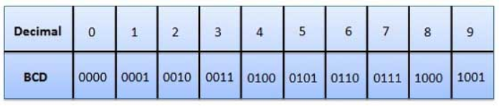
Binary Coded Decimal (BCD) code
In this code each decimal digit is represented by a 4-bit binary number. BCD is a way to express each of the decimal digits with a binary code. With four bits we can represent sixteen numbers (0000 to 1111). But in BCD code only first ten of these are used (0000 to 1001). The remaining six code combinations i.e. 1010 to 1111 are invalid in BCD.

Slide 15

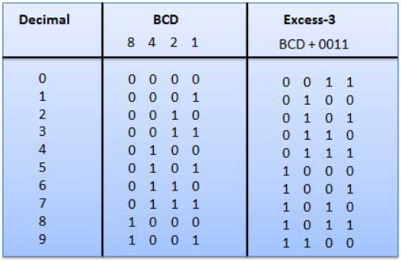
Excess-3 code (XS-3)
The Excess-3 code words are derived from the 8421 BCD code words adding (0011)₂ or (3)₁₀ to each code word in 8421.
CAT
ECV
Exercise: Find Excess-5 code.

Slide 16
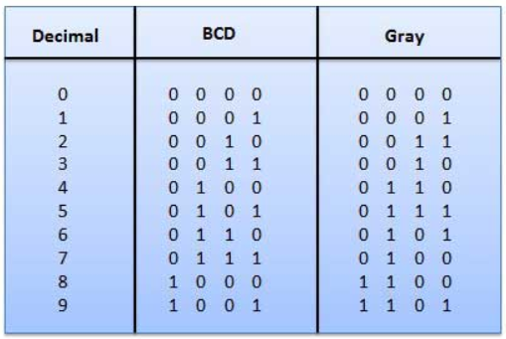
Gray Code (Cyclic Code, Reflected Binary Code (RBC), Reflected Binary (RB) or Grey code)
It has a very special feature that, only one bit will change each time the decimal number is incremented. As only one bit changes at a time, the gray code is called as a unit distance code. Gray code cannot be used for arithmetic operation.

Slide 17
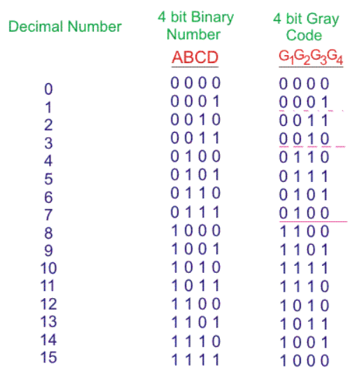
Gray Code

Slide 18
Code Conversion - Binary to Gray (3 bit)
Truth Table:
Equation
Binary Code
A | B | C
0 | 0 | 0
0 | 0 | 1
0 | 1 | 0
0 | 1 | 1
1 | 0 | 0
1 | 0 | 1
1 | 1 | 0
1 | 1 | 1
Gray Code
X | Y | Z
0 | 0 | 0
0 | 0 | 1
0 | 1 | 1
0 | 1 | 0
1 | 1 | 0
1 | 1 | 1
1 | 0 | 1
1 | 0 | 0
X=AB⁰C⁰ +AB⁰C + ABC⁰ +ABC
=AB⁰(C⁰ + C) + AB(C⁰ + C)
=AB⁰ + AB
=A(B⁰ + B) =A
Y=A⁰BC⁰ +A⁰BC + AB⁰C⁰ +AB⁰C
=A⁰B(C⁰ + C) + AB⁰(C⁰ + C)
=A⁰B + AB⁰
=A ⊕ B
Z=A⁰B⁰C + A⁰BC⁰ +AB⁰C + ABC⁰
=A⁰B⁰C +AB⁰C + A⁰BC⁰ + ABC⁰
= B⁰C(A⁰ +A) + BC⁰ (A⁰+ A)
= B⁰C + BC⁰
= B ⊕ C

Slide 19

Code Conversion - Binary to Gray (3 bit)
Truth Table:
Equation
Binary Code
A | B | C
0 | 0 | 0
0 | 0 | 1
0 | 1 | 0
0 | 1 | 1
1 | 0 | 0
1 | 0 | 1
1 | 1 | 0
1 | 1 | 1
Gray Code
X | Y | Z
0 | 0 | 0
0 | 0 | 1
0 | 1 | 1
0 | 1 | 0
1 | 1 | 0
1 | 1 | 1
1 | 0 | 1
1 | 0 | 0
X=A
Y=A ⊕ B
Z= B ⊕ C
A
B
C
X
Y
Z

Slide 20
Code Conversion – Gray to Binary (3 bit)
Truth Table:
Equation
Gray Code
X | Y | Z
0 | 0 | 0
0 | 0 | 1
0 | 1 | 1
0 | 1 | 0
1 | 1 | 0
1 | 1 | 1
1 | 0 | 1
1 | 0 | 0
Binary Code
A | B | C
0 | 0 | 0
0 | 0 | 1
0 | 1 | 0
0 | 1 | 1
1 | 0 | 0
1 | 0 | 1
1 | 1 | 0
1 | 1 | 1
A=XYZ⁰ +XYZ + XY⁰Z +X⁰YZ
=XY(Z⁰ + Z) + Z(XY⁰ + X⁰Y)
=XY + Z(X ⊕ Y)
B=X⁰YZ +X⁰YZ⁰ + XYZ +X⁰YZ
=X⁰Y(Z + Z⁰ ) + YZ (X+X⁰)
=X⁰Y + YZ = Y(X⁰+Z)
C=X⁰Y⁰Z +X⁰YZ⁰ + XYZ +X⁰YZ
=X⁰(Y⁰Z +YZ⁰) + YZ (X+X⁰)
=X⁰(Y ⊕ Z) + YZ

Slide 21



Code Conversion – Gray to Binary (3 bit)
Truth Table:
X
Y
Z
Gray Code
X | Y | Z
0 | 0 | 0
0 | 0 | 1
0 | 1 | 1
0 | 1 | 0
1 | 1 | 0
1 | 1 | 1
1 | 0 | 1
1 | 0 | 0
Binary Code
A | B | C
0 | 0 | 0
0 | 0 | 1
0 | 1 | 0
0 | 1 | 1
1 | 0 | 0
1 | 0 | 1
1 | 1 | 0
1 | 1 | 1
X
Y
Z
Equation
A=XY + Z(X ⊕ Y)
B= Y(X⁰+Z)
C =X⁰(Y ⊕ Z) + YZ

Slide 22
Code Conversion - Binary to Excess-3 (3 bit)
Binary Code
A | B | C
0 | 0 | 0
0 | 0 | 1
0 | 1 | 0
0 | 1 | 1
1 | 0 | 0
1 | 0 | 1
1 | 1 | 0
1 | 1 | 1
 | Excess-3 Code
W | X | Y | Z
0 | 0 | 1 | 1
0 | 1 | 0 | 0
0 | 1 | 0 | 1
0 | 1 | 1 | 0
0 | 1 | 1 | 1
1 | 0 | 0 | 0
1 | 0 | 0 | 1
1 | 0 | 1 | 0
Equation and Diagram
Do Yourself

Slide 23
Code Conversion
Excess-3 to Binary
BCD to Gray
BCD to Excess-3
Gray to BCD
Excess-3 to BCD

