Slide 1
CSE 219: Digital Logic & Computer Design
Tamanna Haque Nipa
Assistant Professor
Dept. of CSE
Stamford University Bangladesh

Slide 2
Integer Arithmetic
Negation
Addition
Subtraction
Multiplication
Division
Comparison

Slide 3
Negation-Example
-7
0111 = 7
1000 = (7)⁰ 1’s Complement
1000 + 1 = 2’s Complement
1001 = -7
-6
0110 = 6
1001 = (6)⁰ 1’s Complement
1001 + 1 = 2’s Complement
1010 = -6

Slide 4
Addition-Example
5 + 4
(-7) + (-6)
1
0
0
0
0
0
Cin =0
Cin =0
0 1 0 1 = +5
1 0 0 1 = -7
0 1 0 0 = +4
1 0 1 0 = -6
0
1 0 0 1 = +9
1
0 0 1 1 = -13
Overflow occurs as 5 and 4 both are +ve but the result is –ve (1001). To correct the result, we need to consider the carry bit.
Overflow occurs as -6 and -7 both are -ve but the result is +ve (0011). To correct the result, we need to consider the carry bit.

Slide 5
Addition-Example
Overflow:
(+ve) + (+ve) = (-ve)
(-ve) + (-ve) = (+ve)
16+ 4
Cin =0
0 1 0 0 0 0 = +16
0 0 0 1 0 0 = +4
0
0 1 0 1 0 0 = +20
Overflow has not occurred as 16 and 4 both are +ve and the result is +ve. The result will not consider the carry bit.

Slide 6
Subtraction-Example
7 – 7 = 7 + (-7)
(-6) - (-4) = -6 + 4
1
1
1
0
0
0
Cin =0
Cin =0
0 1 1 1 = +7
1 0 1 0 = -6
1 0 0 1 = -7
0 1 0 0 = +4
1
0 0 0 0 = +0
0
1 1 1 0 = -2
Overflow has not occurred as 7 and -7 both are not with same sign. The correct result is 0000. We will avoid the carry bit.
Overflow has not occurred as -6 and +4 both are not with same sign. The correct result is 1110. We will avoid the carry bit.

Slide 7
Overflow and Carry
Carry: After addition if any extra bit is found that is carry.
Overflow: If the operands have the same sign but the result shows the opposite sign
Result is larger that what can be stored with the word otherwise error occurs
Increase word size considering the carry bit
When overflow occurs, ALU must signal this fact so that no attempt is made to use the result.

Slide 8
Status/ Flag Register or Condition Bits
The four status bits are symbolized by C, S, Z, and V.
The bits are set or cleared as a result of an operation performed in the ALU.
Bit C : It is set if the output carry of the ALU is 1. It is cleared if the output carry is 0.
Bit S: It is set if the highest-order bit of the result in the output of the ALU (the sign bit) is 1. It is cleared if the highest-order bit is 0.
Bit Z: It is set if the output of the ALU contains all 0’s, and cleared otherwise.
Bit V: It is set if the result is greater than the expected size.

Slide 9
Status Register (Example)
5 + 4
(-7) + (-6)
1
0
0
0
0
0
Cin =0
Cin =0
0 1 0 1 = +5
1 0 0 1 = -7
0 1 0 0 = +4
1 0 1 0 = -6
0
1 0 0 1 = +9
1
0 0 1 1 = -13
S | O/V | C | Z
S | O/V | C | Z
1
1
0
0
0
1
1
0

Slide 10
Status Register (Example)
7 – 7 = 7 + (-7)
(-6) - (-4) = -6 + 4
1
1
1
0
0
0
Cin =0
Cin =0
0 1 1 1 = +7
1 0 1 0 = -6
1 0 0 1 = -7
0 1 0 0 = +4
1
0 0 0 0 = +0
0
1 1 1 0 = -2
S | O/V | C | Z
S | O/V | C | Z
0
0
1
1
1
0
0
0

Slide 11
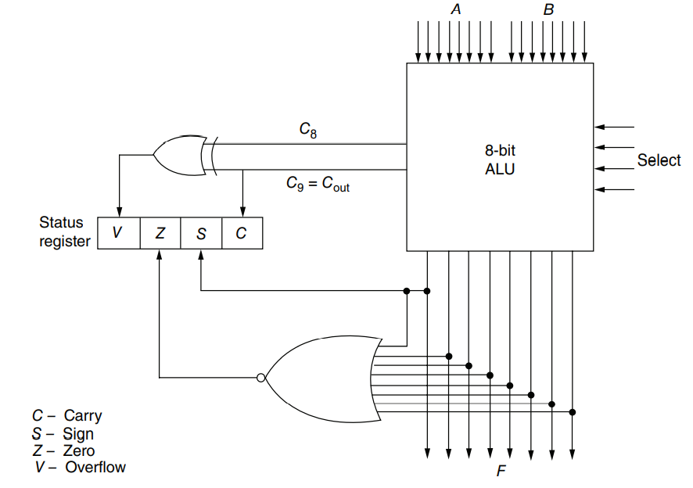
Status Register cont…

Slide 12
Functions of Status Register
Error Correction
Bit Checking
For example, let A = 101 x 1100, where x is the bit to be checked. The AND operation of A with B = 00010000 produces a result 000 x 0000. If x = 0, the Z status bit is set, but if x = 1, the Z bit is cleared since the result is not zero.
A = 101 1 1100
AND B = 000 1 0000
A = 101 0 1100
AND B = 000 1 0000
000 1 0000 (Z=0)
000 0 0000 (Z=1)
Comparison between two values
A > B
A< B
A = B

Slide 13
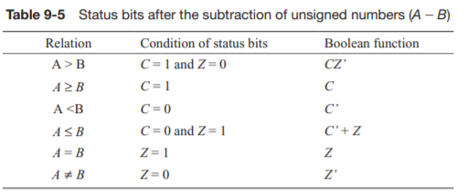
Status Register for comparison
A<B
While comparing 2 values A and B, we need to subtract B from A and check the condition table. A- B = A + (-B)
Unsigned Values
A = 1011 (11)
-B = 0011 (-13)
Unsigned Values
A = 1011 (11)
B = 1101 (13)
-B = 0011 (-13)
0 1110
S | O/V | C | Z
x
x
0
0

Slide 14
Status Register for comparison
A>B
While comparing 2 values A and B, we need to subtract B from A and check the condition table. A- B = A + (-B)
Unsigned Values
A = 1101 (13)
-B = 0101 (-11)
Unsigned Values
A = 1101 (13)
B = 1011 (11)
-B = 0101 (-11)
1 0010
S | O/V | C | Z
x
x
1
0

Slide 15
Status Register for comparison
A=B
While comparing 2 values A and B, we need to subtract B from A and check the condition table. A- B = A + (-B)
Unsigned Values
A = 1101 (13)
-B = 0011 (-13)
Unsigned Values
A = 1101 (13)
B = 1101 (13)
-B = 0011 (-13)
1 0000
S | O/V | C | Z
x
x
1
1

Slide 16
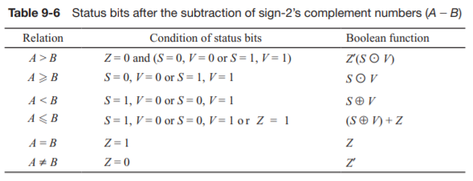
Status Register for comparison
A<B
Signed Values
A = 01011 (11)
-B = 10011 (-13)
Signed Values
A = 01011 (11)
B = 01101 (13)
-B = 10011 (-13)
0 11110
S | O/V | C | Z
1
0
0
0

Slide 17
Status Register for comparison
A>B
Signed Values
A = 01101 (13)
-B = 10101 (-11)
Signed Values
A = 01101 (13)
B = 01011 (11)
-B = 10101 (-11)
1 00010
S | O/V | C | Z
0
0
1
0

Slide 18
Multiplication –Example (unsigned)
1011
x 1101
1011
0000
1011
1011
10001111
Multiplicand (11 dec)
Multiplier (13 dec)
Partial products ( Note: if multiplier bit is 1 copy multiplicand (place value) otherwise zero )
Product (143 dec)
Note: need double length result

Slide 19
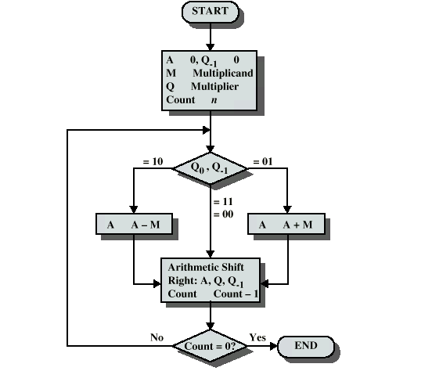
Booth’s Algorithm- Signed Multiplication

Slide 20
Execution of Example
7 x -3 = 0111 x 1101 (0011, 1100 +1 = 1101)
A | Q | Q₋₁ | M | n
0000 | 1101 | 0 | 0111 | 4
1001 | 1101 | 0 | 0111 | 4
1100 | 1110 | 1 | 0111 | 3
A= A - M
ASR (A, Q, Q₋₁)
0000
0111
1001 1101 0
1100 1110 1
1 1001

Slide 21
Execution of Example
7 x -3 = 0111 x 1101 (0011, 1100 +1 = 1101)
A | Q | Q₋₁ | M | n
0000 | 1101 | 0 | 0111 | 4
1001 | 1101 | 0 | 0111 | 4
1100 | 1110 | 1 | 0111 | 3
0011 | 1110 | 1 | 0111 | 3
0001 | 1111 | 0 | 0111 | 2
1010 | 1111 | 0 | 0111 | 2
1101 | 0111 | 1 | 0111 | 1
1110 | 1011 | 1 | 0111 | 0
A= A + M
A= A - M
1100
0111
0001
0111
1 0011
1 1010

Slide 22
Result
7 x -3 = 0111 x 1101 (0011, 1100 +1 = 1101) = - 21
A | Q | Q₋₁ | M | n | Description
0000 | 1101 | 0 | 0111 | 4 | Initialization
1001 | 1101 | 0 | 0111 | 4 | A=A-M
1100 | 1110 | 1 | 0111 | 3 | ASR(A, Q, Q₋₁) and n=n-1
0011 | 1110 | 1 | 0111 | 2 | A=A+M
0001 | 1111 | 0 | 0111 | 2 | ASR(A, Q, Q₋₁) and n=n-1
1010 | 1111 | 0 | 0111 | 2 | A=A-M
1101 | 0111 | 1 | 0111 | 1 | ASR(A, Q, Q₋₁) and n=n-1
1110 | 1011 | 1 | 0111 | 0 | ASR(A, Q, Q₋₁) and n=n-1
-128 | 64 | 32 | 16 | 8 | 4 | 2 | 1
1 | 1 | 1 | 0 | 1 | 0 | 1 | 1
11101011 = -21₍₁₀₎
-128+64+32+8+2+1= -21

