Slide 1
CSE 219: Digital Logic & Computer Design
Tamanna Haque Nipa
Assistant Professor
Dept. of CSE
Stamford University Bangladesh

Slide 2
Logic Circuit Design Process
Problem specification
Truth table derivation
Derivation of logical expression
Simplification of logical expression
Implementation

Slide 3



Deriving Logical Expressions
A
B
C
A | B | C | F
0 | 0 | 0 | 0
0 | 0 | 1 | 0
0 | 1 | 0 | 0
0 | 1 | 1 | 1
1 | 0 | 0 | 0
1 | 0 | 1 | 1
1 | 1 | 0 | 1
1 | 1 | 1 | 1
A⁰BC
F
AB⁰C
ABC⁰
ABC
F = A⁰BC + AB⁰C + ABC⁰ + ABC
(011 101 110 111)
F(a, b, c) = Σ (3, 5, 6, 7)
Sum-of-products (SOP) form

Slide 4
Deriving Logical Expressions (cont..)
Derivation of logical expressions from truth tables can be done by 2 ways
Sum-of-products (SOP) form
Write an AND term for each input combination that produces a 1 output
OR the AND terms to get the final expression
Product-of-sums (POS) form
Write an OR term for each input combination that produces a 0 output
AND the OR terms to get the final expression

Slide 5
Deriving Logical Expressions (cont..)
A
B
C
A | B | C | F
0 | 0 | 0 | 0
0 | 0 | 1 | 0
0 | 1 | 0 | 0
0 | 1 | 1 | 1
1 | 0 | 0 | 0
1 | 0 | 1 | 1
1 | 1 | 0 | 1
1 | 1 | 1 | 1
A+B+C
A+B+C⁰
A+B⁰+C
A⁰+B+C
F
F =(A+B+C)(A+B+C⁰)(A+B⁰+C)(A⁰+B+C)
F = Π (0, 1, 2, 4)
Product of sums (POS) form

Slide 6
SOP to POS Conversion
Convert the equation into POS equation.
F(A,B,C) = A⁰B⁰C + A⁰BC⁰ + AB⁰C⁰ + ABC⁰
0 0 1 0 1 0 1 0 0 1 1 0
F = Σ (1, 2, 4, 6)
F = Π (0, 3, 5, 7)
0 0 0 011 101 111
F =(A+B+C)(A+B⁰+C⁰)(A⁰+B+C⁰)(A⁰+B⁰+C⁰)
[Similarly you can convert POS function to SOP function.]

Slide 7




Laws of Boolean Algebra
Commutative Laws

Slide 8

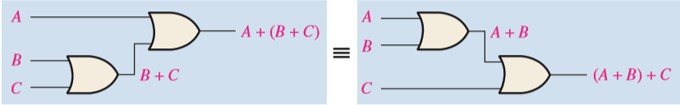

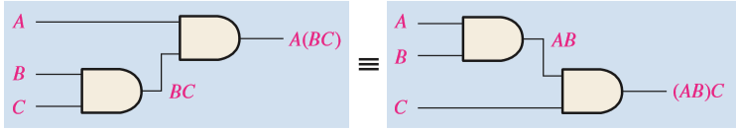
Laws of Boolean Algebra
Associative Laws : A+(B+C) = (A+B)+C = B+(A+C) = A+B+C

Slide 9

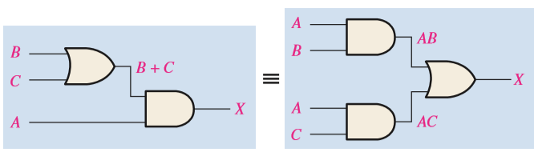
Laws of Boolean Algebra
Distributive Law

Slide 10
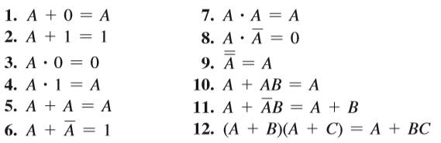
Rules of Boolean Algebra

Slide 11
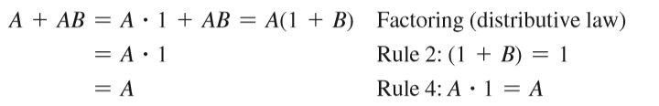
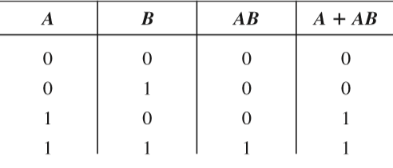
Rule 10: A + AB = A

Slide 12
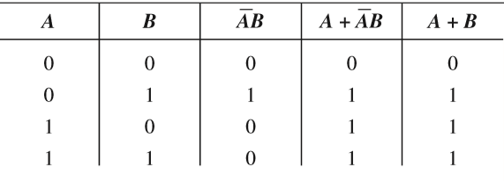
Rule 11: A +A⁰B = A + B

Slide 13
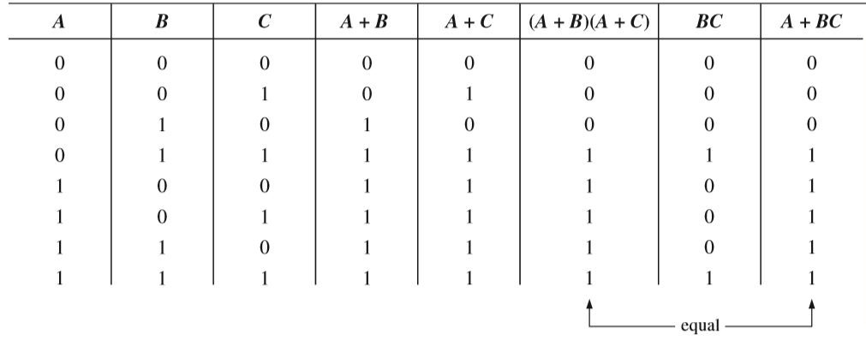
Rule 12: (A + B)(A + C) = A + BC

Slide 14




DeMorgan’s Theorems
The complement of two or more ANDed variables
The complement of two or more ORed variables

Slide 15





Applying DeMorgan’s Theorems

Slide 16





The Standard SOP Form

Slide 17

Converting a Sum Term to Standard POS

Slide 18

Logical Expression Simplification
F = A⁰BC + AB⁰C + ABC⁰ + ABC
= C(A⁰B + AB⁰) + AB(C⁰ + C)
A
B
C
= C(A ⊕ B) + AB
A
B
C
F

Slide 19
Logical Expression Simplification
Three basic methods
Algebraic manipulation 
Use Boolean laws to simplify the expression
Difficult to use 
Don’t know if you have the simplified form
Karnaughmap(K-map)method
Graphical method and easy to use for 3 and 4 variable
Can be used to simplify logical expressions with a few variables
Tabular Method(Quine-McCluskey)
Complex but can simplify when variable is more than 4 or 5
Can be used to simplify logical expressions with a few variables

Slide 20
Logic Simplification Using Boolean Algebra-EXAMPLE 4.9
AB + A(B + C) + B(B + C)
= AB + AB + AC + BB + BC
= AB + AB + AC + B + BC
= AB + AC + B(1 + C)
= AB + AC + B
= B(A+1) + AC
=B + AC
Simplify the Boolean expression: AB⁰ + A(B + C)⁰ + B(B + C)⁰

Slide 21
Logic Simplification Using Boolean Algebra-EXAMPLE 4.10
[AB⁰(C + BD) + A⁰B⁰]C
= [AB⁰C + AB⁰BD + A⁰B⁰]C
= [AB⁰C + A⁰B⁰]C … B⁰B = 0 and A.D.0 = 0
= AB⁰CC + A⁰B⁰C
= AB⁰C + A⁰B⁰C
= B⁰C(A + A⁰)
= B⁰C
Simplify the Boolean expression [AB(C + (BD)⁰) + (AB)⁰]CD

Slide 22
Logic Simplification Using Boolean Algebra-EXAMPLE 4.11
A⁰BC + AB⁰C⁰ + A⁰B⁰C⁰ + AB⁰C + ABC
=BC(A⁰ + A) + B⁰C⁰ (A+ A⁰) + AB⁰C
=BC + B⁰C⁰ + AB⁰C
=(B ⊙ C)+ AB⁰C
Simplify the Boolean expression: ABC⁰ + A⁰B⁰C + A⁰BC + A⁰B⁰C⁰

Slide 23
Logic Simplification Using Boolean Algebra-EXAMPLE 4.12
(AB + AC)⁰ + A⁰B⁰C
=(AB)⁰(AC)⁰ + A⁰B⁰C
=(A⁰ +B⁰)(A⁰+C⁰) + A⁰B⁰C
=A⁰A⁰ + A⁰ B⁰ + B⁰C⁰ + A⁰ C⁰ + A⁰B⁰C
=A⁰ + A⁰ B⁰ + B⁰C⁰ + A⁰ C⁰ + A⁰B⁰C
=A⁰ (1+ B⁰)+ B⁰C⁰ + A⁰ C⁰ + A⁰B⁰C
=A⁰+ B⁰C⁰ + A⁰ C⁰ + A⁰B⁰C
=A⁰(1+C⁰)+ B⁰C⁰ +A⁰B⁰C
=A⁰+ B⁰C⁰ +A⁰B⁰C
=A⁰(1 + B⁰C)+ B⁰C⁰
=A⁰+ B⁰C⁰
Simplify the Boolean expression: (AB)⁰ + (AC)⁰ + A⁰B⁰C⁰

Slide 24
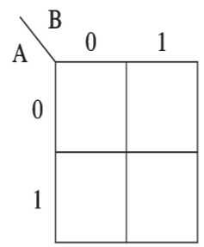
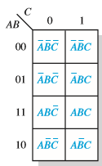
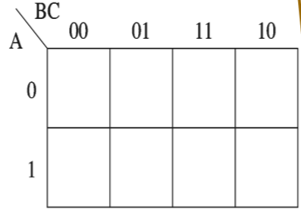
Karnaugh Map(K-Map) Method
2 variable
3 variable
A⁰B⁰
A⁰B
AB⁰
AB

Slide 25
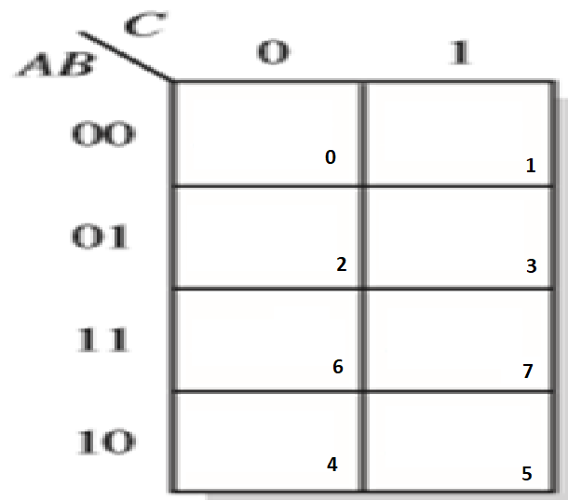
Karnaugh Map(K-Map) Method
3 variable

Slide 26
Example
F(A,B,C)=Σ(1,2,4,6) = A⁰B⁰C+A⁰BC⁰+AB⁰C⁰+ABC⁰
Grouping is done by 1, 2, 4, 8, 16…..
C⁰
C
A⁰B⁰
0
1
= BC⁰
+ AC⁰
+ A⁰B⁰C
A⁰B
1
0
AB
1
0
AB⁰
1
0

Slide 27
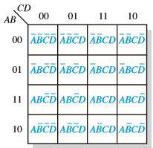
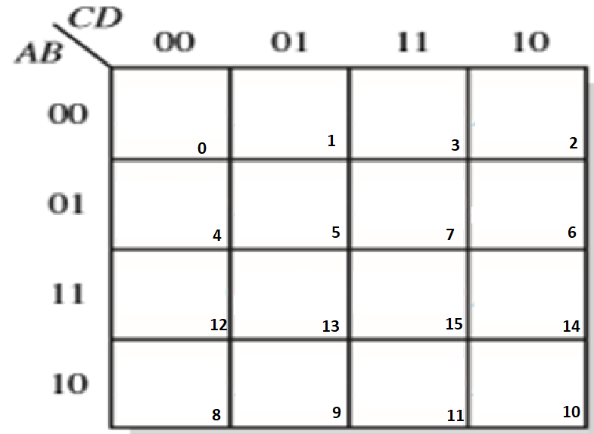
Karnaugh Map(K-Map) Method
4 variable

Slide 28
Example
F=Σ(0,1,4,5,7,9,11,13,14)
C⁰D⁰
C⁰D
CD
CD⁰
A⁰B⁰
1
1
0
0
=A⁰C⁰+C⁰D+A⁰BD+ABCD⁰+AB⁰D
A⁰B
1
1
1
0
AB
0
1
0
1
AB⁰
0
1
1
0

Slide 29
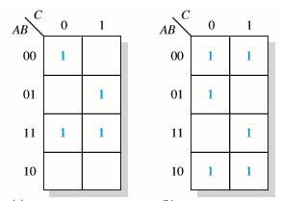
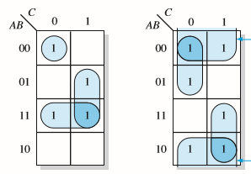
3 Variable Grouping

Slide 30
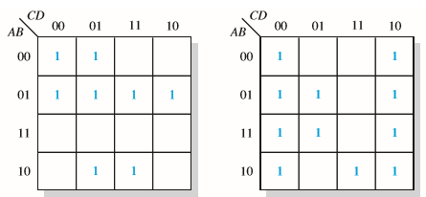
4 Variable Grouping

Slide 31
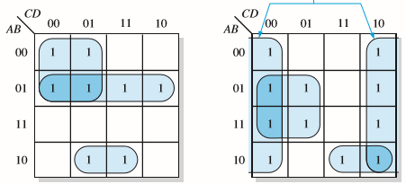
4 Variable Grouping

Slide 32
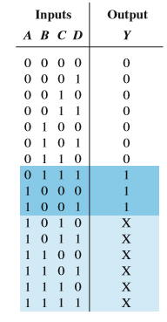
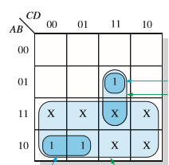
Don’t Care
F=Σ(7,8,9) don’t care(10-15)

Slide 33
Example
F(W,X,Y,Z)=Σ(1,3,4,5,9,11) DC(12,13,14,15)
Y⁰Z⁰
Y⁰Z
YZ
YZ⁰
W⁰X⁰
0
1
1
0
= XY⁰ + X⁰Z
W⁰X
1
1
0
0
WX
X
X
X
X
WX⁰
0
1
1
0

