Slide 1
CSE 219: Digital Logic & Computer Design
Tamanna Haque Nipa
Assistant Professor
Dept. of CSE
Stamford University Bangladesh

Slide 2
Combinational and Sequential Circuits
Types of Logic Circuits:
Combinational Circuits: A combinational circuit consists of logic gates whose outputs at any time are determined from only the present combination of inputs and they have no memory.
Sequential Circuits: A sequential circuit consists of logic gates whose outputs at any time are determined from both the present combination of inputs and previous output. That means sequential circuits use memory elements to store the value of previous output.

Slide 3
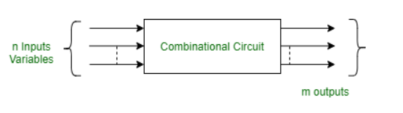
Combinational Circuits
A combinational circuit consists of input variables and output variables. Since these circuits are not dependent upon previous input to generate any output, so are combinational logic circuits. A combinational circuit can have an n number of inputs and m number of outputs.

Slide 4
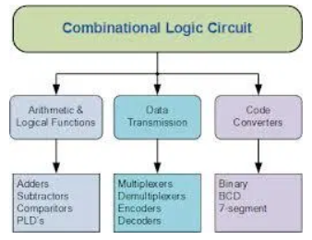
Type of Combinational Circuit

Slide 5
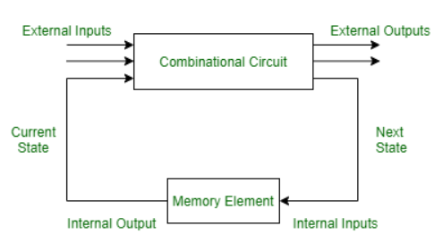
Sequential Circuits
A sequential circuit is specified by a time sequence of inputs, outputs, and internal states. The output of a sequential circuit depends not only the combination of present inputs but also on the previous outputs. Unlike combinational circuits, sequential circuits include memory elements with combinational circuits.

Slide 6
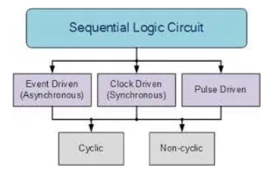
Types of Sequential Circuit

Slide 7
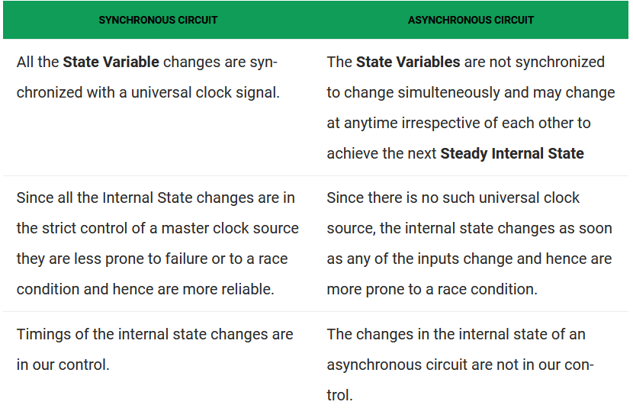
Synchronous and Asynchronous Circuit

Slide 8
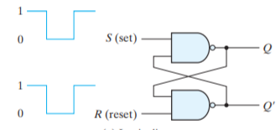
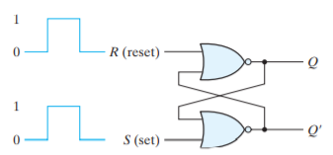
STORAGE ELEMENTS: Latches
SR Latch
NAND Latch
NOR Latch

Slide 9
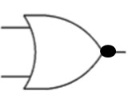
S-R Latch (NOR gate)
1
R
1
/0
A | B | F=(A+B)⁰
0 | 0 | 1
0 | 1 | 0
1 | 0 | 0
1 | 1 | 0
S | R
0 | 0
0 | 1
1 | 0
1 | 1
Q | Q⁰
0 | 1
Q
0
S
Q⁰
NOR Gate
0
/0
/1

Slide 10
S-R Latch (NOR gate)
1
R
0
/0
A | B | F=(A+B)⁰
0 | 0 | 1
0 | 1 | 0
1 | 0 | 0
1 | 1 | 0
S | R
0 | 0
0 | 1
1 | 0
1 | 1
Q | Q⁰
0 | 1
Q
0
S
Q⁰
NOR Gate
1
/1
/1

Slide 11
S-R Latch (NOR gate)
0
R
0
/1
A | B | F=(A+B)⁰
0 | 0 | 1
0 | 1 | 0
1 | 0 | 0
1 | 1 | 0
S | R
0 | 0
0 | 1
1 | 0
1 | 1
Q | Q⁰
0 | 1
1 | 0
Q
1
S
Q⁰
NOR Gate
1
/0
/0

Slide 12
S-R Latch (NOR gate)
0
R
0
/0
A | B | F=(A+B)⁰
0 | 0 | 1
0 | 1 | 0
1 | 0 | 0
1 | 1 | 0
S | R
0 | 0
0 | 1
1 | 0
1 | 1
Q | Q⁰
NC | NC
0 | 1
1 | 0
Q
0
S
Q⁰
NOR Gate
1
/1
/1

Slide 13
S-R Latch (NOR gate)
0
R
1
/1
A | B | F=(A+B)⁰
0 | 0 | 1
0 | 1 | 0
1 | 0 | 0
1 | 1 | 0
S | R
0 | 0
0 | 1
1 | 0
1 | 1
Q | Q⁰
NC | NC
0 | 1
1 | 0
Q
0
S
Q⁰
NOR Gate
0
/0
/0

Slide 14
S-R Latch (NOR gate)
1
R
0
/0
A | B | F=(A+B)⁰
0 | 0 | 1
0 | 1 | 0
1 | 0 | 0
1 | 1 | 0
S | R
0 | 0
0 | 1
1 | 0
1 | 1
Q | Q⁰
NC | NC
0 | 1
1 | 0
0 | 0
Q
1
S
Q⁰
NOR Gate
1
/0
/0

Slide 15
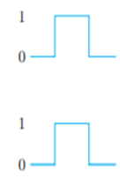
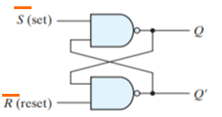
S-R Latch (NAND gate)
S | R | Q | Q⁰
0 | 0 | 1 | 1
0 | 1 | 1 | 0
1 | 0 | 0 | 1
1 | 1 | NC | NC
S | R | Q | Q⁰
0 | 0 | NC | NC
0 | 1 | 0 | 1
1 | 0 | 1 | 0
1 | 1 | 0 | 0

Slide 16
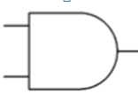
S-R Flip Flop (NOR gate)
R
0
0
1
S | R | Q | Q⁰
0 | 0 | NC | NC
0 | 1 | 0 | 1
1 | 0 | 1 | 0
1 | 1 | I* | I*
Q
1
CLK /EN
1
I* =Indeterminate
Q⁰
1
S
1

Slide 17
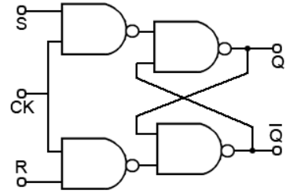
S-R Flip Flop (NAND gate)
S | R | Q | Q⁰
0 | 0 | NC | NC
0 | 1 | 0 | 1
1 | 0 | 1 | 0
1 | 1 | I* | I*
I* =Indeterminate

Slide 18
J-K Flip Flop
1
1
J | K | Q | Q⁰
0 | 0 | NC | NC
0 | 1 | 0 | 1
1 | 0 | 1 | 0
1 | 1 | T* | T*
K
1
/0
1
Q
1
CLK /EN
Q⁰
1
0
J
/0
/1
I* =Toggle
0
0
A | B | F=(A+B)⁰
0 | 0 | 1
0 | 1 | 0
1 | 0 | 0
1 | 1 | 0
NOR Gate

Slide 19
J-K Flip Flop(cont…)
0
1
J | K | Q | Q⁰
0 | 0 | NC | NC
0 | 1 | 0 | 1
1 | 0 | 1 | 0
1 | 1 | T* | T*
K
0
/0
1
Q
1
CLK /EN
Q⁰
1
1
J
/1
/1
I* =Toggle
0
0
A | B | F=(A+B)⁰
0 | 0 | 1
0 | 1 | 0
1 | 0 | 0
1 | 1 | 0
NOR Gate

Slide 20
J-K Flip Flop(cont…)
0
1
J | K | Q | Q⁰
0 | 0 | NC | NC
0 | 1 | 0 | 1
1 | 0 | 1 | 0
1 | 1 | T* | T*
K
0
/1
1
Q
1
CLK /EN
Q⁰
1
1
J
/0
/0
I* =Toggle
1
1
A | B | F=(A+B)⁰
0 | 0 | 1
0 | 1 | 0
1 | 0 | 0
1 | 1 | 0
Toggle Condition
NOR Gate

Slide 21
J-K Flip Flop(cont…)
1
1
J | K | Q | Q⁰
0 | 0 | NC | NC
0 | 1 | 0 | 1
1 | 0 | 1 | 0
1 | 1 | T* | T*
K
1
/0
1
Q
1
CLK /EN
Q⁰
1
0
J
/0
/1
I* =Toggle
1
0
A | B | F=(A+B)⁰
0 | 0 | 1
0 | 1 | 0
1 | 0 | 0
1 | 1 | 0
Toggle Condition
NOR Gate

Slide 22
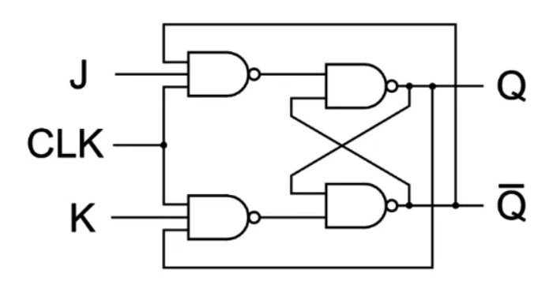
J-K flip Flop (NAND)
J | K | Q | Q⁰
0 | 0 | NC | NC
0 | 1 | 0 | 1
1 | 0 | 1 | 0
1 | 1 | T* | T*

Slide 23
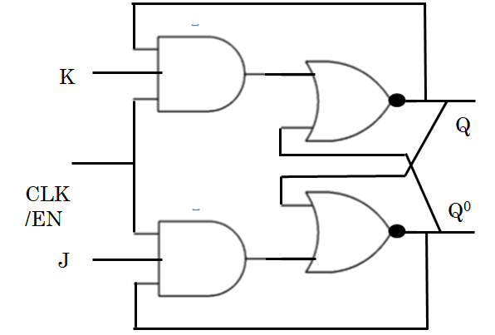
J-K Flip Flop
J
Q
J-K Flip Flop
CLK
Q⁰
K

Slide 24
T Flip Flop (Toggle)
J | K | Q | Q⁰
0 | 0 | NC | NC
0 | 1 | 0 | 1
1 | 0 | 1 | 0
1 | 1 | T* | T*
J
T
Q
J-K Flip Flop
CLK
Q⁰
K
T
0
1
Q | Q⁰
NC | NC
Toggle | Toggle
Applications:
Registers
Counters
Event Detectors
Data Synchronizers
Frequency Divider

Slide 25

D Flip Flop (Data)
J | K | Q | Q⁰
0 | 0 | NC | NC
0 | 1 | 0 | 1
1 | 0 | 1 | 0
1 | 1 | T* | T*
J
D
Q
J-K Flip Flop
CLK
Q⁰
K
D
0
1
Q | Q⁰
0 | 1
1 | 0
Applications:
Data storage registers.
Data transferring as shift registers.
Frequency division circuits.

Slide 26
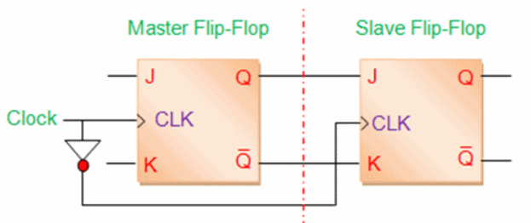
Master-Slave J-K Flip Flop
The Master-Slave Flip-Flop is basically two gated SR flip-flops connected together in a series configuration with the slave having an inverted clock pulse.
The outputs from “Slave” flip-flop are fed back to the inputs of the “Master” with the outputs of the “Master” flip flop being connected to the two inputs of the “Slave” flip flop.
The master-slave flip-flop eliminates all the timing problems
J | K | Q | Q⁰
0 | 0 | NC | NC
0 | 1 | 0 | 1
1 | 0 | 1 | 0
1 | 1 | T* | T*

Slide 27
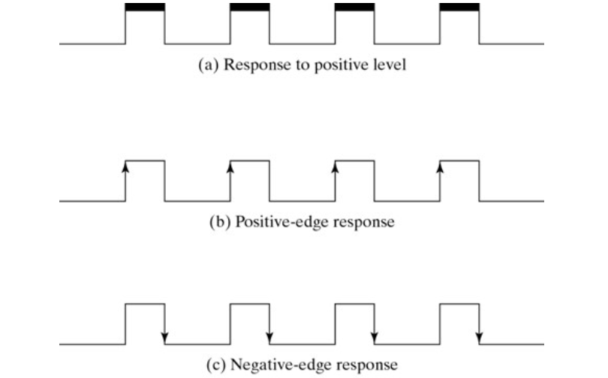
Edge Triggered & Level Triggered

Slide 28
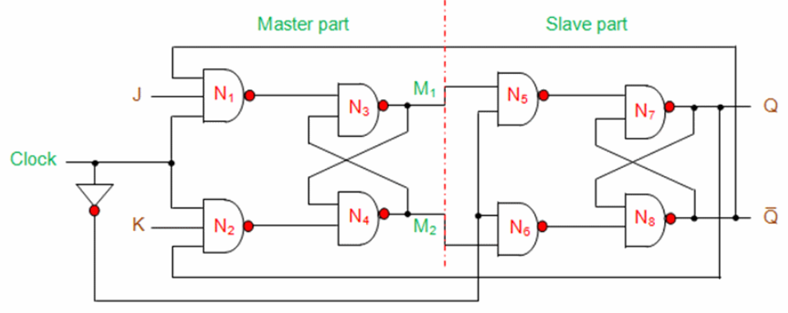
Master-Slave J-K Flip Flop(NAND)

Slide 29
Master-Slave J-K Flip Flop (NOR)
1
K
Q
Q⁰
1
J

Slide 30
CSE 219: Digital Logic & Computer Design
Tamanna Haque Nipa
Assistant Professor
Dept. of CSE
Stamford University Bangladesh

Slide 31
Counter
Types
Asynchronous Counter
Synchronous Counter
Applications of Counter
Frequency counters
Digital clocks
Analog to digital convertors.
Frequency divider circuits. (The frequency divider circuit is that which divides the input frequency exactly by ‘2’.)
For calculating time or timers

Slide 32
Asynchronous Counter (ripple counter)
An asynchronous counter is one in which the flip-flops (FF) within the counter do not change states at exactly the same time because they do not have a common clock pulse.
Propagation delay is higher than that of synchronous counters. [Propagation delay is the length of time taken for a signal to reach its destination. ]
These are slow in operation.
Less number of logic gates required.
Low cost
Complex to design
Standard logic packages are not available

Slide 33
3 bit Asynchronous Up Counter
Q₀
Q₁
Q₂
Q2 | Q1 | Q0
0 | 0 | 0
0 | 0 | 1
0 | 1 | 0
0 | 1 | 1
1 | 0 | 0
1 | 0 | 1
1 | 1 | 0
1 | 1 | 1
Start and repeat
VCC
Q
Q
Q
J₀
J₁
J₂
T Flip Flop
T Flip Flop
T Flip Flop
Q⁰
Q⁰
Q⁰
K₀
K₁
K₂
CLK

Slide 34
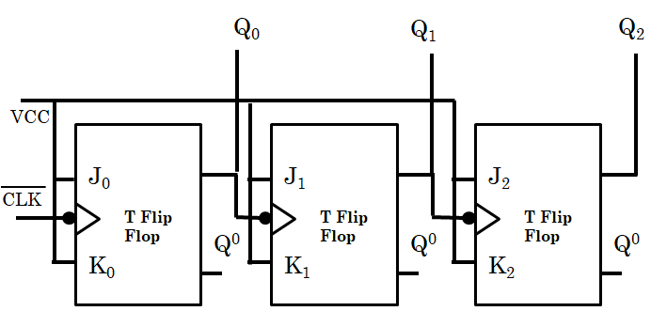
3 bit Asynchronous Up Counter
0
/1
/0
/1
/0
/1
/0
/1
0
/1
/0
/1
0
/1
1
1
0
1
0
Q2 | Q1 | Q0
0 | 0 | 0
Q2 | Q1 | Q0
1 | 0 | 0
0 | 0 | 1
1 | 0 | 1
0 | 1 | 0
1 | 1 | 0
0 | 1 | 1
1 | 1 | 1

Slide 35
3 bit Asynchronous Down Counter
Q
Q
Q
J₀
J₁
J₂
T Flip Flop
T Flip Flop
T Flip Flop
Q⁰
Q⁰
Q⁰
K₀
K₁
K₂
1
Q0⁰
Q1⁰
Q2⁰
0
Q2 | Q1 | Q0
0 | 0 | 0
Q2⁰ | Q1⁰ | Q0⁰
1 | 1 | 1
Q2 | Q1 | Q0
Q2⁰ | Q1⁰ | Q0⁰
1 | 0 | 0
0 | 1 | 1
0 | 0 | 1
1 | 1 | 0
1 | 0 | 1
0 | 1 | 0
0 | 1 | 0
1 | 0 | 1
1 | 1 | 0
0 | 0 | 1
0 | 1 | 1
1 | 0 | 0
1 | 1 | 1
0 | 0 | 0

Slide 36
4 bit Asynchronous Up Counter
Q₃
1
J₃
T Flip Flop
1
Q⁰
K₃
0
1
0
It counts 0000 to 1111.

Slide 37
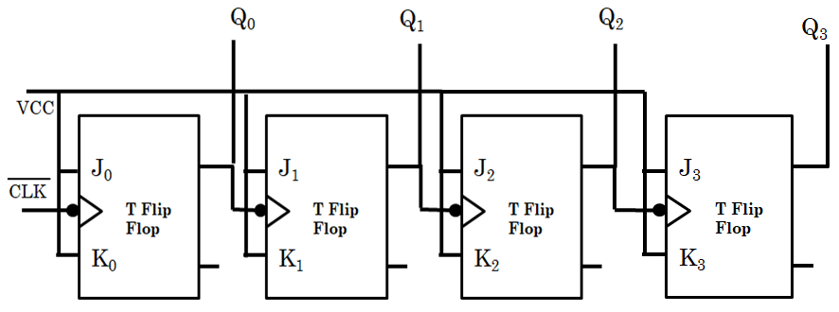

Asynchronous MOD 13 Counter
MOD 13 mean it will count 0000 to 1100 (0 to 12)
13 = (1101)₂
Q3 | Q2 | Q1 | Q0
1 | 1 | 0 | 1
CLR

Slide 38
Asynchronous MOD 10 Counter
MOD 10 mean it will count 0000 to 1001 (0 to 9)
10 = (1010)₂
Q3 | Q2 | Q1 | Q0
1 | 0 | 1 | 0
Asynchronous Decade Counter
CLR

Slide 39
Synchronous Counter
A synchronous counter is one in which all the flip-flops in the counter are clocked at the same time by a common clock pulse
The propagation delay is very low
These are faster than that of ripple counters.
Large number of logic gates are required to design
High cost
Synchronous circuits are easy to design.
Standard logic packages available for synchronous.

Slide 40
3 bit Synchronous Up Counter
Q₀
Q₁
Q₂
Q2 | Q1 | Q0
0 | 0 | 0
0 | 0 | 1
0 | 1 | 0
0 | 1 | 1
1 | 0 | 0
1 | 0 | 1
1 | 1 | 0
1 | 1 | 1
VCC
J₀
J₁
J₂
CLK
T Flip Flop
T Flip Flop
T Flip Flop
K₀
K₁
K₂

Slide 41
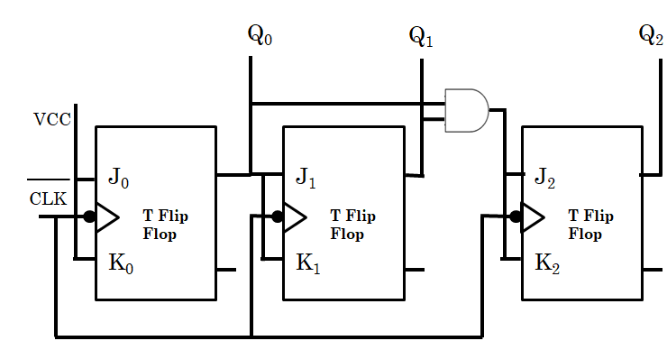
3 bit Synchronous Up Counter
0
/1
/0
/1
/0
/1
/0
/1
0
/0
/1
/0
/0
/1
/1
/0
/0
/1
0
/0
/1
/1
/1
/1
Q2 | Q1 | Q0
0 | 0 | 0
Q2 | Q1 | Q0
1 | 0 | 0
0 | 0 | 1
1 | 0 | 1
0 | 1 | 0
1 | 1 | 0
0 | 1 | 1
1 | 1 | 1

Slide 42
4 bit Synchronous Up Counter
Q₃
J₃
T Flip Flop
K₃

Slide 43
Johnson Counter– 3 bit
Q₀
Q₁
Q₂
/1
/1
/1
0
/0
/0
/0
/1
/1
/1
/0
0
/0
/1
0
/0
/1
/1
Q2 | Q1 | Q0
0 | 0 | 0
D₀
D₁
D₂
CLK
0 | 0 | 1
D Flip Flop
D Flip Flop
D Flip Flop
0 | 1 | 1
1
/0
1 | 1 | 1
1 | 1 | 0
1 | 0 | 0
0 | 0 | 0
Input n bit so output 2n bit.
(3 bit input so it can count 2x3=6 values)
Applications(read yourself)

Slide 44
Ring Counter– 3 bit
Q₀
Q₁
Q₂
/1
/0
/0
0
/1
/0
/1
/0
/0
0
/0
/1
0
/0
/0
Q2 | Q1 | Q0
0 | 0 | 0
1
/0
D₀
D₁
D₂
CLK
0 | 0 | 1
D Flip Flop
D Flip Flop
D Flip Flop
0 | 1 | 0
1 | 0 | 0
0 | 0 | 1
Input n bit so output n bit.
(3 bit input so it can count 3 values)
Applications(read yourself)

Slide 45
Exercise
Synchronous Down Counter
Synchronous MOD Counter

Slide 46
CSE 219: Digital Logic & Computer Design
Tamanna Haque Nipa
Assistant Professor
Dept. of CSE
Stamford University Bangladesh

Slide 47
Floating Point Number Representation
What is floating point?
0.00005
0.0125
- 0.0023
69.00
= 0.5 x 10⁻⁴
= 0.125 x 10⁻¹
= - 0.23 x 10⁻²
= 0.69 x 10²
Basic Format:
$$±Value=±Mantissa×{Base}^{±Exponent}$$
Base will 2 or 10 depending on number system.

Slide 48
Basic Format
$$±Value=±Mantissa×{Base}^{±Exponent}$$
As we need to represent a float value using 0 / 1, so the base must be 2 (fixed).
So we need to store only
M (Mantissa) and
E (Exponent)

Slide 49
Example
Let we are representing a 3 bit float value. That means M and E both are 3 bits.
(---, ---)
(M , E)
Here, M and E both are represented using Sign Magnitude format (integer representation)
We need to find 4 values
Highest +ve value
Highest –ve value
Lowest +ve value and
Lowest –ve value

Slide 50
Example cont… [M and E both are 3 bits (M, E) ]
Highest +ve value (+M, +E)
( 011, 011) = 3 x 2³ = 3 x 8 = 24
Lowest +ve value (+M, -E)
( 001, 111) = 1 x 2⁻³ = 1 x 1/8 = 0.125
Lowest -ve value (-M, +E)
( 111, 011) = -3 x 2³ = -3 x 8 = -24
Highest –ve value (-M, -E)
( 101, 111) = -1 x 2⁻³ = -1 x 1/8 = -0.125

Slide 51
Range – 3 bit FP
xxx
… -24
-0.125
0
0.125
16
24…
So range is
-24 to +24
All values cant be represented
The previous value of +24 is
(010, 011) = +2 x 2³
=2 x 8
= 16

Slide 52
Problems
All values cant be represented (So arithmetic operation is not possible)
0.125 to 0 there are many values
0 to -0.125 there are many values
Underflow
+25 to +∞
-25 to -∞
Overflow
$$ex.\sqrt{−2}$$
Not a Number (NaN)
→ Not defined
Zero representation
→ too many ways

Slide 53
Zero Representation
M must be Zero and E can be anything, 0 x 2E
If M=0, then M can be written as 2 ways
+ve zero , M= 000 and -ve zero, M = 100
As E can be anything, so using 3 bit for E, we will get 8 possible combinations. That means-
M = 000, E = 000
001
010
.
.
111
M = 100, E = 000
001
010
.
.
111
and
2 x 8 = 16 formats
If M and E are 4 bits then 2 x 16 =32 ways we can represent zero
→ Not Possible

Slide 54
Normalization and Biasing
0.000005
0.0005 x 10⁻²
0.5 x 10⁻⁵
5.0 x 10⁻⁶
→ Must be represented in 1 way
√
For binary representation, before point will be 0 and after point the first value must be 1.
0.1bbbbb x 2E [Here, b can be 0 or 1]

Slide 55
IEEE 754 Standard
Types
1) Single Precision (float) → 32 bit
$$value={\left(−1\right)}^{S}×1.M×2^{E−127},0<E<255$$
S=1
E=8 bit
M=23 bit
2) Double Precision (double) → 64 bit
$$value={\left(−1\right)}^{S}×1.M×2^{E−1023},0<E<2047$$
S=1
E=11 bit
M=52 bit

Slide 56
Example (32 bit)
Represent 78.325
$$value={\left(−1\right)}^{S}×1.M×2^{E−127},0<E<255$$
If the value is +ve then S=0 otherwise S=1
To get1.M, the given value must be divided by immediate smaller power of 2.
2 4 8 16 32 64 128 256 512 …..
78.325

Slide 57
Example (32 bit)cont…
$$value={\left(−1\right)}^{S}×1.M×2^{E−127},0<E<255$$
64
2⁶
2^{E-127=6}
Here, E-127=6
» E = 6+127
» E = 133
Excess 127
(Biasing Exponent)

Slide 58
Example (32 bit)cont…
$$value={\left(−1\right)}^{S}×1.M×2^{E−127},0<E<255$$
E = 133 →
1
0
0
0
0
1
0
1
+128 64 32 16 8 4 2 1
133-128=5
5-4=1
We got,
10000101
M=23 bit
0
We have 1.M = 1 is in equation. So it not required to store. We need to covert M into binary value.

Slide 59
Example (32 bit)cont…
$$value={\left(−1\right)}^{S}×1.M×2^{E−127},0<E<255$$
M =
00111…
(we will calculate 5/6 bit positions)
Multiply | Result | Integer Part
0.223828 x 2 | 0.447656 | 0
0.447656 x 2 | 0.895312 | 0
0.895312 x 2 | 1.790624 | 1
0.790624 x 2 | 1.581248 | 1
0.581248 x 2 | 1.162496 | 1
… | … | ….
upto 23 bits

Slide 60
Example (32 bit)cont…
$$value={\left(−1\right)}^{S}×1.M×2^{E−127},0<E<255$$
We got, 78.325 =
0
10000101
00111….
Represent -78.325
1
10000101
00111….

Slide 61
Set Interpretations (32 bit)
If E = 255 and M≠0 then NaN
If E = 255 and M= 0 then ±∞ (overflow)
If E = 0 and M= 0 then zero (0)
If 0<E < 255 and M≠0 then
$$value={\left(−1\right)}^{S}×1.M×2^{E−127},0<E<255$$
If E = 0 and M≠0 then
$$value={\left(−1\right)}^{S}×0.M×2^{E−126}$$
(Underflow)

Slide 62
Exercise
Represent -1.5
Solve Yourself.
Thank You.

Slide 63
CSE 219: Digital Logic & Computer Design
Tamanna Haque Nipa
Assistant Professor
Dept. of CSE
Stamford University Bangladesh

Slide 64
Shift Register
The Shift Register is another type of sequential logic circuit that can be used for the storage or the transfer of binary data.
Applications:
Used for temporary data storage.
Used for data transfer and data manipulation.
Used to produce time delay to digital circuits(SISO, PIPO)
The serial-in parallel-out shift register is used to convert serial data into parallel data
A Parallel in Serial out shift register us used to convert parallel data to serial data.

Slide 65
Types of Shift Register
Basically Shift Register are 4 types
Parallel in Parallel out
Parallel in Serial out
Serial in Serial out
Serial in Parallel out
There are another 2 types of Shift Register
Bidirectional Shift Register
Universal Shift Register
There are 2 types of Shift Register Counter
Johnson Counter
Ring Counter

Slide 66
Parallel in Parallel out(PIPO) – 4 bit
Q₀
Q₁
Q₂
Q₃
D₀
D₁
D₂
D₃
CLK
D Flip Flop
D Flip Flop
D Flip Flop
D Flip Flop
1
1
0
1
1
1
0
1
CLK
1
1
0
1

Slide 67
Serial in Parallel out(SIPO) – 4 bit
Q₀
Q₁
Q₂
Q₃
D₀
D₁
D₂
D₃
CLK
D Flip Flop
D Flip Flop
D Flip Flop
D Flip Flop
CLK

Slide 68
Serial in Parallel out(SIPO) – 4 bit
1
1
0
1
1
0
1
1
CLK
CLK
1st Clock Pulse
2nd Clock Pulse
0
1
1
1
1
0
1
1
3rd Clock Pulse
4th Clock Pulse
Q₀
Q₁
Q₂
Q₃
Q₃
Q₂
Q₁
Q₀
Left Shift

Slide 69
SIPO(Right Shift) – 4 bit
Q₀
Q₁
Q₂
Q₃
D₀
D₁
D₂
D₃
CLK
D Flip Flop
D Flip Flop
D Flip Flop
D Flip Flop
Q₃
Q₂
Q₁
Q₀
Q₃
Q₂
Q₁
Q₀
Left Shift
Right Shift

Slide 70
Serial in Serial out(SISO) – 4 bit
Q₀
Q₁
Q₂
Q₃
VCC
D₀
D₁
D₂
D₃
CLK
D Flip Flop
D Flip Flop
D Flip Flop
D Flip Flop
CLK

Slide 71
Johnson Counter– 3 bit
Q₀
Q₁
Q₂
/1
/1
/1
0
/0
/0
/0
/1
/1
/1
/0
0
/0
/1
0
/0
/1
/1
Q2 | Q1 | Q0
0 | 0 | 0
D₀
D₁
D₂
CLK
0 | 0 | 1
D Flip Flop
D Flip Flop
D Flip Flop
0 | 1 | 1
1
/0
1 | 1 | 1
1 | 1 | 0
1 | 0 | 0
0 | 0 | 0
Input n bit so output 2n bit.
(3 bit input so it can count 2x3=6 values)
Applications(read yourself)

Slide 72
Ring Counter– 3 bit
Q₀
Q₁
Q₂
/1
/0
/0
0
/1
/0
/1
/0
/0
0
/0
/1
0
/0
/0
Q2 | Q1 | Q0
0 | 0 | 0
1
/0
D₀
D₁
D₂
CLK
0 | 0 | 1
D Flip Flop
D Flip Flop
D Flip Flop
0 | 1 | 0
1 | 0 | 0
0 | 0 | 1
Input n bit so output n bit.
(3 bit input so it can count 3 values)
Applications(read yourself)

Slide 73

Parallel in Serial out(PISO) – 3 bit
D₀
D₁
D₂
Shift/Load
L
S
L
S
L
Q₂
D₀
D₁
D₂
CLK
D Flip Flop
D Flip Flop
D Flip Flop
S/L

Slide 74
CSE 219: Digital Logic & Computer Design
Tamanna Haque Nipa
Assistant Professor
Dept. of CSE
Stamford University Bangladesh

Slide 75
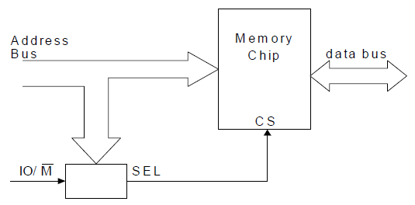
Memory Address Decoding
Address decoding refers to the way a computer system decodes the addresses on the address bus to select memory locations in one or more memory or peripheral devices.

Slide 76
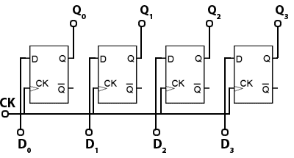
PIPO – 4 bit
IN/OUT
CLK

Slide 77
Address Decoder (4 x 8)
0
8 bit
A₁
2 x 4 line decoder
1
A₀
2
3

Slide 78
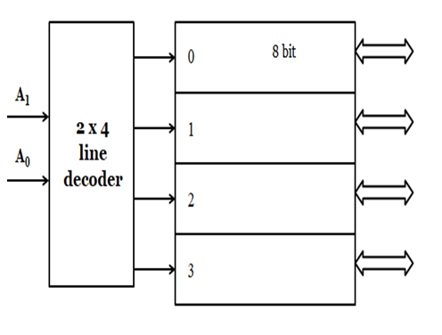
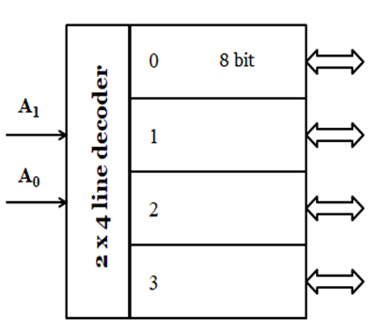
Address Decoder (4 x 8)

Slide 79
Address Decoder (4 x 8)
A₁
4 x 8 RAM / ROM
A₀

Slide 80
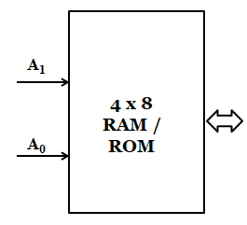
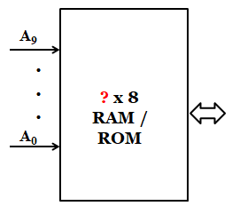
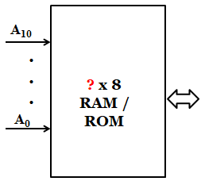
Address Decoder
Address A1 and A0 (2 bit) then addressable memory 2²= 4
Address A0 to A9 (10 bit) then addressable memory 2¹⁰ = 1024 (1 K)
Address A0 to A10 (11 bit) then addressable memory 2¹¹ = 2048 (2 K)

Slide 81
A19
A18
A17
A16
0
E1 0V +5V
RD
ROM
8kX8
3 to 8 decoder
O6
110
CS
A15
A12
A14
O3
A13
A0
RD WR
CS
RAM
1kX8
A9
Address of ROM:
A0
1st Address:
A₁₉ A₁₈ A₁₇ A₁₆ A₁₅ A₁₄ A₁₃ A₁₂ A₁₁ A₁₀ A₉ A₈ A₇ A₆ A₅ A₄ A₃ A₂ A₁ A₀
DC000
1 1 0 1
1 1 0
0 0 0 0 0 0 0 0 0 0 0 0 0
Last Address:
A₁₉ A₁₈ A₁₇ A₁₆ A₁₅ A₁₄ A₁₃ A₁₂ A₁₁ A₁₀ A₉ A₈ A₇ A₆ A₅ A₄ A₃ A₂ A₁ A₀
1 1 0 1 1 1 0 1 1 1 1 1 1 1 1 1 1 1 1 1
DDFFF

Slide 82
A19
A18
A17
A16
0
E1 0V +5V
RD
ROM
8kX8
3 to 8 decoder
O6
CS
A15
A12
A14
011
O3
A13
A0
RD WR
CS
RAM
1kX8
A9
Address of RAM:
A0
1st Address: D6000
A₁₉ A₁₈ A₁₇ A₁₆ A₁₅ A₁₄ A₁₃ A₁₂ A₁₁ A₁₀ A₉ A₈ A₇ A₆ A₅ A₄ A₃ A₂ A₁ A₀
1 1 0 1 0 1 1 0 0 0 0 0 0 0 0 0 0 0 0 0
Last Address: D63FF
A₁₉ A₁₈ A₁₇ A₁₆ A₁₅ A₁₄ A₁₃ A₁₂ A₁₁ A₁₀ A₉ A₈ A₇ A₆ A₅ A₄ A₃ A₂ A₁ A₀
1 1 0 1 0 1 1 0 0 0 1 1 1 1 1 1 1 1 1 1

Slide 83
Memory Allocation
Memory allocation is a process by which computer programs are assigned memory or space.
Types
Non-Preemptive
First Fit
Best Fit
Worst Fit
Preemptive
First In First Out (FIFO)
Least Recently Used(LRU)
Optimal(OPT)

Slide 84
Non-Preemptive-Example
There are 5 process P1 to P5. P1, P2 and P3 has been already allocated and P4 and P5 need to allocated following the 3 algorithms. Find which one is best?
0
Process | Size (kb) | Address
P1 | 150 | 0
P2 | 400 | 300
P3 | 100 | 900
P4 | 150
P5 | 200
P1 = 150 kb
149
FS1 = 150 kb
300
P2 = 400 kb
700
FS2 = 200 kb
900
P3 = 100 kb
1000
1024
FS3 = 24 kb

Slide 85
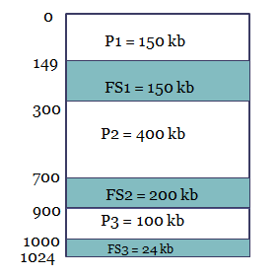
First Fit-Example
Need to fit P4=150 kb and P5= 200kb
0
P1 = 150 kb
149
Choose the first adjustable option
P4= 150 kb
300
P2 = 400 kb
700
P5 = 200 kb
900
P3 = 100 kb
1000
1024
Select FS1(150 kb) / FS2(200kb) / FS3(24kb) for P4= 150kb???
It will select FS1 then P5 will adjust with FS2

Slide 86
First Fit-Example
Need to fit P4=150 kb and P5= 200kb
0
0
P1 = 150 kb
P1 = 150 kb
149
149
Choose the first adjustable option
FS1 = 200 kb
P4= 150 kb
300
300
P2 = 400 kb
P2 = 400 kb
700
700
FS2 = 150 kb
900
900
P3 = 100 kb
P3 = 100 kb
1000
1000
1024
FS3 = 24 kb
1024
Select FS1(150 kb) / FS2(200kb) / FS3(24kb) for P4= 150kb???
It will select FS1 then P5 will adjust with FS2

Slide 87
Best Fit-Example
Need to fit P4=150 kb and P5= 200kb
0
P1 = 150 kb
149
Choose the best adjustable option
P4= 150 kb
300
P2 = 400 kb
700
P5 = 200 kb
900
P3 = 100 kb
1000
1024
Select FS1(150 kb) / FS2(200kb) / FS3(24kb) for P4= 150kb???
It will select FS1 then P5 will adjust with FS2

Slide 88
Best Fit-Example
Need to fit P4=150 kb and P5= 200kb
0
0
P1 = 150 kb
P1 = 150 kb
149
149
P5= 200 kb
Choose the best adjustable option
FS1 = 200 kb
300
300
P2 = 400 kb
P2 = 400 kb
700
700
FS2 = 150 kb
P4=150 kb
900
900
P3 = 100 kb
P3 = 100 kb
1000
1000
1024
FS3 = 24 kb
1024
Select FS1(150 kb) / FS2(200kb) / FS3(24kb) for P4= 150kb???
It will select FS2 for P4 and then P5 will adjust with FS2

Slide 89
Worst Fit-Example
Need to fit P4=150 kb and P5= 200kb
0
P1 = 150 kb
149
Choose the highest free space adjustable option
300
P2 = 400 kb
700
P4 = 150 kb
900
P3 = 100 kb
1000
1024
Select FS1(150 kb) / FS2(200kb) / FS3(24kb) for P4= 150kb???
P4 will select FS2 then P5 need to wait.

Slide 90
Preemptive Allocation-Example
Consider the following page address traces generated by CPU with 3 available frames. Find out the action generated for FIFO, LRU and OPT replacement policies. Which algorithm is best?
1, 3, 1, 4, 7, 4, 5, 3, 2, 1, 2, 1, 3, 4, 6, 7

Slide 91
FIFO
→ hit =5
1 3 1 4 7 4 5 3
*
*
1
1
1
1
7
7
7
7
3
3
3
3
3
5
5
4
4
4
4
3
2 1 2 1 3 4 6 7
*
*
*
2
2
2
2
2
2
6
6
5
1
1
1
1
1
1
7
3
3
3
3
3
4
4
4

Slide 92
LRU
→ hit =5
1 3 1 4 7 4 5 3
*
*
1
1
1
1
1
1
5
5
3
3
3
7
7
7
3
4
4
4
4
4
2 1 2 1 3 4 6 7
*
*
*
3
3
3
3
3
3
3
7
5
1
1
1
1
1
6
6
2
2
2
2
2
4
4
4

Slide 93
OPT
→ hit =6
1 3 1 4 7 4 5 3
*
*
*
1
1
1
1
7
7
5
5
3
3
3
3
3
3
3
4
4
4
4
4
2 1 2 1 3 4 6 7
*
*
*
2
2
2
2
2
4
6
7
3
3
3
3
3
3
3
3
4
1
1
1
1
1
1
1

