Slide 1
Analog Transmission of Digital Data:
1
ASK, FSK, PSK, QAM
Required reading: Garcia 3.7
CSE 3213, Fall 2010
Instructor: N. Vlajic

Slide 2
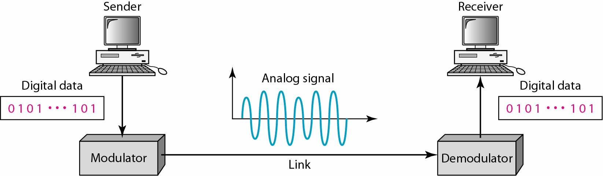
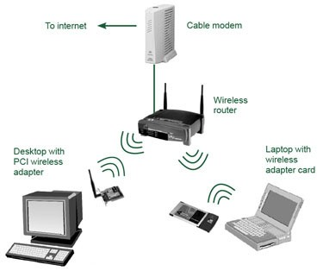
Why Do We Need Digital-to-Analog Conversion?!
2
The medium/channel is band pass, and/or
Multiple users need to share the medium.

Slide 3
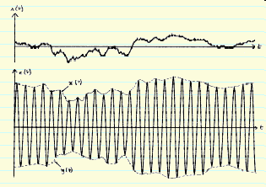
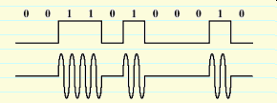
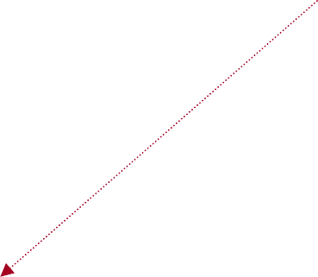
Modulation of Digital Data
3
Modulation – process of converting digital data or a low-pass analog to band-pass (higher-frequency) analog signal
Digital-to-analog modulation.
Analog-to-analog modulation.
Carrier Signal – aka carrier freq. or modulated signal - high freq. signal that acts as a basis for the information signal
information signal is called modulating signal
bandpass channel
freq

Slide 4
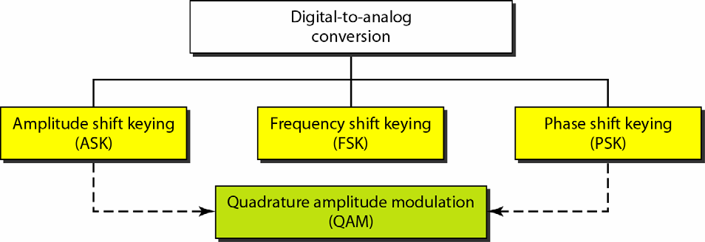
Modulation of Digital Data (cont.)
4
Digital-to-Analog – process of changing one of the characteristic
Modulation
of an analog signal (typically a sinewave) based on the information in a digital signal
sinewave is defined by 3 characteristics (amplitude, frequency, and phase) ⇒ digital data (binary 0 & 1) can be represented by varying any of the three
application: transmission of digital data over telephone wire (modem)
Types of Digital-to-Analog Modulation

Slide 5
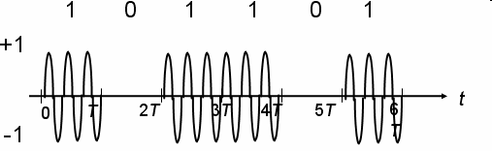
Modulation of Digital Data: ASK
5
ASK – strength of carrier signal is varied to represent binary 1 or 0
both frequency & phase remain constant while amplitude changes
commonly, one of the amplitudes is zero
_{s(t) =} ⎧A₀cos(2πf_{c} t),
binary 0
binary 1
⎧0, binary 0
= ⎨
⎩Acos(2πf_{c} t), binary 1
⎨A cos(2πf t),
⎩ 1
c
+A
Is this picture, from the textbook, entirely correct?!
-A
demodulation:
only the presence or absence of a sinusoid in a given time interval needs to be determined
advantage: simplicity
disadvantage: ASK is very susceptible to noise interference – noise usually (only) affects the amplitude, therefore ASK is the modulation technique most affected by noise
application: ASK is used to transmit digital data over optical fiber

Slide 6
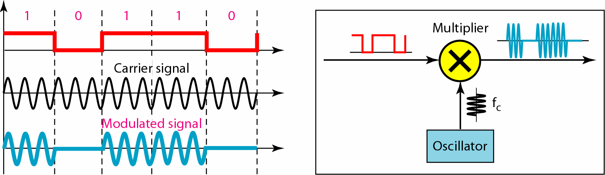
Modulation of Digital Data: ASK (cont.)
6
Example
[ ASK ]
v_{d}(t)
v_{c}(t)
v_{ASK}(t)
v_{d}(f)
v_{c}(f)
f
How does the frequency spectrum of v_{ASK}(t) look like!?

Slide 7
Modulation of Digital Data: ASK (cont.)
7
ASK-Modulated Signal: Frequency Spectrum
cosA ⋅ cosB = ¹ (cos(A - B) + cos(A +B))
2
Carrier signal:
v_{c} (t) = cos(2πf_{c} t) = cos(ω_{c} t) , where 2πf_{c}=ω_{c}
Digital signal: (unipolar!!!)
v (t) = A ⋅ ^{⎡ 1} + ² cosω t − ² cos3ω t + ² cos5ω t −...⎤
d
⎢_{⎣ 2} ⎥⎦
π
0 0
0
3π
5π
Modulated signal:
v _{ASK} (t) = v_{c} (t)⋅ v_{d} (t) =
= cosω t ⋅ ^{⎡ 1} + ² cosω t − ² cos3ω t + ² cos5ω t −...⎤ =
c
⎢_{⎣2}
0 0 0
⎥⎦
+... =
π 3π 5π
= ¹ cosω t + ² cosω t ⋅ cosω t - ²
 | cosω_{c} t ⋅ cos3ω₀t
3π
2 π
c c 0
= ¹ cosω t + ¹ [cos(ω − ω )t + cos(ω + ω )t]-
2 π
c c 0 c 0
− ¹ [cos(ω − 3ω )t + cos(ω + 3ω )t]+...
3π
c 0 c 0
^{ω}d_max
ω_{c}
ω
^{ω}c^{-ω}d_max
ω_{c}
^{ω}c^{+ω}d_max ^{ω}

Slide 8

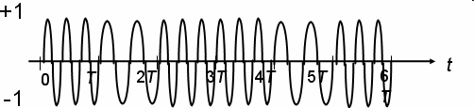
Modulation of Digital Data: FSK
8
FSK – frequency of carrier signal is varied to represent binary 1 or 0
peak amplitude & phase remain constant during each bit interval
_{s(t) =} ⎧Acos(2πf₁t),
binary 0
binary 1
⎨Acos(2πf t),
⎩
2
f₁<f₂
+A
-A
demodulation:
demodulator must be able to determine which of two possible frequencies is present at a given time
advantage:
FSK is less susceptible to errors than ASK – receiver looks for specific frequency changes over a number of intervals, so voltage (noise) spikes can be ignored
disadvantage: FSK spectrum is 2 x ASK spectrum
application: over voice lines, in high-freq. radio transmission, etc.

Slide 9
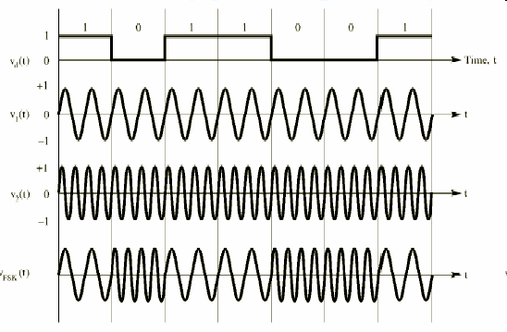
Modulation of Digital Data: FSK (cont.)
9
Example
[ FSK ]
v_{d}(t)
v_{c1}(t)
v_{c2}(t)
v_{FSK}(t)
^{ω}d_max
ω₁
ω₂ ω
ω₁-ω
ω₁
^{ω2 ω}2^{+ω}d_max
ω
d_max

Slide 10
Modulation of Digital Data: FSK
(cont.)
10
FSK-Modulated Signal: Frequency Spectrum
Digital signal:
v_{d} (t) - modulated with ω₁ , and
v_{d} '(t) = 1- v_{d} (t) - modulated with ω₂
Modulated signal:
v_{FSK} (t) = cosω₁t ⋅ v_{d} (t) + cosω₂t ⋅ (1− v_{d} (t)) =
= cosω t ⋅ ^{⎡ 1} + ² cosω t − ² cos3ω t + ² cos5ω t −...⎤ +
1
⎢_{⎣2} ⎥⎦
π
0 0
0
3π
5π
cosω t ⋅ ^{⎡ 1} − ² cosω t + ² cos3ω t − ² cos5ω t −...⎤ =
2
⎢_{⎣2} ⎥⎦
π
0 0
0
3π
5π
= ...
= ¹ cosω t + ¹ [cos(ω − ω )t + cos(ω + ω )t]-
2 π
1 1 0 1 0
− ¹ [cos(ω − 3ω )t + cos(ω + 3ω )t]+ ... +
3π
1 0 1 0
¹ cosω t − ¹ [cos(ω − ω )t + cos(ω + ω )t]-
2 π
2 2 0 2 0
+ ¹ [cos(ω − 3ω )t + cos(ω + 3ω )t]+ ... +
3π
2 0 2 0

Slide 11

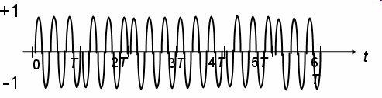
Modulation of Digital Data: PSK
11
PSK – phase of carrier signal is varied to represent binary 1 or 0
peak amplitude & freq. remain constant during each bit interval
example: binary 1 = 0º phase, binary 0 = 180º (πrad) phase
⇒ PSK is equivalent to multiplying carrier signal by +1 when the information is 1, and by -1 when the information is 0
2-PSK, or
Binary PSK,
since only 2 different phases are used.
_{s(t) =} ⎧Acos(2πf_{c} t),
binary 1
binary 0
⎨Acos(2πf t + π),
+A
⎩
c
⎧Acos(2πf t),
binary 1
binary 0
s(t) = ⎨
c
-A
⎩- Acos(2πf_{c} t),
demodulation:
demodulator must determine the phase of received sinusoid with respect to some reference phase
advantage:
PSK is less susceptible to errors than ASK, while it requires/occupies the same bandwidth as ASK
more efficient use of bandwidth (higher data-rate) are possible, compared to FSK !!!
disadvantage:
more complex signal detection / recovery process, than in ASK and FSK

Slide 12
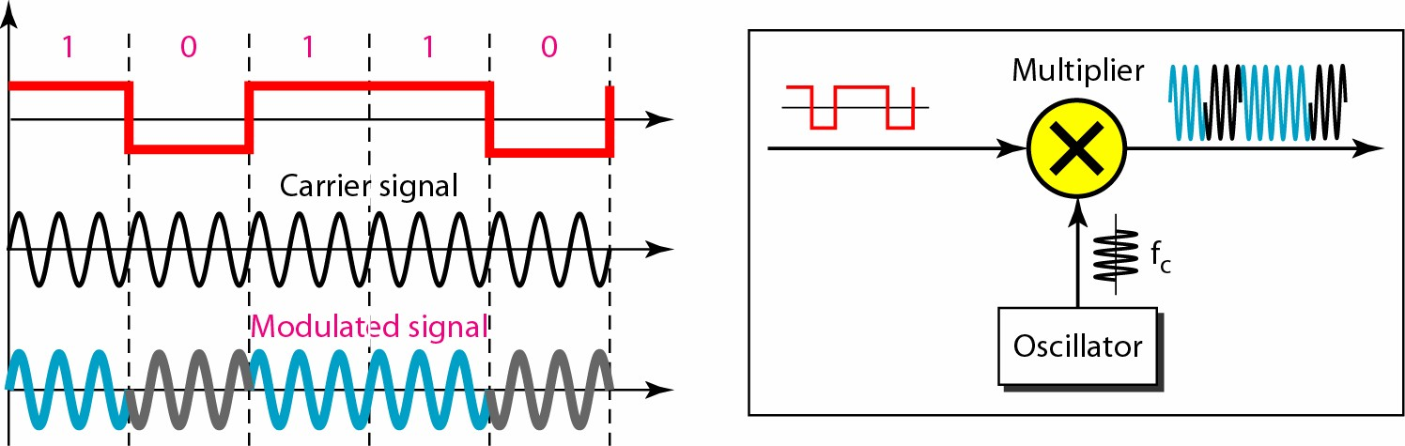
Modulation of Digital Data: PSK (cont.)
12
Example
[ PSK ]
v_{d}(t)
v_{c}(t) v_{PSK}(t)
^{ω}d_max
ω_{c}
ω
^{ω}c^{-ω}d_max
ω_{c}
^{ω}c^{+ω}d_max ^{ω}

Slide 13
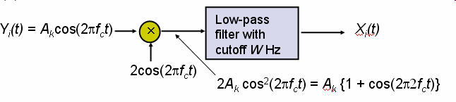
Modulation of Digital Data: PSK (cont.)
13
PSK Detection
multiply the received / modulated signal
± Acos(2πf_{c} t) by 2*cos(2πf_{c}t)
resulting signal
cos² A = ¹ (1+ cos 2A )
2
2Acos² (2πf t) = A[1+ cos(4πf t)],
c c
- 2Acos² (2πf t) = −A[1+ cos(4πf t)],
c c
binary 1
binary 0
by removing the oscillatory part with a
low-pass filter, the original baseband signal (i.e. the original binary sequence) can be easily determined

Slide 14
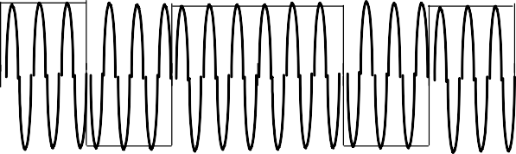
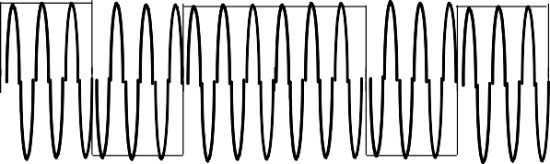
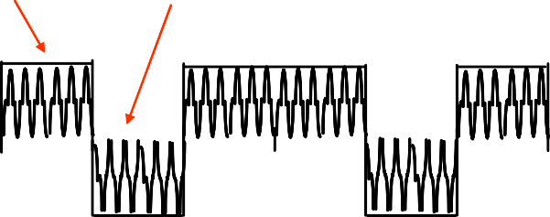
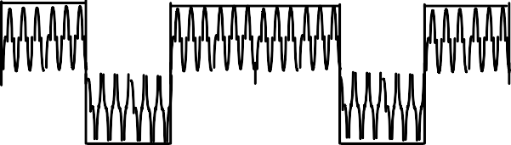
Modulation of Digital Data: PSK (cont.)
14
Information
1
0 1
1
0 1
+A
Baseband Signal
-A
0
T
2T
3T
4T 5T
6T
sender
+A
Modulated Signal
x(t)
0
T
2T
3T
4T 5T
6T
-A
A cos(2πft)
-A cos(2πft)
A {1 + cos(4πft)}
-A {1 + cos(4πft)}
Signal shifted above / below zero level.
After multiplication at receiver
x(t) cos(2πf_{c}t)
+A
receiver
-A
0
T
2T
3T
4T 5T
6T
Baseband signal discernable after smoothing
+A
-A
0
T
2T
3T
4T 5T
6T

Slide 15
Modulation of Digital Data: PSK (cont.)
15
Facts from Modulation Theory
If
W_{c}/2
Data rate = 2*W_{c}/2 = B [bps]
Baseband signal x(t) with bandwidth W_{c}/2
f
then
B
W_{c}
Modulated signal x(t)cos(2πf_{c}t) has bandwidth W_{c} Hz
f
f -B
f
c
f +B
c
c
If bandpass channel has bandwidth W_{c} [Hz],
then baseband channel has W_{c}/2 [Hz] available, so
modulation system supports 2*(W_{c}/2) = W_{c} [pulses/second]
recall Nyqyist Law:
baseband transmission system of bandwidth W_{c} [Hz] can theoretically support 2 W_{c} pulses/sec
How can we recover the factor 2 in supported data-rate !?

Slide 16
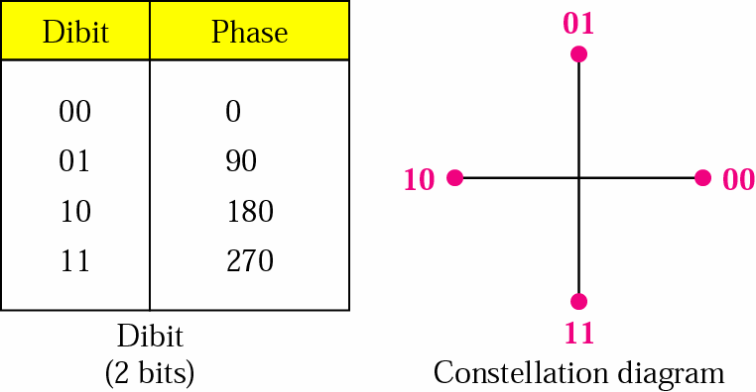
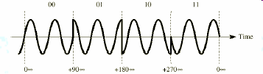

Modulation of Digital Data: PSK (cont.)
16
QPSK = 4-PSK – PSK that uses phase shifts of 90º=π/2 rad ⇒ 4 different signals generated, each representing 2 bits
⎧Acos(2πf_{c} t), binary 00
⎪
π
⎪Acos(2πf_{c} t + ),
binary 01
binary 10
s(t) = ⎪
2
⎨Acos(2πf t + π),
⎪
c
⎪ 3π
Acos(2πf t + ),
binary 11
⎪
c
⎩ 2
advantage: higher data rate than in PSK (2 bits per bit interval), while bandwidth occupancy remains the same
4-PSK can easily be extended to 8-PSK, i.e. n-PSK
however, higher rate PSK schemes are limited by the ability of equipment to distinguish small differences in phase

Slide 17


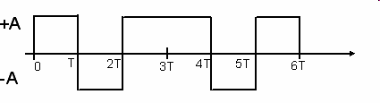


Modulation of Digital Data: QAM
17
Quadrature – uses “two-dimensional” signalling
Amplitude Modulation
original information stream is split into two sequences that consist of odd and even symbols, e.g. B_{k} and A_{k}
(QAM) | 1 | 0 | 1 | 1 | 0 | 1 | …
 | 1 | -1 | 1 | 1 | -1 | 1 | …
 | B₁ | A₁ | B₂ | A₂ | B₃ | A₃ | …
A_{k} sequence (in-phase comp.) is modulated by cos(2πf_{c} t) B_{k} sequence (quadrature-phase comp.) is modulated by sin(2πf_{c} t)
composite signal _{Akcos(2πfc t) + Bk sin(2πfc t)} is sent through the channel
A_{k}
x
Y_{i}(t) = A_{k} cos(2πf_{c}t)
cos(2πf_{c}t)
+
Y(t) = A_{k} cos(2πf_{c}t) + B_{k} sin(2πf_{c}t)
Transmitted Signal
B
x
Y_{q}(t) = B_{k} sin(2πf_{c}t)
k
sin(2πf_{c}t)
advantage:
data rate = 2 bits per bit-interval!

Slide 18
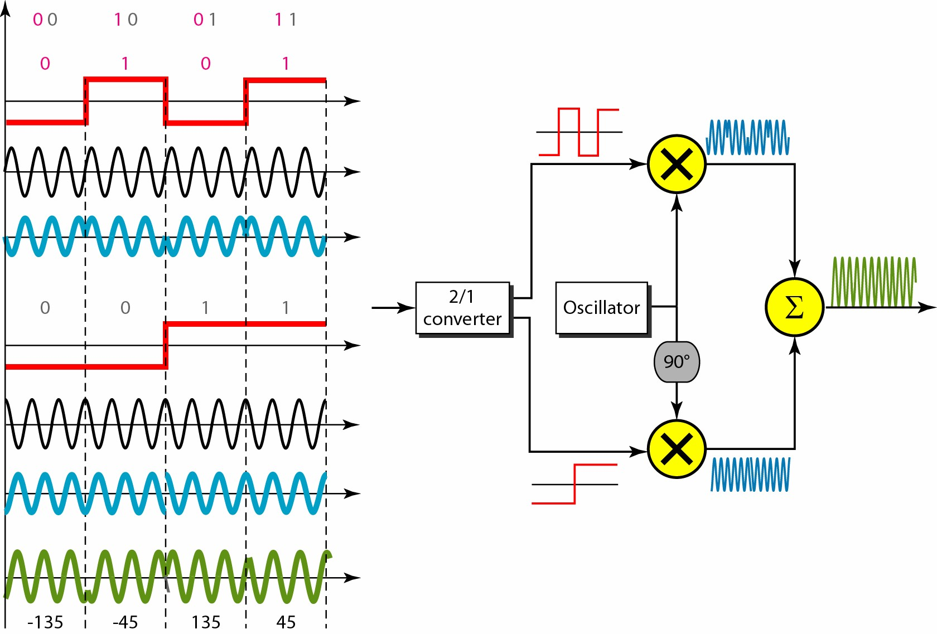
Modulation of Digital Data: QAM (cont.)
18
Example
[ QAM ]
v_{d}(t)
B_{k}
sin(ω_{c}t)
A_{k}
cos(ω_{c}t)

Slide 19
Modulation of Digital Data: QAM
19
QAM Demodulation
by multiplying Y(t) by
2 ⋅ cos(2πf_{c} t) and then low-
pass filtering the resultant signal, sequence A_{k} is obtained
by multiplying Y(t) by
2 ⋅ sin(2πf_{c} t) and then low-
pass filtering the resultant signal, sequence B_{k} is obtained
Lowpass filter (smoother)
Lowpass
filter (smoother)
A_{k}cos(2πf_{c} t) + B_{k} sin(2πf_{c} t) = Y(t)
x
Lowpass
filter (smoother)
A_{k}
2cos(2πf_{c}t)
2A_{k}cos²(2πf_{c}t)+2B_{k} cos(2πf_{c}t)sin(2πf_{c}t)
= A_{k} {1 + cos(4πf_{c}t)}+B_{k} {0 + sin(4πf_{c}t)}
Lowpass filter (smoother)
smoothed to zero
Lowpass
filter (smoother)
x
Lowpass
filter (smoother)
B_{k}
cos² (A) = ¹ (1+ cos(2A))
2
2sin(2πf_{c}t)
2B_{k} sin²(2πf_{c}t)+2A_{k} cos(2πf_{c}t)sin(2πf_{c}t)
= B_{k} {1 - cos(4πf_{c}t)}+A_{k} {0 + sin(4πf_{c}t)}
sin² (A) = ¹ (1− cos(2A))
2
sin(2A) = 2sin(A)cos(A)
smoothed to zero

Slide 20
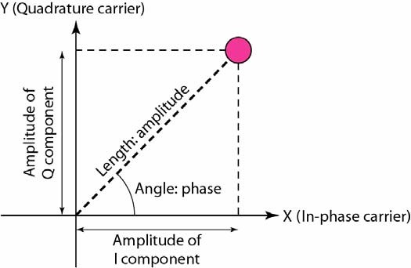
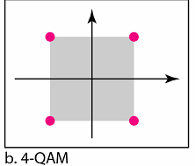
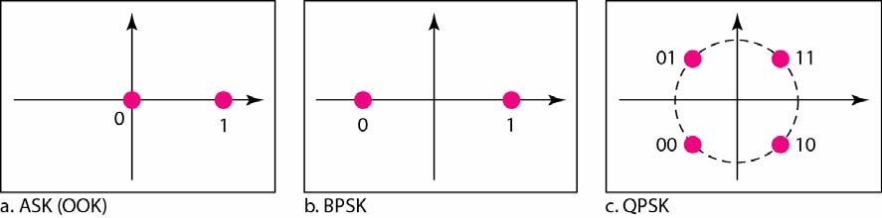
Signal Constellation
20
Constellation Diagram – used to represents possible symbols that may
be selected by a given modulation scheme as points in 2-D plane
X-axis is related to in-phase carrier: cos(ω_{c}t)
the projection of the point on the X-axis defines the peak amplitude of the in-phase component
Y-axis is related to quadrature carrier: sin(ω_{c}t)
the projection of the point on the Y-axis defines the peak amplitude of the quadrature component
the length of line that connects the point to the origin is the peak amplitude of the signal element (combination of X & Y components)
the angle the line makes with the X-axis is the phase of the signal element

Slide 21
Modulation of Digital Data: QAM
21
QAM cont. – QAM can also be seen as a combination of ASK & PSK
Y(t) = A_{k}cos(2πf_{c} t) + B_{k} sin(2πf_{c} t) = (A_{k} B_{k} )
2 ₊ 2
1
-1 ^{B}
² cos(2πf_{c} t + tan
k ₎
A_{k}
B_{k}
(A, A)
(-A,A)
4-level QAM
A_{k}
(-A,-A)
(A,-A)

Slide 22
Modulation of Digital Data: QAM
22
level QAM – the number of bits transmitted per T [sec] interval can be further increased by increasing the number of levels used
in case of 16-level QAM, A_{k} and B_{k} individually can assume 4 different levels: -1, -1/3, 1/3, 1
data rate: 4 bits/pulse ⇒ 4W bits/second
Y(t) = A_{k}cos(2πf_{c} t) + B_{k} sin(2πf_{c} t) = (A_{k} B_{k} )
2 ₊ 2
1
-1 ^{B}
² cos(2πf_{c} t + tan
k ₎
A_{k}
B_{k}
A_{k} and B_{k} individually
can take on 4 different values; the resultant signal can take on (only) 3 different values!!!
A_{k}
In QAM various combinations of amplitude and phase are employed to achieve higher digital data rates.
Amplitude changes are susceptible to noise ⇒ the number of phase shifts used by a QAM system is always greater than the number of amplitude shifts.

