Slide 1
Chapter 1: Introduction

Slide 2
What is an Operating System?
A program that acts as an intermediary between a user of a computer and the computer hardware
Operating system goals:
Execute user programs and make solving user problems easier
Make the computer system convenient to use
Use the computer hardware in an efficient manner

Slide 3
Computer System Structure
Computer system can be divided into four components:
Hardware – provides basic computing resources
CPU, memory, I/O devices
Operating system
Controls and coordinates use of hardware among various applications and users
Application programs – define the ways in which the system resources are used to solve the computing problems of the users
Word processors, compilers, web browsers, database systems, video games
Users
People, machines, other computers

Slide 4
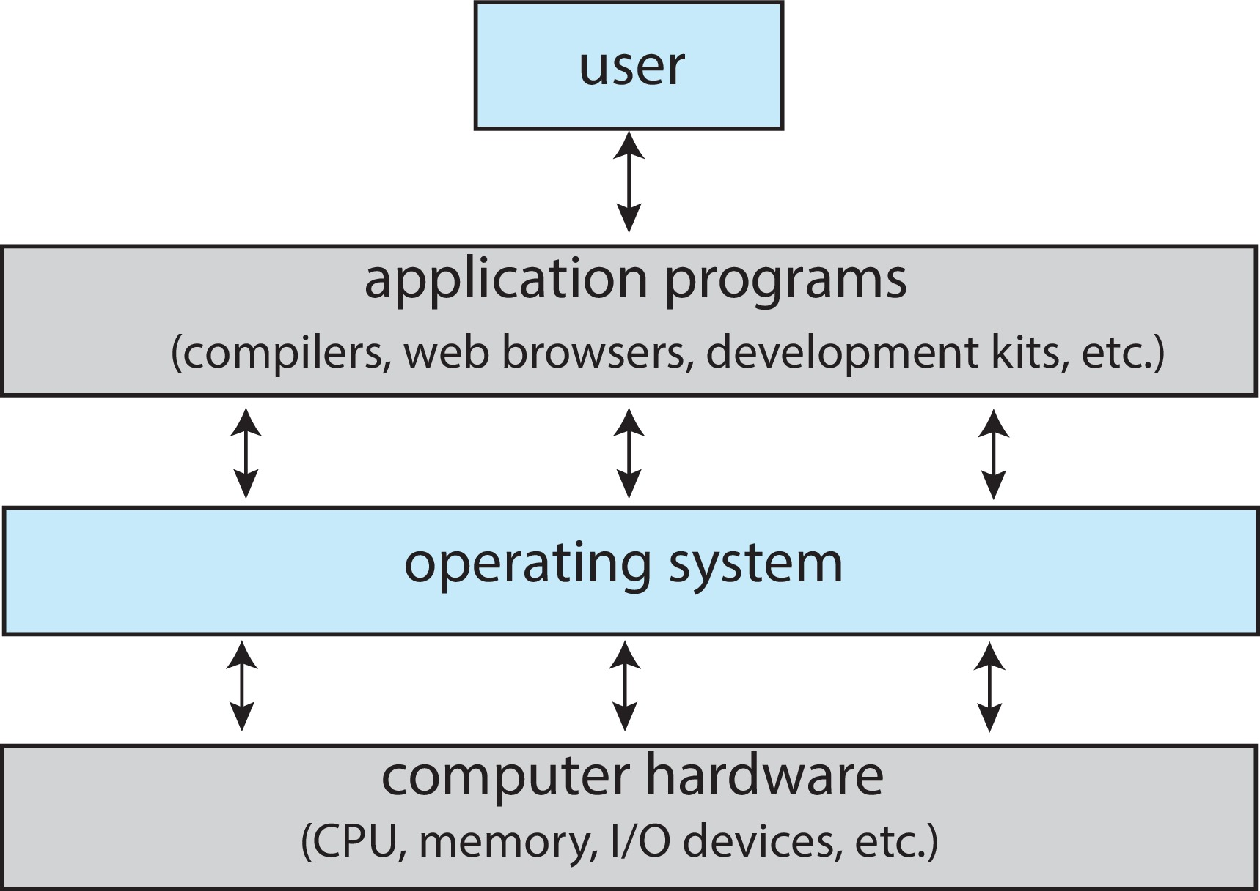
Abstract View of Components of Computer

Slide 5
What Operating Systems Do
Depends on the point of view
Users want convenience, ease of use and good performance
Don’t care about resource utilization
But shared computer such as mainframe or minicomputer must keep all users happy
Operating system is a resource allocator and control program making efficient use of HW and managing execution of user programs

Slide 6
Operating System Definition
No universally accepted definition
“The one program running at all times on the computer” is the kernel, part of the operating system
Everything else is either
A system program (ships with the operating system, but not part of the kernel) , or
An application program, all programs not associated with the operating system
Today’s OSes for general purpose and mobile computing also include middleware – a set of software frameworks that provide additional services to application developers such as databases, multimedia, graphics

Slide 7
Overview of Computer System Structure

Slide 8
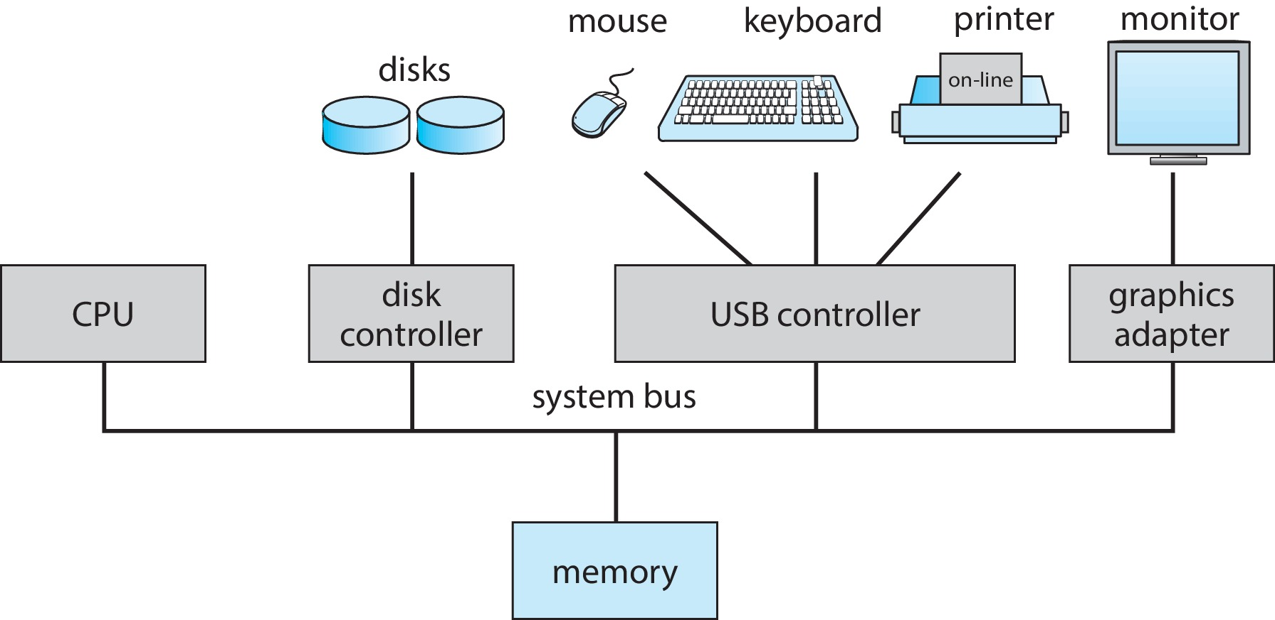
Computer System Organization
Computer-system operation
One or more CPUs, device controllers connect through common bus providing access to shared memory
Concurrent execution of CPUs and devices competing for memory cycles

Slide 9
Computer-System Operation
I/O devices and the CPU can execute concurrently
Each device controller is in charge of a particular device type
Each device controller has a local buffer
Each device controller type has an operating system device driver to manage it
CPU moves data from/to main memory to/from local buffers
I/O is from the device to local buffer of controller
Device controller informs CPU that it has finished its operation by causing an interrupt

Slide 10
Common Functions of Interrupts
Interrupt transfers control to the interrupt service routine generally, through the interrupt vector, which contains the addresses of all the service routines
Interrupt architecture must save the address of the interrupted instruction
A trap or exception is a software-generated interrupt caused either by an error or a user request
An operating system is interrupt driven

Slide 11
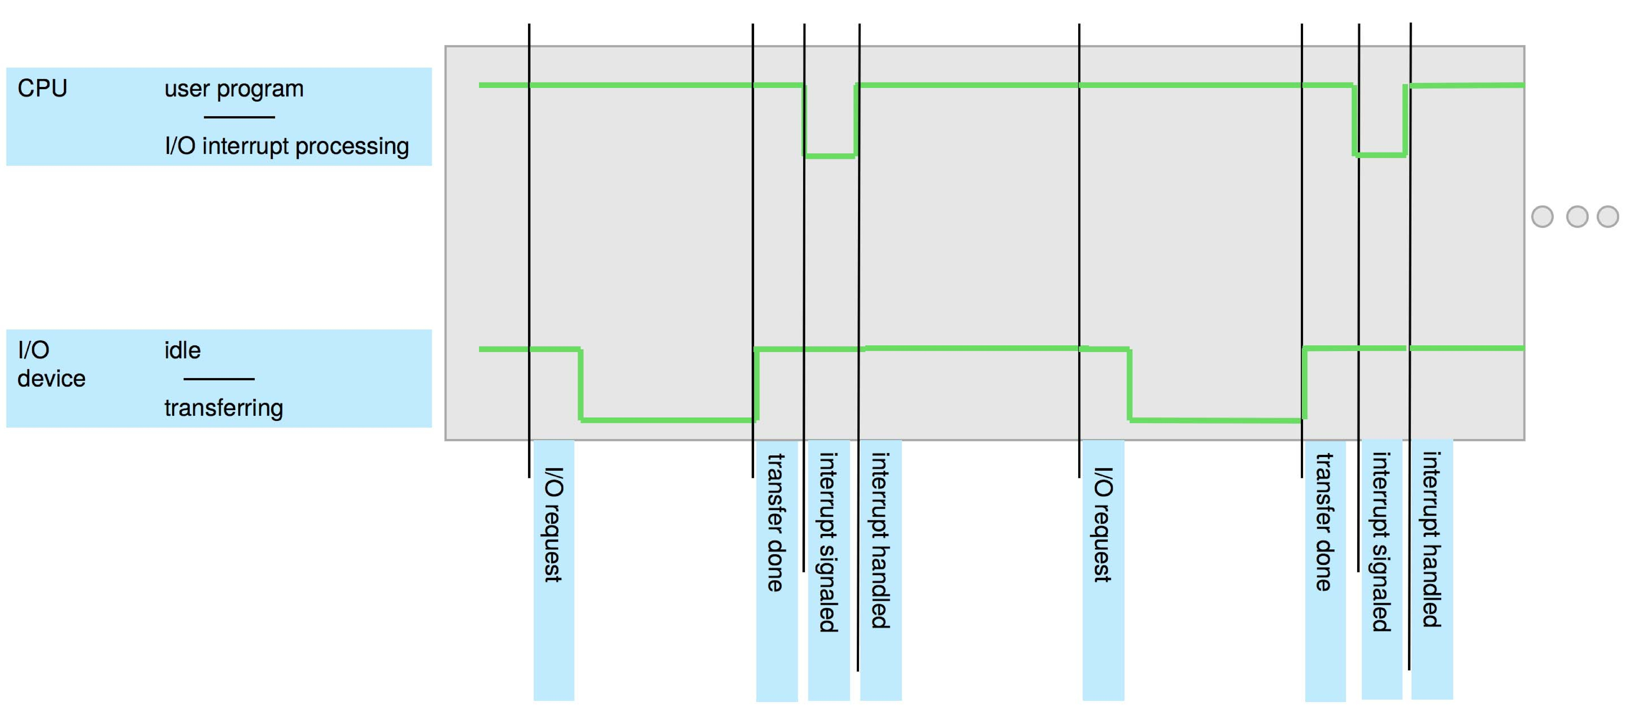
Interrupt Timeline

Slide 12
Interrupt-drive I/O Cycle

Slide 13
Computer Startup
Bootstrap program is loaded at power-up or reboot
Typically stored in ROM or EPROM, generally known as firmware
Initializes all aspects of system
Loads operating system kernel and starts execution

Slide 14
Multitasking (Timesharing)
A logical extension of Batch systems– the CPU switches jobs so frequently that users can interact with each job while it is running, creating interactive computing.
Response time should be < 1 second
Each user has at least one program executing in memory  process
If several jobs ready to run at the same time  CPU scheduling
If processes don’t fit in memory, swapping moves them in and out to run
Virtual memory allows execution of processes not completely in memory

Slide 15
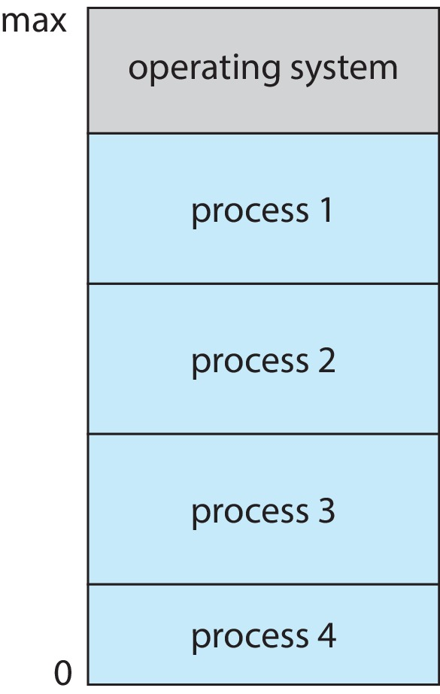
Memory Layout for Multiprogrammed System

Slide 16
Dual-mode Operation
Dual-mode operation allows OS to protect itself and other system components
User mode and kernel mode
Mode bit provided by hardware
Provides ability to distinguish when system is running user code or kernel code.
When a user is running  mode bit is “user”
When kernel code is executing  mode bit is “kernel”
How do we guarantee that user does not explicitly set the mode bit to “kernel”?
System call changes mode to kernel, return from call resets it to user
Some instructions designated as privileged, only executable in kernel mode

Slide 17
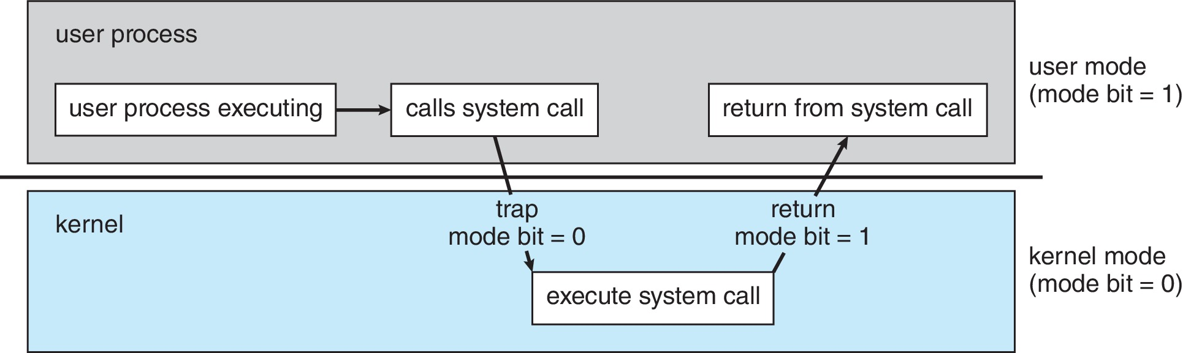
Transition from User to Kernel Mode

Slide 18
Computing Environment
Traditional computing
Mobile computing
Client-server computing
Cloud Computing :
Public cloud,
private cloud,
software as a service
platform as a service
infrastructure as service

