Slide 1
Chapter 2: Operating-System Services

Slide 2
Operating System Services
Operating systems provide an environment for execution of programs and services to programs and users
One set of operating-system services provides functions that are helpful to the user:
User interface - Almost all operating systems have a user interface (UI).
Varies between Command-Line (CLI), Graphics User Interface (GUI), touch-screen, Batch
Program execution - The system must be able to load a program into memory and to run that program, end execution, either normally or abnormally (indicating error)
I/O operations - A running program may require I/O, which may involve a file or an I/O device
File-system manipulation - The file system is of particular interest. Programs need to read and write files and directories, create and delete them, search them, list file Information, permission management.

Slide 3
Operating System Services (Cont.)
One set of operating-system services provides functions that are helpful to the user (Cont.):
Communications – Processes may exchange information, on the same computer or between computers over a network
Communications may be via shared memory or through message passing (packets moved by the OS)
Error detection – OS needs to be constantly aware of possible errors
May occur in the CPU and memory hardware, in I/O devices, in user program
For each type of error, OS should take the appropriate action to ensure correct and consistent computing
Debugging facilities can greatly enhance the user’s and programmer’s abilities to efficiently use the system

Slide 4
Operating System Services (Cont.)
Another set of OS functions exists for ensuring the efficient operation of the system itself via resource sharing
Resource allocation - When multiple users or multiple jobs running concurrently, resources must be allocated to each of them
Many types of resources - CPU cycles, main memory, file storage, I/O devices.
Logging - To keep track of which users use how much and what kinds of computer resources
Protection and security - The owners of information stored in a multiuser or networked computer system may want to control use of that information, concurrent processes should not interfere with each other
Protection involves ensuring that all access to system resources is controlled
Security of the system from outsiders requires user authentication, extends to defending external I/O devices from invalid access attempts

Slide 5
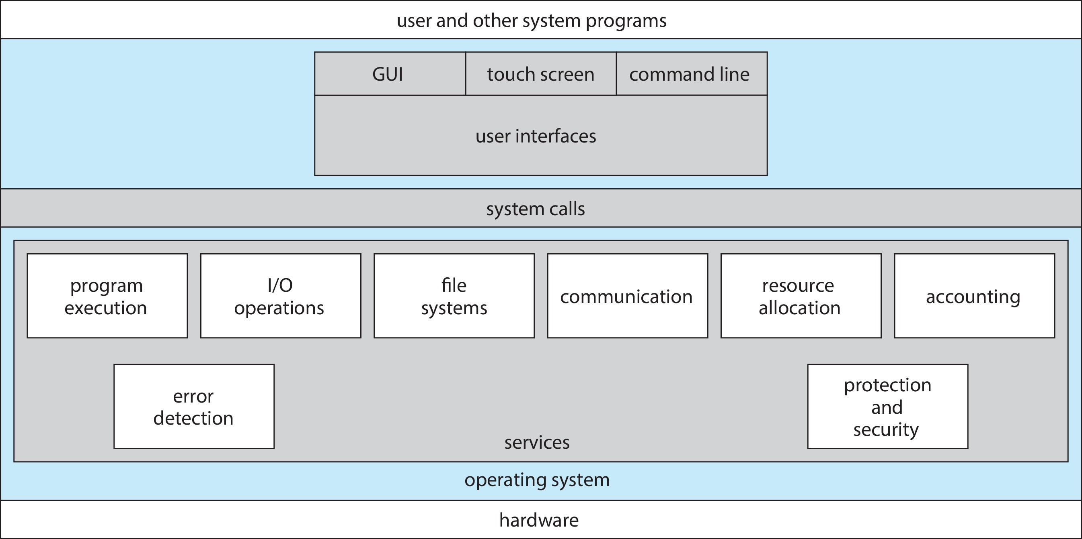
A View of Operating System Services

Slide 6
System Calls
Programming interface to the services provided by the OS
Typically written in a high-level language (C or C++)
Mostly accessed by programs via a high-level Application Programming Interface (API) rather than direct system call use
Three most common APIs are Win32 API for Windows, POSIX API for POSIX-based systems (including virtually all versions of UNIX, Linux, and Mac OS X), and Java API for the Java virtual machine (JVM)

Slide 7
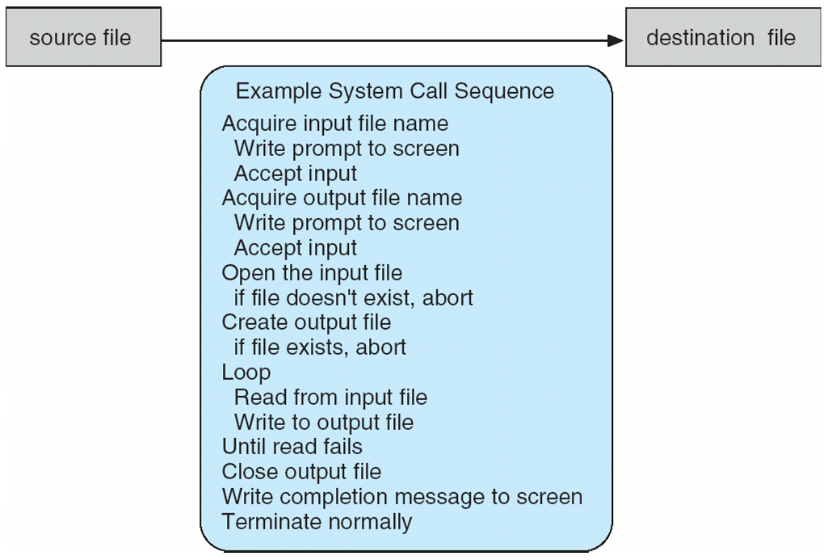
Example of System Calls
System call sequence to copy the contents of one file to another file

Slide 8
System Call Implementation
Typically, a number is associated with each system call
System-call interface maintains a table indexed according to these numbers
The system call interface invokes the intended system call in OS kernel and returns status of the system call and any return values
The caller need know nothing about how the system call is implemented
Just needs to obey API and understand what OS will do as a result call
Most details of OS interface hidden from programmer by API
Managed by run-time support library (set of functions built into libraries included with compiler)

Slide 9
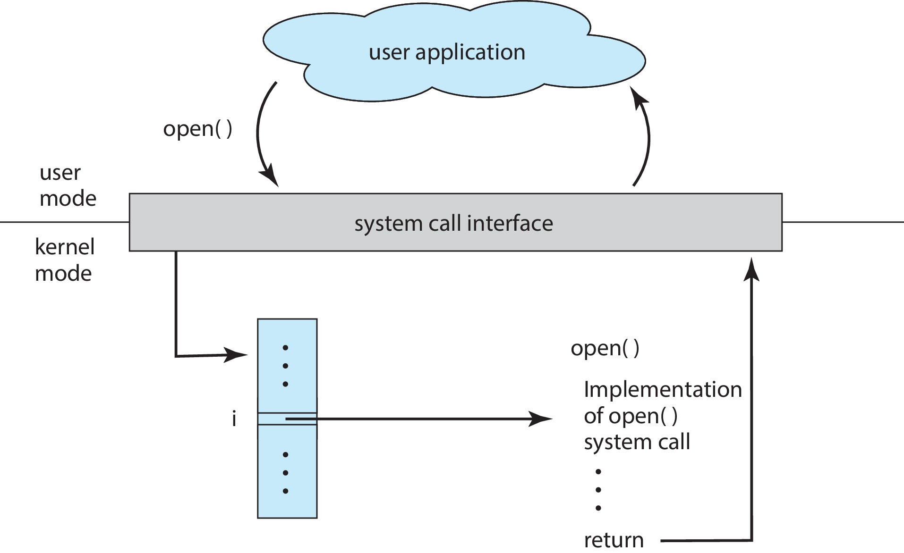
API – System Call – OS Relationship

Slide 10
Types of System Calls
Process control
create process, terminate process
end, abort
load, execute
get process attributes, set process attributes
wait for time
wait event, signal event
allocate and free memory
Dump memory if error
Debugger for determining bugs, single step execution
Locks for managing access to shared data between processes

Slide 11
Types of System Calls (Cont.)
File management
create file, delete file
open, close file
read, write, reposition
get and set file attributes
Device management
request device, release device
read, write, reposition
get device attributes, set device attributes
logically attach or detach devices

Slide 12
Types of System Calls (Cont.)
Information maintenance
get time or date, set time or date
get system data, set system data
get and set process, file, or device attributes
Communications
create, delete communication connection
send, receive messages if message passing model to host name or process name
From client to server
Shared-memory model create and gain access to memory regions
transfer status information
attach and detach remote devices

Slide 13
Types of System Calls (Cont.)
Protection
Control access to resources
Get and set permissions
Allow and deny user access

Slide 14
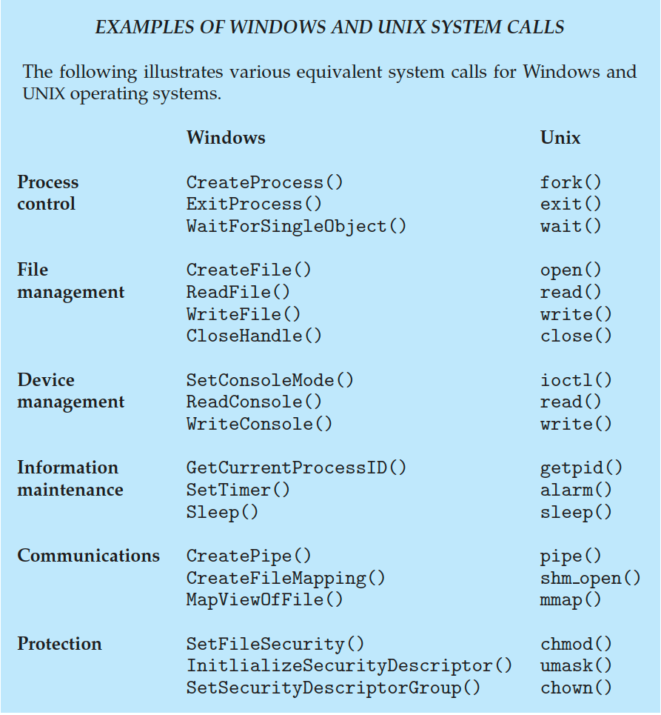
Examples of Windows and Unix System Calls

Slide 15
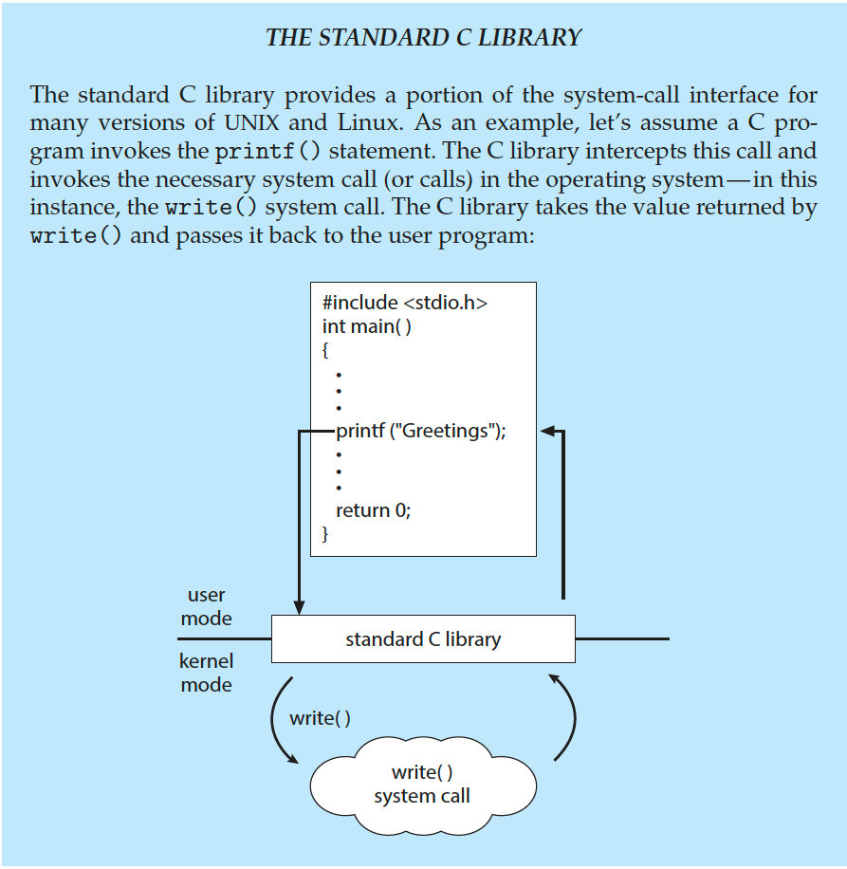
Standard C Library Example
C program invoking printf() library call, which calls write() system call

Slide 16
System Boot
When power initialized on system, execution starts at a fixed memory location
Operating system must be made available to hardware so hardware can start it
Small piece of code – bootstrap loader, BIOS, stored in ROM or EEPROM locates the kernel, loads it into memory, and starts it
Sometimes two-step process where boot block at fixed location loaded by ROM code, which loads bootstrap loader from disk
Modern systems replace BIOS with Unified Extensible Firmware Interface (UEFI)
Common bootstrap loader, GRUB, allows selection of kernel from multiple disks, versions, kernel options
Kernel loads and system is then running
Boot loaders frequently allow various boot states, such as single user mode

Slide 17
Performance Tuning
Improve performance by removing bottlenecks
OS must provide means of computing and displaying measures of system behavior
For example, “top” program or Windows Task Manager

Slide 18
End of Chapter 2

