Slide 1
Chapter 3: Processes

Slide 2
Outline
Process Concept
Process Scheduling
Operations on Processes
Interprocess Communication
IPC in Shared-Memory Systems
IPC in Message-Passing Systems

Slide 3
Process Concept
An operating system executes a variety of programs that run as a process.
Process – a program in execution; process execution must progress in sequential fashion. No parallel execution of instructions of a single process
Memory layout of a process is divided into multiple parts :
The program code, also called text section
Current activity including program counter, processor registers
Stack containing temporary data
Function parameters, return addresses, local variables
Data section containing global variables
Heap containing memory dynamically allocated during run time

Slide 4
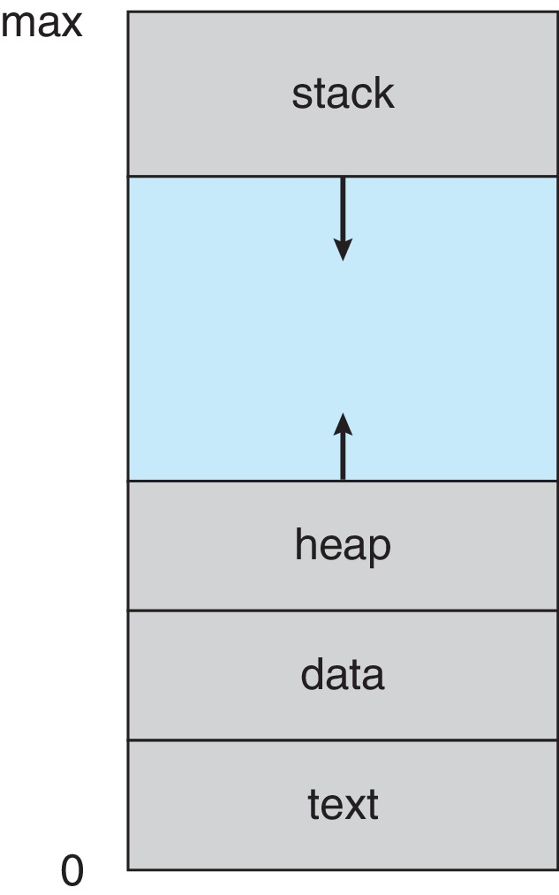
Process in Memory

Slide 5
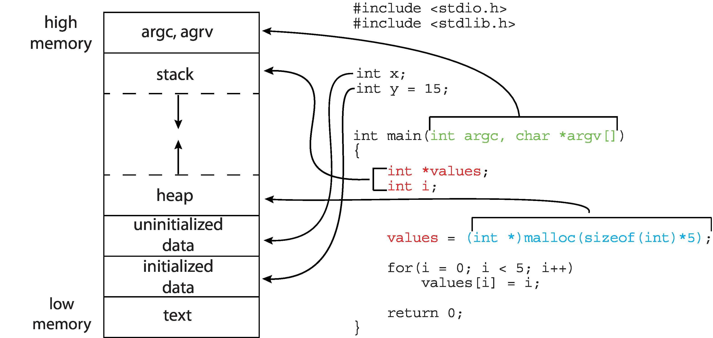
Memory Layout of a C Program

Slide 6
Process State
As a process executes, it changes state
New: The process is being created
Running: Instructions are being executed
Waiting: The process is waiting for some event to occur
Ready: The process is waiting to be assigned to a processor
Terminated: The process has finished execution

Slide 7
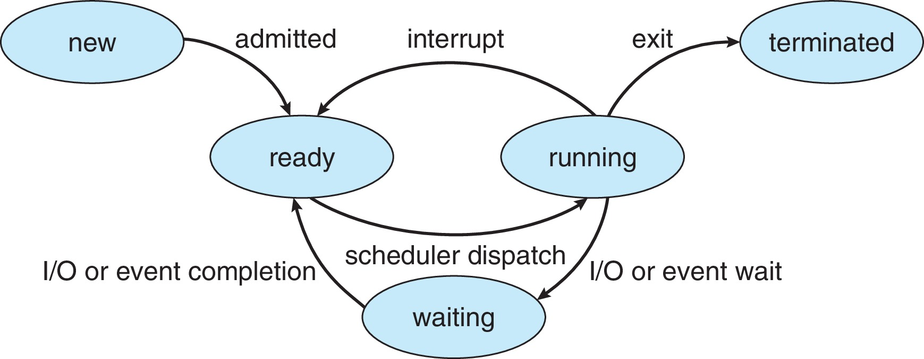
Diagram of Process State
It is important to realize that only one process
can be running on any processor core at any instant.

Slide 8
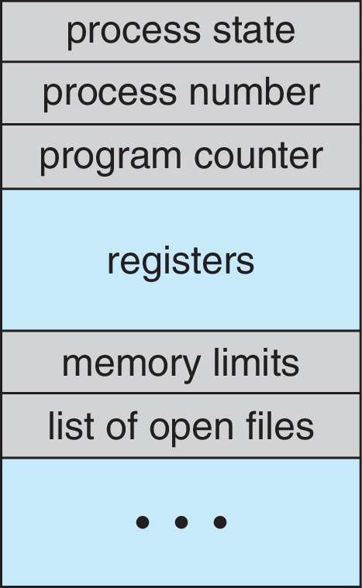
Process Control Block (PCB)
Information associated with each process(also called task control block)
Process state – running, waiting, etc.
Program counter – location of instruction to next execute
CPU registers – contents of all process-centric registers
CPU scheduling information- priorities, scheduling queue pointers
Memory-management information – memory allocated to the process
Accounting information – CPU used, clock time elapsed since start, time limits
I/O status information – I/O devices allocated to process, list of open files

Slide 9
Process Scheduling
Process scheduler selects among available processes for next execution on CPU core
Goal -- Maximize CPU use, quickly switch processes onto CPU core
Maintains scheduling queues of processes
Ready queue – set of all processes residing in main memory, ready and waiting to execute
Wait queues – set of processes waiting for an event (i.e., I/O)
Processes migrate among the various queues

Slide 10
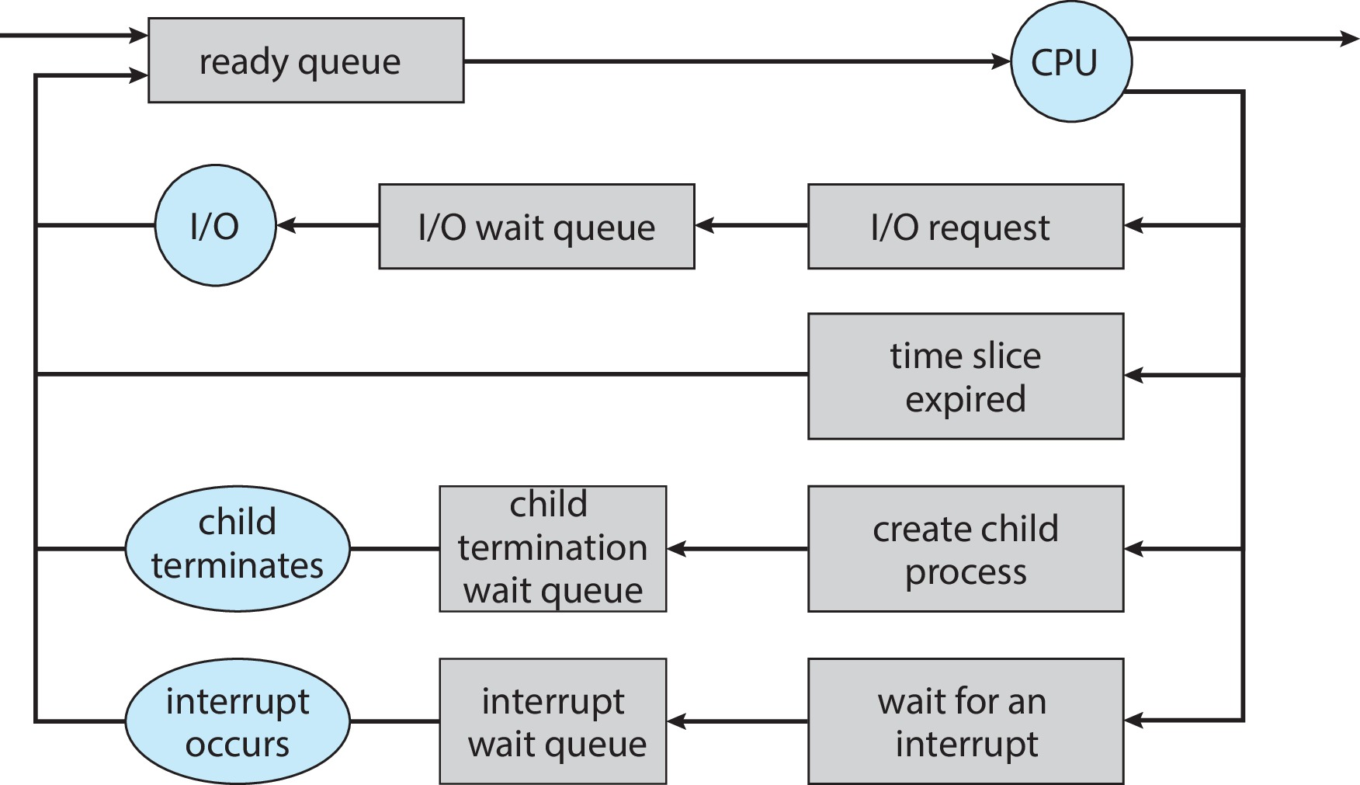
Representation of Process Scheduling

Slide 11
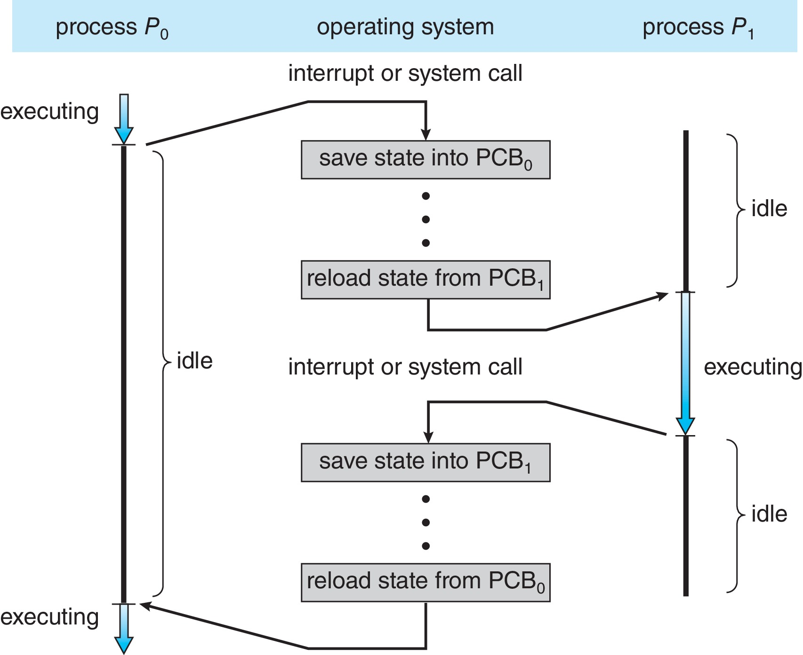
CPU Switch From Process to Process
A context switch occurs when the CPU switches from one process to another.

Slide 12
Context Switch
When CPU switches to another process, the system must save the state of the old process and load the saved state for the new process via a context switch
Context of a process represented in the PCB
Context-switch time is pure overhead; the system does no useful work while switching

Slide 13
Operations on Processes
System must provide mechanisms for:
Process creation
Process termination

Slide 14
Process Creation
Parent process create children processes, which, in turn create other processes, forming a tree of processes
Generally, process identified and managed via a process identifier (pid)
Resource sharing options
Parent and children share all resources
Children share subset of parent’s resources
Parent and child share no resources
Execution options
Parent and children execute concurrently
Parent waits until children terminate

Slide 15
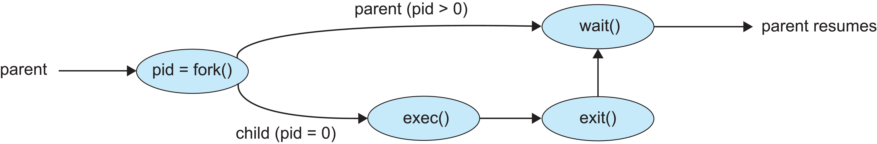
Process Creation (Cont.)
Address space
Child duplicate of parent
Child has a program loaded into it
UNIX examples
fork() system call creates new process
exec() system call used after a fork() to replace the process’ memory space with a new program
Parent process calls wait()waiting for the child to terminate

Slide 16
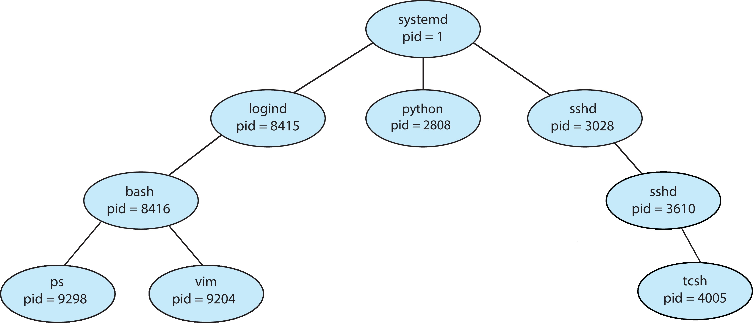
A Tree of Processes in Linux

Slide 17
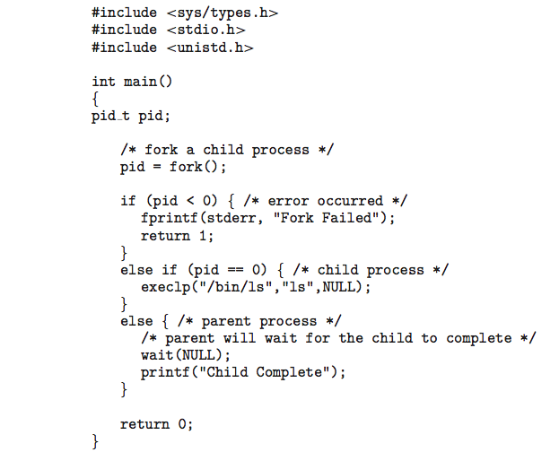
C Program Forking Separate Process

Slide 18
Process Termination
Process executes last statement and then asks the operating system to delete it using the exit() system call.
Returns status data from child to parent (via wait())
Process’ resources are deallocated by operating system
Parent may terminate the execution of children processes using the abort() system call. Some reasons for doing so:
Child has exceeded allocated resources
Task assigned to child is no longer required
The parent is exiting, and the operating systems does not allow a child to continue if its parent terminates

Slide 19
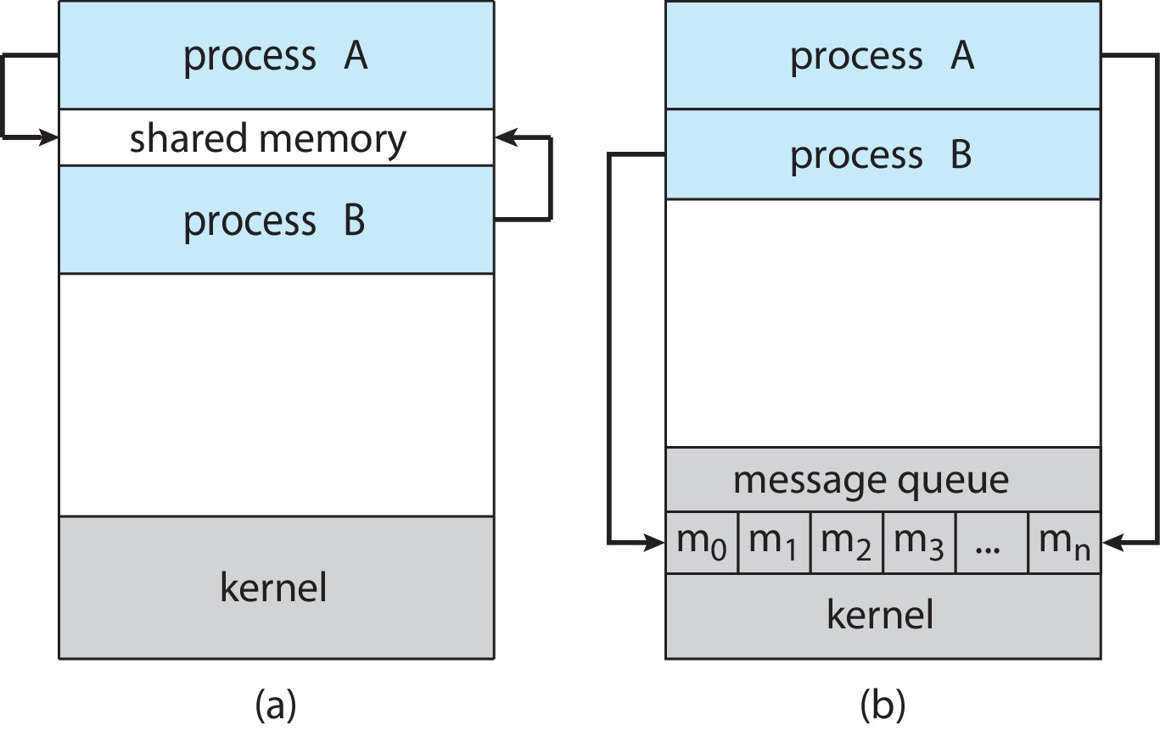
Communications Models
(a) Shared memory. (b) Message passing.

Slide 20
Producer-Consumer Problem
Paradigm for cooperating processes:
producer process produces information that is consumed by a consumer process
Two variations:
unbounded-buffer places no practical limit on the size of the buffer:
Producer never waits
Consumer waits if there is no buffer to consume
bounded-buffer assumes that there is a fixed buffer size
Producer must wait if all buffers are full
Consumer waits if there is no buffer to consume

Slide 21
IPC – Shared Memory
An area of memory shared among the processes that wish to communicate
The communication is under the control of the users processes not the operating system.
Major issues is to provide mechanism that will allow the user processes to synchronize their actions when they access shared memory.

Slide 22
Bounded-Buffer – Shared-Memory Solution
Shared data
#define BUFFER_SIZE 10
typedef struct {
. . .
} item;
item buffer[BUFFER_SIZE];
int in = 0;
int out = 0;
Solution is correct, but can only use BUFFER_SIZE-1 elements

Slide 23
Producer Process – Shared Memory
item next_produced;
while (true) {
/* produce an item in next produced */
while (((in + 1) % BUFFER_SIZE) == out)
; /* do nothing */
buffer[in] = next_produced;
in = (in + 1) % BUFFER_SIZE;
}

Slide 24
Consumer Process – Shared Memory
item next_consumed;
while (true) { while (in == out)
; /* do nothing */ next_consumed = buffer[out];
out = (out + 1) % BUFFER_SIZE;
/* consume the item in next consumed */
}

Slide 25
End of Chapter 3

