Slide 1

WPDD202 - Recall the Unit Outcomes
This unit provides students with an in-depth discussion of the foundational concepts of internet and static websites, and their use in the business. The focus is on the design and development of a static website using HTML5, CSS, and JAVASCRIPT to meet the client needs and technical requirements.

Slide 2
Make a study plan and know what you are preparing for
This will give yourself the best chance of retaining the information you need and giving it the meaning that will help you to excel in your exam.

Slide 3
Organise your notes and revise them often
Organize you notes
It is easier to remember individual details when they are grouped into mini-sections
On your own words, for each week, make notes on lecture + tutorial from a class and materials on Moodle
Practice tutorial exercises
The more you revise your notes the better you would get from them
Try to comprehend the overall structure of the lectures and revise more often
Written summaries, Diagrams, Audio, and Video would help to reconstruct your notes

Slide 4
Summarisation of what have learnt
Week 1 Introduction to Internet and Webpage
You learnt about the Internet, the web, and associated technologies, including web servers and web browsers. You learnt the essential role of HTML in creating webpages and reviewed tools used to create HTML documents. You also learnt how to create a basic HTML webpage. The items listed below include all the new concepts and skills you have learnt in this week.
Exploring the Internet
Creating a basic webpage
Plaining a website
Understanding the basic of HTML
Using a simple text editor to create HTML documents

Slide 5
Summarisation of what have learnt
Week 2 Building a Webpage Template with HTML5
In this week, you learnt how to prepare a website by organising folders for the webpage files, using HTML5 structural elements to create a webpage template, validating the template, and then creating the home page. The items listed below include all the new concepts and skills you have learnt in this week.
Design a website
Using HTML5 semantic elements
Creating a webpage template
Creating a homepage
Validating HTML documents

Slide 6
Summarisation of what have learnt
Week 3 Image Manipulation
In this week, you have learnt how to create many types of hyperlinks. You also inserted new HTML elements, including div elements, image elements, headings, and lists. The items listed below include all the new concepts and skills you have learnt in this week.
Adding links to a webpage
Adding images to a website
Exploring div elements
Adding headings and lists

Slide 7
Summarisation of what have learnt
Week 4 Styles and Style Sheets
In this week, you learnt how to create a CSS file with rules to style HTML elements on a webpage. You linked the CSS file to all of the webpages for the fitness website as example. The items listed below include all the new concepts and skills you have learnt in this week.
Using cascade style sheets
Understanding inline elements and block elements
Creating an external style sheet
Using an HTML document to a CSS file
Creating style rules for structural elements
Creating style rules for classes
Using CSS list properties
Adding comments to CSS files
Validating CSS files

Slide 8
Summarisation of what have learnt
Week 5 Responsive Design
In this week, you learnt how to apply responsive design principles to a website. You modified the fitness website to use a fluid layout, coded images to be flexible, and followed a mobile-first strategy to analyse and modify the webpages in the fitness website. Finally, you added meta tags for responsive design. The items listed below include all the new skills you have learnt in this week.
Creating a fluid layout
Making images flexible
Following a mobile-first strategy
Adding meta tags
Testing webpages in viewports of different sizes

Slide 9
Summarisation of what have learnt
Week 6 Interface Design and Security
In this week, you learnt about a user interface, a web interface, understanding why web browsers has become the de-facto standard user interface to databases, bringing about a number of advantages including: enable large numbers of users to access databases from anywhere​, avoid the need for downloading/installing specialized code, while providing a good graphical user interface​. You learnt the essential role of interface design and security through understanding the SQL injection technique wherein an attacker can excuse malicious SQL statements (also commonly referred to as a malicious payload) that control a web application’s database server.

Slide 10
Summarisation of what have learnt
Week 7 Tables and Forms
In this week, you learnt how to include tables and forms on webpages. You created a table that displays related information and then formatted it using CSS properties you have used before and one new property specific to tables. You also learnt about webpage forms and form controls, including the HTML elements, attributes, and values for creating the controls you need. Finally, you used CSS styles to format a form for mobile, tablet, and desktop viewports. The items listed below include all the new skills you have learnt in this week.
Discovering tables
Styling table elements
Creating webpage forms
Styling forms

Slide 11
Summarisation of what have learnt
Week 8 Adding Multimedia
In this week, you learnt how to integrate audio and video elements within a website. You used HTML5 audio element to insert three audio source elements and specified that it automatically play and display controls. You also learnt how to use the HTML5 video element and insert a video onto a webpage and coded for cross-browser compatibility. Finally, you used CSS styles to format a video for all viewports. The items listed below include all the new skills you have learnt in this week.
Integrating audio
Integrating video

Slide 12
Summarisation of what have learnt
Weeks 9-10 Interactive Web App with JavaScript
In these two weeks, you learnt about the various social media options for a business. You learned how to add social media icons and links to a website. You styled social media icons with CSS. You also learned how to create pop-up windows using JavaScript. You learnt how to write JavaScript code within an HTML document. You also learnt how to write JavaScript functions in an external JavaScript file and reference the file within an HTML page. The items listed below include all the new skills you have learnt in these week.
Adding social media icons and links to the home page
Adding a pop-up window to the home page
Creating a function in an external JavaScript file
Calling a JavaScript function
Writing a JavaScript user-defined function to valid form data

Slide 13
Summarisation of what have learnt
Week 11 Publish and Promote a Website
In this week, you learnt how to add a description meta tag to a webpage. You also learnt how to publish and promote a website. You used the meta tag to create a description for a website. You learnt how to publish your website with an FTP client. You also learnt how to market and promote a website. The items listed below include all the new skills you have learnt in this week.
Using the description meta tag
Publishing a website

Slide 14
Exam Paper Structure
Duration: 2 hours 10 minutes
Exam paper contains 2 sections of different types of questions:
1. Short Questions and Answers – 40 marks
8 questions out of 10 questions – 5 marks each
Questions could be any topic you learnt from Weeks 1-11
Reviewing on your weekly notes/tutorials would be helpful
2. Long Questions and Answers 60 marks
2 questions out of 3 questions – each question having 30 marks
Problem solving-based questions – writing HTML and CSS code
Understanding on how to use HTML and CSS tags to develop a webpage is essential. Practicing on writing HTML and CSS code will definitely help

Slide 15
Sample Question From Section 1
Write down the HTML5 code to embed the video elements in your webpage.
How can you include the alert message in your webpage by using JavaScript.
Visit the website (https://www.harveynorman.com.au). Identify the purpose of the website and intended target audience.
What is the difference between intranet, extranet and internet.

Slide 16
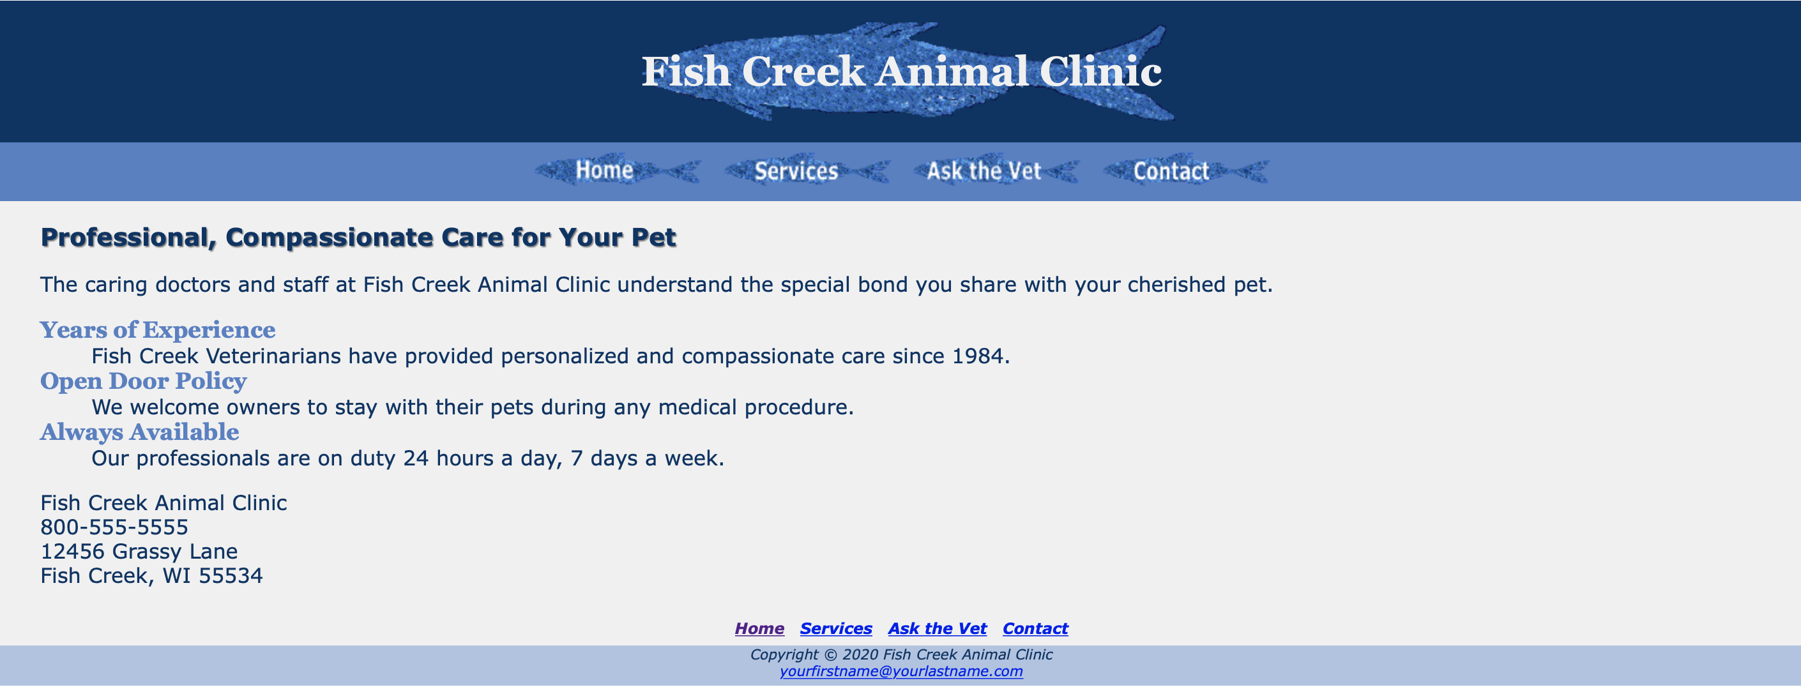
Sample Question From Section 2.
Write down the valid HTML/CSS code for the given page.

Slide 17
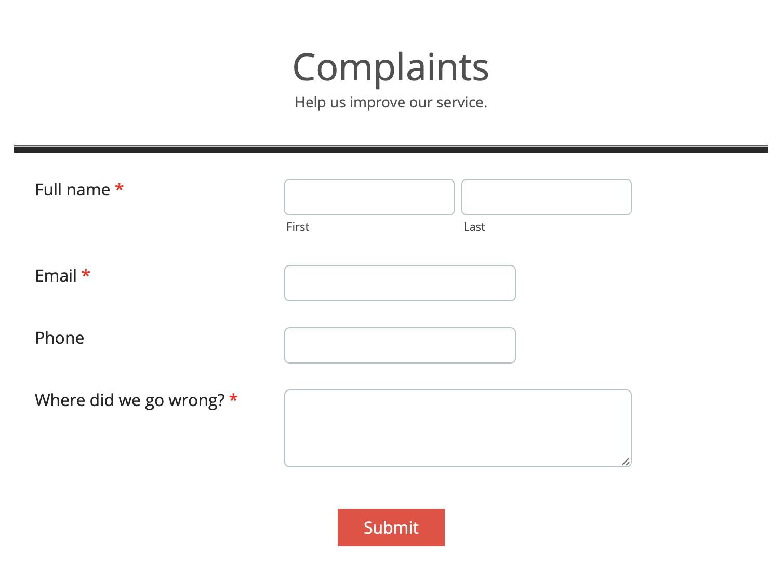
Sample Question From Section 2.
Write down the valid HTML/CSS code for the given Contact Form.

Slide 18
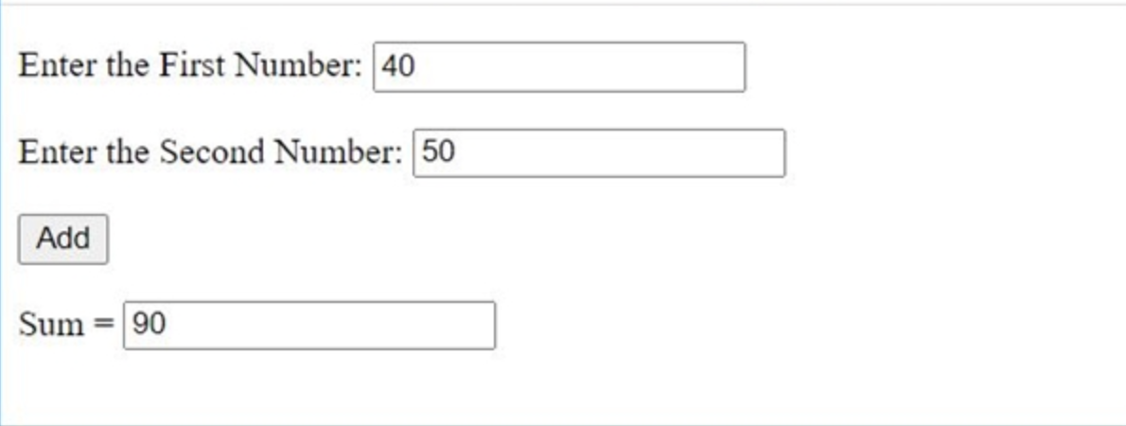
Sample Question From Section 2.
Write down the valid JavaScript code to add two numbers input by the users as shown in the figure.

Slide 19
All the best
&
Good luck

