Slide 1

Object Oriented Design and Programming
Week 5
Version 2 – 18th December 2015

Slide 2
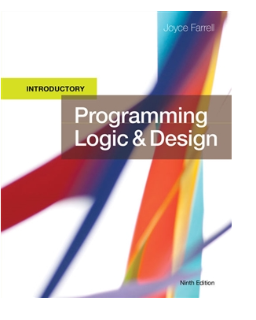
SLIDE TITLE
Farrell, J. (2017) Programming Logic and Design, Comprehensive (9th ed.) Cengage Learning

Slide 3
Programming Logic and Design Ninth Edition
Arrays and basic Array operations

Slide 4
Objectives
Arrays- one dimensional and two dimensional.
Declaration, Creation and Initialization.
Some basic operations

Slide 5
Introduction to Arrays
In computer science, a data structure is a data organization, management, and storage format that enables efficient access and modification
A data structure is a way to organize data in a computer (usually to save time or space).
Data structures play an essential role in computer programming—indeed.
In this lecture, we introduce you to the idea of a data structure and to your ﬁrst data structure, the array.

Slide 6
Introduction to Arrays(continued-1)
The primary purpose of an array :-
facilitate storing large quantities of data of same type.
manipulating large quantities of data of same type.
Have a large amount of data of same type to process?
First put all of the data into one or more arrays.
use indexing to refer to individual elements and to process the data.

Slide 7
Introduction to Arrays(continued-2)
You can use array in following scenarios:
To store exam scores of five exams.
To store stock prices.
To store various departing time of your train in a day from your nearby station.
And many more.

Slide 8
Array in Java
Making an array in a Java program involves three distinct steps:
-Declare the array.
-Create the array.
-Initialize the array elements.

Slide 9
Array in Java(continued-2)
To declare an array:-
- You need to specify a name and the type of data it will contain.
To create it :-
- You need to specify its length (the number of elements).
To initialize it :-
- You need to assign a value to each of its elements.

Slide 10
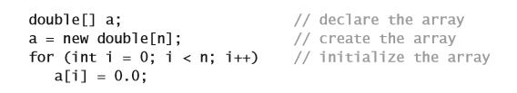
Array in Java(continued-3)
Following code makes an array of n(any number) elements, each of type double and initialized to 0.0:

Slide 11
Array in Java(continued-4)
The ﬁrst statement was the array declaration.
It is just like a declaration of a variable of the corresponding primitive type
Except for the square brackets following the type name, which specify that we are declaring an array.

Slide 12
Array in Java(continued-5)
The second statement creates the array.
It uses the keyword new to allocate memory to store the speciﬁed number of elements. It has to be some number.

Slide 13
Array in Java(continued-6)
The for loop assigns the value 0.0 to each of the n array elements.
We refer to an array element by putting its index in square brackets after the array name.
The code a[i] refers to element i of array a[]

Slide 14
Array Initialization
Arrays can be initialized in different ways:
Using for loop- discussed in previous slide
Standard approach
double a[]={2.5,56,3.5,6.5,3.4,6.8}
Simpler way
a[i]= 2.5 where i can be position of element of array

Slide 15
Array in Java(continued-7)
Zero-based indexing
- The ﬁrst element of an array a[] is a[0] not a[1].
- The second element is a[1] not a[2], and so forth.
Consider the array:
String[] SUITS = { "Clubs", "Diamonds", "Hearts", "Spades" };
What will be value of SUITS[0], SUITS[3]

Slide 16
Array in Java(continued-8)
Array length
Once you create an array in Java, its length is ﬁxed.
Use .length to get a length of array.
For example:
double scores[]={2.5,56,3.5,6.5,3.4,6.8}
scores.length will be 6

Slide 17
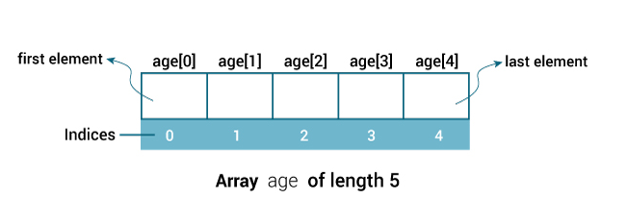
Array in Java(continued-9)
Memory Representation
Arrays are fundamental data structures.
Direct correspondence with memory systems.
The elements of an array are stored consecutively in memory, so that it is easy to quickly access any array value.

Slide 18
Array in Java(continued-10)
Memory allocation
-When you use the keyword new to create an array, Java reserves sufﬁcient space in memory to store the speciﬁed number of elements.
This process is called memory allocation.
Notes:
The same process is required for all variables that you use in a program (but you do not use the keyword new with variables of primitive types because Java knows how much memory to allocate). We call attention to it now because it is your responsibility to create an array before accessing any of its elements. If you fail to adhere to this rule, you will get an uninitialized variable error at compile time.

Slide 19
Array in Java(continued-11)
Bounds checking
use valid indices when referring to an array element.
If you have created an array of length n and use an index whose value is less than 0 or greater than n-1.
program will terminate with an ArrayIndexOutOfBoundsException at run time

Slide 20
Array in Java(continued-12)
Exchanging two values in an array
Use the temporary variable to exchange the values
double temp= scores[1];
scores[1]=scores[2];
scores[2]=temp;

Slide 21
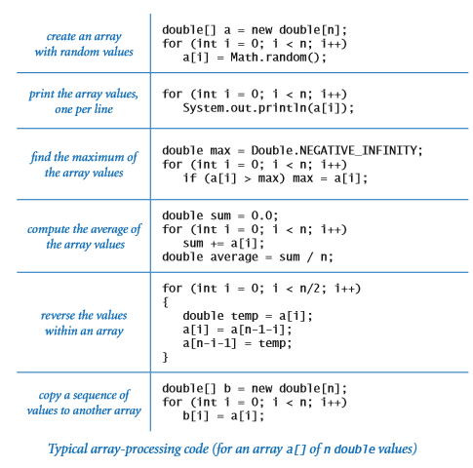
Array in Java(continued-13)
Typical array processing codes

Slide 22
Array in Java(continued-14)
Two Dimensional Array
What if teacher want to store student number and marks obtained?
Use two dimensional array
Similar to matrix of rows and columns.
Declaration and creation of two dimensional array
datatype [][] arrayname= new datatype[rows][columns]
int[][] arrayname= new int[4][2]

Slide 23
Array in Java(continued-15)
Two Dimensional Array Initialisation
int[][] anIntegerArray = new int[5][3]; anIntegerArray[0][0] = 10; anIntegerArray[0][1] = 20; anIntegerArray[0][2] = 30;
Another approach:
int[][] Employees = { {10, 20, 30}, {15, 25, 35}, {22, 44, 66}, {33, 55, 77} };

Slide 24
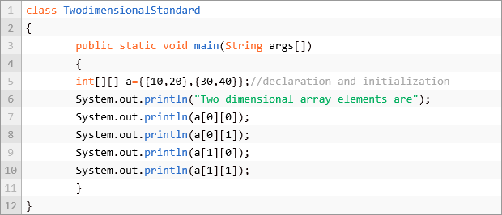
Array in Java(continued-16)
Two Dimensional Array: accessing the array elements
- Standard Approach

Slide 25
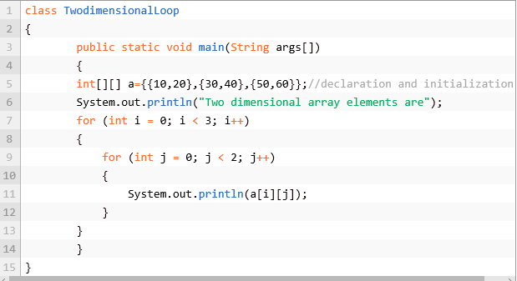
Array in Java(continued-17)
Two Dimensional Array: accessing the array elements
- Using for loop

Slide 26
Summary
Arrays are fourth basic element after assignments, conditionals and loops.
Basic data structure
One dimensional array to store sequence of values of same type.
We use indexing to refer to array elements.
Two dimensional array to store values of same type in form of matrix of various rows and columns.

Slide 27

kent.edu.au Kent Institute Australia Pty. Ltd. ABN 49 003 577 302 ● CRICOS Code: 00161E ● RTO Code: 90458 ● TEQSA Provider Number: PRV12051

