Slide 1

Object Oriented Design and Programming
Week 2
Version 2 – 18th December 2015

Slide 2
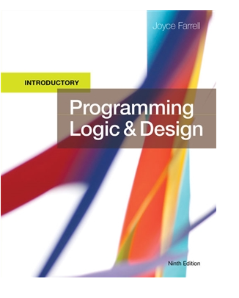
SLIDE TITLE
Farrell, J. (2017) Programming Logic and Design, Comprehensive (9th ed.) Cengage Learning

Slide 3
Chapter 2-Variables and their manipulations
Simple input and output

Slide 4
Objectives
In this chapter, you will learn about:
Declaring and using variables
Data types
Performing arithmetic operations
Declaring and using constants
Object Oriented Programming JAVA basics
Simple input and output

Slide 5
Working with Variables
Variable are named memory locations
Contents can vary or differ over time
Declaration is a statement that provides a variable's:
Data type- specify the type of data it will holds
Identifier - name of variable in memory
Optionally, an initial value

Slide 6
Declaring and Using Variables
What are data types?
Data type describes:
What values can be held by the item
How the item is stored in memory
What operations can be performed on the item
All programming languages support these data types:
Numeric consists of numbers that can be used in math
String is anything not used in math

Slide 7
Understanding a Declaration’s Data Type
Numeric variable
Holds digits
Can perform mathematical operations on it
String variable
Can hold text
Letters of the alphabet
Special characters such as punctuation marks
Type-safety
Prevents assigning values of an incorrect data type

Slide 8
Data types in Java
Java has 8 primitive data types
-Int for integer numbers (26,645445)
-float for floating point numbers (26.5f,6.2f)
-double for floating point numbers (23.6547132654)
-char for characters (“a”,”b”)
-Boolean (True or False)
-long for long integers
-Short for short integers
-Byte

Slide 9
Data Types in Java
https://www.youtube.com/watch?v=Rilk5TayNbI
Watch this video for understanding data types in better way

Slide 10
Data Types- size and description
Data Type | Size | Description
byte | 1 byte | Stores whole numbers from -128 to 127
short | 2 bytes | Stores whole numbers from -32,768 to 32,767
int | 4 bytes | Stores whole numbers from -2,147,483,648 to 2,147,483,647
long | 8 bytes | Stores whole numbers from -9,223,372,036,854,775,808 to 9,223,372,036,854,775,807
float | 4 bytes | Stores fractional numbers. Sufficient for storing 6 to 7 decimal digits
double | 8 bytes | Stores fractional numbers. Sufficient for storing 15 decimal digits
boolean | 1 bit | Stores true or false values
char | 2 bytes | Stores a single character/letter or ASCII values

Slide 11
Understanding a Declaration’s Identifier
An identifier is a variable’s name
Programmer chooses reasonable and descriptive names for variables
Programming languages have rules for creating identifiers
Most languages allow letters and digits
Some languages allow hyphens
Reserved keywords are not allowed

Slide 12
Understanding a Declaration’s Identifier (continued -1)
Variable names are case sensitive
Variable names:
Must be one word
Must start with a letter
Should have some appropriate meaning

Slide 13
Variable Naming Conventions
Camel casing
Variable names have a “hump” in the middle such as hourlyWage (Java convention)
Pascal casing
Variable names have the first letter in each word in uppercase such as HourlyWage
Hungarian notation
A form of camel casing in which the data type is part of the name such as numHourlyWage

Slide 14
Variable Naming Conventions (continued)
Snake casing
Parts of variable names are separated by underscores such as hourly_wage
Mixed case with underscores
Similar to snake casing, but new words start with a uppercase letter such as Hourly_Wage
Kebob case
Parts of variable names are separated by dashes such as hourly-wage

Slide 15
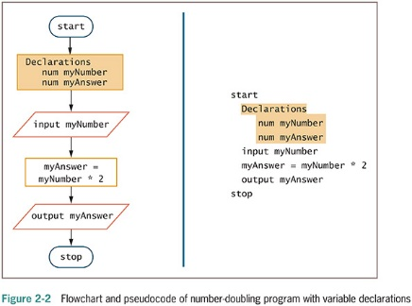
Working with Variables (continued)

Slide 16
Practice task
Can you convert declarations in previous slide using Java programming language?
Use proper data type and naming convention

Slide 17
Assigning Values to Variables
Assignment statement
set myAnswer = myNumber * 2
Assignment operator
Equal sign
A binary operator, meaning it requires two operands—one on each side
Always operates from right to left, which means that it has right-associativity or right-to-left associativity
The result to the left of an assignment operator is called an lvalue

Slide 18
Initializing a Variable
Initializing the variable - declare a starting value
num yourSalary = 14.55
Garbage – a variable’s unknown value
Variables must be declared before they are used in the program

Slide 19
Performing Arithmetic Operations
Standard arithmetic operators:
+ (plus sign)—addition
− (minus sign)—subtraction
* (asterisk)—multiplication
/ (slash)—division (Java does real and integer division)

Slide 20
Performing Arithmetic Operations (continued -1)
Rules of precedence
Also called the order of operations
Dictate the order in which operations in the same statement are carried out
Expressions within parentheses are evaluated first
All the arithmetic operators have left-to-right associativity
Multiplication and division are evaluated next
From left to right
Addition and subtraction are evaluated next
From left to right

Slide 21
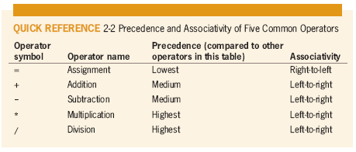
Performing Arithmetic Operations (continued -2)

Slide 22
Constants
There are two types of constants
Numeric constant (or literal numeric constant)
Contains numbers only
Number does not change
String constant (or literal string constant)
Also known as Alphanumeric values
Can contain both alphabetic characters and numbers
Strings are enclosed in quotation marks

Slide 23
Constants in Java
Word “final” will make any variable constant in Java
For Example:
-final int weight=54;
No change of value in program at any point
Can use same value many times

Slide 24
Let’s start learning about input and output in JAVA

Slide 25
Simple input and output
Before we start learning input and output using Java programming language
Little bit about Object Oriented Programming and its basic requirement
Further detailed concepts will be discussed later in this unit

Slide 26
Introduction to Object Oriented Programming JAVA
Java is Object Oriented Programming Language
It uses object and classes
Objects
-Can be tangible or intangible
-Have unique identity, properties and behavior
For example- A Student object
-Properties or Attributes:- Name , Date of Birth
-Behavior:- set name, find age

Slide 27
Introduction to Object Oriented Programming JAVA
Objects of same type are defined using common class.
Objects are instance of Classes.
Each one of you is instance of class Student .
So, classes are the recipe of making objects.
We can create Student 1, Student 2 and so on….

Slide 28
Introduction to Object Oriented Programming JAVA
You can build as many classes as you want in program
For example:-class for student, staff, movie etc.
Think about these classes, properties they can have and operations they can have.
To make some tasks easy, Java has pre-defined classes that we can use in our program

Slide 29
Introduction to Object Oriented Programming JAVA
Have a look on following link and browse Scanner Class
https://docs.oracle.com/javase/9/docs/api/overview-summary.html
Scanner Class- predefined class that we can use for input
More about classes and creation of their objects will be discussed later in unit.
For now, learn simple scanner class and its usage

Slide 30
Simple Input
Analyses of same example:
Input is value that program expect from its user
It can be entered via keyboard, mouse etc.
myNumber is the input in this case

Slide 31
Simple Input
For simple input, just follow steps:
- Import java.util.Scanner in your program
Create Scanner Class Object
Scanner sc= new Scanner (System.in);
Class Name
Use this word to create new object
Class Name
Take input from system
Name of object

Slide 32
Simple Input
For taking mynumber as input from user:-
int mynumber=sc.nextInt();
Method of scanner class to take integer as input
Data type of variable
Assignment operator
Object name that you created in previous line
Name of variable

Slide 33
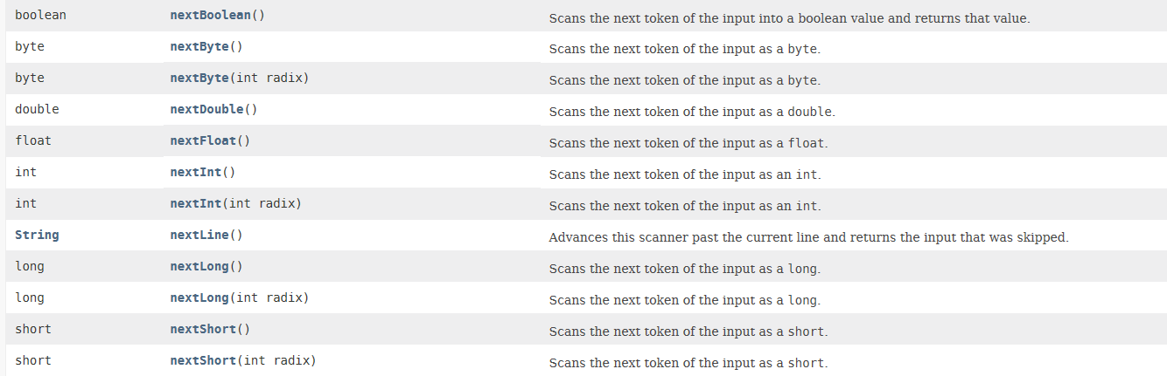
Simple input
Some commonly used methods of Scanner Class:

Slide 34
Simple Output
Analyses of same example:
Output is value that program return to user
It is displayed on screen that is console
myanswer is the output in this case

Slide 35
Simple output
For simple output, just follow steps:
System.out.println(myanswer);
or
System.out.print(myanswer);
First line will display your answer and will go to next line on console
Second line will display your answer and will be on same line
Try to practice both on your systems

Slide 36
Simple output
Have a look on these following lines of code and guess the output:
System.out.println(“Java is interesting”);
int myNumber=98;
System.out.print(“myNumber”);
System.out.println(myNumber);
System.out.println(“myNumber is”+myNumber):
System.out.println(“Java is interesting and “+“myNumber is”+myNumber):
Notes:
Note to lecturers:
Explain the concept of concatenation of strings while explaining these outputs

Slide 37
Simple Output
String myName=“Johnie”;
System.out.println(myName);
System.out.println(“My Name is”+myName+”\n”);
System.out.println(“My Name is”+”\t”+”MyName”);

Slide 38
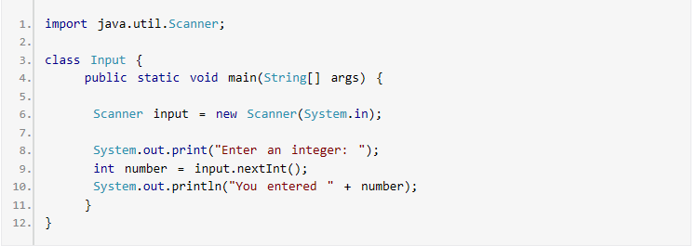
Java Program

Slide 39
Summary
Variables are named memory locations.
Declaration include data type, identifier and optional initial value.
Scanner is one of the class for input.
System is the class to display output.

Slide 40

kent.edu.au Kent Institute Australia Pty. Ltd. ABN 49 003 577 302 ● CRICOS Code: 00161E ● RTO Code: 90458 ● TEQSA Provider Number: PRV12051

